Slide 1



CS 160 and CMPE/SE 131
Software Engineering
March 24 Class Meeting
Department of Computer Science
Department of Computer Engineering
San José State University
Spring 2016
Instructor: Ron Mak
www.cs.sjsu.edu/~mak

Slide 2
Please send me your PowerPoint slides …
… from your conceptual design review
so I can post them to the class website.
Send me your marketing brochure
if you haven’t already done so.

Slide 3
Project Team Design Reviews
Present and defend key aspects of your design.
  CS 160: 15 minutes per team.
  CmpE 131: 12 minutes per team.
Use PowerPoint slides
  Turn in your slides after your presentation.
Briefly discuss your overall design.
Show and explain the design of your
most important or core classes.
  UML class diagrams and/or sequence diagrams.

Slide 4
Project Team Design Reviews, cont’d
Briefly discuss your database design.
  ER diagram
  Relational schema diagram (optional)
Questions and answers at the end.
Audience: Very technical
  Other development engineer
  Technical managers
  Expect “deep” questions from the audience!

Slide 5
Project Team Design Reviews, cont’d
Presentation schedule, CS 160-01
Tuesday, April 5
  Ruby Baby
  Softneers
  TBA
  Underground Railsroad
Thursday, April 7
  Big Trains
  Code-Ninjas
  NoName
  Revy

Slide 6
Project Team Design Reviews, cont’d
Presentation schedule, CS 160-02
Tuesday, April 5
  Spartans on Rails
  SpartanSE
  The A Team
  The Directors
Thursday, April 7
  Face
  Green
  Hacking Bad
  Mak & Cheese

Slide 7
Project Team Design Reviews, cont’d
Presentation schedule, CMPE 131-01
Tuesday, April 5
  NoName4
  Piramides
  Rubber Ducks
  RubyLand
  Sour Patch Kids
  Unispace
Thursday, April 7
  ARMY
  Codiggers
  Cupid’s Minions
  Fabulous
  Gains
  JAMH

Slide 8
“Sins of Software Estimation”
Excerpts from
“10 Deadly Sins of Software Estimation”
  by Steve McConnell
  http://www.ewh.ieee.org/r5/central_texas/austin_cs/presentations/2004.08.26.pdf

Slide 9
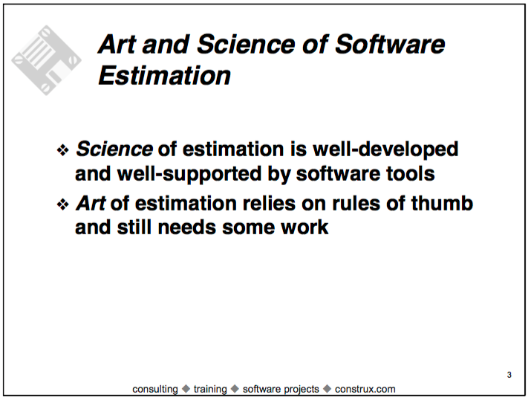
“Sins of Software Estimation”, cont’d

Slide 10

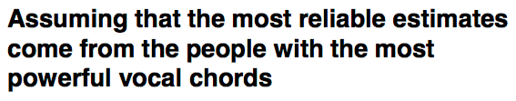
“Sins of Software Estimation”, cont’d

Slide 11
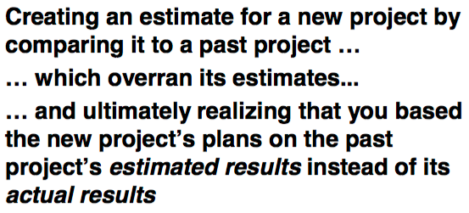
“Sins of Software Estimation”, cont’d

Slide 12
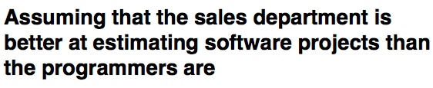
“Sins of Software Estimation”, cont’d

Slide 13
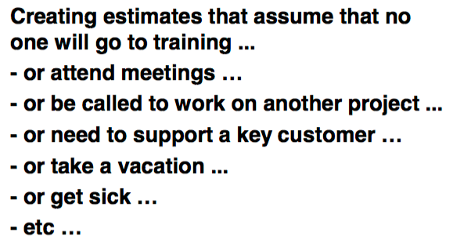
“Sins of Software Estimation”, cont’d

Slide 14
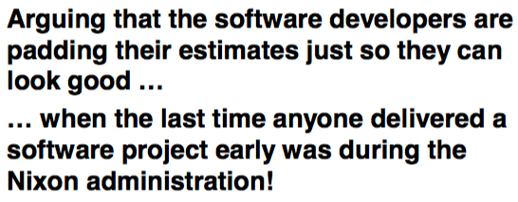
“Sins of Software Estimation”, cont’d

Slide 15
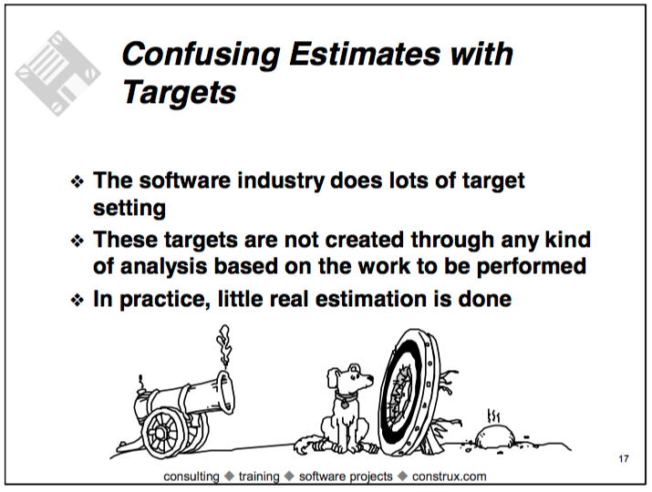
“Sins of Software Estimation”, cont’d

Slide 16
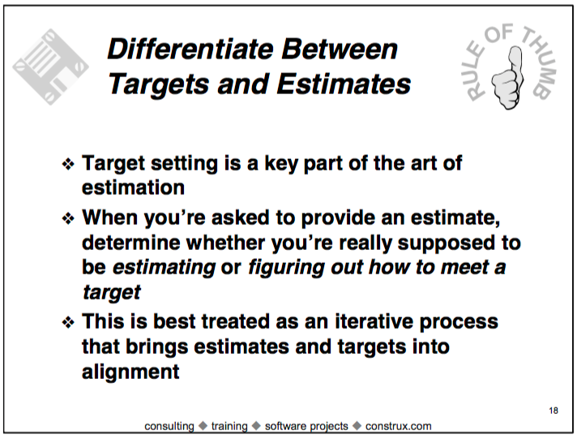
“Sins of Software Estimation”, cont’d

Slide 17
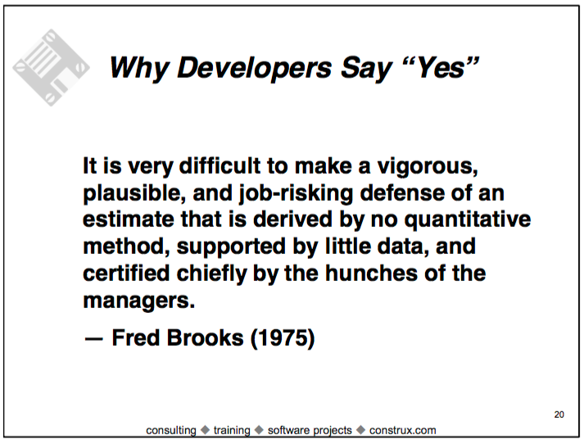
“Sins of Software Estimation”, cont’d

Slide 18
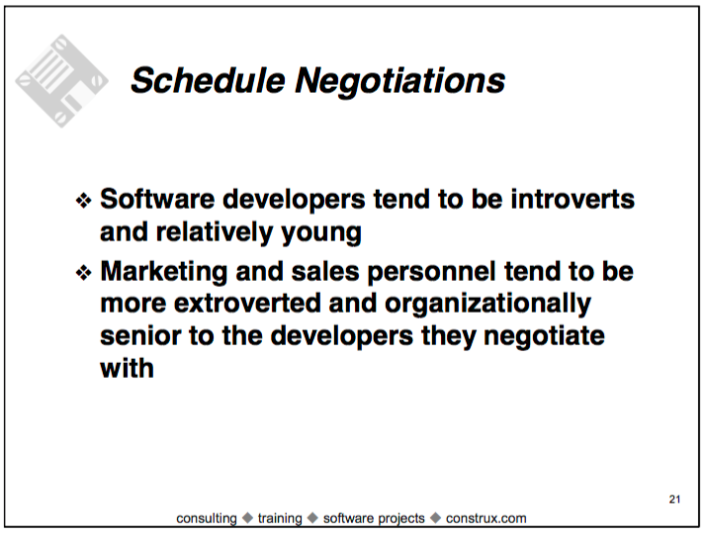
“Sins of Software Estimation”, cont’d

Slide 19
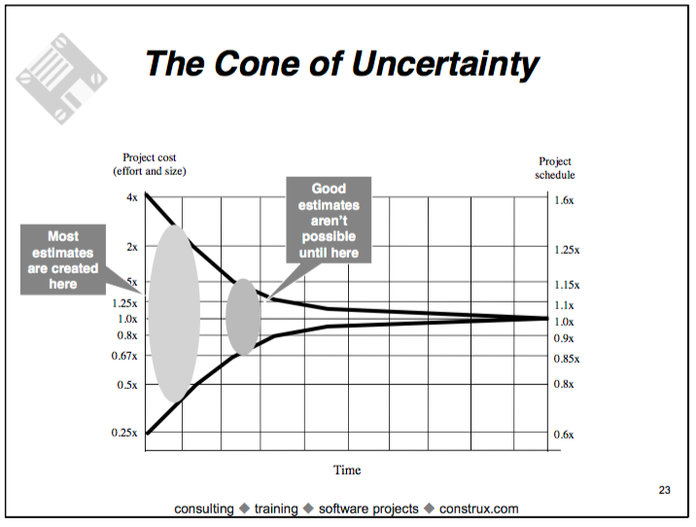
“Sins of Software Estimation”, cont’d

Slide 20
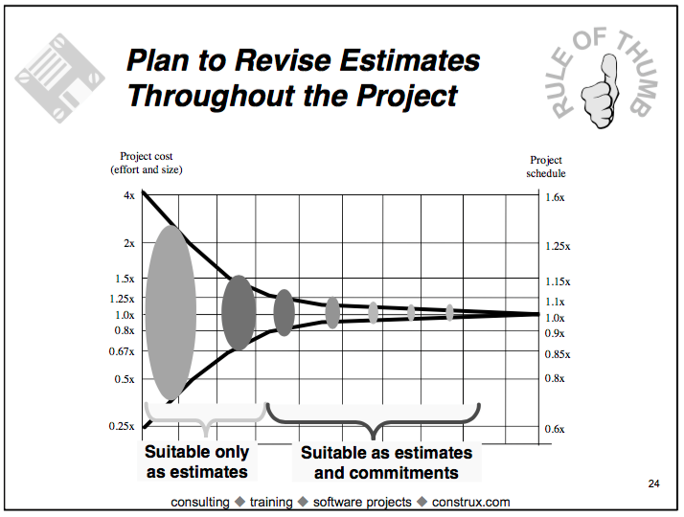
“Sins of Software Estimation”, cont’d

Slide 21
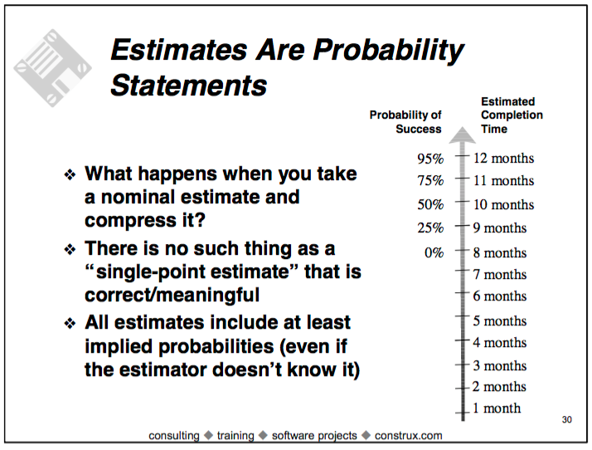
“Sins of Software Estimation”, cont’d

Slide 22
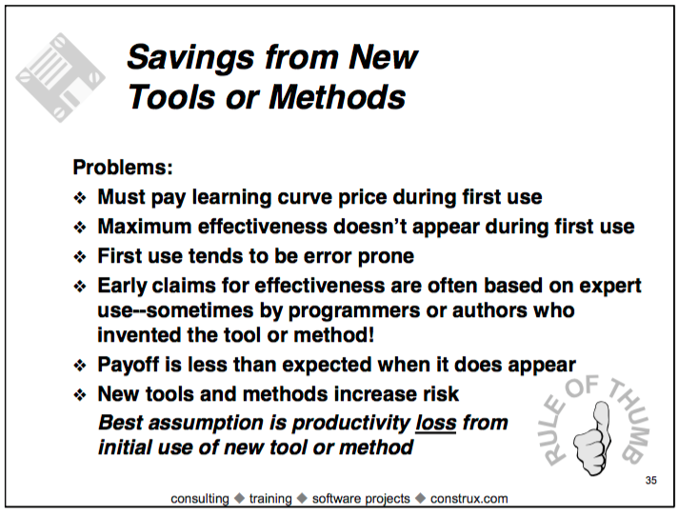
“Sins of Software Estimation”, cont’d

Slide 23
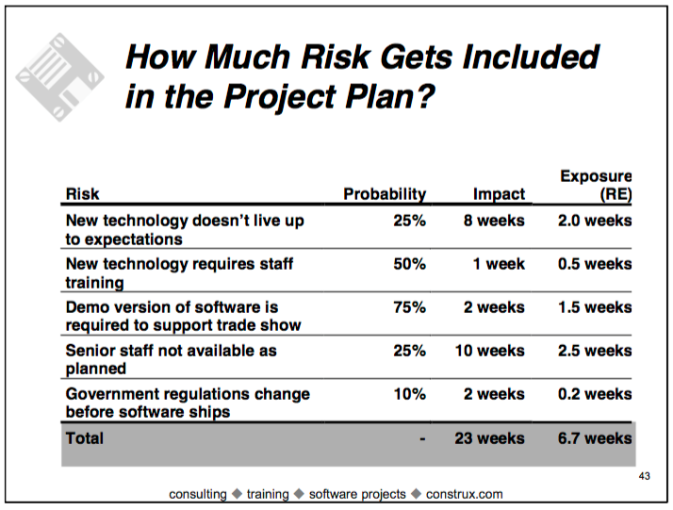
“Sins of Software Estimation”, cont’d

Slide 24
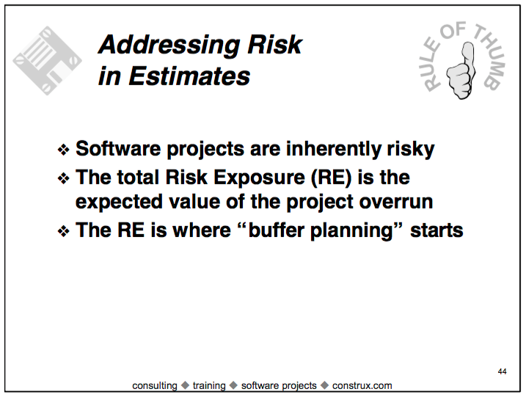
“Sins of Software Estimation”, cont’d

Slide 25
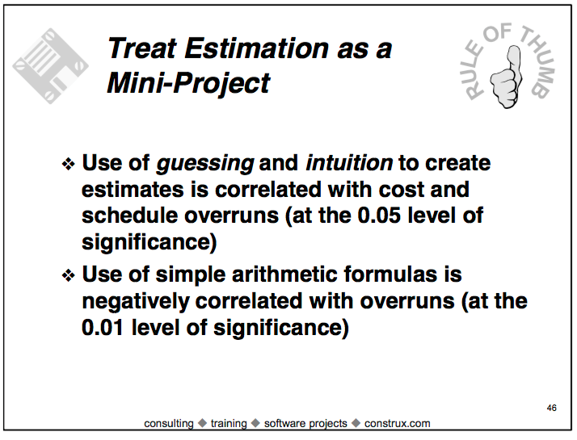
“Sins of Software Estimation”, cont’d

Slide 26
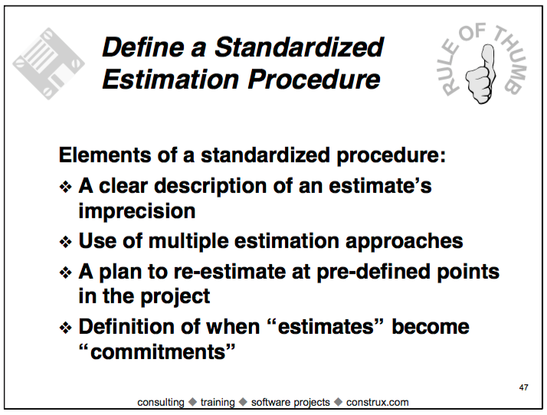
“Sins of Software Estimation”, cont’d

Slide 27
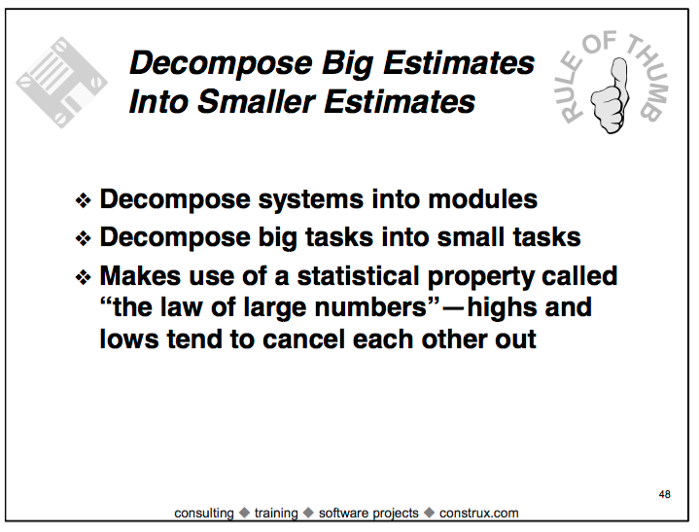
Sins of Software Estimation, cont’d

Slide 28
“Good” Estimates
Estimates don’t need to be perfectly accurate as much as they need to be useful.
Once estimates are put into a schedule,
they become commitments.
  “A good estimate is an estimate that provides a
  clear enough view of the project reality to allow
  the project leadership to make good decisions
  about how to control the project to hit its targets.”
  Steve McConnell, Software Estimation

Slide 29
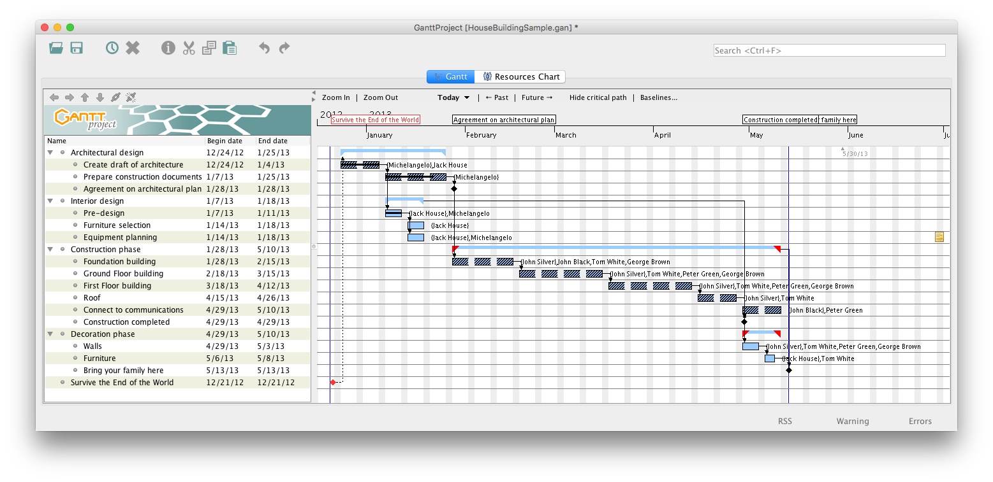
Example Project Schedule: Gantt Chart
Critical path

Slide 30
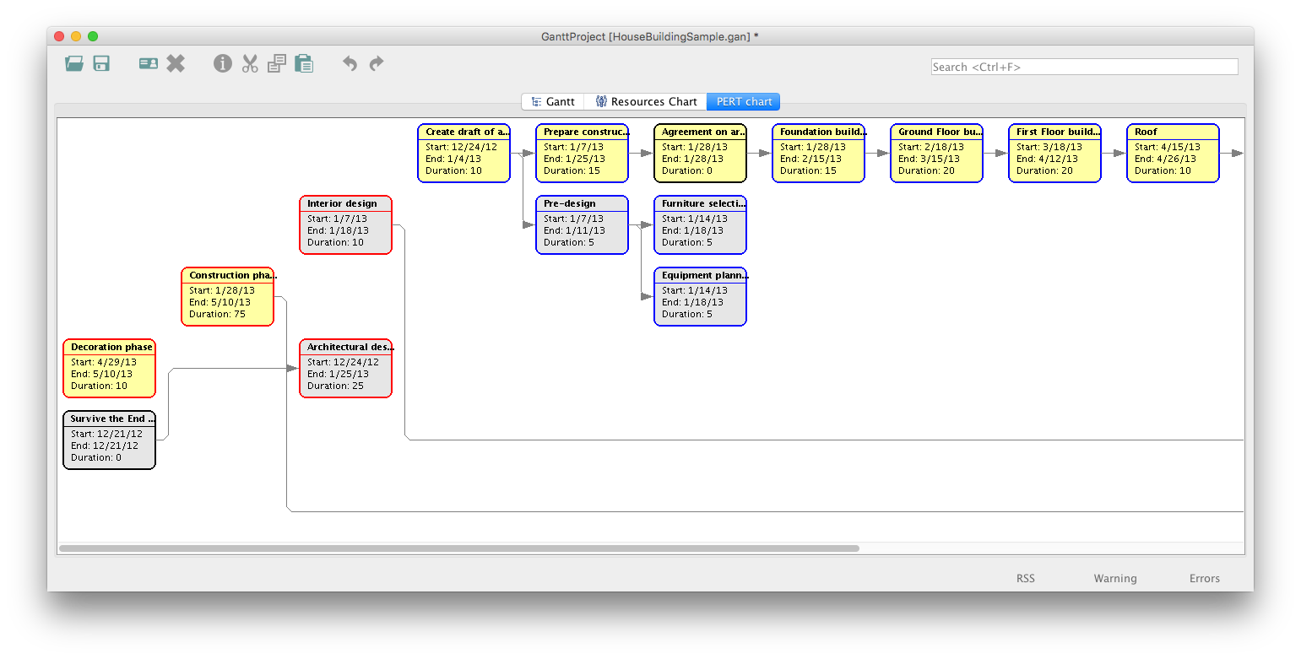
Example Project Schedule: PERT Chart

Slide 31
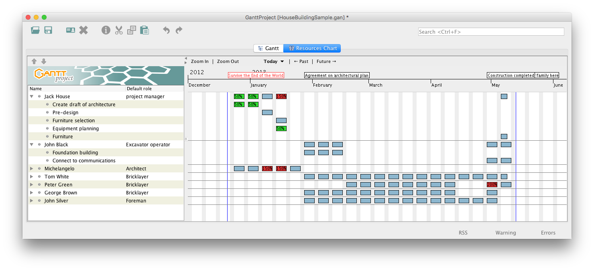
Example Project Schedule: Resources Chart

Slide 32
Work Breakdown Structure (WBS)
A decomposition of a complex project into a hierarchical set of tasks and subtasks.
Can be shown in outline form or as a tree.
Project
Task 1
Task 2
Task 3
Subtask 1.1
Subtask 2.1
Subtask 3.1
Subtask 1.2
Subtask 3.2
Subtask 3.3

Slide 33
WBS Example: Building a House
Architectural design
  Create draft of architecture
  Prepare construction documents
Interior design
  Pre-design
  Select furniture
  Plan equipment
Construction phase
  Build foundation
  Build ground floor
  Build second floor
  Build roof
  Complete wiring and plumbing
Decoration phase
  Walls
  Furniture

Slide 34
Project Schedule
Often represented as Gantt charts.
  Named after Henry Gantt, who developed them
  in 1917.
Enter the work breakdown structure.
Estimate the time requirement for each task
(task duration).
Set task dependencies.
Assign task resources.

Slide 35
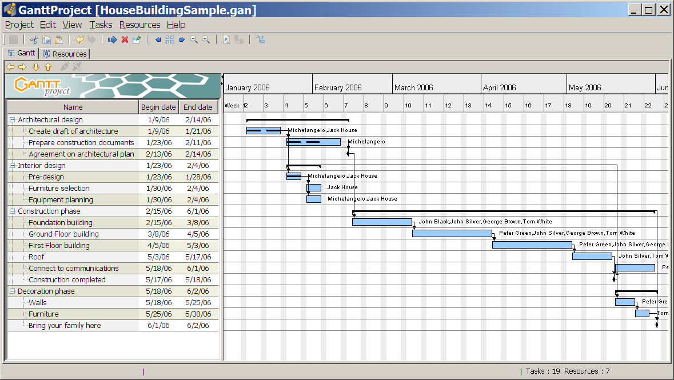
Example Gantt Chart
Progress
Dependencies
Resources
WBS
Time
Time
Milestones

Slide 36
Gantt Chart Demo
Download and install GanttProject from
http://ganttproject.biz/
  Watch the introductory video.
  Similar to (the very expensive) Microsoft Project.
Demo
  Task creation
  Task dependencies
  Resources

Slide 37
Critical Path
Identify the critical path of a schedule.
  The longest path of tasks
  The “long pole in the tent”
The critical path determines
the shortest possible time
to complete the project.
Any delay in the critical path
directly delays the completion
of the overall project.
Demo

Slide 38
PERT Chart
Project Evaluation and Review Technique
Represent the schedule as an
acyclic graph of tasks.
Demo

