Slide 1



CS 160 and CMPE/SE 131
Software Engineering
February 23 Class Meeting
Department of Computer Science
Department of Computer Engineering
San José State University
Spring 2016
Instructor: Ron Mak
www.cs.sjsu.edu/~mak

Slide 2
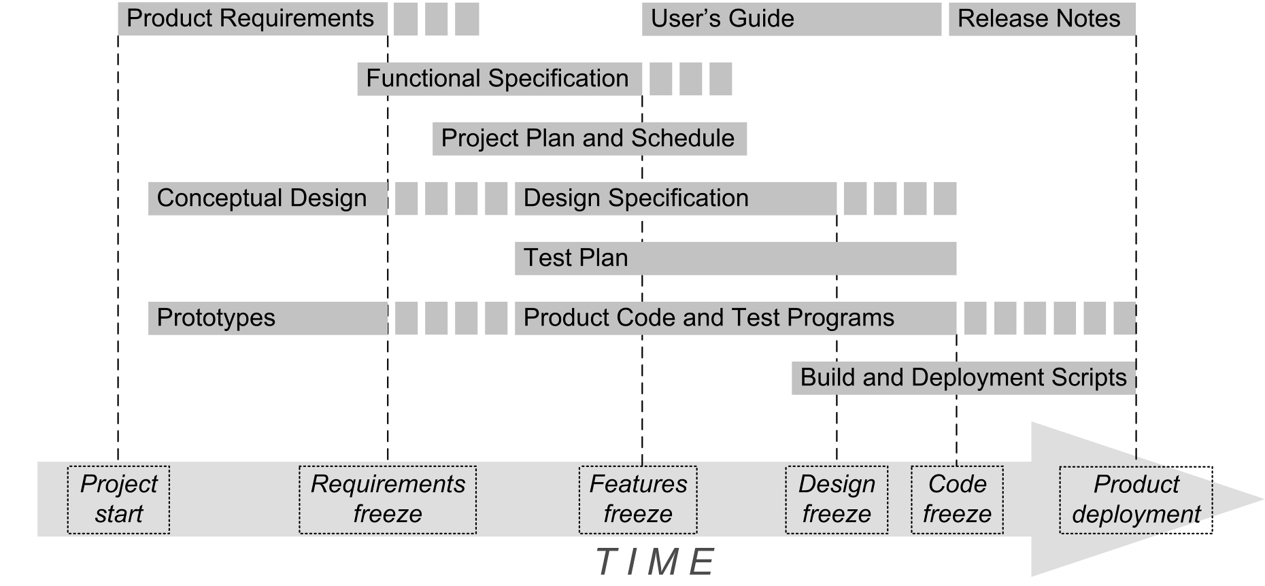
Conceptual Design

Slide 3
Conceptual Design, cont’d
A high-level description of your
application design.
  A written report and an oral presentation.
  A “product pitch”.
Conceptual design ➔ formal design document
  Created by the software developers.
  Understandable by the product’s users, clients,
  and stakeholders.

Slide 4
Conceptual Design Contents
Problem statement and objectives.
  What is the purpose of this application?
  What will it do?
Overview of your solution
  A list of major features
  A description of your application’s major modules and how they will interact with each other
  High-level diagrams
  No implementation details

Slide 5
Conceptual Design Contents, cont’d
Prototype of a key use case
  A sequence of screen shots
  Or a live demo with mocked-up web pages
  (can be static pages)
  Or Rails-generated web pages

Slide 6
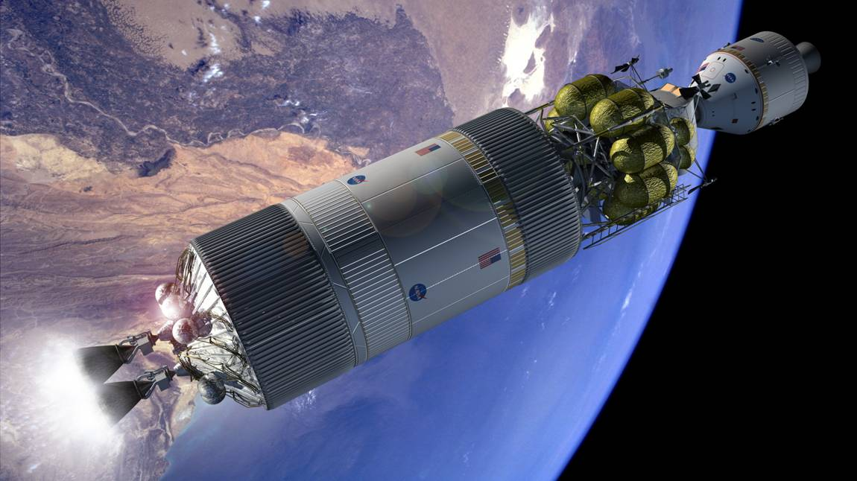
Example Conceptual Design Presentation
Real-time Fault Analysis
for
Manned Space Vehicle Systems
(Based on a real NASA application
and an actual presentation.)

Slide 7
Problem Statement
During emergency situations, a real-time
fault analysis system must rapidly suggest correct remedies for the onboard astronauts to implement.
Space vehicle fault analysis is a daunting task, especially in extremely remote environments.

Slide 8
Project Objectives
Design and develop a real-time fault analysis system for manned space vehicles that overcomes the following challenges:
  Diverse and disparate data sources
  Incomplete or imprecise vehicle sensor data
  Insufficient working knowledge of the vehicle system
  Real time diagnosis and rapid response
  Limited system resources
  Loss of communication with ground control

Slide 9
Product Features
A web application that stores and remembers past faults and their remedies in a repository.
  Each fault is defined by a
  snapshot of sensor readings.
Collect and integrate data from various sources.
  Sensor readings
  Parts lists and maintenance manuals

Slide 10
Product Features, cont’d
When a fault occurs, search for it
in the repository.
  If there is a fault match, display its remedy.
  If there are no exact matches, then display the remedies of the closest matches.
  Compute and display the confidence level of each displayed remedy based on the closeness of match.
Enter the latest fault and its solution
into the repository.
  The repository “gains experience”
  and becomes more useful.

Slide 11
Major Modules
Data
sources
Databases
Sensors
Files
Server system
Web
server
Application
server
Virtual
data views
Data integration server
Faults
matching
engine
Faults database
Matching
rules base
Users
Web
objects
Application
objects
Faults archive server

Slide 12
Fault Analysis Use Case
Name: Fix Coolant Leak
Goal: Provide remedies to a coolant leak.
Summary: An astronaut must be provided remedies to a detected coolant leak in the space vehicle.
Actors: The astronaut and the space vehicle

Slide 13
Fault Analysis Use Case, cont’d
Preconditions
  The astronaut is in the space vehicle.
  The space vehicle is in space.
  The system sensors are actively monitoring
  the vehicle.
Primary trigger
  The vehicle sensors detect a drop
  in the warp engine coolant level.

Slide 14
Fault Analysis Use Case, cont’d
Primary sequence
  The sensor monitor display flags a coolant leak.
  Realtime fault analysis displays possible diagnoses.
    See use case “Match fault”
    See use case “Compute confidence level”
  The astronaut clicks on each diagnosis
  to display the associated remedy.

Slide 15
Fault Analysis Use Case, cont’d
Primary postconditions
  The astronaut chooses the most likely diagnosis.
  The astronaut implements the corresponding remedy.
Alternate sequences
  etc.
Nonfunctional requirements
  The system sensors are constantly active.
  The system displays alerts in real time.
Glossary
  astronaut = a person flying in the space vehicle.
  space vehicle = etc.

Slide 16
Use Case Demo
http://www.cs.sjsu.edu/~mak/CS160/lectures/prototype-100204/

Slide 17
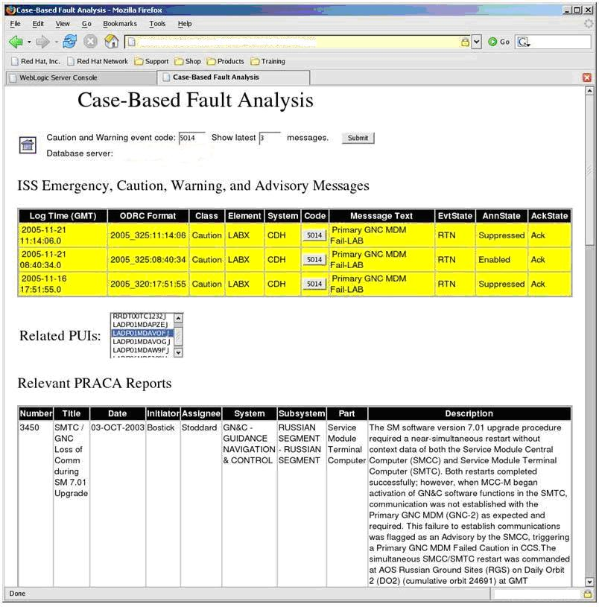
Actual Screen Shot
NASA lingo
  ISS
  International Space Station
  PUI
  Program Unique Identifier (i.e., part number)
  PRACA
  Problem Report and Corrective Action

Slide 18
Assignment #4: Conceptual Design
Oral presentations next week.
  CS 160: 4 teams Tuesday, 4 teams Thursday
  CMPE 131: 6 teams Tuesday, 6 teams Thursday
Do a product pitch for your web application.
  Each CS 160 project team has 15 minutes.
  Each CMPE 131 project team has 12 minutes.
  Grab the audience’s attention in the first minute.
PowerPoint slides plus a live web demo.
  Demo the prototype of a key use case.

Slide 19
Assignment #4: Conceptual Design, cont’d
The rest of the class will represent
potential future users and customers
of your product.
Allow a few minutes for Q&A and suggestions.
The rest of the class will fill out survey forms rating whether or not they would buy and use your product.

Slide 20
Assignment #4: Conceptual Design, cont’d
Create a 1- or 2-page marketing brochure:
  The name of your product (the web application)
  Problem statement and objectives
    What is the purpose of this application?
    What will it do?
  A list of major features
Submit your brochure (as a PDF, JPEG, or GIF) to Canvas at least one day before your presentation.
  Assignments/Brochure
  I will post it on the class website.

Slide 21
Assignment #4: Conceptual Design, cont’d
Presentation schedule, CS 160-01
Tuesday, March 1
  Big Trains
  Code-Ninjas
  NoName
  Revy
Thursday, March 3
  Ruby Baby
  Softneers
  TBA
  Underground Railsroad

Slide 22
Assignment #4: Conceptual Design, cont’d
Presentation schedule, CS 160-02
Tuesday, March 1
  Face
  Green
  Hacking Bad
  Mak & Cheese
Thursday, March 3
  Spartans on Rails
  SpartanSE
  The A Team
  The Directors

Slide 23
Assignment #4: Conceptual Design, cont’d
Presentation schedule, CMPE 131-01
Tuesday, March 1
  ARMY
  Codiggers
  Cupid’s Minions
  Fabulous
  Gains
  JAMH
Thursday, March 3
  NoName4
  Piramides
  Rubber Ducks
  RubyLand
  Sour Patch Kids
  Unispace

Slide 24
Assignment #4: Conceptual Design, cont’d
Add the Conceptual Design to your
Functional Specification.
An overview of your solution
  A list of major features
  A description of your application’s major modules and how they will interact with each other
  High-level architecture diagrams
  No implementation details

Slide 25
Assignment #4: Conceptual Design, cont’d
Screen shots of mocked-up web pages
  Illustrate the sequence of web pages
  for a key use case.
  Taken from your live presentation.
Your revised Functional Specification will be due one week after your oral presentation.
Resubmit to Canvas: Assignment #4

Slide 26
Link to Design Video
https://www.youtube.com/watch?v=BKorP55Aqvg

