Slide 1
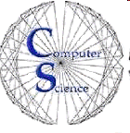

CS 154
Formal Languages and Computability
May 5 Class Meeting
Department of Computer Science
San Jose State University
Spring 2016
Instructor: Ron Mak
www.cs.sjsu.edu/~mak

Slide 2
Formalized Mathematics
Start with a set of axioms ...
  axiom: an assumed given fact
… and a set of precisely defined rules
for logical inference and deduction.
  deduction: Make a specific conclusion based on a given set of facts.
  inference: Make a generalization based on a given set of facts.
Use the rules in a sequence of steps.
  Go from one proven fact to another.

Slide 3
Formalized Mathematics, cont’d
Proposition
  Proven true if you can derive it from the axioms in a finite sequence of logical steps.
  Considered false if it conflicts with another proposition that can be proved to be true.
Formal system of axioms, rules,
and propositions.
  consistent: Cannot prove a proposition true with one sequence of steps and false by another sequence.
  complete: Any proposition in the system can be proven true or false.

Slide 4
Gödel’s Incompleteness Theorem
Kurt Gödel proved in 1931 that any interesting consistent system must be incomplete.
  It must contain some unprovable propositions.
  Incompleteness Theorem
Can unprovable propositions be separated
from provable propositions?
  Are there mechanically verifiable proofs?
Questions explored by Turing, Church, Kleene, and Post in the 1930s.
  Established different models of computation.

Slide 5
Models of Computation
Church and Kleene: recursive functions
Post systems
etc.
Church’s thesis: All models of computation are equivalent in their power to perform calculations.
Turing’s thesis: Any mechanical computation
can be performed by some Turing machine.
Combined: Church-Turing thesis

Slide 6
Primitive Recursive Functions
An alternative to Turing machines
as a model of computation.
Work with the set of positive integers I
rather than with strings.
  Computers can easily convert
  between integers and strings.

Slide 7
Primitive Recursive Functions, cont’d
Built from three basic functions:
  Zero function: z(x) = 0 for all
  Successor function: s(x) = x +1 for all
  Projection functions:
And two basic operations:
  Composition: f (x, y) = h(g₁(x, y), g₂(x, y))
  for defined functions g₁, g₂, and h.
  Primitive recursion:
  p₁(x₁, x₂) = x₁
p₂(x₁, x₂) = x₂
Recurse only on
the last argument.
f (x, 0) = g₁(x)
f (x, s(y)) = h(g₂(x, y), f (x, y))

Slide 8
Primitive Recursive Functions, cont’d
A function is primitive recursive if and only if it can be constructed from the basic functions
z, s, and p_{k} by successive composition and primitive recursion.
Example: add
Example: multiply
add(x, 0) = x
add(x, s(y)) = add(x, y) + 1
add(3, 2) = add(3, 1) + 1
= (add(3, 0) + 1) + 1
= (3 + 1) + 1
= 4 + 1 = 5
mult(x, 0) = 0
mult(x, s(y)) = add(x, mult(x, y))

Slide 9
Subtraction and the Monus Operator
Because I does not include negative values,
we define a special monus operator.
  “subtract as much as you can”
predecessor
subtract
{
x – y if x ≥ y
0 otherwise
x y =
pred(0) = 0
pred(s(y)) = y
subtr(x, 0) = x
subtr(x, s(y)) = pred(subtr(x, y))

Slide 10
Primitive Recursive Functions, cont’d
Most, but not all, common functions are primitive recursive.
The set of all primitive recursive functions
is countable.
  Describe each primitive recursive function
  by a finite string that indicates how it is defined.
  Encode and arrange all the strings in proper order.

Slide 11
Some Functions are not Primitive Recursive
Assume that all functions f: I → I
are countable.
  Therefore, arrange all of them in some order f₁, f₂, …
Construct a computable function g defined as
g always differs from f_{i} for all values of i
Therefore, not all functions are countable.
Therefore, there must be some functions
that are not primitive recursive.
g(i) = f_{i}(i) + 1 for i = 1, 2, …
Diagonalization

Slide 12
Ackermann’s Function
Ackermann’s function A : I × I → I
Not primitive recursive.
Its growth rate exceeds that of
any primitive recursive function
as .
A(0, y) = y + 1
A(x, 0) = A(x – 1, 1)
A(x, y + 1) = A(x – 1, A(x, y))

Slide 13
µ Recursive Functions
Extend the idea of recursive functions.
Define the minimization operator µ:
Example: Let g(x, y) = x + y 3
Then
µy(g(x, y) = the smallest y such that g(x, y) = 0
{
3 – x if x ≤ 3
undefined if x > 3
µy(g(x, y)) =

Slide 14
µ Recursive Functions, cont’d
A function is µ-recursive if it can be:
  constructed from the basic functions by
  a sequence of applications of the µ operator
  and the operations of composition
  and primitive recursion.
A function is µ-recursive
if and only if it is computable.
Therefore, µ-recursive functions are
another model for algorithmic computation.

Slide 15
Efficiency of Computation
To analyze an algorithm, we must measure it.
A convenient measure must be:
  Measuring a resource we care about
  (elapsed time, memory usage, etc.).
  Quantitative, to make comparisons possible.
  Easy to compute.
  A good predictor of the “goodness”
  of the algorithm.
We will be concerned with time complexity.
  How much time does an algorithm take to run?

Slide 16
Example: Reading Books
Algorithm: Read a book.
Measure: Length of time to read a book.
Given a set of books to read, can we predict how long it will take to read each one,
without actually reading it?
Possible ways to compute reading time:
  weight of the book
  physical size (width, height, thickness) of the book
  total number of words
  total number of pages

Slide 17
Efficiency of Computation, cont’d
Our concern generally is not how long
a particular run of an algorithm will take,
but how well the algorithm scales.
How does the run time increase
as the amount of input increases?
  Example: How does the reading time of a book increase as the number of pages increases?
  Example: How does the run time of a particular sort algorithm increase as the number of items to be sorted increases?

Slide 18
Efficiency of Computation, cont’d
When we compare two algorithms,
we want to compare how well they scale.
Can we do this comparison without actually
running the algorithms?
If T(n) is the running time of an
algorithm with n input values, then
how does T(n) change as n increases?

Slide 19
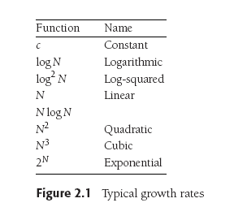
How Well Does an Algorithm Scale?
Data Structures and Algorithms in Java, 3rd ed.
by Mark Allen Weiss
Pearson Education, Inc., 2012
ISBN 978-0-13-257627-7

Slide 20
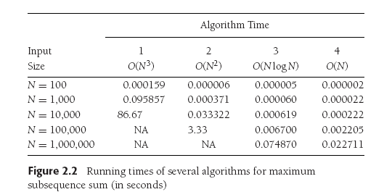
How Well Does an Algorithm Scale? cont’d
Data Structures and Algorithms in Java, 3rd ed.
by Mark Allen Weiss
Pearson Education, Inc., 2012
ISBN 978-0-13-257627-7

Slide 21
How Well Does an Algorithm Scale? cont’d
Data Structures and Algorithms in Java, 3rd ed.
by Mark Allen Weiss
Pearson Education, Inc., 2012
ISBN 978-0-13-257627-7

Slide 22
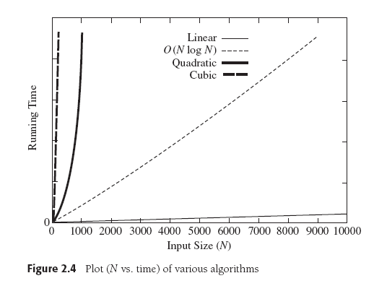
How Well Does an Algorithm Scale? cont’d
Data Structures and Algorithms in Java, 3rd ed.
by Mark Allen Weiss
Pearson Education, Inc., 2012
ISBN 978-0-13-257627-7

Slide 23
Big-Oh and its Cousins
Let T(n) be the running time of an algorithm
with n input values.
T(n) = O(f(n)) if there are positive constants c and n₀ such that T(n) ≤ cf(n) when n ≥ n₀.
In other words, when n is sufficiently large,
function f(n) is an upper bound for
time function T(n).
  We don’t care about small values of n.
T(n) will grow no faster than f(n) as n increases.

Slide 24
Big-Oh and its Cousins: Omega Ω
Let T(n) be the running time of an algorithm
with n input values.
T(n) = Ω(g(n)) if there are positive constants c
and n₀ such that T(n) ≥ cg(n) when n ≥ n₀.
In other words, when n is sufficiently large,
function g(n) is a lower bound for time function T(n).
  We don’t care about small values of n.
T(n) will grow at least as fast as g(n) as n increases.

Slide 25
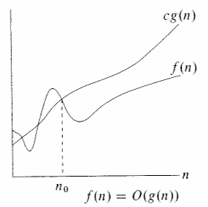
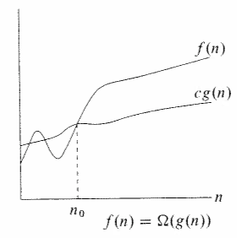
Big-Oh and its Cousins, cont’d
cf (n)
T(n)
T(n)
cg(n)
n
n
T(n) = O( f (n))
T(n) = Ω(g(n))
Upper bound
Lower bound

Slide 26
Big-Oh and its Cousins: Theta Θ
Let T(n) be the running time of an algorithm
with n input values.
T(n) = Θ(h(n)) if and only if:
  T(n) = O(h(n)) and
  T(n) = Ω(h(n))
In other words, the rate of growth of T(n)
equals the rate of growth of h(n).

Slide 27
Scalability of Different Algorithms
Problem: Given an array of positive and negative integers, find the maximum sum
of a contiguous subsequence of the array.
Four algorithms to solve this problem:
  LinearRuntimeGrowth: T(n) = O(n)
  LogarithmicRuntimeGrowth: T(n) = O(n log n)
  QuadraticRuntimeGrowth: T(n) = O(n²)
  CubicRuntimeGrowth: T(n) = O(n³)
Demo

Slide 28
Scalability of Different Algorithms, cont’d
One set of results for the
maximum sum problem.
  Times in milliseconds.
MaxSubseq2.java
n Linear Logarithmic Quadratic Cubic
1000 1 0 4 120
2000 1 2 1 890
3000 0 0 2 1467
4000 0 0 5 3436
5000 1 0 6 6698
6000 0 0 9 11392
7000 0 0 12 18344
8000 0 0 16 27235
9000 0 0 20 39085
10000 0 0 24 53218

Slide 29
Scalability of Different Algorithms, cont’d
Problem: Compute the n^{th} Fibonacci number.
Two algorithms to solve this problem:
  Start with 1, 1, and repeatedly
  add the previous two values.
    LinearGrowthRate: T(N) = O(N)
  Use recursion: fib(n) = fib(n-2) + fib(n-1)
    ExponentialGrowthRate: T(N) = Ω(1.5^{N})
Why is the growth
rate exponential?
Demo

Slide 30
Scalability of Different Algorithms, cont’d
One set of results for the Fibonacci problem.
  Times in milliseconds.
Fibonacci2.java
n Linear Exponential
5 0 0
10 0 1
15 0 0
20 0 2
25 0 3
30 0 4
35 0 45
40 0 504
45 0 5358
50 0 59267

Slide 31
Time Complexity
Time complexity: A rough measure of the time taken by a particular computation.
Characterize the time requirement of a problem as a function of its size.
Use a Turing machine as the computer model.
Assume a TM makes one move per time unit.
Computation time = number of TM moves

Slide 32
Time Complexity, cont’d
A computation that has time complexity T(n) requires a TM to make T(n) moves to complete.
It is impractical to actually program a TM to complete a computation and count its moves.
We are interested mainly in the worse case.
We hope TM analysis will give us the asymptotic growth rate of time complexity.

