Slide 1


CS 154
Formal Languages and Computability
April 28 Class Meeting
Department of Computer Science
San Jose State University
Spring 2016
Instructor: Ron Mak
www.cs.sjsu.edu/~mak

Slide 2
The State-Entry Problem
Let M be a Turing machine and q one of its states.
If M is applied to input string w, is it decidable whether or not state q is ever entered?
Reduce the halting problem to this problem.
  Introduce a new state q_{new} so that a transition
  leading to a final state q_{final} leads to q_{new} instead.
Knowing whether M enters q_{new} on w is equivalent to knowing whether M halts and accepts w.
  Which is undecidable.

Slide 3
An Analogy of Problem Reduction
Suppose the multiplication problem is “undecidable”.
  The calculator on your smart phone is broken, and the multiply function doesn’t always give the right answer.
What about the addition problem?
Assume we have an algorithm to add y + y and y + y + y.
But y + y is 2×y and y + y + y is 3×y.
An algorithm to solve the addition problem would give us an algorithm to solve the multiplication problem.
But multiplication is “undecidable”, and so
the addition algorithm must not exist.
  We reduced the “undecidable” multiplication problem to the addition problem to prove that the latter is also “undecidable”.

Slide 4
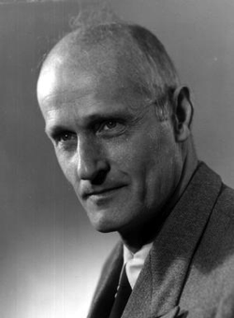
Recall
The family of languages associated with unrestricted grammars is identical to the family of recursively enumerable languages.
There does not exist a membership algorithm for recursively enumerable languages.
Emil Post (Polish-American, 1897-1954)
  Proved that in 1936 that there are
  problems that no algorithm can solve.

Slide 5
The Post Correspondence Problem
You have a collection of domino tiles.
Each tile has a string at the top
and a string at the bottom.
  All the strings are from the same alphabet.
A match: Line up the tiles so that the concatenation of the top strings matches the concatenation of the bottom strings.
  Repetitions permitted and not all tiles need to be used.
  Example: Σ = {a, b, c}
b
abc
a
ca
a
b
ca
a
abc
ca
c
ab
a
ab
ca
a
ab
c

Slide 6
The Post Correspondence Problem, cont’d
Some collections of tiles cannot be matched.
  Example:
  Every top string is longer than every bottom string.
The Post Correspondence Problem (PCP):
Determine whether a collection of domino tiles
has a match.
There is no algorithm to solve the PCP.
Therefore, the PCP is undecidable.
abc
ca
acc
ab
a
c
Why not?

Slide 7
The Modified Post Correspondence Problem
To prove that the PCP is undecidable, we first consider the Modified Post Correspondence Problem (MPCP).
The MPCP designates one of the domino tiles as the starting tile that must be first in line.
We will prove that the MPCP is undecidable by reducing a known undecidable problem to it.
We choose the undecidable membership problem for recursively enumerable languages.

Slide 8
Proof that the MPCP is Undecidable
Suppose we have an unrestricted grammar
G = (V, T, S, P) and a target string w.
We already know that there is no membership algorithm that determines whether any w can be generated by G, i.e., whether
We will reduce the process of deriving a string w that is accepted by grammar G to the modified Post correspondence problem.

Slide 9
Proof that the MPCP is Undecidable, cont’d
Construct a collection of domino tiles with their
top and bottom strings from the production rules of G and a target string w.
Claim: We can predict that if and only if we can predict these dominoes have a match.
Top | Bottom
 | F | F is a symbol not in
a | a | for every
V_{i} | V_{i} | for every
E |  | E is a symbol not in
y_{i} | x_{i} | for every rule in P
starting tile
F and E mark
the start and end
of a derivation.

Slide 10
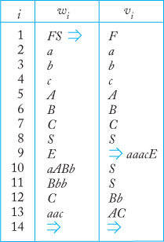
Proof that the MPCP is Undecidable, cont’d
Example:
G has productions
Let w = aaac
Then the derivation
Top
Bottom
starting tile
S → aABb | Bbb
Bb → C
AC → aac
Formal Languages
and Automata, 5th ed.
Peter Linz
Jones & Bartlett, 2012

Slide 11
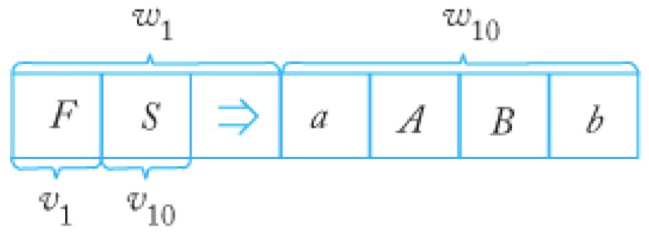
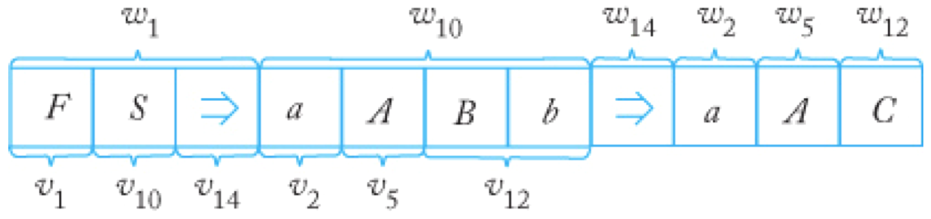
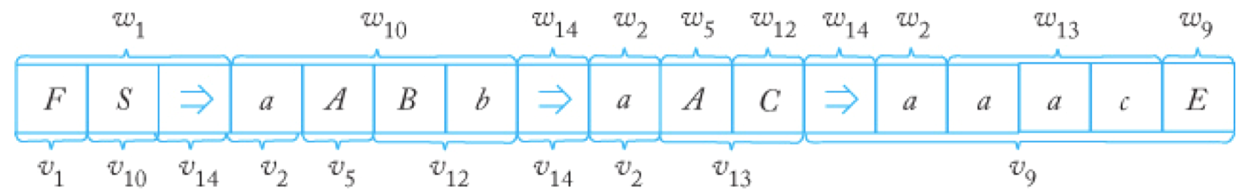
Proof that the MPCP is Undecidable, cont’d
Top
Bottom
Formal Languages
and Automata, 5th ed.
Peter Linz
Jones & Bartlett, 2012

Slide 12
Proof that the MPCP is Undecidable, cont’d
Using
domino
tiles:
aABb
a
A
C
a
aac
E
F
S
a
A
Bb
a
AC
1
10
14
2
5
12
14
2
13
9
Let G = (V, T, S, P) be any unrestricted grammar and
w be any string in T⁺.
Construct a collection of domino tiles from w and G’s productions.
Then the domino tiles have a match if and only if .
Top
Bottom

Slide 13
Proof that the MPCP is Undecidable, cont’d
Assume the MPCP is decidable:
We’ve constructed an algorithm for the membership problem of unrestricted grammar G.
This is a contradiction, since we know that
such an algorithm does not exist.
Therefore, there must not be an algorithm for the MPCP, and so the MPCP is undecidable.
G, w
Create domino tiles
from G and w
MPCP
algorithm
MPCP match
No MPCP match

Slide 14
Proof that the PCP is Undecidable
To prove that the Post correspondence problem is undecidable, we will reduce the modified Post correspondence problem (which we’ve just proven is undecidable) to it.
We first create a new PCP collection of domino tiles based on the MPCP collection of tiles.

Slide 15
Proof that the PCP is Undecidable
Suppose the MPCP dominoes have tiles 1, 2, … n.
  Tile 1 is the starting tile.
Each PCP tile is a copy of the corresponding MPCP tile with the following changes:
  Introduce two special symbols, ♮ and §.
  Into the top string of each tile, we insert the special symbol ♮ after each symbol.
  Into the bottom string of each tile, we insert the special symbol ♮ before each symbol.
  Let y and z be the top string and bottom string, respectively,
  of PCP tile 1.
  Create a new PCP tile 0 with top string ♮y and bottom string z.
  Create a new PCP tile n+1
  with top string § and bottom string ♮§.
♮y
§
z
♮§
0
n+1

Slide 16
Proof that the PCP is Undecidable, cont’d
Then any PCP match must have
tile 0 at the left end and tile n+1
at the right end.
If we ignore the ♮ and § symbols,
a PCP match corresponds to an MPCP match.
♮y
§
z
♮§
0
n+1

Slide 17
Proof that the PCP is Undecidable, cont’d
Example:
If there is a PCP match, then there is a corresponding MPCP match.
PCP
MPCP
i | Top | Bottom
0 | ♮0♮1♮ | ♮0♮1♮1
1 | 0♮1♮ | ♮0♮1♮1
2 | 1♮0♮ | ♮0
3 | 0♮1♮ | ♮1♮1
4 | 1♮ | ♮0
5 | § | ♮§
i | Top | Bottom
1 | 01 | 011
2 | 10 | 0
3 | 01 | 11
4 | 1 | 0
w = 0110110
Match sequence 1, 4, 3, 2
w = ♮0♮1♮1♮0♮1♮1♮0♮§
Match sequence 0, 4, 3, 2, 5

Slide 18
Proof that the PCP is Undecidable, cont’d
Assume that the Post correspondence problem
is decidable.
Then we can construct the following machine:
But this machine decides the modified Post correspondence problem, which we’ve proven is undecidable.
Therefore, there is no algorithm to decide the Post correspondence problem, and the PCP is undecidable.
MPCP dominoes
Create PCP
dominoes
PCP
algorithm
PCP match
MPCP match
No PCP match
No MPCP match

