Slide 1


CS 154
Formal Languages and Computability
April 7 Class Meeting
Department of Computer Science
San Jose State University
Spring 2016
Instructor: Ron Mak
www.cs.sjsu.edu/~mak

Slide 2
Another Heroic-Tragic Figure
Joseph John Rochefort, 1900-1976
  American cryptanalyst during World War II.
Helped break the Japanese naval code.
Enabled a major U.S. victory in the
Battle of Midway.
  Destroyed much of the Japanese navy.
An exemplar of what can happen to you
if you go around your immediate superiors, even if you’re very right.

Slide 3
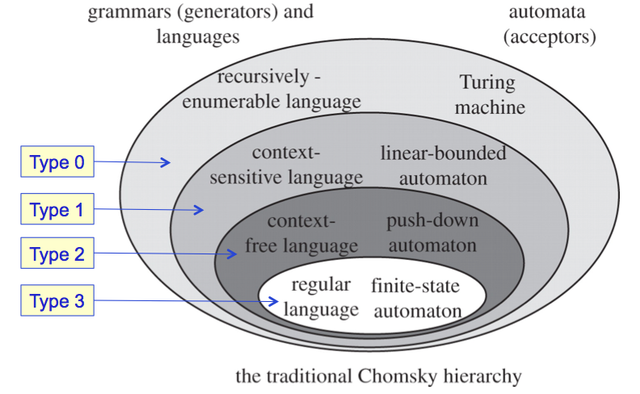
Models of Computation
Machine | Memory | Language | Applications
Finite automaton | Machine states only | Regular | Text searching, text editors
Pushdown automaton | States + stack | Context-free | Programming language compilers
Turing machine | States + infinite tape | Type 0 | Computers

Slide 4
Turing Machine
A Turing Machine (TM) is a model
of a real-world computer.
A TM has the same abilities and
the same inabilities of any computer.
Turing Thesis: Any computational process, such as those carried out by present-day computers, can be done on a Turing machine.
  AKA Church-Turing Thesis
  Church’s lambda notation and Turing’s machines
  are equivalent.

Slide 5
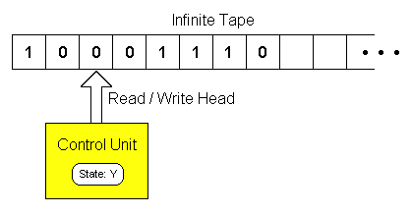
Turing Machine, cont’d
Each tape cell holds one input symbol.
  Blanks precede and follow the input string.
On each step:
  The read/write head can overwrite the current symbol.
  Then the read/write head can move one cell left or right, or stay.
http://science.slc.edu/~jmarshall/courses/2002/fall/cs30/Lectures/week08/Computation.html

Slide 6
Turing Machine Definition
Turing Machine where:
  Q is the set of internal states
  Σ is the input alphabet
  Γ is the tape alphabet
  δ is the transition function
  is the special blank symbol
  is the initial state
  is the set of final states
I use Δ for the blank symbol
instead of the book’s square
for ease of typing.

Slide 7
Turing Machine Transition Function
The transition function
has two arguments:
  the current state
  the current tape symbol being read
Results:
  a new state
  a new tape symbol that replaces the current one
  a head move to the left (L), right (R), or stay (S).
The textbook
doesn’t include S.

Slide 8
Turing Machine Example #1
A TM that accepts the language L = {a^{n}b^{n} : n ≥ 1}
Pseudocode:
  If the current input symbol (CIS) = a
  then write Δ, else REJECT.
  Move head right until CIS = Δ.
  Move head left.
  If CIS = b then write Δ, else REJECT.
  Move head left until CIS = Δ.
  Move head right.
  If CIS = Δ then ACCEPT, else go to step 1.

Slide 9
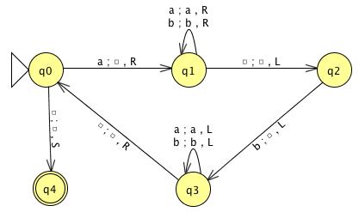
Turing Machine Example #1, cont’d
  If CIS = a then write Δ,
  else REJECT.
  Move head right until CIS = Δ.
  Move head left.
  If CIS = b then write Δ,
  else REJECT.
  Move head left until CIS = Δ.
  Move head right.
  If CIS = Δ then ACCEPT,
  else go to step 1.
q₀: Replace the leftmost a with a blank
q₁: Skip right to a blank
q₂: Replace the rightmost b with a blank
q₃: Skip left to a blank
q₄: ACCEPT
Demo G11.2

Slide 10
Turing Machine Example #2
An alternate TM that accepts the same
language L = {a^{n}b^{n} : n ≥ 1}
  Example 9.7 of the textbook.
Pseudocode:
  Replace the leftmost a by an x.
  Move head right until the leftmost b, replace by a y.
  Move head left until the leftmost a.
  Repeat until a’s and b’s are simultaneously exhausted, then ACCEPT.
  Else REJECT.

Slide 11
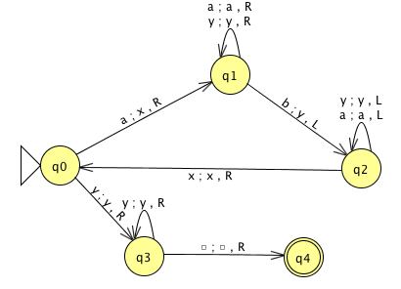
Turing Machine Example #2, cont’d
  Replace the leftmost a by an x.
  Move head right until the leftmost b, replace by a y.
  Move head left until the leftmost a.
  Repeat until a’s and b’s are simultaneously exhausted,
  then ACCEPT.
  Else REJECT.
q₀: Replace the leftmost a with an x
q₁: Skip right to the leftmost b
and replace the b with a y
q₂: Skip left to an x and go right one cell
q₃: Skip y’s to the right until a blank, then ACCEPT
q₄: Else REJECT
Demo Jexample9.7.jff

Slide 12
Instantaneous Descriptions
We can also use
instantaneous descriptions.
  For input aabb:
q₀aabb xq₁abb xaq₁bb xq₂ayb
q₂xayb xq_{o}ayb xxq₁yb
xxyq₁b xxq₂yy xq₂xyy
xxq₀y y xxyq₃y xxyyq₃
xxyyΔq₄Δ

Slide 13
Instantaneous Descriptions, cont’d
q₀aabb xq₁abb xaq₁bb xq₂ayb
Because
we can write
q₂xayb xq_{o}ayb xxq₁yb
xxyq₁b xxq₂yy xq₂xyy
xxq₀y y xxyq₃y xxyyq₃
xxyyΔq₄Δ
q₀aabb * xxyyΔq₄Δ

Slide 14
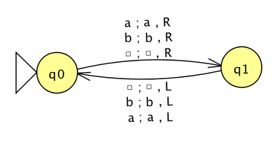
Turing Machine Example #3
What does this TM do?
Not all TMs will halt!
  Stuck in an infinite loop.

Slide 15
Turing Machines as Language Acceptors
A string w is accepted by a TM if
  w is written on the tape with blanks before and after
  The TM reads w, enters a final state, and halts.
The string w is rejected by the TM if
  The TM halts in a nonfinal state.
  The TM fails to halt.
Let be a TM.
Then the language L(M) consists of all strings over Σ that are accepted by M.

Slide 16
Turing Machines as Transducers
Because TMs are models for all computers,
we must also consider TMs that produce output.
  i.e., transducers
Input for a TM’s computation are the nonblank symbols on the tape at the initial time.
Output is whatever is on the tape at the conclusion of the computation.

Slide 17
Turing-Computable Functions
Suppose M is a transducer TM that is
given input w and produces output f(w).
f is a function such that
for some final state q_{final} of M.
  For input string w, TM M produces output string f(w)
  and halts in a final state.
A function f over domain D is Turing-computable if there is a TM such that for all strings .
q₀w *
q₀w *

Slide 18
Is Addition Turing-Computable?
Given two positive integers x and y,
design a TM that computes x + y.
Represent the quantities x and y by strings of
x 1’s and y 1’s, respectively, (unary notation) and separate the two strings with a 0.
  Example: Represent 3 + 2 as 111011
Program the TM to move the 0
to the right end of the string.
  Example: 3 + 2 = 5, or 111110

Slide 19
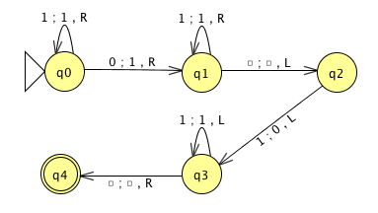
Is Addition Turing-Computable? cont’d
Demo: Jexample9.9.jff

Slide 20
Assignment #6
Create and program Turing machines to:
Accept the language L₁ = {a^{n}b^{m}a^{n+m} : n ≥ 0, m ≥ 1}
Accept the language L₂ = {w : n_{a}(w) = n_{b}(w)}
Compute the function f(x) = x mod 3
where x is a positive integer.
Shift an entire input string consisting of
0’s and 1’s one cell to the right.
  10 points extra credit if you can program a TM
  to do this right shift without ever moving the
  read/write head to the left.

