Slide 1
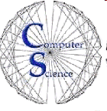

CS 154
Formal Languages and Computability
March 15 Class Meeting
Department of Computer Science
San Jose State University
Spring 2016
Instructor: Ron Mak
www.cs.sjsu.edu/~mak

Slide 2
Context-Free Languages and NPDAs
For any context-free language L,
there exists an NPDA M such that L = L(M).
If L = L(M) for some NPDA M,
then L is a context-free language.

Slide 3
Convert a DFA to a Regular Grammar
Construct a right-linear regular grammar such that the derivation of a string mimics how the DFA processes that string.
  Each production is either or .
Introduce a variable for each state.
For each transition
add the production
If B is a final state, add the production

Slide 4
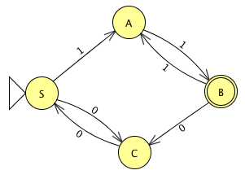
Example: DFA → Regular Grammar
Add variables
S, A, B, and C.
For the regular expression
(11 + 00)*11

Slide 5
Convert a Context-Free Grammar to a PDA
The PDA picks a leftmost derivation
and checks whether or not it was correct.
Do this using only a stack for storage.

Slide 6
Convert a CFG to a PDA, cont’d
Match terminals to the left of the leftmost variable to symbols in the input string.
Push the remaining symbols of the production onto the stack, with the leftmost symbol on top.
At each step:
  Variable on top of the stack: Pick a production and replace the variable by the right-hand side.
  Terminal on top: Pop the symbol and check that it matches the current input symbol (reject if not).
When the stack is empty, check that the input is done (reject if not).

Slide 7
Example: CFG → PDA
From the context-free grammar
do a leftmost derivation of the string 011100:
S 0S1S 01S 011S0S 0111S0S0S 01110S0S
011100S 011100

Slide 8
Example: CFG → PDA, cont’d
Input | Stack (top at left) | Action | Production
011100 | S | replace | S → 0S1S
011100 | 0S1S | pop and match
11100 | S1S | replace | S → λ
11100 | 1S | pop and match
1100 | S | replace | S → 1S0S
1100 | 1S0S | pop and match
100 | S0S | replace | S → 1S0S
100 | 1S0S0S | pop and match
00 | S0S0S | replace | S → λ
00 | 0S0S | pop and match
0 | S0S | replace | S → λ
0 | 0S | pop and match
 | S | replace | S → λ
 |  | accept

Slide 9
Example: CFG → PDA, cont’d
Convert the grammar to Greibach normal form:
The PDA will have three states {q₀, q₁, q₂}
with initial state q₀ and final state q₂.

Slide 10
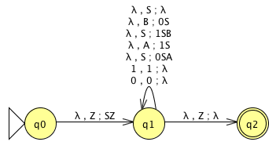
Example: CFG → PDA, cont’d
Stack start symbol: z

Slide 11
Convert an NPDA to a Context-Free Grammar
Basically, reverse the previous process so that the grammar simulates the moves of the PDA.
The variable part of a sentential form
should be the content of the stack.
The terminal prefix of a sentential form
should be the processed input symbols.

Slide 12
Convert an NPDA to a CFG, cont’d
We can label the variables of the grammar (qAp) such that if and only if
the NPDA removes A from the stack while reading v and going from state q to state p.
Therefore, if we choose (q₀zq_{f}) as the start symbol, then if and only if the NPDA removes the stack start symbol z
(thus creating an empty stack) while reading w and going from state q₀ to state q_{f}.
  But that’s how the NPDA accepts w.

Slide 13
Convert an NPDA to a CFG, cont’d
Pop:
  In state q, pop symbol A while reading a
  and going to state p.
  Add the production
Push:
  In state q with A on top of the stack,
  push B while reading a and going to state p.
  Add the collection of productions
  for every state r and s.
  To erase A, first push B, then erase B going from state p to s, and finally erase A going from state s to r.

Slide 14
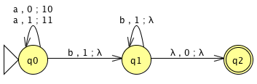
Example: NPDA → CFG
Let
Start
Push
1
a
Read
Accept
b
0
Pop
1
Read
λ
Pop

Slide 15
Example: NPDA → CFG, cont’d
Start symbol: (q₀0q₂)
Three pops:

Slide 16
Example: NPDA → CFG, cont’d
Pushes: 18 productions of the form
for each and
Do not include useless productions such as

Slide 17
Example: NPDA → CFG, cont’d
The final CFG with start symbol (q₀0q₂):
Demo: G8.5x

Slide 18
Deterministic Context-Free Language
A deterministic pushdown automaton (DPDA) never has a choice in its move.
The set δ(q, a, b) contains only one element.
  Given an input symbol and a symbol at the top of the stack, at most one move is possible.
If δ(q, λ, b) is not empty, then δ(q, c, b)
must be empty for every c in Σ.
  If an λ-move is possible for some configuration,
  no input-consuming alternative is available.

Slide 19
Example Deterministic CFL
The language
is deterministic context-free language.
The transition function of its PDA
with the stack start symbol 0 is

Slide 20
NPDA for
Start
q₀
Push w onto the stack:
Guess the string middle:
Match input w^{R} vs. stack:
Successful match:
a
Read
b
δ(q₀, a, a) = { (q₀, aa) }
δ(q₀, b, a) = { (q₀, ba) }
δ(q₀, a, b) = { (q₀, ab) }
δ(q₀, b, b) = { (q₀, bb) }
δ(q₀, a, z) = { (q₀, az) }
δ(q₀, b, z) = { (q₀, bz) }
Push
a
Push
b
Guess!
a
q₁
b
Pop
a
Read
b
Pop
λ
δ(q₀, λ, a) = { (q₁, a) }
δ(q₀, λ, b) = { (q₁, b) }
Pop
z
Accept
q₂
Q = {q₀, q₁, q₂}
Σ = {a, b}
Γ = {a, b, z}
stack start symbol = z
F = {q₂}
δ(q₁, a, a) = { (q₁, λ) }
δ(q₁, b, b) = { (q₁, λ) }
δ(q₁, λ, z) = { (q₂, z) }

Slide 21
Pumping Lemma for Context-Free Languages
Yes, there is one for context-free languages, too.
Like the one for regular languages,
use the pumping lemma to prove
that a language is not context-free.
Unfortunately, it’s even harder to use
than the one for regular languages.

