Slide 1


CS 154
Formal Languages and Computability
February 4 Class Meeting
Department of Computer Science
San Jose State University
Spring 2016
Instructor: Ron Mak
www.cs.sjsu.edu/~mak

Slide 2
Did We Understand …
The proof that |uv| = |u| + |v| ?
The fact that L** = L* ?

Slide 3
Grammars
A grammar G is defined as the quadruple
where:
  V is a finite set of objects called variables
  T is a finite set of objects called terminal symbols
  S in V is a special symbol called the start variable
  P is a finite set of production rules
G = (V, T, S, P)

Slide 4
Grammar Examples
Let grammar
with P given by
Then
so we can write
Therefore, the string aabb is in the language
sentential forms
*
L(G) = {a^{n}b^{n} : n ≥ 0}

Slide 5
Grammar Examples, cont’d
Find a grammar that generates the language
The language is similar to the previous example but with an extra b. We add the production rule
Therefore, G = ({S, A}, {a, b}, S, P) with the production rules
L = {a^{n}b^{n+1} : n ≥ 0}
S → Ab
S → Ab
A → aAb
A → λ
Or:
S → Ab
A → aAb|λ

Slide 6
Equivalent Grammars
Two grammars are equivalent if they both generate the same language:
It is not always easy to discover whether or not two grammars are equivalent.
L(G₁) = L(G₂)

Slide 7
Automata
An automaton is an abstract model
of a digital computer.
  Plural: automata
It can read symbols from an input “file”.
  A string of symbols from an alphabet.
  It can read the file only from left to right,
  one symbol at a time.
It can produce output.

Slide 8
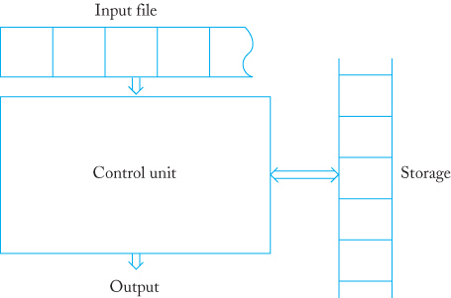
Automata, cont’d
It has a limited amount of
temporary storage.
  Each storage cell can hold one symbol.
  The automaton can read and change the contents of the storage cells.
It has a control unit.
Formal Languages
and Automata, 5th ed.
Peter Linz
Jones & Bartlett, 2012

Slide 9
Control Unit
The control unit can be in any one of a finite number of internal states.
At any given moment:
  The control unit is in some internal state.
  The input mechanism is scanning
  a particular symbol from the input.
The automaton operates in discrete time steps.
The control unit’s next internal state is determined by the transition function.

Slide 10
Transition Function
The transition function determines the
next state of the control unit based on:
  the current state
  the current input symbol
  information currently in the temporary storage
From one time step to another:
  output may be produced
  temporary storage contents may be changed

Slide 11
Automaton Configuration
A configuration refers to a particular state of:
  the control unit
  the input
  the temporary storage
The transition of the automaton from one configuration to the next is a move.

Slide 12
Acceptors and Transducers
An automaton whose output is limited to “yes” or “no” for any given input is an acceptor.
  It either accepts the input string or not.
An automaton that can produce any string
of symbols as output is a transducer.

Slide 13
Deterministic vs. Nondeterministic
Deterministic automaton
  Each move is uniquely determined
  by the current configuration.
  If we know the internal state, the input, and the contents of internal storage ➔ we can exactly predict the future behavior of the automaton.
Nondeterministic automaton
  At each point, the automaton can have several possible moves ➔ we can only predict a set of possible actions.
The relationship between deterministic and nondeterministic automata
will play a significant role in our study of formal languages and computation.

Slide 14
Deterministic Acceptors
A deterministic finite acceptor (DFA) is the quintuple
where:
  Q is the finite set of internal states
  Σ is the input alphabet, a finite set of symbols
  is a total transition function
  is the initial state
  is a set of final states
M = (Q, Σ, δ, q₀, F)
Total function: A function that is defined for all inputs
of the right type (i.e., for all inputs from a given domain).

Slide 15
DFA Operation
At the initial time:
  In internal state q₀
  Input mechanism on the leftmost input symbol
During each move:
  Consume one input symbol by advancing
  the input one symbol to the right.

Slide 16
DFA Operation, cont’d
The transition from one internal state to another is governed by the transition function
Example:
  If the automaton is at the initial state q₀, and
  If the input symbol is a, and
  If
  Then the DFA will go to state q₁.
We can visualize and represent a finite automaton with a transition graph.
δ(q₀, a) = q₁

Slide 17
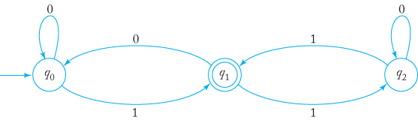
Transition Graph Example
initial vertex
final vertex
The DFA
where δ is given by
M = ({q₀, q₁, q₂}, {0, 1}, δ, q₀, {q₁})
δ(q₀, 0) = q₀ | δ(q₀, 1) = q₁
δ(q₁, 0) = q₀ | δ(q₁, 1) = q₂
δ(q₂, 0) = q₂ | δ(q₂, 1) = q₁
Formal Languages
and Automata, 5th ed.
Peter Linz
Jones & Bartlett, 2012

Slide 18
DFA Operation, cont’d
The automaton accepts its input string if:
  The automaton reaches the end of the input string.
  And it’s in one of its final states.
Otherwise, the automaton rejects the string.

Slide 19
Transition Graph Example, cont’d
Will this automaton accept or reject:
  01
  00
  101
  0111
  11001
  100
  1100
JFLAP demo
Formal Languages
and Automata, 5th ed.
Peter Linz
Jones & Bartlett, 2012

Slide 20
Extended Transition Function
Transition on a string rather than a single symbol.
  Do a regular transition on each symbol of the string.
Give the state after reading the entire string.

Slide 21
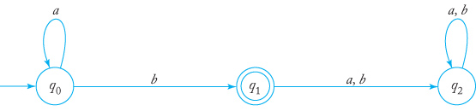
State Transition Matrix
We can implement a state transition matrix
with a state transition matrix.
trap state
 | a | b
q₀ | q₀ | q₁
q₁ | q₂ | q₂
q₂ | q₂ | q₂
Formal Languages
and Automata, 5th ed.
Peter Linz
Jones & Bartlett, 2012

Slide 22
A Practical Application
You are given the text of the novel
War and Peace as a plain text file.
Write a program to search the text
for these names:
  Boris Drubetskoy
  Joseph Bazdeev
  Makar Alexeevich
For each name found, print the line number and the position within the line.
  Line and position numbers start with 1

Slide 23
A Practical Application, cont’d
A name can span two lines.
  First name at the end of one line.
  Last name at the beginning of the next line.
How efficiently can this program run?
  Run and time the program 10 times and time each run.
  Print the minimum, maximum, and median times
  (in milliseconds).
  To compare among different machines,
  also calculate the “performance number”:
  run time in ms X processor speed in GHz
  (lower performance numbers are better)

Slide 24
A Practical Application, cont’d
State transition diagram to recognize “Boris” and “Makar”:
0
B
1
o
2
r
3
i
4
s
Recognize
“Boris”
M
5
a
6
k
7
a
8
r
Recognize
“Makar”

Slide 25
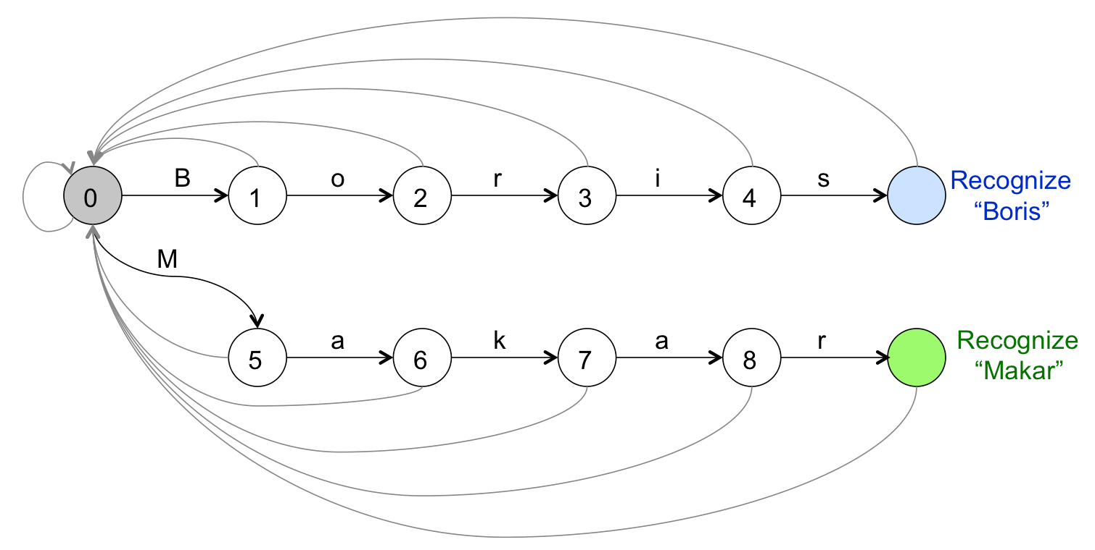
A Practical Application, cont’d
The state transition matrix
 |  | B | M | a | i | k | o | r | s
0 | 0 | 1 | 5 | 0 | 0 | 0 | 0 | 0 | 0
1 | 0 | 0 | 0 | 0 | 0 | 0 | 2 | 0 | 0
2 | 0 | 0 | 0 | 0 | 0 | 0 | 0 | 3 | 0
3 | 0 | 0 | 0 | 0 | 4 | 0 | 0 | 0 | 0
4 | 0 | 0 | 0 | 0 | 0 | 0 | 0 | 0
5 | 0 | 0 | 0 | 6 | 0 | 0 | 0 | 0 | 0
6 | 0 | 0 | 0 | 0 | 0 | 7 | 0 | 0 | 0
7 | 0 | 0 | 0 | 8 | 0 | 0 | 0 | 0 | 0
8 | 0 | 0 | 0 | 0 | 0 | 0 | 0 |  | 0

Slide 26
A Practical Application, cont’d
private static final int MATRIX[][] = {
// Starting state 0
/* other,A,B,D,J,M,a,b,c,d,e,h,i,k,l,o,p,r,s,t,u,v,x,y,z,sp,\n */
/* 0 */ {0,0,1,0,16,29,0,0,0,0,0,0,0,0,0,0,0,0,0,0,0,0,0,0,0,0,0},
// Boris Drubetskoy
/* other,A,B,D,J,M,a,b,c,d,e,h,i,k,l,o,p,r,s,t,u,v,x,y,z,sp,\n */
/* 1 */ {0,0,0,0,0,0,0,0,0,0,0,0,0,0,0,2,0,0,0,0,0,0,0,0,0,0,0},
/* 2 */ {0,0,0,0,0,0,0,0,0,0,0,0,0,0,0,0,0,3,0,0,0,0,0,0,0,0,0},
/* 3 */ {0,0,0,0,0,0,0,0,0,0,0,0,4,0,0,0,0,0,0,0,0,0,0,0,0,0,0},
/* 4 */ {0,0,0,0,0,0,0,0,0,0,0,0,0,0,0,0,0,0,5,0,0,0,0,0,0,0,0},
/* 5 */ {0,0,0,0,0,0,0,0,0,0,0,0,0,0,0,0,0,0,0,0,0,0,0,0,0,6,6},
/* 6 */ {0,0,0,7,0,0,0,0,0,0,0,0,0,0,0,0,0,0,0,0,0,0,0,0,0,0,0},
/* 7 */ {0,0,0,0,0,0,0,0,0,0,0,0,0,0,0,0,0,8,0,0,0,0,0,0,0,0,0},
/* 8 */ {0,0,0,0,0,0,0,0,0,0,0,0,0,0,0,0,0,0,0,0,9,0,0,0,0,0,0},
/* 9 */ {0,0,0,0,0,0,0,10,0,0,0,0,0,0,0,0,0,0,0,0,0,0,0,0,0,0,0},
/* 10 */ {0,0,0,0,0,0,0,0,0,0,11,0,0,0,0,0,0,0,0,0,0,0,0,0,0,0,0},
/* 11 */ {0,0,0,0,0,0,0,0,0,0,0,0,0,0,0,0,0,0,0,12,0,0,0,0,0,0,0},
/* 12 */ {0,0,0,0,0,0,0,0,0,0,0,0,0,0,0,0,0,0,13,0,0,0,0,0,0,0,0},
/* 13 */ {0,0,0,0,0,0,0,0,0,0,0,0,0,14,0,0,0,0,0,0,0,0,0,0,0,0,0},
/* 14 */ {0,0,0,0,0,0,0,0,0,0,0,0,0,0,0,15,0,0,0,0,0,0,0,0,0,0,0},
/* 15 */ {0,0,0,0,0,0,0,0,0,0,0,0,0,0,0,0,0,0,0,0,0,0,0,BD,0,0,0},
…
};

Slide 27
A Practical Application, cont’d
private int index(char ch)
{
switch (ch) {
case 'A' : return 1;
case 'B' : return 2;
case 'D' : return 3;
case 'J' : return 4;
case 'M' : return 5;
case 'a' : return 6;
case 'b' : return 7;
case 'c' : return 8;
case 'd' : return 9;
case 'e' : return 10;
case 'h' : return 11;
case 'i' : return 12;
case 'k' : return 13;
case 'l' : return 14;
case 'o' : return 15;
case 'p' : return 16;
case 'r' : return 17;
case 's' : return 18;
case 't' : return 19;
case 'u' : return 20;
case 'v' : return 21;
case 'x' : return 22;
case 'y' : return 23;
case 'z' : return 24;
case ' ' : return 25;
case '\n' : return 26;
default : return 0;
}
}

Slide 28
Languages and DFAs
Recall that an acceptor is an automaton that either accepts or rejects input strings.
The set of all strings that the DFA
accepts constitutes the language
The DFA represents the language’s rules.

