Slide 1


CS 153: Concepts of Compiler Design
November 12 Class Meeting
Department of Computer Science
San Jose State University
Fall 2024
Instructor: Ron Mak
www.cs.sjsu.edu/~mak

Slide 2
On Writing Compilers
Compiler-writing is a highly advanced programming skill.
  Looks very impressive on resumes.
Even if you will never have to write a compiler professionally, the advanced skills are applicable to other software projects.
  Teamwork is critical.
  Your employers will know that you can handle the most complex projects.

Slide 3
Compilation Challenges
Compiling a program written in one high-level language such as Pascal to object code for a machine architecture designed for a different high-level language such as the Java Virtual Machine can be mostly straightforward, but there can be challenges!
  array subscripting
  nested procedures and functions
  allocation of local data structures
  modes of procedure and function parameters

Slide 4
Compilation Challenge: Subscripts
Pascal allows an array index type to be any subrange.
  In subscripts for the JVM, we must subtract the lower bound of the subrange.
  Example:
...
VAR
i : INTEGER;
data = ARRAY [5..10] OF REAL;
BEGIN
i = 4;
data[i + 3] = 3.14;
...
END.
int i;
double data[6]
...
i = 4;
data[(i + 3) – 5] = 3.14;
...

Slide 5
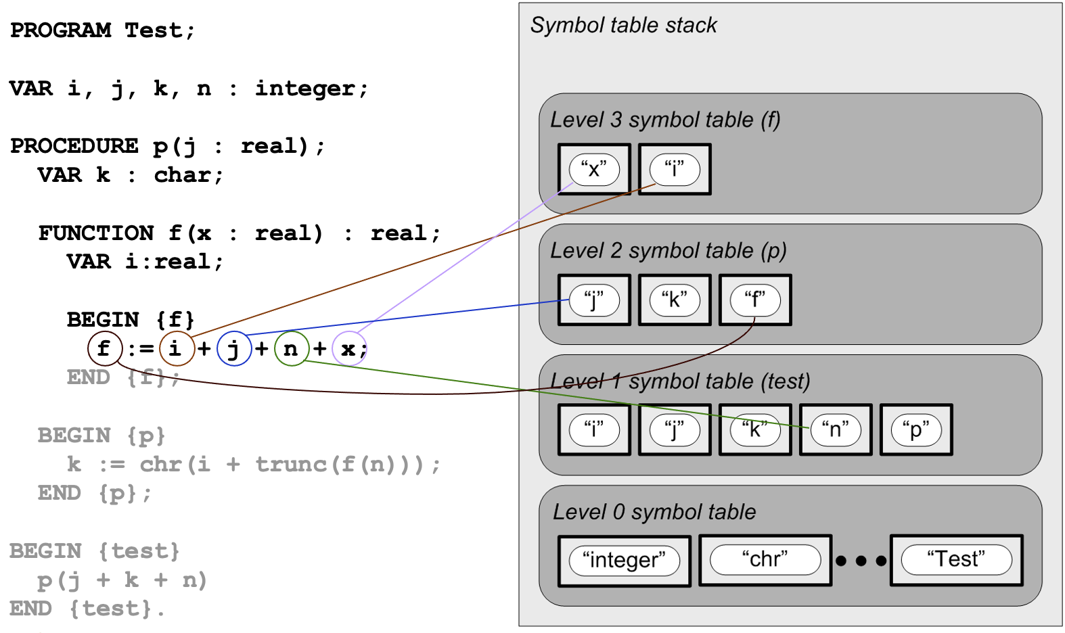
Compilation Challenge: Nested Routines
Pascal allows nested procedures and functions, which can result in deeply nested scopes.
  The JVM does not support nested methods.

Slide 6
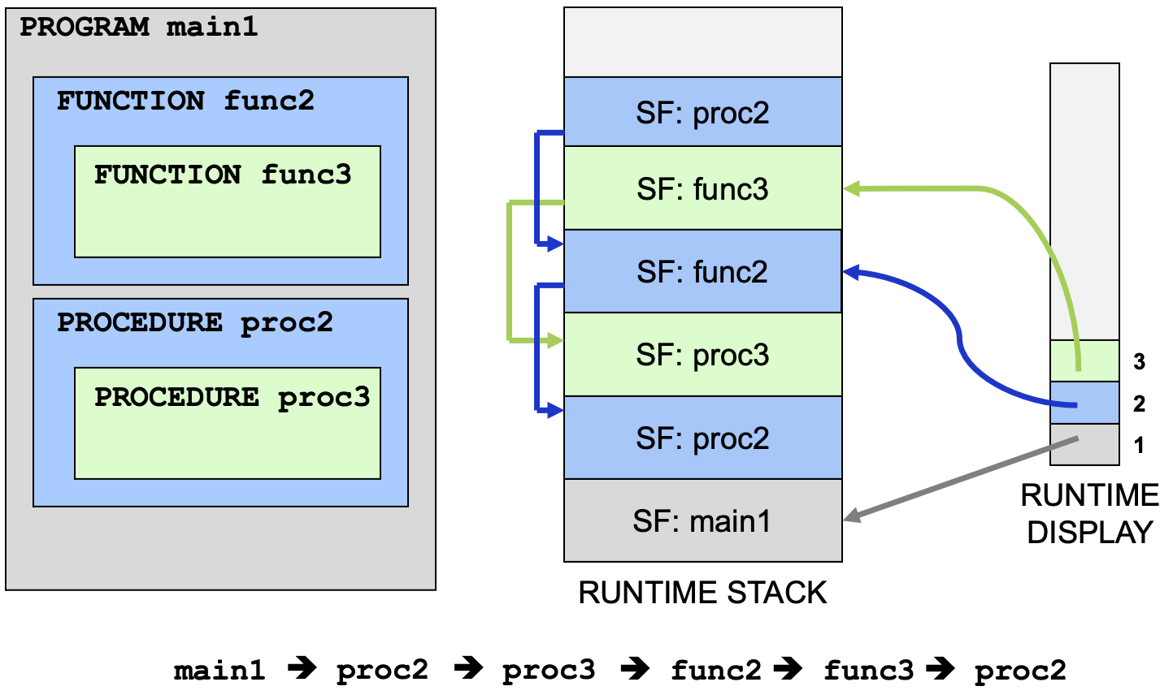
Compilation Challenge: Nested Routines, cont’d
There’s a good reason modern languages like Java don’t support nested methods.
  Maintaining a runtime display and backlinks in the runtime stack hurts performance.

Slide 7
Compilation Challenge: Local Data
In Pascal, all local data is automatically allocated and deallocated on the runtime stack.
  Example:
TYPE
rec = RECORD
fld : INTEGER;
END;
PROCEDURE proc(...);
VAR
r : rec;
BEGIN
...
r.fld := 12;
...
END;
The record value of local
variable r is automatically
allocated on the runtime stack
whenever proc is called, and
it is automatically deallocated
whenever proc returns.

Slide 8
Compilation Challenge: Local Data, cont’d
Java allocates data structures in the heap, and we must explicitly create the data with new.
Java’s automatic garbage collection deallocates data structures that no longer have pointers pointing to them.
  In languages like C and C++, we must explicitly free or delete the data.
public class Rec
{
...
}
...
Rec r = new Rec();

Slide 9
Compilation Challenge: Parameters
All parameters of Pascal procedures and functions can be passed by value or by reference.
  Example:
Java and the JVM can only pass by value.
TYPE
vec = ARRAY [1..10] OF REAL;
rec = RECORD
...
END;
FUNCTION foo(x, y : REAL; v, w : VEC; r : REC;
VAR z : real; VAR vv : vec; VAR rr : REC) : REAL;
Passed by value
Passed by reference

Slide 10
Compilation Challenge: Parameters, cont’d
Besides pass by value and pass by reference, some languages support pass by name.
  Example in pseudo-Pascal:
...
VAR i : INTEGER;
FUNCTION sum(NAME i, j : INTEGER) : INTEGER;
VAR total : INTEGER;
BEGIN
total := 0;
FOR i := 1 TO 100 DO total := total + j;
sum := total;
END;
...
BEGIN
WRITELN(sum(i, i*i))
END.
How does this work?
What value is printed?

Slide 11
Compilation Challenge: Parameters, cont’d
...
VAR i : INTEGER;
FUNCTION sum(NAME i, j : INTEGER) : INTEGER;
VAR total : INTEGER;
BEGIN
total := 0;
FOR i := 1 TO 100 DO total := total + j;
sum := total;
END;
...
BEGIN
WRITELN(sum(i, i*i))
END.
Can we implement name parameters with Java’s lambda expressions?
Print the sum of
the squares
of 1 through 100.
In the function, each i is a reference to the global i
(as if the parameter were passed by reference).
But in the function, each j is re-evaluated in the context of the caller, so it’s the current value of i*i.
The effect is that parameter j is textually substituted by argument i*i.

Slide 12
Speed Comparisons
The Pascal program Hilbert10000.pas performs 10,000 times:
  Generate a 5 x 5 Hilbert matrix.
  Invert the matrix.
  Multiply the matrix by its inverse (= identity matrix)
  Invert the inverse (= the original Hilbert matrix)
  Print the results only after the 10,000th iteration.

Slide 13
Speed Comparisons, cont’d
Compare execution times:
  Interpreter: 21,855 ms
  Converted Java program: 91 ms
  Compiled to Jasmin and assembled: 91 ms
Demo

Slide 14
Stack Machine vs. Register Machine
A key difference is how arithmetic operations are performed.
The JVM has a stack machine architecture.
  No registers.
  Operations are performed on operand stacks within each stack frame.
  Many instructions that have zero or few operands, so smaller programs.
  Instructions that pop their operands off the local operand stack and push the results back onto the stack.

Slide 15
Stack Machine vs. Register Machine, cont’d
Compiling for stack architectures:
  Pro: Easier code generation for arithmetic operations.
  Con: Keep track of what’s on the stack.
A register-based machine architecture relies on arithmetic operations performed in registers.
  Instructions generally have one, two, or more operands.
  Register-to-register and register-to-memory.
  Different machines have different numbers of integer, floating-point, address, and general-purpose registers.

Slide 16
Stack Machine vs. Register Machine, cont’d
Compiling for register machines:
  Pro: Easier to keep track of what’s in the registers.
  Con: Deciding which registers to use and how long to keep a value in a register.

Slide 17
Stack Machine vs. Register Machine, cont’d
What about register-based machines that have only a few registers?
The compiler must allocate temporary variables to hold the intermediate results of calculations.
  Temporaries can vary by type (integer, float, character, etc.) and by size (single, double, etc.)
  Allocate a new temporary each time one is required.
  Reuse a temporary (of the appropriate type and size) that is no longer needed.
Later: An example of a compiler for a machine with only a few registers.

Slide 18
CISC vs. RISC
CISC: Complex Instruction Set Computer
Goal: Operations should be accomplished in as few machine (assembly) instructions as possible.
  Each instruction can cause several machine-level operations that are normally hidden.
CISC is easier for compiler writers because they need to emit fewer instructions.
  The instructions are often tailored to handle the operations of high-level languages.

Slide 19
CISC vs. RISC, cont’d
CISC example:
  Multiply the values in memory locations labeled A and B and store the result back into memory location A.
  The operation may involve copying values from memory into machine registers, performing the multiplication in the registers, and copying the product back out to memory.
  The register operations are hidden from the programmer.
  Several clock cycles may be required for each instruction.
MULT A, B

Slide 20
CISC vs. RISC, cont’d
RISC: Reduced Instruction Set Computer
Goal: Simple machine instructions each of which is executed in only one clock cycle.
  Each instruction performs a low machine-level operation.
RISC is more work for compiler writers because high-level language operations must be broken down into more instructions.

Slide 21
CISC vs. RISC, cont’d
RISC example:
  Multiply the values in memory locations labeled A and B and store the result back into memory location A.
  Lower-level LOAD and STORE instructions that access the machine registers R1 and R2.
  Each instruction takes one clock cycle.
LOAD R1, A
LOAD R2, B
MULT R1, R2
STORE A, R1

Slide 22
CISC vs. RISC, cont’d
Example CISC processors
  Intel
  AMD
Example RISC processors
  ARM (Advanced RISC Machine)
  MIPS
  Apple silicon (M1, M2, M3, M4)

