Slide 1


CS 153
Concepts of Compiler Design
October 15 Class Meeting
Department of Computer Science
San Jose State University
Fall 2024
Instructor: Ron Mak
www.cs.sjsu.edu/~mak

Slide 2
Example Conversion: Newton3.pas
PROGRAM Newton3;
VAR
number : integer;
FUNCTION root(x : real) : real;
VAR
r, prev, diff : real;
BEGIN
r := 1;
prev := 0;
REPEAT
r := (x/r + r)/2;
diff := r - prev;
IF diff < 0 THEN diff := -diff;
prev := r
UNTIL diff < 1.0e-10;
root := r
END;
PROCEDURE print(n : integer; root : real);
BEGIN
writeln('The square root of ', n:4,
' is ', root:8:4)
END;
BEGIN
FOR number := 1 TO 25 DO BEGIN
print(number, root(number))
END
END.
public class Newton3
{
private static java.util.Scanner _sysin =
new java.util.Scanner(System.in);
private static int number;
static double root(double x)
{
double root;
double r;
double prev;
double diff;
r = 1;
prev = 0;
do
{
r = (x/r + r)/2;
diff = r - prev;
if (diff < 0)
diff = -diff;
prev = r;
}
while (!(diff < 1.0e-10));
root = r;
return root;
}
...

Slide 3
Example Conversion: Newton3.pas
...
static void print(int n, double root)
{
System.out.printf("The square root of %4d is %8.4f\n",
n, root);
}
public static void main(String[] args)
{
java.time.Instant _start = java.time.Instant.now();
for (number = 1; number <= 25; number++)
{
print(number, root(number));
}
java.time.Instant _end = java.time.Instant.now();
long _elapsed =
java.time.Duration.between(_start, _end)
.toMillis();
System.out.printf(
"\n[%,d milliseconds execution time.]\n",
_elapsed);
}
}
...
PROCEDURE print(n : integer; root : real);
BEGIN
writeln('The square root of ', n:4,
' is ', root:8:4)
END;
BEGIN
FOR number := 1 TO 25 DO BEGIN
print(number, root(number))
END
END.

Slide 4
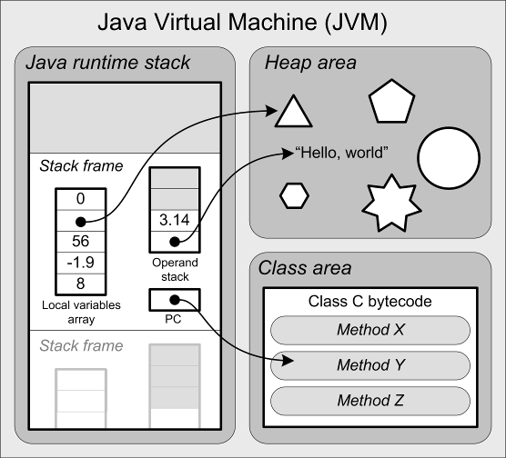
Local Variables
Local variables do not
have names in Jasmin.
  Fields of a class do have
  names, as we’ll see later.
Refer to a local variable
by its slot number
in the local variables array
of the active stack frame.
  Example:
  iload 5 ; Push the int value in local slot #5

Slide 5
Local Variables, cont’d
Since each long and double value requires
two consecutive slots, refer to the value using the lower slot number.
  Example:
  lstore 3 ; Pop the long value
  ; from the top two stack elements
  ; and store it into local slots #3 and #4

Slide 6
Local Variables, cont’d
Do not confuse constant values
with slot numbers!
  It depends on the instruction.
  Examples:
  bipush 14 ; push the constant value 14
  iload 14 ; push the value in local slot #14

Slide 7
Local Variables, cont’d
The values of a function’s parameters are implicitly assigned to slots starting with #0.
  Example Java method:
  k ➔ local slot #0
  m ➔ local slot #1
  x ➔ local slot #3
  s ➔ local slot #4
  Jasmin function signature:
  public static double func(int k, long m,
  float x, String[][] s)
What happened to slot #2?
  .method public static func(IJF[[Ljava/lang/String;)D

Slide 8
Load and Store Instructions
In general:
iload n ; push the int value in local slot #n
lload n ; push the long value in local slot #n
fload n ; push the float value in local slot #n
dload n ; push the double value in local slot #n
aload n ; push the reference in local slot #n
Shortcut examples
(for certain small values of slot number n):
iload_0 ; push the int value in local slot #0
lload_2 ; push the long value in local slot #2
fload_1 ; push the float value in local slot #1
dload_3 ; push the double value in local slot #3
aload_2 ; push the reference in local slot #2
Store instructions are similar.

Slide 9
Arithmetic Instructions
Addition
iadd ladd fadd dadd
Subtraction
isub lsub fsub dsub
Multiplication
imul lmul fmul dmul
Division and remaindering
idiv ldiv fdiv ddiv
Negation
ineg lneg fneg dneg
Operands are on top of
the operand stack.
Pop off the operands and replace them with the result value.
Negation has only one operand, the others each has two.
Int and float operands each takes a single stack element.
Long and double operands each takes two operand stack elements.

Slide 10
Other Instructions
Bitwise operations
  Left and right shifts
  And, or, exclusive or
Type conversions
  int ➔ float
Widening and narrowing
  int ➔ long
  double ➔ long
Stack manipulations
  Push and pop
  Swap and duplicate
Array operations
  Allocate array
  Index element
Object operations
Control instructions

Slide 11
Code Templates
Syntax diagrams
  Specify the source language grammar
  Help us write the parsers
Code templates
  Specify what object code to generate
  Help us write the code emitters

Slide 12
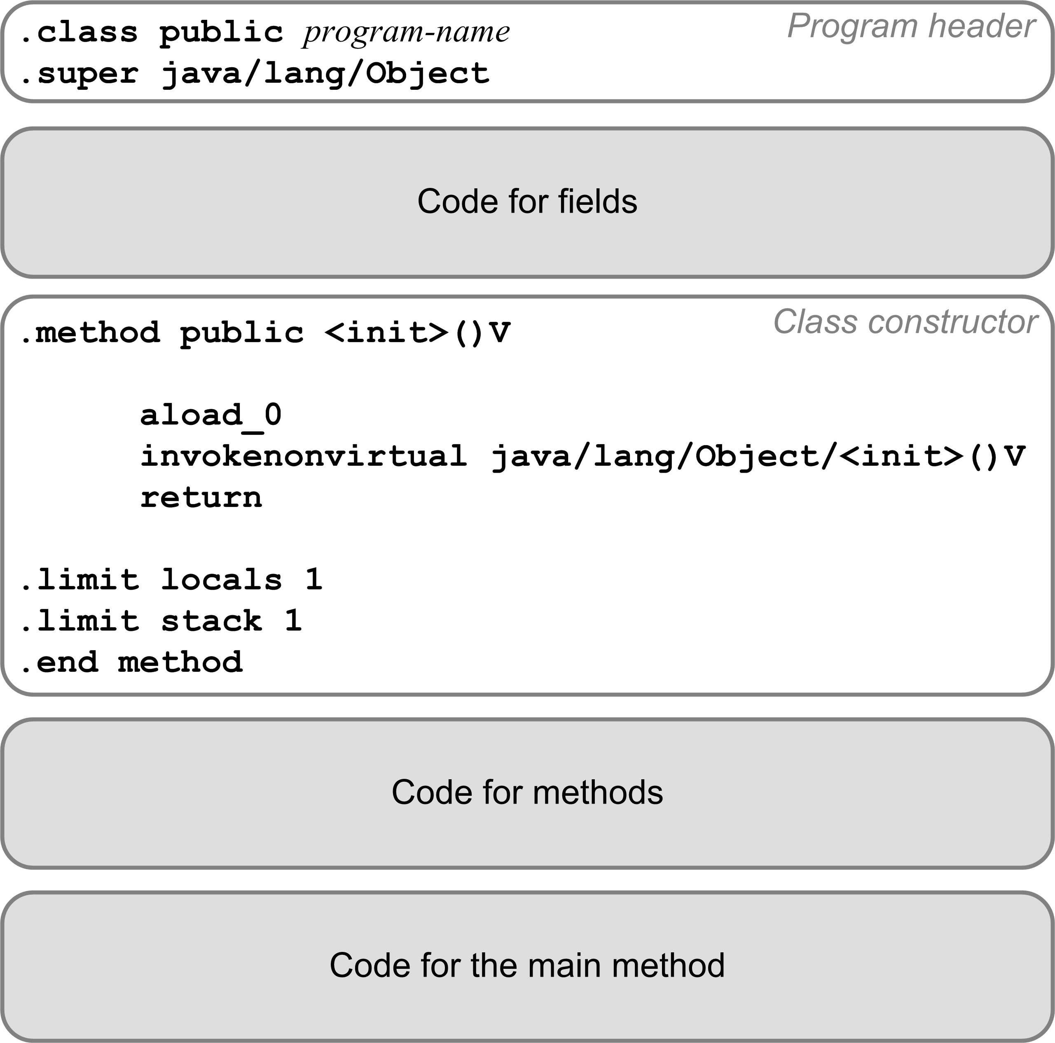
Code Template for a Pascal Program
Translate a Pascal program into a
public class.
Program variables become class fields.
Must have a
default constructor.
Each procedure or function becomes a private static method.
The main program code becomes the public static
main method.

Slide 13
Compilation Strategy
We’ll compile a Pascal program
as if it were a public Java class.
  The Pascal program name becomes
  the Java class name.
The main program becomes the
main method of the Java class.
We’ll compile each program variable
as if it were a field of the Java class.
  Fields do have names in a Jasmin program.
  Recall that local variables and parameters
  are referred to only by their slot numbers.

Slide 14
Compilation Strategy, cont’d
We’ll compile each Pascal procedure or function as if it were a private static method
of the Java class.
Local variables and formal parameters of the method do not have names in a Jasmin program.
  Jasmin instructions refer to local variables and parameters by their slot numbers of the local variables array.

Slide 15
Jasmin Datatype Descriptors
Java Scalar type | Jasmin Type Descriptor
int | I
float | F
boolean | Z
char | C
Java Array type | Jasmin Type Descriptor
java.lang.String[] | [Ljava/lang/String;
Newton[][] | [[LNewton;
int[][][] | [[[I
Java Class | Jasmin Type Descriptor
java.lang.String | Ljava/lang/String;
java.util.HashMap | Ljava/util/HashMap;
Newton | LNewton;
  public static double func(int k, long m,
  float x, String[][] s)
  .method public static func(IJF[[Ljava/lang/String;)D

Slide 16
Jasmin Assembly Code Generation
Our compiler will follow the same pattern for Jasmin assembly code generation as our converter did to convert Pascal programs to Java.
Code templates will be our guide to code generation.

Slide 17
Program Fields

Slide 18
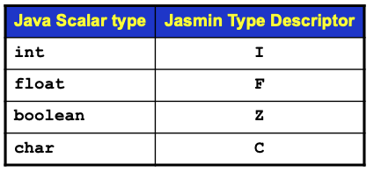
Program Fields, cont’d
For example:
PROGRAM test;
VAR
i, j, k : integer;
x, y : real;
p, q : boolean;
ch : char;
index : 1..10;
Pascal program variables
Compiles to:
.field private static ch C
.field private static i I
.field private static index I
.field private static j I
.field private static k I
.field private static p Z
.field private static q Z
.field private static x F
.field private static y F

Slide 19
Code Template for the Main Method, cont’d

Slide 20
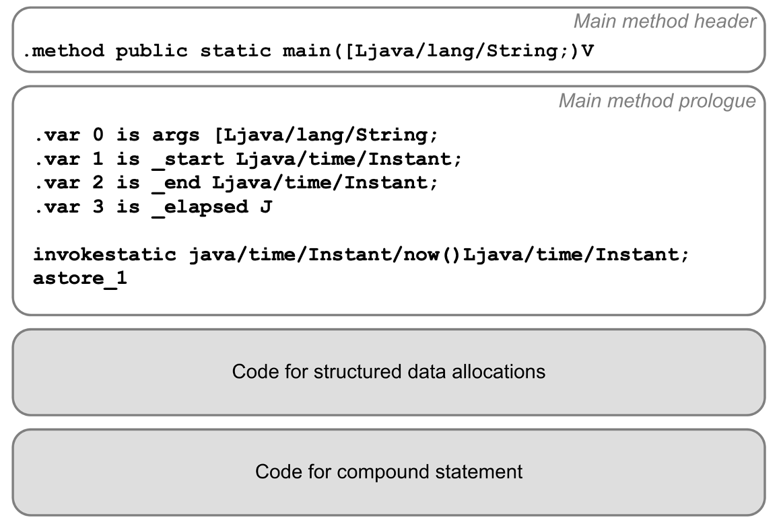
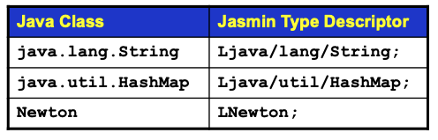
Code Template for the Main Method, cont’d
The main method prologue initializes the runtime timer.
Main method epilogue

Slide 21
Code Template for the Main Method, cont’d
The main method epilogue prints the elapsed run time.
Main program epilogue
invokestatic java/time/Instant/now()Ljava/time/Instant;
astore_2
aload_1
aload_2
invokestatic java/time/Duration/between(Ljava/time/temporal/Temporal;Ljava/time/temporal/Temporal;)Ljava/time/Duration;
invokevirtual java/time/Duration/toMillis()J
lstore_3
getstatic java/lang/System/out Ljava/io/PrintStream;
ldc "\n[%,d milliseconds execution time.]\n"
iconst_1
anewarray java/lang/Object
dup
iconst_0
lload_3
invokestatic java/lang/Long/valueOf(J)Ljava/lang/Long;
aastore
invokevirtual java/io/PrintStream/printf(Ljava/lang/String;[Ljava/lang/Object;)Ljava/io/PrintStream;
pop
return
.limit locals 6
.limit stack 7
.end method

Slide 22
Loading a Program Variable’s Value
To load (push) a program variable’s value
onto the operand stack:
getstatic program-name/variable-name type-descriptor
Examples:
getstatic Test/count I
getstatic Test/radius F
Java Scalar type | Jasmin Type Descriptor
int | I
float | F
boolean | Z
char | C

Slide 23
Storing a Program Variable’s Value
To store (pop) a value from the operand stack
into a program variable:
putstatic program-name/variable-name type-descriptor
Examples:
putstatic Test/count I
putstatic Test/radius F
Java Scalar type | Jasmin Type Descriptor
int | I
float | F
boolean | Z
char | C

Slide 24
Code for Procedures and Functions

Slide 25
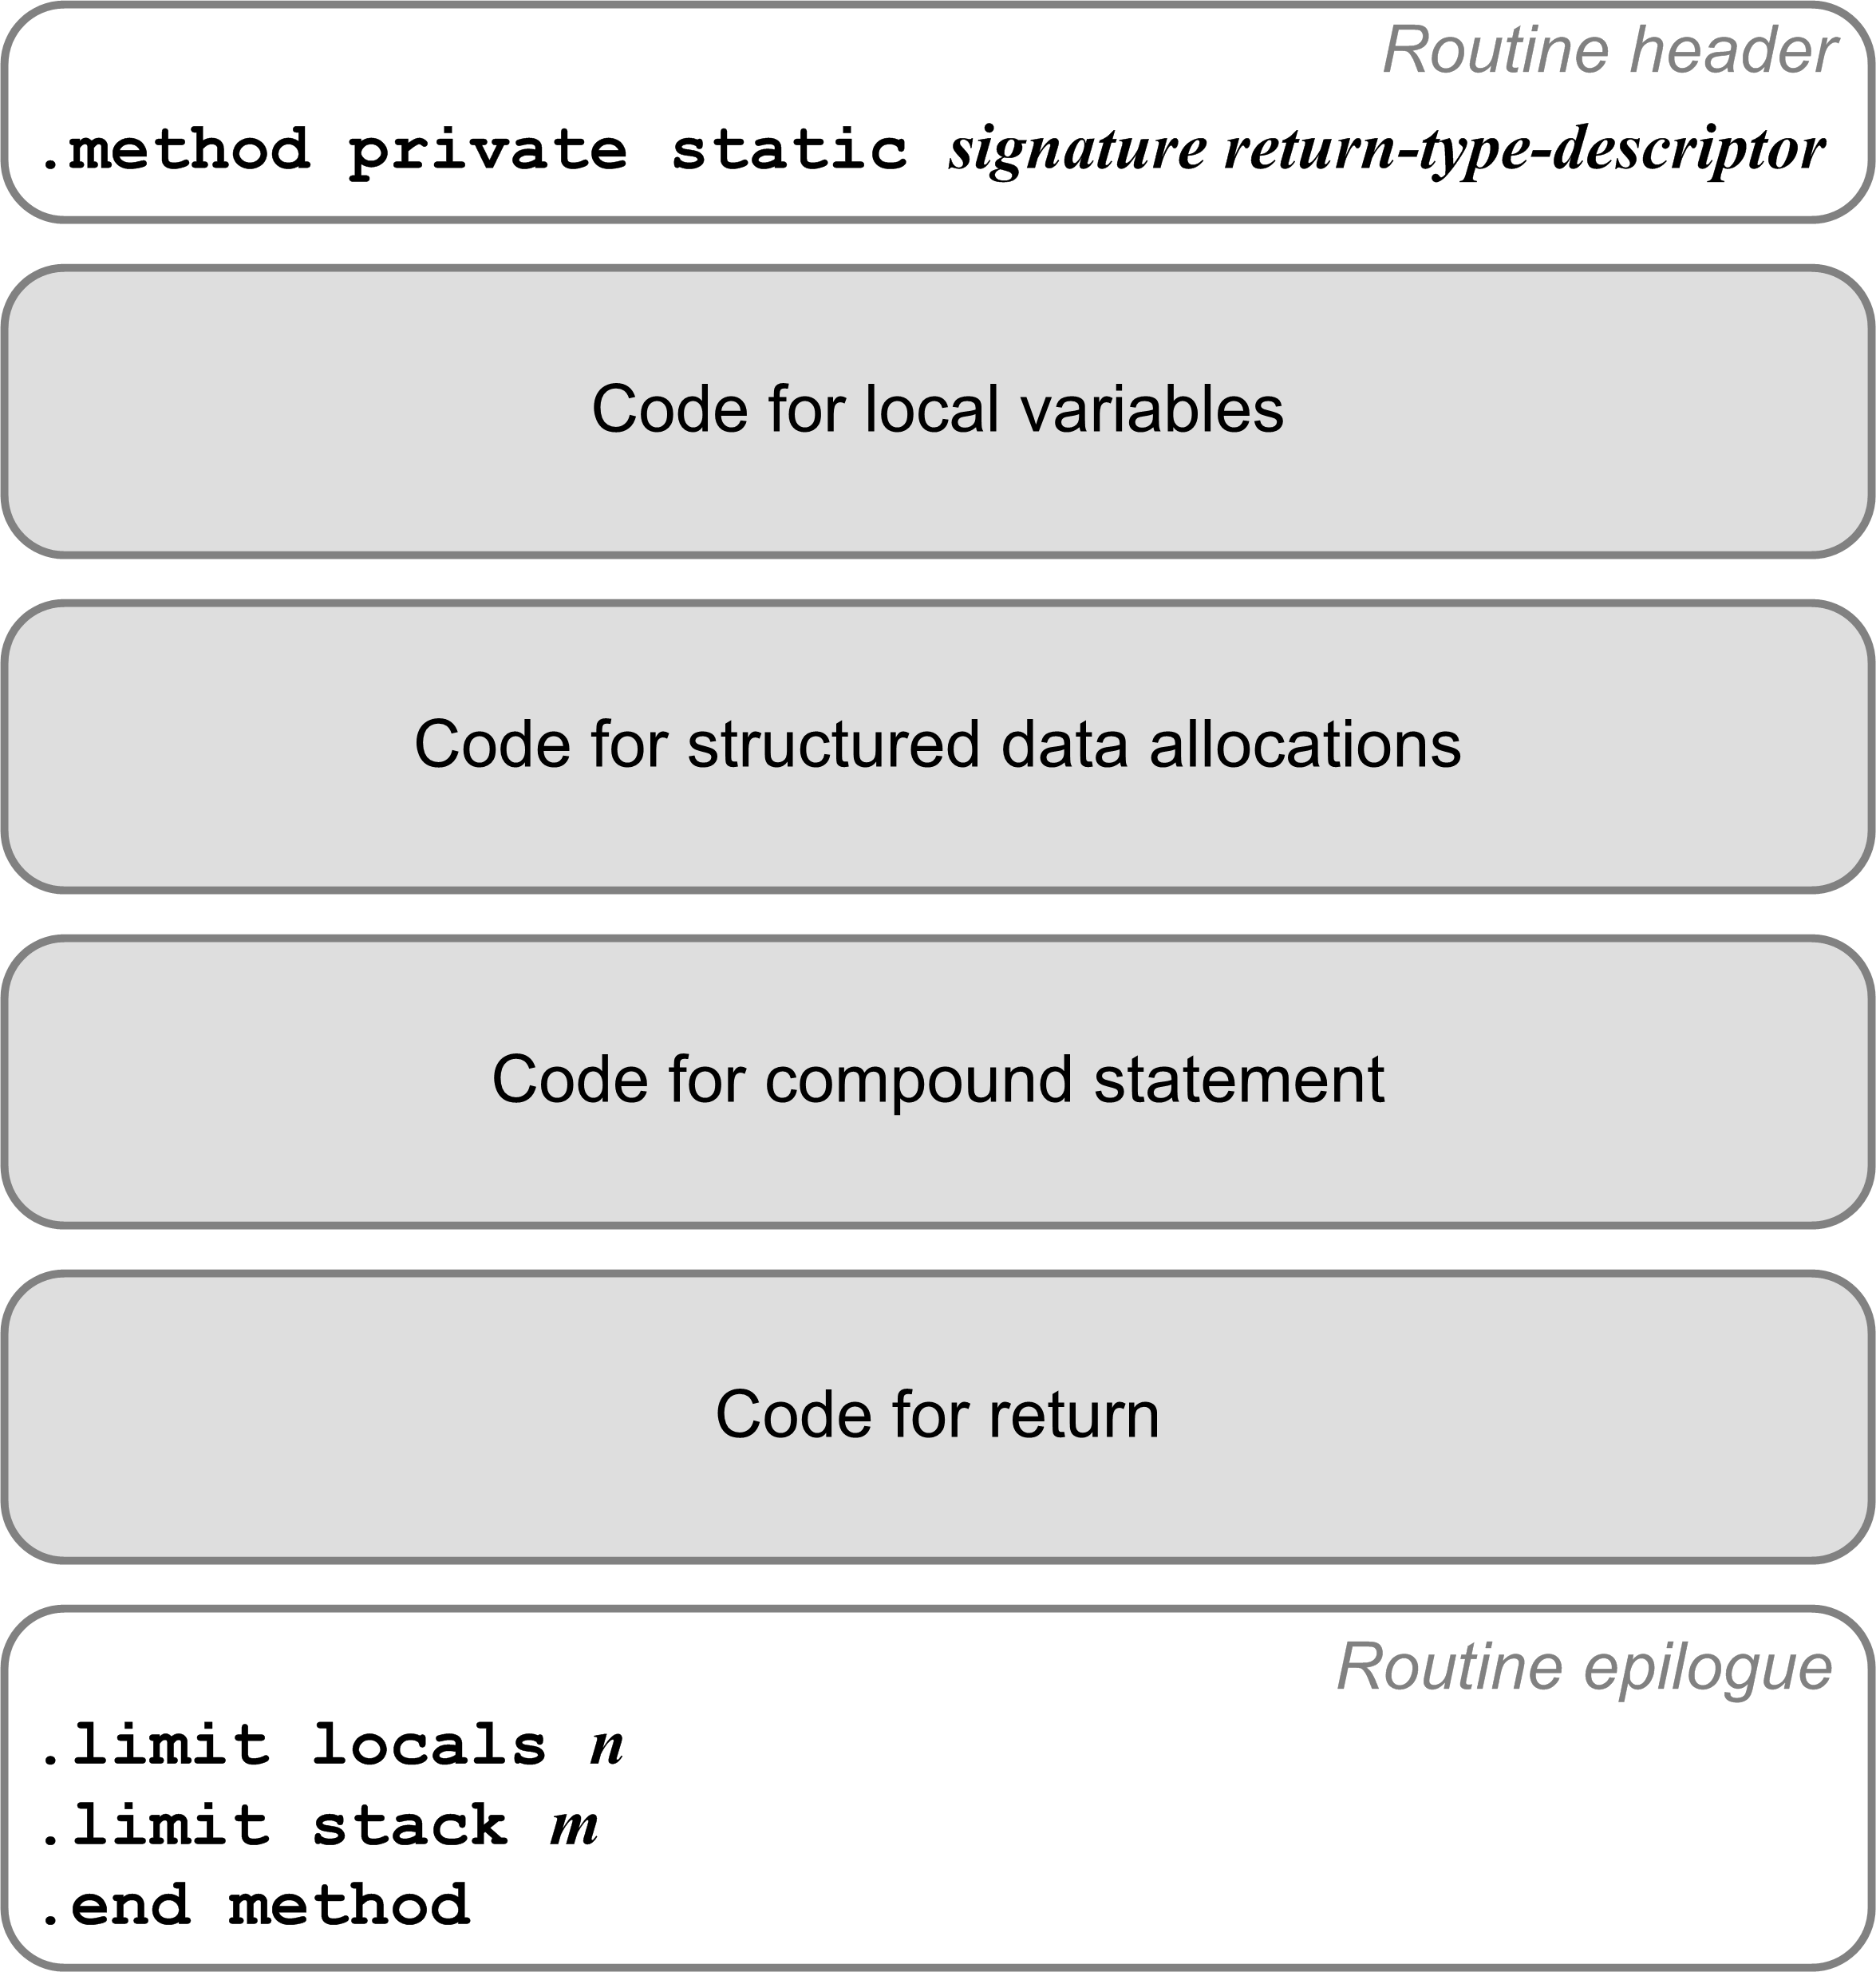
Code for Procedures and Functions
Each a private static method.
Method signature:
  Routine’s name
  Type descriptors of the formal parameters and return value.
Example:
TYPE
arr = ARRAY [1..5] OF real;
FUNCTION func(i, j : integer;
x, y : real;
p : boolean;
ch : char;
vector : arr;
length : integer)
: real;
Compiles to:
.method private static func(IIFFZC[FI)F

Slide 26
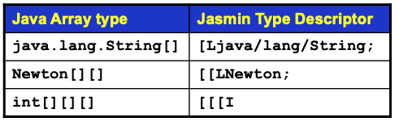
Compiling Local Variables
TYPE
arr = ARRAY [1..5] OF real;
FUNCTION func(i, j : integer;
x, y : real;
p : boolean;
ch : char;
vector : arr;
length : integer)
: real;
VAR
n : integer;
z : real;
w : arr;
Compiles to:
.method private static func(IIFFZC[FI)F
.var 5 is ch C
.var 0 is i I
.var 1 is j I
.var 7 is length I
.var 8 is n I
.var 4 is p Z
.var 6 is vector [F
.var 10 is w [F
.var 2 is x F
.var 3 is y F
.var 9 is z F
.var 11 is func F
Add a local variables array slot number
to each variable’s symbol table entry.

Slide 27
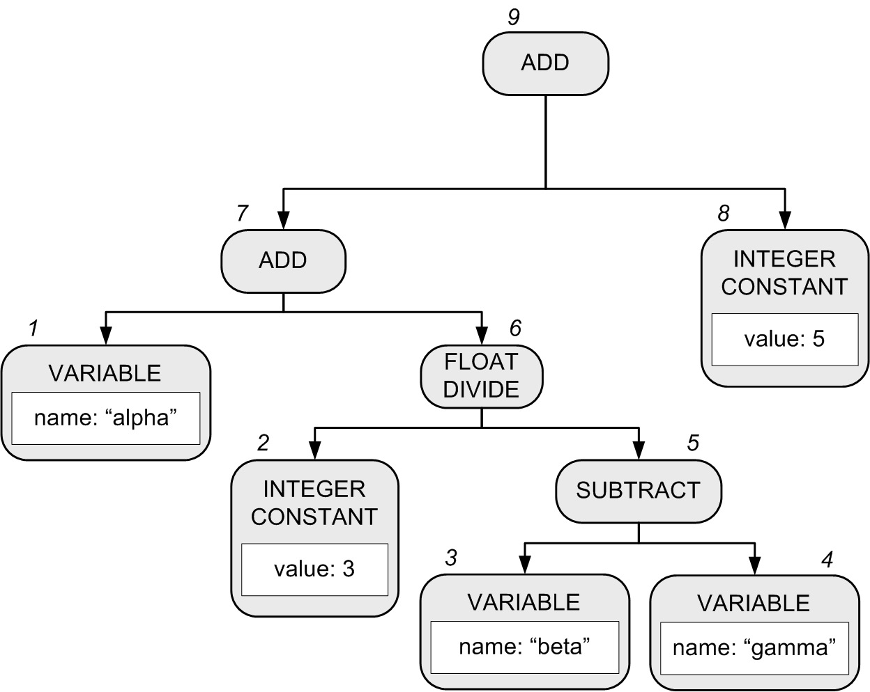
Generating Code for Expressions
alpha + 3/(beta - gamma) + 5
Recall that in our Pascal interpreter, the expression executor visits the nodes of the expression parse tree in order to execute the expression.
  Pascal’s operator precedence rules are encoded in the structure of the parse tree.
Notes:
START HERE.

Slide 28
Generating Code for Expressions
A compiler’s expression code generator also must visit the tree nodes to generate code for the expression.
  Yet another set of visit methods, in backend class Compiler.
  Assume that alpha, beta, and gamma are local real variables
  alpha ➔ local variable slot #0
  beta ➔ local variable slot #1
  gamma ➔ local variable slot #2
1 fload_0
2 ldc 3.0
3 fload_1
4 fload_2
5 fsub
6 fdiv
7 fadd
8 ldc 5.0
9 fadd
alpha + 3/(beta - gamma) + 5

Slide 29
Classes Containing Visit Methods
Semantic checking (front end)
  frontend.Semantics
Execution (backend interpreter)
  backend.interpreter.Executor
Conversion (backend language convertor)
  backend.converter.Converter
Compiler (backend compiler)
  backend.compiler.Compiler
The visit methods all visit
the same parse tree!
Pass 2
Pass 3
Pass 3
Pass 3

Slide 30
Compare Integer Values
Jasmin has a set of instructions each of which
pop off the top two integer values from the operand stack, compare them, and then branch if the comparison is true.
Instruction | Action
if_icmpeq label | Branch to label if [TOS-1] == [TOS]
if_icmpne label | Branch to label if [TOS-1] != [TOS]
if_icmpgt label | Branch to label if [TOS-1] > [TOS]
if_icmpge label | Branch to label if [TOS-1] >= [TOS]
if_icmplt label | Branch to label if [TOS-1] < [TOS]
if_icmple label | Branch to label if [TOS-1] <= [TOS]

Slide 31
Compare Integer Values, cont’d
Instruction | Action
if_icmpeq label | Branch to label if [TOS-1] == [TOS]
if_icmpne label | Branch to label if [TOS-1] != [TOS]
if_icmpgt label | Branch to label if [TOS-1] > [TOS]
if_icmpge label | Branch to label if [TOS-1] >= [TOS]
if_icmplt label | Branch to label if [TOS-1] < [TOS]
if_icmple label | Branch to label if [TOS-1] <= [TOS]
The two values are popped off
the operand stack.
  [TOS] is the value at the top of the stack.
  [TOS-1] is the value just under the one
  at the top of the stack.

Slide 32
Compare Integer Values, cont’d
You can also pop off only the single integer value at the top of the operand stack, compare it to 0, and then branch if the comparison is true.
The top value is popped off the stack.
Instruction | Action
ifeq label | Branch to label if [TOS] == 0
ifne label | Branch to label if [TOS] != 0
ifgt label | Branch to label if [TOS] > 0
ifge label | Branch to label if [TOS] >= 0
iflt label | Branch to label if [TOS] < 0
ifle label | Branch to label if [TOS] <= 0

Slide 33
Compare Values of Other Datatypes
Instructions lcmp, fcmp, and dcmp compare two long, float, or double values at the top of the operand stack.
  Each pops off the top two values, compares them, and then pushes the integer value -1, 0, or 1 back onto the operand stack.
    If [TOS-1] < [TOS], push -1.
    If [TOS-1] == [TOS], push 0.
    If [TOS-1] > [TOS], push 1.
Then use instructions iflt, ifeq, or ifgt
to test for the -1, 0, or 1.

