Slide 1


CS 153: Concepts of Compiler Design
September 24 Class Meeting
Department of Computer Science
San Jose State University
Fall 2024
Instructor: Ron Mak
www.cs.sjsu.edu/~mak

Slide 2
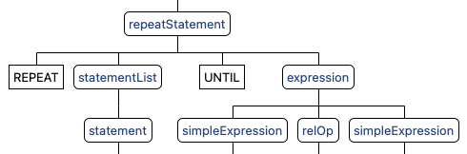
Grammar ➔ Parse Tree ➔ Visit Method
Pcl4.g4
repeatStatement : REPEAT statementList UNTIL expression ;
TestRepeat.txt
REPEAT
i := j*k + j/k - j
UNTIL i >= 0;
@Override
public Object visitRepeatStatement(Pcl4Parser.RepeatStatementContext ctx)
{
Pcl4Parser.StatementListContext listCtx = ctx.statementList();
boolean value;
do
{
visit(listCtx);
value = (Boolean) visit(ctx.expression());
} while (!value);
return null;
}
Executor.java

Slide 3
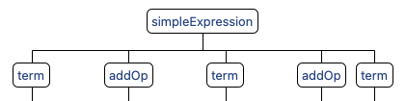
public Object visitSimpleExpression(Pcl4Parser.SimpleExpressionContext ctx)
{
int count = ctx.term().size();
Boolean negate = (ctx.sign() != null)
&& ctx.sign().getText().equals("-");
// First term.
Pcl4Parser.TermContext termCtx1 = ctx.term(0);
Object operand1 = visit(termCtx1);
if (negate) operand1 = -((Double) operand1);
// Loop over the subsequent terms.
for (int i = 1; i < count; i++)
{
String op = ctx.addOp(i-1).getText().toLowerCase();
Pcl4Parser.TermContext termCtx2 = ctx.term(i);
Object operand2 = visit(termCtx2);
if (operand2 instanceof Double)
{
double value1 = (Double) operand1;
double value2 = (Double) operand2;
operand1 = (op.equals("+")) ? value1 + value2
: value1 - value2;
}
else if (operand2 instanceof Boolean)
{
operand1 = ((Boolean) operand1) || ((Boolean) operand2);
}
else // String
{
operand1 = ((String) operand1) + ((String) operand2);
}
}
return operand1;
}
Pcl4.g4
simpleExpression
: sign? term (addOp term)* ;
addOp : '+' | '-' | OR ;
TestRepeat.txt
j*k + j/k - j
The grammar rule contains
multiple terms and addOps.
The context object ctx
stores them in arraylists.
Executor.java

Slide 4
Scope and the Symbol Table Stack
Global scope
  Nesting level 0:
  At the bottom of the symbol table stack.
  All predefined global identifiers such as
  integer, real, boolean, char.
Program scope
  Nesting level 1:
  One up from the bottom of the stack.
  All identifiers declared at the “top level”
  of a program (not in a procedure or function).

Slide 5
Scope and the Symbol Table Stack, cont’d
As the parser parses a program from top to bottom, it enters and exits nested scopes.
Whenever the parser enters a scope,
it must push that scope’s symbol table
onto the symbol table stack.
Whenever the parser exits a scope,
it must pop that scope’s symbol table
off the stack.

Slide 6
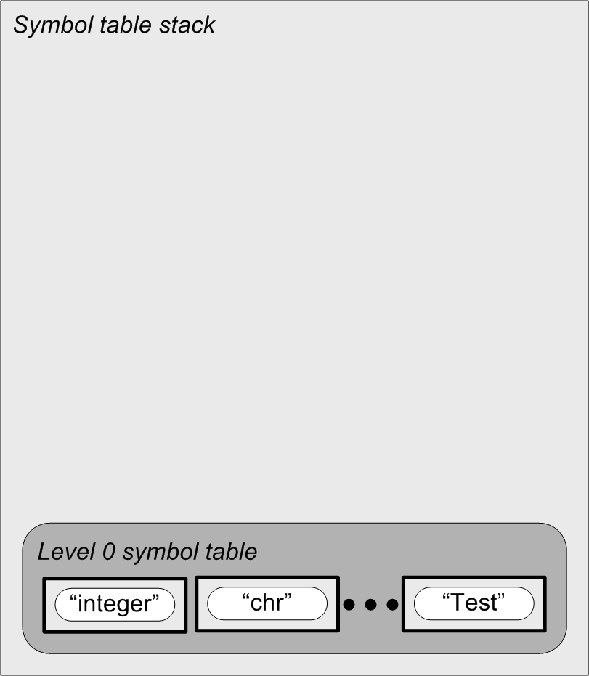
Nested Scopes and the Symbol Table Stack
PROGRAM Test;
VAR i, j, k, n : integer;
PROCEDURE p(j : real);
VAR k : char;
FUNCTION f(x : real) : real;
VAR i:real;
BEGIN {f}
f := i + j + n + x;
END {f};
BEGIN {p}
k := chr(i + trunc(f(n)));
END {p};
BEGIN {test}
p(j + k + n)
END {test}.
Note that the program name
Test is defined in the global
scope at level 0.

Slide 7
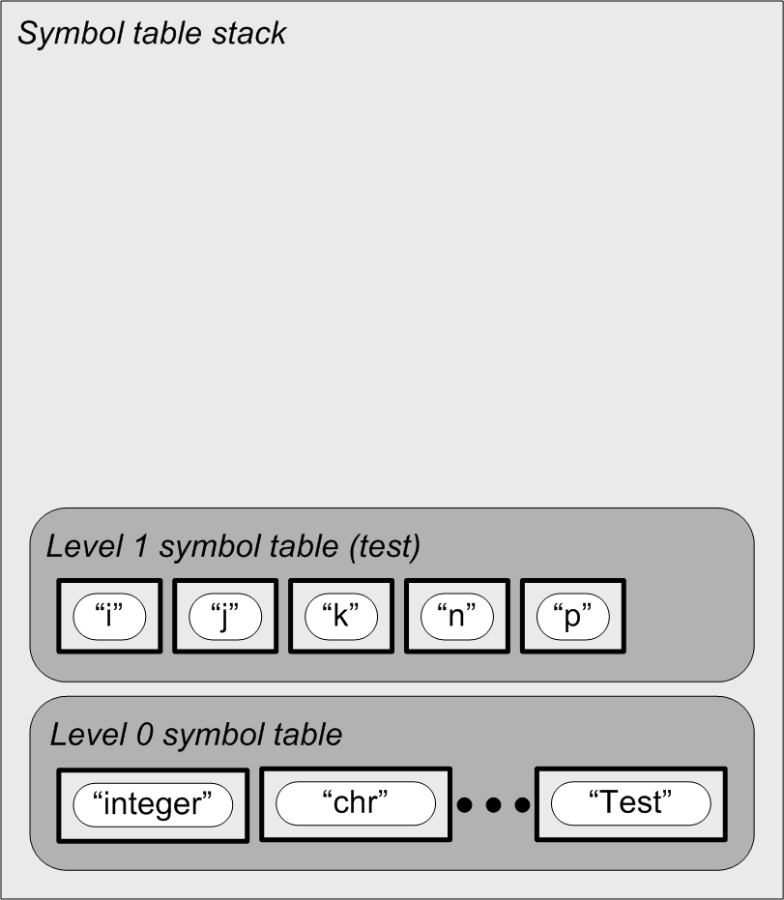
Nested Scopes and the Symbol Table Stack
PROGRAM Test;
VAR i, j, k, n : integer;
PROCEDURE p(j : real);
VAR k : char;
FUNCTION f(x : real) : real;
VAR i:real;
BEGIN {f}
f := i + j + n + x;
END {f};
BEGIN {p}
k := chr(i + trunc(f(n)));
END {p};
BEGIN {test}
p(j + k + n)
END {test}.

Slide 8
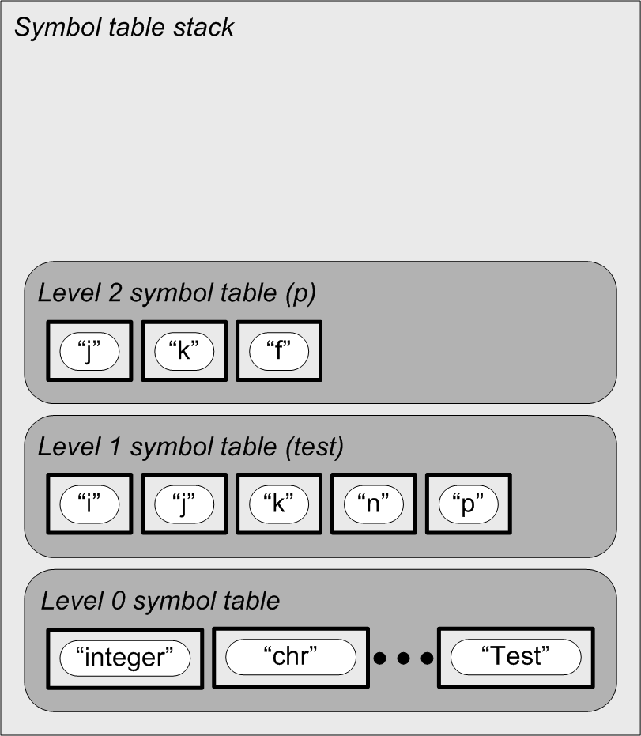
Nested Scopes and the Symbol Table Stack
PROGRAM Test;
VAR i, j, k, n : integer;
PROCEDURE p(j : real);
VAR k : char;
FUNCTION f(x : real) : real;
VAR i:real;
BEGIN {f}
f := i + j + n + x;
END {f};
BEGIN {p}
k := chr(i + trunc(f(n)));
END {p};
BEGIN {test}
p(j + k + n)
END {test}.

Slide 9
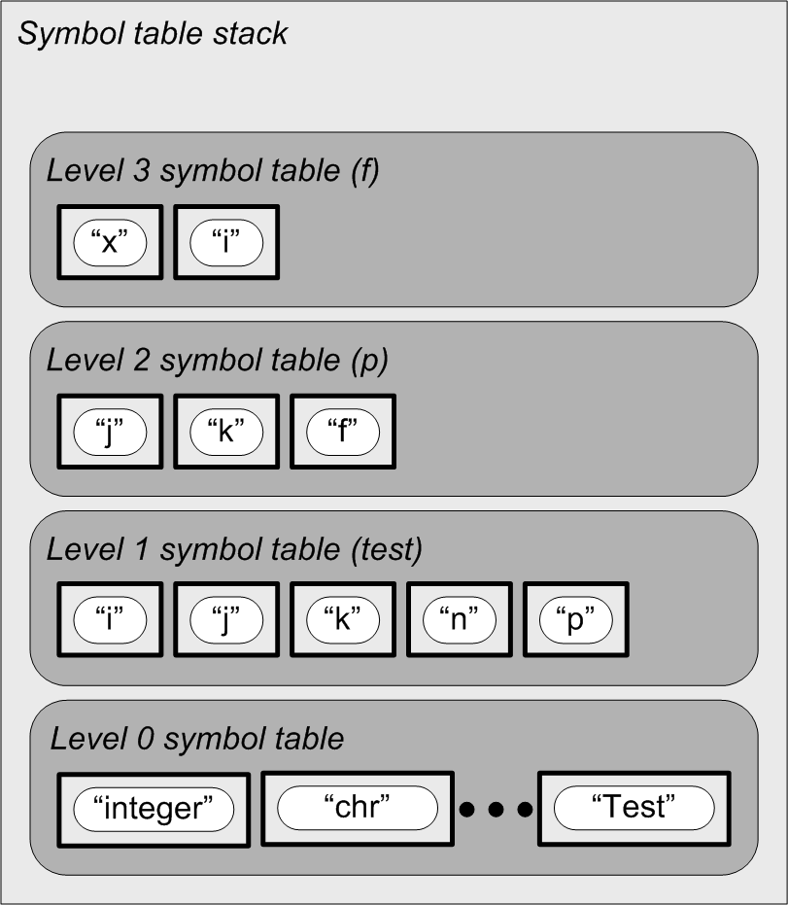
Nested Scopes and the Symbol Table Stack
PROGRAM Test;
VAR i, j, k, n : integer;
PROCEDURE p(j : real);
VAR k : char;
FUNCTION f(x : real) : real;
VAR i:real;
BEGIN {f}
f := i + j + n + x;
END {f};
BEGIN {p}
k := chr(i + trunc(f(n)));
END {p};
BEGIN {test}
p(j + k + n)
END {test}.

Slide 10
Nested Scopes and the Symbol Table Stack
PROGRAM Test;
VAR i, j, k, n : integer;
PROCEDURE p(j : real);
VAR k : char;
FUNCTION f(x : real) : real;
VAR i:real;
BEGIN {f}
f := i + j + n + x;
END {f};
BEGIN {p}
k := chr(i + trunc(f(n)));
END {p};
BEGIN {test}
p(j + k + n)
END {test}.

Slide 11
Nested Scopes and the Symbol Table Stack
PROGRAM Test;
VAR i, j, k, n : integer;
PROCEDURE p(j : real);
VAR k : char;
FUNCTION f(x : real) : real;
VAR i:real;
BEGIN {f}
f := i + j + n + x;
END {f};
BEGIN {p}
k := chr(i + trunc(f(n)));
END {p};
BEGIN {test}
p(j + k + n)
END {test}.

Slide 12
Nested Scopes and the Symbol Table Stack
PROGRAM Test;
VAR i, j, k, n : integer;
PROCEDURE p(j : real);
VAR k : char;
FUNCTION f(x : real) : real;
VAR i:real;
BEGIN {f}
f := i + j + n + x;
END {f};
BEGIN {p}
k := chr(i + trunc(f(n)));
END {p};
BEGIN {test}
p(j + k + n)
END {test}.

Slide 13
Nested Scopes and the Symbol Table Stack
PROGRAM Test;
VAR i, j, k, n : integer;
PROCEDURE p(j : real);
VAR k : char;
FUNCTION f(x : real) : real;
VAR i:real;
BEGIN {f}
f := i + j + n + x;
END {f};
BEGIN {p}
k := chr(i + trunc(f(n)));
END {p};
BEGIN {test}
p(j + k + n)
END {test}.
Each routine’s local
names are defined
in that routine’s scope.
Each routine’s name
is defined in the
parent’s scope.

Slide 14
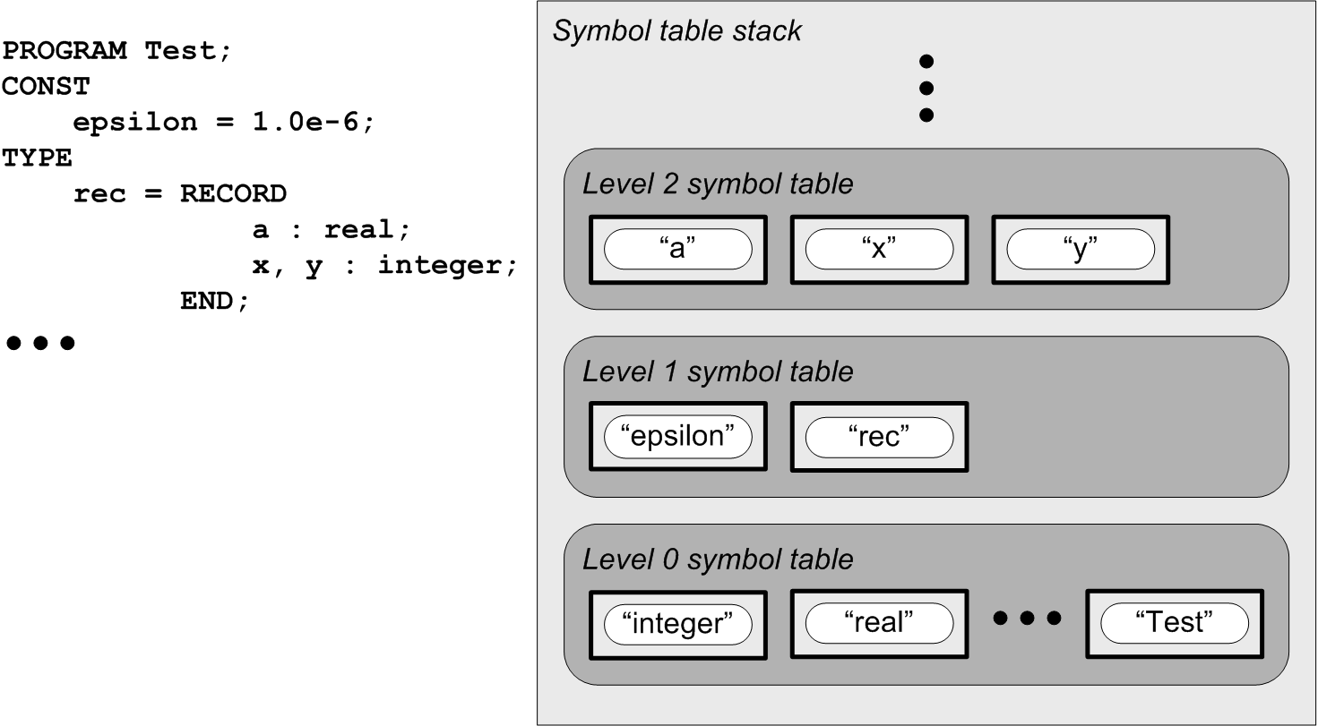
The Scope of Record Fields
Each record type has a symbol table:
Parser is here!
Program symbol table
Note that the program name
Test is defined in the global
scope at level 0.
Global symbol table

Slide 15
Class Symtab
Symtab.java
public class Symtab
extends TreeMap<String, SymtabEntry>
{
private static final long serialVersionUID = 0L;
private int nestingLevel; // scope nesting level
private SymtabEntry ownerEntry; // symtab entry of this symtab's owner
public static final String UNNAMED_PREFIX = "_unnamed_";
private static int unnamedIndex = 0;
public static String generateUnnamedName()
{
unnamedIndex++;
return UNNAMED_PREFIX + unnamedIndex;
}
public Symtab(int nestingLevel)
{
this.nestingLevel = nestingLevel;
}

Slide 16
Class Symtab, cont’d
Symtab.java
public int getNestingLevel() { return nestingLevel; }
public SymtabEntry getOwner() { return ownerEntry; }
public void setOwner(SymtabEntry ownerEntry)
{
this.ownerEntry = ownerEntry;
}
public SymtabEntry enter(String name, Kind kind)
{
SymtabEntry entry = new SymtabEntry(name, kind, this);
put(name, entry);
return entry;
}
public SymtabEntry lookup(String name) { return get(name); }

Slide 17
Class Symtab, cont’d
public ArrayList<SymtabEntry> sortedEntries()
{
Collection<SymtabEntry> entries = values();
Iterator<SymtabEntry> iter = entries.iterator();
ArrayList<SymtabEntry> list = new ArrayList<SymtabEntry>(size());
// Iterate over the sorted entries and append them to the list.
while (iter.hasNext()) list.add(iter.next());
return list; // sorted list of entries
}
public void resetVariables(Kind kind)
{
Collection<SymtabEntry> entries = values();
Iterator<SymtabEntry> it = entries.iterator();
// Iterate over the entries and reset their kind.
while (it.hasNext())
{
SymtabEntry entry = it.next();
if (entry.getKind() == VARIABLE) entry.setKind(kind);
}
}
}
Symtab.java

Slide 18
Class SymtabStack
SymtabStack.java
public class SymtabStack
extends ArrayList<Symtab>
{
private static final long serialVersionUID = 0L;
private int currentNestingLevel; // current scope nesting level
private SymtabEntry programEntry; // entry for the main program id
public SymtabStack()
{
this.currentNestingLevel = 0;
add(new Symtab(currentNestingLevel));
}
public int getCurrentNestingLevel() { return currentNestingLevel; }
public SymtabEntry getProgramEntry() { return programEntry; }
public void setProgramEntry(SymtabEntry entry) { this.programEntry = entry; }
public Symtab getLocalSymtab() { return get(currentNestingLevel); }
...

Slide 19
Class SymtabStack, cont’d
public Symtab push()
{
Symtab symtab = new Symtab(++currentNestingLevel);
add(symtab);
return symtab;
}
public Symtab push(Symtab symtab)
{
++currentNestingLevel;
add(symtab);
return symtab;
}
public Symtab pop()
{
Symtab symtab = get(currentNestingLevel);
remove(currentNestingLevel--);
return symtab;
}
SymtabStack.java

Slide 20
Class SymtabStack, cont’d
SymtabEntry.java
public SymtabEntry enterLocal(String name, Kind kind)
{
return get(currentNestingLevel).enter(name, kind);
}
public SymtabEntry lookupLocal(String name)
{
return get(currentNestingLevel).lookup(name);
}
public SymtabEntry lookup(String name)
{
SymtabEntry foundEntry = null;
// Search the current and enclosing scopes.
for (int i = currentNestingLevel; (i >= 0) && (foundEntry == null); --i)
{
foundEntry = get(i).lookup(name);
}
return foundEntry;
}
}
Why both lookupLocal()
and lookup()?

Slide 21
Class SymtabEntry
SymtabEntry.java
public class SymtabEntry
{
private String name; // entry name
private Kind kind; // what kind of identifier
private Symtab symtab; // parent symbol table
private Typespec typespec; // type specification
private int slotNumber; // local variables array slot number
private ArrayList<Integer> lineNumbers; // source line numbers
private EntryInfo info; // entry information
public enum Kind
{
CONSTANT, ENUMERATION_CONSTANT, TYPE, VARIABLE, RECORD_FIELD,
VALUE_PARAMETER, REFERENCE_PARAMETER, PROGRAM_PARAMETER,
PROGRAM, PROCEDURE, FUNCTION,
UNDEFINED;
public String toString() { return super.toString().toLowerCase(); }
}

Slide 22
Class SymtabEntry, cont’d
SymtabEntry.java
private interface EntryInfo {}
private class ValueInfo implements EntryInfo
{
private Object value;
}
public SymtabEntry(String name, Kind kind, Symtab symtab)
{
this.name = name;
this.kind = kind;
this.symtab = symtab;
this.lineNumbers = new ArrayList<Integer>();
// Initialize the appropriate entry information.
switch (kind)
{
case CONSTANT:
case ENUMERATION_CONSTANT:
case VARIABLE:
case RECORD_FIELD:
case VALUE_PARAMETER:
info = new ValueInfo();
break;
default: break;
}
}

Slide 23
Class SymtabEntry, cont’d
SymtabEntry.java
public String getName() { return name; }
public Kind getKind() { return kind; }
public void setKind(Kind kind) { this.kind = kind; }
public Symtab getSymtab() { return symtab; }
public Typespec getType() { return typespec; }
public void setType(Typespec typespec) { this.typespec = typespec; }
public ArrayList<Integer> getLineNumbers() { return lineNumbers; }
public void appendLineNumber(int lineNumber)
{
lineNumbers.add(lineNumber);
}
public Object getValue() { return ((ValueInfo) info).value; }
public void setValue(Object value) { ((ValueInfo) info).value = value; }
}

Slide 24
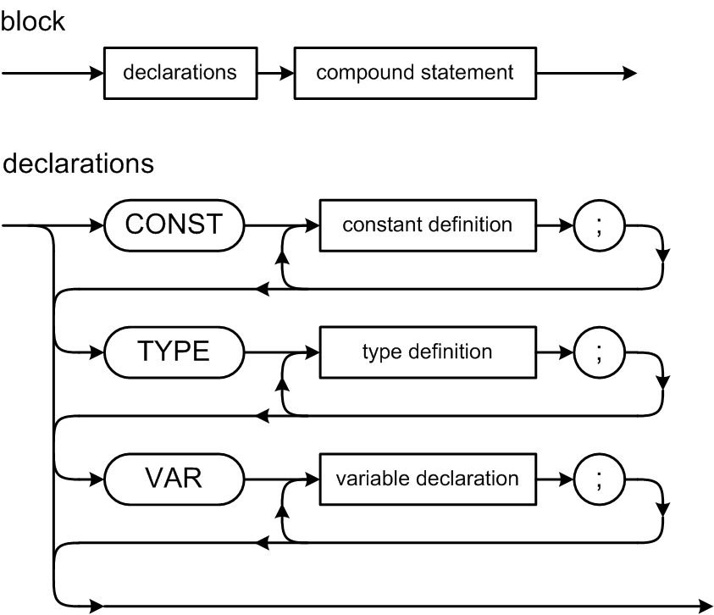
Pascal Declarations
The CONST, TYPE, and VAR parts are optional, but they must come in this order.
Note that constants and types are defined, but variables are declared.
Collectively, you refer to all of them as declarations.

Slide 25
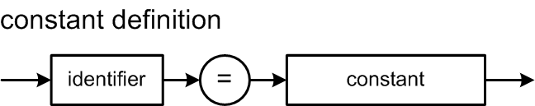
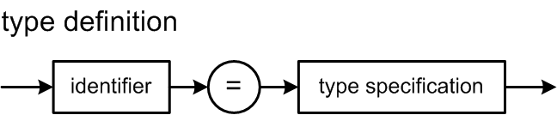
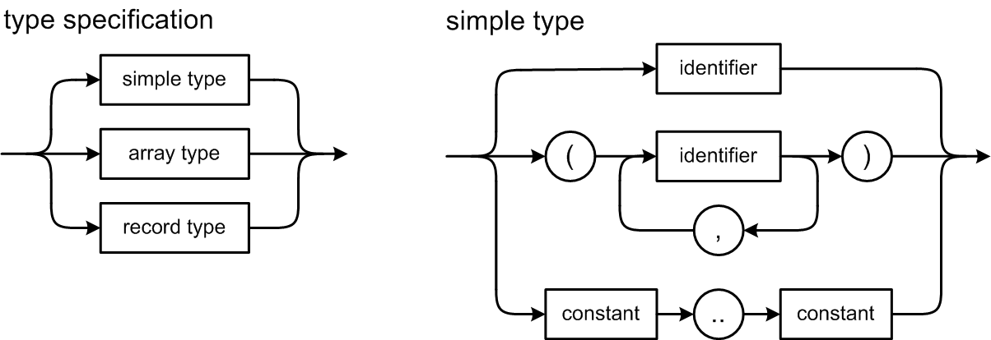
Pascal Declarations, cont’d

Slide 26
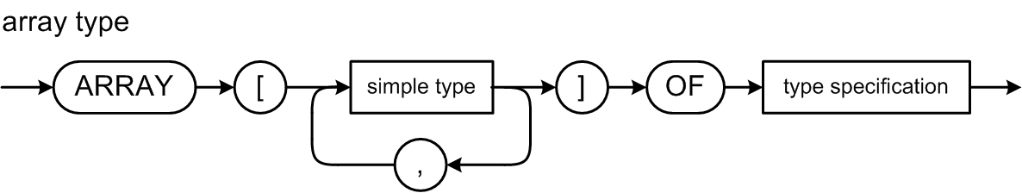
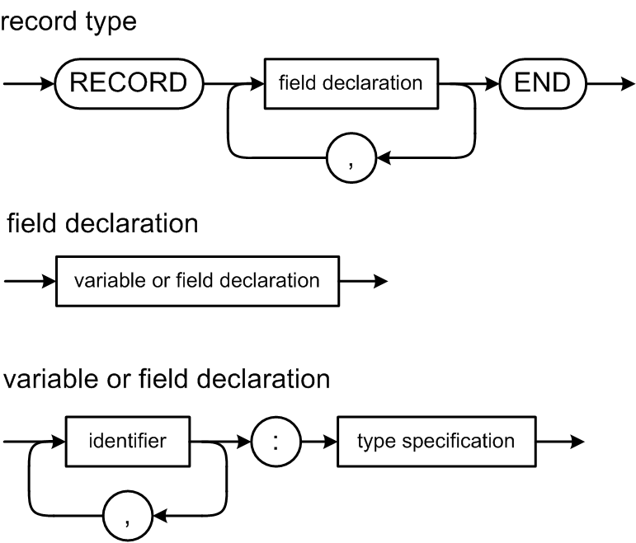
Pascal Declarations, cont’d

Slide 27
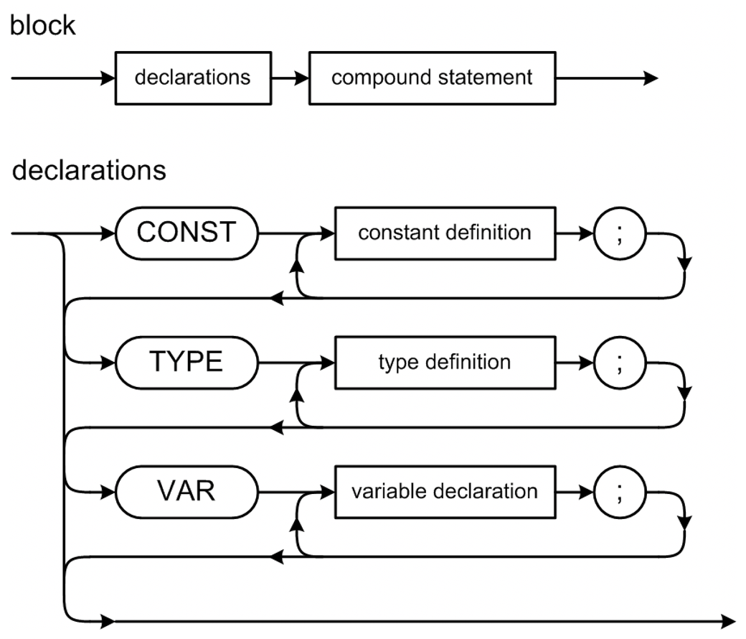
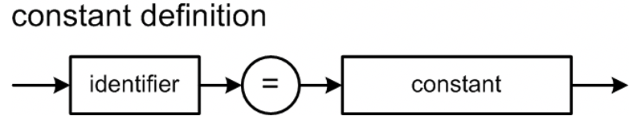
Grammar File Pcl5.g4
Pcl5.g4
grammar Pcl5;
@header {
package antlr4;
}
program : programHeader block '.' ;
programHeader : PROGRAM IDENTIFIER programParameters? ';' ;
programParameters : '(' IDENTIFIER ( ',' IDENTIFIER )* ')' ;
block : declarations compoundStatement ;
declarations : ( constantsPart ';' )? ( typesPart ';' )?
( variablesPart ';' )? ( routinesPart ';')? ;
constantsPart : CONST constantDefinitionsList ;
constantDefinitionsList : constantDefinition ( ';' constantDefinition )* ;
constantDefinition : constantIdentifier '=' constant ;
constantIdentifier : IDENTIFIER ;
constant
: sign? ( IDENTIFIER | unsignedNumber )
| characterConstant
| stringConstant
;

Slide 28
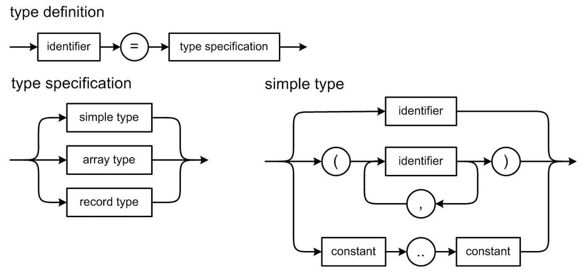
Grammar File Pcl5.g4, cont’d
Pcl5.g4
typesPart : TYPE typeDefinitionsList ;
typeDefinitionsList : typeDefinition ( ';' typeDefinition )* ;
typeDefinition : typeIdentifier '=' typeSpecification ;
typeIdentifier : IDENTIFIER ;
typeSpecification
: simpleType # simpleTypespec
| arrayType # arrayTypespec
| recordType # recordTypespec
;
simpleType
: typeIdentifier # typeIdentifierTypespec
| enumerationType # enumerationTypespec
| subrangeType # subrangeTypespec
;

Slide 29
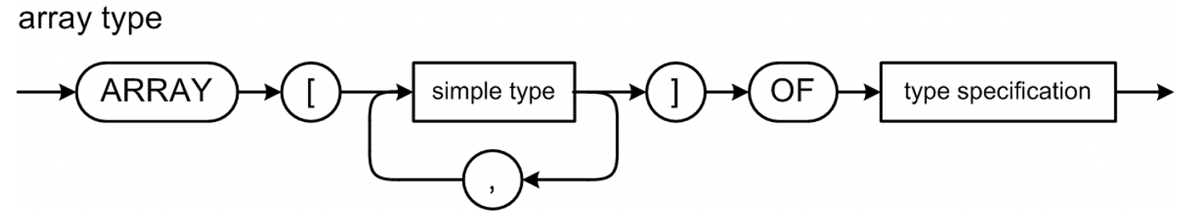
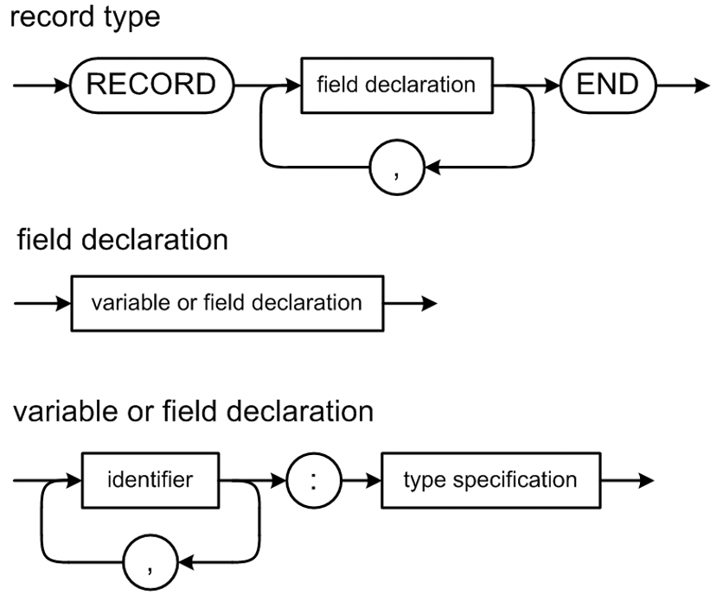
Grammar File Pcl5.g4, cont’d
Pcl5.g4
enumerationType : '(' enumerationConstant ( ',' enumerationConstant )* ')' ;
enumerationConstant : constantIdentifier ;
subrangeType : constant '..' constant ;
arrayType
: ARRAY '[' arrayDimensionList ']' OF typeSpecification ;
arrayDimensionList : simpleType ( ',' simpleType )* ;
recordType : RECORD recordFields ';'? END ;
recordFields : variableDeclarationsList ;
variablesPart : VAR variableDeclarationsList ;
variableDeclarationsList : variableDeclarations ( ';' variableDeclarations )* ;
variableDeclarations : variableIdentifierList ':' typeSpecification ;
variableIdentifierList : variableIdentifier ( ',' variableIdentifier )* ;
variableIdentifier : IDENTIFIER ;
routinesPart : ;

Slide 30
Declarations and the Symbol Table
Identifiers from Pascal declarations that
we will enter into a symbol table, names of:
  constants
  types
  enumeration values
  record fields
  variables
Information from parsing type specifications:
  simple types
  array types
  record types
Notes:
START HERE.

Slide 31
Type Specification Attributes
Each type specification has certain attributes
depending on its form.
Type form
Type specification attributes
Scalar
None
Enumeration
List of enumeration constant identifiers
Subrange
Base type
Minimum value
Maximum value
Array
Index type
Element type
Element count
Record
A separate symbol table for the field identifiers

Slide 32
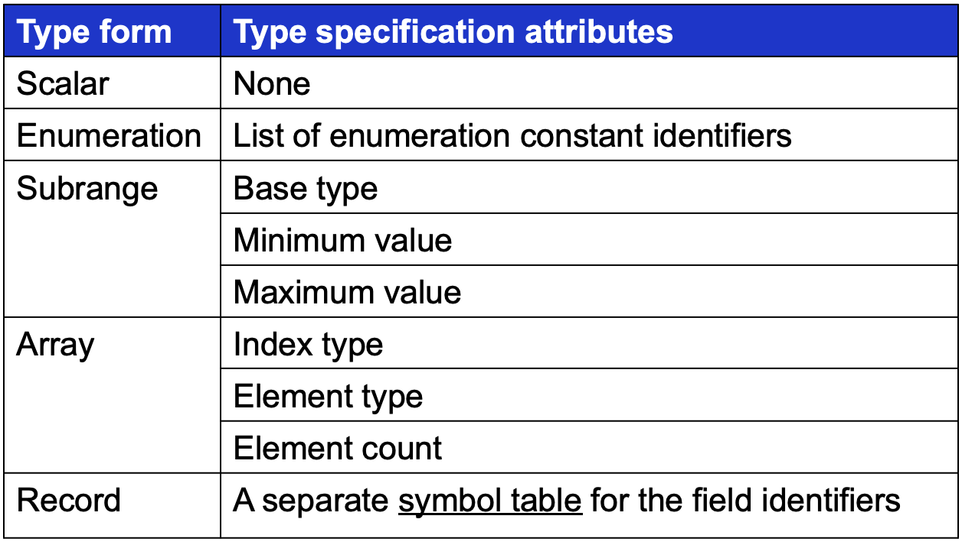
Class Typespec
Typespec.java
public class Typespec
{
private Form form; // type form
private SymtabEntry identifier; // type identifier
private TypeInfo info; // type information
public enum Form
{
SCALAR, ENUMERATION, SUBRANGE, ARRAY, RECORD, UNKNOWN;
public String toString() { return super.toString().toLowerCase(); }
}

Slide 33
Class Typespec, cont’d
Typespec.java
private interface TypeInfo {}
private class EnumerationInfo implements TypeInfo
{
private ArrayList<SymtabEntry> constants;
}
private class SubrangeInfo implements TypeInfo
{
private Typespec baseType;
private int minValue;
private int maxValue;
}
private class ArrayInfo implements TypeInfo
{
private Typespec indexType;
private Typespec elementType;
private int elementCount;
}
private class RecordInfo implements TypeInfo
{
String typePath;
private Symtab symtab;
}

Slide 34
Class Typespec, cont’d
Typespec.java
public Typespec(Form form)
{
this.form = form;
this.identifier = null;
// Initialize the appropriate type information.
switch (form)
{
case ENUMERATION:
info = new EnumerationInfo();
((EnumerationInfo) info).constants =
new ArrayList<SymtabEntry>();
break;
case SUBRANGE:
info = new SubrangeInfo();
((SubrangeInfo) info).minValue = 0;
((SubrangeInfo) info).maxValue = 0;
((SubrangeInfo) info).baseType = null;
break;
...

Slide 35
Class Typespec, cont’d
Typespec.java
...
case ARRAY:
info = new ArrayInfo();
((ArrayInfo) info).indexType = null;
((ArrayInfo) info).elementType = null;
((ArrayInfo) info).elementCount = 0;
break;
case RECORD:
info = new RecordInfo();
((RecordInfo) info).typePath = null;
((RecordInfo) info).symtab = null;
break;
default: break;
}
}

Slide 36
Class Typespec, cont’d
Typespec.java
public boolean isStructured()
{
return (form == Form.ARRAY) || (form == Form.RECORD);
}
public Form getForm() { return form; }
public SymtabEntry getIdentifier() { return identifier; }
public void setIdentifier(SymtabEntry identifier)
{
this.identifier = identifier;
}
public Typespec baseType()
{
return form == Form.SUBRANGE ? ((SubrangeInfo) info).baseType : this;
}

Slide 37
Class Typespec, cont’d
Typespec.java
public Typespec getSubrangeBaseType()
{
return ((SubrangeInfo) info).baseType;
}
public void setSubrangeBaseType(Typespec baseType)
{
((SubrangeInfo) info).baseType = baseType;
}
public int getSubrangeMinValue() { return ((SubrangeInfo) info).minValue; }
public int getSubrangeMaxValue() { return ((SubrangeInfo) info).maxValue; }
public void setSubrangeMinValue(int minValue)
{
((SubrangeInfo) info).minValue = minValue;
}
public void setSubrangeMaxValue(int maxValue)
{
((SubrangeInfo) info).maxValue = maxValue;
}

Slide 38
Class Typespec, cont’d
Typespec.java
public ArrayList<SymtabEntry> getEnumerationConstants()
{
return ((EnumerationInfo) info).constants;
}
public void setEnumerationConstants(ArrayList<SymtabEntry> constants)
{
((EnumerationInfo) info).constants = constants;
}

Slide 39
Class Typespec, cont’d
Typespec.java
public Typespec getArrayIndexType()
{
return ((ArrayInfo) info).indexType;
}
public void setArrayIndexType(Typespec indexType)
{
((ArrayInfo) info).indexType = indexType;
}
public Typespec getArrayElementType()
{
return ((ArrayInfo) info).elementType;
}
public void setArrayElementType(Typespec elementType)
{
((ArrayInfo) info).elementType = elementType;
}

Slide 40
Class Typespec, cont’d
Typespec.java
public int getArrayElementCount() { return ((ArrayInfo) info).elementCount; }
public void setArrayElementCount(int elementCount)
{
((ArrayInfo) info).elementCount = elementCount;
}
public Typespec getArrayBaseType()
{
Typespec elmtType = this;
while (elmtType.form == Form.ARRAY)
{
elmtType = elmtType.getArrayElementType();
}
return elmtType.baseType();
}

Slide 41
Class Typespec, cont’d
Typespec.java
public Symtab getRecordSymtab() { return ((RecordInfo) info).symtab; }
public void setRecordSymtab(Symtab symtab)
{
((RecordInfo) info).symtab = symtab;
}

