Slide 1


CS 153: Concepts of Compiler Design
September 12 Class Meeting
Department of Computer Science
San Jose State University
Fall 2024
Instructor: Ron Mak
www.cs.sjsu.edu/~mak

Slide 2
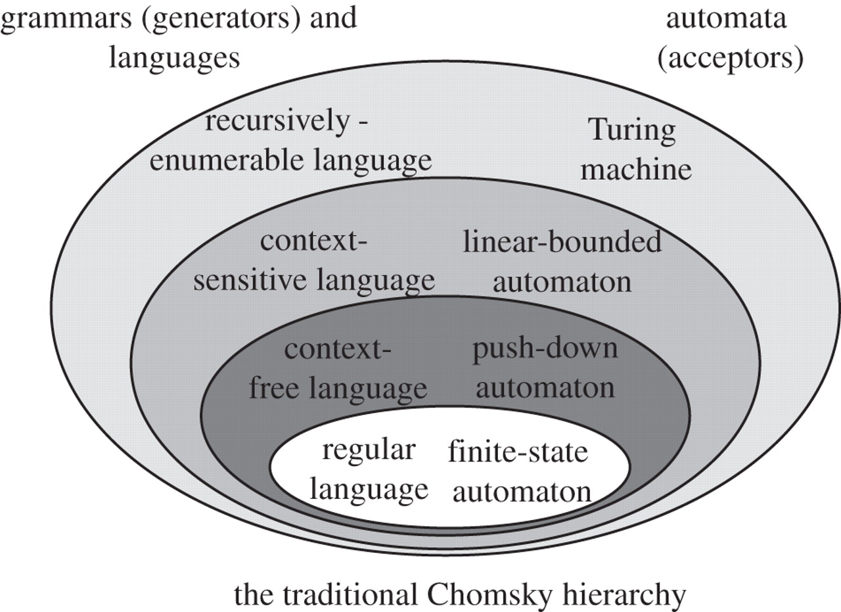
Chomsky Hierarchy of Languages
Define statements and expressions
Parsers
Define tokens
Scanners
http://rstb.royalsocietypublishing.org/content/367/1598/1933

Slide 3
Regular Expressions
Uses certain metasymbols.
  Symbols that are part of the regular expression
  but are not part of the token.
Metasymbols | Meaning
' ' | surround a literal character
\ | quote a metacharacter to become a literal character
[ ] | enclose a set of included characters
~ | precedes an element not to be included
- | specify a range of characters
* | follows an element repeated 0 or more times
+ | follows an element repeated at least one time
? | follows an optional element (0 or 1 time)
| | separates element choices (“or”)
( ) | group elements to be a single element

Slide 4
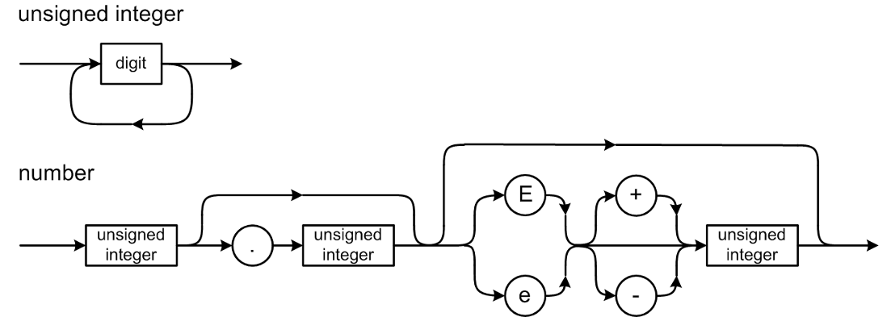
Regular Expressions and Tokens
Metasymbols | Meaning
' ' | surround a literal character
\ | quote a metacharacter to become a literal character
[ ] | enclose a set of included characters
~ | precedes an element not to be included
- | specify a range of characters
* | follows an element repeated 0 or more times
+ | follows an element repeated at least one time
? | follows an optional element (0 or 1 time)
| | separates element choices (“or”)
( ) | group elements to be a single element
IDENTIFIER : [a-zA-Z][a-zA-Z0-9]* ;
INTEGER : [0-9]+ ;
REAL : INTEGER '.' INTEGER
| INTEGER ('e' | 'E') ('+' | '-')? INTEGER
| INTEGER '.' INTEGER ('e' | 'E') ('+' | '-')? INTEGER
;
ANTLR 4 notation

Slide 5
Regular Expressions and Tokens, cont’d
NEWLINE : '\r'? '\n' -> skip ;
WS : [ \t]+ -> skip ;
QUOTE : '\'' ;
STRING_CHAR : QUOTE QUOTE // two consecutive quotes
| ~('\'') // any non-quote character
;
CHARACTER_CHAR : ~('\'') ; // any non-quote character
CHARACTER : QUOTE CHARACTER_CHAR QUOTE ;
STRING : QUOTE STRING_CHAR* QUOTE ;
ANTLR 4 notation

Slide 6
Backus Naur Form (BNF)
A text-based way to describe
source language syntax.
  Named after John Backus and Peter Naur.
Text-based means it can be read by a program.
Example: A compiler-compiler such as ANTLR that can automatically generate a parser and a scanner for a source language after reading the
language’s syntax rules written in BNF.

Slide 7
Backus Naur Form (BNF), cont’d
We can use BNF to describe the rules of a context-free grammar.
Also uses certain metasymbols.
Metasymbols | Meaning
::= | “is defined as”
| | “or”
< > | Surround names of nonterminal (not literal) items

Slide 8
BNF Example: U.S. Postal Address
<postal-address> ::= <name-part> <street-part> <city-state-part>
<name-part> ::= <first-part> <last-name>
| <first-part> <last-name> <suffix>
<first-part> ::= <first-name> | <capital-letter> .
<suffix> ::= Sr. | Jr. | <roman-numeral>
<street-part> ::= <house-number> <street-name>
| <house-number> <street-name> <apartment-number>
<city-state-part > ::= <city-name> , <state-code> <ZIP-code>
<first-name> ::= <name>
<last-name> ::= <name>
<street-name> ::= <name>
<city-name> ::= <name>
<house-number> ::= <number>
<apartment-number> ::= <number>
<state-code> ::= <capital-letter> <capital-letter>
<capital-letter> ::= A|B|C|D|E|F|G|H|I|J|K|L|M
|N|O|P|Q|R|S|T|U|V|W|X|Y|Z
<name> ::= …
<number> ::= …
etc.
Mary Jane
123 Easy Street
San Jose, CA 95192
Metasymbols | Meaning
::= | “is defined as”
| | “or”
< > | Surround names of nonterminal (not literal) items

Slide 9
BNF: Optional and Repeated Items
To show optional items in BNF,
use the vertical bar | (“or”).
Example: “An expression is a
simple expression optionally followed
by a relational operator and
another simple expression.”
  <expression> ::=
  <simple expression>
  | <simple expression> <rel op> <simple expression>

Slide 10
BNF: Optional and Repeated Items, cont’d
In a printed report or manuscript,
would look more like
  <expression> ::=
  <simple expression>
  | <simple expression> <rel op> <simple expression>
<expression> <simple expression> | <simple expression> <relational operator> <simple expression>

Slide 11
BNF: Optional and Repeated Items
BNF uses recursion for repeated items.
Example: “A digit sequence is a digit
followed by zero or more digits.”
  <digit sequence> ::= <digit>
  | <digit> <digit sequence>
Right
recursive
  <digit sequence> ::= <digit>
  | <digit sequence> <digit>
Left
recursive
Be wary of left recursion in practice.

Slide 12
BNF Example: Pascal IF Statement
<if statement> ::= IF <expression> THEN <statement>
| IF <expression> THEN <statement> ELSE <statement>
It should be straightforward to write
a parsing method from either
the syntax diagram or the BNF.

Slide 13
Grammars and Languages
A grammar defines a language.
Grammar: The set of all the BNF rules
(or syntax diagrams)
Language: The set of all the legal strings of tokens according to the grammar
Legal string of tokens: A syntactically correct statement

Slide 14
Grammars and Languages
A statement is in the language
(it’s syntactically correct) if it can be
derived by the grammar.
Each grammar rule can produce
a token string in the language.
  AKA production rule
The sequence of productions required to arrive at a syntactically correct token string is the derivation of the string.
Syntax only.
No semantics!

Slide 15
Grammars and Languages, cont’d
Example: A very simplified
expression grammar:
What strings (expressions) can we derive
from this grammar?
<expr> ::= <digit>
| <expr> <op> <expr>
| ( <expr> )
<digit> ::= 0|1|2|3|4|5|6|7|8|9
<op> ::= + | *

Slide 16
Derivations and Productions
Is (1 + 2)*3 valid in our expression language?
DERIVATION
GRAMMAR RULE
<expr> ➔ <expr> <op> <expr>
<expr> ::= <expr> <op> <expr>
➔ <expr> <op> <digit>
<expr> ::= <digit>
➔ <expr> <op> 3
<digit> ::= 3
➔ <expr>*3
<op> ::= *
➔ ( <expr> )*3
<expr> ::= ( <expr> )
➔ ( <expr> <op> <expr> )*3
<expr> ::= <expr> <op> <expr>
➔ ( <expr> <op> <digit> )*3
<expr> ::= <digit>
➔ ( <exp> <op> 2 )*3
<digit> ::= 2
➔ ( <expr> + 2 )*3
<op> ::= +
➔ ( <digit> + 2 )*3
<expr> ::= <digit>
➔ ( 1 + 2 )*3
<digit> ::= 1
Yes! The expression is valid.
<expr> ::= <digit>
| <expr> <op> <expr>
| ( <expr> )
<digit> ::= 0|1|2|3|4|5|6|7|8|9
<op> ::= + | *

Slide 17
ANTLR’s BNF
ANTLR 4 extends BNF by including metasymbols from regular expressions.
Nonterminals are simply named and not surrounded by < >.
Metasymbols | Meaning
: | “is defined as”
~ | precedes an element not included
* | follows an element repeated 0 or more times
+ | follows an element repeated at least one time
? | follows an optional element (0 or 1 time)
| | separates element choices (“or”)
( ) | group elements to be a single element

Slide 18
ANTLR’s BNF, cont’d
statement : compoundStatement
| assignmentStatement
| ifStatement
| caseStatement
| repeatStatement
| whileStatement
| forStatement
| withStatement
| writeStatement
| writelnStatement
| readStatement
| readlnStatement
| procedureCallStatement
| emptyStatement
;
compoundStatement : BEGIN statementList END ;
emptyStatement : ;
statementList : statement ( ';' statement )* ;
assignmentStatement : lhs ':=' rhs ;
lhs : variable ;
rhs : expression ;
ANTLR 4 notation

Slide 19
ANTLR’s BNF, cont’d
ifStatement : IF expression THEN trueStatement ( ELSE falseStatement )? ;
trueStatement : statement ;
falseStatement : statement ;
caseStatement : CASE expression OF caseBranchList END ;
caseBranchList : caseBranch ( ';' caseBranch )* ;
caseBranch : caseConstantList ':' statement | ;
caseConstantList : caseConstant ( ',' caseConstant )* ;
caseConstant : constant ;
repeatStatement : REPEAT statementList UNTIL expression ;
whileStatement : WHILE expression DO statement ;
forStatement : FOR variable ':=' expression
( TO | DOWNTO ) expression DO statement ;

Slide 20
ANTLR’s BNF, cont’d
expression : simpleExpression (relOp simpleExpression)? ;
simpleExpression : sign? term (addOp term)* ;
term : factor (mulOp factor)* ;
factor : variable
| number
| characterConstant
| stringConstant
| functionCall
| NOT factor
| '(' expression ')'
;
relOp : '=' | '<>' | '<' | '<=' | '>' | '>=' ;
addOp : '+' | '-' | OR ;
mulOp : '*' | '/' | DIV | MOD | AND ;

Slide 21
Compiler-Compilers
Professional compiler writers generally
do not write scanners and parsers
from scratch.
A compiler-compiler is a tool
for writing compilers.
It can include:
  A scanner generator
  A parser generator
  Parse tree builder and utilities

Slide 22
Compiler-Compilers, cont’d
Feed a compiler-compiler a grammar
written in a textual form such as
regular expressions for tokens and
BNF for production rules.
The compiler-compiler generates a scanner, parser, and a parse tree utilities implemented
in a high-level language.
  Such as Java and C++

Slide 23
Popular Compiler-Compilers
Yacc
  “Yet another compiler-compiler”
  Generates a bottom-up parser written in C.
  GNU version: Bison
Lex
  Generates a scanner written in C.
  GNU version: Flex
JavaCC
  Generates a scanner and a top-down parser written in Java.
ANTLR 4
  Generates a scanner, parser, and parse tree routines
  written in Java, C++, Python, ...
The code generated by a
compiler-compiler can be in a
high level language such as
Java or C++. However, you
may find that code to be ugly
and hard to read.

Slide 24
ANTLR 4 Compiler-Compiler
Feed ANTLR 4 the grammar for a source language and it will automatically generate a scanner and a parser for that language.
  Define the source language’s tokens
  with regular expressions.
  ➔ ANTLR 4 generates a scanner
  for the source language.
  Specify the grammar’s production rules
  in a notation based on BNF.
  ➔ ANTLR 4 generates a parser
  for the source language.

Slide 25
ANTLR 4 Compiler-Compiler, cont’d
The generated scanner and parser
are written in Java.
  ANTLR calls the scanner a lexer.
  lexeme = token
  lexical analyzer = scanner
  lexical analysis = scanning
The default implementation language of the generated scanner and parser is Java.
  A command-line option specifies C++, Python,
  or several other languages.

Slide 26
Download and Install
Download and install ANTLR 4:
http://www.antlr.org/
ANTLR 4 book:
The Definitive ANTLR 4 Reference
by Terence Parr
https://www.amazon.com/Definitive-ANTLR-4-Reference/dp/1934356999/ref=sr_1_1?s=books&ie=UTF8&qid=1508372536&sr=1-1&keywords=antlr4
antlr-4.13.2-complete.jar
(current version)

Slide 27
Windows 10
If you are on Windows 10, I recommend that you use the Windows Subsystem for Linux and install Ubuntu:
  https://docs.microsoft.com/en-us/windows/wsl/install-win10
  https://ubuntu.com/tutorials/tutorial-ubuntu-on-windows#1-overview

Slide 28
ANTLR 4 Plug-ins for IDEs
http://www.antlr.org/tools.html
Eclipse plugin: https://github.com/antlr4ide/antlr4ide
  Scroll down for installation instructions.
  The instructions specify old versions of the software. Use the latest versions.

Slide 29
My Tutorials
Go to http://www.cs.sjsu.edu/~mak/tutorials/index.html
  “Install Ubuntu on Windows 10 and on VirtualBox”
  “Configure Ubuntu for Software Development”
  “Install Eclipse for Java and C++ Development”
  “Install and Configure ANTLR 4 for Ubuntu and MacOS X”

Slide 30
Review: DFA for a Pascal Identifier or Number
private static final int matrix[][] = {
/* letter digit + - . E other */
/* 0 */ { 1, 4, 3, 3, ERR, 1, ERR },
/* 1 */ { 1, 1, -2, -2, -2, 1, -2 },
/* 2 */ { ERR, ERR, ERR, ERR, ERR, ERR, ERR },
/* 3 */ { ERR, 4, ERR, ERR, ERR, ERR, ERR },
/* 4 */ { -5, 4, -5, -5, 6, 9, -5 },
/* 5 */ { ERR, ERR, ERR, ERR, ERR, ERR, ERR },
/* 6 */ { ERR, 7, ERR, ERR, ERR, ERR, ERR },
/* 7 */ { -8, 7, -8, -8, -8, 9, -8 },
/* 8 */ { ERR, ERR, ERR, ERR, ERR, ERR, ERR },
/* 9 */ { ERR, 11, 10, 10, ERR, ERR, ERR },
/* 10 */ { ERR, 11, ERR, ERR, ERR, ERR, ERR },
/* 11 */ { -12, 11, -12, -12, -12, -12, -12 },
/* 12 */ { ERR, ERR, ERR, ERR, ERR, ERR, ERR },
};
Negative numbers
in the matrix are
accepting states.
letter
0
letter
1
[other]
2
digit
+
-
digit
E
digit
digit
digit
digit
.
+
3
4
6
digit
7
E
9
10
digit
11
[other]
12
digit
-
[other]
[other]
5
8

Slide 31
The ANTLR Lexer
The ANTLR-generated lexer (scanner)
is a DFA created from the regular expressions in the grammar file that describe the tokens.

Slide 32
Example ANTLR Grammar File
Expr.g4
grammar Expr;
program: statement+ ; // at least one statement
statement : expr NEWLINE
| IDENTIFER '=' expr NEWLINE
| NEWLINE
;
expr: expr ('*'|'/') expr
| expr ('+'|'-') expr
| INTEGER
| IDENTIFER
| '(' expr ')'
;
IDENTIFER : [a-zA-Z]+ ;
INTEGER : [0-9]+ ;
NEWLINE : '\r'? '\n' ;
WS : [ \t]+ -> skip ; // skip whitespace
input.txt
193
a = 5
b = 6
a+b*2
(1+2)*3
production
rules
The ANTLR grammar file is based on BNF and regular expressions.
error.txt
193
a = 5
b = 6
(a+b*2
(1+2)*3
tokens

Slide 33
A Java Main Program for ANTLR
import org.antlr.v4.runtime.*;
import org.antlr.v4.runtime.tree.*;
import java.io.FileInputStream;
import java.io.IOException;
public class ExprMain
{
public static void main(String[] args)
{
String sourceFileName = args[0];
FileInputStream source = null; // input stream
CharStream chars = null; // character stream
try
{
source = new FileInputStream(sourceFileName);
chars = CharStreams.fromStream(source);
}
catch (IOException ex)
{
System.out.println("Source file error: " + sourceFileName);
System.exit(-1);
}
ExprMain.java
The name of our “compiler”.
Create the input file stream
from the source file.
Create the character stream
from the source file stream.

Slide 34
A Java Main Program for ANTLR, cont’d
// Create a lexer which scans the character stream
// to create a token stream.
ExprLexer lexer = new ExprLexer(chars);
CommonTokenStream tokens = new CommonTokenStream(lexer);
// Print the token stream.
System.out.println("Token stream contents:");
tokens.fill();
for (Token token : tokens.getTokens())
{
System.out.println(token.toString());
}
// Create a parser which parses the token stream
// to create a parse tree.
ExprParser parser = new ExprParser(tokens);
ParseTree tree = parser.program();
// Print the parse tree in Lisp format.
System.out.println("\nParse tree (Lisp format):");
System.out.println(tree.toStringTree(parser));
}
}
Generate a lexer (scanner) that is
connected to the character stream.
Create the token stream using the lexer.
What’s in the token stream?
Generate a parser that is
connected to the token stream.
Create the parse tree.
Print the parse tree.
ExprMain.java

Slide 35
Environment Setup
First set up your environment,
or create equivalent shell scripts.
  Use your own file paths, of course.
export ANTLR_JAR="$HOME/ANTLR4.13.2/antlr-4.13.2-complete.jar"
export CLASSPATH="$CLASSPATH:$ANTLR_JAR"
alias antlr4="java -jar $ANTLR_JAR"
alias grun='java org.antlr.v4.gui.TestRig'

Slide 36
On the Command Line: Run antlr4
ANTLR-ExprTestJava: ls
Expr.g4 ExprMain.java input.txt
ANTLR-ExprTestJava: antlr4 Expr.g4
ANTLR-ExprTestJava: ls
Expr.g4 ExprBaseListener.java ExprLexer.tokens ExprParser.java
Expr.interp ExprLexer.interp ExprListener.java input.txt
Expr.tokens ExprLexer.java ExprMain.java

Slide 37
Run the Generated Parser ExprMain
ANTLR-ExprTestJava: javac ExprMain.java
ANTLR-ExprTestJava: java ExprMain input.txt
Tokens:
[@0,0:2='193',<9>,1:0]
[@1,3:3='\n',<10>,1:3]
[@2,4:4='a',<8>,2:0]
[@3,6:6='=',<1>,2:2]
[@4,8:8='5',<9>,2:4]
[@5,9:9='\n',<10>,2:5]
[@6,10:10='b',<8>,3:0]
[@7,12:12='=',<1>,3:2]
[@8,14:14='6',<9>,3:4]
[@9,15:15='\n',<10>,3:5]
[@10,16:16='a',<8>,4:0]
[@11,17:17='+',<4>,4:1]
[@12,18:18='b',<8>,4:2]
[@13,19:19='*',<2>,4:3]
[@14,20:20='2',<9>,4:4]
[@15,21:21='\n',<10>,4:5]
[@16,22:22='(',<6>,5:0]
[@17,23:23='1',<9>,5:1]
[@18,24:24='+',<4>,5:2]
[@19,25:25='2',<9>,5:3]
[@20,26:26=')',<7>,5:4]
[@21,27:27='*',<2>,5:5]
[@22,28:28='3',<9>,5:6]
[@23,29:29='\n',<10>,5:7]
[@24,30:29='<EOF>',<-1>,6:0]
Parse tree (Lisp format):
(program (statement (expr 193) \n) (statement a = (expr 5) \n) (statement b = (expr 6) \n)
(statement (expr (expr a) + (expr (expr b) * (expr 2))) \n)
(statement (expr (expr ( (expr (expr 1) + (expr 2)) )) * (expr 3)) \n))
input.txt
193
a = 5
b = 6
a+b*2
(1+2)*3

Slide 38
Rudimentary Syntax Error Checking
ANTLR-ExprTestJava: java ExprMain error.txt
Tokens:
[@0,0:2='193',<9>,1:0]
[@1,3:3='\n',<10>,1:3]
[@2,4:4='a',<8>,2:0]
[@3,6:6='=',<1>,2:2]
[@4,8:8='5',<9>,2:4]
[@5,9:9='\n',<10>,2:5]
[@6,10:10='b',<8>,3:0]
[@7,12:12='=',<1>,3:2]
[@8,14:14='6',<9>,3:4]
[@9,15:15='\n',<10>,3:5]
[@10,16:16='(',<6>,4:0]
[@11,17:17='a',<8>,4:1]
[@12,18:18='+',<4>,4:2]
[@13,19:19='b',<8>,4:3]
[@14,20:20='*',<2>,4:4]
[@15,21:21='2',<9>,4:5]
[@16,22:22='\n',<10>,4:6]
[@17,23:23='(',<6>,5:0]
[@18,24:24='1',<9>,5:1]
[@19,25:25='+',<4>,5:2]
[@20,26:26='2',<9>,5:3]
[@21,27:27=')',<7>,5:4]
[@22,28:28='*',<2>,5:5]
[@23,29:29='3',<9>,5:6]
[@24,30:30='\n',<10>,5:7]
[@25,31:30='<EOF>',<-1>,6:0]
line 4:6 missing ')' at '\n'
Parse tree (Lisp format):
(program (statement (expr 193) \n) (statement a = (expr 5) \n) (statement b = (expr 6) \n)
(statement (expr ( (expr (expr a) + (expr (expr b) * (expr 2))) <missing ')'>) \n)
(statement (expr (expr ( (expr (expr 1) + (expr 2)) )) * (expr 3)) \n))
error.txt
193
a = 5
b = 6
(a+b*2
(1+2)*3

Slide 39
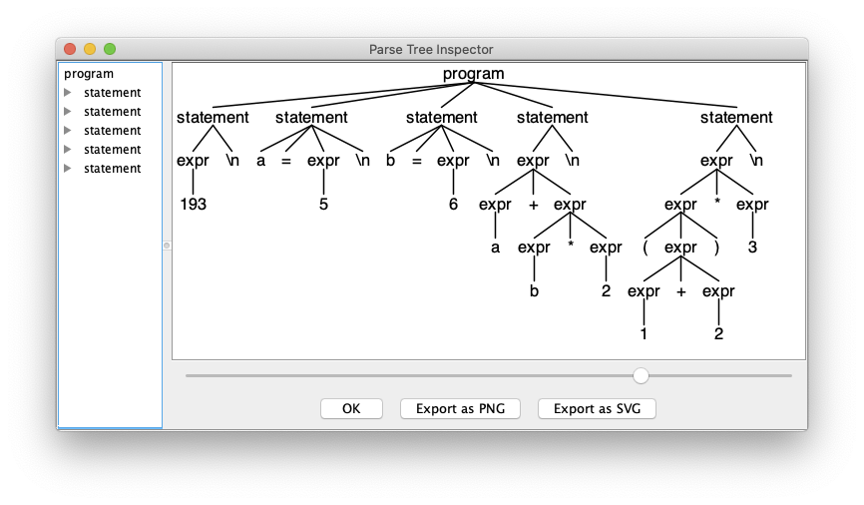
On the Command Line: Run grun
ExprMain.java
ANTLR-ExprTestJava: antlr4 Expr.g4
ANTLR-ExprTestJava: javac *.java
ANTLR-ExprTestJava: grun Expr program -gui input.txt
root rule
input file
grammar name
Expr.g
grammar Expr;
program: statement+ ; // at least one statement
statement : expr NEWLINE
| IDENTIFER '=' expr NEWLINE
| NEWLINE
;
expr: expr ('*'|'/') expr
| expr ('+'|'-') expr
| INTEGER
| IDENTIFER
| '(' expr ')'
;
IDENTIFER : [a-zA-Z]+ ;
INTEGER : [0-9]+ ;
NEWLINE : '\r'? '\n' ;
WS : [ \t]+ -> skip ; // skip whitespace
Demo

Slide 40
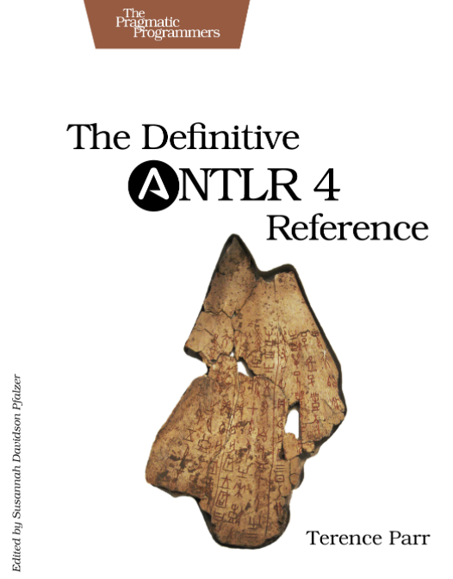
ANTLR 4 Reference Manual
Buy from Amazon (paperback):
https://www.amazon.com/Definitive-ANTLR-4-Reference/dp/1934356999/ref=sr_1_1?s=books&ie=UTF8&qid=1508372536&sr=1-1&keywords=antlr4
Buy from The Pragmatic Bookshelf (eBook):
https://pragprog.com/titles/tpantlr2/the-definitive-antlr-4-reference/

Slide 41
ANTLR 4 IDE Plug-ins
Java development environments
  https://github.com/antlr/antlr4/blob/master/doc/java-target.md
  https://www.antlr.org/tools.html
Eclipse
  https://github.com/jknack/antlr4ide
JetBrains
  https://plugins.jetbrains.com/plugin/7358-antlr-v4/
Demo

