Slide 1


CS 149: Operating Systems
May 12 Class Meeting
Department of Computer Science
San Jose State University
Spring 2015
Instructor: Ron Mak
www.cs.sjsu.edu/~mak

Slide 2
Android
Designed by Google to run on mobile devices.
  NASA uses Android for its “cube sats”.
Based on the Linux kernel and facilities.
  Much written in Java.
Combines open-source code with
closed-source third-party applications.
  Supports a wide variety of
  proprietary cloud services.
  Google Play online store for Android apps.

Slide 3
Android Design Goals
Open-source platform for mobile devices
Support 3rd party apps with robust, stable API
3rd party apps compete on level playing field
Users need not deeply trust 3rd party apps
Support mobile user interaction
Manage app processes for users
Encourage apps to interoperate, collaborate
Full general-purpose OS

Slide 4
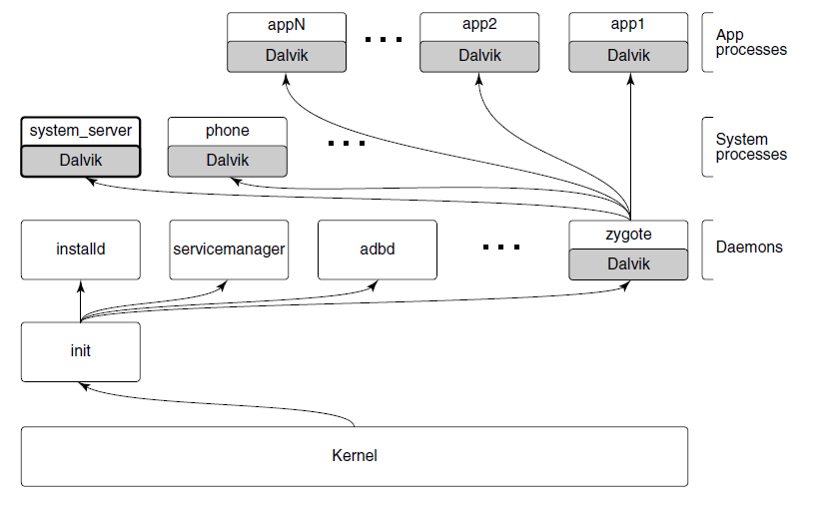
Android Architecture
Modern Operating Systems, 4th ed.
Andrew Tanenbaum and Herbert Bos
Pearson, 2014
ISBN: 978-0133591620

Slide 5
Android Architecture, cont'd
The init process starts Android daemons.
  Focused on low-level functions such as
  managing file systems and hardware access.
Additional layer of processes that run
Dalvik's Java language environment.
  Dalvik is a managed runtime environment.
  Brought up by the zygote native daemon.
  JVM bytecode is translated to Dalvik bytecode.

Slide 6
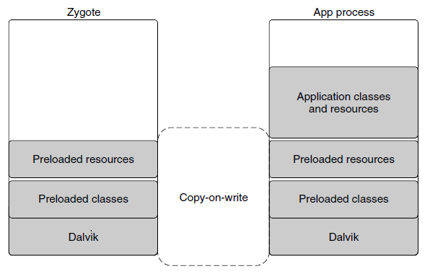
Dalvik
Modern Operating Systems, 4th ed.
Andrew Tanenbaum and Herbert Bos
Pearson, 2014
ISBN: 978-0133591620

Slide 7
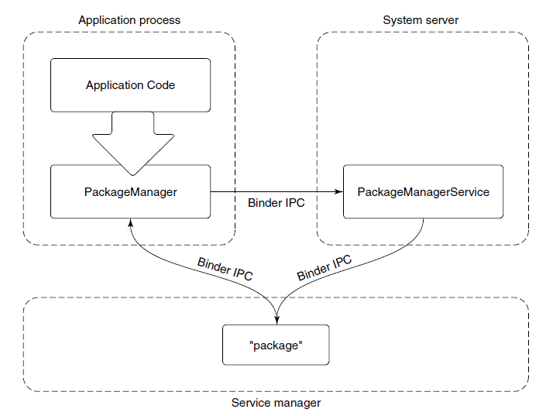
Android Application Framework
Modern Operating Systems, 4th ed.
Andrew Tanenbaum and Herbert Bos
Pearson, 2014
ISBN: 978-0133591620

Slide 8
Package Manager Example
The package manager provides a framework API for apps to call in their local process.
  The PackageManager class connects to the corresponding service in the system server.
  The PackageManager makes calls on the service.
Calls are implemented as
interprocess communication.
  Android Binder IPC mechanism.

Slide 9
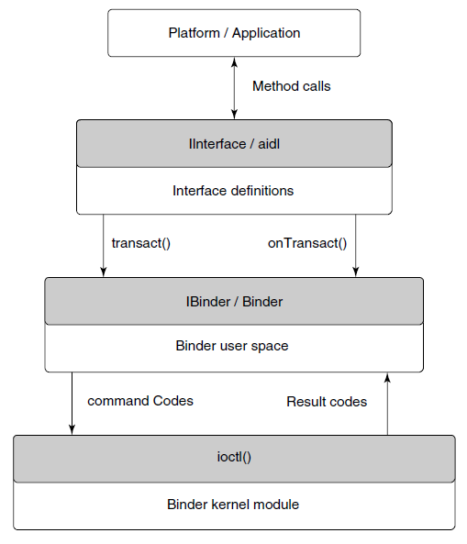
Binder IPC
Relies on remote procedure calls (RPC).
Modern Operating Systems, 4th ed.
Andrew Tanenbaum and Herbert Bos
Pearson, 2014
ISBN: 978-0133591620

Slide 10
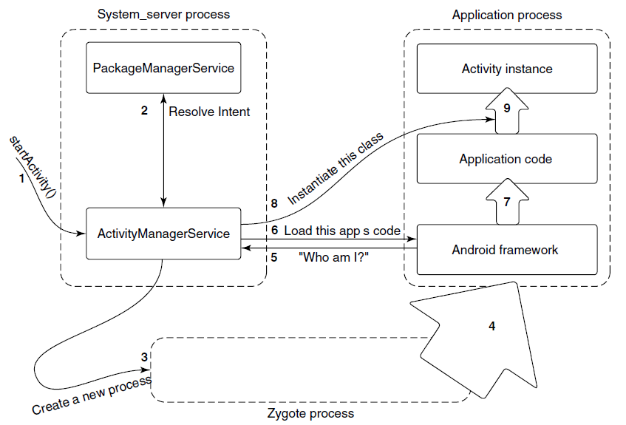
Launching a New Application Process
Modern Operating Systems, 4th ed.
Andrew Tanenbaum and Herbert Bos
Pearson, 2014
ISBN: 978-0133591620

Slide 11
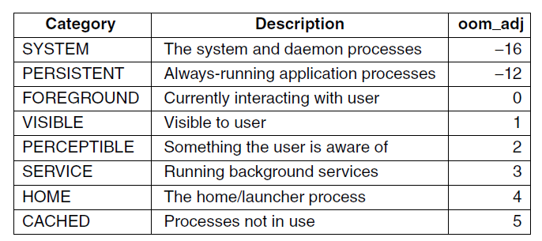
Process Lifecycle
Process importance categories.
oom_adj: a strict ordering to determine which processes
to kill first in an out-of-memory situation.
Modern Operating Systems, 4th ed.
Andrew Tanenbaum and Herbert Bos
Pearson, 2014
ISBN: 978-0133591620

Slide 12
Postmortem Reports
Due Monday, May 18 at 11:59 PM
  A few paragraphs.
  Word document or just an email message
  Individual and private.
What did you learn in this class?
What were your accomplishments
on your project team?
How well did each of your teammates do?

Slide 13
Final Exam
Section 3 (9:00 AM):
  Thursday, May 21 at 7:15 – 9:30 AM in DH 450
Section 2 (3:00 PM):
  Monday, May 18 at 2:45 – 5:00 PM in MH 233
Section 8 (6:00 PM):
  Tuesday, May 19 at 5:15 – 7:30 PM in MH 223
It will be similar to the midterm.
  Covers the entire semester.
  More emphasis on the second half.

Slide 14
Disk Storage
Industry standard I/O bus
Host-attached storage
Network-attached storage (NAS)
Storage-area network (SAN)

Slide 15
Disk Storage, cont'd
Disk scheduling algorithms
  FCFS: first-come first-served
  SSTF: shortest seek time first
  SCAN: elevator scheduling
  C-SCAN: circular scan
  LOOK and C-LOOK
Hierarchical storage management (HSM)
RAID

Slide 16
File Systems
File types
File attributes
File operations
File tables
File locking
File structure
  Sequential access
  Direct (random) access

Slide 17
File Systems, cont'd
Disk structure
  Partitions
Directories
  Operations
  Single- and two-level
  Tree-structured
  Acyclic graphs

Slide 18
File Systems, cont'd
File path names
Mounting a file system
File protection
  Unix

Slide 19
File Systems, cont'd
Implementation
  Layered architecture
Master boot record
  Superblock
  File-control blocks (inodes)
File allocation algorithms
  Contiguous
  Linked
  File allocation table (FAT)
  Indexed

Slide 20
File Systems, cont'd
UNIX directories
Disk block size
Free space management
Reliability
Consistency

Slide 21
File Systems, cont'd
Performance
  Caching
  Read ahead
  Disk arm motion
Log-structured
Virtual
Networked file system (NFS)
  NFS mounting

Slide 22
I/O
Device controllers
Polling
I/O interrupts
  Priority levels
  Application-level interrupt handlers
Sockets
  select()
Clocks and timers

Slide 23
Virtualization
Virtual machine manager
  Types
  Implementation

Slide 24
Distributed Systems
Advantages
Network operating systems
Distributed operating systems
Network structure
  LAN and WAN

Slide 25
Distributed Systems, cont'd
Communication structure
Naming
  Domain name service (DNS)
Routing
  Fixed, virtual, dynamic
Contention
  CSMA/CD

Slide 26
Distributed Systems, cont'd
Connection strategies
  Circuit, message, packet switching
Communications protocols
  ISO 7-layer model
  TCP/IP protocol layers
Ethernet
Failure detection
  Reconfiguration
Network design issues

Slide 27
Distributed Systems, cont'd
Distributed file system
  Structure
  Naming and transparency
  Naming schemes
Remote file access
Caching
  Location
  Update policy
  Consistency

Slide 28
Protection
Principle of least privilege
Granularity
Domains
  UNIX domains
  Domain switching

Slide 29
Protection, cont'd
Access matrix
Access control list
Capability list
Role-based access control
Covert channels
Program-level protection

Slide 30
Security
Violations
Methods
  Man in the middle
  Trojan horse
  Trap door
  Logic bomb
  Stack and buffer overflow

Slide 31
Security, cont'd
Levels
Viruses
Internet worms
Port scanning
Denial of service
User authentication
Firewalls
Cryptography

Slide 32
Case Studies
Linux
Windows 7
Android

Slide 33
IBM Manual, 1925
All parts should go together without forcing.
You must remember that the parts you are
reassembling were disassembled by you.
Therefore, if you can’t get them together again,
there must be a reason.
By all means, do not use a hammer.

