Slide 1
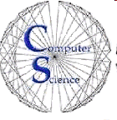

CS 149: Operating Systems
April 28 Class Meeting
Department of Computer Science
San Jose State University
Spring 2015
Instructor: Ron Mak
www.cs.sjsu.edu/~mak

Slide 2
Unofficial Field Trip
Computer History Museum in Mt. View
  http://www.computerhistory.org/
Saturday, May 9, 11:30 – closing time
  Special free admission.
  Do a self-guided tour of the new Revolution exhibit.
  See a life-size working model of Charles Babbage’s
  Difference Engine in operation, a hand-cranked mechanical computer designed in the early 1800s.
  Experience a fully restored IBM 1401 mainframe computer
  from the early 1960s in operation.
    General info: http://en.wikipedia.org/wiki/IBM_1401
    My summer seminar: http://www.cs.sjsu.edu/~mak/1401/
    Restoration: http://ed-thelen.org/1401Project/1401RestorationPage.html
Extra credit
fun quiz!

Slide 3
Distributed File System (DFS)
A distributed implementation of the
classic time-sharing model of a file system.
  Multiple users share files and storage resources.
A DFS manages a set of
dispersed storage devices.

Slide 4
Distributed File System (DFS), cont’d
The overall storage space managed by a DFS is composed of different, remotely located, smaller storage spaces.
There is usually a correspondence
between storage spaces and sets of files.

Slide 5
DFS Structure
Service
  Software running on one or more machines.
  Provide a particular type of function
  to unknown clients.

Slide 6
DFS Structure, cont’d
Server
  Service software running on a single machine.
Client
  Process that invokes a service using
  a set of operations that forms its client interface.
  A client interface for a file service is formed by
  a set of primitive file operations (create, delete,
  read, write).
  The client interface of a DFS should be transparent.
  Don’t distinguish between local and remote files.

Slide 7
Naming and Transparency
Naming
  Mapping between logical and physical objects.
Multilevel mapping
  Abstraction of a file that hides the details of
  how and where on the disk the file is actually stored.

Slide 8
Naming and Transparency, cont’d
A transparent DFS hides the location
in the network where the file is stored.
For a file being replicated in several sites,
the mapping returns a set of the locations
of the file’s replicas.
Both the existence of multiple copies and their location are hidden from a client.

Slide 9
Naming and Transparency, cont’d
Location transparency
  A file name does not reveal
  the file’s physical storage location.
Location independence
  A file name does not need to be changed
  when the file’s physical storage location changes.

Slide 10
Naming and Transparency, cont’d
File migration (file mobility)
  Automatically change a file’s location.
  Examples:
    The Hadoop Distributed File System (HDFS)
    Amazon’s S3 (Simple Storage Service)
    cloud storage facility

Slide 11
Naming Schemes
Files are named by combination
of their host name and local name.
  Guarantees a unique system-wide name.
Mount remote directories to local directories.
  Give the appearance of a coherent directory tree.
Only mounted remote directories
can be accessed transparently.

Slide 12
Naming Schemes, cont’d
Total integration of the component file systems.
A single global name structure
spans all the files in the system.
If a server is unavailable, some arbitrary set of directories on different machines also becomes unavailable.

Slide 13
Remote File Access
Remote-service mechanism
  A server on the network handles
  all remote file access requests.
Retain recently accessed disk blocks in a cache.
  Reduce network traffic.
  Repeated accesses to the same information
  can be handled locally.
  If needed data is not already cached,
  a copy of data is brought from the server to the user.
    Accesses are performed on the cached copy.

Slide 14
Remote File Access, cont’d
Identify files with one master copy
residing at the server.
  Copies of (parts of) the file
  are scattered in different caches.
Cache-consistency problem
  Keep the cached copies consistent
  with the master file.
Network virtual memory
  Demand-paged virtual memory
  with a remote backing store.

Slide 15
Cache Location
Advantages of disk caches:
  More reliable.
  Cached data kept on disk are still there during recovery and don’t need to be fetched again.
Advantages of main memory caches:
  Permit workstations to be diskless.
  Data can be accessed more quickly.
  Performance speedup in bigger memories.

Slide 16
Cache Update Policy: Write-Through
Write data through to disk as soon as
they are placed on any cache.
Reliable, but poor performance.

Slide 17
Cache Update Policy: Delayed Write
Modifications are written to the cache
and then written through to the server later.
  AKA write-back caching
Write accesses complete quickly.
  Some data cached may be overwritten
  before they are written back, and so
  don’t need to be written to the server at all.
Poor reliability
  Unwritten data will be lost whenever
  a user machine crashes.

Slide 18
Cache Update Policy: Delayed Write, cont’d
Variation: Scan the cache at regular intervals.
  Flush blocks that have been modified
  since the last scan.
Variation: Write-on-close
  Write data back to the server when the file is closed.
  Best for files that are open for long periods
  and are frequently modified.

Slide 19
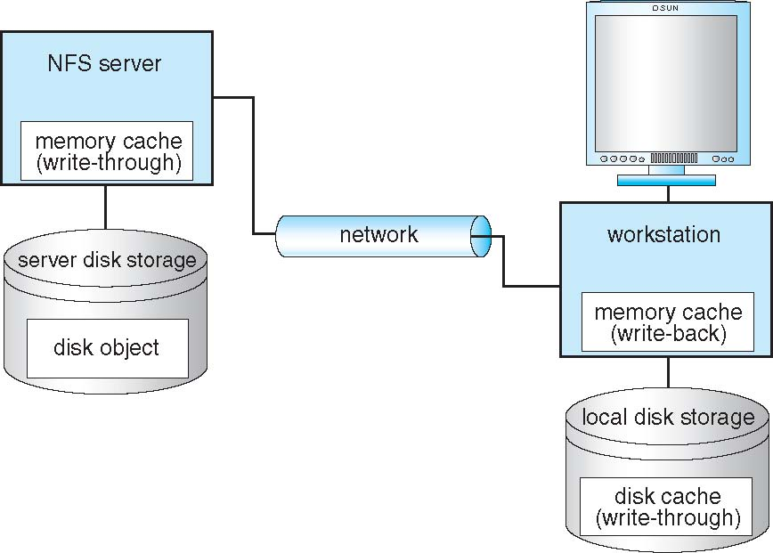
Data Caching in a Network
Operating Systems Concepts, 9th edition
Silberschatz, Galvin, and Gagne
(c) 2013 John Wiley & Sons. All rights reserved. 978-1-118-06333-0

Slide 20
Caching Consistency
Is the locally cached copy of the data
consistent with the master copy?

Slide 21
Caching Consistency, cont’d
Client-initiated
  The client initiates a validity check.
  The server checks whether the local data are consistent with the master copy.
Server-initiated
  The server records, for each client,
  the (parts of) files it caches.
  The server reacts when it detects
  a potential inconsistency.

Slide 22
Protection
An operating system must protect users and processes from each other’s activities.
  Mechanisms to control the access by programs, processes, or users to the computer system resources.
Each resource object has a unique name
and can be accessed through
a well-defined set of operations.
  Ensure that each object is accessed correctly and only by those processes that are allowed to do so.

Slide 23
Principle of Least Authority (POLA)
A guiding principle of protection.
Give programs, users and systems
just enough privileges to perform their tasks.
Limit damage if an entity has a bug or gets abused.
“Need to know”
  At any time, a process should be able to access
  only those resources that it currently requires
  to complete its task.

Slide 24
Protection Granularity
Rough-grained privilege management
is easier and simpler.
  Principle of least authority done in large chunks.
  Example: Traditional UNIX processes either have abilities of the associated user or of root.
Fine-grained management is more complex
and more overhead, but more protective.
  Examples:
    File access control lists (ACLs)
    Role-based access control (RBAC)

Slide 25
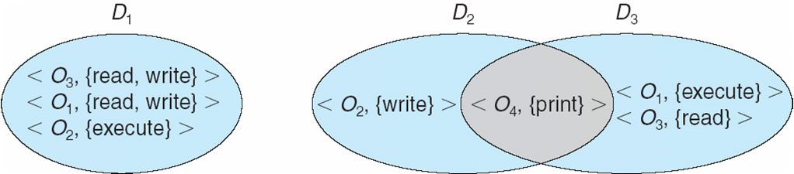
Protection Domains
A domain is a set of resource objects
and their allowable operations.
  A set of access rights as <object-name, rights-set> pairs
  Example: <file F, {read, write}>
Users, processes, and program procedures
can be in domains.
Operating Systems Concepts, 9th edition
Silberschatz, Galvin, and Gagne
(c) 2013 John Wiley & Sons. All rights reserved. 978-1-118-06333-0

Slide 26
UNIX Domains
In UNIX, a process’s domain is defined
by its UID (user ID) and GID (group ID).
A (UID, GID) combination determines:
  A complete list of all the
  accessible resource objects.
  Whether they can be read, written, or executed.

Slide 27
UNIX Domains, cont’d
Two processes with the same (UID, GID) combination have access to the
same set of objects.
Processes with different (UID, GID) combinations will have access
to different but possibly overlapping
sets of objects.

Slide 28
UNIX Domain Switching
A system call causes a domain switch
from the user’s domain to that of the kernel.
When a process executes a file
with the SETUID or SETGID bit on,
it acquires the UID or GID of the file owner.
  Get a different set of access rights.
  The UID and GID are reset
  when the execution completes.

Slide 29
UNIX Domain Switching, cont’d
Domain switch accomplished via passwords.
  The su command temporarily switches
  to another user’s domain when
  the other domain’s password is provided.
Domain switching via commands
  The sudo command prefix executes
  a specified command in another domain.

Slide 30
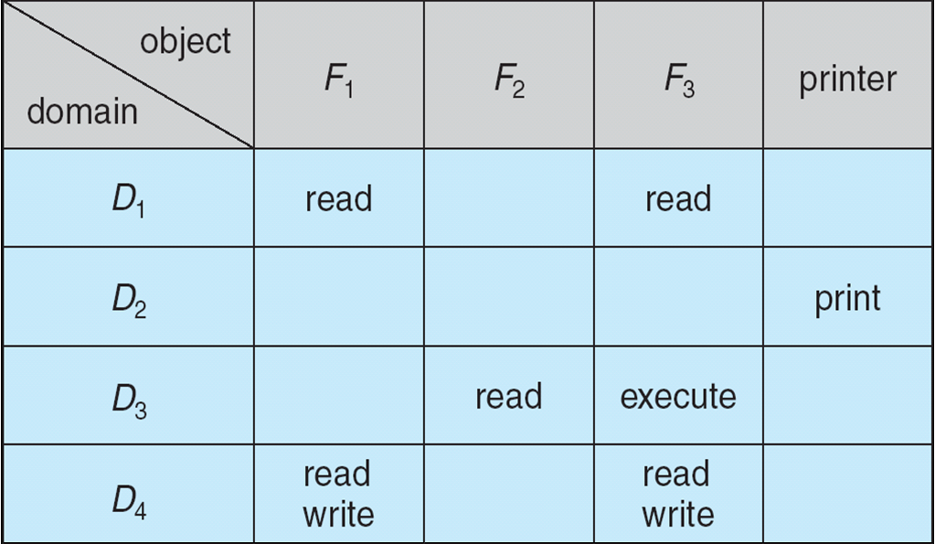
The Access Matrix
Rows represent domains
Columns represent objects
Access(i, j) is the set of operations that a process executing in Domain_{i} can invoke on Object_{j}
Operating Systems Concepts, 9th edition
Silberschatz, Galvin, and Gagne
(c) 2013 John Wiley & Sons. All rights reserved. 978-1-118-06333-0

Slide 31
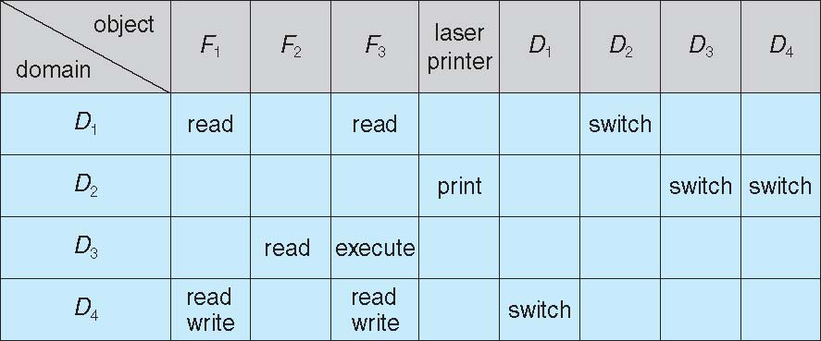
The Access Matrix, cont’d
Domains are also objects.
  Allow switching operations between domains.
Operating Systems Concepts, 9th edition
Silberschatz, Galvin, and Gagne
(c) 2013 John Wiley & Sons. All rights reserved. 978-1-118-06333-0

Slide 32
The Access Matrix, cont’d
Separate mechanism from policy
  Mechanism
    The operating system provides access matrix + rules.
    The OS ensures that the matrix is only manipulated by
    authorized agents and that rules are strictly enforced.
  Policy
    User dictates policy.
    Who can access what object and in what mode.
The access matrix is generally very sparse.
  Can be implemented in other more efficient ways.

Slide 33
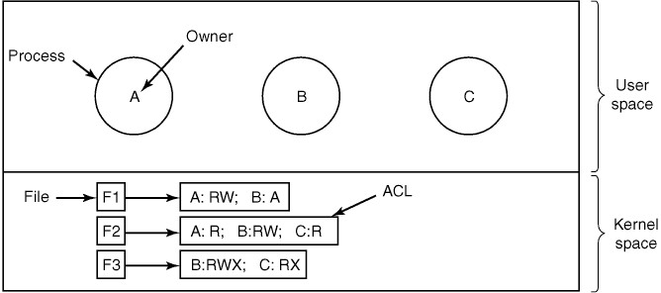
Access Control List
Use access control lists (ACLs)
to protect resources.
  A file’s ACL determines which processes
  can read, write, or execute it.
Modern Operating Systems, 3rd ed.
Andrew Tanenbaum
(c) 2008 Prentice-Hall, Inc.. 0-13-600663-9
All rights reserved

Slide 34
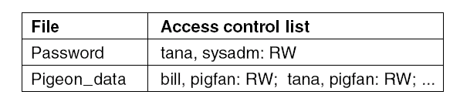
Access Control List, cont’d
An ACL can also define access rights
for groups of users.
  When a request is made to access an object,
  the caller’s UID and GID are checked to see
  if they’re present in the ACL.
Groups can define roles.

Slide 35
Access Control List, cont’d
An ACL represents a column
of an access matrix.
Operating Systems Concepts, 9th edition
Silberschatz, Galvin, and Gagne
(c) 2013 John Wiley & Sons. All rights reserved. 978-1-118-06333-0

Slide 36
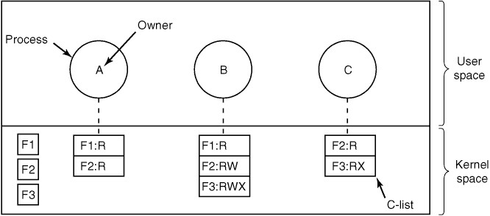
Capability List
Each process has a capability list.
  The list includes objects that the process can access and what operations it can perform on each object.
In other words, the list defines the process’s domain.
Modern Operating Systems, 3rd ed.
Andrew Tanenbaum
(c) 2008 Prentice-Hall, Inc.. 0-13-600663-9
All rights reserved

Slide 37
Capability List, cont’d
A capability list represents a row
of an access matrix.
Operating Systems Concepts, 9th edition
Silberschatz, Galvin, and Gagne
(c) 2013 John Wiley & Sons. All rights reserved. 978-1-118-06333-0

Slide 38
Capability List, cont’d
Capability lists must be protected
from user tampering.
Tagged memory architecture
  Memory locations each has an extra tag bit
  that tells whether or not it contains a capability.
  Tagged memory can only be modified
  by kernel programs.

Slide 39
Capability List, cont’d
Maintain capability lists
inside the operating system.
  Example: UNIX file descriptors
  point to capability lists.
Use encryption.

Slide 40
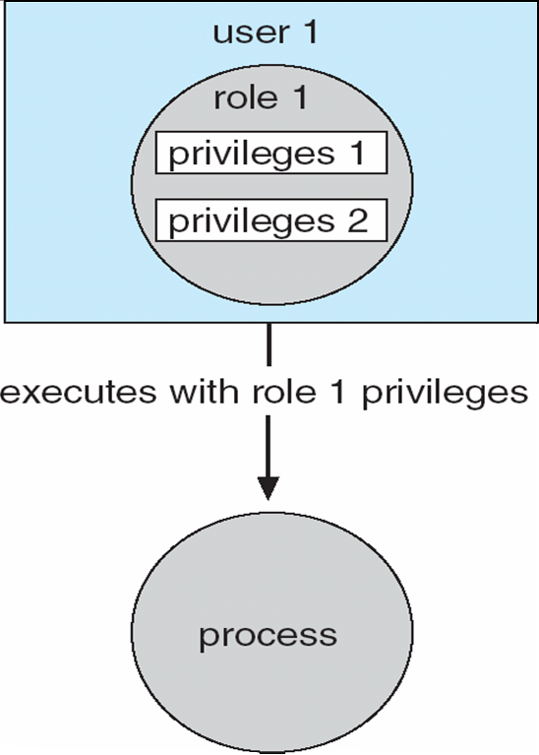
Role-Based Access Control (RBAC)
Implements the principle of least authority.
Users are assigned roles
that grant access to
privileges and programs
  Enable a role via a password
  to gain its privileges.
Operating Systems Concepts, 9th edition
Silberschatz, Galvin, and Gagne
(c) 2013 John Wiley & Sons. All rights reserved. 978-1-118-06333-0

Slide 41
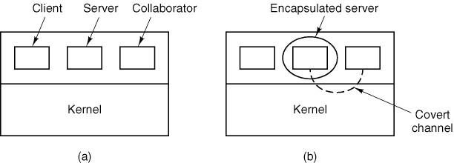
Covert Channels
Protection mechanisms are often insufficient
to solve the confinement problem.
  Sensitive data between a client process and a server process leaks out to a collaborator process via covert channels.
Modern Operating Systems, 3rd ed.
Andrew Tanenbaum
(c) 2008 Prentice-Hall, Inc.. 0-13-600663-9
All rights reserved

Slide 42
Covert Channels
An untrustworthy server can secretly
send information to a collaborator.
  Modulate CPU usage
  “Morse code” via file locking and unlocking
  Signal via acquiring and releasing resources
Finding covert channels and then blocking them
are extremely difficult to accomplish.

Slide 43
Program-Level Protection
Programming languages can have
built-in protection mechanisms.
  Allow the high-level description of policies
  for the allocation and use of resources.
  Provide software for protection enforcement
  when automatic hardware-supported checking
  is unavailable.

Slide 44
Program-Level Protection: Jav a
The Java Virtual Machine (JVM)
is a protected “sandbox”.
Stack inspection
  When a program requests access to a
  protected resource, the JVM inspects
  the program’s runtime stack.
  The request is denied if any stack frame is found that does not have the proper access rights.
Type safety
Data encapsulation

