Slide 1


CS 149: Operating Systems
April 9 Class Meeting
Department of Computer Science
San Jose State University
Spring 2015
Instructor: Ron Mak
www.cs.sjsu.edu/~mak

Slide 2
Implementing Directories
UNIX treats a directory exactly
the same way as a file.
  A type field indicates that it’s a directory.
The superblock on the disk gives
the location of the inodes.
The first inode points to the root directory.

Slide 3
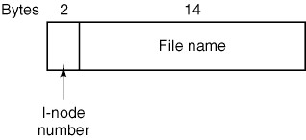
Implementing Directories, cont’d
The main function of the directory is to map
the ASCII name of a file to the information
needed to locate the file data.
  A UNIX directory entry:
Modern Operating Systems, 3rd ed.
Andrew Tanenbaum
(c) 2008 Prentice-Hall, Inc.. 0-13-600663-9
All rights reserved

Slide 4
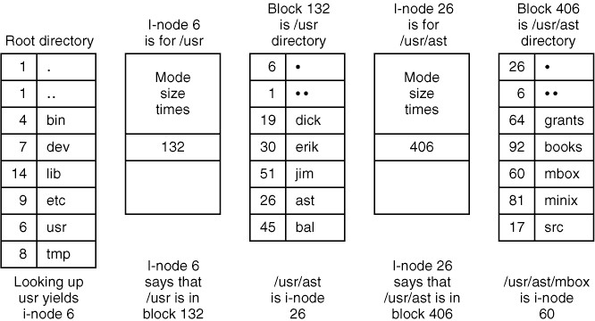
UNIX Directories
Lookup of /usr/ast/mbox:
The steps to look up /usr/ast/mbox.
Modern Operating Systems, 3rd ed.
Andrew Tanenbaum
(c) 2008 Prentice-Hall, Inc.. 0-13-600663-9
All rights reserved

Slide 5
Exercise #1
Create two small text files, file1.txt and file3.txt, containing different contents. Obtain the inode number of file1.txt with the command
ls –li file1.txt
What inode number did you get?

Slide 6
Exercise #2
The UNIX file system supports hard links and soft (symbolic) links. Enter the following command to create a hard link between file1.txt and file2.txt:
ln file1.txt file2.txt
What are the inode values of file1.txt and file2.txt?
Explain why they are the same or different.
The inode values should be the same.
A hard link is like an “alias” to a file.
Both names refer to the same file.

Slide 7
Exercise #3
Do file1.txt and file2.txt now have
the same or different contents?
Explain why this is so.
The contents are the same
because they are the same file.

Slide 8
Exercise #4
Edit file2.txt to change its contents. After you have done so, examine the contents of file1.txt.
Are the contents the same or different?
Explain why this is so.
The contents continue to be the same, since
both names file1.txt and file2.txt
refer to the same file.

Slide 9
Exercise #5
Remove file1.txt with the command
rm file1.txt
Does file2.txt still exist?
Explain why this is so.
The rm command only decrements
the count of links to an inode,
and the count is still greater than zero.

Slide 10
Exercise #6
Create a symbolic link to file to file3.txt with the command
ln –s file3.txt file4.txt
What are the inode values of file3.txt
and file4.txt?
Explain why they are the same or different.
The inode values are system-dependent,
but they should be different numbers.
file4.txt is a separate file. It’s a special type
that is merely a link to file3.txt.

Slide 11
Exercise #7
Edit the contents of file4.txt.
Examine the contents of file3.txt
and explain what you see.
file3.txt will have the same
contents as file4.txt.
When you edited file4.txt,
you were really editing file3.txt.

Slide 12
Exercise #8
Remove file3.txt.
Explain what happens when
you then try to edit file4.txt.
What happens depends on the Linux system
and what editor you used.
Either you get a message about a file no longer existing,
or you were allowed to edit a file. In the latter case,
a new file3.txt is created and that’s what you edited.

Slide 13
Exercise #9
Explain what you see from the command
ls –li file*.txt
If a new file3.txt was created
when you edited file4.txt,
you will see that it is a new file
with a different inode number
than the original file3.txt.

Slide 14
Disk Block Size
Large block size
  Much wasted space due to internal fragmentation.
Small block size
  More efficient use of space.
  Each file consists of many blocks.
  Reading a file will be slow.

Slide 15
Disk Block Size
The solid curve (left-hand scale) gives the data rate of a disk.
The dashed curve (right-hand scale) gives the disk space efficiency.
All files are 2 KB.
Modern Operating Systems, 3rd ed.
Andrew Tanenbaum
(c) 2008 Prentice-Hall, Inc.. 0-13-600663-9
All rights reserved

Slide 16
Free Disk Space Management: Bit Vector
0
1
2
n-1
…
1 ⇒ block[i] free
0 ⇒ block[i] occupied
bit[i] =
Modern Operating Systems, 3rd ed.
Andrew Tanenbaum
(c) 2008 Prentice-Hall, Inc.. 0-13-600663-9
All rights reserved

Slide 17
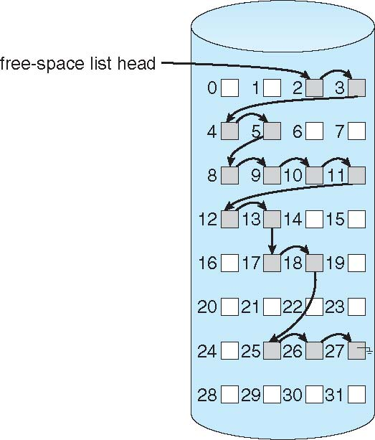
Free Disk Space Management: Linked List
Operating Systems Concepts, 9th edition
Silberschatz, Galvin, and Gagne
(c) 2013 John Wiley & Sons. All rights reserved. 978-1-118-06333-0

Slide 18
File System Reliability
Destruction of a file system can be
a greater disaster than the destruction
of a computer!
Hardware can be replaced.
Data often cannot easily be replaced.

Slide 19
Bad Disk Blocks
A hard disk usually contain bad blocks
even when new.
  It’s too expensive to manufacture “perfect” disks.
Spare sectors are provided on each disk.
  The disk controller replaces bad sectors with spares.
One approach:
A dummy file that contains all the bad blocks.
  Keeps the bad blocks off the free list.

Slide 20
Backups
Backups
  Recover from disaster.
  Recover from user stupidity.
Incremental backups
  Do a complete file system dump periodically.
  Frequently backup only the files that changed.

Slide 21
Dumps
Physical dump
  Dump an entire disk starting from block 0.
Logical dump
  Only dump the files located in selected directories.
  Must save all the information necessary
  to recreate the entire path to a file.

Slide 22
File System Consistency
What happens if a computer crashes
during an I/O operation?
  The file system wasn’t able to write
  all the modified blocks to disk.
  The file system is left in an inconsistent state.

Slide 23
File System Consistency, cont’d
UNIX has the fsck (file system check) utility.
Windows has the chkdsk (check disk) utility.
Two kinds of consistency checks:
blocks and files.
  How many times a disk block is present in a file.
  How many times a disk block appears in the free list.
  Make sure a data block is not present
  in two or more files.

Slide 24
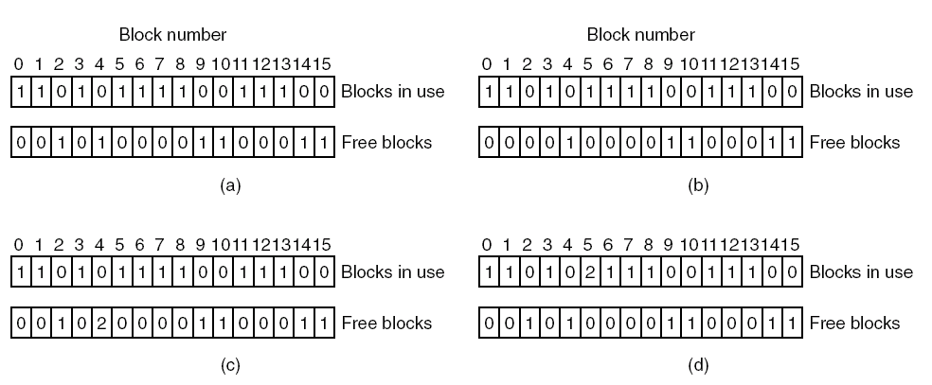
File System Consistency, cont’d
(a) Consistent.
(c) Duplicate block in free list.
(b) Missing block.
(d) Duplicate data block.
Modern Operating Systems, 3rd ed.
Andrew Tanenbaum
(c) 2008 Prentice-Hall, Inc.. 0-13-600663-9
All rights reserved

Slide 25
File System Performance: Block Cache
AKA buffer cache
Disk blocks are kept in memory.
  A read request first checks if the desired block
  is in memory.
Write-through cache: Modified blocks in the cache are immediately written back to the disk.

Slide 26
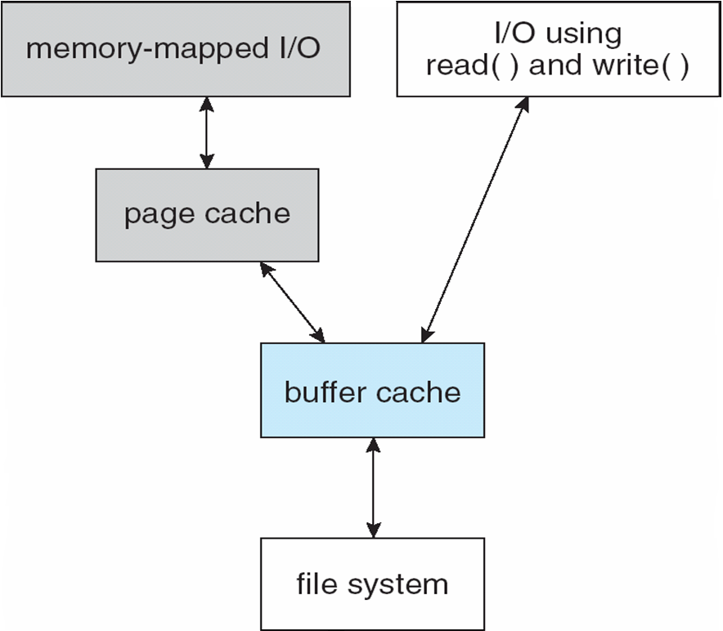
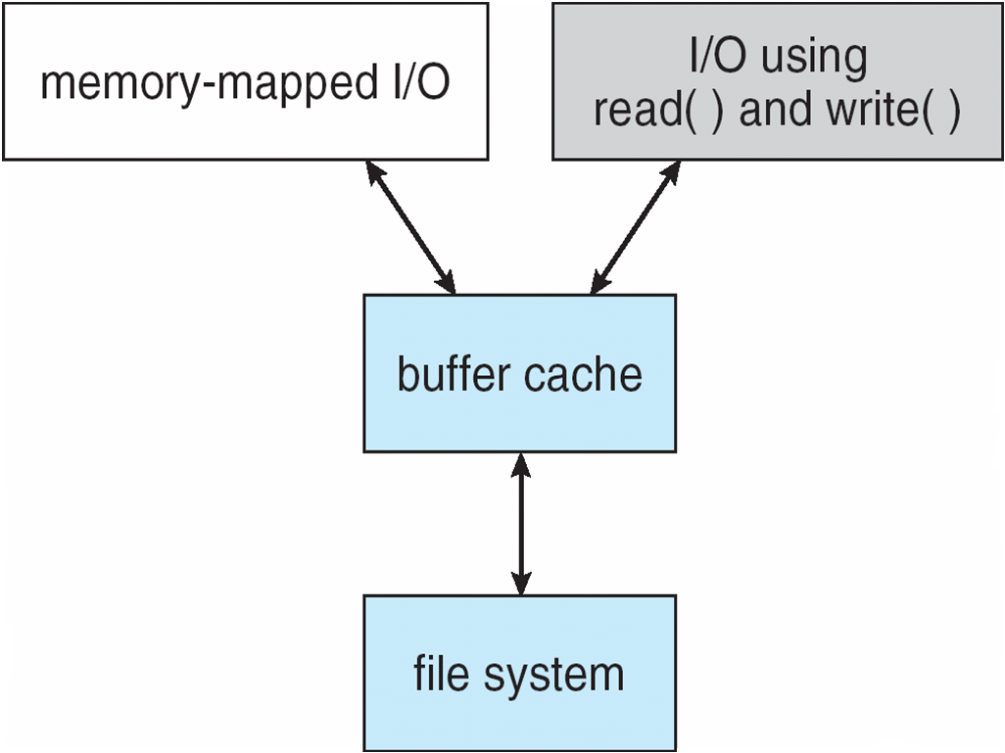
File System Performance: Unified Buffer Cache
Instead of having both a page cache and a buffer cache (double caching), unify the two caches.
Operating Systems Concepts, 9th edition
Silberschatz, Galvin, and Gagne
(c) 2013 John Wiley & Sons. All rights reserved. 978-1-118-06333-0

Slide 27
File System Performance: Block Read Ahead
Try to get disk blocks into the cache
before they’re needed.
If asked to read block k,
read both blocks k and k+1.
  Related to locality of reference.
Keep track of cache hits to see
if read ahead is effective.

Slide 28
File System Performance: Reduced Disk Arm Motion
Put disk blocks likely to be accessed in sequence close to each other.
  Preferably in the same cylinder.
Allocate groups of consecutive blocks.
Place inodes in the middle of the disk
instead of at the start.
Why?
Modern Operating Systems, 3rd ed.
Andrew Tanenbaum
(c) 2008 Prentice-Hall, Inc.. 0-13-600663-9
All rights reserved

