Slide 1


CS 149: Operating Systems
April 2 Class Meeting
Department of Computer Science
San Jose State University
Spring 2015
Instructor: Ron Mak
www.cs.sjsu.edu/~mak

Slide 2
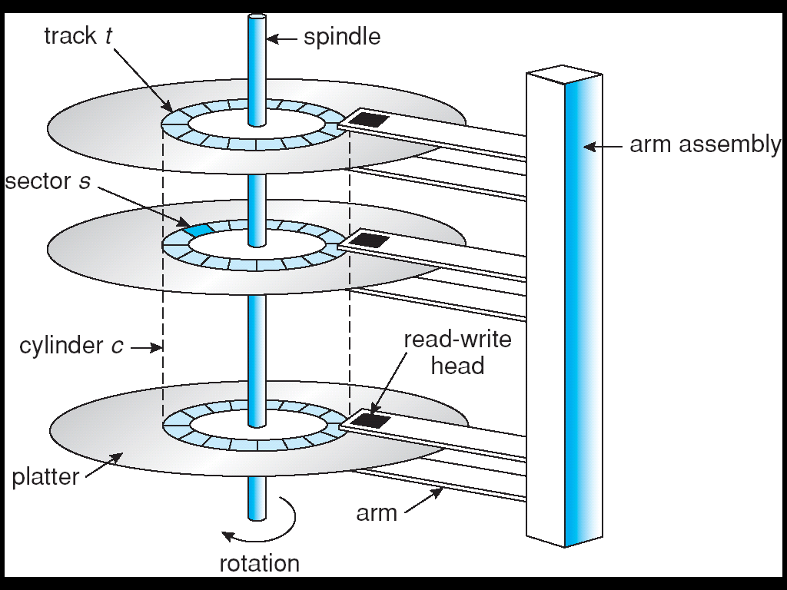
Hard Disk Storage
Magnetic disks provide secondary storage.
Issues include:
  Transfer rate
    Rate at which data
    flows from the
    disk drive into the
    computer.
  Random-access time
    Seek time: to move
    the disk arm to the
    desired cylinder.
    +
    Rotational latency:
    time for the desired
    sector to rotate under
    the read-write head.
Operating Systems Concepts, 9th edition
Silberschatz, Galvin, and Gagne
(c) 2013 John Wiley & Sons. All rights reserved. 978-1-118-06333-0

Slide 3
Hard Disk Drives
Disk drives are attached to a computer
via an industry-standard I/O bus.
  EIDE: Enhanced Integrated Drive Electronics
  ATA: Advanced Technology Attachment
  SATA: Serial ATA
  USB: Universal Serial Bus
  FC: Fiber Channel
  SCSI: Small Computer-Systems Interface
Host controller at the computer end of the bus.
Disk controller built into each disk drive.

Slide 4
Host-Attached Storage
Accesses storage via local I/O ports.
Uses a bus architecture (IDE, SCSI, FC, etc.)

Slide 5
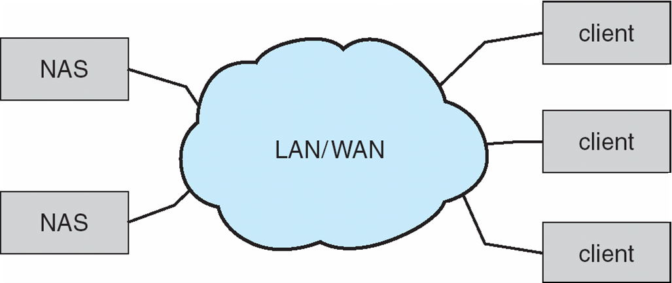
Network-Attached Storage (NAS)
Special-purpose storage system
accessed remotely over a data network.
Clients access NAS via remote procedure calls.
  Example: NFS for UNIX systems.
  Carried via TCP or UDP over an IP network.
  Storage I/O operations consume bandwidth on the data network.
Operating Systems Concepts, 9th edition
Silberschatz, Galvin, and Gagne
(c) 2013 John Wiley & Sons. All rights reserved. 978-1-118-06333-0

Slide 6
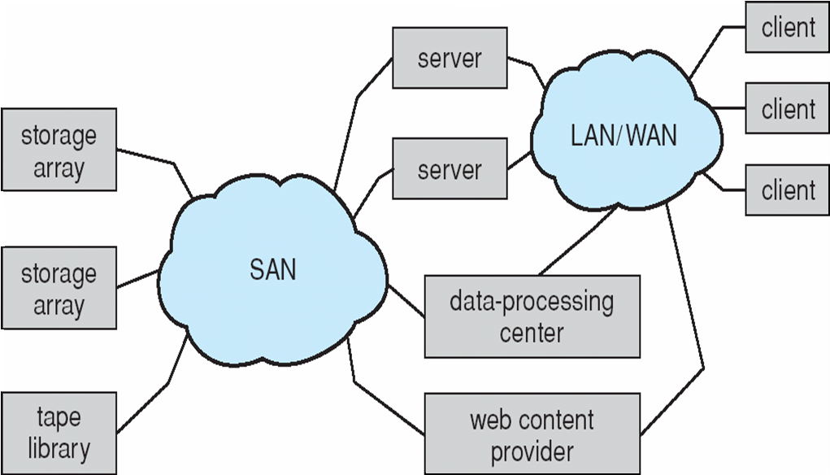
Storage-Area Network (SAN)
Private network connecting
servers and storage units.
Extremely flexible.
  Multiple hosts and multiple storage arrays
  can connect to a SAN.
  Doesn’t hog the
  regular data network.
Operating Systems Concepts, 9th edition
Silberschatz, Galvin, and Gagne
(c) 2013 John Wiley & Sons. All rights reserved. 978-1-118-06333-0

Slide 7
Disk Scheduling
The operating system is responsible for
fast disk access time and high disk bandwidth.
  Bandwidth: total number of bytes transferred divided by the total time between the first request for service and the completion of the last transfer.
Additional factors:
seek time and rotational latency
  Seek time: the time for the disk arm to move the heads to the cylinder containing the desired sector.
  Rotational latency: the additional time for the disk to rotate the desired sector under the disk head.

Slide 8
Disk Scheduling Algorithms
FCFS: First Come First Served
SSTF: Shortest Seek Time First
SCAN (AKA elevator scheduling)
C-Scan: Circular SCAN
LOOK and C-LOOK

Slide 9
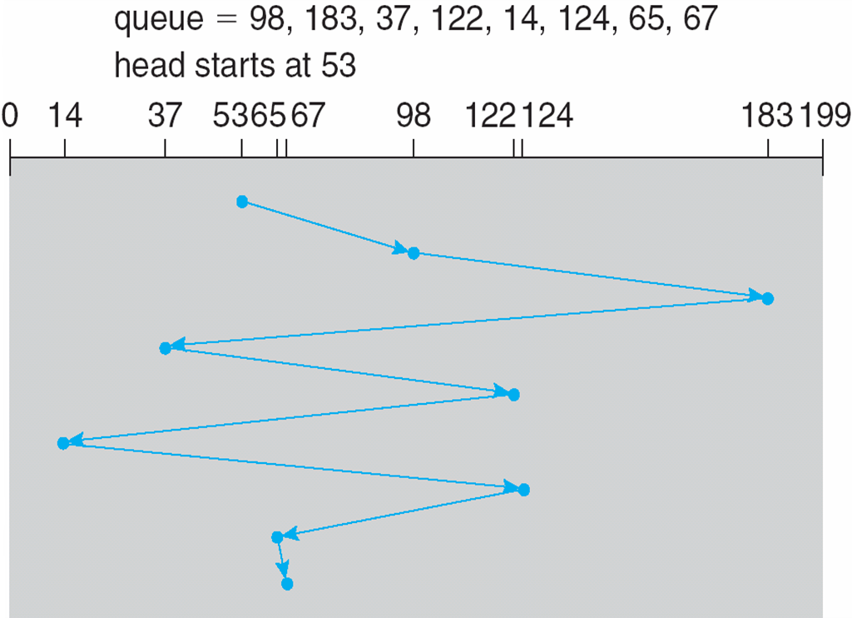
FCFS Disk Scheduling
Intrinsically fair, but generally
does not provide the best service.
  Example: total head movement of 640 cylinders
Operating Systems Concepts, 9th edition
Silberschatz, Galvin, and Gagne
(c) 2013 John Wiley & Sons. All rights reserved. 978-1-118-06333-0

Slide 10
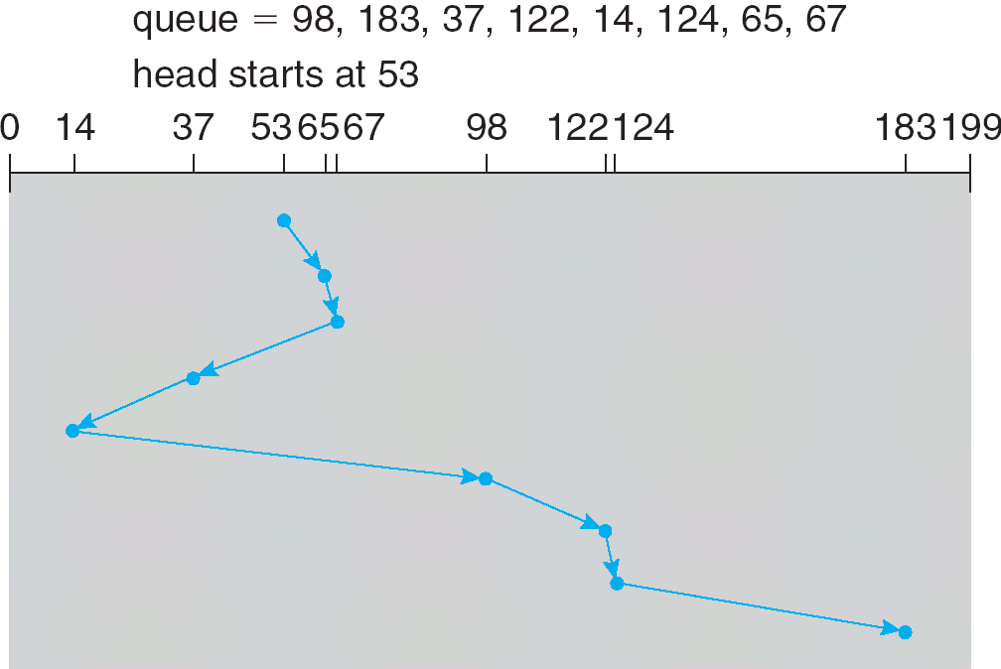
SSTF Disk Scheduling
Select the request with the least seek time from the current position of the read/write head.
  Example: total head movement of 236 cylinders
Operating Systems Concepts, 9th edition
Silberschatz, Galvin, and Gagne
(c) 2013 John Wiley & Sons. All rights reserved. 978-1-118-06333-0

Slide 11
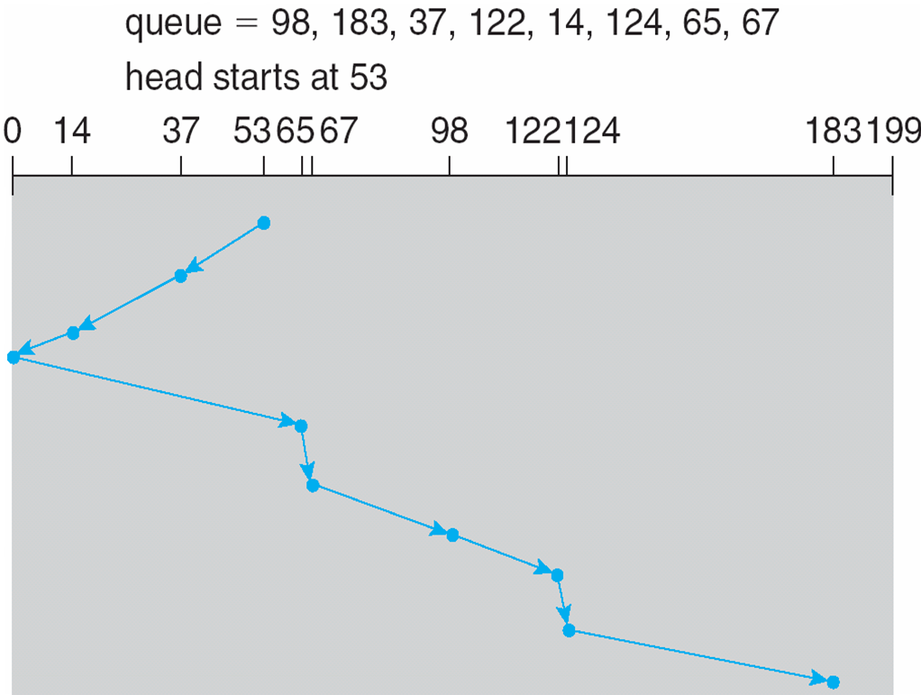
SCAN Disk Scheduling
The disk arm first moves in one direction to service requests and then in the other direction.
  Example: total head movement of 236 cylinders
Why is this
inefficient?
Operating Systems Concepts, 9th edition
Silberschatz, Galvin, and Gagne
(c) 2013 John Wiley & Sons. All rights reserved. 978-1-118-06333-0

Slide 12
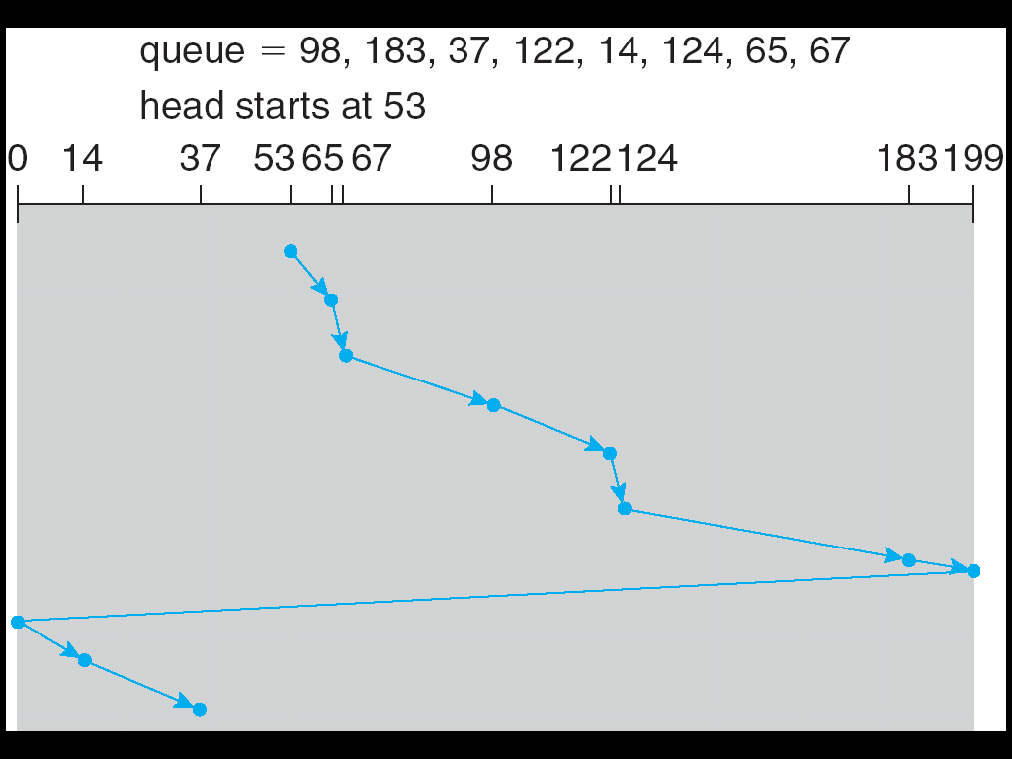
C-SCAN Disk Scheduling
Service requests by moving the disk arm in
one direction only, with wraparound at the end.
  Example: total head movement of 382 cylinders
Include the
wraparound
in the head
movement
calculation.
Operating Systems Concepts, 9th edition
Silberschatz, Galvin, and Gagne
(c) 2013 John Wiley & Sons. All rights reserved. 978-1-118-06333-0

Slide 13
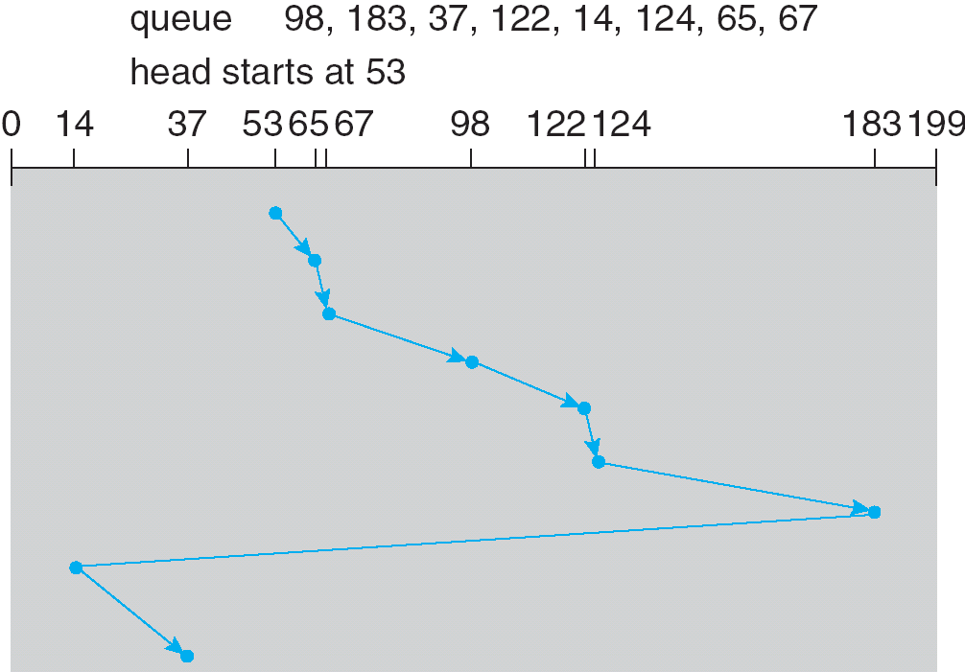
LOOK and C-LOOK Disk Scheduling
Like SCAN and C-SCAN except the disk arm only goes as far as necessary before returning.
  Example: total head movement of 322 cylinders
Operating Systems Concepts, 9th edition
Silberschatz, Galvin, and Gagne
(c) 2013 John Wiley & Sons. All rights reserved. 978-1-118-06333-0

Slide 14
Disk Scheduling Choices
Disk manufacturers implement disk-scheduling algorithms in the controller hardware.
  Take advantage of hardware features.
  The OS sends batches of requests to the controller.
OS scheduling responsibilities
  Some I/O requests are more important than others.
  Demand paging has higher priority than applications.
  The order of disk writes may be important
  for reliability.
  Manage swap space (virtual memory).

Slide 15
Assignment #5
Suppose that a disk drive has 5,000 cylinders, numbered 0 to 4999. The drive is currently serving a request at cylinder 2270, and the previous request was at cylinder 2063.
The queue of pending requests, in FIFO order, is:
2121, 1207, 2303, 2689, 551, 1680, 198, 1403, 4899, 3141
For each of the following disk-scheduling algorithms, starting from the current head position, what is the order of cylinders visited by the head?
What is the total distance (in cylinders) that the disk arm moves to satisfy all the pending requests for each of the following disk-scheduling algorithms?
  FCFS
  SSTF
  SCAN
16 points each,
plus bonus 4 points
if you get them all correct.
  LOOK
  C-SCAN
  C-LOOK

Slide 16
Assignment #5, cont’d
Calculations only – no programming required!
  Hint: Use a spreadsheet.
Email your answers to ron.mak@sjsu.edu
  Subject line:
  CS 149-section number Assignment #5 team name
  CC your partner’s email address so I can “reply all”.
Due Friday, April 10 at 11:59 PM.
_

Slide 17
Hierarchical Storage Management (HSM)
Primary storage
  Main memory
Secondary storage
  Disk
Tertiary storage
  Removable disks and magnetic tape
HSM is often used in supercomputing centers.
  Keep small and frequently used data
  in secondary storage.
  Keep large, old, inactive data in tertiary storage.

Slide 18
RAID
Redundant Array of Independent Disks
Suppose the mean time to failure of a single disk
is 100,000 hours.
  Then the mean time to failure of an array of 100 disks is 100,000/100 = 1000 hours = 41.66 days.

Slide 19
RAID, cont’d
RAID increases reliability by adding redundancy.
Mirroring
  Maintain multiple copies of data.
Striping
  Spread data blocks of a file across multiple disks.
Error correcting codes (ECC)
  Use parity bits and checksums.

Slide 20
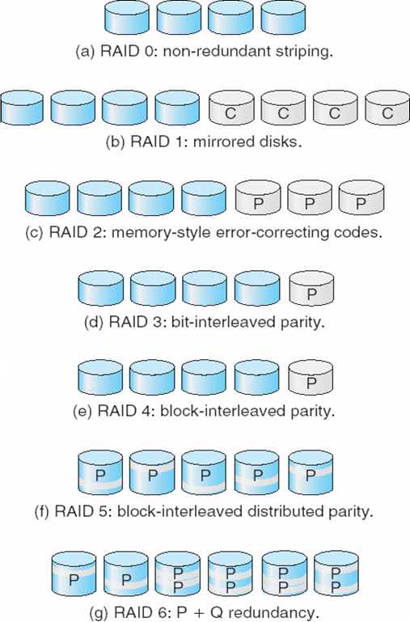
RAID, cont’d
Different levels of RAID have different levels of reliability and performance costs.
  RAID levels 0 through 6
  RAID levels 0+1 and 1+0
Example: 4 disks of data
  P: error-correcting bits
  C: copy of the data
Operating Systems Concepts, 9th edition
Silberschatz, Galvin, and Gagne
(c) 2013 John Wiley & Sons. All rights reserved. 978-1-118-06333-0

Slide 21
RAID, cont’d
RAID tutorial:
http://www.thegeekstuff.com/2010/08/raid-levels-tutorial/
Operating Systems Concepts, 9th edition
Silberschatz, Galvin, and Gagne
(c) 2013 John Wiley & Sons. All rights reserved. 978-1-118-06333-0

Slide 22
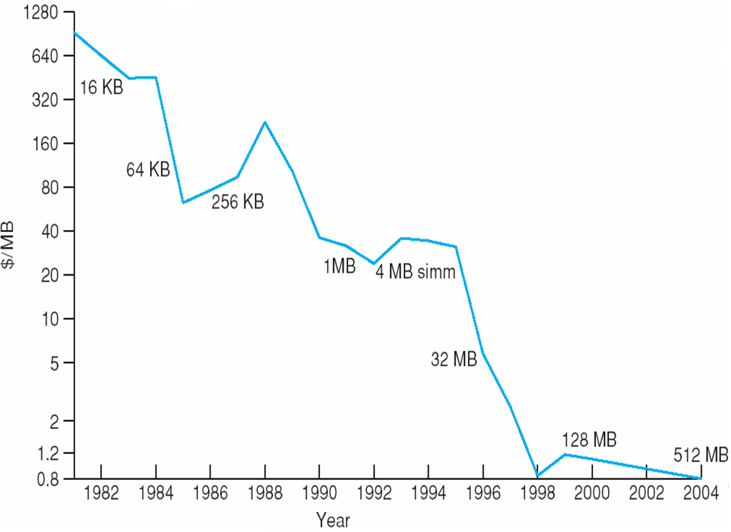
Price per Megabyte of DRAM
Operating Systems Concepts, 9th edition
Silberschatz, Galvin, and Gagne
(c) 2013 John Wiley & Sons. All rights reserved. 978-1-118-06333-0

Slide 23
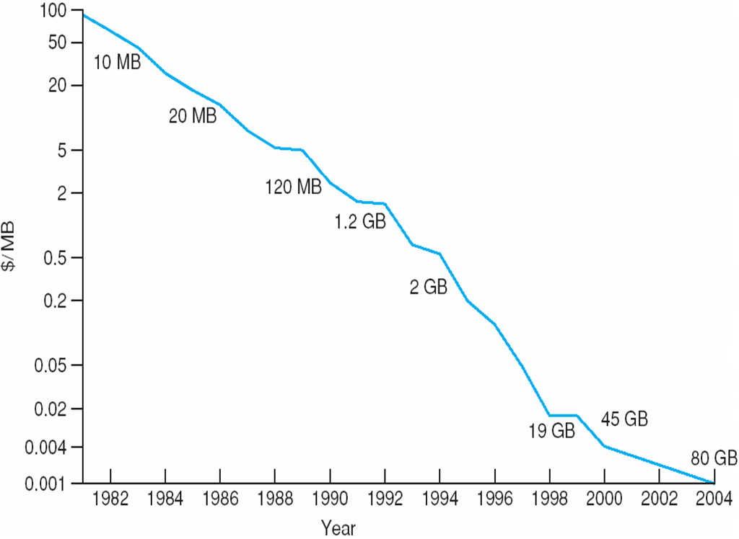
Price per Megabyte of Magnetic Hard Disk
Operating Systems Concepts, 9th edition
Silberschatz, Galvin, and Gagne
(c) 2013 John Wiley & Sons. All rights reserved. 978-1-118-06333-0

Slide 24
File Systems
How we store data on external media
(such as disks).
Three essential requirements for
long-term information storage:
  It must be possible to store a very large amount
  of information.
  Nonvolatile: The information must survive
  the termination of the process using it.
  Concurrent access by multiple processes.

Slide 25
Files
From the user’s and programmer’s perspective, a file is the smallest allotment of secondary storage.
You cannot write data to a disk
unless the data is within a file.

Slide 26
Files, cont’d
The operating system maps files
onto secondary storage.
Generally, you don’t need to worry about
where or how the data is stored.
  You just access the file by its name.
Therefore, the file system is an
abstraction of physical storage.

Slide 27
Types of Files
Most common
  ASCII (text) files
  Binary files
Every operating system must recognize
an executable file that it can load and run.
UNIX: A “magic number” stored at the beginning of the file indicates its type.
Windows: A “file extension”
(a suffix to the file name) indicates the file type.

Slide 28
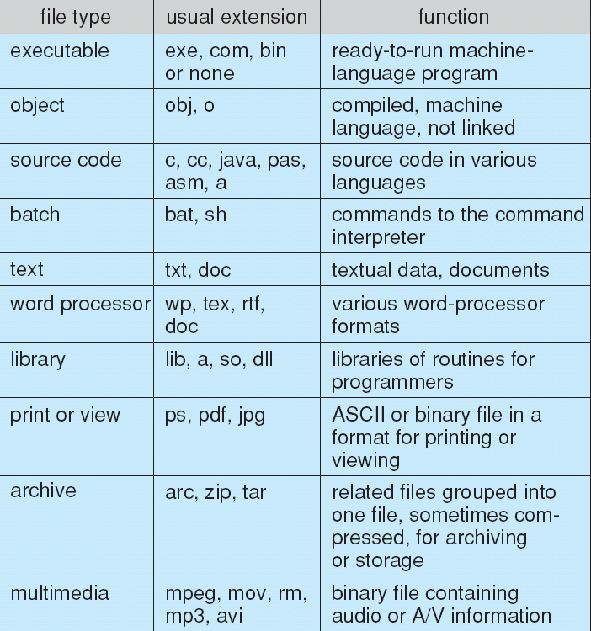
File Types

Slide 29
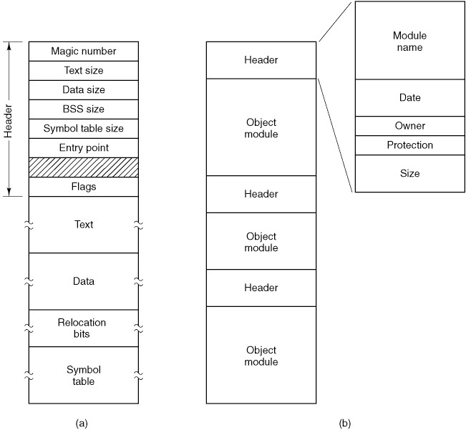
File Types, cont’d
An executable file
Modern Operating Systems, 3rd ed.
Andrew Tanenbaum
(c) 2008 Prentice-Hall, Inc.. 0-13-600663-9
All rights reserved

Slide 30
File Types, cont’d
An archive
(library) file
Modern Operating Systems, 3rd ed.
Andrew Tanenbaum
(c) 2008 Prentice-Hall, Inc.. 0-13-600663-9
All rights reserved

Slide 31
File Attributes (Metadata)
Name: the only human-readable information
Identifier: unique tag (number) identifies file within file system
Type: needed to support different types
Location: pointer to file location on device
Size: current file size
Protection: controls who can do reading,
writing, executing
Time, date, and user identification: data for protection, security, and usage monitoring

Slide 32
File Attributes (Metadata), cont’d
Information about files are kept in the
directory structure maintained on the disk.
Many variations, including
extended file attributes
such as file checksum.

Slide 33
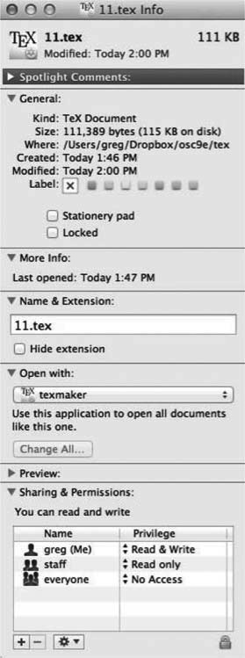
File Attributes, cont’d
Mac OS X file attributes display
Operating Systems Concepts, 9th edition
Silberschatz, Galvin, and Gagne
(c) 2013 John Wiley & Sons. All rights reserved. 978-1-118-06333-0

Slide 34
File Operations
A file is an abstract data type (ADT).
The OS supports various operations on files:
Create
Delete
Open
Close
Read
Write
Append
Seek
Get attributes
Set attributes
Rename
Lock

Slide 35
Opening a File
Most file operations involve an
expensive search of file directories.
Avoid this search by caching in memory
the directory information about a file
when the file is opened.

Slide 36
Open File Table
Contains information about all open files.
When a file is opened, an pointer into this table is returned.
When a file operation is requested,
information about the file is obtained
via the pointer.

Slide 37
Two Levels of Internal File Tables
Per process
  File pointer
    Keep track of the last position read or written
  What files a process has open.
  Access rights and other accounting information.
System wide
  File location, access dates, size, etc.
  File-open count
    Number of times a file is open.
    Allows removal of data from the open-file table
    when the last process using the file closes it.

Slide 38
File Locking
Provided by some operating systems
and file systems.
Mediates access to a file.
Shared lock
  Similar to a reader lock.
  Several processes can acquire concurrently.
Exclusive lock
  Similar to a writer lock.

Slide 39
File Locking, cont’d
Mandatory lock
  Once a process acquires an exclusive lock, the OS prevents any other process from accessing the locked file.
Advisory lock
  Software developers ensure that locks are properly acquired and released.

