Slide 1


CS 149: Operating Systems
March 19 Class Meeting
Department of Computer Science
San Jose State University
Spring 2015
Instructor: Ron Mak
www.cs.sjsu.edu/~mak

Slide 2
Midterm Solution: Question 1
Briefly explain why Round Robin (RR) process scheduling is ideal for interactive systems.
  Good response time
  Fair and consistent

Slide 3
Midterm Solution: Question 2
Briefly describe a situation where, with preemptive Highest Priority First (HPF) process scheduling, a low priority process can block a high priority process.
  The low priority process can hold a non-preemptable resource (such as the printer) needed by the high priority process.
  This situation is called priority inversion.

Slide 4
Midterm Solution: Question 3
Assume the following
processes all arrived
at time 0. In a hard
real-time system, each
process must complete by its deadline.
  Schedule the processes
  so that each one finishes
  the earliest before its
  deadline.
  Timeline:
Process | CPU Burst | Deadline
P0 | 350 | 575
P1 | 125 | 550
P2 | 475 | 1050
P3 | 250 | none
P4 | 75 | 200
Process | Start time | End time
P0 | 200 | 550
P1 | 75 | 200
P2 | 550 | 1025
P3 | 1025 | 1275
P4 | 0 | 75
0
75
200
550
1025
1275
P4
P1
P0
P2
P3

Slide 5
Midterm Solution: Question 4
Briefly describe a situation where an application requires more than one mutex.
  A multithreaded application accesses
  more than one shared resource,
  each of which requires mutual exclusion.
  Therefore, each thread can have multiple
  critical regions, one per shared resource.
  Each critical region needs to be protected
  by a separate mutex.

Slide 6
Midterm Solution: Question 5
Consider the teacher’s office hour multithreaded simulation program.
  Why was it necessary to lock a mutex before printing an event line and then unlock that mutex after printing the line?
    Each event line was constructed
    by multiple calls to printf().
    Without the mutex, events happening simultaneously would cause their printf() calls to be interleaved, causing the event line to be corrupted.

Slide 7
Midterm Solution: Question 5, cont’d
  Suppose Prof. Zemma Fore team-teaches a class with Dr. Wayton Post. They have adjacent offices, and they hold their office hours at the same time for their joint class. Now there are six chairs outside their offices for waiting students.
  Briefly describe what changes you will need to make to the simulation program to accommodate the addition of Dr. Post.
    Increase constant CHAIR_COUNT to 6
    Start a second teacher thread for Dr. Post.
    A student can meet with either Prof. Fore or Dr. Post.

Slide 8
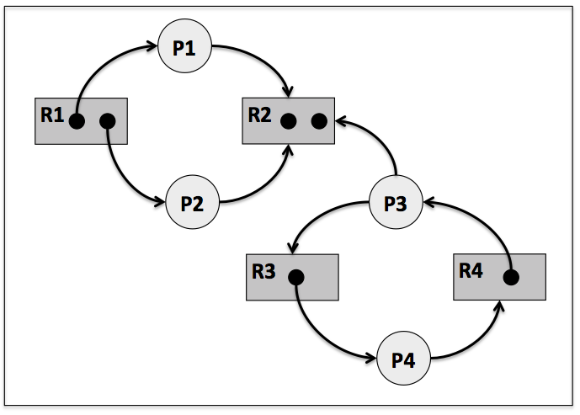
Midterm Solution: Question 6
Consider the following
resource allocation graph.
  Which processes (if any)
  are only temporarily blocked,
  and why?
    Processes P1 and P2 are temporarily blocked.
    Either P1 or P2 (or both at the same time) can acquire
    an R2 resource and complete.
  Which processes (if any) are deadlocked, and why?
    Processes P3 and P4 are deadlocked.
    Each is trying to acquire a resource held by the other.

Slide 9
Midterm Solution: Question 7
  1. Mutual exclusion
  2. Hold and wait
  3. No preemption
  4. Circular wait
Consider the Dining Philosophers
problem with five philosophers, and
the four conditions that must hold
for a deadlock to occur. For each of the following strategies to prevent a deadlock, identify which of the four conditions is it breaking and explain how.
  Philosophers 1 through 4 each acquires the left fork first and then the right fork. Philosopher 5 must first acquire the right fork and then the left fork.
    This imposes an ordering on forks to break circular wait.

Slide 10
Midterm Solution: Question 7, cont’d
  1. Mutual exclusion
  2. Hold and wait
  3. No preemption
  4. Circular wait
  A more senior philosopher can
  take a fork away from a less
  senior neighbor.
    This breaks no preemption.
  A philosopher can acquire the left and right forks
  only if both forks are available.
    No philosopher can grab one fork and then wait for
    another fork. This breaks hold and wait.

Slide 11
Midterm Solution: Question 8
The theoretical optimal page replacement algorithm serves as a bottom-line reference for the other algorithms. Whenever a page fault occurs, it looks ahead into the future and chooses the page that will not be referenced the longest to be the victim. Given the page reference string and the three page frames, fill in the page numbers for the algorithm. Check the circle if a page fault occurred.
Page reference string
0
1
2
3
0
1
2
3
0
1
2
3
4
5
6
7
0
0
0
0
0
0
0
0
0
1
1
1
4
4
4
7
1
1
1
1
1
2
2
2
2
2
2
2
5
5
5
2
3
3
3
3
3
3
3
3
3
3
3
6
6
Check if
page fault
arbitrary choices

Slide 12
Midterm Solution: Question 9
Briefly explain the mechanism by which a 20-bit address in a machine instruction can at run time address a terabyte of physical memory.
  Part of the 20-bit address is an index to a
  page table entry and the rest is an offset into a page.
  The indexed entry in the page table can contain a wide enough address (the starting address of a page frame) that when combined with the offset from the 20-bit address, the effective address can address a terabyte of physical memory.

Slide 13
Midterm Solution: Question 10
Why is a process’s working set only an approximation of the process’s locality?
  A process can have multiple localities
  during its execution.
  The localities can have different sizes (as measured by time or number of page references).
  A working set has a fixed size as determined
  by its Δ parameter.

Slide 14
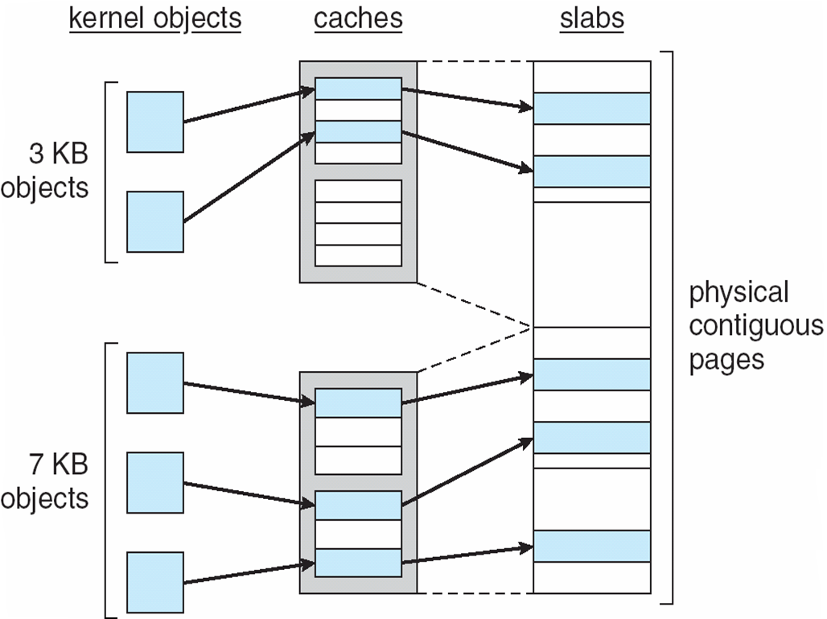
Linux Kernel Memory Allocation, cont’d
Object caches consist
of pointers to one or more
slabs which can store a
number of objects of the
same type.
Operating Systems Concepts, 9th edition
Silberschatz, Galvin, and Gagne
(c) 2013 John Wiley & Sons. All rights reserved. 978-1-118-06333-0

Slide 15
Operating System Design Goals
Define the right abstractions
  Processes and threads
  Semaphores and mutexes
  Virtual memory
  File systems
  Pipes

Slide 16
Operating System Design Goals, cont’d
Provide primitive operations
  System calls
  Start and stop processes and threads
  Signal and wait
  Read and write files

Slide 17
Operating System Design Goals, cont’d
Ensure isolation
  Handle multiple users
  Protection mechanisms
  Isolate faults
Manage the hardware
  I/O devices
  Memory management unit
  Interrupt controllers

Slide 18
Design Challenges
Operating systems live for a very long time.
Operating systems have become
extremely large.
Designers need to provide for
considerable generality.
  No one can predict how systems will be used.
Need to be portable and run
on different platforms.

Slide 19
Design Challenges
Need to be backward compatible
with some previous operating system.
Must deal with concurrency.
Must deal with potentially hostile users.
Many users want to share some of their information and resources with selected
other users.

Slide 20
Principles for Interface Design
Simplicity
  Perfection is reached not when there is no longer anything to add, but when there is no longer anything to take away. Antoine de St. Exupery
Completeness
  Everything should be as simple as possible,
  but no simpler. Albert Einstein
Efficiency
  If a feature or system call cannot be implemented efficiently, it is probably not worth having. Tanenbaum

Slide 21
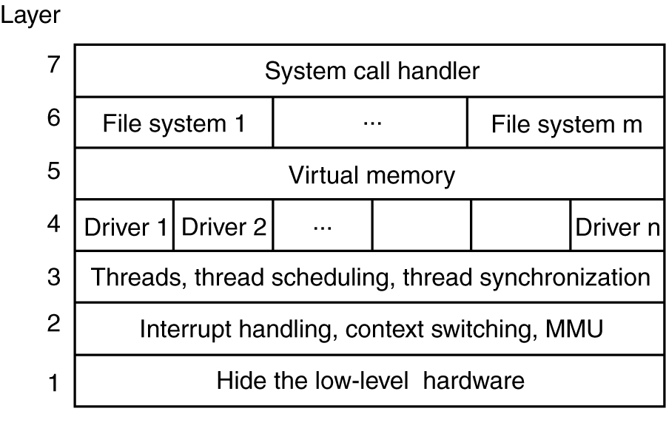
A Layered OS Architecture
A possible design for a modern layered operating system.
Modern Operating Systems, 3rd ed.
Andrew Tanenbaum
(c) 2008 Prentice-Hall, Inc.. 0-13-600663-9
All rights reserved

Slide 22
Hide the Low-Level Hardware
Hide word-length dependencies during compilation:
#include "config.h"
init( )
#if (CPU = PENTIUM)
...
#endif
#if (CPU = SPARC)
...
#endif
#include "config.h"
#if (WORD_LENGTH == 32)
typedef int Register
#endif
#if (WORD_LENGTH == 64)
typedef long Register
#endif
Register R0, R1, R3;

Slide 23
Performance
Why are operating systems slow?
What should be optimized?
Space-time tradeoffs
Caching
Exploiting locality
Optimize the common case

Slide 24
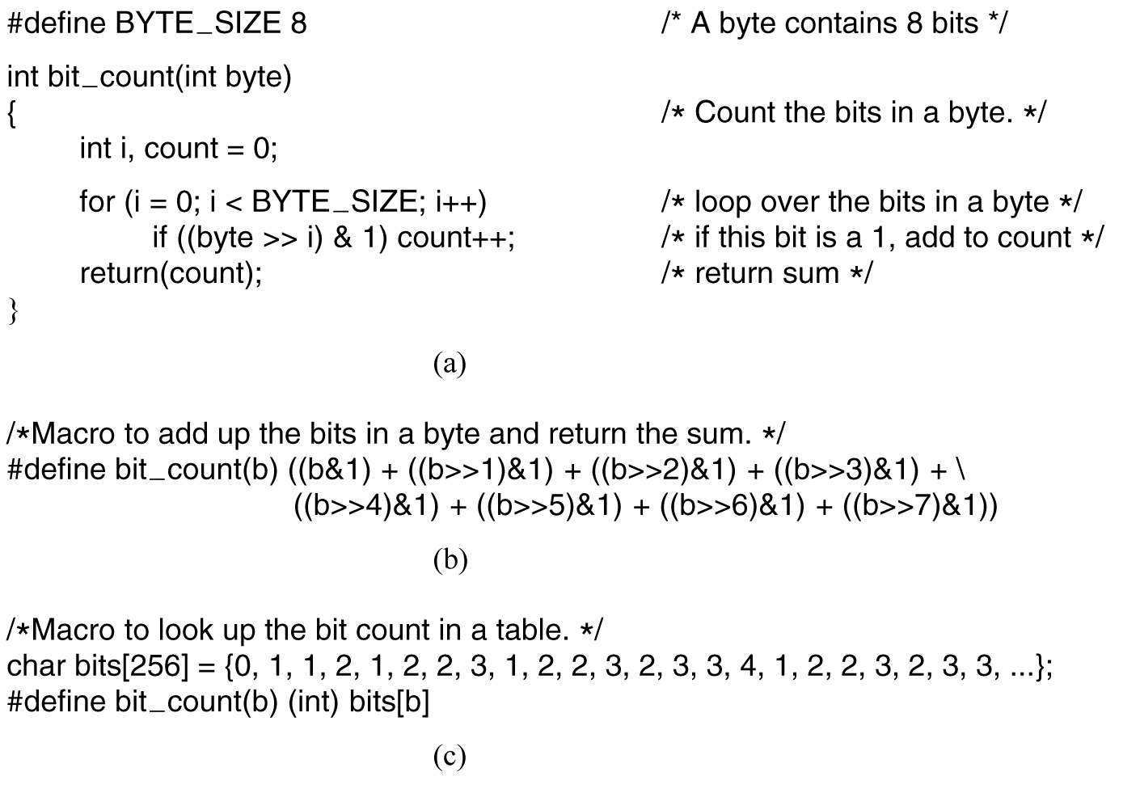
Example Space-Time Tradeoff
Count bits in a byte:
Procedure
Macro
Table lookup
Modern Operating Systems, 3rd ed.
Andrew Tanenbaum
(c) 2008 Prentice-Hall, Inc.. 0-13-600663-9
All rights reserved

Slide 25
Lessons from The Mythical Man Month
The classic book about designing OS/360
for a large IBM mainframe computer during
the mid 1960s.
  http://www.amazon.com/Mythical-Man-Month-Software-Engineering-Anniversary/dp/0201835959/ref=sr_1_1?s=books&ie=UTF8&qid=1395217138&sr=1-1&keywords=mythical+man+month
Large project design
  1/3 planning
  1/6 coding
  1/4 module testing
  1/4 system testing

Slide 26
Lessons from The Mythical Man Month
People and time not interchangeable.
  Work cannot be fully parallelized.
  Work must be partitioned into large numbers
  of modules.
  Debugging is highly sequential.
“Adding manpower to a
late software project
makes it later.”

Slide 27
Operating System Trends
Virtualization
Multicore chips
Large address space
Networking
Parallel and distributed systems
Multimedia
Mobile computers
Embedded systems
Sensor networks

