Slide 1


CS 149: Operating Systems
March 5 Class Meeting
Department of Computer Science
San Jose State University
Spring 2015
Instructor: Ron Mak
www.cs.sjsu.edu/~mak

Slide 2
Internal or External Fragmentation?
Variable-sized partitions
Entire processes occupy contiguous partitions
of physical memory.
Fixed-sized page frames
Parts of processes occupy page frames distributed throughout physical memory.
P3
P1
P2
P3
P2
P1
P
3
P2
P
1
P
2
P1

Slide 3
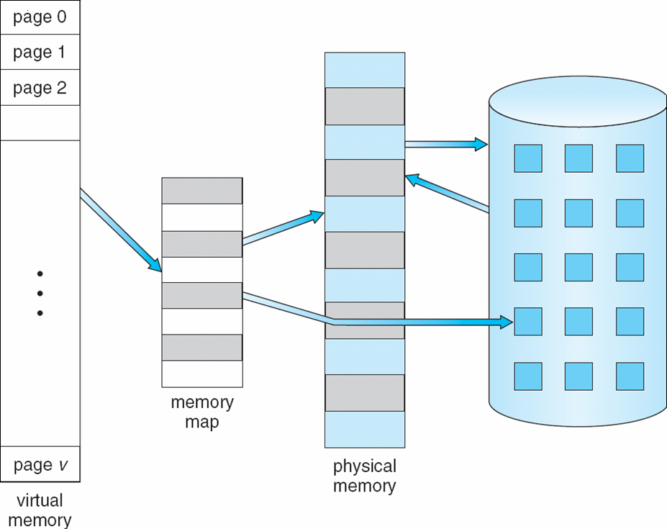
Virtual Memory
Use paging to create virtual memory that is
larger than physical memory.
Operating Systems Concepts with Java, 8th edition
Silberschatz, Galvin, and Gagne
(c) 2010 John Wiley & Sons. All rights reserved. 0-13-142938-8

Slide 4
Demand Paging
Unlike swapping, not all of a program
needs to be loaded into memory at once.
Only load program pages when needed.
Pages that are never accessed
are never loaded.

Slide 5
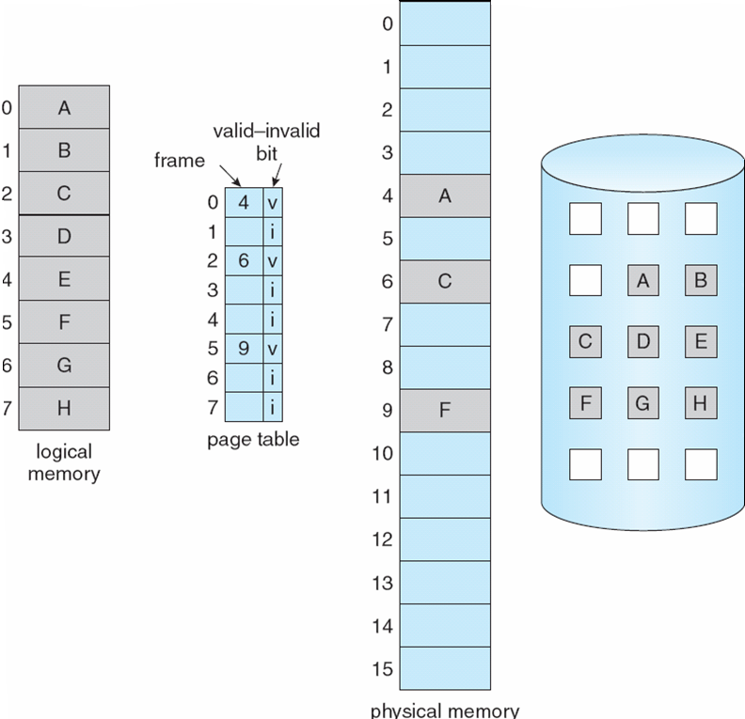
Demand Paging, cont’d
Operating Systems Concepts with Java, 8th edition
Silberschatz, Galvin, and Gagne
(c) 2010 John Wiley & Sons. All rights reserved. 0-13-142938-8

Slide 6
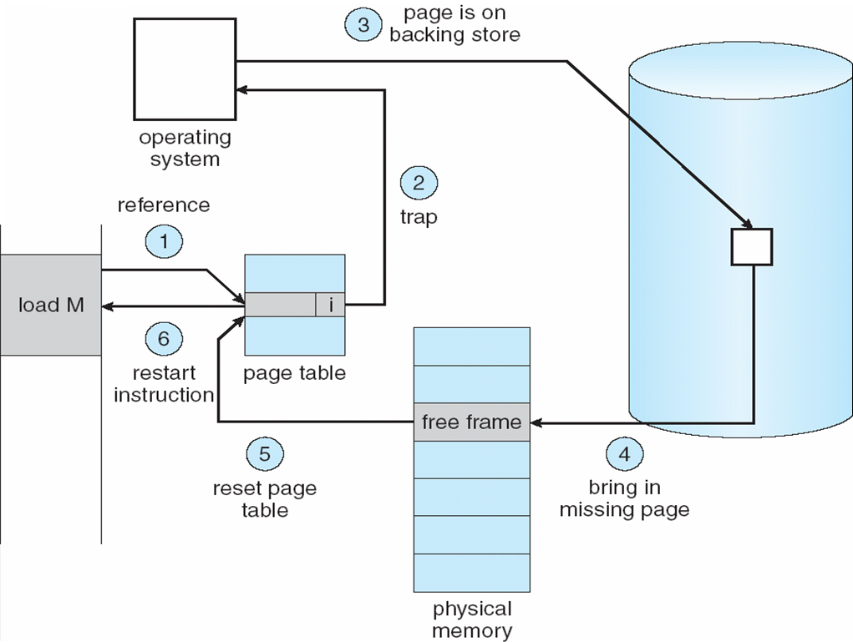
Page Fault
A page fault occurs
whenever a program
tries to access
a page that is
not currently
in memory.
Operating Systems Concepts with Java, 8th edition
Silberschatz, Galvin, and Gagne
(c) 2010 John Wiley & Sons. All rights reserved. 0-13-142938-8

Slide 7
Copy-on-Write
After a call to fork()
  Both parent and child share
  the same pages in memory.
  Recall that we said that after forking, the parent
  and child processes have separate memory.
As soon as one process attempts
to modify a page:
  A copy of the page is created.
  The copied page is mapped into the address space of the process that wants to write to the page.

Slide 8
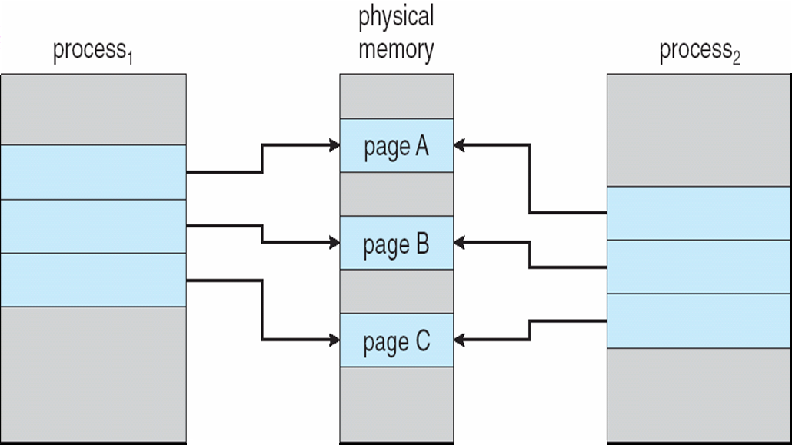
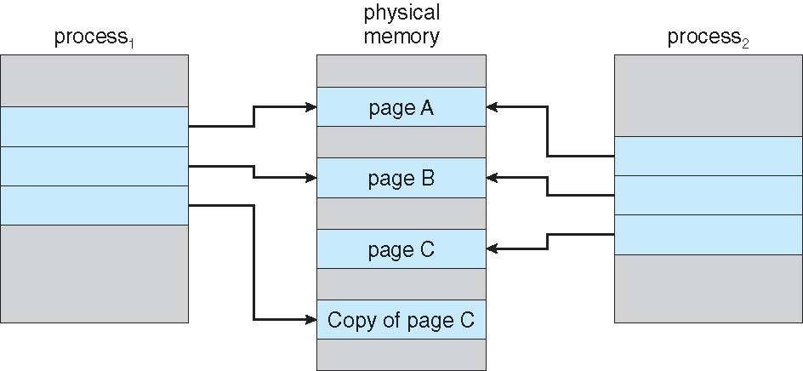
Copy-on-Write, cont’d
Just after the
fork() call:
After process₁ has
written to page C:
Operating Systems Concepts with Java, 8th edition
Silberschatz, Galvin, and Gagne
(c) 2010 John Wiley & Sons. All rights reserved. 0-13-142938-8

Slide 9
Page Replacement
When a page fault occurs, the operating system must choose a “victim” page to evict from memory to make room for the page to be loaded from disk.
If the victim page has not been modified,
then its copy on disk is up-to-date.

Slide 10
Page Replacement
If the victim page has been modified,
then the page must be written to disk.
  Overwrite the old page.
Which page should be evicted from memory?
  Several algorithms to decide.

Slide 11
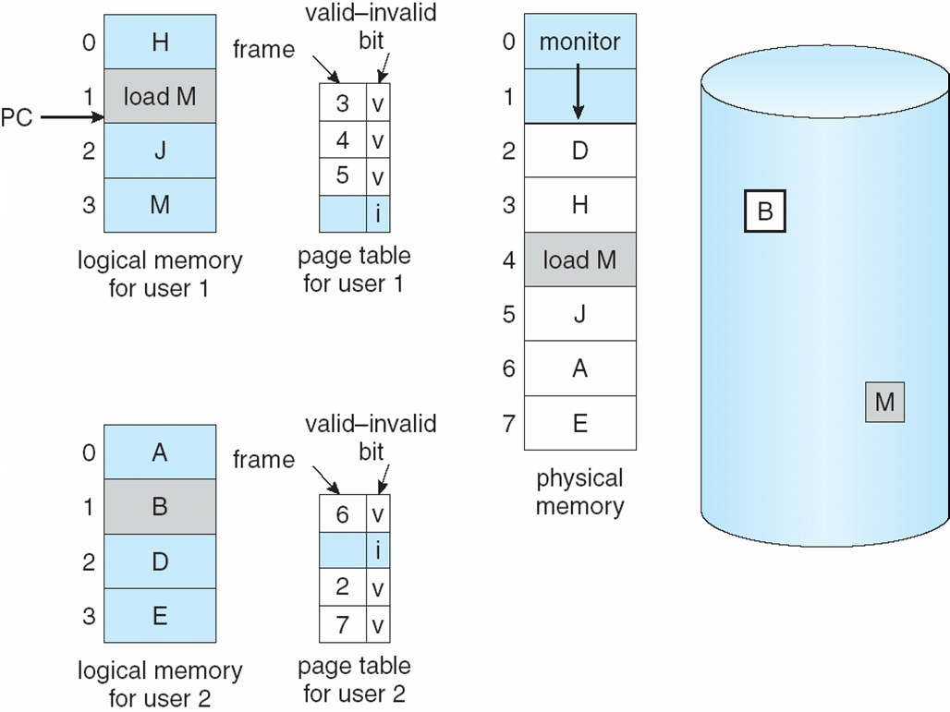
Page Replacement, cont’d
No room to load page B.
Operating Systems Concepts with Java, 8th edition
Silberschatz, Galvin, and Gagne
(c) 2010 John Wiley & Sons. All rights reserved. 0-13-142938-8

Slide 12
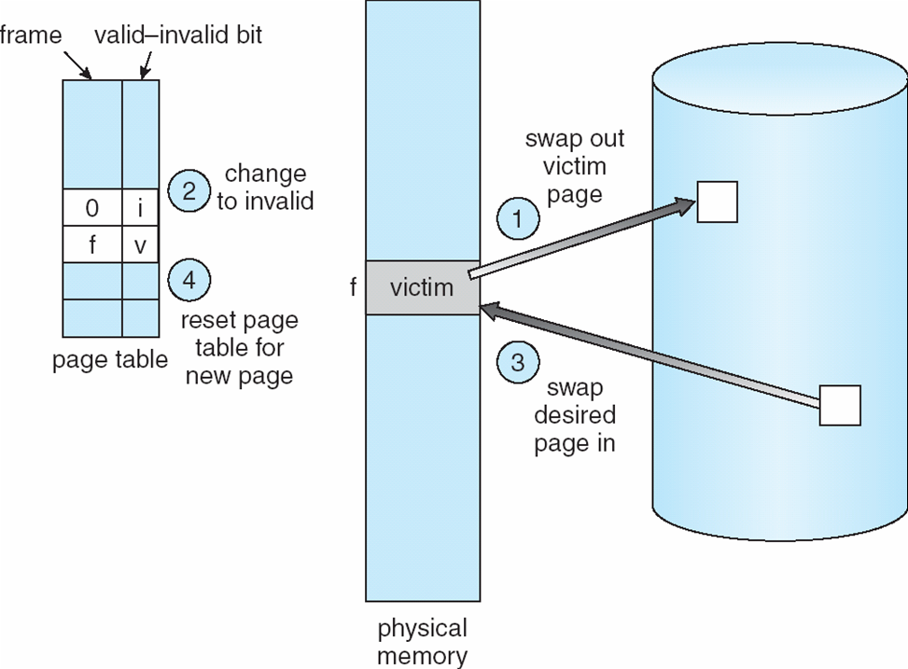
Page Replacement, cont’d
Operating Systems Concepts with Java, 8th edition
Silberschatz, Galvin, and Gagne
(c) 2010 John Wiley & Sons. All rights reserved. 0-13-142938-8

Slide 13
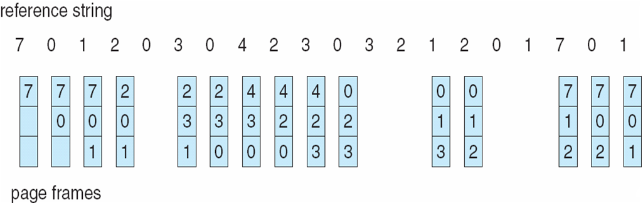
First-In, First-Out (FIFO)
Pages are evicted from memory in the order
that they were loaded into memory.
Operating Systems Concepts with Java, 8th edition
Silberschatz, Galvin, and Gagne
(c) 2010 John Wiley & Sons. All rights reserved. 0-13-142938-8

Slide 14
Second Chance
Modification of FIFO.
Before evicting the oldest page,
check its reference bit.
If the page is not being referenced, evict it.
If it is being referenced, put it back at the tail of the queue as if it were a new page just loaded (the second chance).
  Clear the reference bit.
  Reset its load time to the current time.
Modern Operating Systems, 3rd ed.
Andrew Tanenbaum
(c) 2008 Prentice-Hall, Inc.. 0-13-600663-9
All rights reserved

Slide 15
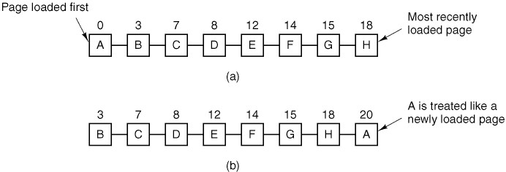
Second Chance, cont’d

Slide 16
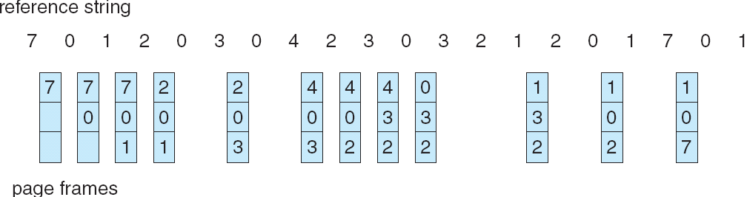
Least Recently Used (LRU)
The victim page is the one that
hadn’t been referenced the longest.
Need to keep track of the time
when each page was last referenced.
Operating Systems Concepts with Java, 8th edition
Silberschatz, Galvin, and Gagne
(c) 2010 John Wiley & Sons. All rights reserved. 0-13-142938-8

Slide 17
Least Frequently Used (LFU)
Evict the page that has the lowest use count.
Problems:
  If a page was heavily used at the beginning of a program’s execution, it may stay in memory
  even if it’s never referenced again.
  A page that was just loaded may be the least frequently used page. Reference locality says it will be used again soon.

Slide 18
Most Frequently Used (MFU)
Evict the page that has the highest use count.
Pages with the smallest use count probably just got loaded, and they will be used again soon.

Slide 19
Random Pick
Randomly pick a page to evict.
This can have surprisingly good results.

Slide 20
Working Set
The set of pages a process is currently using.
If a process’s working set can fit in memory,
there will be few page faults.
Operating Systems Concepts with Java, 8th edition
Silberschatz, Galvin, and Gagne
(c) 2010 John Wiley & Sons. All rights reserved. 0-13-142938-8

Slide 21
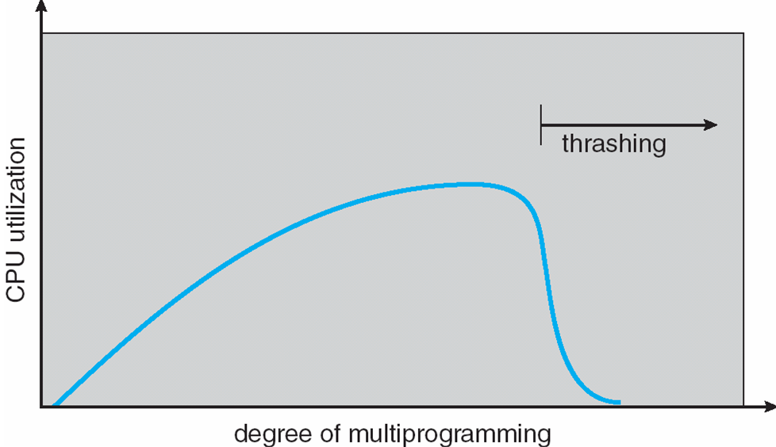
Thrashing
A process’s working set cannot fit
into available memory.
  Many page faults – one every few instructions.
Pages are constantly being
loaded and evicted.
  Disk I/O is very slow
  compared to the speed
  of the CPU.
  The process spends
  more time paging
  than executing.
Operating Systems Concepts with Java, 8th edition
Silberschatz, Galvin, and Gagne
(c) 2010 John Wiley & Sons. All rights reserved. 0-13-142938-8

Slide 22
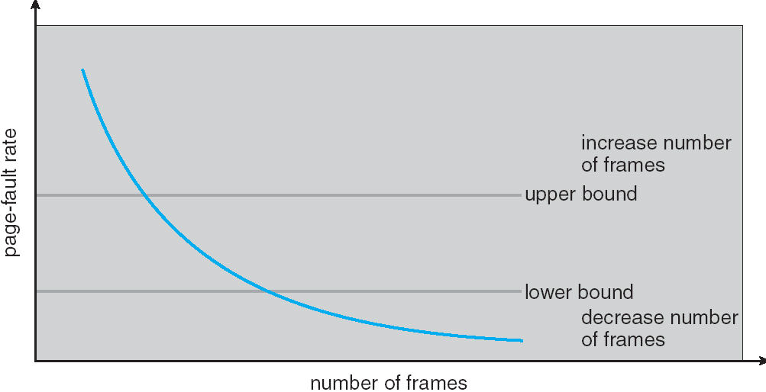
Page Fault Frequency (PFF)
To prevent thrashing, we need to control the
page fault frequency (PFF) of a process.
  Too high: The process needs more page frames,
  or it will thrash.
  Too low: The process has too many page frames.
Operating Systems Concepts with Java, 8th edition
Silberschatz, Galvin, and Gagne
(c) 2010 John Wiley & Sons. All rights reserved. 0-13-142938-8

Slide 23
Assignment #4
The purpose of this assignment is to explore
  Memory allocation algorithms for swapping.
  Page replacement algorithms for paging.
Write a series of small simulation programs
in either Java, C, or C++ (your choice).
  As in Assignment #2, you will generate
  simulated processes.
  You should not need to make any
  process management system calls.

Slide 24
Assignment #4: Swapping
Main memory has 100 MB for swapping
with variable sized partitions.
Processes have randomly and evenly distributed
  Sizes of 5, 11, 17, or 31 MB.
  Durations of 1, 2, 3, 4, or 5 seconds.
The process scheduler uses FCFS.
Write one or more programs that simulate the first fit, next fit, best fit, and worst fit memory allocation algorithms. It’s a busy time, so randomly generate enough simulated processes so that the job queue is never empty.

Slide 25
Assignment #4: Swapping, cont’d
Run each algorithm 5 times simulating 1 minute each time to get an average of the number of processes successfully swapped into memory (but not necessarily completed) during the minute.
  Generate new random processes before each run.
Each time a process is swapped in or completes (and therefore is removed from memory), print a memory map of physical memory, e.g., AAAA....BBBBBBBB..CCCC where the letters are the process names
(one letter per MB) and the dots are holes
(one dot per MB).

Slide 26
Assignment #4: Swapping, cont’d
There is no memory compaction.
For each algorithm, print the average number of processes that were successfully swapped in.
Extra credit (up to 10 points)
  Rerun all your algorithms, but this time,
  after 30 (simulated) seconds, you can do
  one memory compaction.
  On average for each algorithm, how many MB
  were copied during compaction?

Slide 27
Assignment #4: Paging
You are running a process that consists of 10 pages numbered 0 through 9.
Physical memory has 4 page frames.
There are 10 page frames always available
on disk.
The process makes random references to its pages. Due to locality of reference, after referencing a page i, there is a
70% probability that the next reference
will be to page i, i-1, or i+1.

Slide 28
Assignment #4: Paging, cont’d
In other words, there is a 70% probability that for a given i, Δi will be -1, 0, or +1.
Otherwise, |Δi| > 1.
TIP: Given page reference i, to compute the next page reference, first generate a random number r from 0 through 9.
  If 0 ≤ r < 7, then generate a
  random Δi to be -1, 0, or +1.
  If 7 ≤ r ≤ 9, then randomly generate 2 ≤ Δi ≤ 8.
  The next value of i is i + Δi. The value of i wraps around from 9 to 0.

Slide 29
Assignment #4: Paging, cont’d
Simulate the page replacement algorithms FIFO, LRU, LFU, MFU and random pick.
Run each algorithm 5 times, 100 page references each time, to compute an
average hit ratio of pages already in memory.
For each reference, print the page numbers of the pages in memory and (if any) which page needed to be paged in and which page was evicted. Print the size and duration of a new entering process.
When the process starts, none of its pages
are in memory.

Slide 30
Assignment #4: Paging, cont’d
Your output for each run could look like:
It may be easier to pivot this output so that time and the references go down the page and you print the page frames horizontally.
  Print also on each line which page was loaded and which page was evicted, if any.

Slide 31
Assignment #4, cont’d
Email to ron.mak@sjsu.edu a zip file named after your team that contains:
  Your source files.
  Your output.
  A short report describing your results.
    Note clearly in your report if you did the extra credit.
Subject line:
CS 149-section Assignment #4 team name
  Don’t forget to CC all your team members.
Due: Friday, March 20.

