Slide 1


CS 149: Operating Systems
February 26 Class Meeting
Department of Computer Science
San Jose State University
Spring 2015
Instructor: Ron Mak
www.cs.sjsu.edu/~mak

Slide 2
Memory Hierarchy
Small amount of very fast, expensive,
volatile cache memory.
  volatile: contents disappear when the power goes off
Gigabytes of medium-speed, medium-price,
volatile main memory.
  RAM: random access memory
Gigabytes or terabytes of slow, cheap,
non-volatile disk storage.

Slide 3
Memory/Storage Speed Comparisons
Suppose your computer ran at human speeds.
  1 CPU cycle: 1 second
Then the time to retrieve one byte from:
  SRAM
    5 seconds
  DRAM
    2 minutes
  Flash
    1 day
  Hard drive
    2 months
  Tape
    1,000 years

Slide 4
Memory Manager
The memory manager manages
the memory hierarchy.
  Resides in the OS kernel.
Keep track of which parts of memory are in use.
Allocate memory to processes.
Deallocate the memory
when the processes complete.
Swap the contents of main memory to and from disk when main memory isn’t large enough to hold all the active processes.

Slide 5
Memory Manager, cont’d
Today’s mobile devices and embedded systems
can use simple memory management schemes
from the old mainframe days.
Run one application at a time.
  Share memory between the program and the OS.

Slide 6
Monoprogramming Systems
Three models:
  OS resides at the “bottom” of main memory.
    Formerly used by mainframes and minicomputers.
    Rarely used today.
  OS resides in read-only memory (ROM)
  at the top of main memory.
    Used by some mobile devices and embedded systems.
  Part of the OS resides in main memory,
  some parts such as device drivers reside in ROM.
    Early PCs: DOS in RAM and the
    Basic Input Output System (BIOS) in ROM.

Slide 7
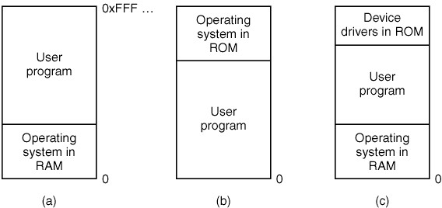
Monoprogramming Systems, cont’d
Modern Operating Systems, 3rd ed.
Andrew Tanenbaum
(c) 2008 Prentice-Hall, Inc.. 0-13-600663-9
All rights reserved

Slide 8
Multiprogramming with Fixed Partitions
Modern OS’s allow multiple processes
to run at the same time.
  An easy memory management scheme is to
  divide main memory into fixed-size
  (possibly unequal-sized) partitions.
  Partition sizes and boundaries can be configured.
When a process is scheduled to execute,
it is entered into the queue for the smallest memory partition large enough to hold it.
  Any memory left over in the partition is wasted.

Slide 9
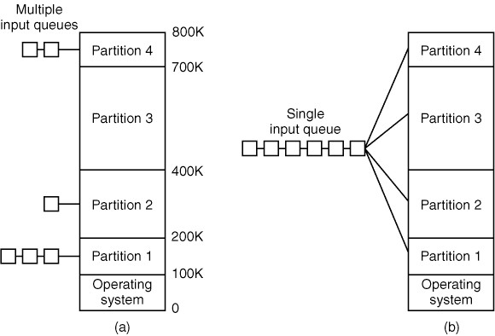
Multiprogramming Fixed Partitions, cont’d
What’s inefficient about this scheme?
  If a larger partition is available but processes are queued
  for a smaller partition,
  the available partition isn’t used.
Modern Operating Systems, 3rd ed.
Andrew Tanenbaum
(c) 2008 Prentice-Hall, Inc.. 0-13-600663-9
All rights reserved

Slide 10
Multiprogramming Fixed Partitions, cont’d
Use a single queue for all memory partitions.
  When a partition becomes free, search the queue for a process that can best use
  the partition size.
Smaller processes
may starve.
  Always have small partitions available.
  Use an aging algorithm.
Modern Operating Systems, 3rd ed.
Andrew Tanenbaum
(c) 2008 Prentice-Hall, Inc.. 0-13-600663-9
All rights reserved

Slide 11
Process Relocation
How can the OS enable processes
to run in any part of main memory?
Compiled programs can refer to
memory addresses.
You generally do not want a process
to be able to run only at specific
memory addresses.

Slide 12
Process Relocation Solutions
Whenever a process is loaded into main memory, modify all the addresses used by the code.
  No longer done on today’s computer systems.
Base and limit registers in the hardware.
  Whenever a process is loaded, put the address of the
  start of its partition in the process’s base register and the size of the partition in the limit register.
  All memory references by the process are
  relative to the base register and checked against
  the limit register.
  Slows down each memory reference.

Slide 13
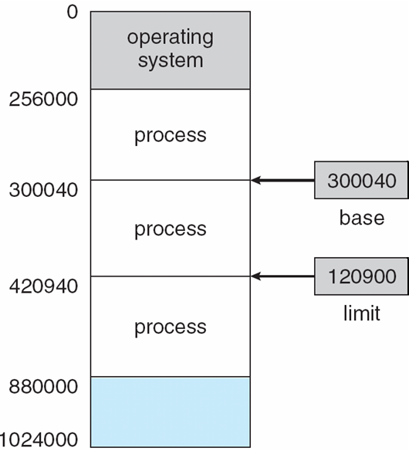
Process Relocation Solutions, cont’d
Operating Systems Concepts with Java, 8th edition
Silberschatz, Galvin, and Gagne
(c) 2010 John Wiley & Sons. All rights reserved. 0-13-142938-8

Slide 14
Process Protection
The OS protects processes from each other.
  Do not allow the code of one process to access
  the memory of another process.
  Unless the processes have agree to use
  shared memory.
Old mainframe technique:
  Divide main memory into blocks.
  Assign a protection code to each block.
  Each process uses a key code that allows the process to access memory blocks with only
  certain protection codes.

Slide 15
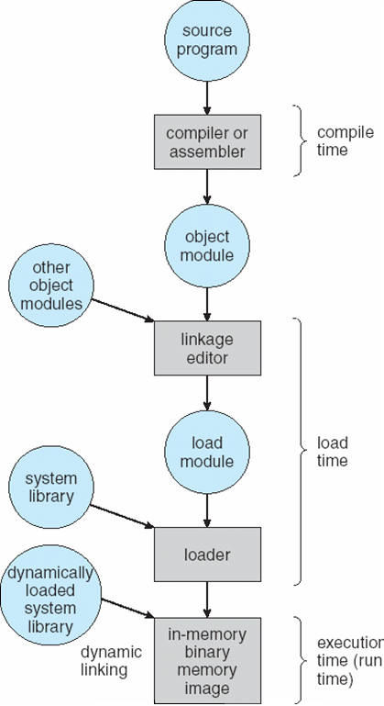
Address Binding
Operating Systems Concepts with Java, 8th edition
Silberschatz, Galvin, and Gagne
(c) 2010 John Wiley & Sons. All rights reserved. 0-13-142938-8

Slide 16
Address Binding, cont’d
A programming language compiler will bind
symbolic addresses used in a program to
relocatable addresses.

Slide 17
Address Binding, cont’d
Example: The memory location of variable X
is 24 bytes from the beginning of the code module.
  The “address” 24 is relocatable because
  it’s relative to the start of the code module.
At run time, the code module can be
placed anywhere in main memory,
but variable X will always be 24 bytes
from the beginning of the module.

Slide 18
Compile-Time Binding
Suppose it is known at program compile time exactly where in physical main memory the program will run.
The compiler can generate absolute code with physical memory addresses.
If the program needs to run elsewhere in main memory, it will have to be recompiled.

Slide 19
Load-Time Binding
The compiler generates relocatable code.
Final address binding is delayed until load time.
If the starting address changes,
just reload the program to incorporate
the changed address.

Slide 20
Execution-Time Binding
Special hardware enables a process
to move during its execution from one
memory segment to another.
Most general-purpose operating systems
use this feature.

Slide 21
Logical vs. Physical Address Space
Logical address (AKA virtual address)
  A memory address generated by the CPU
  while a process is running.
Physical address
  A memory address seen by the memory manager,
  such as in the memory-address register.

Slide 22
Logical vs. Physical Address Space, cont’d
Logical address space
(AKA virtual address space)
  The set of all logical addresses generated by a program.
Physical address space
  The set of all physical addresses
  corresponding to the logical addresses.
Memory-management unit (MMU)
  A hardware device that does the runtime mapping
  from virtual to physical address.

Slide 23
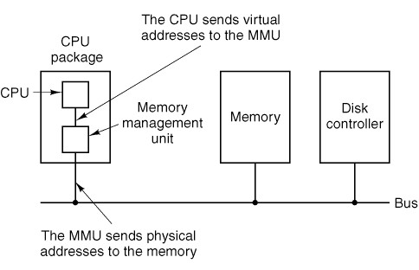
Logical vs. Physical Address Space, cont’d
Modern Operating Systems, 3rd ed.
Andrew Tanenbaum
(c) 2008 Prentice-Hall, Inc.. 0-13-600663-9
All rights reserved

Slide 24
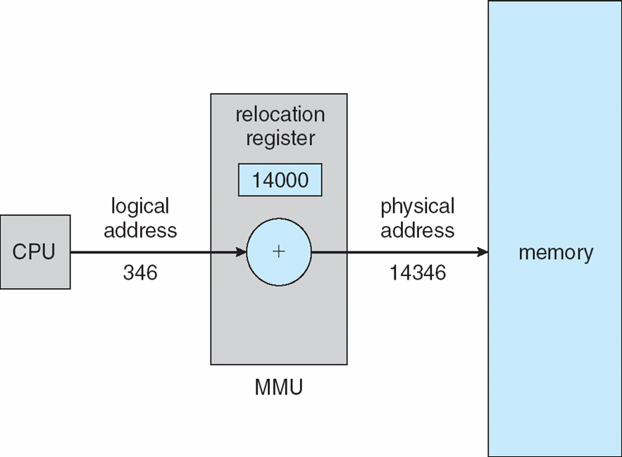
Logical vs. Physical Address Space, cont’d
Dynamic relocation using a relocation register.
Operating Systems Concepts with Java, 8th edition
Silberschatz, Galvin, and Gagne
(c) 2010 John Wiley & Sons. All rights reserved. 0-13-142938-8

Slide 25
Dynamic Loading
Dynamic loading allows only part of a program
to be loaded into memory at run time.
Routines are kept on disk as relocatable code.
A routine is not loaded until it’s called.

Slide 26
Dynamic Loading, cont’d
When a routine (already in memory)
calls another routine:
  The caller first checks if the desired routine
  is already in memory.
  If not, the relocatable linking loader loads the
  desired routine into memory and updates the process’s address tables.
  Then control passes to the newly loaded routine.

Slide 27
Dynamic Linking
Dynamically linked libraries contain routines
that are not linked to programs until run time.
Each program no longer needs to statically link
to its own copy of the library routines.
Saves disk and memory space.
Microsoft Windows: DLLs

Slide 28
Dynamic Linking, cont’d
A program that calls a dynamically linked library routine contains a stub for the routine.
The stub serves as a proxy for the library routine.
It appears to the program to be
the library routine itself.
At run time, the stub can load and link
to the library routine.

Slide 29
Dynamic Linking, cont’d
This is a good way to issue software updates.
Just issue a new version of the dynamically linked library.
Programs that use the library routines don’t need to recompile if the new library version is compatible with the old version.

Slide 30
Swapping
What if there isn’t sufficient main memory to hold all the currently active processes?
Swapping: The process scheduler works with the memory manager to load a process in its entirety from disk into main memory before the process can execute.

Slide 31
Swapping, cont’d
Whenever the process blocks, the process scheduler and memory manager can decide to write the entire process back onto disk.
Free up the process’s memory resources
to be available for other processes.
Swapping requires a backing store,
usually a very fast hard disk.

Slide 32
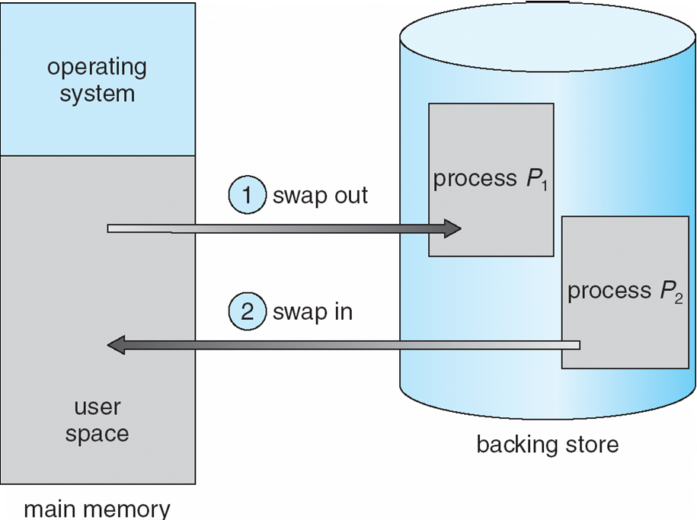
Swapping, cont’d
Operating Systems Concepts with Java, 8th edition
Silberschatz, Galvin, and Gagne
(c) 2010 John Wiley & Sons. All rights reserved. 0-13-142938-8

Slide 33
Swapping, cont’d
The OS maintains a ready queue of processes
whose memory images are either
  On the backing store, or
  Already in main memory and are ready to run.

Slide 34
Swapping, cont’d
Whenever the process scheduler decides
to execute a process, it calls the dispatcher.
  The dispatcher checks whether the next process
  in the ready queue is in memory.
  If the process is not in memory and main memory
  is already full, the dispatcher can swap out a process currently in memory and swap in the desired process.
Context-switch time can be very expensive.
  Swapping is disk I/O.

Slide 35
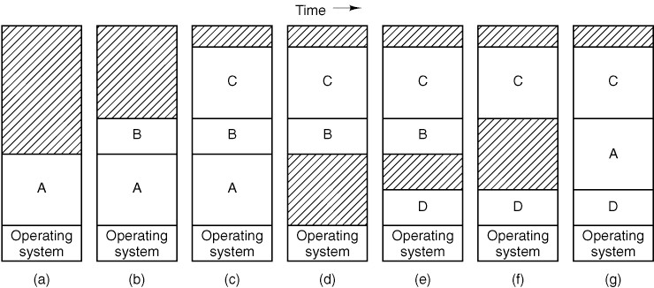
Variable Partition Scheme
The number, location, and sizes of the partitions
vary dynamically as processes come and go.
  More flexible than fixed partitions,
  but more complex to manage.
Modern Operating Systems, 3rd ed.
Andrew Tanenbaum
(c) 2008 Prentice-Hall, Inc.. 0-13-600663-9
All rights reserved

Slide 36
Memory Compaction
Swapping can create multiple “holes”
in main memory.
Memory compaction can occur in order to
slide processes over to eliminate the holes.
  Similar to garbage collection by
  the Java Virtual Machine.
Compaction time may be disruptive to some applications, especially real-time applications that can’t tolerate interruptions.

Slide 37
Memory Demands
A process may demand more memory
during execution.
  Its data segment, stack, or both may grow.
  Allocate memory to a process with extra “headroom”.
If a process requests more main memory but none is available and the swap area on disk is full, the process must block waiting for memory to become available, or be killed by the OS.

Slide 38
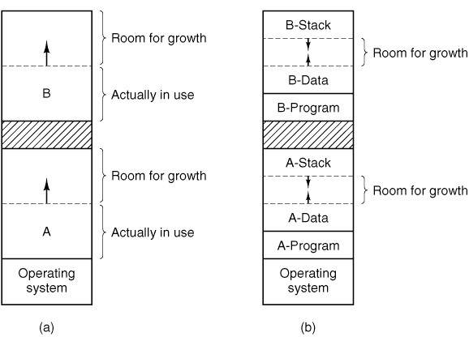
Memory Demands, cont’d
Modern Operating Systems, 3rd ed.
Andrew Tanenbaum
(c) 2008 Prentice-Hall, Inc.. 0-13-600663-9
All rights reserved

Slide 39
Keeping Track of Memory
The memory manager must keep track of which parts of main memory are currently allocated to processes and which parts are free.
Bitmaps can keep track of which allocation units
are allocated and which are free.
  0 = free unit
  1 = allocated unit

Slide 40
Keeping Track of Memory, cont’d
The size of an allocation unit is an
important computer system design issue.
A smaller unit size allows finer granularity
in allocating memory to processes, but the bitmaps need to be larger.
A larger unit size means smaller bitmaps,
but more wasted memory when the amount of memory requested by a process is not a multiple of the allocation unit size.

Slide 41
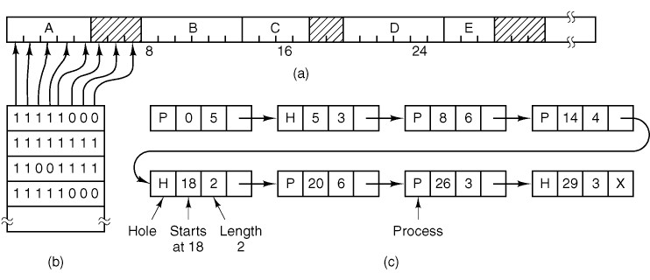
Keeping Track of Memory, cont’d
The memory manager can maintain either a bitmap or a linked list of allocated and free memory segments.
  A segment is either a process
  or a hole between processes.
Modern Operating Systems, 3rd ed.
Andrew Tanenbaum
(c) 2008 Prentice-Hall, Inc.. 0-13-600663-9
All rights reserved

Slide 42
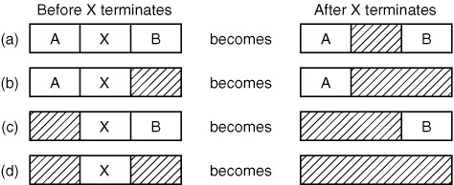
Keeping Track of Memory, cont’d
A linked list entry changes from “process” to “hole” when the process terminates.
Two adjacent hole entries can coalesce
into a single entry for a (larger) hole.
Modern Operating Systems, 3rd ed.
Andrew Tanenbaum
(c) 2008 Prentice-Hall, Inc.. 0-13-600663-9
All rights reserved

