Slide 1


CS 149: Operating Systems
February 5 Class Meeting
Department of Computer Science
San Jose State University
Spring 2015
Instructor: Ron Mak
www.cs.sjsu.edu/~mak

Slide 2
Practice Problem #2
Assume:
Draw timelines for the scheduling algorithms
FCFS, SJF, HPF (nonpreemptive), and RR.
What is the turnaround time of each process for each
of these scheduling algorithms?
What is the total waiting time for each process for each
of these scheduling algorithms?
Which of these scheduling algorithms results in the
minimum average waiting time over all the processes?
Process | Burst Time | Priority
P1 | 10 | 3
P2 | 1 | 1
P3 | 2 | 3
P4 | 1 | 4
P5 | 5 | 2
All arrived at time 0 in the
order P1, P2, P3, P4, P5.
Highest priority = 1
Time quantum = 1

Slide 3
Practice Problem #2
Timelines:
 | 1 | 2 | 3 | 4 | 5 | 6 | 7 | 8 | 9 | 10 | 11 | 12 | 13 | 14 | 15 | 16 | 17 | 18 | 19
FCFS | P1 | P1 | P1 | P1 | P1 | P1 | P1 | P1 | P1 | P1 | P2 | P3 | P3 | P4 | P5 | P5 | P5 | P5 | P5
SJF | P2 | P4 | P3 | P3 | P5 | P5 | P5 | P5 | P5 | P1 | P1 | P1 | P1 | P1 | P1 | P1 | P1 | P1 | P1
HPF | P2 | P5 | P5 | P5 | P5 | P5 | P1 | P1 | P1 | P1 | P1 | P1 | P1 | P1 | P1 | P1 | P3 | P3 | P4
RR | P1 | P2 | P3 | P4 | P5 | P1 | P3 | P5 | P1 | P5 | P1 | P5 | P1 | P5 | P1 | P1 | P1 | P1 | P1
Turnaround times:
Total waiting times:
 | P1 | P2 | P3 | P4 | P5
FCFS | 10 | 11 | 13 | 14 | 19
SJF | 19 | 1 | 4 | 2 | 9
HPF | 16 | 1 | 18 | 19 | 6
RR | 19 | 2 | 7 | 4 | 14
 | P1 | P2 | P3 | P4 | P5
FCFS | 0 | 10 | 11 | 13 | 14
SJF | 9 | 0 | 2 | 1 | 4
HPF | 6 | 0 | 16 | 18 | 1
RR | 9 | 1 | 5 | 3 | 9
Minimum average
waiting time

Slide 4
Shortest Process Next
As in Shortest Job Next in a batch system,
schedule the shortest interactive process next.
Use past command run times to predict which interactive process will have the shortest time next.

Slide 5
Shortest Process Next, cont’d
Use aging to compute the weighted sum of
past run times T₀, T₁, T₂, etc. of a process
by dividing the sums by 2:
T₀
T₀/2 + T₁/2
T₀/4 + T₁/4 + T₂/2
T₀/8 + T₁/8 + T₂/4 + T₃/2
The older run times
progressively become
less significant.

Slide 6
Lottery Scheduling
Processes are given “lottery tickets” that enable them to use system resources, such as the CPU.
Higher priority processes get more lottery tickets.
Cooperating processes can exchange tickets.

Slide 7
Fair-Share Scheduling
The scheduler take into account
who owns a process before scheduling it.
An owner of processes gets a fair share
of the machine, no matter how many
processes he owns.
Example:
  User 1 owns processes A, B, C, and D.
  User 2 owns processes e.
  If each user gets an equal share of the machine,
  then with Round Robin scheduling:
A e B e C e D e A e B e C e D e ...

Slide 8
Scheduling Realtime Systems
Time is essential.
External physical devices generate events.
A process must react to an event
within a fixed amount of time.
Events may be periodic (occur at regular intervals) or aperiodic (occur unpredictably).

Slide 9
Scheduling Realtime Systems, cont’d
Hard real time
  Absolute deadlines that must be met.
Soft real time
  A small number of deadline misses are tolerable.

Slide 10
Scheduling an Interrupt Routine
Part of a process scheduler’s job is to
handle interrupts.
Each I/O device class (e.g., hard disk,
CD ROM drive, terminal, etc.) has an
interrupt descriptor table.
One table entry is the interrupt vector
that contains the address of the
interrupt service routine.

Slide 11
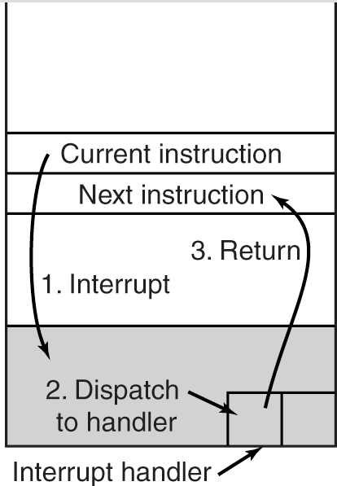
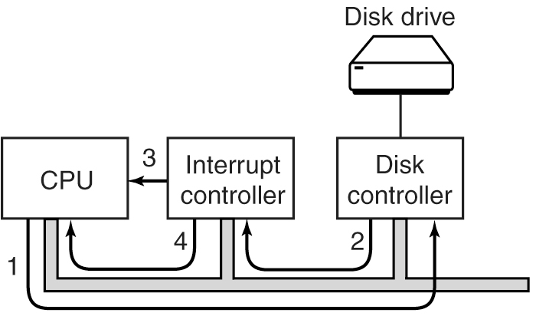
Scheduling an Interrupt Routine, cont’d
When an interrupt occurs:
The driver tells the disk controller what to do.
After the disk controller is done,
it signals the interrupt controller.
If the interrupt controller accepts the interrupt,
it informs the CPU.
The interrupt controller puts the
device number on the bus.
Modern Operating Systems, 3rd ed.
Andrew Tanenbaum
(c) 2008 Prentice-Hall, Inc.. 0-13-600663-9
All rights reserved

Slide 12
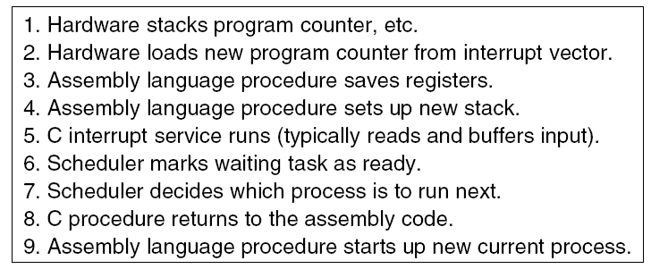
Scheduling an Interrupt Routine, cont’d
When an interrupt occurs, cont’d:
Modern Operating Systems, 3rd ed.
Andrew Tanenbaum
(c) 2008 Prentice-Hall, Inc.. 0-13-600663-9
All rights reserved

Slide 13
Assignment #2
Write a program in Java or C that runs
process scheduling algorithms:
  First-come first-served (FCFS) [nonpreemptive]
  Shortest job first (SJF) [nonpreemptive]
  Shortest remaining time (SRT) [preemptive]
  Round robin (RR) [preemptive]
  Highest priority first (HPF) [nonpreemptive and preemptive] with 4 levels of priority
Run each scheduling algorithm for 100 quanta
(time slices).

Slide 14
Assignment #2, cont’d
Before each run of an algorithm,
create a set of simulated processes.
  Each simulated process is simply a data structure that stores information about the process.
For each simulated process,
randomly generate:
  An arrival time: a float value
  from 0 through 99 (quanta).
  An expected run time: a float value
  from 0.1 through 10 quanta.
  A priority: integer 1, 2, 3, or 4 (1 is highest)

Slide 15
Assignment #2, cont’d
Tip: For debugging, you may want the same
(pseudo) random numbers each time.
For this to happen, you should set the seed
of the random number generator to a value, such as 0.
For Java, see http://docs.oracle.com/javase/6/docs/api/java/util/Random.html

Slide 16
Assignment #2, cont’d
Assume only one ready queue.
  Sort the simulated processes so that they
  enter the queue in arrival time order.
Your process scheduler can do
process switching only at the
start of each time quantum.
For this assignment, only consider CPU time
for each process
  no I/O wait times
  no process switching overhead

Slide 17
Assignment #2, cont’d
For RR, use a time slice of 1 quantum.
For HPF, use 4 priority queues.
  Do separate runs for nonpreemptive scheduling
  and for preemptive scheduling.
  Consider HPF to be two algorithms,
  giving 6 algorithms altogether.
  For preemptive scheduling, use RR with a
  time slice of 1 quantum for each priority queue.
  For nonpreemptive scheduling, use FCFS.

Slide 18
Assignment #2, cont’d
Each simulation run should last until the completion of the last process,
even if it goes beyond 100 quanta.
No process should get the CPU for the first time
after time quantum 99.

Slide 19
Assignment #2, cont’d
How many simulated processes should you create before each algorithm run?
Create enough so that the CPU is never idle
for more than 2 consecutive quanta waiting for work to do.
  Except possibly at the very beginning of each run.
It’s OK to create more processes for a run than you can actually use.

Slide 20
Assignment #2, cont’d
Run each scheduling algorithm simulation
5 times to get averages for the output statistics (next slide).
Clear the ready queue before each run
and create a new set of simulated processes.

Slide 21
Assignment #2, cont’d
Output for each algorithm run (total 30 runs):
  Each created process’s name (such as A, B, C, ...),
  arrival time, expected run time, and priority.
  A time line of the 100+ quanta, such as ABCDABCD ...
  Show a process’s name in a quantum even if
  it completed execution before the end of that quantum.
    Then the CPU is idle at least until
    the start of the next quantum.

Slide 22
Assignment #2, cont’d
Output for each algorithm run, cont’d:
  Calculated statistics for the processes for the run:
    Average turnaround time
    Average waiting time
    Average response time
  Calculated statistic for the algorithm for the run:
    Throughput

Slide 23
Assignment #2, cont’d
For each run of HPF:
  Compute the averages and throughput separately
  for each priority queue.
  Compute the overall averages and throughput
  for the run.

Slide 24
Assignment #2, cont’d
Your statistics should only include
the simulated processes that actually ran.
  If you created too many simulated processes,
  don’t count the ones that never started.
  For HPF, if a priority queue has a low throughput,
  starvation probably occurred but you might not know
  how many processes starved.

Slide 25
Assignment #2, cont’d
Final output and report
  The average statistics over 5 runs
  for each scheduling algorithm.
  A short report (1 or 2 pages) that discusses
  which algorithm appears to be best
  for each of the calculated statistics.

Slide 26
Assignment #2, cont’d
Extra credit (up to 15 points)
  Add aging to both HPF nonpreemptive and HPF preemptive.
  After a process has waited for 5 quanta at a
  priority level, bump it up to the next higher level.

Slide 27
Assignment #2, cont’d
Create a zip file containing:
  Your Java or C source files.
  A text file containing output from
  your simulation runs.
  Your report as a Word document or PDF.
Name the zip file after your team name,
for example, supercoders.zip

Slide 28
Assignment #2, cont’d
Email the zip file to ron.mak@sjsu.edu.
  Subject line should be:
  CS 149-n Assignment #2 team name
  CC all your team members.
Due Monday, February 16.

Slide 29
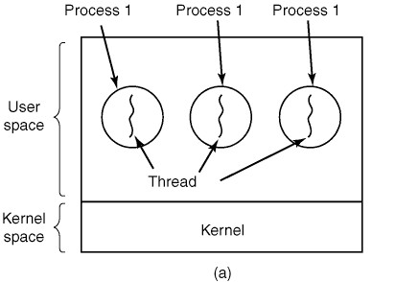
Threads
Traditionally, each process has its own
address space and a single thread of control.
Modern Operating Systems, 3rd ed.
Andrew Tanenbaum
(c) 2008 Prentice-Hall, Inc.. 0-13-600663-9
All rights reserved

Slide 30
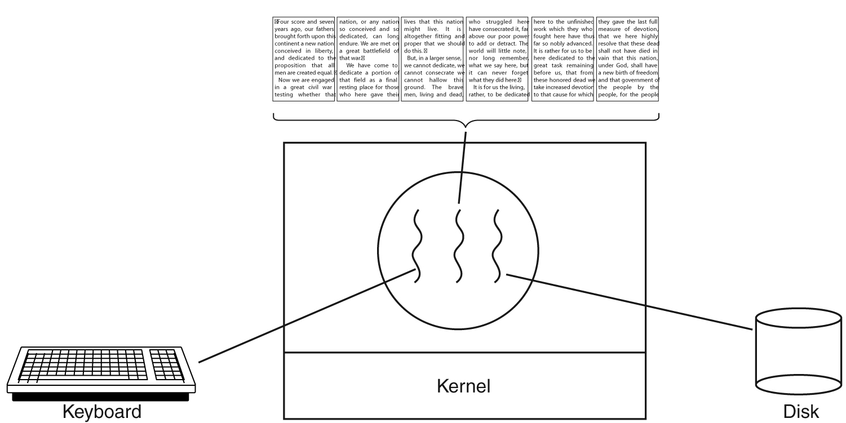
Threads, cont’d
Operating systems can support a process having multiple threads of control all running in the same address space.
  A word processor process with three threads
  of control:
Modern Operating Systems, 3rd ed.
Andrew Tanenbaum
(c) 2008 Prentice-Hall, Inc.. 0-13-600663-9
All rights reserved

Slide 31
Threads, cont’d
Each thread (AKA lightweight process) has:
  A program counter.
  Registers to hold its current working variables.
  A runtime stack.

Slide 32
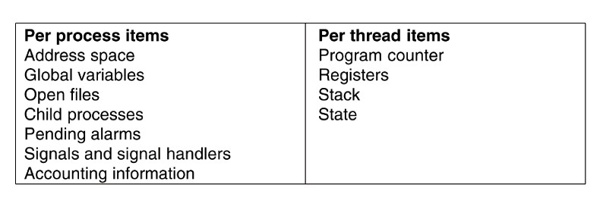
Threads, cont’d
Additions to the Process Control Block (PCB)
to support threads:
Modern Operating Systems, 3rd ed.
Andrew Tanenbaum
(c) 2008 Prentice-Hall, Inc.. 0-13-600663-9
All rights reserved

Slide 33
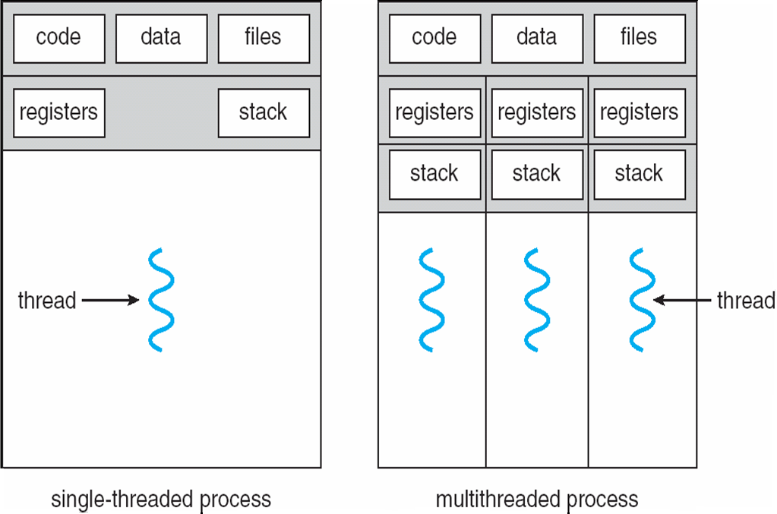
Threads, cont’d
Operating Systems Concepts with Java, 8th edition
Silberschatz, Galvin, and Gagne
(c) 2010 John Wiley & Sons. All rights reserved. 0-13-142938-8

Slide 34
Benefits of Threads
Responsiveness
Resource Sharing
Economy
Scalability

Slide 35
Threads and Multicore Systems
Multicore systems present additional challenges to programmers, including:
  Dividing activities
  Balance
  Data splitting
  Data dependency
  Testing and debugging

Slide 36
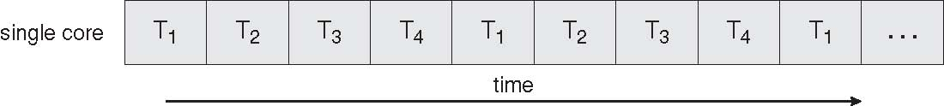
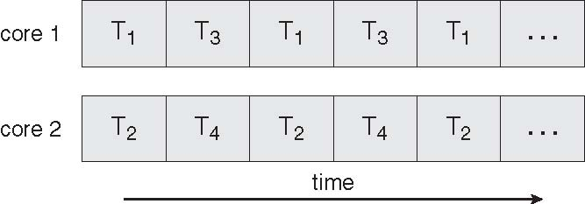
Concurrent Execution of Threads
Single core system:
Multicore system:
Operating Systems Concepts with Java, 8th edition
Silberschatz, Galvin, and Gagne
(c) 2010 John Wiley & Sons. All rights reserved. 0-13-142938-8

Slide 37
Thread Scheduling
Now we have two levels of concurrency:
processes and threads.
User-level threads
  The OS kernel doesn’t know about threads.
  The process’s thread scheduler schedules its threads to run during the each time quantum.
  Each process maintains its own private thread table.

Slide 38
Thread Scheduling, cont’d
Two levels of concurrency, cont’d
Kernel-level threads
  The OS kernel picks the threads to run.
  It may or may not consider which process
  the thread belongs to.

Slide 39
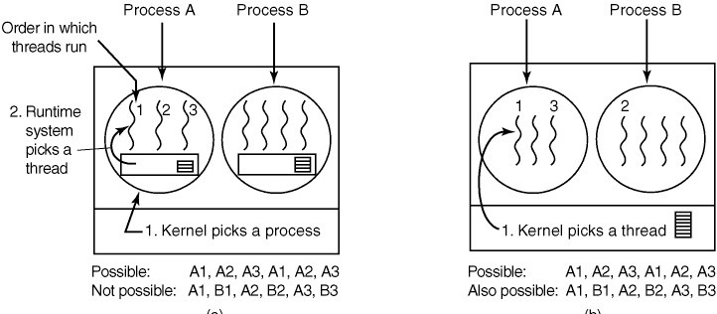
Thread Scheduling, cont’d
Possible scheduling of user-level threads.
Operating Systems: Design and Implementation
Tanenbaum & Woodhull
(c) 2006 Prentice-Hall, Inc. All rights reserved. 0-13-142938-8

Slide 40
Thread Scheduling, cont’d
Possible scheduling of kernel-level threads.
Operating Systems: Design and Implementation
Tanenbaum & Woodhull
(c) 2006 Prentice-Hall, Inc. All rights reserved. 0-13-142938-8

Slide 41
Thread Scheduling, cont’d
Performance differences between user-level and kernel-level threads:
  A thread switch from one user-level thread
  to another within the same process is fast.
  A thread switch with kernel-level threads
  can involve an complete process switch.
Kernel-level thread switching is optimized
if the switches are as much as possible
among threads within the same process.

Slide 42
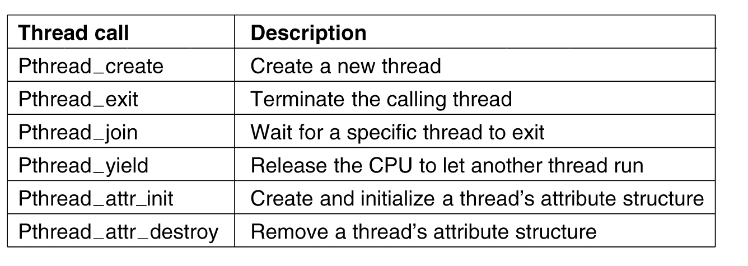
POSIX Threads
The POSIX standard for threads is implemented by the Pthreads package.
Actually, the PThreads function names are all in lower case:
pthread_create, pthread_exit, pthread_attr_init, etc.
Modern Operating Systems, 3rd ed.
Andrew Tanenbaum
(c) 2008 Prentice-Hall, Inc.. 0-13-600663-9
All rights reserved

