Slide 1


CS 149: Operating Systems
January 22 Class Meeting
Department of Computer Science
San Jose State University
Spring 2015
Instructor: Ron Mak
www.cs.sjsu.edu/~mak

Slide 2
Basic Info
Office hours
  TuTh 7:30 - 8:30 PM
  MH 413
Class website
  http://www.cs.sjsu.edu/~mak/
  Green sheet
  Assignments
  Lecture notes

Slide 3
Project Teams
Assignments will be done by
small project teams.
Form your own teams of 3 or 4 members each.
Choose your team members wisely!
  Be sure you’ll be able to meet and communicate
  with each other and work together well.
  No moving from team to team.

Slide 4
Project Teams, cont’d
Each team member will receive the same score on each team assignment and team project.
Each team email to ron.mak@sjsu.edu
by Monday, January 26:
  Your team name
  A list of team members and email addresses
Subject: CS 149-n Team Team Name
  Where n is your section number (2, 3, or 8)
  Example: CS 149-3 Team Super Coders

Slide 5
Individual Responsibilities
  You are personally responsible for participating
  and contributing to your team’s work, and for
  understanding each part of the work for every
  assignment whether or not you worked on that part.

Slide 6
Postmortem Assessment Report
At the end of the semester, each student will individually turn in a short (one page) report:
  A brief description of what you learned in the course.
  An assessment of your personal accomplishments
  for your project team.
  An assessment of each of
  your project team members.
  _

Slide 7
Your Individual Overall Class Grade
65% assignments (team scores)
15% midterm exam (individual score)
20% final exam (individual score)
Final letter grade based on the class curve.

Slide 8
Participation is Important
Can move your final grade up or down,
especially in borderline cases.
Participation in class.
Participation in your team.
  As reported by the postmortem assessment reports.

Slide 9
Take roll!

Slide 10
What is an Operating System?
The layer of “system software”
between the machine hardware
and the application programs.
Operating Systems: Design and Implementation
Tanenbaum & Woodhull
(c) 2006 Prentice-Hall, Inc. All rights reserved. 0-13-142938-8

Slide 11
Why Study Operating Systems?
Become a better programmer.
  Your applications can make better use
  of the underlying system.
  Be a systems programmer.
Become a power computer user.
  Understand how to invoke OS services
  at the command line.
  Be able to write shell scripts.
Become a better computer designer.
  Understand hardware and software tradeoffs.

Slide 12
Purpose of an Operating System
An extended machine or virtual machine
  Easier to use and program
  than the underlying hardware.
A resource manager
  Programs share resources in time and space.

Slide 13
What Resources Does an OS Manage?
CPUs
  process management
Main memory
  memory management
Data storage
  disk management
  file management
I/O devices
  I/O management
Networking, virtualization, security, etc.

Slide 14
Abstractions
An operating systems provides abstractions
of the computer system.
Abstractions are useful for computer users
and for software developers.

Slide 15
Abstractions, cont’d
CPU ➔ multiple processes
  Process: A program that is running
  locally or remotely.
Physical memory ➔ virtual memory
  Processes can simultaneously occupy
  more memory than is physically available.
Disk storage ➔ files
  Don’t worry about allocating space on disk drives
  that are local or on a network server.

Slide 16
UNIX as an Example OS
In this class, we will use UNIX
as an example operating system.
We will write system calls using the C language.
Install Debian Linux on your PC or Mac
as a virtual machine.

Slide 17
VirtualBox (PC and Mac)
Challenging to set up, but very powerful.
  Free software from Oracle: https://www.virtualbox.org/
  Latest version is 4.3.20
Download the Debian ISO file.
  Debian Linux distro: http://www.debian.org/distrib/
  Latest version is 7.8.0
  Download "small installation image" which is a .iso file.
  ISO: optical disk image: a .iso file

Slide 18
VirtualBox (PC and Mac), cont’d
Load the Debian ISO file into VirtualBox
to create a Debian virtual machine (VM).
  You can run multiple VMs simultaneously,
  each with a different operating system.
  Subject to your disk and memory limitations.
Also install VirtualBox “guest additions”
  Allows you to mount a shared folder
  that is accessible by both
  the VM and the host machine.
Installation demo
next Tuesday.

Slide 19
Operating System Generations
Generation 1 (1945 – 55)
  Vacuum tubes and plugboards
Generation 2 (1955 – 65)
  Transistors and batch systems
Generation 3 (1965 – 80)
  ICs and multiprogramming
Generation 4 (1980 – Present)
  Personal and mobile computers
  _

Slide 20
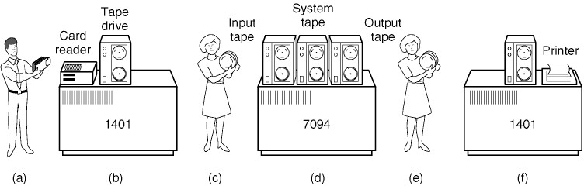
Historical Perspective
Early batch computer systems
  Programmers bring punched cards
  to the IBM 1401 computer system.
  The1401 reads a
  batch of jobs onto tape.
Operating Systems: Design and Implementation
Tanenbaum & Woodhull
(c) 2006 Prentice-Hall, Inc. All rights reserved. 0-13-142938-8

Slide 21
Historical Perspective, cont’d
Early batch computer systems
  A computer operator carries the input tape
  to a “large scale” IBM 7094.
  The 7094 does
  the computing.
Operating Systems: Design and Implementation
Tanenbaum & Woodhull
(c) 2006 Prentice-Hall, Inc. All rights reserved. 0-13-142938-8

Slide 22
Historical Perspective, cont’d
Early batch computer systems
  The operator carries the output tape
  to the IBM 1401.
  The 1401 prints output.
Operating Systems: Design and Implementation
Tanenbaum & Woodhull
(c) 2006 Prentice-Hall, Inc. All rights reserved. 0-13-142938-8

Slide 23
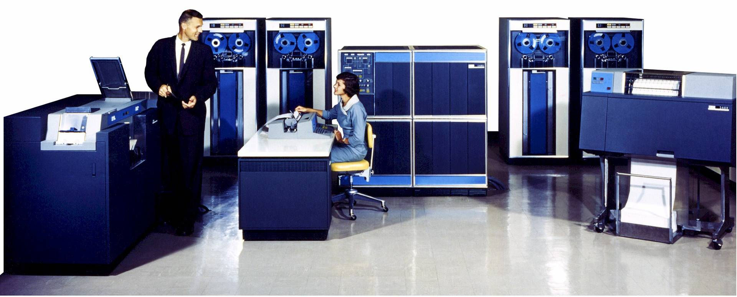
What was the IBM 1401?
A “small scale” computer system
developed by IBM in the late 1950s.
1402 Card Read Punch
1407 Console
1401 CPU
729 Tape Drive
1403 Line Printer

Slide 24
Computing Before the IBM 1401
Business data processing involved applications that manipulated data records:
  Inventory
  Billing and receivables
  Payroll

Slide 25
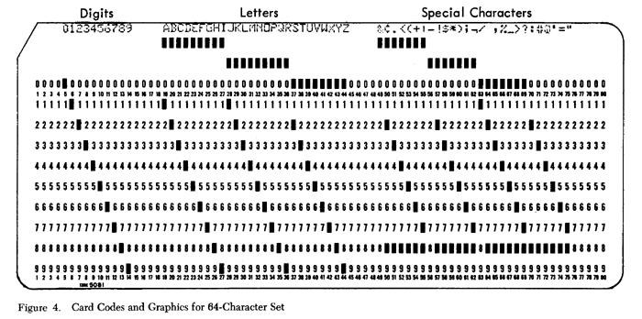
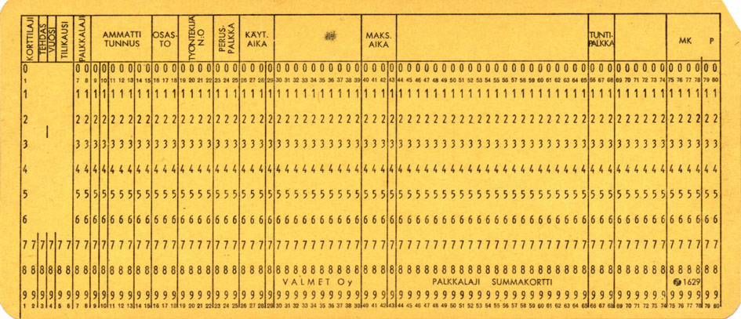
Computing Before the IBM 1401
Data was stored in punched cards called “IBM cards” or
“Hollerith cards”
  Named after
  Herman Hollerith.
80 columns per card, one character per column.
Up to 12 punched holes per column.
Alphanumeric data, often grouped
into fields.

Slide 26
Computing Before the IBM 1401
A data processing application involved
passing decks of punched cards through electromechanical “unit record” machines.
Repetitive sort, calculate, collate, and tabulate operations ...
  ... were programmed with hand-wired
  plugboard control panels.
  _

Slide 27
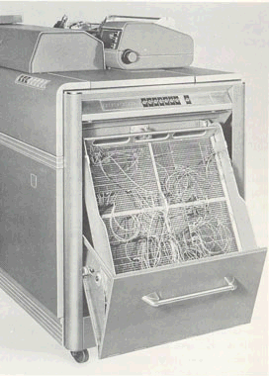
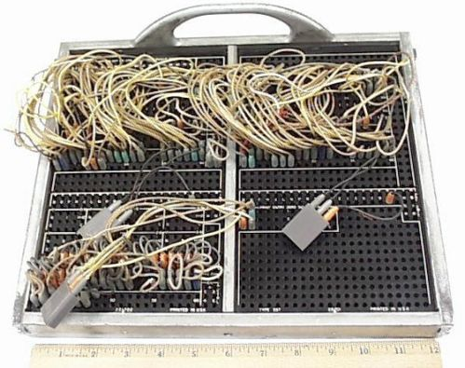
Plugboard Control Panel
IBM 407 Accounting Machine (1949)

Slide 28
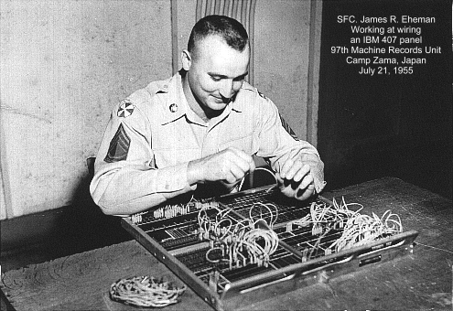
Programming a Plugboard
“Programming” was hand-wiring plugboards.
“Hmm, should I pass this parameter by value or by reference?”

Slide 29
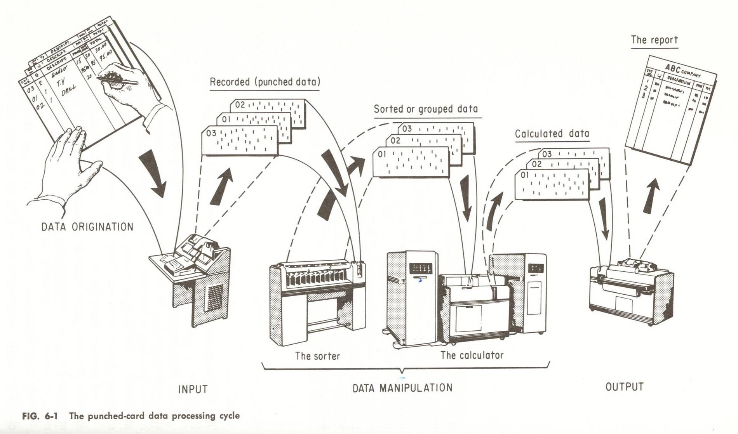
Data Processing

Slide 30
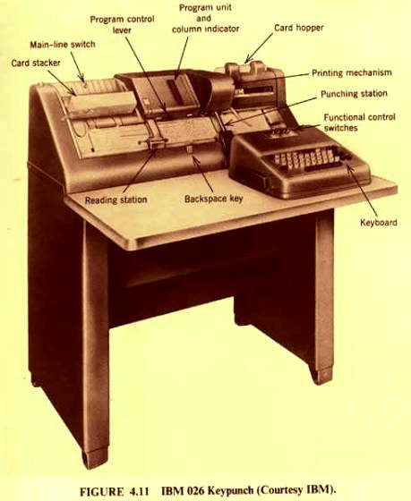
Data Processing
Cards were punched manually at a keypunch machine.
Or they were punched automatically by
unit-record equipment
under program control.

Slide 31
Running a Data Processing Application ...
... meant passing decks of cards
through a sequence of unit-record machines.
  Each machine was programmed via its plugboard
  to perform its task for the application.
  Each machine had little or no memory.
  The punched cards stored the data records
  The data records moved as the cards moved.
An entire work culture evolved around punched cards!

Slide 32
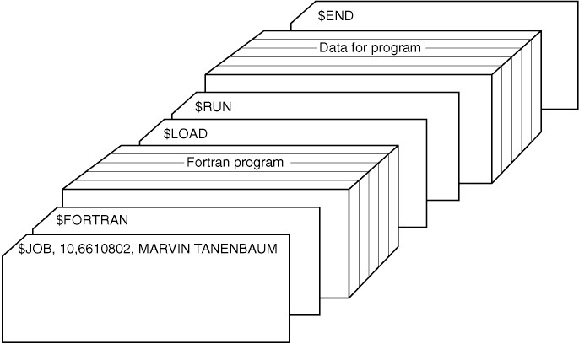
A Data Processing Job
A typical “job”.
Operating Systems: Design and Implementation
Tanenbaum & Woodhull
(c) 2006 Prentice-Hall, Inc. All rights reserved. 0-13-142938-8

Slide 33
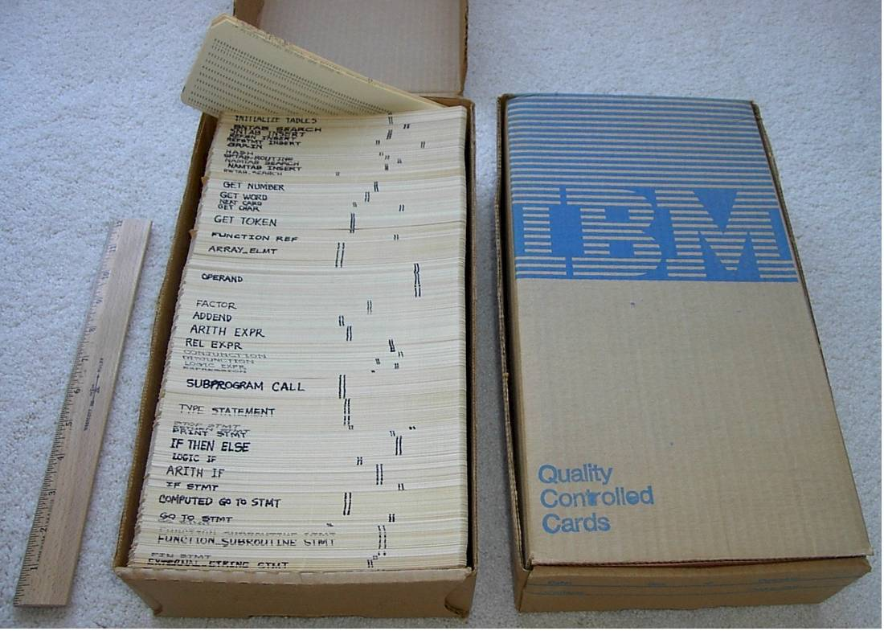
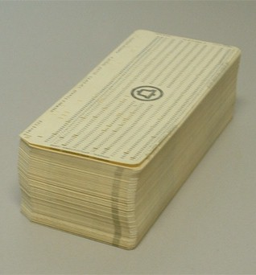
A Data Processing Program
Data processing was all about punched cards.
My school compiler project:
  3½ boxes of punched cards
  Each box = 2000 cards, 10 lbs.

Slide 34
The IBM 1401 Computer System
Memory was a limited resource.
  The main CPU unit contained up to 4K characters of
  core memory (1 character = 8 bits).
  You could add the IBM 1406 memory unit which contained up to 12K of additional memory
  Maximum memory was 16K.
K = 1000
In the 1401, each core bit cost 60¢ ($3/bit in today’s dollars).

Slide 35
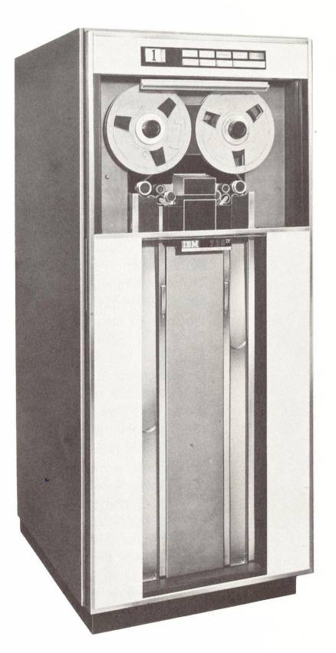
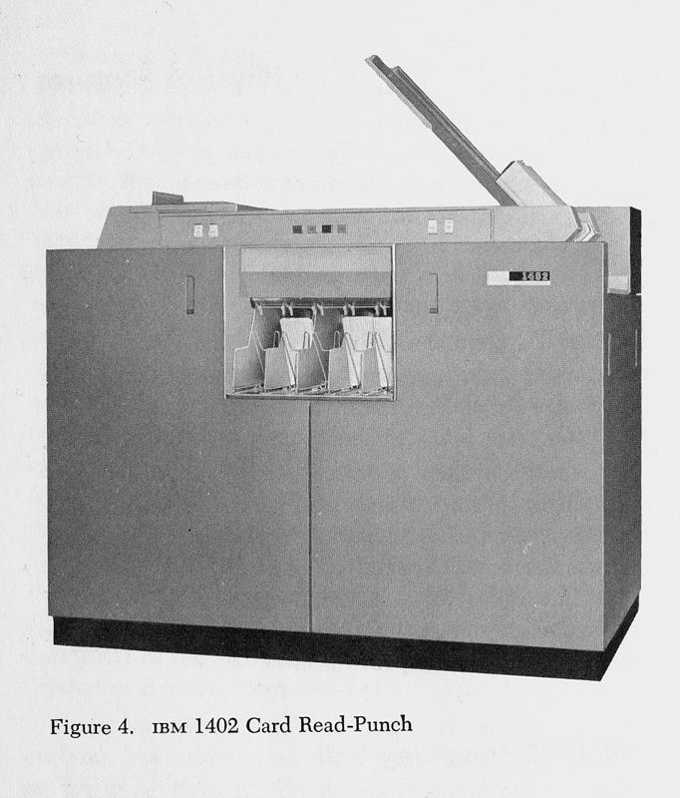
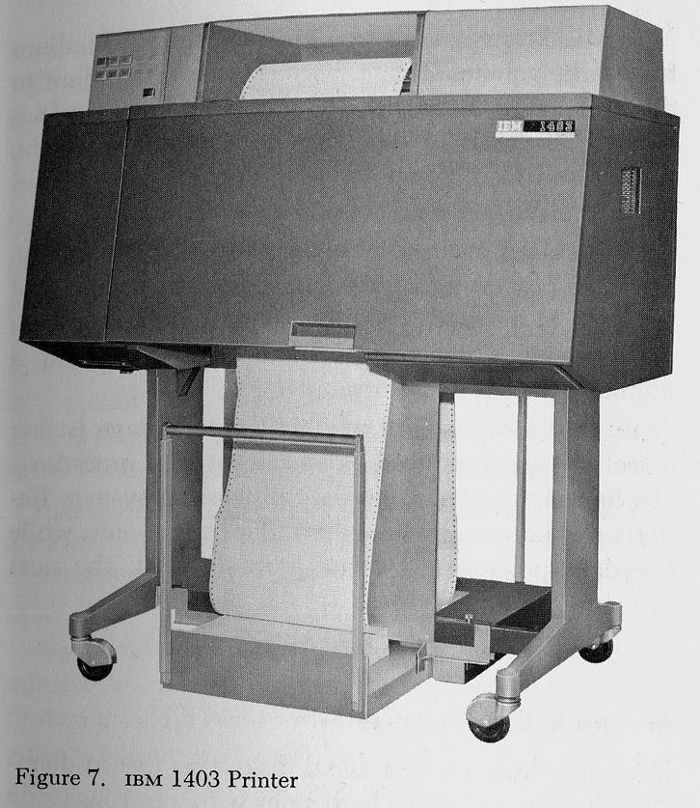
The IBM 1401 Computer System
The 1401 computer system had amazing peripherals
(I/O devices).
  1403 Line Printer
  1402 Card Reader Punch
  729 Magnetic Tape Drives
  Disk drives became available later.

Slide 36
The 1401 Architecture
11.5 microsecond clock cycle
  Add two decimal digits in one cycle, or
  Move one character between memory and a peripheral
87 KHz
  Today’s 4 GHz PC can add two 20-digit numbers about 1 million times faster than a 1401.
  A single laptop computer today has more computing power than all the 1401 systems ever installed.

Slide 37
How the 1401 Transformed Data Processing
It was cheap enough for small businesses.
Programs were stored in main memory.
  No more plugboards!
Transferred data from punched cards
to magnetic tape and disk.
Customers could program their own machines.
  Autocoder assembly language.
  “High level” languages:
    FORTRAN, COBOL, RPG

Slide 38
The 1401 Had No Operating System!
Only one program ran at a time.
  The program had full control of the machine.
Programmers had to know how to code instructions to read and write the I/O devices.
  Example: The read instruction read the contents
  of the next card from the card reader into
  memory locations 101-180.
  Example: The print instruction printed whatever
  was in memory locations 201-332 to the next line
  of the line printer.
The card reader and line printer were
directly connected to the CPU

