Slide 1


CS 144
Advanced C++ Programming
April 16 Class Meeting
Department of Computer Engineering
San Jose State University
Spring 2019
Instructor: Ron Mak
www.cs.sjsu.edu/~mak

Slide 2
Review: Lambda Expressions
Person.h
#include <string>
using namespace std;
enum class Gender { M, F };
class Person
{
public:
Person(string f, string l, Gender g)
: first(f), last(l), gender(g) {}
virtual ~Person() {}
string first;
string last;
Gender gender;
};

Slide 3
Review: Lambda Expressions, cont’d
#include <iostream>
#include <vector>
#include "Person.h"
vector<Person> init();
ostream& operator <<(ostream& outs, Person &p);
vector<Person> match(const vector<Person> people, bool f(const Person &p));
int main()
{
vector<Person> people = init();
vector<Person> males;
vector<Person> cs;
cout << "Males:" << endl;
males = match(people, [] (const Person &p) -> bool
{
return p.gender == Gender::M;
});
for (Person& p : males) cout << p << endl;
cout << endl << "Last name starts with C:" << endl;
cs = match(people, [] (const Person &p) -> bool
{
return p.last[0] == 'C';
});
for (Person& p : cs) cout << p << endl;
}
PersonTest2.cpp

Slide 4
Review: Lambda Expressions, cont’d
PersonTest2.cpp
vector<Person> match(const vector<Person> people,
bool f(const Person &p))
{
vector<Person> matches;
for (const Person& p : people) if (f(p)) matches.push_back(p);
return matches;
}

Slide 5
Lambda Expression with Capture
A lambda expression can “capture” variables
that are in its scope to use inside its body.
  Capture either by value or by reference.
If you pass a lambda expression to a function, and the lambda expression does capturing, then function’s corresponding formal parameter must use std::function.
  Instead of:
  Use:
vector<Person> match(const vector<Person> people,
bool f(const Person &p));
vector<Person> match(const vector<Person> people,
function<bool(const Person &p)> f)

Slide 6
Lambda Expression with Capture, cont’d
vector<Person> init();
ostream& operator <<(ostream& outs, Person &p);
vector<Person> match(const vector<Person> people,
function<bool(const Person &p)> f);
int main()
{
int count = 0;
vector<Person> people = init();
vector<Person> males;
vector<Person> cs;
cout << "Males:" << endl;
males = match(people, [&count] (const Person &p) -> bool
{
if (p.gender == Gender::M)
{
count++;
return true;
}
else return false;
});
cout << "count = " << count << endl;
for (Person& p : males) cout << p << endl;
...
PersonTest3.cpp

Slide 7
Lambda Expression with Capture, cont’d
PersonTest3.cpp
...
cout << endl << "Last name starts with C:" << endl;
count = 0;
cs = match(people, [&count] (const Person &p) -> bool
{
if (p.last[0] == 'C')
{
count++;
return true;
}
else return false;
});
cout << "count = " << count << endl;
for (Person& p : cs) cout << p << endl;
}

Slide 8
Lambda Expression with Capture, cont’d
PersonTest3.cpp
vector<Person> match(const vector<Person> people,
function<bool(const Person &p)> f)
{
vector<Person> matches;
for (const Person& p : people) if (f(p)) matches.push_back(p);
return matches;
}
predicate: A Boolean function whose return value depends on the values of its parameters.
  Example: Function f above.

Slide 9
A Review of Iteration (Looping)
First initialize the value of the control variable:
The loop body must update the value
of the control variable.
Test the control variable for the terminal value.
  Each update brings the control variable’s value closer to the terminal value.
Initialize the
control variable i
int i = 0;
while (i < 10)
{
cout << i << endl;
i++;
}
Test the value of the control variable
for the terminal value
Loop body
Update the value
of the control variable

Slide 10
A Review of Iteration (Looping), cont’d
Initialize the
control variable i
int i = 0;
while (i < 10)
{
cout << i << endl;
i++;
}
Test the value of the control variable
for the terminal value
Loop body
Update the value
of the control variable
This review of iteration is a way to introduce
the concept of recursion.

Slide 11
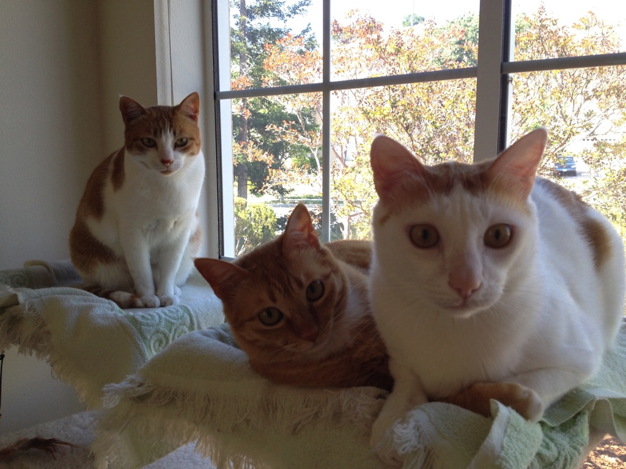
Recursion
A new way to think???
Recursion requires a whole new way of thinking.
Recursion is a required skill for all programmers.

Slide 12
How to Think Recursively
Does this problem contain a
simpler but similar case of the problem?
Can I solve the overall problem
if I can solve the simpler case?
Is there a simplest case that has
an immediate and obvious solution?
The simplest case is called the base case.
  There may be more than one base case.

Slide 13
Some Initial Examples of Recursion
We’ll start with some examples of simple problems that we’ll solve using recursion.
Recursion is not necessarily the best way
to solve these problems.
But these simple problems help us to understand how to use recursion.

Slide 14
Factorials: The Classic Recursion Problem
5! = 5 x 4 x 3 x 2 x 1
= 5 x 4!
Therefore, we can solve 5! if we can solve 4!
  4! is a simpler but similar case of the problem.
We can solve 4! = 4 x 3! if we can solve 3!
We can solve 3! = 3 x 2! if we can solve 2!
We can solve 2! = 2 x 1! if we can solve 1!
But by definition, 1! = 1

Slide 15
Factorials, cont’d
But by definition, 1! = 1
  That’s the simplest case (base case) with an
  immediate and obvious solution.
Therefore, 2! = 2 x 1! = 2 x 1 = 2
Therefore, 3! = 3 x 2! = 3 x 2 = 6
Therefore, 4! = 4 x 3! = 4 x 6 = 24
Therefore, 5! = 5 x 4! = 5 x 24 = 120

Slide 16
Factorials, cont’d
Solve n! recursively:
What’s the base case?
  1! = 1
What’s the simpler but similar case?
  (n-1)!
  Note that n-1 is closer to the base case of 1.
Factorial.cpp
int fact(int n)
{
if (n == 1) return 1;
else return n*fact(n-1);
}
Reaching the base case stops the recursion
and returns an immediate value.
Otherwise, recursively solve the simpler case.

Slide 17
Recursive Multiplication
Solve i x j recursively.
Base cases:
  i equals 0: product = 0
  i equals 1: product = j
Simpler but similar case:
  If we can solve the problem for i-1
  (which is closer to 0 and 1),
  then i x j is j + [(i-1) x j]

Slide 18
Recursive Multiplication, cont’d
Multiply.cpp
long multiply(int i, int j)
{
switch (i)
{
case 0: return 0;
case 1: return j;
default: return j + multiply(i-1, j);
}
}

Slide 19
Iterative Fibonacci
Fibonacci sequence: 1 1 2 3 5 8 13 21 34 55
  f_{n} = f_{n-2} + f_{n-1}
  f₁ = 1
  f₂ = 1
An iterative
solution:
Fibonacci1.cpp
long fibonacci(int n)
{
if (n <= 2) return 1;
else {
long older = 1;
long old = 1;
long next = 1;
for (int i = 3; i <= n; i++) {
next = older + old;
older = old;
old = next;
}
return next;
}
}

Slide 20
Recursive Fibonacci
  According to the definition:
    f_{n} = f_{n-2} + f_{n-1}
    f₁ = 1
    f₂ = 1
Fibonacci2.cpp
long fibonacci(int n)
{
if (n <= 2) return 1;
else return fibonacci(n-2) + fibonacci(n-1);
}

Slide 21
Recursive Fibonacci, cont’d
Why does the recursive solution
take a long time when n is large?
Let’s trace the recursive calls:
Fibonacci3.cpp
long fibonacci(int n)
{
cout << "Called fibonacci(" << n << ")" << endl;
long f;
if (n <= 2) f = 1;
else f = fibonacci(n-2) + fibonacci(n-1);
cout << "Returning fibonacci(" << n << ") = " << f << endl;
return f;
}

Slide 22
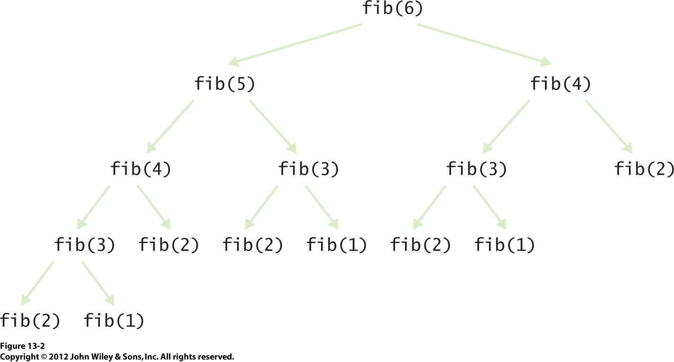
Recursive Fibonacci, cont’d
Recursion is
not always good!

Slide 23
Member of
Given a vector of n integers, is x in the list?
Base case
  The vector is empty: x is not in the vector.
Simpler but similar case:
  Either x is equal to the first element in the vector,
  or x is in the rest of the vector.
  The rest of the vector is one element shorter,
  so it’s closer to the base case.

Slide 24
Member of, cont’d
MemberOf.cpp
bool member_of(const int value, vector<int>& v)
{
if (v.size() == 0) return false; // Base case
if (v[0] == value) return true; // Is it the first element?
v.erase(v.begin()); // Remove the first element.
return member_of(value, v); // Is it in the rest of the vector?
}
0 10 20 30 40 50 60 70 80 90 100
50 is in the vector.
75 is not in the vector.
80 is in the vector.
92 is not in the vector.

Slide 25
Reverse
Reverse the values of a list of n integers.
Base case
  The list is empty or it contains only one value:
  Just return the list.
Simpler but similar case:
  Take out the first value of the list.
  Reverse the rest of the list.
  Append the removed value to the end of the reversed rest of the list.

Slide 26
Reverse, cont’d
Reverse.java
void reverse(vector<int>& v)
{
if (v.size() <= 1) return; // Base case
int first = v.front(); // Remember the first element.
v.erase(v.begin()); // Remove the first element.
reverse(v); // Reverse the rest of the vector.
v.push_back(first); // Append the first element to the end.
}
10 20 30 40 50 60 70 80 90
90 80 70 60 50 40 30 20 10

Slide 27
Unique
Given a list of n integers in a list, remove all the duplicate values so that what remains is a list of unique values.
Base case
  The list is empty or it contains only one value:
  Just return the list (it’s empty or it has a single unique value).
Simpler but similar case:
  Take out the first value. Make the rest of the list unique. Then if the value we took out is not in the rest of the list, put it back. Otherwise, leave it out.

Slide 28
Unique, cont’d
Unique.cpp
void unique(vector<int>& v)
{
if (v.size() <= 1) return; // Base case
int first = v.front(); // Remember the first element.
v.erase(v.begin()); // Remove the first element.
unique(v); // Make the rest of the vector unique.
if (!member_of(first, v)) // If the first element
{ // is not in the rest of the list,
v.insert(v.begin(), first); // put back the first element.
}
}
30 10 50 80 50 10 40 10 70
30 80 50 40 10 70

Slide 29
Better Recursion Problems
Some problems are a natural fit for recursion.
They are much more easily solved
with recursion than without.

Slide 30
Word Permutations
Given a word, generate all the permutations of the letters of the word.
  Example: “eat”: eat eta aet ate tea tae
Base cases
  Empty word: No permutations.
  Single-letter word: The only permutation is the letter.
Simpler but similar case:
  One letter at a time, remove the letter and generate the permutations of the rest of the word.
  Prepend the removed letter to each permutation.

Slide 31
Word Permutations, cont’d
vector<string> generate_permutations(string word)
{
vector<string> permutations;
// Base case: Return an empty vector.
if (word.length() == 0) return permutations;
// Base case: Return a vector with a one-letter word.
if (word.length() == 1)
{
permutations.push_back(word);
return permutations;
}
...
Permutations.cpp

Slide 32
Word Permutations, cont’d
...
// Simpler but similar case.
else
{
// Loop for each letter of the word.
for (int i = 0; i < word.length(); i++)
{
char removed_letter = word[i];
string shorter_word = word.substr(0, i) + word.substr(i + 1);
vector<string> shorter_permutations =
generate_permutations(shorter_word);
for (string shorter_perm : shorter_permutations)
{
permutations.push_back(removed_letter + shorter_perm);
}
}
return permutations;
}
}

Slide 33
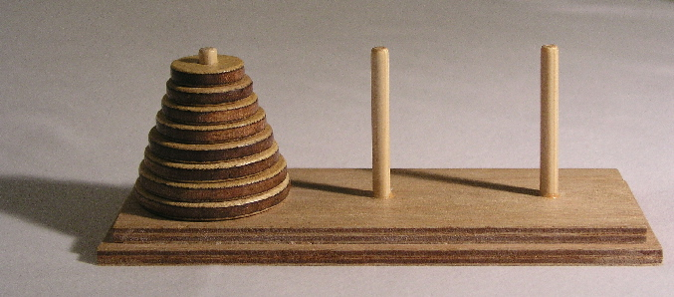
Towers of Hanoi
Goal: Move the stack of disks from the source pin
to the destination pin.
  You can move only one disk at a time.
  You cannot put a larger disk on top of a smaller disk.
  Use the third pin for temporary disk storage.
Animation: http://towersofhanoi.info/Animate.aspx

Slide 34
Towers of Hanoi, cont’d
Label the pins A, B, and C. Initial roles:
  A: source
  B: destination
  C: temporary
Base case: n = 1 disk
  Move disk from A to B (source ➔ destination)
Simpler but similar case: n-1 disks
  Solve for n-1 disks: A to C (source ➔ temp)
  Move 1 disk from A to B (source ➔ destination)
  Solve for n-1 disks: C to B (temp ➔ destination)
During recursive calls, the pins
will assume different roles.

Slide 35
Towers of Hanoi, cont’d
Hanoi.cpp
enum Pin { A = 'A', B = 'B', C = 'C' };
void solve(const int n, const Pin source, const Pin dest, const Pin temp);
void move(const Pin from, const Pin to);
int main()
{
int n;
cout << "Number of disks? ";
cin >> n;
cout << "Solve for " << n << " disks:" << endl << endl;
solve(n, Pin::A, Pin::B, Pin::C);
}
void move(Pin from, Pin to)
{
cout << "Move disk from " << static_cast<char>(from)
<< " to " << static_cast<char>(to) << endl;
}

Slide 36
Towers of Hanoi, cont’d
Solve n disks (source = A, destination = B)
  Solve for n-1 disks: A to C (source ➔ temp)
  Move 1 disk from A to B (source ➔ destination)
  Solve for n-1 disks: C to B (temp ➔ destination)
void solve(const int n, const Pin source, const Pin dest, const Pin temp)
{
if (n == 1) move(source, dest); // Base case
else
{
solve(n-1, source, temp, dest); // Solve source ==> temp
move(source, dest); // Move 1 disk source ==> dest
solve(n-1, temp, dest, source); // Solve temp ==> dest
}
}

Slide 37
Linear Search
Search for a target value
in an array of n elements.
  The array is not sorted in any way.
What choices do we have?
  Look at all the elements one at a time.
On average, you have to examine
half of the array.

Slide 38
Binary Search
Now assume that the array is sorted.
  Smallest value to largest value.
First check the middle element.
Is the target value smaller
than the middle element?
  If so, search the first half of the array.
Is the target value larger
than the middle element?
  If so, search the second half of the array.

Slide 39
Binary Search, cont’d
The binary search keeps cutting in half
the part of the array it’s searching.
  Next search either the first half or the second half.
  Eventually, you’ll either find the target value,
  or conclude that the value is not in the array.

Slide 40
Iterative Binary Search
It’s easy to write an iterative binary search:
int search(int value, vector<int> v, int low, int high)
{
while (low <= high) {
int mid = (low + high)/2;
cout << " low " << setw(2) << low << " mid " << setw(2) << mid
<< " high " << setw(2) << high << endl;
if (value == v[mid]) return mid;
if (value < v[mid]) high = mid-1;
else low = mid+1;
}
return -1;
}
Get the index of the midpoint
of the subrange.
Found the target value?
Next search either the first half
or the second half.
The target value is not in the array.
BinarySearchIterative.cpp

Slide 41
Iterative Binary Search, cont’d
0 10 20 30 40 50 60 70 80 90
Searching for 80
low 0 mid 5 high 10
low 6 mid 8 high 10
Value 80 found at index 8
Searching for 42
low 0 mid 5 high 10
low 0 mid 2 high 4
low 3 mid 3 high 4
low 4 mid 4 high 4
Value 42 not found
Searching for 10
low 0 mid 5 high 10
low 0 mid 2 high 4
low 0 mid 0 high 1
low 1 mid 1 high 1
Value 10 found at index 1

Slide 42
Elegant Recursion
Al though an iterative solution
may be more efficient, sometimes
a recursive solution is more elegant.

Slide 43
Recursive Binary Search
A binary search can be done recursively:
int search(int value, vector<int> v, int low, int high)
{
if (low <= high) {
int mid = (low + high)/2;
cout << " low " << setw(2) << low << " mid " << setw(2) << mid
<< " high " << setw(2) << high << endl;
if (value == v[mid]) return mid;
if (value < v[mid]) return search(value, v, low, mid-1);
else return search(value, v, mid+1, high);
}
return -1;
}
Get the index of the midpoint
of the subrange.
Found the target value?
Next search either the first half
or the second half.
The target value
is not in the subrange.
BinarySearchRecursive.cpp

