Slide 1


CS 144
Advanced C++ Programming
April 11 Class Meeting
Department of Computer Engineering
San Jose State University
Spring 2019
Instructor: Ron Mak
www.cs.sjsu.edu/~mak

Slide 2


Slide 3
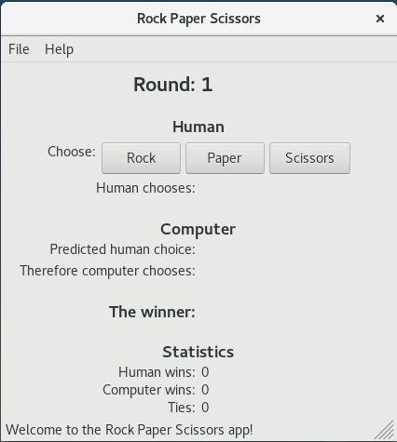
wx-RPS: Linux

Slide 4
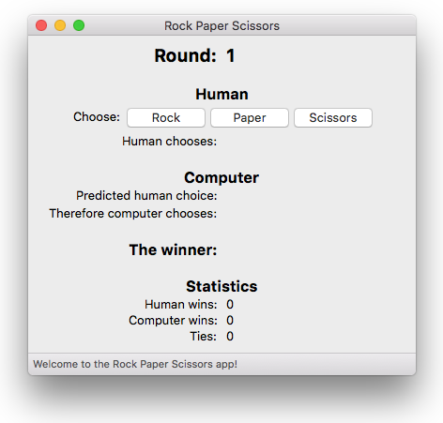
wx-RPS: Mac OS X

Slide 5
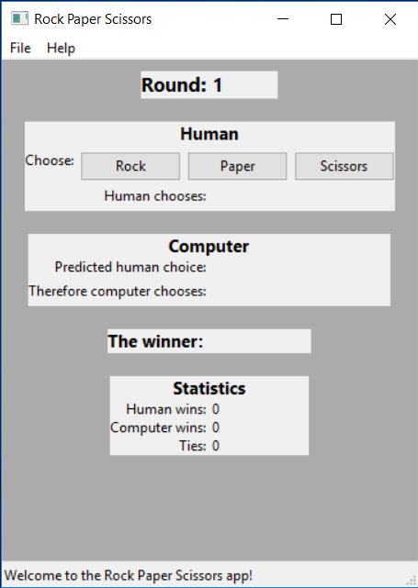
wx-RPS: Windows 10
Why does the app look
so ugly on Windows?

Slide 6
Review: Inversion of Control
The software framework controls the execution flow, not the programmer.
The programmer registers callback functions,
mostly as event handlers, with the framework.
  Bind an event handler to a control, such as a button.
The framework invokes a callback function at the appropriate time.
  Example: When an event occurs (such as a button click by the user), call the event handler that’s bound to the event.

Slide 7
wxWidgets Button Event Handlers
Create the buttons:
Bind the event handlers:
wxButton *rock_button = new wxButton(button_panel, wxID_ANY,
choice_to_wxString(ROCK));
wxButton *paper_button = new wxButton(button_panel, wxID_ANY,
choice_to_wxString(PAPER));
wxButton *scissors_button = new wxButton(button_panel, wxID_ANY,
choice_to_wxString(SCISSORS));
rock_button->Bind (wxEVT_BUTTON, &ButtonPanel::on_rock, this);
paper_button->Bind (wxEVT_BUTTON, &ButtonPanel::on_paper, this);
scissors_button->Bind(wxEVT_BUTTON, &ButtonPanel::on_scissors, this);
void ButtonPanel::on_rock(wxCommandEvent& event)
{
update_button_choice_text(ROCK);
}

Slide 8
wxWidgets Menu Event Handlers
Menu item identifiers:
Bind with an event table:
enum
{
ID_Hello = 1,
ID_Bonjour = 2,
ID_GutenTag = 3
};
wxBEGIN_EVENT_TABLE(HelloWorldFrame, wxFrame)
EVT_MENU(ID_Hello, HelloWorldFrame::OnHello)
EVT_MENU(ID_Bonjour, HelloWorldFrame::OnBonjour)
EVT_MENU(ID_GutenTag, HelloWorldFrame::OnGutenTag)
EVT_MENU(wxID_ABOUT, HelloWorldFrame::OnAbout)
EVT_MENU(wxID_EXIT, HelloWorldFrame::OnExit)
wxEND_EVENT_TABLE()
void HelloWorldFrame::OnBonjour(wxCommandEvent& event)
{
wxMessageBox( "Bonjour, monde!",
"OnBonjour", wxOK | wxICON_INFORMATION );
}

Slide 9
wxWidgets Sample Programs
Examine the sample programs to answer
“how to” questions.
  Example: How do you prompt for and get a integer value from the user?
  This can be done using a dialog box. Therefore, look at sample program dialogs.
Dialogs.cpp (lines 977-980)
long res = wxGetNumberFromUser(
wxT("This is some text, actually a lot of text.\n")
wxT("Even two rows of text."),
wxT("Enter a number:"), wxT("Numeric input test"),
50, 0, 100, this );

Slide 10
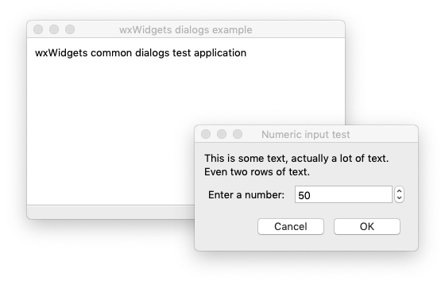
wxWidgets Sample Programs, cont’d

Slide 11
The auto Keyword
In a declaration of a variable that is also being initialized, the compiler can infer the type of the variable from the initialization expression.
  type inference, AKA type determination
Use auto instead of a complicated type name.
  Examples: Instead of:
  Use:
steady_clock::time_point start_time = steady_clock::now();
auto start_time = steady_clock::now();
From the initialization expression steady_clock::now() the compiler can infer that
start_time has type steady_clock::time_point.

Slide 12
The decltype Pseudo-Function
decltype takes a variable as an argument.
Returns the type associated with the variable.
Use to create another variable with the same type.
  Ensure that two variables have the same type.
  Example:
auto start_time = steady_clock::now();
...
decltype(start_time) end_time;

Slide 13
Function Objects
A function object is an instance of a class that overloads the function call operator.
The function call operator is the
pair of parentheses ()
  That’s the operator used to call a function.
  Yes, you can overload the function call operator!
Example: A class to generates pseudo-random integer values within a given range. The function call returns the next integer value.

Slide 14
Function Object: Random Integers
RandomInt.h
#include <ctime>
using namespace std;
class RandomInt
{
public:
RandomInt(int min, int max) : min(min), max(max)
{
srand(time(NULL)); // seed the random number generator
}
int operator()();
private:
int min, max;
};
inline int RandomInt::operator()()
{
return min + rand()%(max - min + 1);
}

Slide 15
Function Object: Random Integers, cont’d
RandomIntTester.cpp
#include <iostream>
#include "RandomInt.h"
int main()
{
RandomInt ri(5, 12);
for (int i = 0; i < 10; i++) cout << ri() << endl;
return 0;
}
7
11
8
8
10
12
11
8
5
7

Slide 16
Function Objects, cont’d
A function object is an object, so therefore,
  You can store it in a variable.
  You can pass it as an argument to a function.
  You can return it as the value of a function.
A function object can maintain state
across multiple invocations.
  Stored in its member variables.

Slide 17
Function Object: Summation
A function object can hold state.
Summation.h
class Summation
{
public:
Summation() : sum(0) {}
int operator ()(int amount);
private:
int sum;
};
inline int Summation::operator()(int amount)
{
sum += amount;
return sum;
}

Slide 18
Function Object: Summation, cont’d
#include <iostream>
#include <iomanip>
#include "Summation.h"
using namespace std;
int main()
{
Summation adder;
for(int i = 0; i < 10; i++)
{
cout << "Add " << i << ": "
<< setw(2) << adder(i) << endl;
}
return 0;
}
Add 0: 0
Add 1: 1
Add 2: 3
Add 3: 6
Add 4: 10
Add 5: 15
Add 6: 21
Add 7: 28
Add 8: 36
Add 9: 45

Slide 19
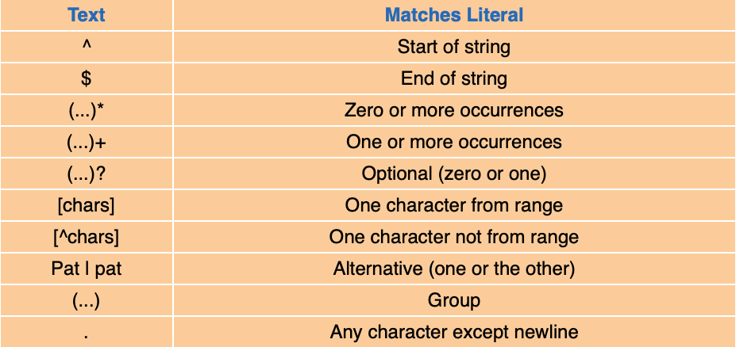
Regular Expressions
Use regular expressions to search strings for substrings that match various patterns.
  Common patterns:
Big C++, 2nd edition
by Cay Horstmann and Timothy Budd
John Wiley & Sons, 2005

Slide 20
Regular Expression Example
#include <iostream>
#include <string>
#include <regex>
using namespace std;
int main()
{
string str = "This new subject is fun";
regex pattern("This (.*)(sub)(.*) is fun");
smatch result;
if (regex_search(str, result, pattern))
{
for (int i = 0; i < result.size(); i++)
{
cout << result[i] << endl;
}
}
return 0;
}
This new subject is fun
new
sub
ject

Slide 21
Lambda Expressions
Person.h
#include <string>
using namespace std;
enum class Gender { M, F };
class Person
{
public:
Person(string f, string l, Gender g)
: first(f), last(l), gender(g) {}
virtual ~Person() {}
string first;
string last;
Gender gender;
};

Slide 22
Lambda Expressions, cont’d
#include <iostream>
#include <vector>
#include "Person.h"
vector<Person> init();
ostream& operator <<(ostream& outs, Person &p);
vector<Person> match(const vector<Person> people, bool f(const Person &p));
bool is_male(const Person &p);
bool is_C(const Person &p);
int main()
{
vector<Person> people = init();
vector<Person> males;
vector<Person> cs;
cout << "Males:" << endl;
males = match(people, is_male);
for (Person& p : males) cout << p << endl;
cout << endl << "Last name starts with C:" << endl;
cs = match(people, is_C);
for (Person& p : cs) cout << p << endl;
}
PersonTest1.cpp

Slide 23
Lambda Expressions, cont’d
PersonTest1.cpp
vector<Person> init()
{
vector<Person> v;
v.push_back(Person("Ron", "Mak", Gender::M));
v.push_back(Person("Marie", "Curie", Gender::F));
v.push_back(Person("Agatha", "Cristie", Gender::F));
v.push_back(Person("Barack", "Obama", Gender::M));
return v;
}
ostream& operator <<(ostream& outs, Person &p)
{
outs << " {" << "first=" << p.first << ", last=" << p.last
<< ", gender=" << (p.gender == Gender::F ? "F" : "M") << "}";
return outs;
}
vector<Person> match(const vector<Person> people, bool f(const Person &p))
{
vector<Person> matches;
for (const Person& p : people) if (f(p)) matches.push_back(p);
return matches;
}

Slide 24
Lambda Expressions, cont’d
bool is_male(const Person &p)
{
return p.gender == Gender::M;
}
bool is_C(const Person &p)
{
return p.last[0] == 'C';
}
PersonTest1.cpp
Males:
{first=Ron, last=Mak, gender=M}
{first=Barack, last=Obama, gender=M}
Last name starts with C:
{first=Marie, last=Curie, gender=F}
{first=Agatha, last=Cristie, gender=F}

Slide 25
Lambda Expressions, cont’d
#include <iostream>
#include <vector>
#include "Person.h"
vector<Person> init();
ostream& operator <<(ostream& outs, Person &p);
vector<Person> match(const vector<Person> people, bool f(const Person &p));
int main()
{
vector<Person> people = init();
vector<Person> males;
vector<Person> cs;
cout << "Males:" << endl;
males = match(people, [] (const Person &p) -> bool
{
return p.gender == Gender::M;
});
for (Person& p : males) cout << p << endl;
cout << endl << "Last name starts with C:" << endl;
cs = match(people, [] (const Person &p) -> bool
{
return p.last[0] == 'C';
});
for (Person& p : cs) cout << p << endl;
}
PersonTest2.cpp

