Slide 1


CS 144
Advanced C++ Programming
April 9 Class Meeting
Department of Computer Engineering
San Jose State University
Spring 2019
Instructor: Ron Mak
www.cs.sjsu.edu/~mak

Slide 2
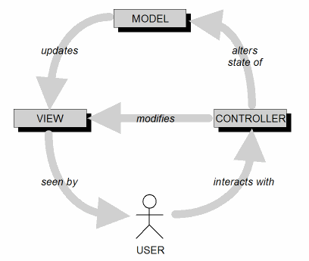
Model-View-Controller Architecture (MVC)
Design goal: Identify which application components are model, view, or controller.
A user cannot directly modify the model.

Slide 3
MVC Implementation: Loose Coupling
Keep the implementations of the
three objects types separate.
Each type of objects does not depend
on how the other types are implemented.
Your application is
  easier to develop and maintain
  faster to develop
  more robust (resilient to runtime errors)

Slide 4
MVC Model Objects
Represent the persistent information
maintained by your application.
The information can be kept in a database.

Slide 5
MVC View Objects
View objects represent
user interface components.
  Input components such as text fields and checkboxes.
In each use case, users interact
with at least one view object.
A view object collects information from users
in a form that the model and controller objects
can use.

Slide 6
MVC Controller Objects
Coordinate the model and view objects.
  Often have no physical counterpart in the real world.
Collect information from view objects
for dispatch to model objects.
This is how user-entered data can
update the model.

Slide 7
Software Frameworks
A software framework consists of a set of cooperating classes.
  These classes implement the essential mechanisms
  for a particular problem domain.
  Example: wxWidgets is a C++ software framework
  for multi-platform GUI programming.
A framework imposes a structure on the
design and development of applications.
  It has classes and API that implement the structure.
  It is more than simply a library.

Slide 8
Software Frameworks, cont’d
An programmer builds an application by:
  Subclassing framework classes.
  Adding new classes that provide
  custom functionality.
Inversion of control
  The framework controls the execution flow.
  The programmer registers callback functions,
  mostly as event handlers, with the framework.
  The framework invokes the callback functions at the appropriate times, such as in response to events.

Slide 9
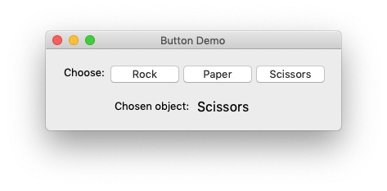
Button Demo

Slide 10
Button Demo, cont’d
ButtonPanel.h
class ButtonPanel : public wxPanel
{
public:
ButtonPanel(wxFrame *parent) : wxPanel(parent, wxID_ANY)
{
init();
}
// Event handlers
void on_rock(wxCommandEvent& event);
void on_paper(wxCommandEvent& event);
void on_scissors(wxCommandEvent& event);
private:
wxStaticText *button_chosen_text;
void init();
void update_button_choice_text(const Choice choice);
};

Slide 11
Button Demo, cont’d
ButtonPanel.cpp
#include "ButtonPanel.h"
void ButtonPanel::init()
{
wxSizer *sizer = new wxBoxSizer(wxVERTICAL);
wxPanel *button_panel = new wxPanel(this, wxID_ANY);
wxSizer *button_sizer = new wxBoxSizer(wxHORIZONTAL);
wxStaticText *choose_text = new wxStaticText(button_panel, wxID_ANY,
"Choose:");
wxButton *rock_button = new wxButton(button_panel, wxID_ANY,
choice_to_wxString(ROCK));
wxButton *paper_button = new wxButton(button_panel, wxID_ANY,
choice_to_wxString(PAPER));
wxButton *scissors_button = new wxButton(button_panel, wxID_ANY,
choice_to_wxString(SCISSORS));
...

Slide 12
Button Demo, cont’d
...
rock_button->Bind (wxEVT_BUTTON, &ButtonPanel::on_rock, this);
paper_button->Bind (wxEVT_BUTTON, &ButtonPanel::on_paper, this);
scissors_button->Bind(wxEVT_BUTTON, &ButtonPanel::on_scissors, this);
button_sizer->Add(choose_text, 0, 0, 0);
button_sizer->AddSpacer(5);
button_sizer->Add(rock_button, 0, 0, 0);
button_sizer->AddSpacer(5);
button_sizer->Add(paper_button, 0, 0, 0);
button_sizer->AddSpacer(5);
button_sizer->Add(scissors_button, 0, 0, 0);
button_panel->SetSizer(button_sizer);
wxPanel *chosen_panel = new wxPanel(this, wxID_ANY);
wxSizer *chosen_sizer = new wxGridSizer(2, 0, 5);
...

Slide 13
Button Demo, cont’d
...
wxStaticText *chosen_text = new wxStaticText(chosen_panel, wxID_ANY,
"Chosen object:");
button_chosen_text = new wxStaticText(chosen_panel, wxID_ANY, "");
button_chosen_text->SetFont(button_chosen_text->GetFont().Larger());
chosen_sizer->Add(chosen_text, 0, wxALIGN_RIGHT, 0);
chosen_sizer->Add(button_chosen_text, 0, 0, 0);
chosen_panel->SetSizer(chosen_sizer);
sizer->Add(button_panel, 0, wxALIGN_CENTER, 0);
sizer->AddSpacer(20);
sizer->Add(chosen_panel, 0, wxALIGN_CENTER, 0);
sizer->AddSpacer(20);
SetSizer(sizer);
}

Slide 14
Button Demo, cont’d
void ButtonPanel::on_rock(wxCommandEvent& event)
{
update_button_choice_text(ROCK);
}
void ButtonPanel::on_paper(wxCommandEvent& event)
{
update_button_choice_text(PAPER);
}
void ButtonPanel::on_scissors(wxCommandEvent& event)
{
update_button_choice_text(SCISSORS);
}
void ButtonPanel::update_button_choice_text(const Choice choice)
{
button_chosen_text->SetLabelText(choice_to_wxString(choice));
}

Slide 15
Assignment #9. GUI-Based RPS Game
Develop a GUI-based version of a
Rock-Paper-Scissors game.

Slide 16
Assignment #9: Required Features
Display which round it is.
For each round, there is a way for the human player to choose rock, paper, or scissors. The computer makes a random choice.
  Display the human’s and the computer’s choices.
Display who won each round (or was it a tie).
Display a running count of human wins, computer wins, and ties.
The default is 20 rounds per game.
  Provide an interactive way to change that number.

Slide 17
Assignment #9, cont’d
Required menu commands
  About
  Exit
  Start a new game
Due Tuesday, April 16.
  100 points

Slide 18
Assignment #9 Extra Credit
Add some basic machine learning
to the program.
  Make the computer’s choices smarter
  rather than simply random.
ML makes it increasingly difficult for a human
to beat the computer.
  In the long run, the computer will win more rounds than a human player.

Slide 19
Simple Machine Learning for RPS
Human players of the Rock Paper Scissors game try to develop strategies to beat the opponent.
Therefore, humans generally do not
make random choices.
Human choices exhibit patterns that
a computer can discover and exploit.

Slide 20
Simple Machine Learning for RPS, cont’d
Continuously record the last N choices
between the human and the computer player.
  Throw out the oldest choice in order
  to add a new one.
For example, suppose N = 5 and during the game, the recorded choices are (the human’s choices are underlined):
  The last choice was made by the human,
  and it was paper.
  PSRSP

Slide 21
Simple Machine Learning for RPS, cont’d
For each recorded sequence that ends with the human’s choice, the computer should store how many times that sequence has occurred (each sequence’s frequency).
  For example, for N = 5, the stored sequences and their frequencies may be (in no particular order, human choices are underlined):
RSPSR:1, SPRPP:3, RSPRS:2, RSPSS:4, RSPSP:3, SSRPP:2

Slide 22
Simple Machine Learning for RPS, cont’d
Stored frequencies:
RSPSR:1, SPRPP:3, RSPRS:2, RSPSS:4, RSPSP:3, SSRPP:2
Suppose that in the previous round, the human chose rock and the computer chose scissors. Then in the current round, the human chose paper and the computer chose scissors. Therefore, the last four choices were RSPS.

Slide 23
Simple Machine Learning for RPS, cont’d
Stored frequencies:
RSPSR:1, SPRPP:3, RSPRS:2, RSPSS:4, RSPSP:3, SSRPP:2
Last four choices:
RSPS
The computer can predict that the human will most likely next choose scissors, since RSPSS appears more times than RSPSR and RSPSP in the stored frequencies.
  Therefore, in the next round, the computer should choose rock to beat the human’s predicted choice
  of scissors.
  Update the stored frequencies with the round’s choices.

Slide 24
Simple Machine Learning for RPS, cont’d
When a game ends, write the frequency data
to a file, so that when a new game begins, these frequencies can be read back in.
As the computer plays more games
and stores more frequency data,
it becomes increasingly more capable
of predicting the human’s next choice.
In the long run, the computer will become
very difficult for humans to beat.

Slide 25
Assignment #9 Extra Credit, cont’d
If the computer uses ML, also display what the computer predicted the human will choose.
Extra credit: up to 50 points

Slide 26
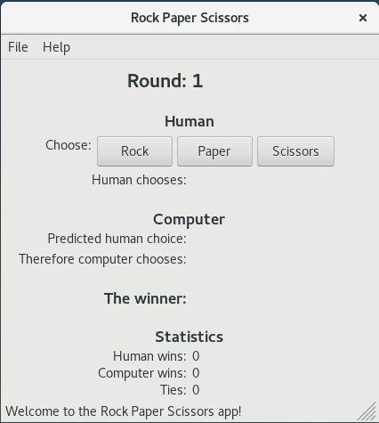
wx-RPS: Linux

