Slide 1


CS 144
Advanced C++ Programming
March 14 Class Meeting
Department of Computer Engineering
San Jose State University
Spring 2019
Instructor: Ron Mak
www.cs.sjsu.edu/~mak

Slide 2
Object-Oriented Programming
Encapsulation
  Classes
Inheritance
  Subclasses
Polymorphism
  Virtual functions

Slide 3
Inheritance
A very powerful and important feature
of object-oriented programming.
A new class (the derived class) is created from another class (the base class).
The base class is also called the superclass
or parent class.
A derived class is also called the subclass
or the child class.

Slide 4
Inheritance, cont’d
A child class inherits member variables and functions from its parent class.
Person.cpp
class Person
{
public:
string activity() { return "Eat and sleep."; }
};
class Student : public Person
{
public:
string study() { return "Study and study." ; }
};
A Student “is a” Person.

Slide 5
Inheritance, cont’d
class Person
{
public:
string activity() { return "Eat and sleep."; }
};
class Student : public Person
{
public:
string study() { return "Study and study." ; }
};
Person.cpp
Let s be type Student.
  Valid: s.study()
  Valid: s.activity()
Subclass Student inherits the member function activity from its superclass.

Slide 6
Superclasses and Subclasses
class Employee
{
public:
Employee(string nam) : name(nam), salary(0) {}
string get_name() const { return name; }
double get_salary() const { return salary; }
void set_salary(const double sal) { salary = sal; }
private:
string name;
double salary;
}
Employee1.h
What are the differences between
Manager and Employee?
The constructor of class Manager
calls the constructor of its
superclass Employee.
The get_salary function of
class Manager calls the
get_salary function of its
superclass Employee.
class Manager : public Employee
{
public:
Manager(string nam) : Employee(nam), bonus(0) {}
double get_bonus() const { return bonus; }
void set_bonus(const double bon) { bonus = bon; }
double get_salary() const { return Employee::get_salary() + bonus; }
private:
double bonus;
};
The subclass overrides
the get_salary member
function of its superclass.
Manager1.h

Slide 7

Superclasses and Subclasses, cont’d
Employee is the superclass.
Manager is the subclass.
  A manager “is a”
  employee.
  A manager is a
  specialized type
  of employee.
  The set of Manager
  objects is a subset
  of the set of Employee objects.
Object-Oriented Design & Patterns
by Cay Horstmann
John Wiley & Sons, 2006.

Slide 8
Invoke a Superclass Member Function
Suppose a manager’s salary is his regular employee salary plus a bonus that only managers get.
class Manager : public Employee
{
public:
double get_salary() const
{
return salary + bonus;
}
...
}
What’s wrong
with this solution?
A subclass cannot access the
private fields of its superclass.
What’s wrong
with this solution?
public:
double get_salary() const
{
return get_salary() + bonus;
}
Infinite recursion!

Slide 9
Invoke a Superclass Member Function, cont’d
Name the superclass and use the
scope resolution operator ::
class Manager : public Employee
{
public:
...
double get_salary() const
{
return Employee::get_salary() + bonus;
}
...
}

Slide 10
Invoke a Superclass Constructor
You can name the superclass in the
subclass constructor to call
the superclass constructor.
Pass any required parameters.
class Manager : public Employee
{
public:
Manager(string nam) : Employee(nam), bonus(0)
{
...
}
...
}

Slide 11
Invoke a Superclass Constructor, cont’d
If a subclass constructor does not explicitly
call a superclass constructor, the superclass’s default constructor (the one without parameters) is called automatically.
In this case, the superclass must have
a default constructor.

Slide 12
Invoke a Constructor from Another
A class can invoke one of its constructors
from another constructor.
  Called delegating constructors.
First became available
with C++11.
class Manager : public Employee
{
public:
Manager(string name) : Employee(name), bonus(0)
{
...
}
Manager(string name, double bon) : Manager(name), bonus(bon)
{
...
}
}

Slide 13
Missing Bonus?
#include <iostream>
#include "Employee1.h"
#include "Manager1.h"
using namespace std;
void print(Employee *ptr);
int main()
{
Employee *emp = new Employee("Ron");
emp->set_salary(100000);
print(emp);
Manager *mgr = new Manager("Mary");
mgr->set_salary(200000);
mgr->set_bonus(1000);
print(mgr);
return 0;
}
void print(Employee *ptr)
{
cout << ptr->get_name() << " makes " << ptr->get_salary() << endl;
}
EmployeeTest1.cpp
Ron makes 100000
Mary makes 200000
What happened
to Mary’s bonus?

Slide 14
Overridden Member Functions
Manager *mgr = new Manager("Mary");
mgr->set_salary(200000);
mgr->set_bonus(1000);
print(mgr);
...
void print(Employee *ptr)
{
cout << ptr->get_name() << " makes " << ptr->get_salary() << endl;
}
The data type of variable ptr is Employee*.
The data type of the passed object value is Manager*.
At run time, which member function is called?
  Employee::get_salary()
  Manager::get_salary()

Slide 15
Overridden Member Functions
Manager *mgr = new Manager("Mary");
mgr->set_salary(200000);
mgr->set_bonus(1000);
print(mgr);
...
void print(Employee *ptr)
{
cout << ptr->get_name() << " makes " << ptr->get_salary() << endl;
}
The data type of ptr is pointer to Employee*, and so Employee::get_salary() was called.
But since the data type of mgr is Manager*,
we really wanted the print function to call Manager::get_salary().

Slide 16
Overridden Member Functions
Manager *mgr = new Manager("Mary");
mgr->set_salary(200000);
mgr->set_bonus(1000);
print(mgr);
...
void print(Employee *ptr)
{
cout << ptr->get_name() << " makes " << ptr->get_salary() << endl;
}
Which get_salary() to call should be determined not by the data type of variable ptr, but instead by the data type of its runtime value.
  Parameter ptr was pointing to a Manager object.
This is the important object-oriented principle of polymorphism.

Slide 17
Polymorphism, cont’d
To make get_salary() polymorphic in C++,
we must declare it to be virtual.
  You only need to declare it virtual in the base class.
class Employee
{
public:
...
virtual double get_salary() const { return salary; }
...
}
Employee2.h
class Manager : public Employee
{
public:
...
double get_salary() const { return Employee::get_salary() + bonus; }
...
}
Manager2.h

Slide 18
Polymorphism, cont’d
Polymorphism is not free.
C++ must consult a virtual table at run time for every class that contains a virtual function.
  C++ cannot tell at compile time what the value
  (and hence value’s data type) of the variable will be.
Consulting the virtual table to determine which member function to call will affect performance.
  Use polymorphism judiciously.
Demo

Slide 19
Subclasses
Animal.cpp
class Animal
{
public:
string speak() { return "Shhh!"; }
};
class Mammal : public Animal
{
public:
string speak() { return "Grrr!" ; }
};
class Cat : public Mammal
{
public:
string speak() { return "Roar!"; }
};
class Kitty : public Cat
{
public:
string speak() { return "Meow!"; }
};
string make_sound(Cat& c) { return c.speak(); }
int main()
{
Kitty k;
cout << make_sound(k) << endl;
}
Variable k is a Kitty.
  k is also a Cat,
  a Mammal,
  and an Animal.
  Each subclass overrides the definition of member function speak.
What is the output?
  The type of parameter c is a Cat.
Roar!

Slide 20
Polymorphism
Polymorphism is the ability of a variable
to have different behaviors at run time.
How the variable behaves depends
not on the type of the variable,
but on the type of its value at run time.
Polymorphism is implemented in C++
with virtual functions.

Slide 21
Polymorphism, cont’d
Person.cpp
class Person
{
public:
virtual string activity() { return "Eat and sleep."; }
};
class Student : public Person
{
public:
string activity() { return "Study and study." ; }
};
class EngineeringMajor : public Student
{
public:
string activity() { return "Design and build."; }
};
class SoftwareMajor : public EngineeringMajor
{
public:
string activity() { return "Code and test."; }
};
string do_it(Student& s) { return s.activity(); }
int main()
{
SoftwareMajor sw;
cout << do_it(sw) << endl;
}
What is the output?
  Member function activity is virtual in Person and all subclasses.
  The type of parameter s is Student.
  The type of the value of s is SoftwareMajor.
Code and test.

Slide 22
Polymorphism, cont’d
Person.cpp
string activity(Student& s) { return s.activity(); }
int main()
{
SoftwareMajor sw;
cout << do_it(sw) << endl;
EngineeringMajor em;
cout << do_it(em) << endl;
Student st;
cout << do_it(st) << endl;
}
Code and test.
Design and build.
Study and study.

Slide 23
Virtual Destructors
class Employee
{
public:
Employee() { cout << "Employee called" << endl; }
~Employee() { cout << "~Employee called" << endl; }
};
class Manager : public Employee
{
public:
Manager() { cout << "Manager called" << endl; }
~Manager() { cout << "~Manager called" << endl; }
private:
string name;
};
Employee.h
Demo
#include "Employee.h"
int main()
{
Employee *ptr = new Manager();
delete ptr;
return 0;
}
Which destructor(s) is/are called?
DestructorTest.cpp

Slide 24
Virtual Destructors, cont’d
From now on, make destructors virtual.
  Example:
A virtual destructor ensures that the
correct destructor is called for an object
when the object is being destroyed.
virtual ~Foo();

Slide 25
Class Hierarchies
Object-oriented programming uses
class hierarchies.
  AKA inheritance hierarchies.
In the real world, hierarchies express
general/specific relationships among concepts.

Slide 26
Class Hierarchies, cont’d
The most general superclass is at the
root of a tree.
More specific subclasses are children.
The most specific subclasses are leafs.
Class hierarchies can be complex.
  But they shouldn’t be.

Slide 27
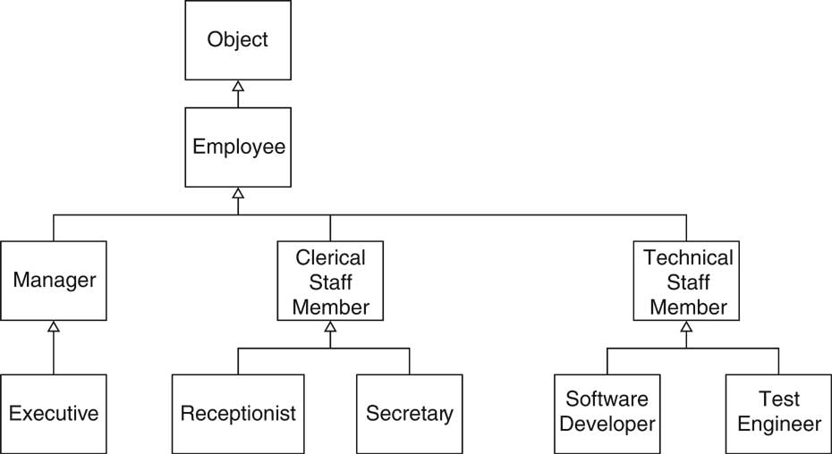
Class Hierarchies, cont’d
Object-Oriented Design & Patterns
by Cay Horstmann
John Wiley & Sons, 2006.

Slide 28
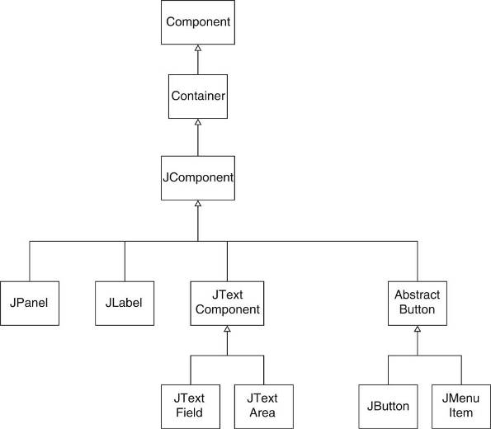
Class Hierarchies, cont’d
Java’s “Swing”
GUI classes.
Object-Oriented Design & Patterns
by Cay Horstmann
John Wiley & Sons, 2006.

Slide 29
The Liskov Substitution Principle
Named after Barbara Liskov.
  MIT computer science professor.
  A pioneer in object-oriented programming.
Wherever there is a superclass object,
you can substitute a subclass object.

Slide 30
The Liskov Substitution Principle, cont’d
Wherever there is a superclass object,
you can substitute a subclass object.
  Example: The superclass Employee object
  is substituted by the subclass Manager object.
  Polymorphism enables automatically calling the correct get_salary() function in both cases.
Employee *ptr = new Employee("John Doe");
cout << "salary = " << ptr->get_salary() << endl;
Employee * ptr = new Manager("Mary Jane");
cout << "salary = " << ptr->get_salary() << endl;
30

Slide 31
Point-Circle-Rectangle
class Point
{
public:
Point(int x, int y) : x(x), y(y) {}
virtual ~Point() {}
int get_x() const { return x; }
int get_y() const { return y; }
void move(const int dx, const int dy) { x += dx; y += dy; }
private:
int x, y;
};
Is there anything
wrong with this code?
class Circle : public Point
{
public:
Circle(Point center, int r)
: Point(center.get_x(), center.get_y()),
radius(r)
{}
private:
int radius;
};
A Circle has a center Point.
But a Circle is not a Point.

Slide 32
Point-Circle-Rectangle, cont’d
Even worse!
  The upper-left corner is kept in the superclass.
  The lower-right corner is a member variable.
class Rectangle : public Point
{
public:
Rectangle(Point upper_left, Point lr)
: Point(upper_left.get_x(), upper_left.get_y()),
lower_right(lr)
{}
void move(int dx, int dy) // override Point::move()
{
Point::move(dx, dy);
lower_right.move(dx, dy);
}
private:
Point lower_right;
};
A Rectangle has two Points.
But a Rectangle is not a Point.
Violates the Liskov Substitution Principle:
You cannot substitute a Point by a Rectangle.

Slide 33
Vector-Stack
#include <string>
#include <vector>
using namespace std;
class Stack : public vector<string>
{
public:
Stack();
void push(string item);
string pop();
};
void Stack::push(string item)
{
this->push_back(item);
}
T Stack::pop()
{
string top_item =
this->at(this->size() - 1);
this->pop_back();
return top_item;
}
VectorStack.cpp
int main()
{
Stack stk;
stk.push("A");
stk.push("B");
stk.push("C");
stk.erase(stk.begin() + 1); // remove "B"
}
A stack is not a special case
of a vector.
What is wrong
with this code?
Violates the Liskov Substitution Principle:
You cannot substitute a vector by a stack.

Slide 34
Vector-Stack, Fixed
#include <string>
#include <vector>
using namespace std;
class Stack
{
public:
Stack();
void push(string item);
string pop();
private:
vector<string> stack;
};
void Stack::push(string item)
{
stack.push_back(item);
}
T Stack::pop()
{
string top_item =
this->at(this->size() - 1);
stack.pop_back();
return top_item;
}
int main()
{
Stack<string> stk;
stk.push("A");
stk.push("B");
stk.push("C");
//stk.erase(stk.begin() + 1); // not allowed
}
Delegate storage
to a private vector.
A stack is not a vector.

