Slide 1


CS 144
Advanced C++ Programming
January 31 Class Meeting
Department of Computer Engineering
San Jose State University
Spring 2019
Instructor: Ron Mak
www.cs.sjsu.edu/~mak

Slide 2
Predefined Functions
C++ includes predefined functions.
  AKA “built-in” functions
  Example: Math function sqrt
Predefined functions are stored in libraries.
  Your program will need to include the appropriate library header files to enable the compiler to recognize the names of the predefined functions.
  Example: #include <cmath>
  in order to use predefined math functions like sqrt

Slide 3
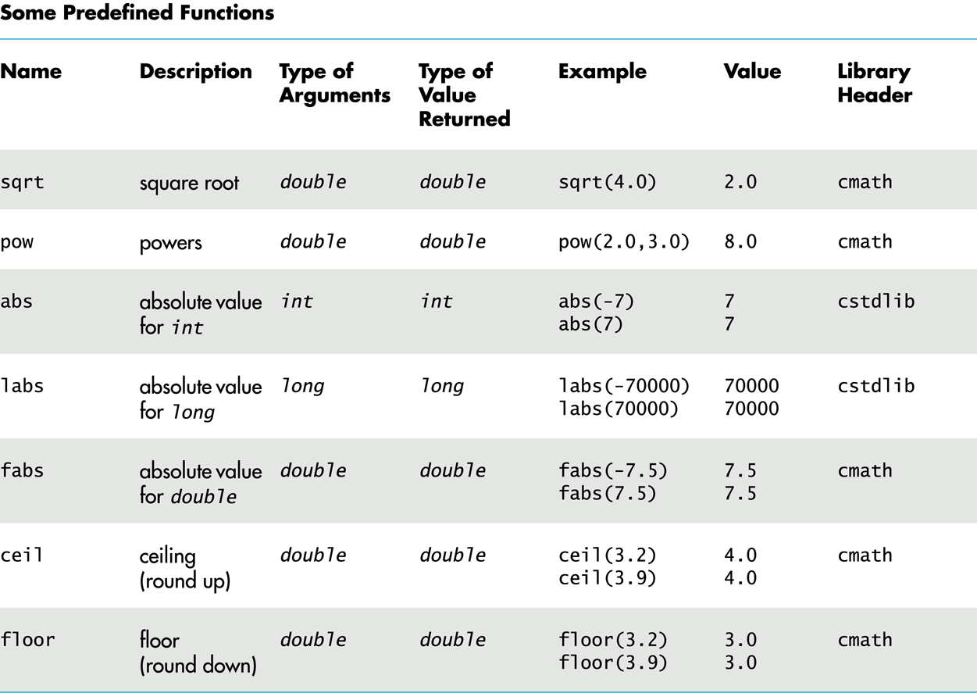
Predefined Functions, cont’d

Slide 4
Random Numbers
To generate (pseudo-) random numbers
using the predefined functions, first include
two library header files:
“Seed” the random number generator:
  If you don’t seed, you’ll always get the same “random” sequence (which may be useful for debugging).
#include <cstdlib>
#include <ctime>
srand(time(0));

Slide 5
Random Numbers, cont’d
Each subsequent call returns a “random” number ≥ 0 and ≤ RAND_MAX.
  RAND_MAX is library-dependent but is guaranteed to be at least 32,767.
Use + and % to scale to a desired number range.
  Example: Each execution of the expression
  returns a random number
  with the value 1, 2, 3, 4, 5, or 6.
rand();
rand()%6 + 1

Slide 6
Type Casting
Suppose integer variables i and j are initialized to 5 and 2, respectively.
What is the value of the division i/j ?
What if we wanted to have a quotient
of type double?
  We want to keep the fraction.

Slide 7
Type Casting, cont’d
One way is to convert one of the operands
to double.
  Then the quotient will be type double.
Why won’t the following work?
double quotient = static_cast<double>(i)/j;
double quotient = static_cast<double>(i/j);

Slide 8
Programmer-Defined Functions
In addition to using the predefined functions, you can write your own functions.
Programmer-defined functions are critical
for good program design.
In your C++ program, you can call a programmer-defined function only after the function has been declared or defined.

Slide 9
Function Declarations
A function declaration specifies:
  The function name.
  The number, order, and data types
  of its formal parameters.
  The data type of its return value.
Example:
double total_cost(double unit_cost, int count);

Slide 10
Function Definitions
After you’ve declared a function,
you must define it.
  Write the code that is executed
  whenever the function is called.
  A return statement terminates execution
  of the function and returns a value to the caller.
Example:
double total_cost(double unit_cost, int count)
{
double total = count*unit_cost;
return total;
}

Slide 11
Function Calls
Call a function that you wrote just as you would call a predefined function.
Example:
int how_many;
double how_much;
double spent;
how_many = 5;
how_much = 29.99;
spent = total_cost(how_much, how_many);

Slide 12
Void Functions
A void function performs some task
but does not return a value.
Therefore, its return statement terminates the function execution but does not include a value.
  A return statement is not necessary for a void function if the function terminates “naturally”
  after it finishes executing the last statement.
Example void
function definition:
void print_TF(bool b)
{
if (b) cout << "T";
else cout << "F";
}

Slide 13
Void Functions, cont’d
A call to a void function cannot be part of an expression, since the function doesn’t return
a value.
Instead, call a void function as a statement
by itself.
Example:
bool flag = true;
print_TF(flag);

Slide 14
Coding Convention with Functions
First declare all your functions.
Document each declaration with a comment that describes:
  What the function does.
  What is each function parameter.
  What is the return value.
Define the main function.
Define the functions.
  Now you only need to document each function’s internal operations.

Slide 15
Coding Convention with Functions, cont’d
#include <iostream>
using namespace std;
/**
* Add two integers and return their sum.
* @param n1 the first integer
* @param n2 the second integer
* @return their sum.
*/
int make_sum(int n1, int n2);
/**
* Print an integer value;
* @param n the value to print.
*/
void print(int n);
int main()
{
int i = 5, j = 7;
int sum = make_sum(i, j);
print(sum);
}
The declarations tell you what
the functions will do and provide
the overall structure of the
program without all the details.
int make_sum(int n1, int n2)
{
return n1 + n2; // return their sum
}
void print(int n)
{
cout << "The value is " << n << endl;
}

Slide 16
Top-Down Design
Top-down design is an important
software engineering principle.
Start with the “topmost subproblem”
of a programming problem.
  Write a function that solves the topmost subproblem.
Break each subproblem into smaller subproblems.
  Write a function that solves each subproblem.
  This process is called stepwise refinement.

Slide 17
Top-Down Design, cont’d
The result is a hierarchical decomposition
of the problem.
AKA functional decomposition

Slide 18
Top-Down Design Example
Write a program that inputs positive integer values up to 999,999 from the user and translates each value into words.
Example:
  The user enters 482
  The program writes “four hundred eighty-two”
Repeat until the user enters a value ≤ 0.

Slide 19
Top-Down Design Example, cont’d
What is the topmost problem?
  Read numbers entered by the user
  until the user enters a value ≤ 0.
  Translate each number to words.
This is a high-level description of what
the program is supposed to do.

Slide 20
Refinement 1
Loop to read and print the numbers.
Call a translate function,
but it doesn’t do anything yet.

Slide 21
Refinement 2
How to translate a number into words?
  Break the number into separate digits.
  Translate the digits into words such as one, two, ..., ten, eleven, twelve, ..., twenty, thirty, etc.
Refine the translate function to handle
some simple cases:
  Translate_ones: 1 through 9
  Translate_teens: 11 through 19
These functions each returns one word.

Slide 22
Refinement 3
The translate function takes a 3-digit number and separates out the hundreds digit.
Translate the hundreds digit.
  Translate_hundreds
  Do this simply by translating a hundreds digit as we did a ones digit, and append the word hundred.

Slide 23
Refinement 3, cont’d
Translate the last two digits:
  We can already translate a teens number.
  Otherwise, break apart the two digits
  into a tens digit and a ones digit.
    Translate_tens: 10, 20, 30, ..., 90
  We can already translate a ones digit.

Slide 24
Refinement 4
Add a hyphen between twenty, thirty, etc.
and a ones word.

Slide 25
Refinement 5
Break a 6-digit number into a 3-digit first part and a 3-digit second part.
Translate the first part and append the word thousand.
Translate the second part.

Slide 26
Scope and Local Variables
Any variable declared inside a function is
local to that function.
  The scope of the variable is that function.
  Scope refers to the part of the program
  where the variable is accessible.
  The variable is not accessible
  from outside the function.
  A variable with the same name declared inside another function is a different variable.
The same is true for any variable
declared inside the main function.

Slide 27
Block Scope
You can declare variables inside of a block.
  A block of code is delimited by { and }.
The variables are local to the block.
  Example:
if (x < y)
{
int i;
...
}

Slide 28
Global Constants and Variables
If a constant or a variable is declared
outside of and before the main and the
function definitions, then that constant
or variable is global, and it is accessible
by the main and any function.
Global variables are not recommended.
  If a function modifies a global variable,
  that can affect other functions.
  Such “side effects” of a function can make a program error-prone and difficult to maintain.

