Slide 1


CMPE 280
Web UI Design and Development
April 14 Class Meeting
Department of Computer Engineering
San Jose State University
Spring 2020
Instructor: Ron Mak
www.cs.sjsu.edu/~mak

Slide 2
User Interface Design Patterns
Organization
Navigation
Page layout
List
Action

Slide 3
Action Controls
Buttons
Menu bars
Pop-up menus
Drop-down menus
Toolbars
Links
Action panels
Hover tools
Double-clicking
Keyboard actions
Drag-and-drop
Typed commands

Slide 4
Action Design Patterns
Ways to present action.
Indicate progress of actions.
Give users a sense of closure.
Allow users to preview actions.
Allow users to cancel actions.
Allow users to undo actions.

Slide 5
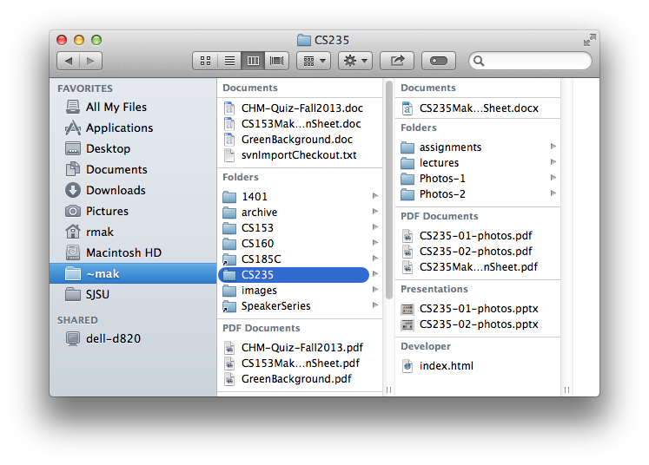
Action: Button Groups
What
  Group related actions.
  Multiple groups for
  multiple sets of actions
When
  Many possible actions.
  Related sets of actions.
Why
  Gestalt principles.
  Actions that can take place in a given context.
  Button clusters are easy to pick out within in a complex layout.

Slide 6
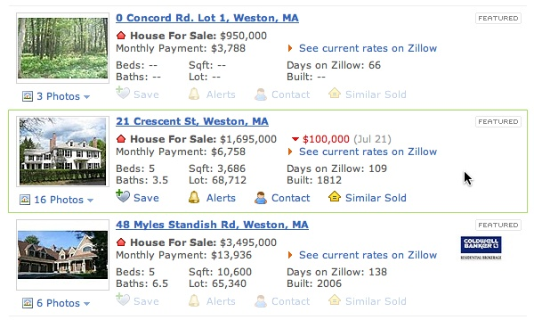
Action: Hover Tools
What
  Place controls next to the item they act upon.
  Hide or disable the controls until the user hovers the mouse over the item.
When
  Many possible actions.
  Keep user interface as uncluttered as possible.
Why
  Show or enable only relevant controls.
Designing Interfaces, 2nd ed.
by Jenifer Tidwell
O’Reilly Media, 2011

Slide 7
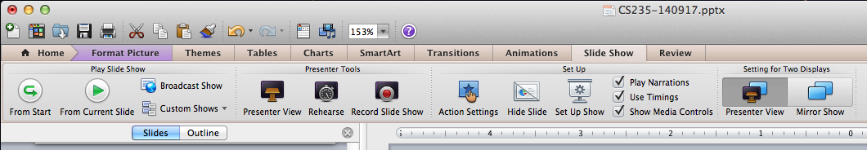
Action: Action Panel
What
  A panel of related controls that is
  richly organized and always visible.
When
  The controls need to be visible always.
  Sufficient space to display the controls.
Why
  Users will always know what actions are available.

Slide 8
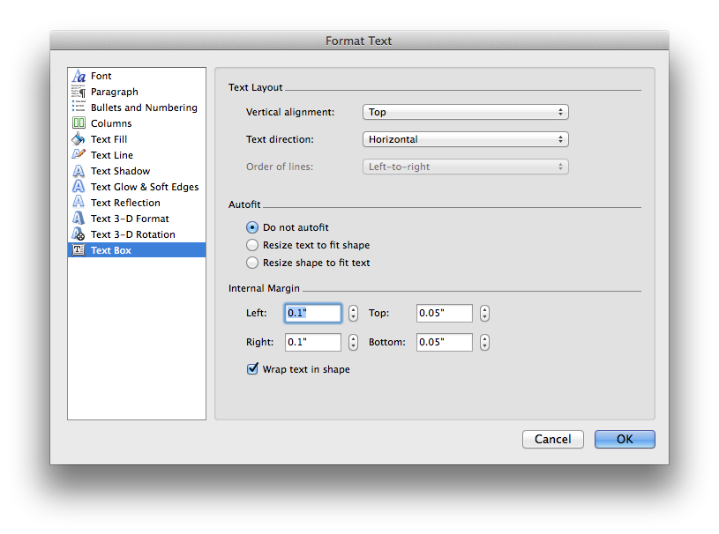
Action: Prominent “Done” Button
What
  Place the button that
  completes an action
  prominently at the
  end of the visual flow.
When
  Whenever you need a
  Done, Submit, OK, or
  Continue button.
Why
  Give the user a sense of closure.
  The user knows that an action was done.

Slide 9
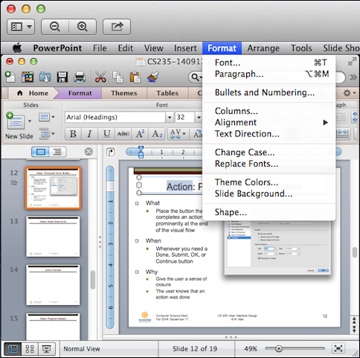
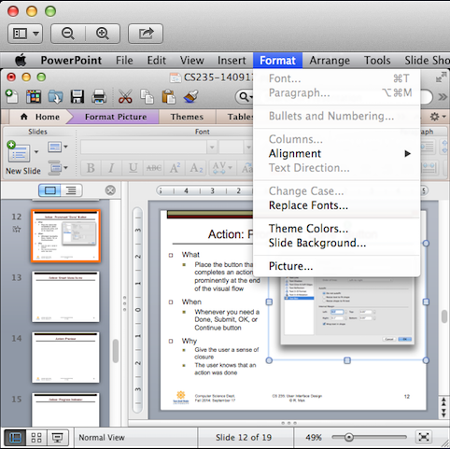
Action: Smart Menu Items
What
  Dynamically
  change or
  disable
  menu items.
When
  Different
  actions for
  different
  contexts.
Why
  Only show actions that are
  relevant for a given context,
  such as a user selection.

Slide 10
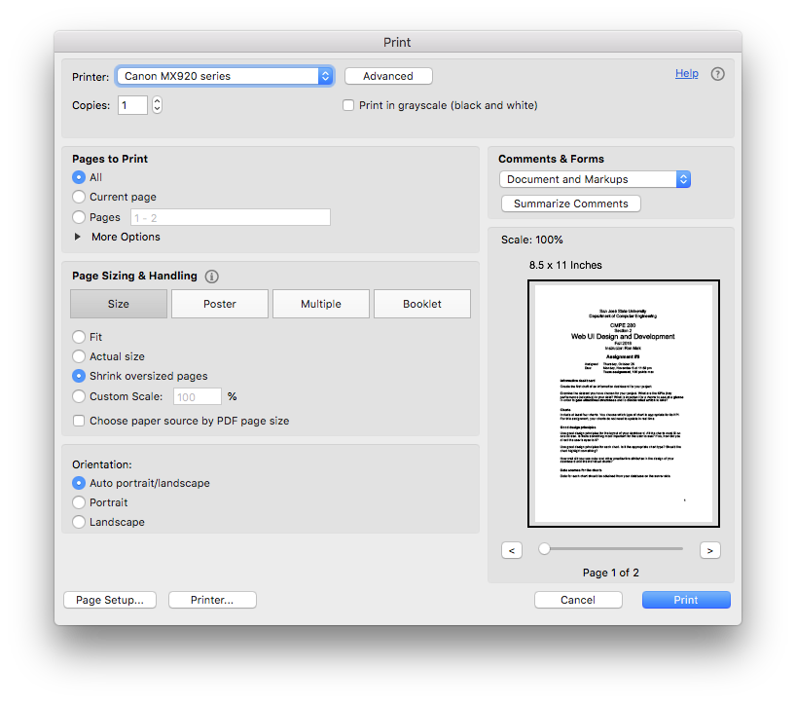
Action: Preview
What
  Show a preview or summary of the results of a pending action.
When
  The user is about to perform an action that will produce results.
Why
  Assure the user
  that the results
  will be correct.
  Help prevent errors.

Slide 11
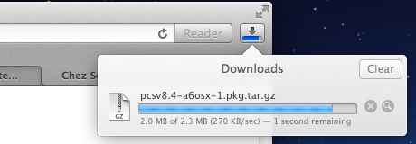
Action: Progress Indicator
What
  Show how much
  progress a
  time-consuming
  action has made.
When
  A time-consuming action runs in the background.
Why
  Assure the user that progress is being made.
  Indicate how much work remains.

Slide 12
Action: Cancelability
What
  Provide a way
  to cancel a
  time-consuming
  action.
When
  A time-consuming action runs.
Why
  Users change their minds.
  A user wants to terminate
  a time-consuming action.

Slide 13
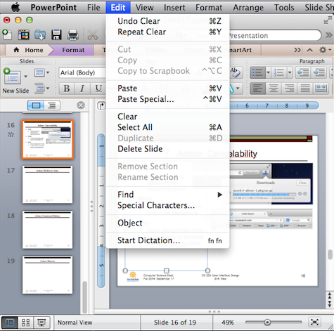
Action: Multilevel Undo
What
  Allow the user to reverse a sequence of actions.
When
  A highly interactive interface with many
  user actions.
Why
  Provide an interface that is safe to explore.
  Users are confident that errors aren’t permanent.
  No need to “checkpoint” data and revert to an earlier version.

Slide 14
Actions You Can Generally Undo
Text entry
Drawing changes
Layout changes
Creation, deletion, or rearrangement of items
Cut, copy, or paste operations
File operations: create, delete, rename
Database operations

Slide 15
Actions You Generally Cannot Undo
Navigation between pages or windows
Mouse or text cursor movements
Scrollbar position
Window or panel positions and sizes
Changes made in a modal dialog box

Slide 16
User Interface Design Patterns
Organization
Navigation
Page layout
List
Action
User input

Slide 17
Principles of Getting Input from Users
Make sure the user understands
what’s asked for and why.
Give the user a list of options.
Give meaningful and sensible error messages.
  Be forgiving.
Be aware of users’ mental models.
The choice of input controls determine the user’s expectations of what is asked for.
Do lots of usability testing.

Slide 18

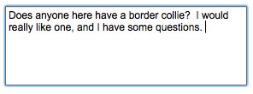

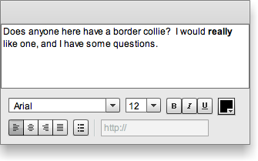
Text Input Controls
Single-line text
Multiline text
Structured text
Text editor
Designing Interfaces, 2nd ed.
by Jenifer Tidwell
O’Reilly Media, 2011

Slide 19




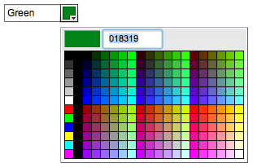
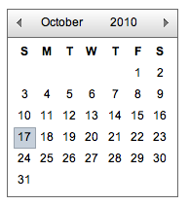
Choice Controls
Checkbox
Spinner
Radio buttons
Slider
Toggle buttons
Dropdown chooser
Calendar chooser
Designing Interfaces, 2nd ed.
by Jenifer Tidwell
O’Reilly Media, 2011

Slide 20
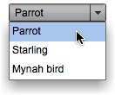
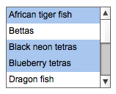
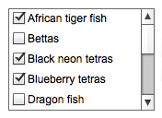
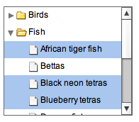
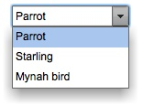
Controls for List Item Selection
Dropdown list
Multiple selection list
Checkbox list
Combo box
Multiple selection tree
Designing Interfaces, 2nd ed.
by Jenifer Tidwell
O’Reilly Media, 2011

Slide 21
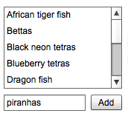
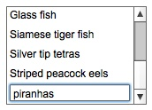
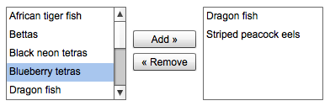
Controls for Creating Lists
List with new-item row
List with add button
List builder
Designing Interfaces, 2nd ed.
by Jenifer Tidwell
O’Reilly Media, 2011

Slide 22
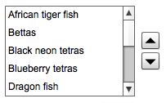
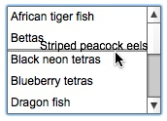
Controls for Sorting Lists
List with up-down buttons
List with internal
drag-and-drop
Designing Interfaces, 2nd ed.
by Jenifer Tidwell
O’Reilly Media, 2011

Slide 23
User Input Design Patterns
Allow users to select from choices.
Allow users to input text.

Slide 24

Input: Forgiving Format
What
  An input text field that allows a variety of input formats and syntax
When
  The user needs to enter information that can be typed in a variety of ways
Why
  Users are unpredictable
  Friendlier for users
Designing Interfaces, 2nd ed.
by Jenifer Tidwell
O’Reilly Media, 2011

Slide 25

Input: Structured Format
What
  A set of text input fields that reflect the structure of the requested data.
When
  Input data must have
  a fixed structure.
Why
  Provide a clue to users.
  Reduce data entry errors.
Credit card number:
Designing Interfaces, 2nd ed.
by Jenifer Tidwell
O’Reilly Media, 2011

Slide 26

Input: Fill-in-the-Blanks
What
  A sentence or phrase with one or more “blanks”
  for the user to fill in.
When
  User input is in several related parts.
Why
  Self-explanatory interface.
  Hints to the user
Designing Interfaces, 2nd ed.
by Jenifer Tidwell
O’Reilly Media, 2011

Slide 27
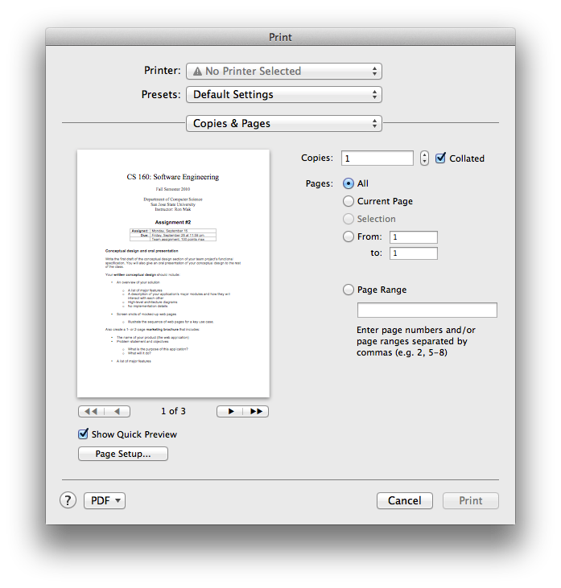
Input: Tips and Hints
What
  Explanatory text that provides tips or hints about the desired input.
When
  A form with a variety
  of input fields.
Why
  Tell users what input
  is desired.
  Users don’t need to consult documentation.

Slide 28
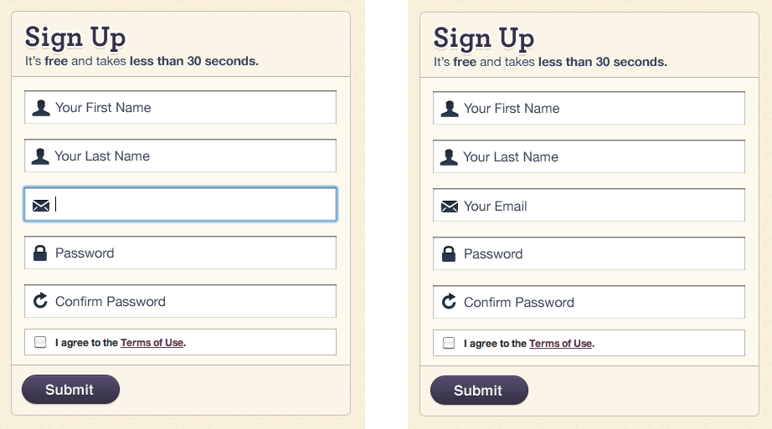
Input: Prompting Text Field
What
  Text input fields
  pre-filled with
  user prompts.
When
  A form with
  a variety of
  input fields.
Why
  Tell users what
  input is desired.
  Users don’t need to consult documentation.
Designing Interfaces, 2nd ed.
by Jenifer Tidwell
O’Reilly Media, 2011

Slide 29
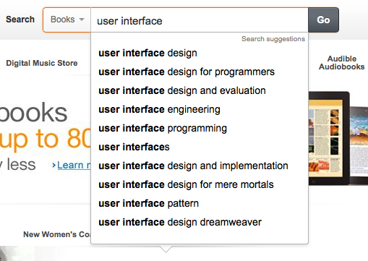
Input: Auto-Completion
What
  Anticipate possible
  input data based on
  what the user has
  already typed.
When
  A list of possible ways
  to complete the input.
Why
  User-friendly time saver.
  Users don’t have to remember long input.
  Users can reuse previous input.

Slide 30
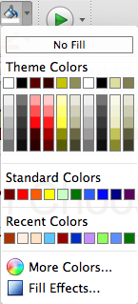
Input: Dropdown Chooser
What
  A dropdown menu
  with a variety of items.
  Different ways to display the items.
When
  The user must choose
  from a set of items.
Why
  Users are already familiar with dropdown menus.
  Compact way to present menu items.
  Display menu items only when needed.

Slide 31
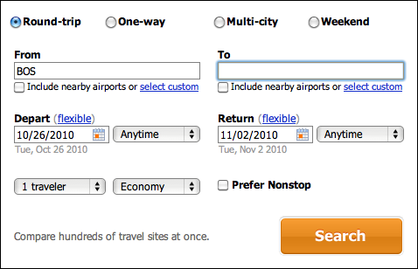
Input: Good Defaults
What
  Pre-fill input fields
  with likely user input.
When
  Reasonable guesses of what the user will enter.
Why
  User-friendly
  time-saver.
  Less knowledge required by the user.
Designing Interfaces, 2nd ed.
by Jenifer Tidwell
O’Reilly Media, 2011

Slide 32
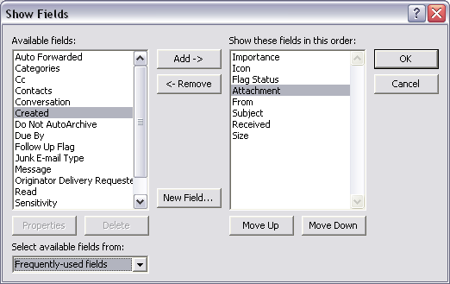
Input: List Builder
What
  Source and
  destination lists.
  Add and Remove
  buttons, or drag-and-
  drop between the lists.
When
  The user must create
  a list using items from
  another list.
Why
  The user can see the available choices for the destination list.
  Clear what the destination list will be.
Designing Interfaces, 2nd ed.
by Jenifer Tidwell
O’Reilly Media, 2011

Slide 33
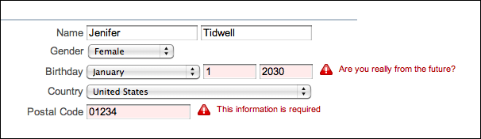
Input: Same-Page Error Messages
What
  Display error messages on the same page.
  Display error messages next to the erroneous input.
When
  User might enter bad input.
Why
  Immediate feedback near the erroneous input.
Designing Interfaces, 2nd ed.
by Jenifer Tidwell
O’Reilly Media, 2011

Slide 34
Project Oral Presentations
PowerPoint slides and live demo
  At most 20 minutes each.
What to present
  What is your data? What does it contain?
  What does your information dashboard show?
    What are the KPIs and why are they important?
    What decisions will be prompted by your dashboard?
  Use your website to present the story about your data.
  Questions and answers.
The rest of the class will
evaluate each presentation
by filling out a Canvas survey.

Slide 35
Presentation Schedule
Tuesday, Apr. 28
  .
  .
  .
Thursday, Apr. 30
  .
  .
  .
Tuesday, May 5
  .
  .
  .
Thursday, May 7
  .
  .
  .
  .

Slide 36
Example Survey Questions
How well did the team describe:
  What its application is about?
  Who were its clients?
  Its application architecture and technologies?
  Its data source and how it was stored?
GUI design
  Organization and navigation design patterns?
  Layout and list design patterns?
  Action and user input design patterns?
  What is the overall quality of the user experience?

Slide 37
Example Survey Questions, cont’d
Tell a story about the data
  What KPIs were displayed in the dashboard?
  What decisions can be made from the dashboard?
  How well did the team tell its story about the data?
  How well did the data visualizations
  support the story?
Overall, how well did the team do on its demo?
How well did the team handle the Q&A?

Slide 38
Project Reports
Material from your oral presentation
Plus:
  High-level overview of your application architecture.
  What client-side, server-side, and database technologies did you use?
  Where did you get your data? How did you store it?
  How did you create your data visualizations?
  What UI design patterns did you implement?

Slide 39
Project Reports, cont’d
For the grader:
  Instructions on how to run your application.
  Screen shots.
  Zip file of source code.
  Zip file of your dataset (subset only if large).
Final project reports due Monday, May 11.

