Slide 1


CMPE 280
Web UI Design and Development
April 9 Class Meeting
Department of Computer Engineering
San Jose State University
Spring 2020
Instructor: Ron Mak
www.cs.sjsu.edu/~mak

Slide 2
User Interface Design Patterns
Organization
Navigation
Page layout
List

Slide 3
Page Layout
Manipulate page attention to convey:
  meaning
  sequence
  points of interaction
Visual hierarchy:
  What’s important?
  What’s related?

Slide 4
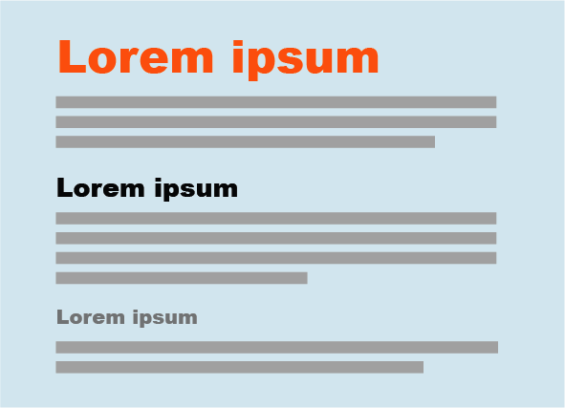
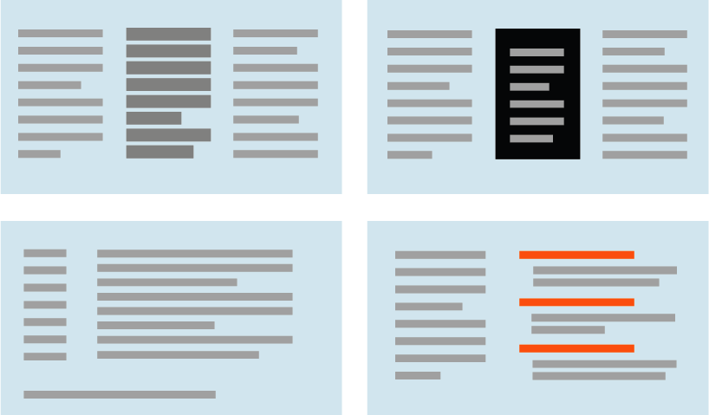
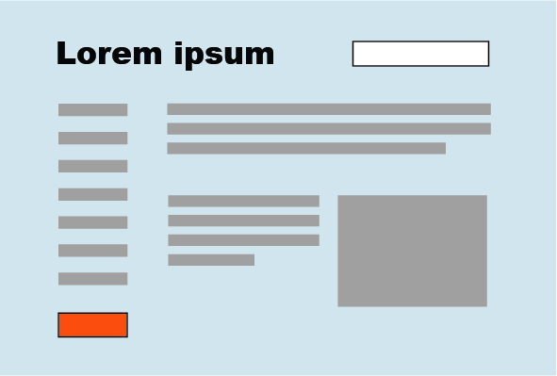
How to Show Importance
Text sizes to show hierarchy
Text density
Background color
Visual rhythm
Position and size
Emphasize small items
Designing Interfaces, 2nd ed.
by Jenifer Tidwell
O’Reilly Media, 2011

Slide 5
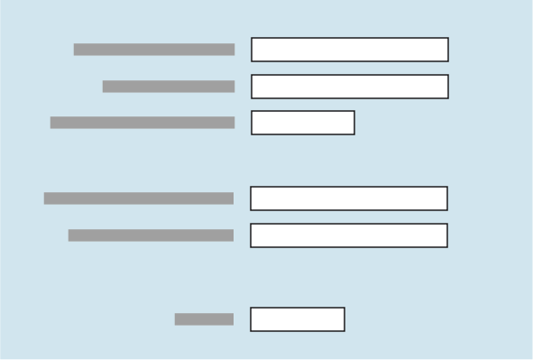
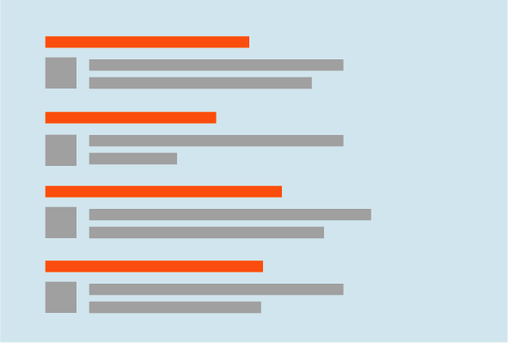



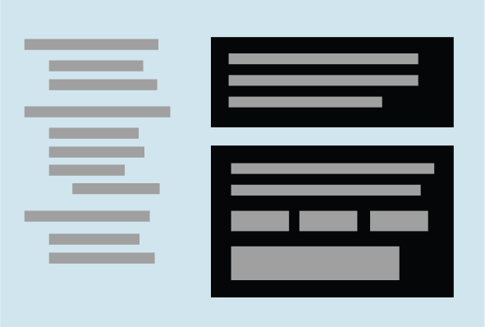
How to Show Relationships
Grouped related items
List of items
Captions and comments
Peer items
One distinguished item
Containment
Designing Interfaces, 2nd ed.
by Jenifer Tidwell
O’Reilly Media, 2011

Slide 6
Four Gestalt Principles
gestalt: An organized whole that is perceived
as more than the sum of its parts.
Proximity
  Viewers will associate together items
  that are placed close together.
Similarity
  Viewers will associate two things that have
  the same shape, size, orientation, etc.

Slide 7
Four Gestalt Principles, cont’d
gestalt: An organized whole that is perceived
as more than the sum of its parts.
Continuity
  Viewers’ eyes want to see continuous lines
  and curves formed by the alignment of items.
Closure
  Viewers’ eyes want to see implicit
  simple closed forms such as rectangles.

Slide 8
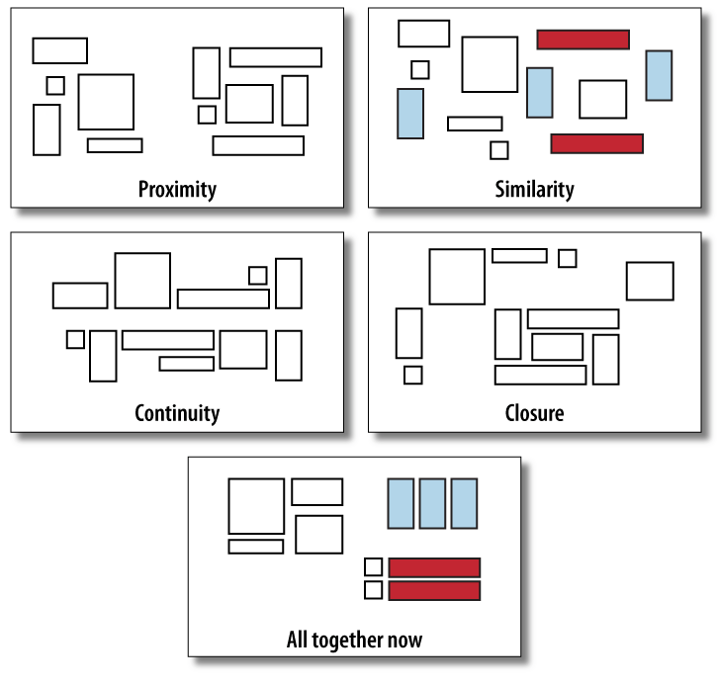
Four Gestalt Principles, cont’d
Designing Interfaces, 2nd ed.
by Jenifer Tidwell
O’Reilly Media, 2011

Slide 9
Page Layout Design Patterns
Page layout design patterns provide
specific ways to incorporate the
layout concepts and principles.
Solve layout problems.

Slide 10
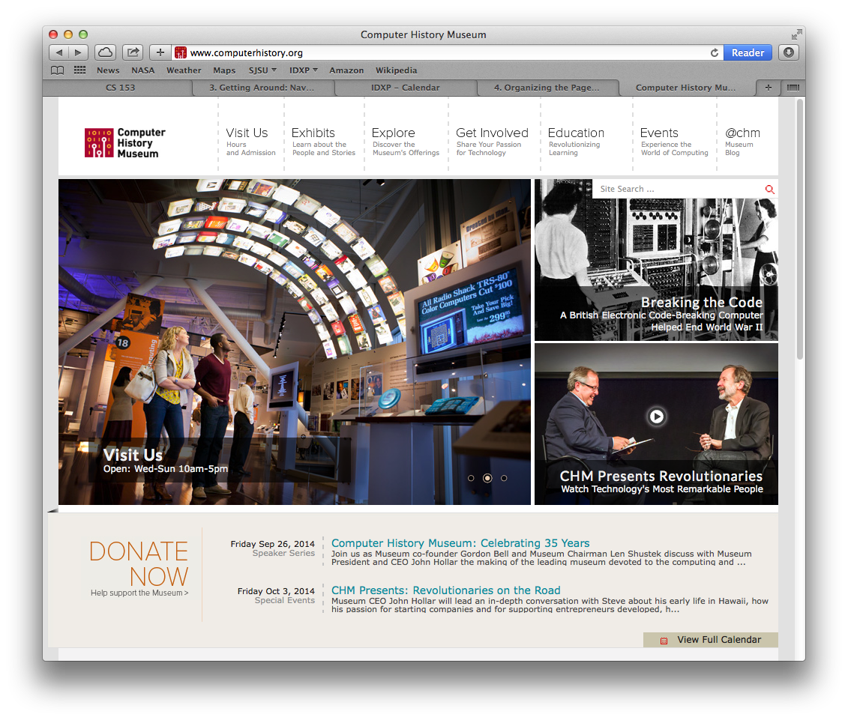
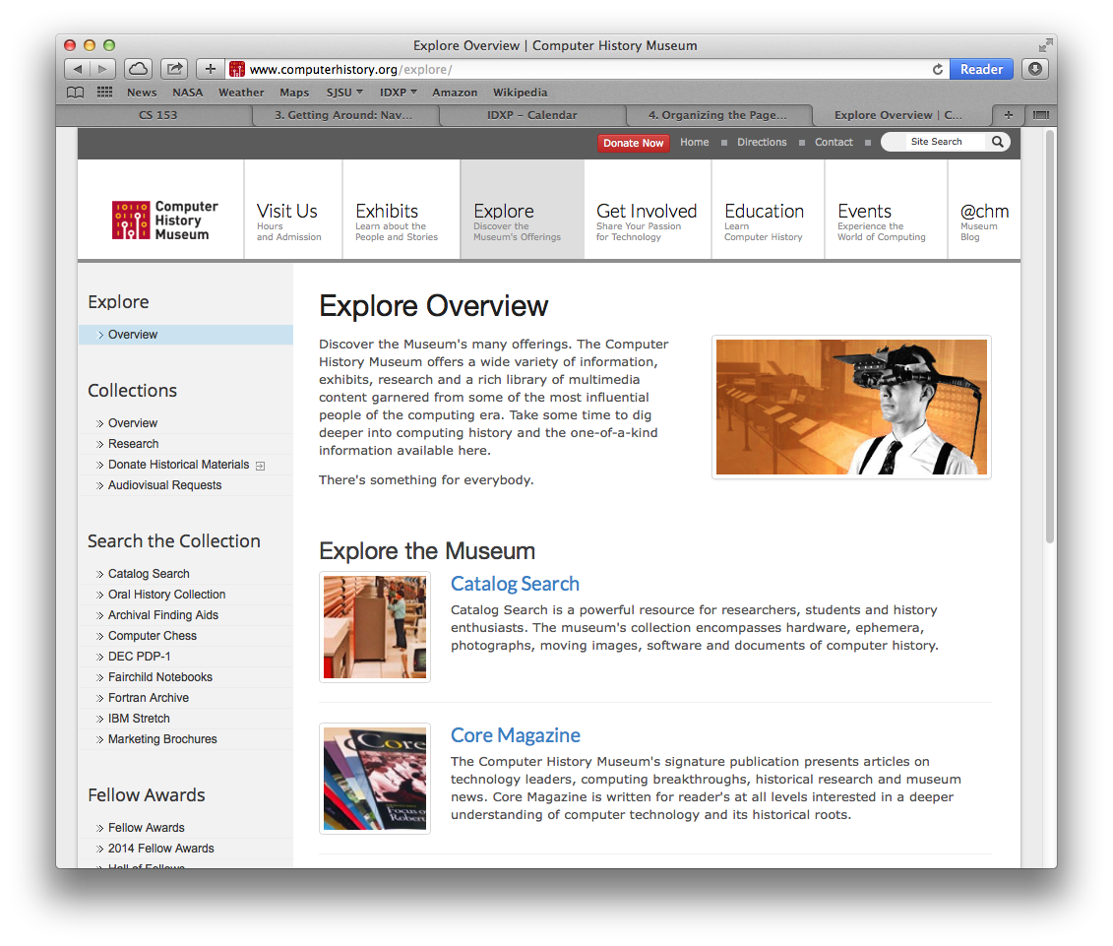
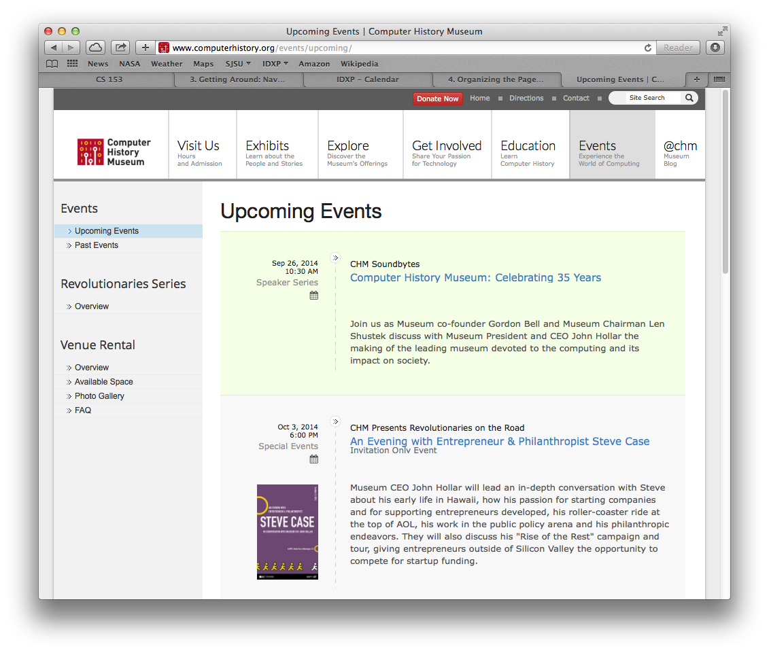
Layout: Visual Framework
What
  A common framework for all application pages but which allows flexibility to handle varying page content.
When
  Designing an application with multiple pages
  You want the pages to appear to belong together.
Why
  Provide consistency.
  Help page content stand out.

Slide 11
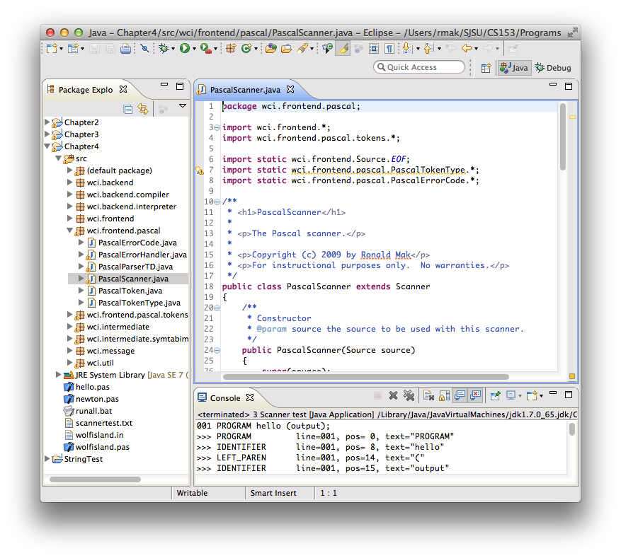
Layout: Center Stage
What
  The most important part of the UI has the largest subsection of the page.
  Secondary windows cluster around in smaller subpanels.
When
  The page’s primary job is to show a single unit of information or to permit a single task.
Why
  Guide the user to the most important part.

Slide 12
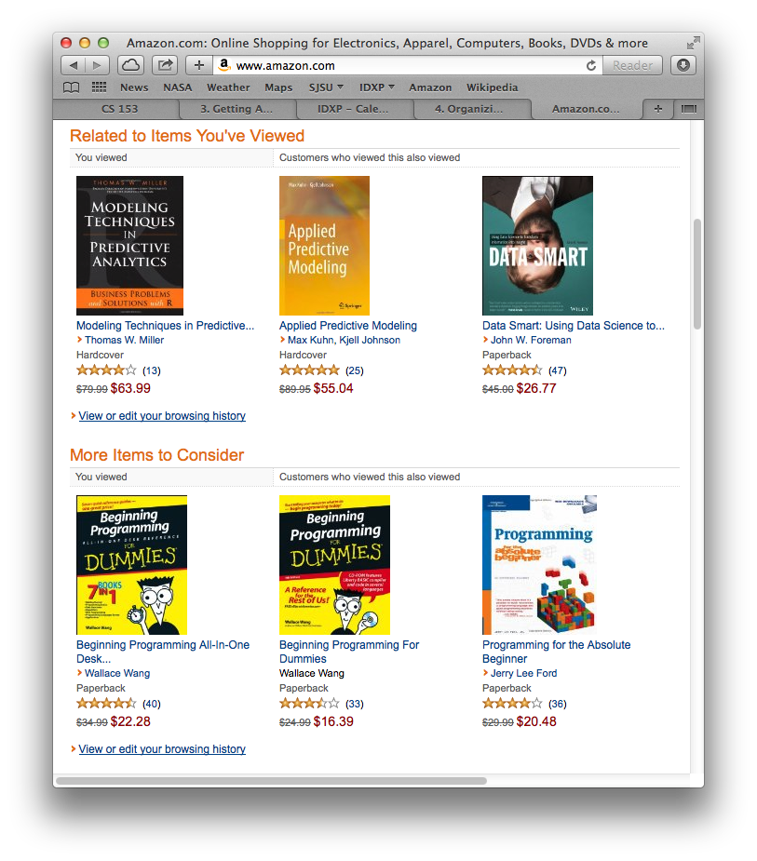
Layout: Grid of Equals
What
  Arrange equally important items in a grid, each with equal visual weight.
When
  Many items have similar style and importance.
  Allow the user to preview.
Why
  Give each item
  equal importance.
  Tell the user the
  items are similar.
  Neat and orderly.

Slide 13
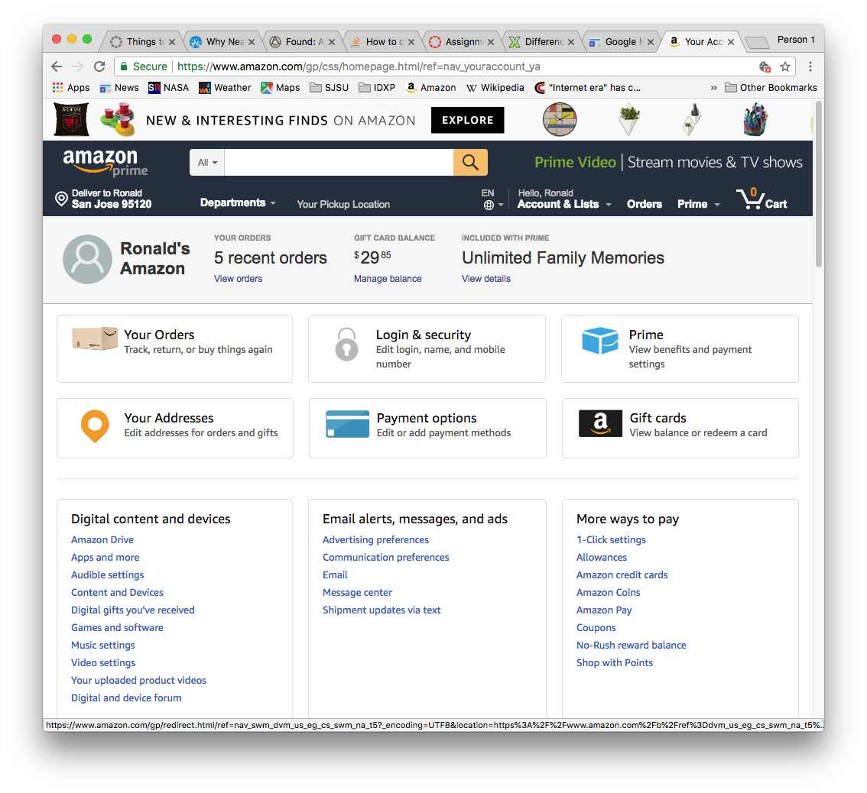
Layout: Tiled Sections
What
  Visually separate
  sections of content.
  Each section has
  a strong title.
When
  Make the page
  easy to scan
  with grouped content.
Why
  Content is structured into easily digestible chunks.
  Obvious information architecture.

Slide 14
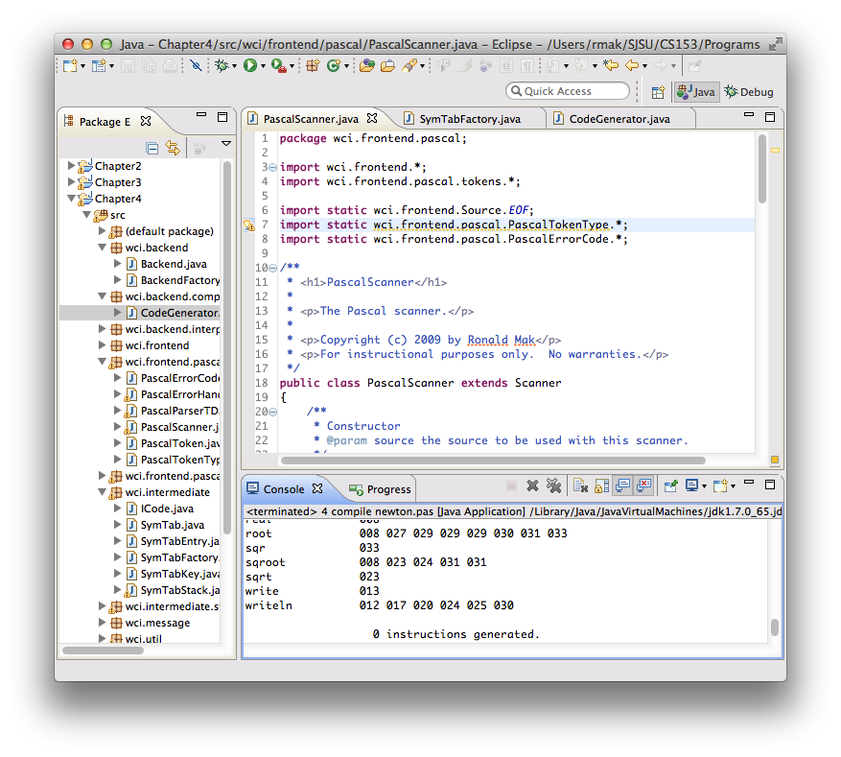
Layout: Module Tabs
What
  Put content modules into separate tabs.
  Only one tab is visible at a time.
When
  Multiple content types.
  Users only need to see one type at a time.
Why
  Tabs have a familiar physical model.
  Less cluttered user interface

Slide 15
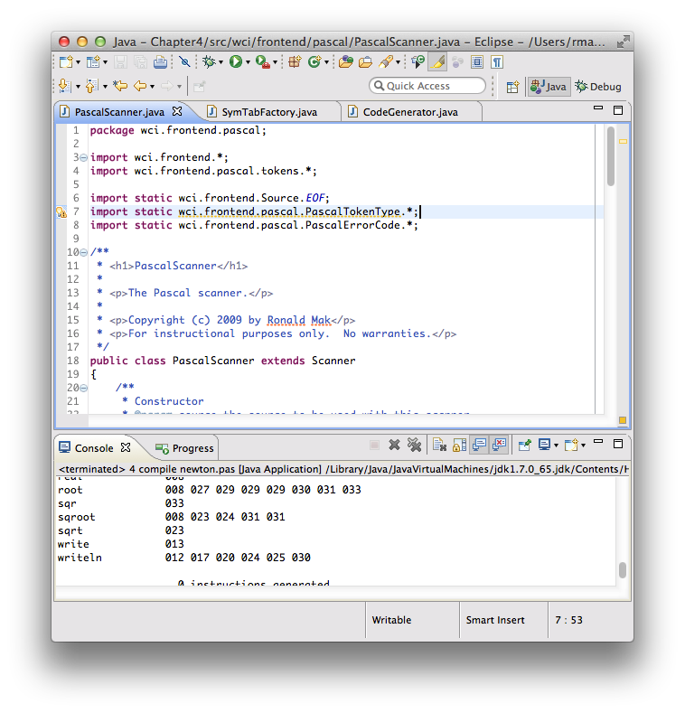
Layout: Collapsible Panel
What
  The user can open and close secondary content panels.
When
  Not enough room to show all content panels.
  Different users have different needs.
Why
  Allow the user to choose what to see.

Slide 16
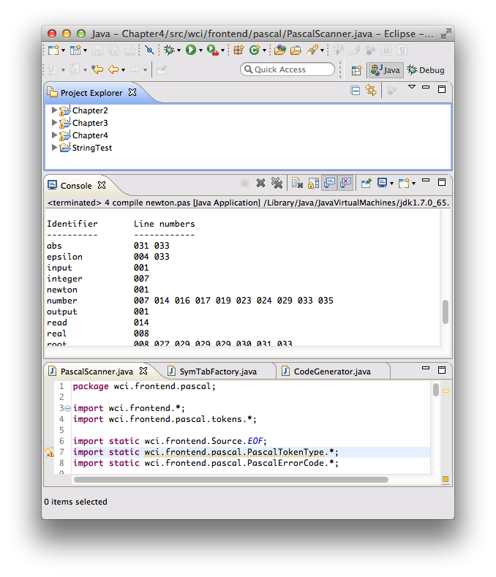
Layout: Movable Panels
What
  The user can rearrange content panels.
When
  Different arrangements for different purposes
  Different users have different needs.
Why
  Allow the user to arrange the panels
  to suit his or her needs and preferences.

Slide 17
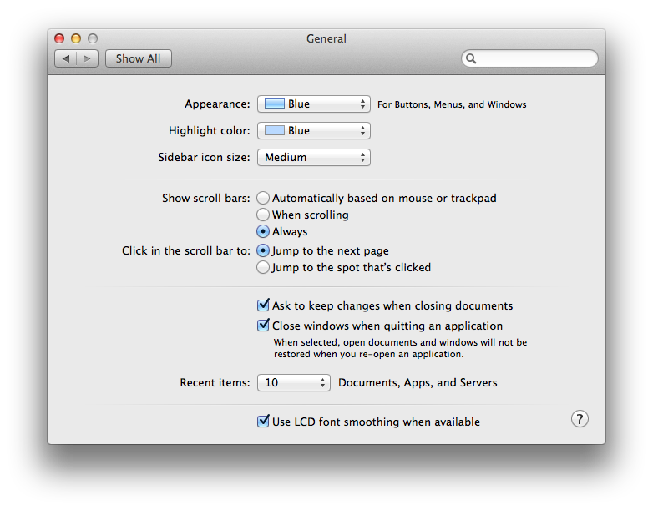
Layout: Left-Right Alignment
What
  A two-column arrangement.
  Right-aligned labels on the left.
  Left-aligned items
  on the right.
When
  An input form or any other set of labeled items.
Why
  Neat with strong perceptual grouping.

Slide 18
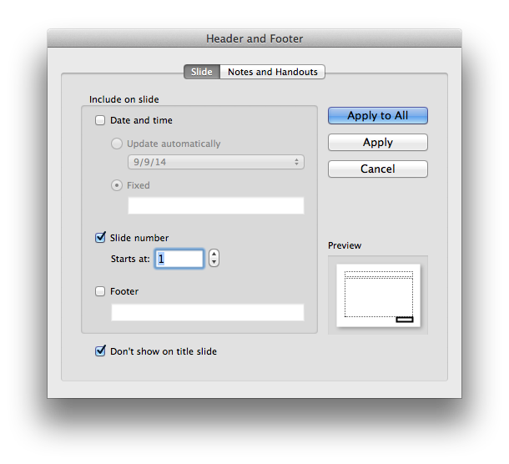
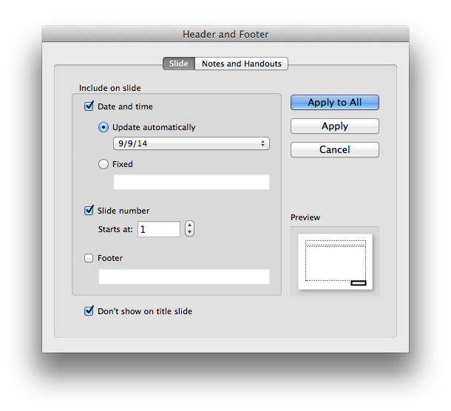
Layout: Responsive Enabling
What
  Progressively enable UI components as the user selects options.
When
  Lead a user through
  a complex task
  step by step.
  The user can easily change his or her mind.
Why
  The user can see
  all the options.
  Only the required options are enabled.

Slide 19
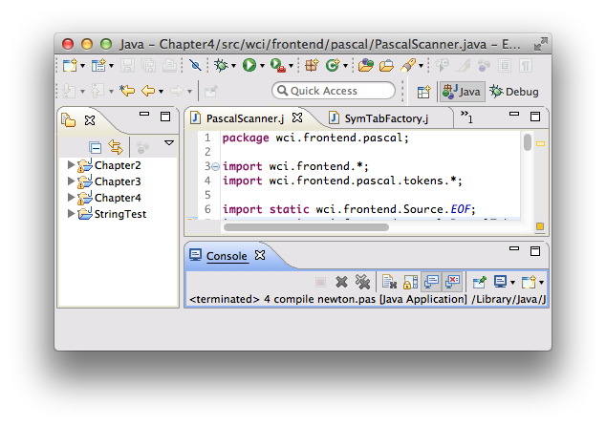
Layout: Self-Adjusting Layout
What
  The page contents automatically resize
  to maintain the same arrangement for a different window size and aspect ratio.
When
  Users can resize windows as desired.
Why
  Users choose window sizes and aspect ratios unpredictably.

Slide 20
Data Analysis
We have too much information.
  False!
  Data represents a wealth of potential.
We don’t know how to make
the best use of the data.
  True!
  Today’s software tools can assist us
  in doing data analysis.
  The tools’ effectiveness depend on
  how skilled we are in using them.

Slide 21
Data Analysis, cont’d
Analysis: Take things apart to understand them.
Data analysis: Make sense of data.
  Meanings reside in data.
Take the data apart to understand
relationships among the parts.
  How does this part relate to that part?
  Are they similar or different?
  How are they changing?
  Does one part’s change cause another part
  to change?

Slide 22
Data Analysis, cont’d
Wrong:
Correct:
Data Analysis
Tool
Data
Decisions
Data Analysis
Tool
Data Visualization
Data
Decisions

Slide 23
Stages of Data Analytics
See what’s happening now.
  Descriptive analytics
Understand why it’s happening.
  Diagnostic analytics
Predict what is likely to happen in the future.
  Create opportunities
  Prevent problems
  Determine what actions will cause this future.
  Predictive analytics
Help with decision-making.
  Prescriptive analytics

Slide 24
Become Acquainted with a Data Set
Ways to become acquainted with a data set
for the first time.
  See the paper:
  http://www.perceptualedge.com/articles/visual_business_intelligence/exploratory_vistas.pdf

Slide 25
Traits of Meaningful Data
High volume
  More data increases the chance we’ll find
  what we need or see something interesting.
Historical
  Make sense of the present by seeing
  patterns from the past.
Consistent
  Keep the data consistent despite changes over time.
  Adjust the data as necessary to current definitions.

Slide 26
Traits of Meaningful Data, cont’d
Multivariate
  The more variables we have when trying
  to make sense of data, the richer the
  opportunities for discovery.
Atomic
  Able to drill down to the lowest level of detail.
  Don’t omit details when storing data.
Clean
  “Garbage in, garbage out”.
  Information that is accurate, complete, and error-free.

Slide 27
Traits of Meaningful Data, cont’d
Clear
  Not cryptic.
  Expressed in familiar terms.
Dimensionally structured
  Dimensions and measures (facts).
  Dimensions are categorical data.
    Examples: departments, regions, products, time
  Measures are quantitative data.
    Examples: sales, profits, revenue, expenses
    In other words, facts.

Slide 28
Traits of Meaningful Data, cont’d
Richly segmented
  Segmented into meaningful groups.
    Examples: geographic regions, product categories
Known pedigree
  How did the data come to be.
  Where did it came from.
  How was it calculated.

Slide 29
Data Visualization
Data Visualization
Activities | Exploration Sense-making | Communication
Technologies | Information visualization Scientific visualization | Graphical presentation
Immediate goal | Understanding
End goal | Good decisions

Slide 30
Tools for Creating Data Visualizations
Highcharts
  JavaScript library to create interactive web charts.
  Free: http://www.highcharts.com/products/highcharts
D3.js
  JavaScript library for manipulating documents
  based on data.
  HTML, SVG, and CSS
  Allows great control over the visual result.
  Free: https://github.com/mbostock/d3/releases/download/v3.4.13/d3.zip

Slide 31
Tools for Creating Data Visualizations, cont’d
Google Charts
  Rich gallery of interactive charts and data tools.
  Free: https://developers.google.com/chart
Tableau Public
  Create data visualizations for the web.
  Choose from a palette of visual widgets.
  Free: http://www.tableausoftware.com/products/public

Slide 32
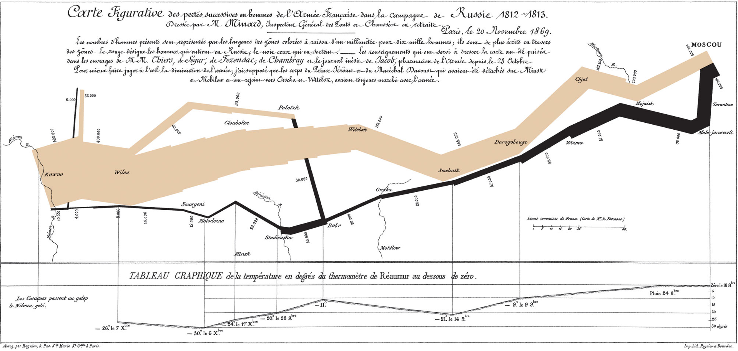
The Classic Data Visualization
Chart by Charles Minard made in 1869 of the French troops
during Napoleon’s disastrous Russian Campaign, 1812-1813
http://en.wikipedia.org/wiki/Charles_Joseph_Minard#mediaviewer/File:Minard.png

Slide 33
Prerequisites for a Successful Data Analyst
Interested
  You must care about the data.
  Sense that what you do is important and valuable.
Curious
  Enjoy figuring things out.
  Wonder how things work or why they happen.
  Crave information.
Self-motivated
  Don’t need to be told what to do.

Slide 34
Prerequisites, cont’d
Open-minded and flexible
  Willingness to accept what you find.
  Willingness to discover that you are wrong.
Imaginative
  Creativity to navigate unknown territories.
  Repeatedly ask “what if I try this?”
Skeptical
  Never be entirely sure of the data or the methods.
  Be willing to look from a different perspective.

Slide 35
Prerequisites, cont’d
Aware of what’s worthwhile
  Have priorities.
  Not all data is equally valuable.
Methodical
  Repeat known successful processes
  until the goal is reached.
Capable of spotting patterns
  Discern patterns of meaning within
  visual representations of data.
  Spot meaningful patterns and ignore the rest.

Slide 36
Prerequisites, cont’d
Analytical
  Recognize the individual parts of something complex and how the parts relate to one another.
Synthetical
  Look at pieces and see how they may fit together.
  See the big picture.
Familiar with data
  Understand the rules and meanings of data.
Skilled in the practices of data analysis

Slide 37

Visual Perception
Our eyes are drawn to familiar patterns.
  We see what we know and expect.
Can you see
the dolphin?
Now You See It
by Stephen Few
Analytics Press, 2009

Slide 38
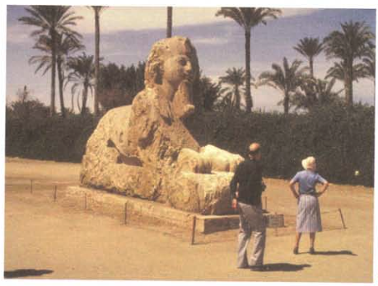
Visual Perception, cont’d
Memory plays an important role in cognition.
  Working memory is extremely limited.
Now You See It
by Stephen Few
Analytics Press, 2009

Slide 39
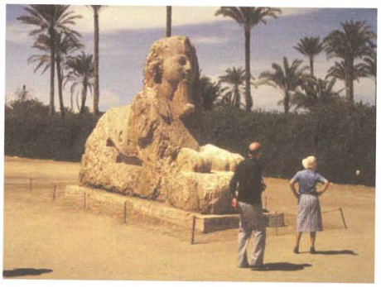
Visual Perception, cont’d
  Working memory is extremely limited, cont’d.
  What changed?
Now You See It
by Stephen Few
Analytics Press, 2009

Slide 40
User Interface Design Patterns
Organization
Navigation
Page layout
List

Slide 41
Why Display Lists of Items?
Get an overview of all items
Browse item by item
Search for a specific item
Sort and filter items
Rearrange, add, delete, or re-categorize items

Slide 42
Information Architecture for Lists
Length of the list
Order of the items
Item grouping
Item types
User interaction with the list
Dynamic behavior of the list

Slide 43
Questions about Displaying Lists
How to show the details of an item
that the user selected from a list?
How to display a list that has graphical items?
How to manage a very long list?
How to display list that is organized
into categories or hierarchies?

Slide 44
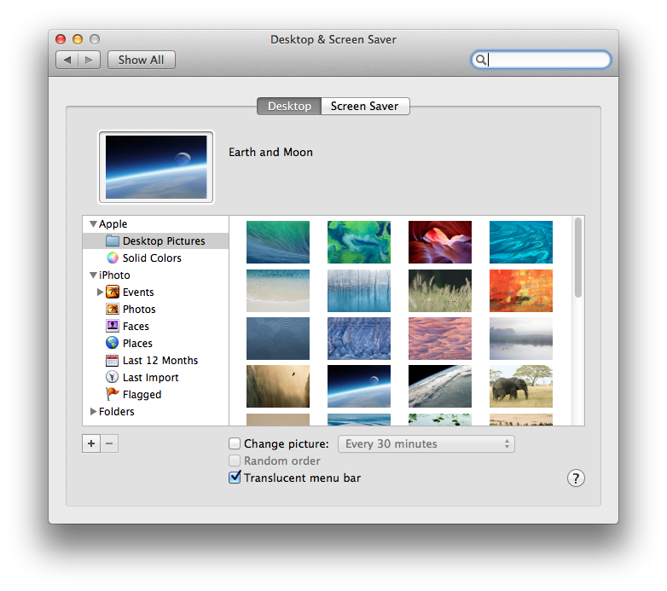
Lists: Two-Panel Selector
What
  Two panels side-by-side.
  First panel show a list
  of selectable items.
  Second panel shows the selected item’s content.
When
  Show the entire
  list of items.
  Each item has content.
Why
  Reduced physical effort.
  Reduced visual cognitive load.
  Less user memory burden.

Slide 45
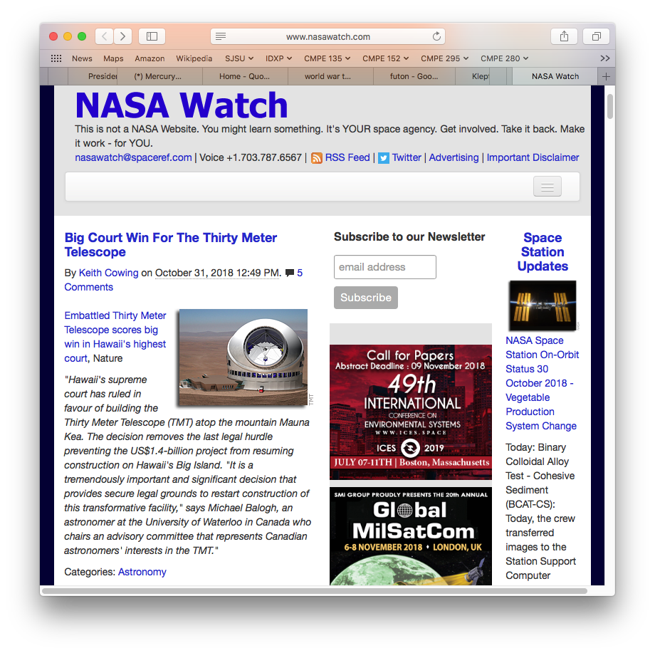
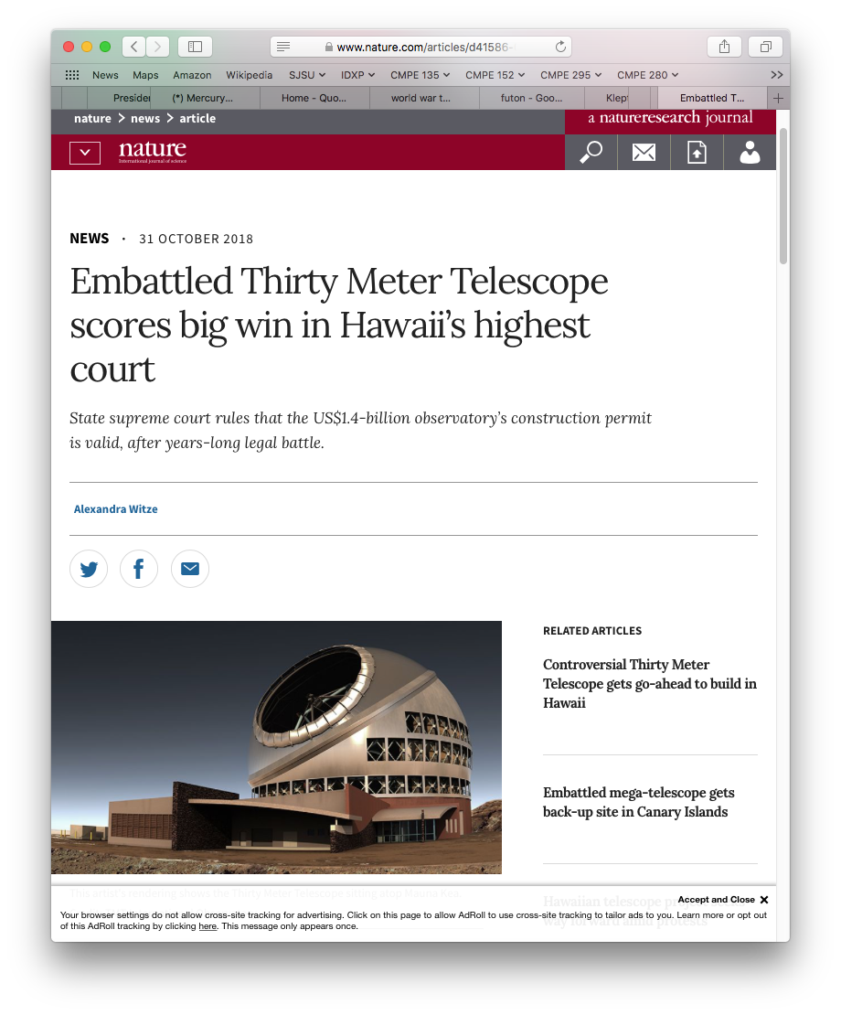
Lists: One-Window Drilldown
What
  A list of selectable items
  in a single window.
  When the user selects an item, replace the list with the item details.
When
  Each item has content.
  Limited available space.
  Large list and large content.
Why
  Only option when space
  is tight.

Slide 46
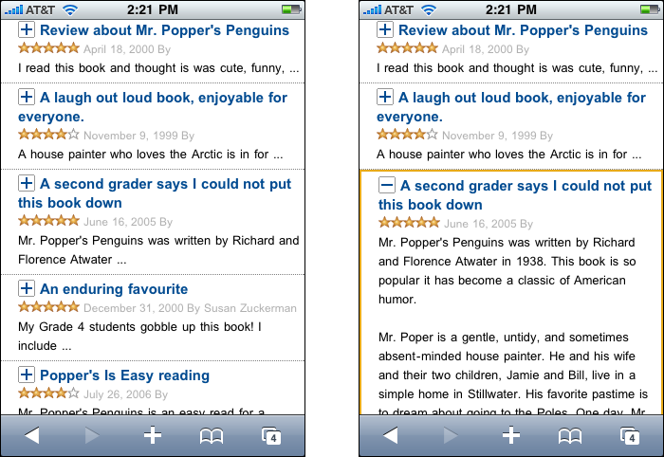
Lists: List Inlay
What
  Display a list of items as a column.
  When the user selects an
  item, show the item details
  in place within the list.
  The user can independently open and close item details.
When
  Each item has a small
  amount of content.
  Insufficient space to show
  all the items’ contents.
Why
  User can choose what to view.
Designing Interfaces, 2nd ed.
by Jenifer Tidwell
O’Reilly Media, 2011

Slide 47
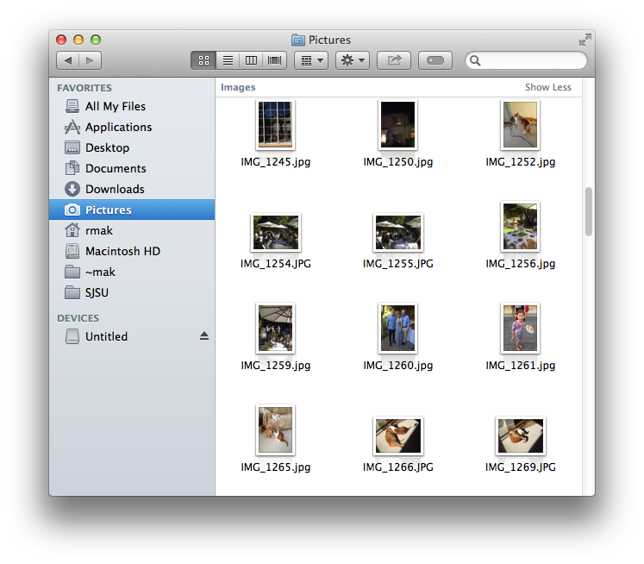
Lists: Thumbnail Grid
What
  Arrange a list of items as
  a grid of thumbnail images.
  Each thumbnail is labeled.
  Show the larger sized
  content of a selected item.
When
  Items have content representable and recognizable in a smaller format.
Why
  Attractive way to display a large list of items.
  Thumbnails are easy targets.

Slide 48
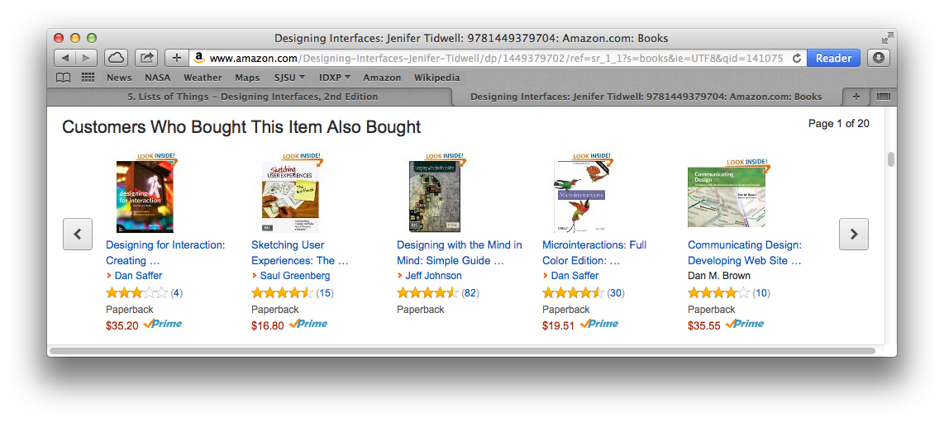
Lists: Carousel
What
  List items arranged in a scrollable horizontal strip.
When
  Insufficient space for a thumbnail grid.
Why
  Encourage users to scroll and browse.

Slide 49
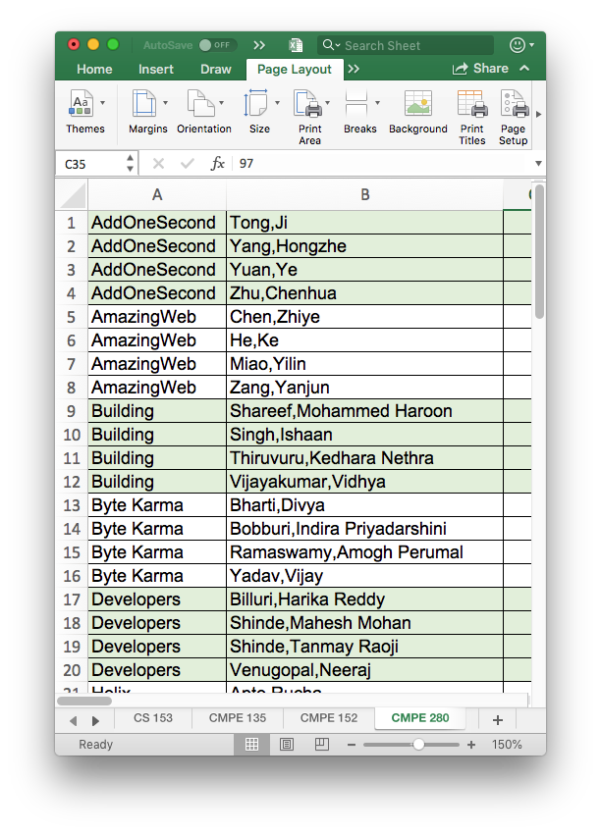
Lists: Striped Rows
What
  Table rows are striped with alternating colors.
When
  Need to group rows.
Why
  Easy to see groups.
  Easy for a user’s eyes
  to track row contents
  from left to right.

Slide 50
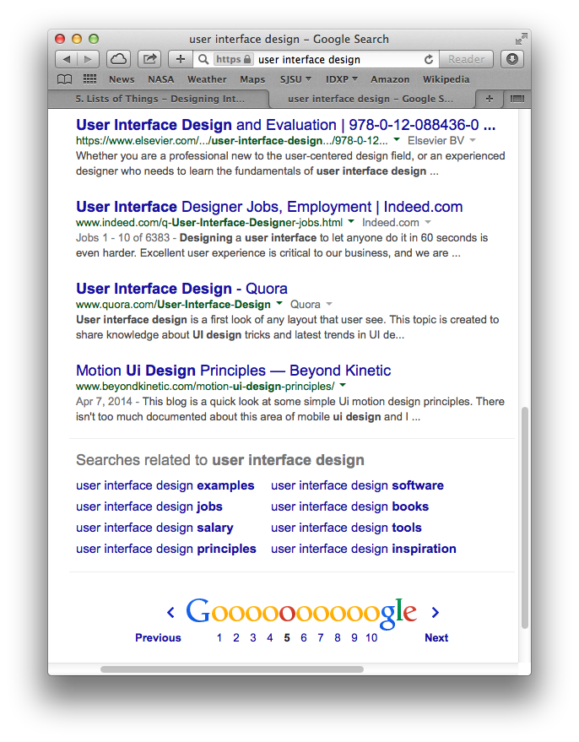
Lists: Pagination
What
  Break a long list into pages.
  Display one page at a time.
  Navigation controls: first, last, next, previous.
When
  A very long list of items.
  Too much time to load and render the entire list all at once.
Why
  Break the list into manageable chunks.
  The paging metaphor
  is well known.

Slide 51
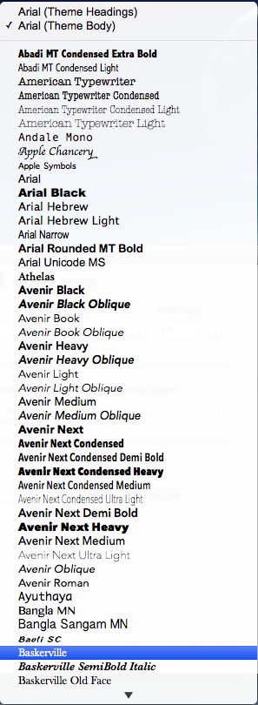
Lists: Jump to Item
What
  A scrollable list of text items.
  When the user starts to type the text content of an item, jump to that item and select it.
When
  A long list of text items.
  Only a portion of the list is visible.
  Scrolling may be tedious
Why
  User already knows what to look for.
  Quick and direct access by the user.
  Takes advantage of the computer’s
  fast searching.
User
types
“Bas”

Slide 52
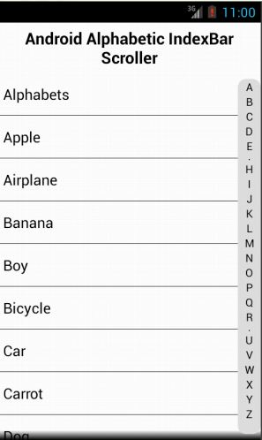
Lists: Alphabet Scroller
What
  An alphabetized list.
  Display the letters of the alphabet.
  Users can select a letter to jump-scroll to the part of the list that begins with the selected letter.
When
  Users are searching for an item
  in an alphabetized list.
Why
  Users don’t have to scroll sequentially through the list from the beginning.
  Selecting a letter takes a user close to where the desired item is located.
http://www.codeproject.com/Tips/548592/Android-Alphabetic-IndexBar-Scroller

Slide 53
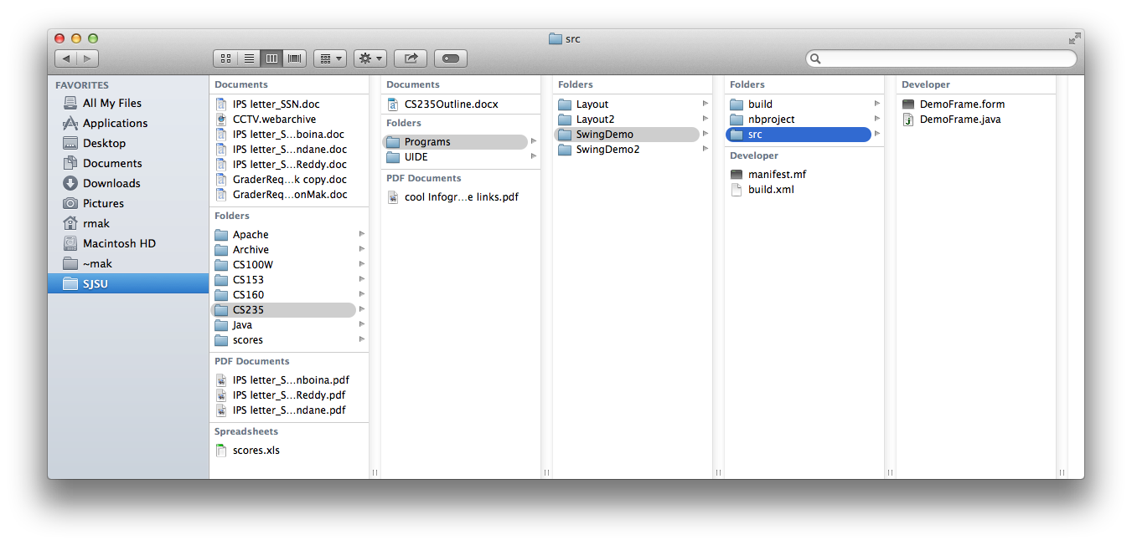
Lists: Cascading Lists
What
  Display a hierarchy
  of selectable lists
  at each level.
  Select an item to
  display that item’s
  children in the
  next list.
When
  A list of items arranged in a possibly deep hierarchy.
Why
  Display more of the hierarchy be spreading it out over several lists.
  The user can more easily keep track of which level she’s on.

Slide 54
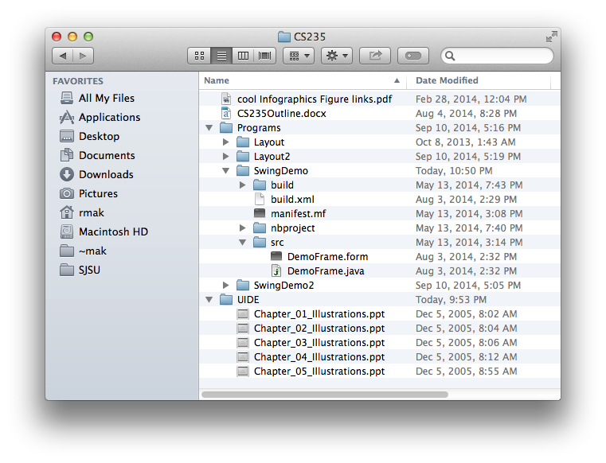
Lists: Tree Table
What
  Display items in a
  single column.
  Use an outline structure
  to show hierarchy.
  Users can expand
  or collapse items
  independently.
When
  A list of items arranged in
  a possibly deep hierarchy.
Why
  Users can choose whether or not to view
  an item’s descendants and to what level.

Slide 55
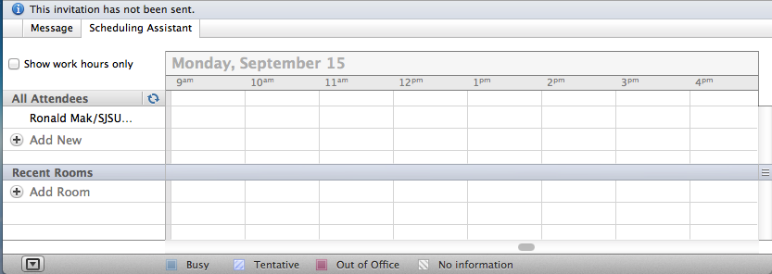
Lists: New-Item Row
What
  Use the last item of a list to create a new item in place.
When
  Users need to create new items at the end of a list.
Why
  Add the new item at its final position in the list..

