Slide 1


CMPE 280
Web UI Design and Development
April 7 Class Meeting
Department of Computer Engineering
San Jose State University
Spring 2020
Instructor: Ron Mak
www.cs.sjsu.edu/~mak

Slide 2
Types of Data
Categorical data
  Represents things
  Labeled mutually exclusively
  No numerical value
Ordinal data
  Has a clear ordering.
Quantitative
  Numerical data that can be measured
  and aggregated.

Slide 3
Types of Data, cont’d
Data | Data Type | Encoding | Note
Episode | Categorical | Position | Each episode is represented by a dot. Each dot has its own position on the canvas.
Episode Number | Ordinal | Position | The x-axis shows the number of each episode in each season.
Season | Ordinal | Color | Each season is represented by a different color (hue).
 |  | Position | Each season also has its own section on the chart.
IMDB rating | Ordinal | Position | The better the episode, the higher it is on the y-axis.
Average season rating | Quantitative | Position | The horizontal bar in each pane shows the average rating of the episodes in each season.
The Big Book of Dashboards
by Steve Wexler, et al.
Wiley, 2017
ISBN 978-1-110-28271-6

Slide 4
Use of Color
Use color sparingly.
Storytelling with Data
by Cole Nussbaumer Knaflic
Wiley, 2017
ISBN 978-1-110-28271-6

Slide 5
Use of Color, cont’d
Winning visualization by Shine Pulikathara during the 2015 Tableau Iron Viz competition.
The Big Book of Dashboards
by Steve Wexler, et al.
Wiley, 2017
ISBN 978-1-110-28271-6

Slide 6
Use of Color in Data Visualization
The Big Book of Dashboards
by Steve Wexler, et al.
Wiley, 2017
ISBN 978-1-110-28271-6

Slide 7
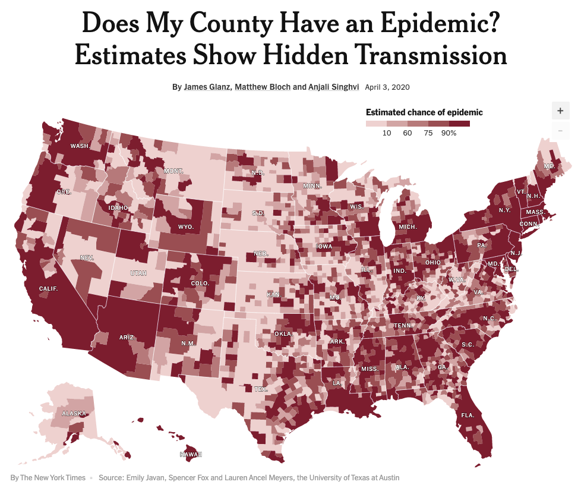
Sequential Color
Use a single color from light to dark.
https://www.nytimes.com/interactive/2020/04/03/us/coronavirus-county-epidemics.html?action=click&module=Top%20Stories&pgtype=Homepage

Slide 8
Diverging Color
Show a range diverging from a midpoint.
The Big Book of Dashboards
by Steve Wexler, et al.
Wiley, 2017
ISBN 978-1-110-28271-6

Slide 9
Categorical Color
Use different hues to distinguish among different categories.
The Big Book of Dashboards
by Steve Wexler, et al.
Wiley, 2017
ISBN 978-1-110-28271-6

Slide 10
Highlight Color
Make something stand out.
The Big Book of Dashboards
by Steve Wexler, et al.
Wiley, 2017
ISBN 978-1-110-28271-6

Slide 11
Alerting Color
Draw attention to something very important.
  Use bright, alarming colors.
The Big Book of Dashboards
by Steve Wexler, et al.
Wiley, 2017
ISBN 978-1-110-28271-6

Slide 12
Color Vision Deficiency
Three cone cells in the retina are required
to see all colors well.
Approximately 8% of males and 0.4% of females have color vision deficiency (CVD)
  AKA “color blindness”
Depending on which cones are weak:
  Protanopia: long-wave cones (red weak)
  Deuteranopia: medium-wave cones (green weak)
  Tritanopia: short-wave cones (blue)
The Big Book of Dashboards
by Steve Wexler, et al.
Wiley, 2017
ISBN 978-1-110-28271-6

Slide 13
Color Vision Deficiency, cont’d
Be wary of the colors you use to accommodate viewers with color vision deficiency.
red weak
The Big Book of Dashboards
by Steve Wexler, et al.
Wiley, 2017
ISBN 978-1-110-28271-6

Slide 14
Color Vision Deficiency, cont’d
red weak
The Big Book of Dashboards
by Steve Wexler, et al.
Wiley, 2017
ISBN 978-1-110-28271-6

Slide 15
Color Vision Deficiency, cont’d
red weak
The Big Book of Dashboards
by Steve Wexler, et al.
Wiley, 2017
ISBN 978-1-110-28271-6

Slide 16
Color Vision Deficiency, cont’d
green weak
The Big Book of Dashboards
by Steve Wexler, et al.
Wiley, 2017
ISBN 978-1-110-28271-6

Slide 17
Good Design Examples
Suppose you want to emphasize the effect of having a bachelor’s degree on marriage.
Storytelling with Data
by Cole Nussbaumer Knaflic
Wiley, 2017
ISBN 978-1-110-28271-6

Slide 18
Good Design Examples, cont’d
Highlight what’s important.
Storytelling with Data
by Cole Nussbaumer Knaflic
Wiley, 2017
ISBN 978-1-110-28271-6

Slide 19
Good Design Examples, cont’d
Eliminate distractions!
Storytelling with Data
by Cole Nussbaumer Knaflic
Wiley, 2017
ISBN 978-1-110-28271-6

Slide 20
Good Design Examples, cont’d
Unaesthetic design
Storytelling with Data
by Cole Nussbaumer Knaflic
Wiley, 2017
ISBN 978-1-110-28271-6

Slide 21
Good Design Examples, cont’d
Aesthetic design
Storytelling with Data
by Cole Nussbaumer Knaflic
Wiley, 2017
ISBN 978-1-110-28271-6

Slide 22
Good Design Examples, cont’d
Same data shown much
better than the pie chart.
The Big Book of Dashboards
by Steve Wexler, et al.
Wiley, 2017
ISBN 978-1-110-28271-6

Slide 23
Types of Charts
Bar chart
Time-Series Line Chart
Scatter Plot
Dot Plot
The Big Book of Dashboards
by Steve Wexler, et al.
Wiley, 2017
ISBN 978-1-110-28271-6

Slide 24
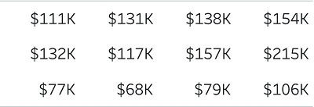
Types of Charts, cont’d
Choropleth map
Symbol map
Table
Highlight table
The Big Book of Dashboards
by Steve Wexler, et al.
Wiley, 2017
ISBN 978-1-110-28271-6

Slide 25
Types of Charts, cont’d
One of the best ways to show actual versus target comparisons.
The Big Book of Dashboards
by Steve Wexler, et al.
Wiley, 2017
ISBN 978-1-110-28271-6

Slide 26
KPI Chart Example
KPI = Key Performance Indicator
sparklines
The Big Book of Dashboards
by Steve Wexler, et al.
Wiley, 2017
ISBN 978-1-110-28271-6

Slide 27
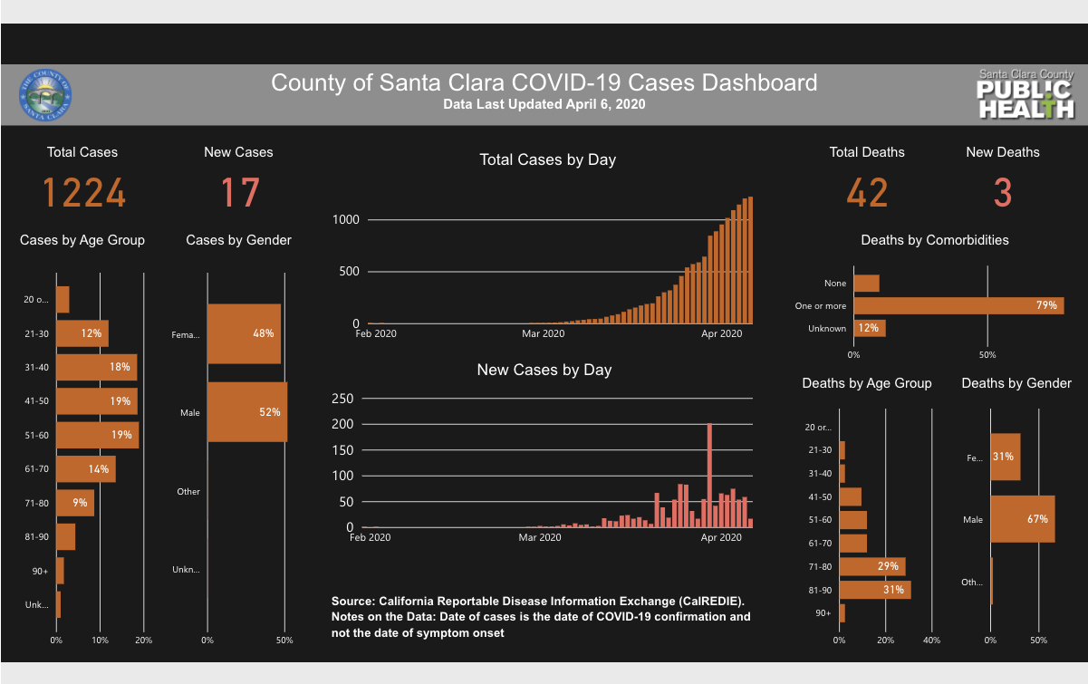
COVID-19 Dashboard Example
https://www.sccgov.org/sites/phd/DiseaseInformation/novel-coronavirus/Pages/dashboard.aspx

Slide 28
Assignment #6: Information Dashboard
Create an information dashboard from your data.
  At least four charts.
  Must fit on one webpage without scrolling.
  Ideally, use the dataset chosen for your project.
  The dashboard does not need to update in real time.
Explain in a short report:
  How you used good dashboard design principles.
  For each chart, how you used good chart design principles.
Due Friday, April 17.

Slide 29
Assignment #6, cont’d
JavaScript chart-generation libraries
  D3.js
  Google Charts
  Highcharts
Tableau Public
Google “JavaScript data visualization”

Slide 30
Design Patterns
A design pattern is
  A description of a problem.
  A solution that you can apply
  to many programming situations.
Design patterns show you how to
build good user interfaces.
  Design patterns are proven design experience.
  Design patterns describe best practices.
  Design patterns capture structural and behavioral features of an interface.

Slide 31
Design Patterns
Design patterns are not code,
but are general solutions to design problems.
  You apply them to your specific application.
Design patterns give programmers a
very high-level pattern language and a
short-cut vocabulary to discuss design issues.
  Independent of specific implementations.
  “We should use the canvas+palette pattern here.”
  “The wizard pattern will simplify this code.”

Slide 32
What Each Design Pattern Should Have
A short name
What: a brief description of the pattern
When to use: a brief description of the context
Why: a description of the problem that it solves

Slide 33
Design Patterns, cont’d
The building architect Christopher Alexander formulated over 250 patterns for architectural design for physical buildings.
Co-authored A Pattern Language:
Towns, Buildings, Construction
published in 1977.

Slide 34
User Interface Design Patterns
Organization
Navigation
Page layout
List

Slide 35
Organization Design Patterns
Feature, Search,
and Browse
News Stream
Picture Manager
Dashboard
Canvas + Palette
Wizard
Settings Editor
Alternate Views
Multiple Workspaces
Multilevel Help

Slide 36
Organization Design Patterns
Design patterns for the high-level overall layout of an application’s user interface.
Information architecture
  How to organize an information space.
Interaction model
  Determine how users navigate.
  Establish consistency.

Slide 37
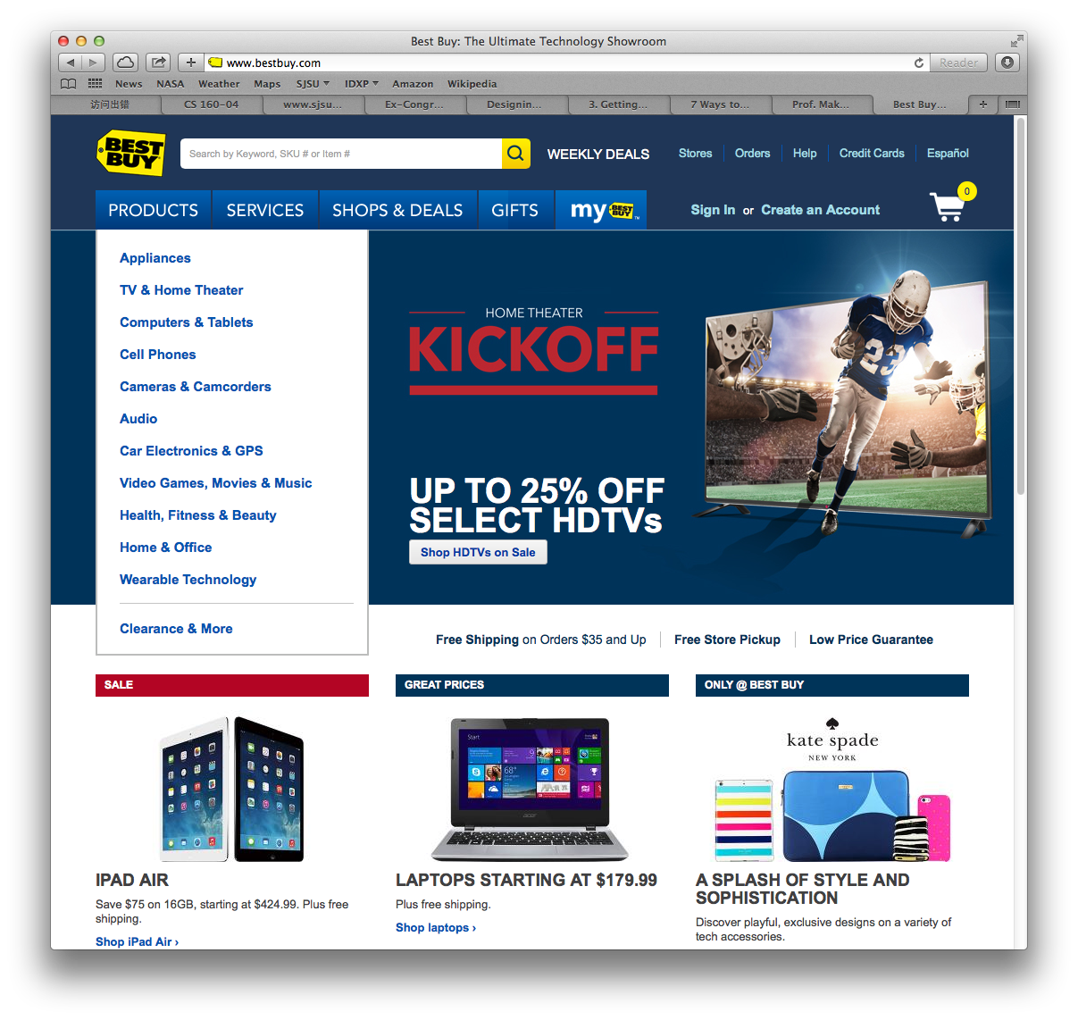
Organization: Feature, Search, and Browse
What
  A featured item.
  A search box.
  A list to browse.
When
  Engage the user.
  Provide other options.
  Enable searching.
Why
  Browsing and searching are common.
  Hook the user with the featured item.

Slide 38
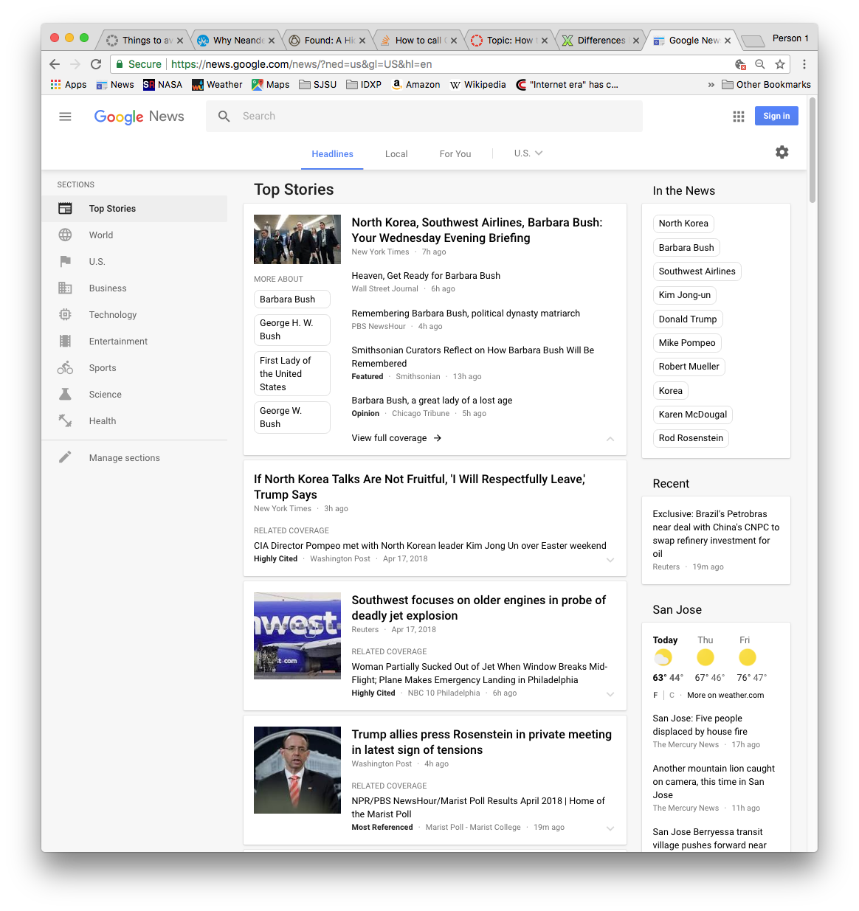
Organization: News Stream
What
  Time-sensitive items.
  Reverse chronological order.
  Frequent updates.
When
  Communications channels.
  Timely content.
Why
  Allow users to keep up with news streams.
  Users can check often.

Slide 39
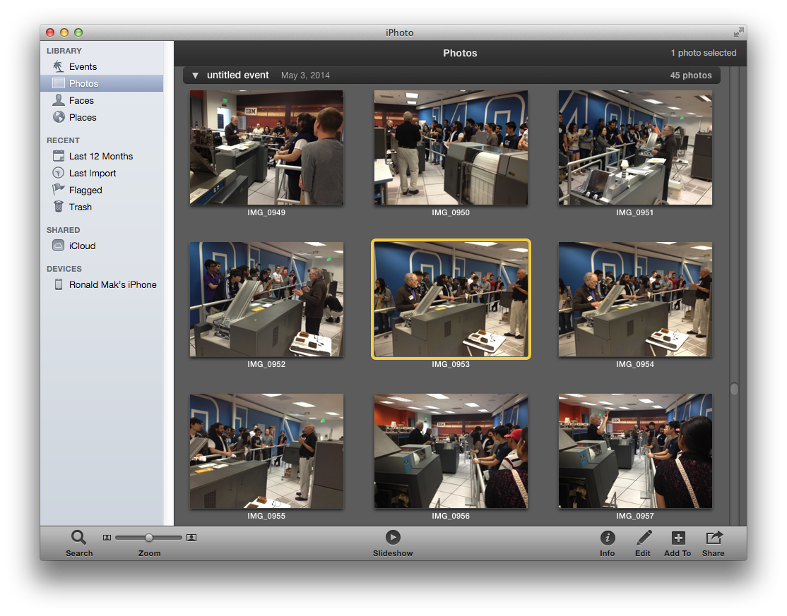
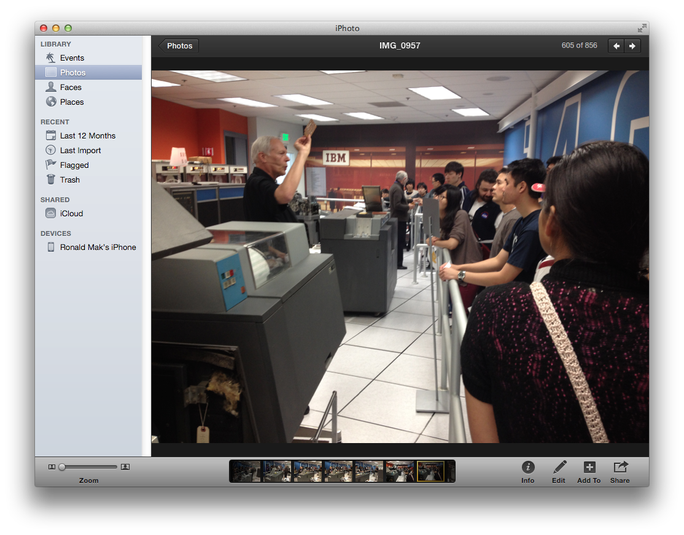
Organization: Picture Manager
What
  Thumbnails of pictures for browsing.
  Feature one picture.
When
  A collection of pictures to organize.
Why
  A natural way for users to organize and browse a picture collection

Slide 40
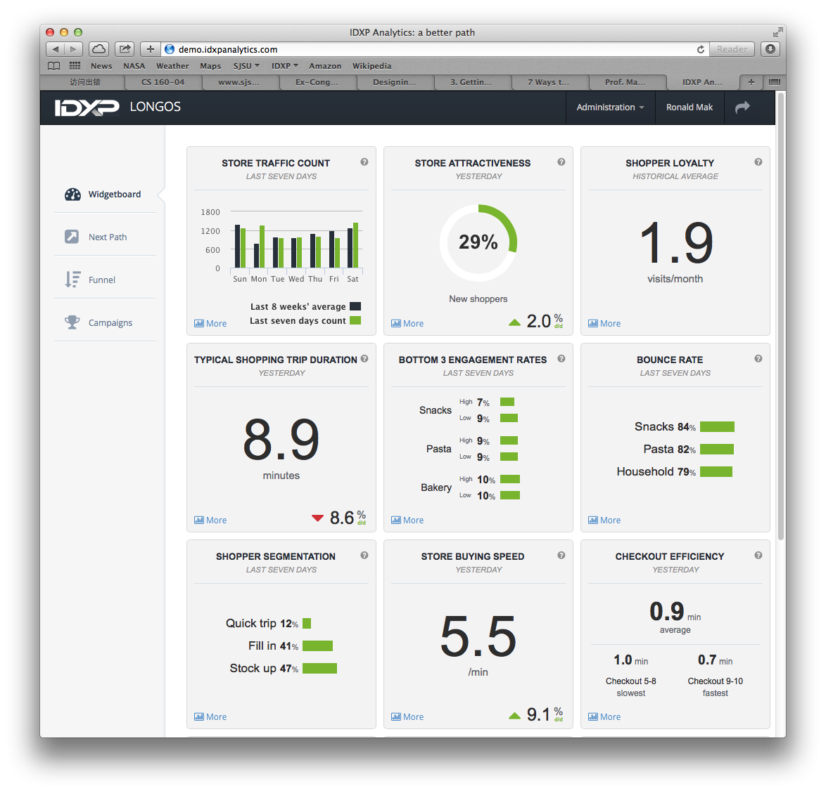
Organization: Dashboard
What
  Single information-dense page.
  Information widgets frequently updated.
When
  An incoming flow of information.
Why
  Users need to monitor the information.
  See what’s important at a glance.

Slide 41
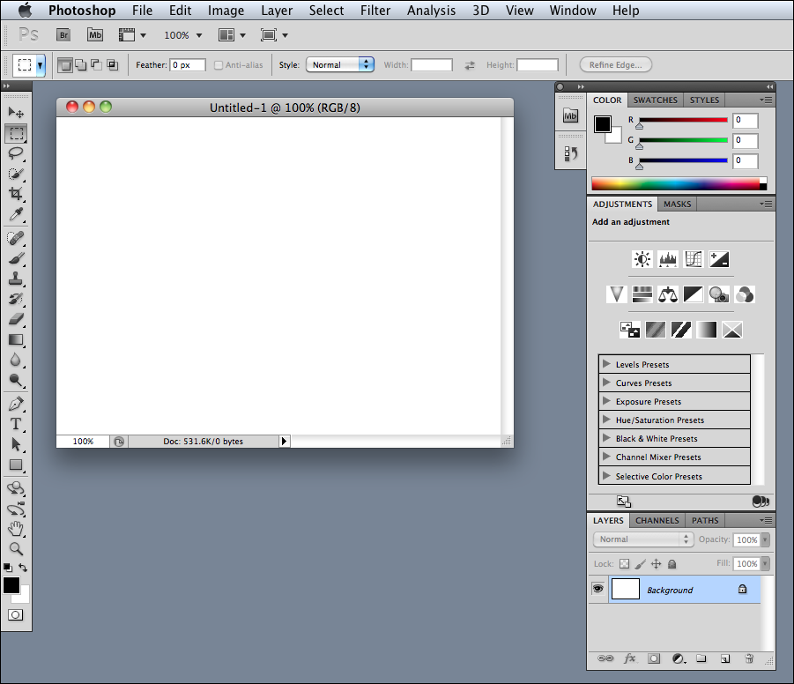
Organization: Canvas + Palette
What
  Palette of drawing tools.
  Canvas for drawing.
When
  A graphics editor.
  Create new objects.
  Arrange object in
  virtual space.
Why
  Closely matches a user’s mental model
  of how to create
  some artwork.
Designing Interfaces, 2nd ed.
by Jenifer Tidwell
O’Reilly Media, 2011

Slide 42
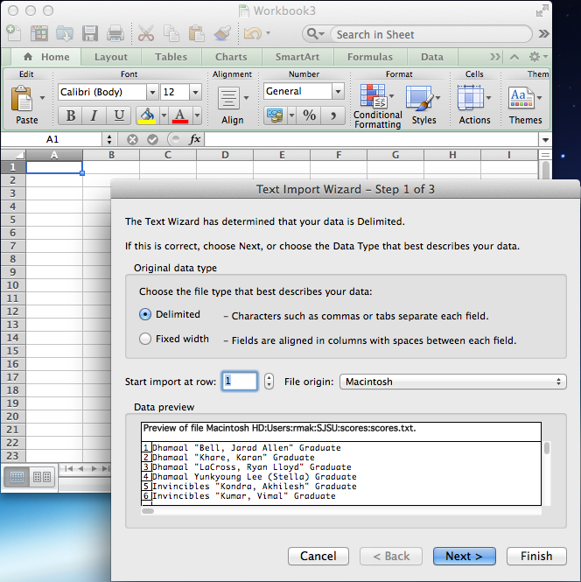
Organization: Wizard
What
  Steps to accomplish
  a specific task.
When
  A complicated task.
  “Don’t make me think. Just tell me what
  to do next.”
Why
  Handholding for the beginning user.
  But can be frustrating for experienced users.

Slide 43
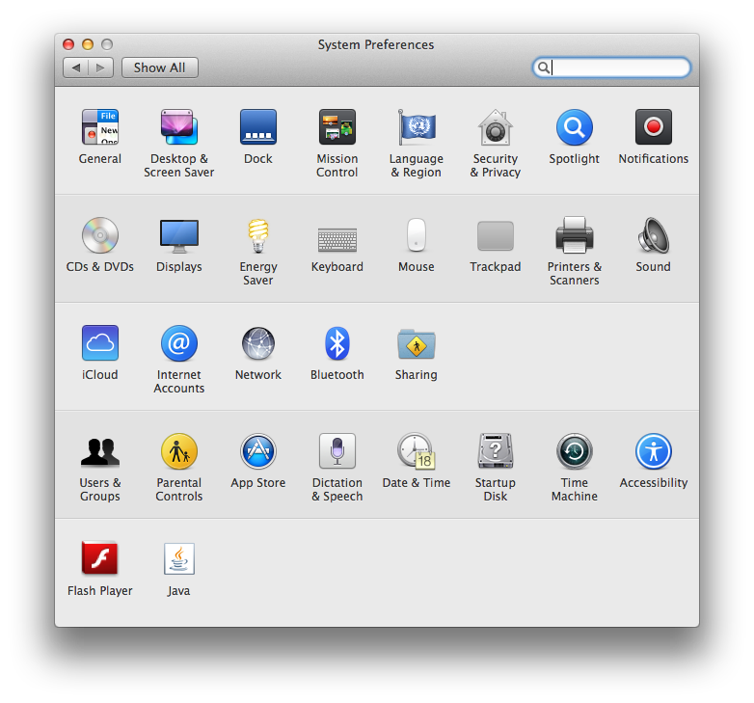
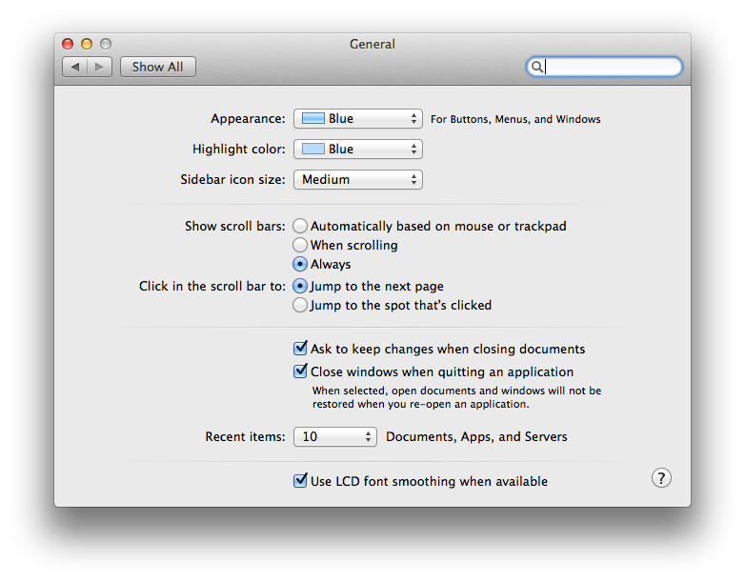
Organization: Settings Editor
What
  One place to change settings, preferences,
  or properties.
  Group content.
When
  Users have many choices to create a profile for an application.
Why
  Easy to find and use.
  See all choices in
  one place.

Slide 44
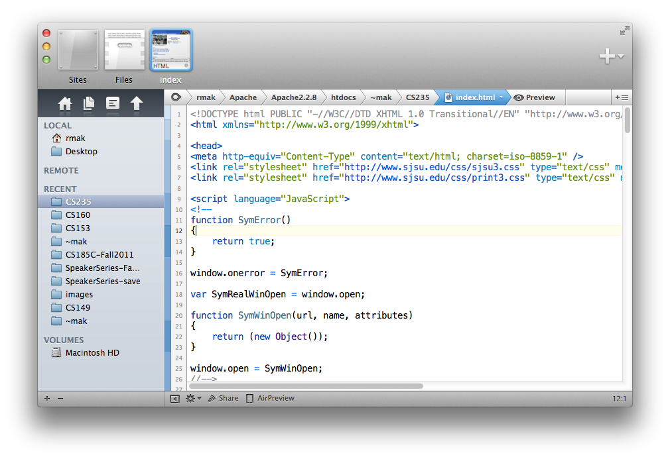
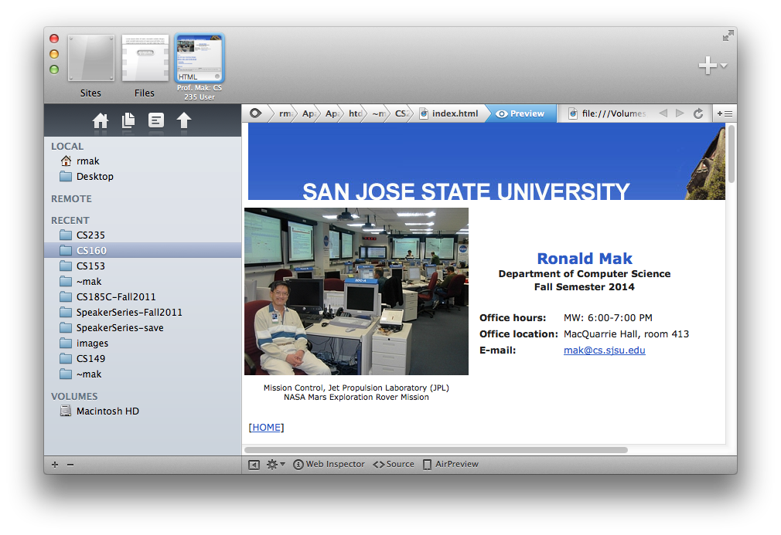
Organization: Alternative Views
What
  Show multiple views
  of the same data
  in different formats.
When
  A single view is insufficient.
  Users can choose views.
Why
  Different views show different aspects
  of the data.
  Different users may prefer different views.

Slide 45
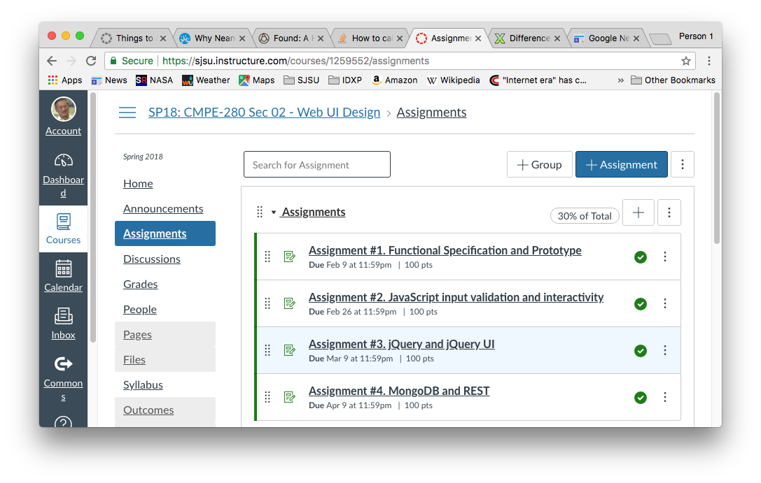
Organization: Multiple Workspaces
What
  Multiple tabs or windows to view different pages, one at a time.
When
  An application can manage multiple pages of content
  Each page is
  separately
  managed.
Why
  Users want to
  multitask.
  Don’t want to
  open multiple
  copies of the
  application.

Slide 46
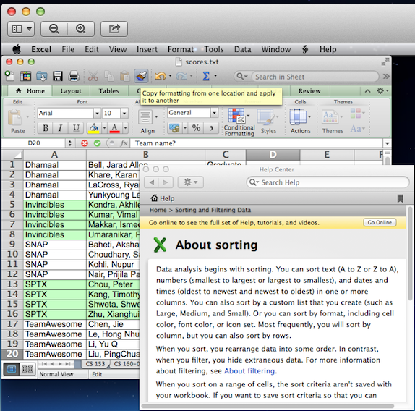
Organization: Multilevel Help
What
  A variety of ways to provide help to the user.
When
  A complex application.
  Users need with specific features or tasks.
Why
  Provide help when
  and where needed.
  Help can be light-
  or heavyweight.
  Reminders, tips, or tutorials as necessary.

Slide 47
User Interface Design Patterns
Organization
Navigation
Page layout
List
Action
User input

Slide 48
Navigation Design Patterns
Clear Entry Points
Hub and Spoke
Fully Connected
Multilevel
Sequential
Pyramid
Pan and Zoom
Modal Dialog
Escape Hatch
Bookmark

Slide 49
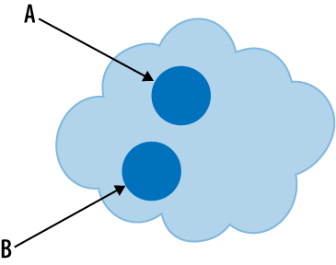
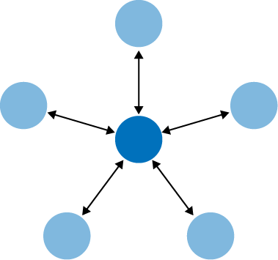
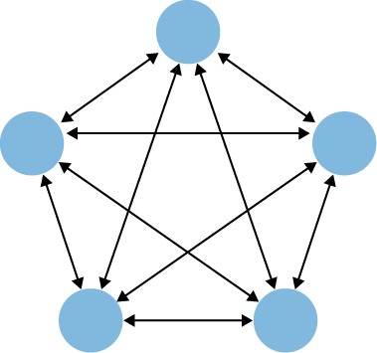
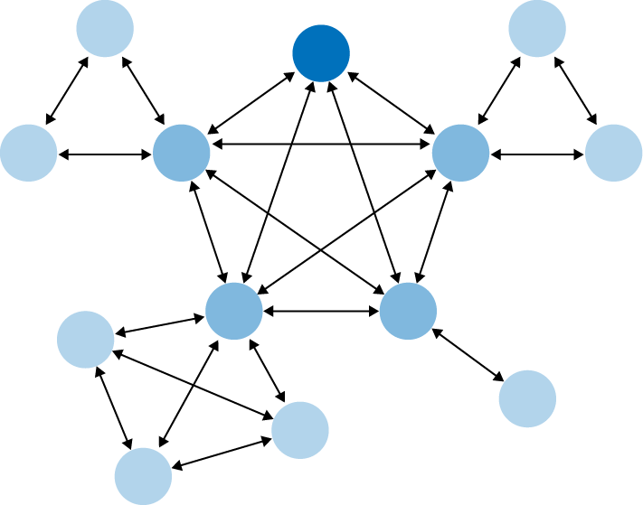
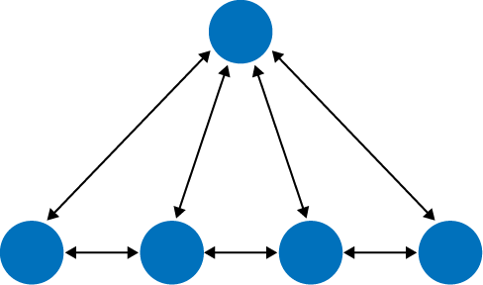

Navigation Design Patterns
Clear entry points
Hub and spoke
Fully connected
Sequential
Multilevel
Pyramid
Designing Interfaces, 2nd ed.
by Jenifer Tidwell
O’Reilly Media, 2011

Slide 50

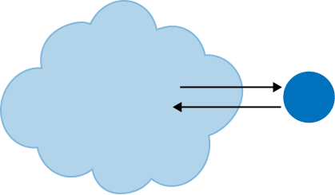
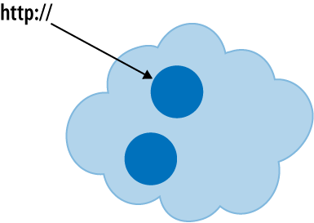
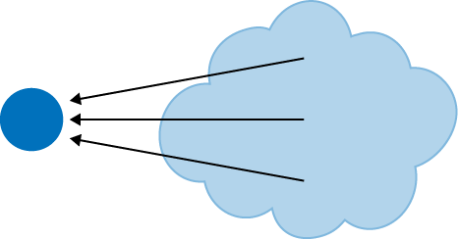
Navigation Design Patterns, cont’d
Pan and zoom
Modal dialog
Escape hatch
Bookmark
Designing Interfaces, 2nd ed.
by Jenifer Tidwell
O’Reilly Media, 2011

Slide 51
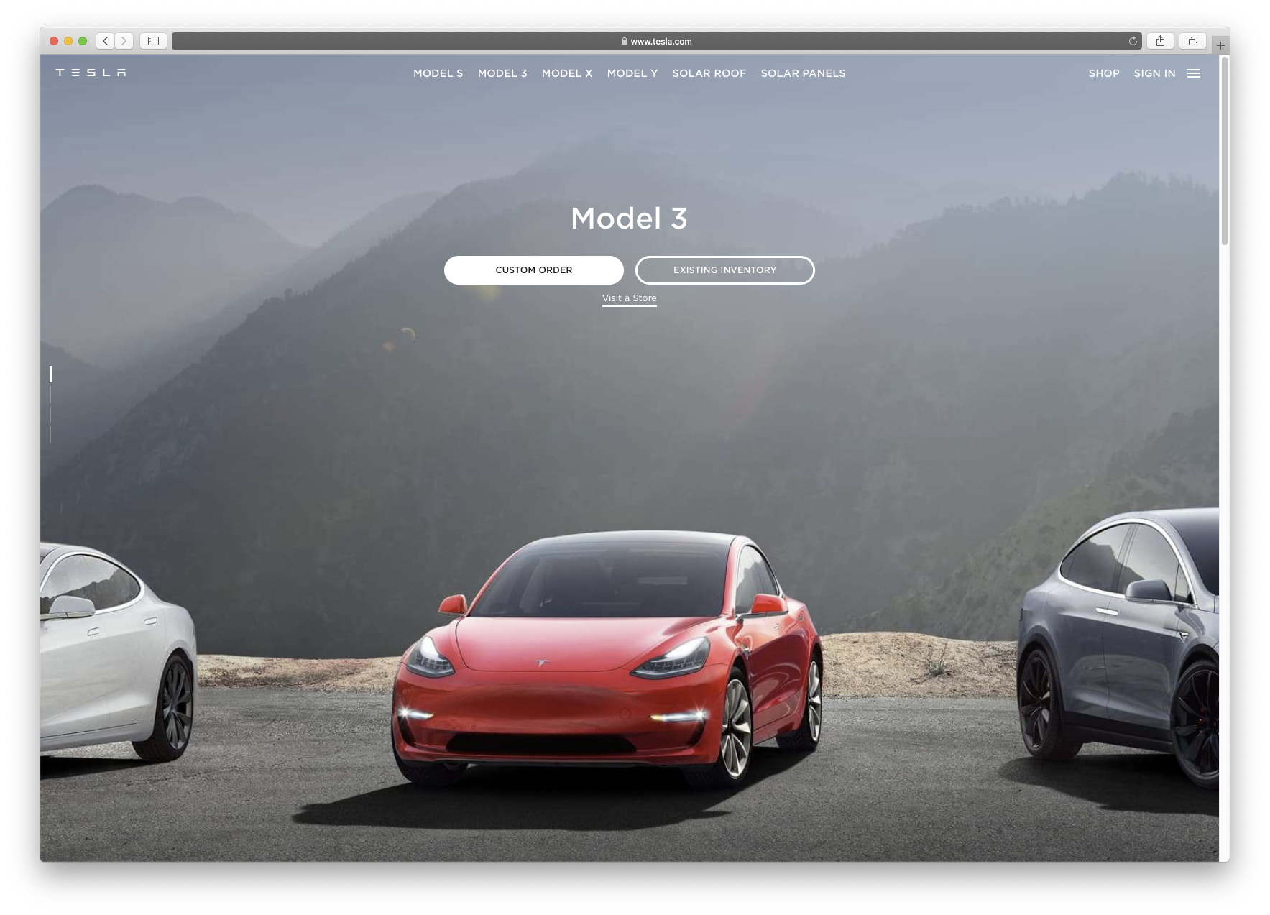
Navigation: Clear Entry Points
What
  Only a few main entry points into the interface.
  Task oriented, clear calls to action.
When
  Ideal for first-time or infrequent users.
  Can be bypassed by experienced users.
Why
  Avoid too much
  clutter when an
  application is
  first opened.
  Do not over-
  whelm a novice
  user.

Slide 52
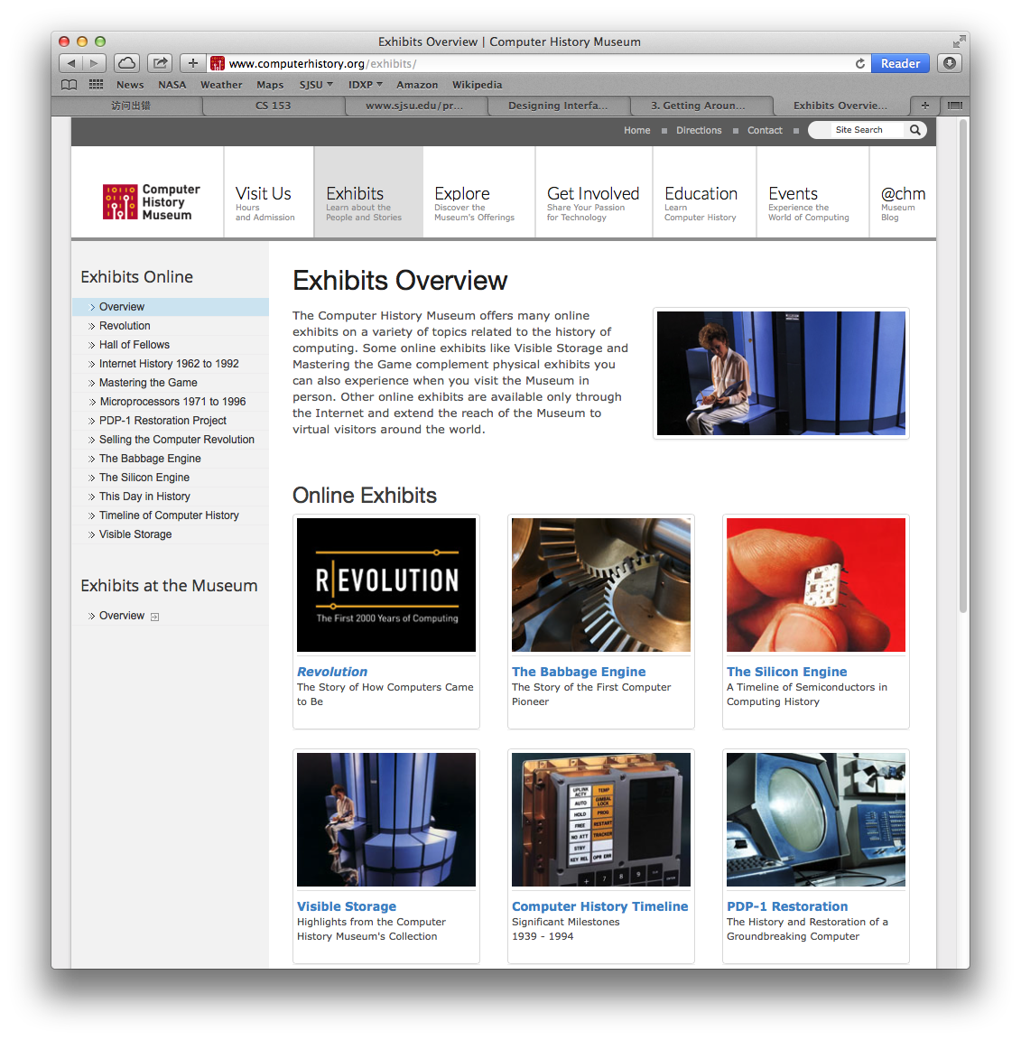
Navigation: Hub and Spoke
What
  A page filled with links to other pages.
When
  A table of contents or a portal to show the user where to go from here.
Why
  The user can decide where to go.
  Return to this page to go elsewhere.

Slide 53
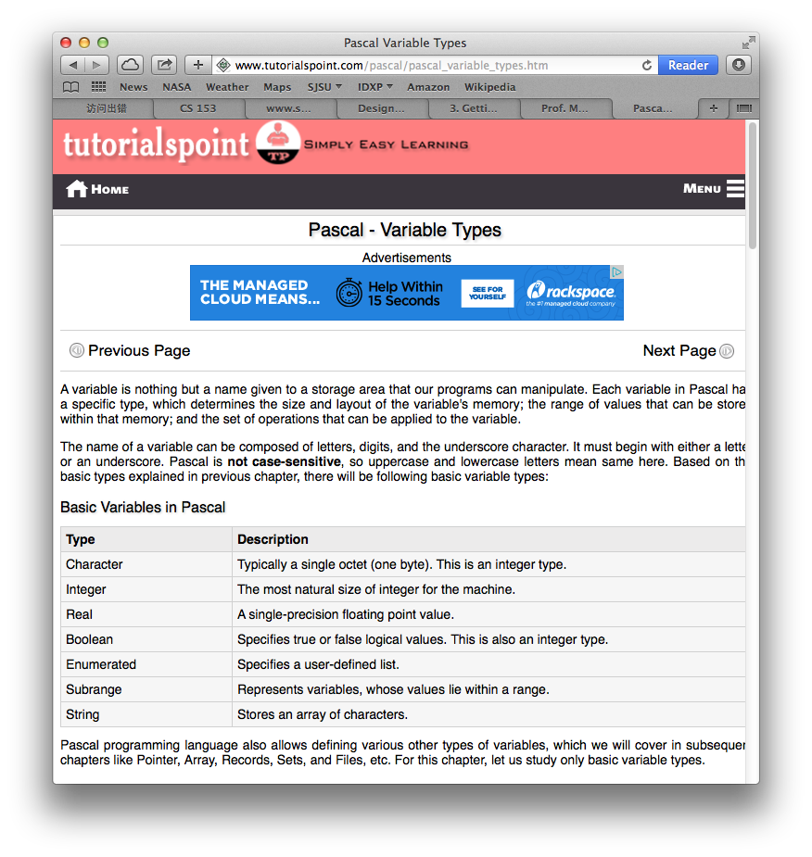
Navigation: Pyramid
What
  Sequential pages with back and next links.
  A link to return to the top.
When
  Sequential text organized by chapters.
  Return to the table of contents at the top to pick another chapter.
Why
  Matches a user’s
  mental model of a tutorial.

Slide 54
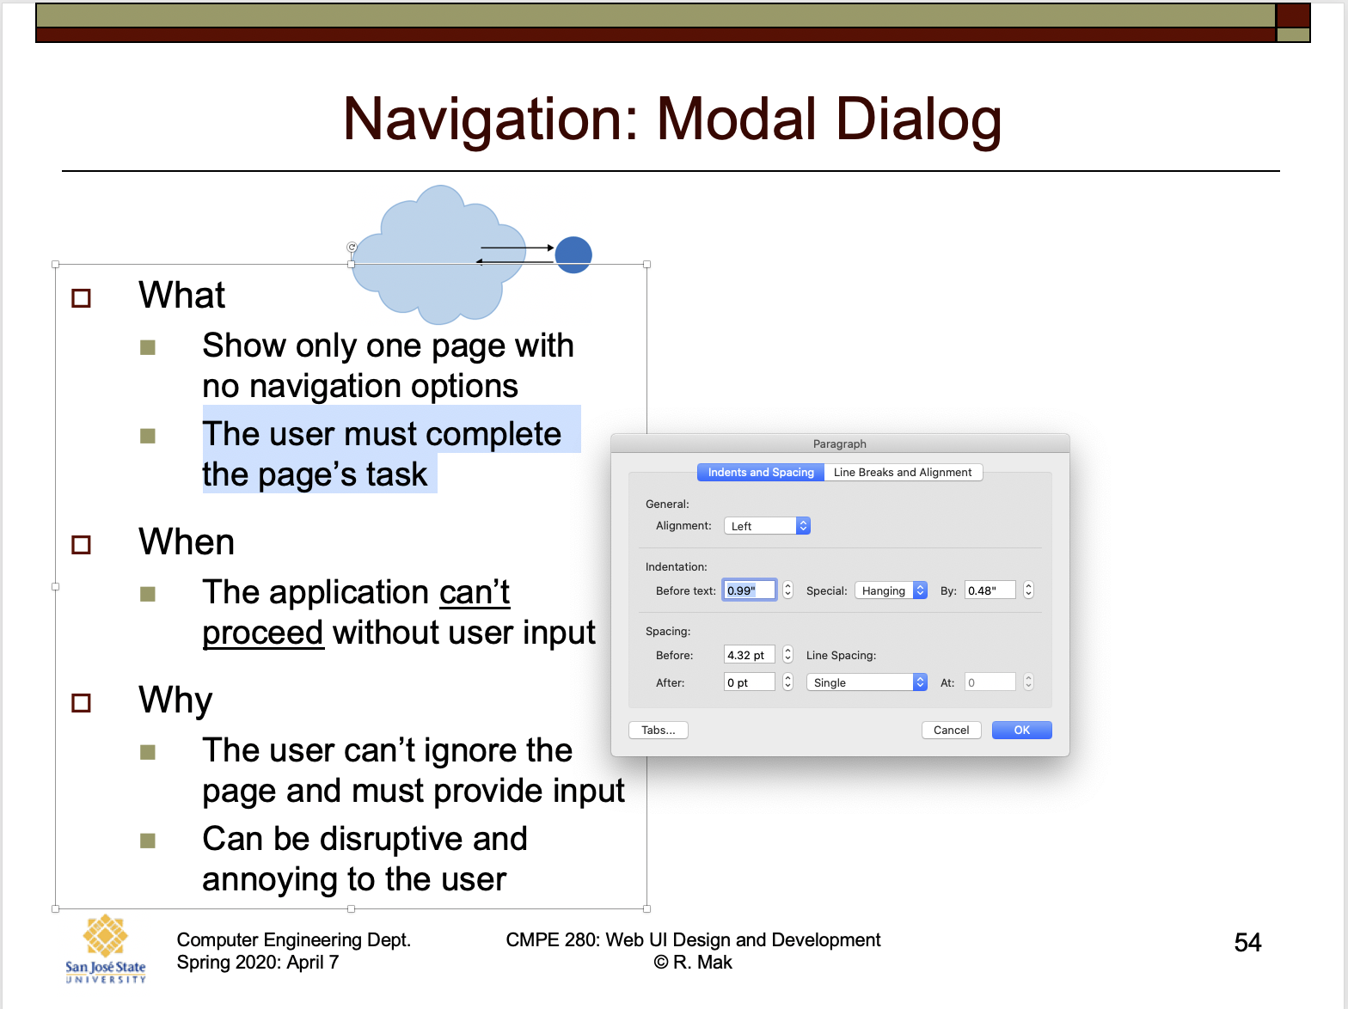
Navigation: Modal Dialog
What
  Show only one page with
  no navigation options.
  The user must complete
  the page’s task.
When
  The application can’t proceed without user input.
Why
  The user can’t ignore the page and must provide input.
  Can be disruptive and annoying to the user.

Slide 55
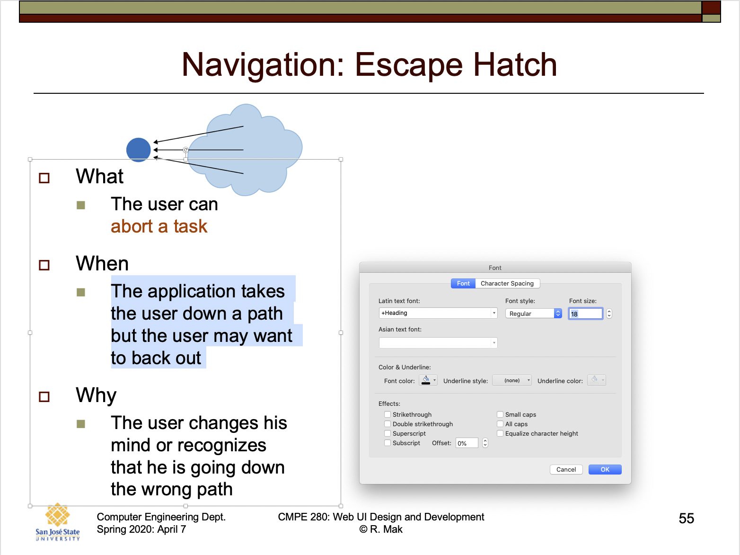
Navigation: Escape Hatch
What
  The user can
  abort a task.
When
  The application takes
  the user down a path
  but the user may want
  to back out.
Why
  The user changes his
  mind or recognizes
  that he is going down
  the wrong path.

Slide 56
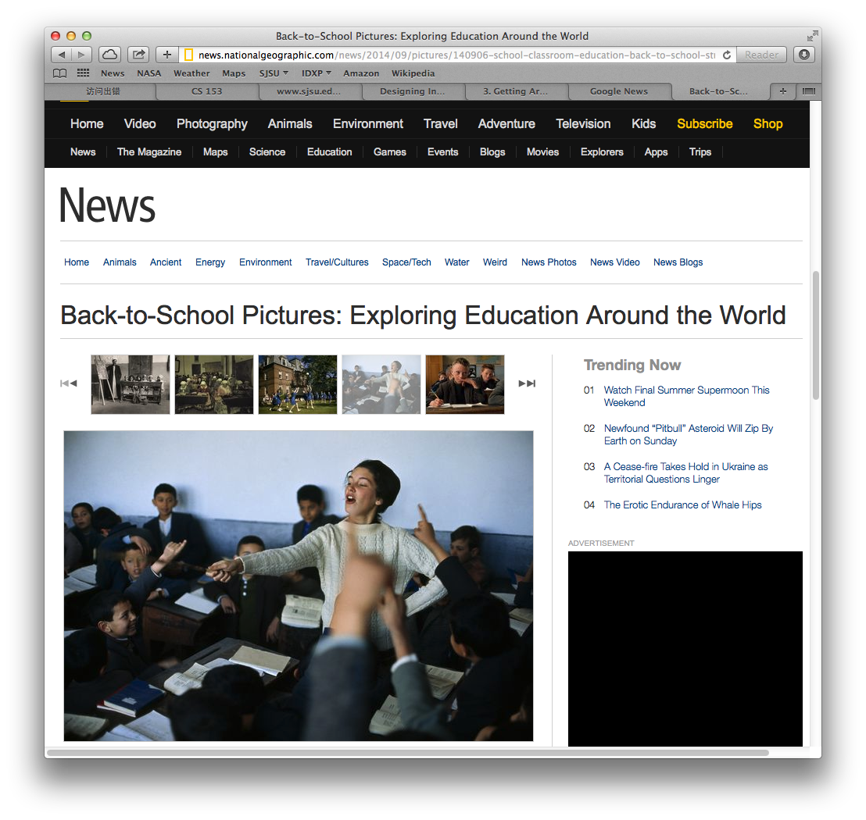
Navigation: Sequence Map
What
  Show a map of pages in sequence.
  Include “you are here”.
When
  The application takes the user along a linear path.
Why
  The map tells the user how far he has gone and how much farther he has to go.

Slide 57
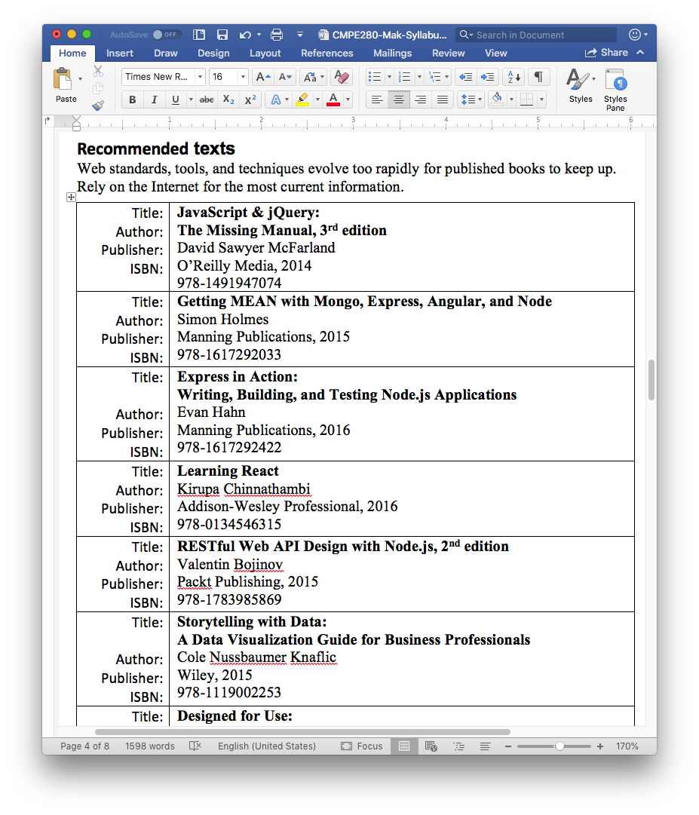
Navigation: Annotated Scrollbar
What
  The scrollbar says “you are here”.
When
  The application is document-centric or allows pan-and-zoom.
Why
  While manipulating the scrollbars, the user needs to know what part of content
  is being displayed.

Slide 58
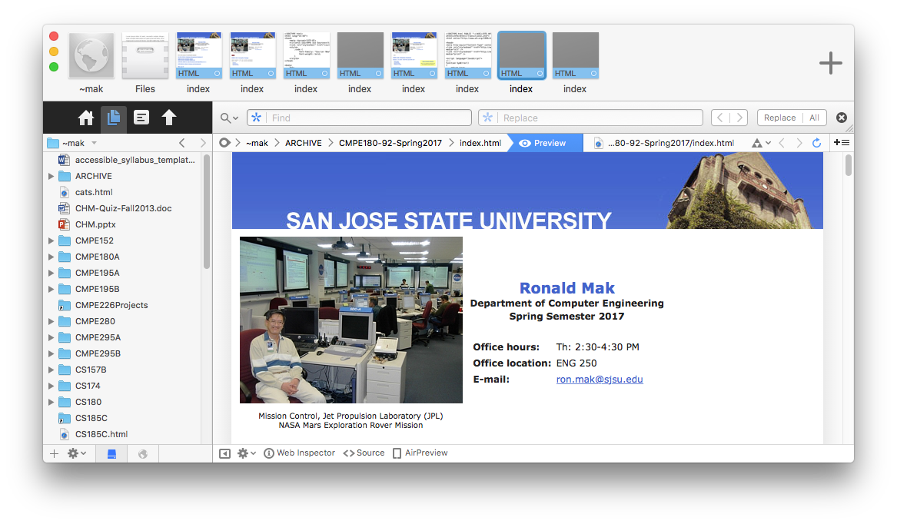
Navigation: Breadcrumbs
What
  On each page in a deep hierarchy,
  show a list of the parent pages in order.
When
  In a deep hierarchy, users need help to keep track of where they are
  A user can go back up to any point in the hierarchy.
Why
  Allow a user to
  move forward and
  back through a
  deep hierarchy.
  The user knows
  where he is in the
  hierarchy.

