Slide 1


CMPE 280
Web UI Design and Development
March 26 Class Meeting
Department of Computer Engineering
San Jose State University
Spring 2020
Instructor: Ron Mak
www.cs.sjsu.edu/~mak

Slide 2
Assignment #6: Information Dashboard
Create an information dashboard from your data.
  At least four charts.
  Must fit on one webpage without scrolling.
  Ideally, use the dataset chosen for your project.
  The dashboard does not need to update in real time.
Explain in a short report:
  How you used good dashboard design principles.
  For each chart, how you used good chart design principles.
Due Friday, April 17.

Slide 3
Assignment #6, cont’d
JavaScript chart-generation libraries
  D3.js
  Google Charts
  Highcharts
Tableau Public
Google “JavaScript data visualization”

Slide 4
Credits
Unless otherwise credited, the examples and illustrations in the following slides are from:
Storytelling with Data
A Data Visualization Guide
for Business Professionals
by Cole Nussbaumer Knaflic
Wiley, 2017
ISBN 978-1-110-28271-6

Slide 5
Avoid Spaghetti Graphs
Too many lines overlapping.
  Difficult to focus on a single series at a time.

Slide 6
Avoid Spaghetti Graphs, cont’d
Emphasize one line at a time.

Slide 7
Avoid Spaghetti Graphs, cont’d
Emphasize one line at a time, cont’d

Slide 8
Avoid Spaghetti Graphs, cont’d
Spatial separation: Pull the lines apart vertically.
These are sparklines.
There are no axes,
so they’re designed
only to show trend.

Slide 9
Avoid Spaghetti Graphs, cont’d
Pull the lines apart horizontally.

Slide 10
Avoid Spaghetti Graphs, cont’d
Combined approach with vertical separation.
Too cluttered?

Slide 11
Avoid Spaghetti Graphs, cont’d
Combined approach with horizontal separation.
Too cluttered?

Slide 12
Sparklines
A sparkline is a very small line chart.
  Typically drawn without axes or coordinates.
Present the general shape of the variation (typically over time) in some measurement.
  Examples: temperature, stock price, etc.
Small enough to be embedded in text, or several sparklines may be grouped together.
Intended to be succinct and memorable.
  Located where they are discussed.

Slide 13
Sparklines, cont’d
https://chandoo.org/wp/excel-sparklines-tutorial/

Slide 14
Sparklines, cont’d
https://www.danielpradilla.info/blog/sparklines-datawords/

Slide 15
Exploratory vs. Explanatory Analysis
Exploratory analysis
  Understand the data.
  Highlight what’s noteworthy or important.
Explanatory analysis
  Communicate the results of the analysis.
  Tell a specific story about the results.

Slide 16
Explanatory Analysis and Communication
Who is your audience?
What do you want your audience
to know or to do?
  What decision should they make?
  What action should they take?
How can you use your data to make your point?
  What mechanism will you use to communicate?
  How will your audience consume the information?
  How much detail will be needed?

Slide 17
Storytelling with Data: Example 1
The data:

Slide 18
Storytelling with Data: Example 1, cont’d
The story:

Slide 19
Storytelling with Data: Example 2
The data:
Remember the
warning about
pie charts!

Slide 20
Storytelling with Data: Example 2, cont’d
The story:

Slide 21
Storytelling with Data: Example 2, cont’d
What is the point you’re trying to get across?

Slide 22
Storytelling with Data: Example 2, cont’d
Or simply show the numbers directly.

Slide 23
Storytelling with Data: Example 3
The data:

Slide 24
Storytelling with Data: Example 3, cont’d
The story:

Slide 25
The 5-Minute Narrative
Storytelling:
How did we
go from here:
To here?

Slide 26
The 5-Minute Narrative, cont’d
Our goal:
  Understand how prices have
  changed over time in the
  competitive landscape.
  Use this knowledge to inform
  the pricing of our product.
  Make a specific recommendation.

Slide 27
The 5-Minute Narrative, cont’d

Slide 28
The 5-Minute Narrative, cont’d

Slide 29
The 5-Minute Narrative, cont’d

Slide 30
The 5-Minute Narrative, cont’d

Slide 31
The 5-Minute Narrative, cont’d

Slide 32
The 5-Minute Narrative, cont’d

Slide 33
The 5-Minute Narrative, cont’d

Slide 34
The 5-Minute Narrative, cont’d

Slide 35
Logical Order of Presentation
Use a logical order to present your information.
Example:
  Your company’s product has many features.
  You survey your customers to understand
  whether they are using each of the features
  and how satisfied they are.
  You want to put your data analysis to good use.

Slide 36
Logical Order of Presentation
The initial chart:

Slide 37
Logical Order of Presentation, cont’d
Highlight the positive story:

Slide 38
Logical Order of Presentation, cont’d
Highlight dissatisfaction

Slide 39
Logical Order of Presentation, cont’d
Focus on unused features.

Slide 40
Logical Order of Presentation, cont’d
Satisfaction

Slide 41
Logical Order of Presentation, cont’d
Dissatisfaction

Slide 42
Logical Order of Presentation, cont’d
Unused features

Slide 43
Logical Order of Presentation, cont’d
Comprehensive visual

Slide 44
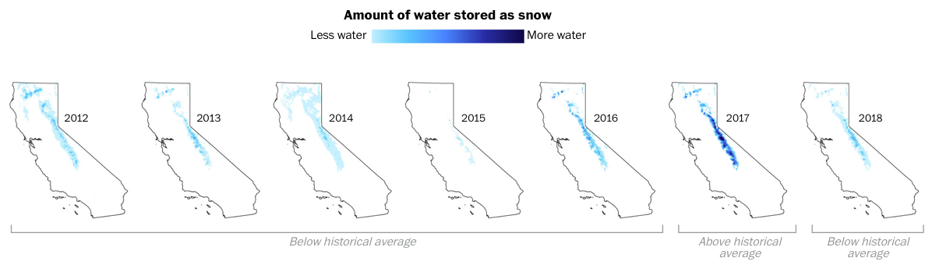
Data Visualization Examples from the Web
https://www.washingtonpost.com/graphics/2018/national/california-snow/?utm_term=.1caebac8be65

Slide 45
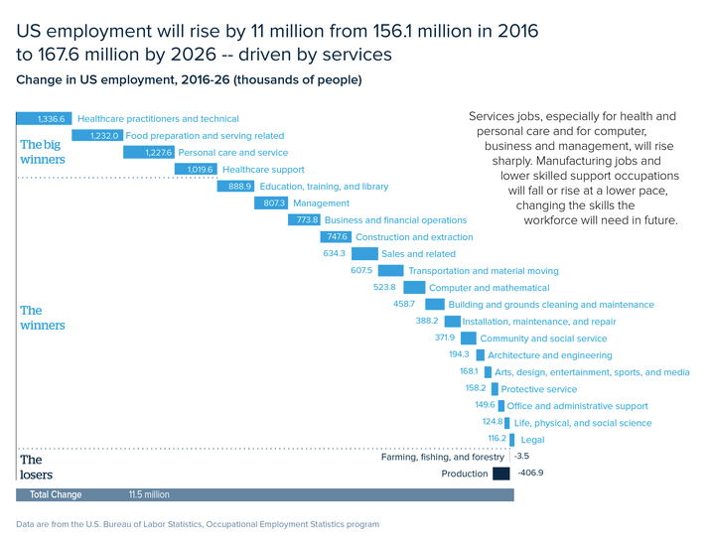
Data Visualization Examples from the Web
http://www.storytellingwithdata.com/blog/2018/5/15/may-swdchallenge-recap-the-waterfall-chart

Slide 46
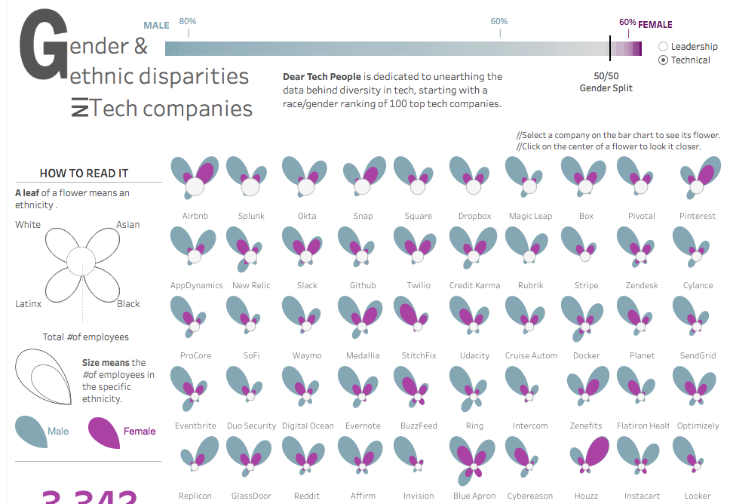

Slide 47
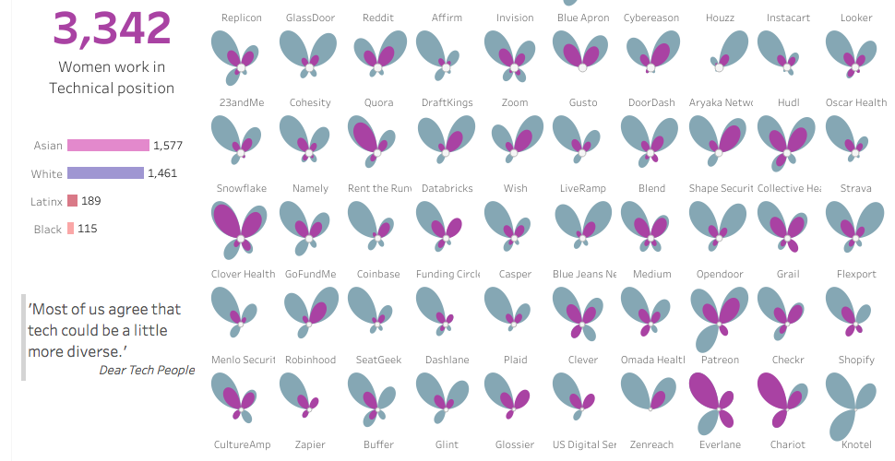
https://public.tableau.com/profile/yvette#!/vizhome/GenderEthnicDisparitiesinTechCompanies/GenderEthnicdisparitiesinTechCompanies

Slide 48
Stories about COVID-19
Great story-telling.
  Data visualizations illustrate the stories.
The coronavirus and a call to action now.
  https://medium.com/@tomaspueyo/coronavirus-act-today-or-people-will-die-f4d3d9cd99ca
  https://medium.com/@tomaspueyo/coronavirus-the-hammer-and-the-dance-be9337092b56
Why social distancing is important.
  https://www.washingtonpost.com/graphics/2020/world/corona-simulator/?itid=hp_hp-top-table-main_virus-simulator520pm%3Ahomepage%2Fstory-ans

Slide 49
Past Student Projects
Several years ago, I taught the
graduate Computer Science course
CS 235 User Interface Design.
The semester projects were also to
use data visualizations to tell a story.
See some example projects at
http://www.cs.sjsu.edu/~mak/CS235Projects/
I expect you to do even better projects.

