Slide 1


CMPE 280
Web UI Design and Development
March 24 Class Meeting
Department of Computer Engineering
San Jose State University
Spring 2020
Instructor: Ron Mak
www.cs.sjsu.edu/~mak

Slide 2
Misuse or Overuse Color
Color can be used in powerful ways:
  highlight data
  encode data
  create a relationship between individual items
Make color choices thoughtfully.
A common problem is the use of
too many colors, especially bright colors.
  The use of too many colors can assault visually.
  When overused, color loses its power to
  highlight what’s most important.
https://www.perceptualedge.com/articles/Whitepapers/Common_Pitfalls.pdf

Slide 3
Misuse or Overuse Color, cont’d
Unemployment Figures
Government Districts in Comparison
https://twitter.com/eagereyes/status/768827027558322176

Slide 4
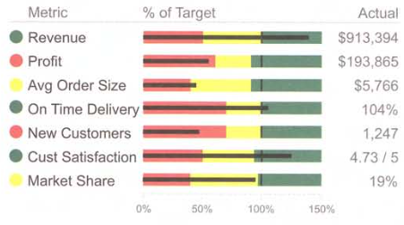
Misuse or Overuse Color, cont’d
Now the important
items stand out.
Information Dashboard Design, 2nd ed.
by Stephen Few
Analytics Press, 2013

Slide 5
Misuse or Overuse Color, cont’d
Colors that don’t encode any meaning:
Information Dashboard Design, 2nd ed.
by Stephen Few
Analytics Press, 2013

Slide 6
Misuse or Overuse Color, cont’d
Distracting use of color gradients.
Information Dashboard Design, 2nd ed.
by Stephen Few
Analytics Press, 2013

Slide 7
Misuse or Overuse Color, cont’d
http://www.integratedots.com/key-design-considerations-for-dashboard/

Slide 8
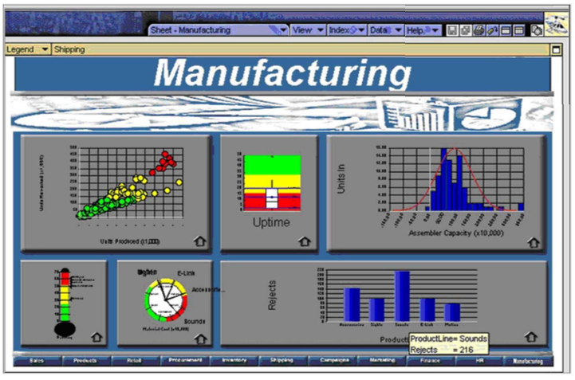
Unattractive Visual Display
Don’t make ugly dashboards!
https://www.perceptualedge.com/articles/Whitepapers/Common_Pitfalls.pdf

Slide 9
Data-Ink Ratio
Maximize the data-ink ratio (within reason).
  Every bit of ink on a graphic requires a reason.
  Nearly always, the reason should be that
  the ink presents new information.
Keep it simple!
Eliminate chart junk!

Slide 10
Data-Ink Ratio, cont’d
Reduce the non-data pixels.
  Eliminate all unnecessary non-data pixels.
  De-emphasize and regularize
  the non-data pixels that remain.
Enhance the data pixels.
  Eliminate all unnecessary data pixels.
  Highlight the most important data pixels that remain.

Slide 11
Data-Ink Ratio, cont’d
Low data-ink ratio vs. high data-ink ratio.
http://www.infovis-wiki.net/index.php/Data-Ink_Ratio

Slide 12
Data-Ink Ratio, cont’d
Too high percentage of non-data pixels:
Information Dashboard Design, 2nd ed.
by Stephen Few
Analytics Press, 2013

Slide 13
Data-Ink Ratio, cont’d
Unnecessary borders fragment the display.
Information Dashboard Design, 2nd ed.
by Stephen Few
Analytics Press, 2013

Slide 14
Data-Ink Ratio, cont’d
Unnecessary and distracting fill colors.
Information Dashboard Design, 2nd ed.
by Stephen Few
Analytics Press, 2013

Slide 15
Data-Ink Ratio, cont’d
Unnecessary grid lines in graphs.
Information Dashboard Design, 2nd ed.
by Stephen Few
Analytics Press, 2013

Slide 16
Data-Ink Ratio, cont’d
Unnecessary grid lines in tables.
Information Dashboard Design, 2nd ed.
by Stephen Few
Analytics Press, 2013

Slide 17
Data-Ink Ratio, cont’d
Complete borders instead of x- and y-axes.
Information Dashboard Design, 2nd ed.
by Stephen Few
Analytics Press, 2013

Slide 18
Data-Ink Ratio, cont’d
Make separator lines lighter.
Information Dashboard Design, 2nd ed.
by Stephen Few
Analytics Press, 2013

Slide 19
Data-Ink Ratio, cont’d
Make grid lines lighter.
Information Dashboard Design, 2nd ed.
by Stephen Few
Analytics Press, 2013

Slide 20
Data-Ink Ratio, cont’d
Mute the shading used to delineate table rows.
Information Dashboard Design, 2nd ed.
by Stephen Few
Analytics Press, 2013

Slide 21
Data-Ink Ratio, cont’d
Mute the shading used to delineate table rows.
Information Dashboard Design, 2nd ed.
by Stephen Few
Analytics Press, 2013

Slide 22
Dashboards Should Not Need Instructions
Information Dashboard Design, 2nd ed.
by Stephen Few
Analytics Press, 2013

Slide 23
Avoid Chart Junk
Information Dashboard Design, 2nd ed.
by Stephen Few
Analytics Press, 2013

Slide 24
Avoid Chart Junk, cont’d

Slide 25
Avoid Chart Junk, cont’d
https://medium.com/learning-ux/chart-junk-consistent-data-presentation-serious-nerd-love-e1de5edd48cb

Slide 26
Three Levels of Situational Awareness
Perception of the elements of the environment.
Comprehension of the current situation.
Projection of future status.
Knowledge in a vacuum is meaningless.
Achieving objectives requires
the successful application of knowledge
in contextually appropriate ways.

Slide 27
Four Stages of Performance Monitoring
Update high-level situational awareness.
Identify and focus on particular items
that need attention.
  Update awareness of this item in greater detail.
  Determine whether action is required.
Access any additional information required to act, to determine an appropriate response.
Respond.

Slide 28
Three Stages of Decision Making
Frame the problem to be solved.
Collect relevant information
leading to a decision.
Reflect and review.

Slide 29
Why Data Visualization?
What do the following four groups of numbers tell you?
Group A |  |  | Group B |  |  | Group C |  |  | Group D
x | y |  | x | y |  | x | y |  | x | y
10 | 8.04 |  | 10 | 9.14 |  | 10 | 7.46 |  | 8 | 6.58
8 | 6.95 |  | 8 | 8.14 |  | 8 | 6.77 |  | 8 | 5.76
13 | 7.58 |  | 13 | 8.74 |  | 13 | 12.74 |  | 8 | 7.71
9 | 8.81 |  | 9 | 8.77 |  | 9 | 7.11 |  | 8 | 8.84
11 | 8.33 |  | 11 | 9.26 |  | 11 | 7.81 |  | 8 | 8.47
14 | 9.96 |  | 14 | 8.1 |  | 14 | 8.84 |  | 8 | 7.04
6 | 7.24 |  | 6 | 6.13 |  | 6 | 6.08 |  | 8 | 5.25
4 | 4.26 |  | 4 | 3.1 |  | 4 | 5.39 |  | 19 | 12.5
12 | 10.84 |  | 12 | 9.13 |  | 12 | 8.15 |  | 8 | 5.56
7 | 4.82 |  | 7 | 7.26 |  | 7 | 6.42 |  | 8 | 7.91
5 | 5.68 |  | 5 | 4.74 |  | 5 | 5.73 |  | 8 | 6.89
The Big Book of Dashboards
by Steve Wexler, et al.
Wiley, 2017
ISBN 978-1-110-28271-6

Slide 30
Why Data Visualization? cont’d
The Big Book of Dashboards
by Steve Wexler, et al.
Wiley, 2017
ISBN 978-1-110-28271-6

Slide 31
Why Data Visualization? cont’d
What are the trends in sales?
Category | 2013 Q1 | 2013 Q2 | 2013 Q3 | 2013 Q4 | 2014 Q1 | 2014 Q2 | 2014 Q3 | 2014 Q4
Furniture | $463,988 | $352,779 | $338,169 | $317,735 | $320,875 | $287,934 | $319,537 | $324,319
Office Supplies | $232,558 | $290,055 | $265,083 | $246,946 | $219,514 | $202,412 | $198,268 | $279,679
Technology | $563,866 | $244,045 | $432,299 | $461,616 | $285,527 | $353,237 | $338,360 | $420,018
Category | 2015 Q1 | 2015 Q2 | 2015 Q3 | 2015 Q4 | 2016 Q1 | 2016 Q2 | 2016 Q3 | 2016 Q4
Furniture | $307,028 | $273,836 | $290,886 | $397,912 | $337,299 | $245,445 | $286,972 | $313,878
Office Supplies | $207,363 | $183,631 | $191,405 | $217,950 | $241,281 | $286,548 | $217,198 | $272,870
Technology | $333,002 | $291,116 | $356,243 | $386,445 | $386,387 | $397,201 | $359,656 | $375,229
The Big Book of Dashboards
by Steve Wexler, et al.
Wiley, 2017
ISBN 978-1-110-28271-6

Slide 32
Preattentive Attributes
Direct the viewer’s attention to what’s
most important on a webpage.
  Especially for an information dashboard.
Our ancient predators helped our brains develop greater efficiency in sight and
speed of recognition and response.
Our brains notice preattentive attributes
before we realize that happened.
  We can use preattentive attributes to direct
  the viewer’s attention on a webpage.

Slide 33
Preattentive Attributes, cont’d
We perceive the following visual attributes
preattentively—prior to conscious awareness.
  length
  width
  orientation
  size
  shape
  curvature
  enclosure
  spatial grouping
  blur
  hue
  color intensity
  2-D position
  direction of motion

Slide 34
Preattentive Attributes, cont’d
Storytelling with Data
by Cole Nussbaumer Knaflic
Wiley, 2017
ISBN 978-1-110-28271-6

Slide 35
Uses of Preattentive Attributes
Where are the 9’s?
The Big Book of Dashboards
by Steve Wexler, et al.
Wiley, 2017
ISBN 978-1-110-28271-6

Slide 36
Uses of Preattentive Attributes, cont’d
Do these images help?
The Big Book of Dashboards
by Steve Wexler, et al.
Wiley, 2015
ISBN 978-1-110-00225-3

Slide 37
Uses of Preattentive Attributes, cont’d
The Big Book of Dashboards
by Steve Wexler, et al.
Wiley, 2017
ISBN 978-1-110-28271-6

Slide 38
Uses of Preattentive Attributes, cont’d
How many 9’s are there?
The Big Book of Dashboards
by Steve Wexler, et al.
Wiley, 2017
ISBN 978-1-110-28271-6

Slide 39
Preattentive Attributes in Graphs
How does the number of 9’s rank with the numbers of the other digits?
The Big Book of Dashboards
by Steve Wexler, et al.
Wiley, 2017
ISBN 978-1-110-28271-6

Slide 40
Preattentive Attributes in Graphs, cont’d
No preattentive attributes to provide visual cues for how to process this graph.
Storytelling with Data
by Cole Nussbaumer Knaflic
Wiley, 2017
ISBN 978-1-110-28271-6

Slide 41
Preattentive Attributes in Graphs, cont’d
Tell a story with the data!
Storytelling with Data
by Cole Nussbaumer Knaflic
Wiley, 2017
ISBN 978-1-110-28271-6

Slide 42
Preattentive Attributes in Graphs, cont’d
Lead your viewers from the macro to the micro parts of your story.
  Create a visual hierarchy.
Storytelling with Data
by Cole Nussbaumer Knaflic
Wiley, 2017
ISBN 978-1-110-28271-6

Slide 43
Highlighting in Graphs
What is important in the following graph?
Can we emphasize that the volume of incoming tickets exceeds our ability to process them?
Storytelling with Data
by Cole Nussbaumer Knaflic
Wiley, 2017
ISBN 978-1-110-28271-6

Slide 44
Highlighting in Graphs, cont’d
Make the Processed line stand out better.
What if it’s important to convey actual amounts?
Storytelling with Data
by Cole Nussbaumer Knaflic
Wiley, 2017
ISBN 978-1-110-28271-6

Slide 45
Highlighting in Graphs, cont’d
Does this look cluttered?
Can we emphasize the gap between the Received and Processed amounts on the right side?
Storytelling with Data
by Cole Nussbaumer Knaflic
Wiley, 2017
ISBN 978-1-110-28271-6

Slide 46
Highlighting in Graphs, cont’d
Use data labels sparingly to help draw attention to what’s important.
Storytelling with Data
by Cole Nussbaumer Knaflic
Wiley, 2017
ISBN 978-1-110-28271-6

Slide 47
Preattentive Attributes in Text
Storytelling with Data
by Cole Nussbaumer Knaflic
Wiley, 2017
ISBN 978-1-110-28271-6

