Slide 1


CMPE 280
Web UI Design and Development
February 27 Class Meeting
Department of Computer Engineering
San Jose State University
Spring 2020
Instructor: Ron Mak
www.cs.sjsu.edu/~mak

Slide 2
The jQuery User Interface Toolkit
The jQuery User Interface Toolkit
is built on top of the jQuery library.
New cross-platform UI features:
  UI elements: scrollbars
    tabs, date pickers, etc.
  Advanced user interaction
    drag and drop
    resize objects
  Theme templates
    control your application’s look and feel
  Icon library

Slide 3
The jQuery User Interface Toolkit, cont’d
Build a modern application.
  That just happens to run inside a web browser.
  Add visual effects.
Single-page application (SPA)
Open source
  Download from http://jqueryui.com

Slide 4
Themes
A jQuery theme is a visual rule set.
  Defines a particular look and feel.
  Implemented by a complex CSS document
  that you can download and link to your web pages.
Visit the jQuery Theme Roller at
http://jqueryui.com/themeroller/
  Widgets (tool objects)
  Select and download themes.
  Modify themes or create new themes.

Slide 5
Drag an Object
Call jQuery UI’s draggable() function
on an object to enable it to be dragged
with a mouse.

Slide 6
Drag an Object, cont’d
<head>
<title>Drag</title>
<meta charset= "UTF-8" />
<script type="text/javascript"
src="js/jquery.js">
</script>
<script type="text/javascript"
src="js/jquery-ui-lightness/jquery-ui.min.js">
</script>
<script type="text/javascript"
src="js/drag.js">
</script>
</head>
<body>
<h1>Drag Demo</h1>
<div id="dragMe">
<img src="images/Bristol.png" width="200" />
</div>
</body>
drag.html
drag.js
$(init);
function init()
{
$("#dragMe").draggable();
}

Slide 7
UI Icons
Each UI Toolkit download includes an images folder that contains the icon files.
To insert an icon, create a span
where icon-name is obtained from the
Theme Roller.
Hover the mouse over the desired icon
to see its name.
<span class="ui-icon icon-name"></span>

Slide 8
Resize an Object
Call a jQuery object’s resizable() function
on an object to enable it to be resized with a mouse.
Add the following jQuery UI classes
to the object:
  ui-widget
  ui-widget-content
  ui-corner-all

Slide 9
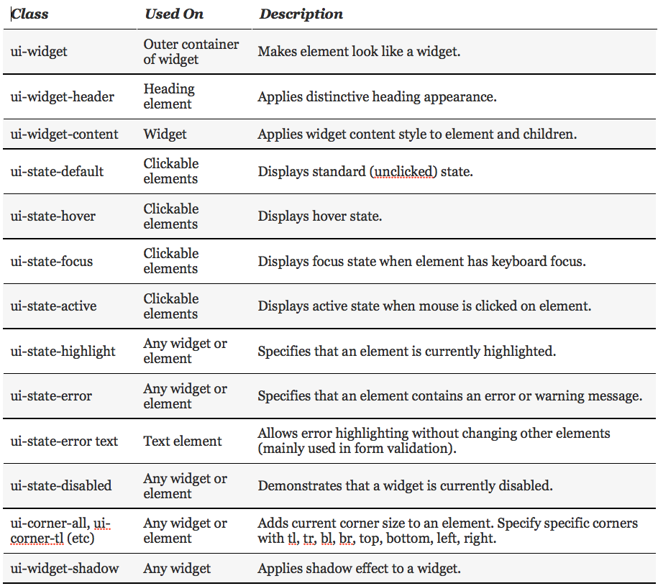
jQuery UI Toolkit Classes for CSS

Slide 10
Resize an Object, cont’d
<head>
<meta http-equiv="content-type"
content="text/xml; charset=utf-8" />
<link rel = "stylesheet"
type = "text/css"
href = "css/jquery-ui-lightness/jquery-ui.min.css" />
<link rel = "stylesheet"
type = "text/css"
href = "css/resize.css" />
<script type = "text/javascript"
src = "js/jquery.js">
</script>
<script type = "text/javascript"
src = "js/jquery-ui-lightness/jquery-ui.min.js">
</script>
<script type = "text/javascript"
src="js/resize.js">
</script>
<title>resize.html</title>
</head>
resize.html

Slide 11
Resize an Object, cont’d
resize.html
<body>
<h1>Resize Demo</h1>
<div id="resizeMe">
<h2>
<span class="ui-icon ui-icon-heart"></span>
Resize me
<span class="ui-icon ui-icon-star"></span>
</h2>
<p>
Drag a corner or side to resize.
</p>
</div>
</body>

Slide 12
Resize an Object, cont’d
resize.js
$(init);
function init()
{
$("#resizeMe").resizable();
$("div").addClass("ui-widget")
.addClass("ui-widget-content")
.addClass("ui-corner-all");
$(":header").addClass("ui-widget-header")
.addClass("ui-corner-all");
}
:header is a jQuery extension
that matches all header elements.

Slide 13
Drag and Drop an Object
Call jQuery UI’s droppable() function
on an object to enable it to be a drop target.
Use the bind() function to bind drop-in
and drop-out events to the object.
  Attach a callback function to each event.
UI variable ui-draggable refers to the object that triggered the drop-in callback function.

Slide 14
Drag and Drop an Object, cont’d
dragdrop.html
<body>
<h1>Drag and Drop Demo</h1>
<div class="dragMe">
DRAG ME
</div>
<div id="target">
DROP HERE
</div>
</body>
</html>

Slide 15
Drag and Drop an Object, cont’d
.dragMe {
width: 100px;
height: 100px;
border: 1px solid blue;
text-align: center;
background-color: white;
position: absolute;
z-index: 100;
}
#target {
width: 200px;
height: 200px;
border: 1px solid red;
text-align: center;
position: absolute;
left: 300px;
top: 100px;
z-index: 0;
}
dragdrop.css

Slide 16
Drag and Drop an Object, cont’d
dragdrop.js
$(init);
function init()
{
cloneDragMe();
$(".dragMe").draggable();
$("#target").droppable();
$("#target").bind("drop", highlightTarget);
$("#target").bind("dropout", resetTarget);
}

Slide 17
Drag and Drop an Object, cont’d
dragdrop.js
function highlightTarget(event, ui)
{
$("#target").addClass("ui-state-highlight")
.html("Dropped ")
.append(ui.draggable.text());
}
function resetTarget(event, ui)
{
$("#target").removeClass("ui-state-highlight")
.html("Drop on me");
}

Slide 18
Drag and Drop an Object, cont’d
dragdrop.js
function cloneDragMe()
{
for (i = 1; i <= 4; i++){
zValue = 101 + i;
xPos = 20*i;
yPos = 80 + 20*i + "px";
$("div:first").clone()
.insertAfter("div:first")
.css("left", xPos)
.css("top", yPos)
.css("zIndex", zValue)
.append(" #" + i);
}
}

Slide 19
jQuery UI Widgets
Popular jQuery UI widgets include:
  accordion
  tabs
  date picker
  slider
  selectable elements
  sortable lists
  dialog boxes

Slide 20
Accordion Widget
Create an outer div to be the accordion widget.
Create a heading for each collapsible element of the accordion widget.
  The headings are contained inside the outer div.
  Make all the headings at the same level.
Follow each heading with an inner div to contain the contents of the collapsible element.

Slide 21
Accordion Widget, cont’d
accordion.html
<body>
<h1>Accordion Demo</h1>
<div id="accordion">
<h2>CMPE 180A Data Structures and Algorithms in C++</h2>
<div>
<p>
Data representation and preprocessing, proximity,
...
</p>
<p>
<strong>Prerequisite:</strong> Admission into MS
Computer Engineering or MS Software Engineering.
</p>
</div>
<h2>CMPE 226 Database Systems</h2>
<div> ... </div>
...
</div>
</body>
Outer div
Inner div
Inner div

Slide 22
Accordion Widget, cont’d
accordion.js
$(init);
function init()
{
$("#accordion").accordion();
}

Slide 23
Tabs Widget
Create an outer div to be the tabs widget.
The first element contained in the div must be an ordered or unordered list to serve as the tabs directory.
Each list item is a local link to an inner div
that contains the tab contents.

Slide 24
Tabs Widget, cont’d
tabs.html
<body>
<h1 class="ui-state-default">Tabs Demo</h1>
<div id="tabs">
<ul>
<li><a href="#CMPE180A">CMPE 180A</a></li>
<li><a href="#CMPE226">CMPE 226</a></li>
<li><a href="#CMPE280">CMPE 280</a></li>
<li><a href="#CMPE295A">CMPE 295A</a></li>
</ul>
<div id="CMPE180A">
...
</div>
<div id="CMPE226">
...
</div>
...
</div>
</body>
Outer div
Tabs directory
Inner divs
js/tabs.js
$(init);
function init()
{
$("#tabs").tabs();
}

Slide 25
AJAX Tabs
Use AJAX to obtain the contents of a tab.
Specify the file to be loaded from the server
as a link in the corresponding item in the
tabs directory list.

Slide 26
AJAX Tabs, cont’d
ajaxtabs.html
<body>
<h1 class="ui-state-default">AJAX Tabs Demo</h1>
<div id="tabs">
<ul>
<li><a href="courses/CMPE180A.html">CMPE 180A</a></li>
<li><a href="courses/CMPE226.html">CMPE 226</a></li>
<li><a href="courses/CMPE280.html">CMPE 280</a></li>
<li><a href="courses/CMPE295A.html">CMPE 295A</a></li>
</ul>
</div>
</body>

Slide 27
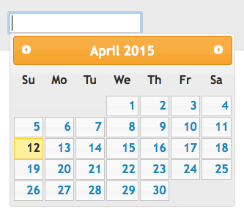
Date Picker Widget
widgets.html
<input type="text" id="datePicker" />
$("#datePicker").datepicker();
js/widgets.js

Slide 28
Slider Widget
widgets.html
<div id="slider"></div>
<div id="slideOutput">0</div>
$("#slider").slider().bind("slide", reportSlider);
...
function reportSlider()
{
var sliderVal = $("#slider").slider("value");
$("#slideOutput").html(sliderVal);
}
js/widgets.js

Slide 29

Selectable Widget
<ul id="selectable">
<li>alpha</li>
<li>beta</li>
<li>gamma</li>
<li>delta</li>
</ul>
widgets.html
$("#selectable").selectable();
js/widgets.js

Slide 30


Sortable Widget
<ul id="sortable">
<li>alpha</li>
<li>beta</li>
<li>gamma</li>
<li>delta</li>
</ul>
widgets.html
$("#sortable").sortable();
js/widgets.js

Slide 31
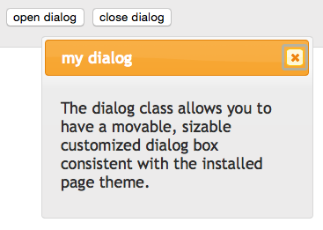
Dialog Widget
<div id="dialog" title="my dialog">
<p>
The dialog class allows you
to have a movable sizable
customized dialog box
consistent the installed
page theme.
</p>
</div>
<input type="button"
value="open dialog"
onclick="openDialog()" />
<input type="button"
value="close dialog"
onclick="closeDialog()" />
widgets.html

Slide 32
Dialog Widget, cont’d
js/widgets.js
function openDialog()
{
$("#dialog").dialog("open");
}
function closeDialog()
{
$("#dialog").dialog("close");
}

Slide 33
Assignment #4
Add jQuery and jQuery UI functionality
to your web app.
  Pick and use a theme.
  Or create a new theme.
Have at least one on-screen object that is:
  resizable
  dragged and dropped
Use jQuery UI widgets:
  AJAX tabs (either node.js or Apache web server)
  at least two other interactive widgets

Slide 34
Assignment #4, cont’d
Include a short informal report that points out the jQuery and jQuery UI features of your app.
  The purpose of each feature.
  How it behaves (you can use screenshots).
  How you implemented it.
You may use other client-side libraries in your final project, but for this assignment, you must use at least jQuery and jQuery UI.
Due Friday, March 6.

