Slide 1


CMPE 280
Web UI Design and Development
February 20 Class Meeting
Department of Computer Engineering
San Jose State University
Spring 2020
Instructor: Ron Mak
www.cs.sjsu.edu/~mak

Slide 2
More JavaScript Regular Expressions
JavaScript uses regular expressions for
more than just pattern matching.
You can use regular expressions also for
string manipulation.

Slide 3
Example: Reversing Names
Suppose you had a list of names, such as
You want to reverse the names, last name first, and insert a comma:
Bill Clinton
George Bush
Barack Obama
Donald Trump
Clinton, Bill
Bush, George
Obama, Barack
Trump, Donald
Demo

Slide 4
Reversing Names, cont’d
re/reverse.html
<body>
<h1>Reverse names:</h1>
<form action="">
Enter a list of names with first name first,
one per line:<br>
<textarea id="names" rows="10" cols="50"></textarea>
<p>
<input type="button" value="Reverse names"
onclick=reverseNames() />
<input type="reset" />
</p>
</form>
</body>

Slide 5
Reversing Names, cont’d
re/reverse.js
function reverseNames()
{
var names = document.getElementById("names").value;
var splitter = /\s*\n\s*/;
var nameList = names.split(splitter);
var newList = new Array;
var reverser = /(\S+)\s(\S+)/;
for (var i = 0; i < nameList.length; i++) {
if (nameList[i].trim().length > 0) {
newList[i] = nameList[i].replace(reverser, "$2, $1");
newNames += newList[i] + "\n";
}
}
document.getElementById("names").value = newNames;
}
Use the pattern to split the string
into an array of names. The
pattern separates the names.
\s is a whitespace character.
\S = non-whitespace character
Replace each name string
using the reverser pattern.

Slide 6
Example: Formatting Names
Suppose you allow users to be sloppy:
But you still want:
BiLL CLinTON
GeOrGe BuSh
barack OBAMA
dOnAlD truMP
Clinton, Bill
Bush, George
Obama, Barack
Trump, Donald
Demo

Slide 7
Formatting Names, cont’d
Our regular expression for formatting names:
  Split the first and last names each into
  an initial letter followed by the rest of the letters.
Call the regular expression’s exec() method on each string.
  Automatically sets JavaScript’s
  built-in RegExp object.
  Use RegExp.$1, RegExp.$2, etc.
  to access stored parts of the match.
var formatter = /\s*(\S)(\S+)\s+(\S)(\S+)\s*/

Slide 8
Formatting Names, cont’d
re/format.js
var newNames = "";
for (var i = 0; i < nameList.length; i++) {
if (nameList[i].trim().length > 0) {
formatter.exec(nameList[i]);
newList[i] = RegExp.$3.toUpperCase()
+ RegExp.$4.toLowerCase()
+ ", "
+ RegExp.$1.toUpperCase()
+ RegExp.$2.toLowerCase();
newNames += newList[i] + "\n";
}
}

Slide 9
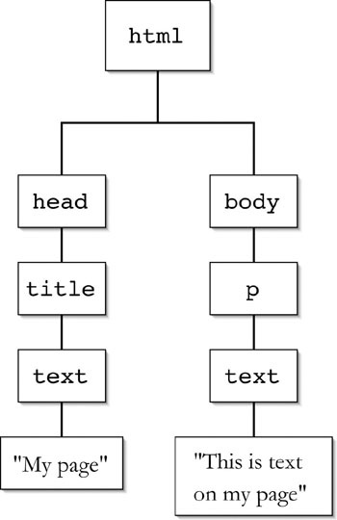
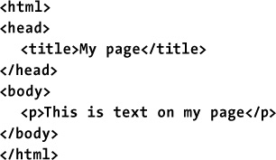
More Document Object Model (DOM)
Recall the DOM.
  Example:
JavaScript, 9th ed.
by Tom Negrino and Dori Smith
Peachpit Press, 2015
ISBN 978-0-321-99670-1

Slide 10
DOM, cont’d
Also recall how we used innerHTML and JavaScript to modify the DOM:
<body>
<form action="">
<fieldset>
...
</fieldset>
</form>
<div id="outputDiv">
<p>Output will appear here.</p>
</div>
</body>
document.getElementById("outputDiv").innerHTML =
"<p><strong>" +
x + " + " + y + " = " + sum +
"</strong></p>”;

Slide 11
DOM, cont’d
document.getElementById("outputDiv").innerHTML =
"<p><strong>" +
x + " + " + y + " = " + sum +
"</strong></p>";
Using innerHTML is error-prone.
  You can create elements with unclosed tags,
  or invalid tags.
A safer way to modify the DOM is to use JavaScript’s DOM manipulation API.

Slide 12
Example: DOM Modification
<head>
<title>Node Actions</title>
<script src="nodes.js"></script>
</head>
<body>
<h1>Node actions</h1>
<form id="theForm">
Enter some text and choose an action:
<p><textarea id="textArea" rows="5" cols="30"></textarea></p>
<p>
Node action:
<select id="chooser">
<option value="Add">Add to end</option>
<option value="Insert">Insert before</option>
<option value="Replace">Replace</option>
<option value="Delete">Delete</option>
</select>
Paragraph:
<select id="indexer"></select>
<input type=button value="Do it!" onclick=nodeAction() />
</p>
</form>
<hr />
<div id="workspace"> </div>
</body>
dom/nodes.html
The node whose children we will manipulate
using JavaScript’s DOM API.

Slide 13
DOM Modification, cont’d
dom/nodes.js
window.onload = init;
var textArea;
var chooser;
var indexer;
var workspace;
function init()
{
textArea = document.getElementById("textArea");
chooser = document.getElementById("chooser");
indexer = document.getElementById("indexer");
workspace = document.getElementById("workspace");
}

Slide 14
DOM Modification: Add a Child Node
dom/nodes.js
function addNode()
{
var text = textArea.value;
var textNode = document.createTextNode(text);
var pNode = document.createElement("p");
pNode.appendChild(textNode);
workspace.appendChild(pNode);
textArea.value = "";
}

Slide 15
DOM Modification: Insert a Child Node
dom/nodes.js
function insertNode()
{
var textNode = textArea.value;
var index = indexer.selectedIndex;
var textNode = document.createTextNode(textNode);
var pNode = document.createElement("p");
pNode.appendChild(textNode);
var pNodes = workspace.getElementsByTagName("p");
var chosenPNode = pNodes.item(index);
workspace.insertBefore(pNode, chosenPNode);
textArea.value = "";
}

Slide 16
DOM Modification: Replace a Child Node
dom/nodes.js
function replaceNode()
{
var text = textArea.value;
var index = indexer.selectedIndex;
var textNode = document.createTextNode(text);
var pNode = document.createElement("p");
pNode.appendChild(textNode);
var pNodes = workspace.getElementsByTagName("p");
var chosenPNode = pNodes.item(index);
workspace.replaceChild(pNode, chosenPNode);
textArea.value = "";
}

Slide 17
DOM Modification: Delete a Child Node
dom/nodes.js
function deleteNode()
{
var index = indexer.selectedIndex;
var pNodes = workspace.getElementsByTagName("p");
var chosenPNode = pNodes.item(index);
workspace.removeChild(chosenPNode);
}

Slide 18
Custom JavaScript Objects
At run time, a JavaScript variable
can have any value.
Create a custom object simply by giving it properties and methods.

Slide 19
Example Custom JavaScript Object
objects/person.html
var person = new Object();
person.name = "Mary";
person.age = 20;
person.nextYear = function()
{
return this.age + 1;
};
alert("Name = " + this.name +
", age = " + this.age +
", age next year = " + this.nextYear());
Demo

Slide 20
JavaScript Classes and Objects
A JavaScript class has a constructor function.
  Example:
function Person(name, age)
{
this.name = name;
this.age = age;
this.nextYear = function()
{
return this.age + 1;
};
}
Convention: Capitalize
the constructor name.

Slide 21
Example Object Instantiation
Use the constructor to create new instances:
objects/people.html
function createPeople()
{
mary = new Person("Mary", 20);
john = new Person("John", 25);
showPerson(mary);
showPerson(john);
}
function showPerson(p)
{
alert("Name = " + p.name +
", age = " + p.age +
", age next year = " + p.nextYear());
}
Demo

Slide 22
Prototype Objects
A JavaScript class is a set of objects
that inherit properties from the same
prototype object.
objects/prototype.html
Person.prototype = {
toString: function()
{
return "Person[name: '" + this.name +
"', age: " + this.age + "]";
}
}
function createPeople()
{
mary = new Person("Mary", 20);
john = new Person("John", 25);
alert(mary);
alert(john);
}
Demo

Slide 23
Web Browser – Web Server Cycle
Each time you submit form data from the web browser to the web server, you must wait for:
  The data to upload to the web server.
  The web server to generate the next web page.
  The next web page to download to your browser.
  Your browser to render the next web page.
You experience a noticeable page refresh.

Slide 24
Web Browser – Web Server Cycle, cont’d
Example:
  Click the submit button.
  JavaScript code on the server opens and reads a text file and generates a new web page containing the contents of the text file.
  The browser displays the new web page.

Slide 25
Web Browser – Web Server Cycle, cont’d
<body>
<form action="text-response"
method="get">
<fieldset>
<legend>User input</legend>
<p>
<label>First name:</label>
<input name="firstName" type="text" />
</p>
<p>
<label>Last name:</label>
<input name="lastName" type="text" />
</p>
<p>
<input type="submit" value="Submit" />
</p>
</fieldset>
</form>
</body>
Client side

Slide 26
Web Browser – Web Server Cycle, cont’d
Server side
// Process the form data and send a response.
app.get('/text-response’,
function(req, res)
{
var firstName = req.param('firstName');
var lastName = req.param('lastName');
var html = 'Hello, ' + firstName + ' ' + lastName + '!';
res.send(html);
}
);

Slide 27
AJAX
Asynchronous JavaScript and XML
Tighter communication between the web browser and the web server.
  Shortens the browser-server cycle.
  The server generates and downloads part of a page.
  The web browser refreshes only the part of the page that needs to change.
The browser and server work asynchronously.
  The browser does not have to wait
  for the download from the server.

Slide 28
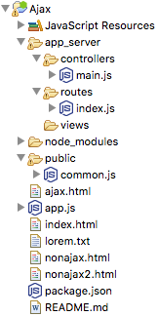
AJAX Example
We will compare AJAX to non-AJAX.
Demo

Slide 29
AJAX Example, cont’d
module.exports.home = function(request, result)
{
sendPage('index.html', result);
};
module.exports.get_nonajax = function(request, result)
{
sendPage('nonajax.html', result);
};
module.exports.post_nonajax = function(request, result)
{
sendPage('nonajax2.html', result);
};
module.exports.get_ajax = function(request, result)
{
sendPage('ajax.html', result);
};
module.exports.post_ajax = function(request, result)
{
sendPage('lorem.txt', result);
};
controllers/main.js

Slide 30
AJAX Example, cont’d
public/common.js
var request;
function doAJAX()
{
request = new XMLHttpRequest();
request.open("POST", "/ajax");
request.onreadystatechange = displayFile;
request.send(null);
}
function displayFile()
{
if (request.readyState == 4) {
if (request.status == 200) {
var text = request.responseText;
text = text.replace(/\n/g, "<br />");
document.getElementById("output").innerHTML =
"<p>" + text + "</p>";
}
}
}
Function displayFile()
will be called asynchronously.

Slide 31
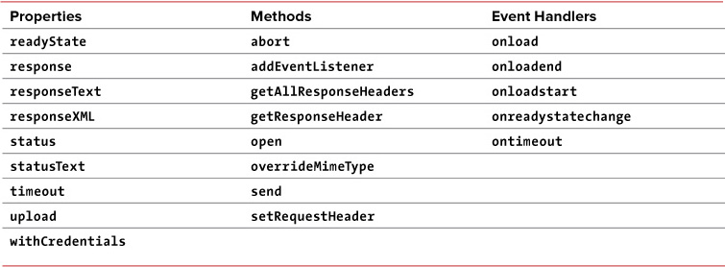
The XMLHttpRequest Object
Use the properties and methods of the XMLHttpRequest object to control a request from the web browser to the web server.
See also: http://www.w3schools.com/xml/dom_http.asp
JavaScript, 9th ed.
by Tom Negrino and Dori Smith
Peachpit Press, 2015
ISBN 978-0-321-99670-1

Slide 32
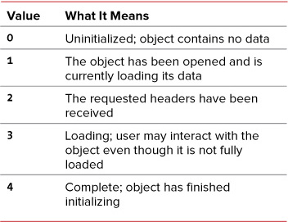
readyState Property Values
JavaScript, 9th ed.
by Tom Negrino and Dori Smith
Peachpit Press, 2015
ISBN 978-0-321-99670-1

