Slide 1


CMPE 280
Web UI Design and Development
January 30 Class Meeting
Department of Computer Engineering
San Jose State University
Spring 2020
Instructor: Ron Mak
www.cs.sjsu.edu/~mak

Slide 2
Teams?

Slide 3
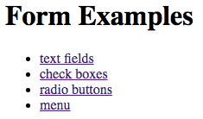
Form Examples: Home Page
index.html
<!DOCTYPE html>
<html lang="en-US">
<head>
<meta charset="UTF-8">
<title>Forms Examples</title>
</head>
<body>
<h1>Form Examples</h1>
<ul>
<li><a href="textfields">text fields</a></li>
<li><a href="checkboxes">check boxes</a></li>
<li><a href="radiobuttons">radio buttons</a></li>
<li><a href="menu">menu</a></li>
</ul>
</body>
</html>
Request this form:
localhost:3000/

Slide 4
Form Examples: Home Page, cont’d
Router:
Controller:
app_server/routes/index.js
/*
* GET home page.
*/
router.get('/', ctrlMain.home);
app_server/controllers/main.js
/*
* GET home page.
*/
module.exports.home = function(request, result)
{
sendPage('index.html', result);
};
file on the server

Slide 5
Form Examples: Home Page, cont’d
Controller, cont’d
  Instead of hard-coding the contents of file index.html in the controller as we did in the Hello World example, function sendPage reads the file on the server and sends it to the client.
function sendPage(fileName, result)
{
var html = '';
// Read the file one line at a time.
lineReader.eachLine(fileName,
function(line, last)
{
html += line + '\n';
if (last)
{
result.send(html);
return false;
}
else
{
return true;
}
});
}
Callback
function
app_server/controllers/main.js

Slide 6
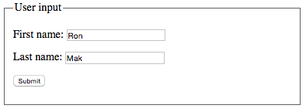
Form Examples: Text Input Fields
text.html
<body>
<form action="textfields"
method="post">
<fieldset>
<legend>User input</legend>
<p>
<label>First name:</label>
<input name="firstName" type="text" />
</p>
<p>
<label>Last name:</label>
<input name="lastName" type="text" />
</p>
<p>
<input type="submit" value="Submit" />
</p>
</fieldset>
</form>
</body>
Get request to get this form:
GET localhost:3000/textfields
Post request to process this form:
POST localhost:3000/textfields

Slide 7
Form Examples: Text Input Fields, cont’d
Router:
Controller:
app_server/routes/index.js
router.get('/textfields', ctrlMain.get_textfields);
router.post('/textfields', ctrlMain.post_textfields);
module.exports.get_textfields = function(request, result)
{
sendPage('text.html', result);
};
module.exports.post_textfields = function(request, result)
{
var text = ' Hello, ' + getName(request);
sendBody(text, result);
};
app_server/controllers/main.js

Slide 8
Form Examples: Text Input Fields, cont’d
Controller, cont’d
app_server/controllers/main.js
/**
* Extract the first and last names from the request.
* @param request the HTTP request.
* @returns a string containing the first and last names.
*/
function getName(request)
{
var firstName = request.param('firstName');
var lastName = request.param('lastName');
return firstName + ' ' + lastName + '!';
}

Slide 9
Form Examples: Text Input Fields, cont’d
app_server/controllers/main.js
/**
* Send the contents of an HTML page to the client
* with an inserted body text.
* @param text the body text.
* @param result the HTTP result.
*/
function sendBody(text, result)
{
var html = '<!DOCTYPE html>\n'
+ '<html lang="en-US">\n'
+ '<head>\n'
+ ' <meta charset="UTF-8">\n'
+ ' <title>Form Examples</title>\n'
+ '</head>\n'
+ '<body>\n'
+ ' ' + text + '\n' // insert the body text
+ '</body>\n'
+ '</html>\n';
result.send(html);
}
Demo

Slide 10
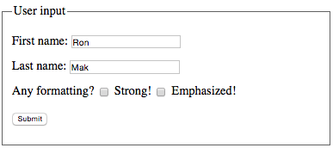
Form Examples: Check Boxes
checkbox.html
<body>
<form action="checkboxes"
method="post">
<fieldset>
...
<p>
<label>Any formatting?</label>
<input type="checkbox"
name="strong"
value="strong" /> Strong!
<input type="checkbox"
name="em"
value="em" /> Emphasized!
</p>
...
</fieldset>
</form>
</body>
Get request to get this form:
GET localhost:3000/checkboxes
Post request to process this form:
POST localhost:3000/checkboxes

Slide 11
Form Examples: Check Boxes, cont’d
Router:
Controller:
app_server/routes/index.js
router.get('/checkboxes', ctrlMain.get_checkboxes);
router.post('/checkboxes', ctrlMain.post_checkboxes);
module.exports.get_checkboxes = function(request, result)
{
sendPage('checkbox.html', result);
};
module.exports.post_checkboxes = function(request, result)
{
var text = ' Hello, ' + getName(request);
text = modify(text, request);
sendBody(text, result);
};
app_server/controllers/main.js

Slide 12
Form Examples: Check Boxes, cont’d
/**
* Extract the strong and emphasized values from the request.
* Surround the text with <strong> or <em> tags.
* @param text the text to surround.
* @param request the HTTP request.
* @returns a string containing the surrounded text.
*/
function modify(text, request)
{
if (request.body.strong)
{
text = '<strong>' + text + '</strong>';
}
if (request.body.em)
{
text = '<em>' + text + '</em>';
}
return text;
}
Demo
app_server/controllers/main.js

Slide 13
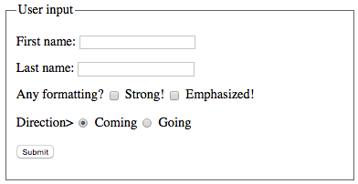
Form Examples: Radio Buttons
<body>
<form action="radiobuttons"
method="post">
<fieldset>
...
<p>
<label>Direction></label>
<input type="radio"
name="direction"
value="coming"
checked /> Coming
<input type="radio"
name="direction"
value="going" /> Going
</p>
...
</fieldset>
</form>
</body>
Every radio button
in the same group
must have the
same name
(e.g., direction).
Get request to get this form:
GET localhost:3000/radiobuttons
Post request to process this form:
POST localhost:3000/radiobuttons
radio.html

Slide 14
Form Examples: RadioButtons, cont’d
Router:
Controller:
app_server/routes/index.js
router.get('/radiobuttons', ctrlMain.get_radiobuttons);
router.post('/radiobuttons', ctrlMain.post_radiobutton);
module.exports.get_radiobuttons = function(request, result)
{
sendPage('radio.html', result);
};
module.exports.post_radiobuttons = function(request, result)
{
var direction = request.body.direction;
var text = direction === 'coming’ ? 'Hello’ : 'Goodbye';
text = text + ', ' + getName(request);
text = modify(text, request);
sendBody(text, result);
};
Demo
app_server/controllers/main.js

Slide 15
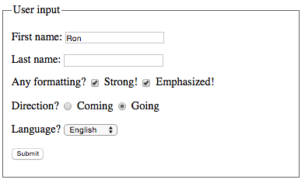
Form Examples: Menu
<body>
<form action="menu"
method="post">
<fieldset>
...
<p>
<label>Language?</label>
<select name="language">
<option value="english" selected>English</option>
<option value="french">Français</option>
<option value="german">Deutsch</option>
</selct>
</p>
<p>
<input type="submit" value="Submit" />
</p>
</fieldset>
</form>
</body>
Get request to get this form:
GET localhost:3000/menu
Post request to process this form:
POST localhost:3000/menu
select.html

Slide 16
Form Examples: Menu, cont’d
Router:
Controller:
app_server/routes/index.js
router.get('/menu', ctrlMain.get_menu);
router.post('/menu', ctrlMain.post_menu);
module.exports.get_menu = function(request, result)
{
sendPage('select.html', result);
};
app_server/controllers/main.js

Slide 17
Form Examples: Menu, cont’d
module.exports.post_menu = function(request, result)
{
var direction = request.body.direction;
var language = request.body.language;
var text;
// Process language and direction.
if(direction === "coming")
{
switch(language)
{
case "english":
text = "Hello";
break;
case "french":
text = "Bonjour";
break;
case "german":
text = "Guten Tag";
break;
default:
text ="";
}
}
app_server/controllers/main.js

Slide 18
Form Examples: Menu, cont’d
else if (direction === "going")
{
switch (language)
{
case "english":
text = "Goodbye";
break;
case "french":
text = "Au revoir";
break;
case "german":
text = "Auf wiedersehen";
break;
default:
text ="";
}
}
text = text +', ' + getName(request);
text = modify(text, request);
sendBody(text, result);
};
app_server/controllers/main.js
Demo

Slide 19
Requirements Elicitation
Requires communication between the developers and customers.
  Customer: users, clients, and stakeholders
  Client: who pays for your application
  Stakeholder: whoever else is interested in the success of your application (e.g., shareholders)
Customers can validate the requirements.
Creates a contract between the customer
and the developers.

Slide 20
Requirements Elicitation, cont’d
Result: A Functional Specification
written non-technically so that the
customers can read and understand it.
No implementation details!
The Functional Specification should be implementation-independent.

Slide 21
Bridging the Gap
Customers
  Have a general idea of what the system should do.
  Have little experience with software development.
  Are experts in their domain.
Software developers
  May have little knowledge of the application domain.
  Have experience with software technology.
  Are geeks with poor social skills.

Slide 22
Functional Requirements
What the system (the application)
shall be able to do or allow users to do.
  The application shall use GPS
  to determine the user’s location.
  The application must default to the option
  most frequently chosen by the users.
  The application must allow the user to choose between a text display or a graphics display.
  The user shall be able to make
  an online withdrawal or deposit.

Slide 23
Nonfunctional Requirements
Issues regarding usability, reliability, performance, supportability, etc.
  The application must respond to user input
  within 5 seconds.
  The application shall run on the Windows, Mac,
  and Linux platforms.
  The new GUI must resemble the old GUI.
  Error messages shall be displayed in English
  and Spanish.
Constraints that the system must meet.

Slide 24
Requirements are Strong Statements
Use strong declarative statements
with “shall” and “must”.
  The application shall use GPS to determine
  the user’s location.
  The application must respond to user input
  within 5 seconds.

Slide 25
Requirements Must Be…
Complete
  Are all system features and constraints
  described by requirements?
Consistent
  No two requirements can contradict each other.
Clear
  Each requirement must be unambiguous.
Correct
  No errors in the requirements.

Slide 26
Requirements Must Be, cont’d
Realistic
  Can the system be implemented?
Verifiable
  Can the system be tested?
Traceable
  Can each requirement be traced
  to an application function or constraint?
  Can each application function or constraint
  be traced to a requirement?

Slide 27
Requirements Must Be, cont’d
Understandable
  Requirements must be written in non-technical jargon-free language that is meaningful to both
  the application’s developers and the application’s customers.

Slide 28
How to Get Requirements
Interview future users of your application.
Observe how the users currently work.
  Can you improve how they currently do things?
  Can you make them more productive?
Stated requirements
  The customer tells you want he or she wants.
Implied requirements
  What do you think the customer wants?

Slide 29
How to Get Requirements, cont’d
Customers don’t always know what they want.
  They will know more after you
  show them a prototype.
  They will change their minds.
It’s an iterative process!

Slide 30
How to Get Requirements, cont’d
If the developers force the customers
to come up with the requirements too soon, they may make something up!
Such requirements will most likely be
wrong or incomplete and lead you astray.

Slide 31
Use Cases
A use case describes a single task that your application must allow an actor to accomplish
or a single goal that an actor must achieve.
Actors are external agents that interact or communicate with the application.
  actors = role abstractions
  An actor can be a person or another application.

Slide 32
Use Cases, cont’d
Uses cases are an important way for the developers of a software application and its customers to communicate:
  What functionality the application must have.
  What steps to achieve the functionality.
An application’s use cases capture the bulk
of the customer’s understanding of what the application is supposed to do.

Slide 33
Use Cases, cont’d
A use case includes:
  A complete sequence of actions or events
  from the point of view of an actor.
  A primary sequence
  Any alternate sequences (“exception paths”).
A sequence is triggered by an actor.
Focus on what the application must do,
not how to do it.
A use case treats the application
as a “black box”.

Slide 34
Example: Bank ATM System
system = application
system
Start up
ATM
system boundary
actor
Shut down
ATM
use cases
Operator
Log in
customer
interaction
When you draw a
use case diagram,
do not include the
red labels and arrows.
Log out
customer
Withdraw
cash
Customer
Display
balance
UML use case diagram
Bank

Slide 35
Example Use Case Description
Name: Withdraw Cash
Goal: Customer withdraws cash from ATM.
Summary: A customer who has logged in can withdraw up to $500 cash in $20 bills.
Actors: The customer and the bank

Slide 36
Example Use Case Description, cont’d
Preconditions:
  The ATM has been started up.
    See use case “Start up ATM”.
  The customer has inserted a valid bank card.
  The customer has entered a correct PIN.
Trigger: The customer selects the
“Withdraw Cash” option.

Slide 37
Example Use Case Description, cont’d
Primary sequence:
  The system prompts the customer for the amount.
  The customer chooses from a list of amounts
  or enters a amount.
  The customer confirms and submits the amount.
    (The ATM communicates with the bank
    to check the customer’s account.)
  The system dispenses the amount in $20 bills.
    (The bank deducts the amount
    from the customer’s balance.)
  The system displays the customer’s balance
    See use case “Display balance”.
At most about 10 steps.
Another use case.

Slide 38
Example Use Case Description, cont’d
Alternate sequences:
  3.1 The customer entered an amount
  that is not a multiple of $20.
    3.1.1 The system displays a message to the customer .
    3.1.2. The system prompts the customer for a new amount.
  3.2 The customer’s bank balance is insufficient.
    3.2.1 etc.

Slide 39
Example Use Case Description, cont’d
Postconditions:
  The customer receives the desired amount of cash.
    The amount is deducted from the customer’s account.
    The customer sees the new account balance.
  OR: The customer receives no cash.
    The customer’s account is unchanged.
What must be true after the use case is done.

Slide 40
Example Use Case Description, cont’d
Nonfunctional requirements:
  The system responds to each customer input
  within 15 seconds.
  The system displays messages in either
  English or Spanish.
Glossary
  customer = a person who wants to withdraw cash from the ATM.
  bank = a system that maintains customer accounts and balances.
  etc.

Slide 41
Use Case Description Guidelines
Use case names should be verb-object.
  Each name should describe an achievable goal or doable task (e.g., “Withdraw Cash”).
Keep use cases short, simple, and informal.
  Clients and users need to understand them.
  No GUI or implementation details.

Slide 42
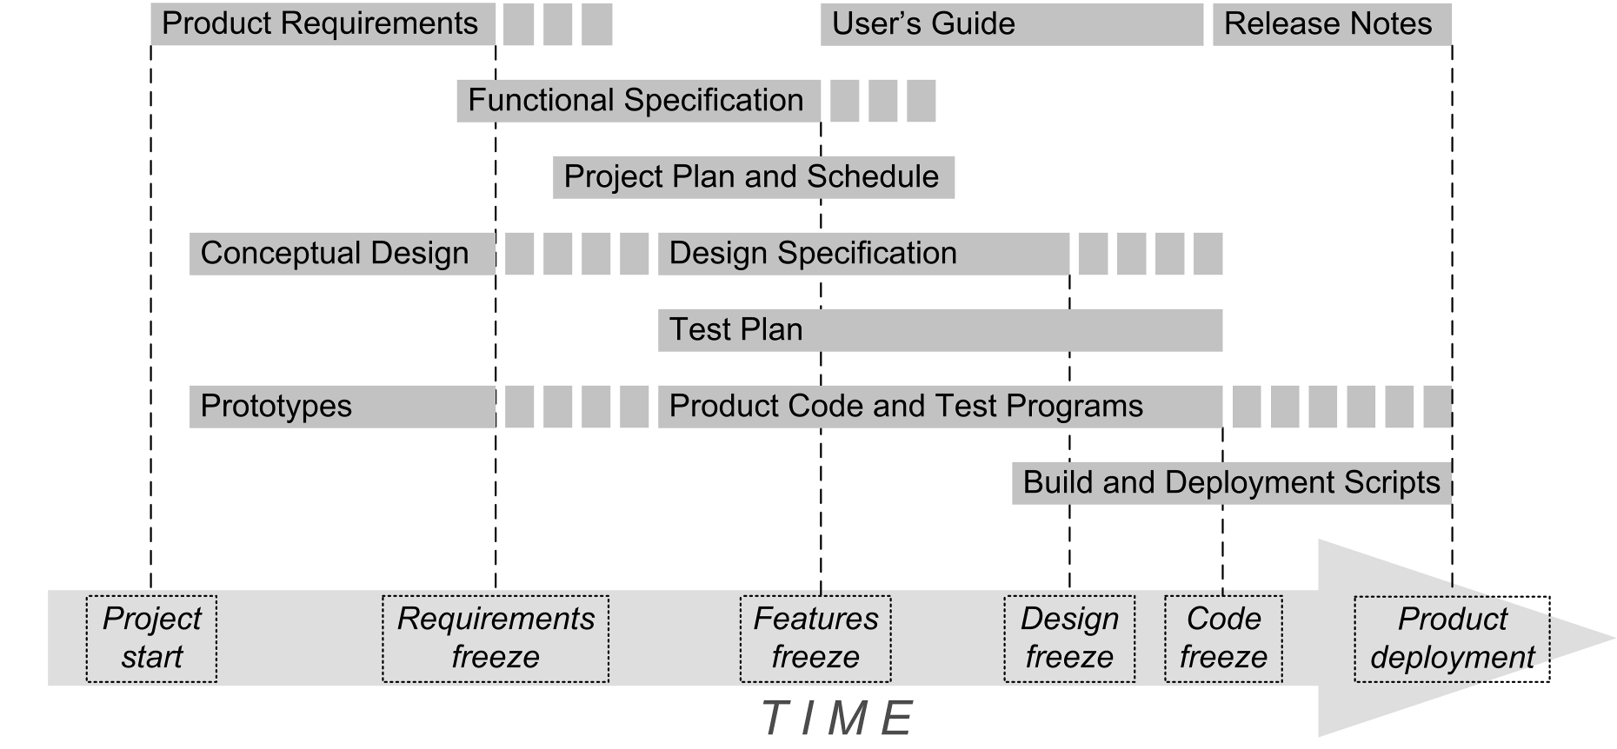
Functional Specification Primary Contents
Product name
Clear problem
statement
  What is the
  problem?
Objectives
  What is your
  application
  supposed to
  accomplish?
Functional requirements
Nonfunctional requirements
Use cases

Slide 43
Assignment #1: Functional Specification
Each project team creates the first draft
of the Functional Specification for its
final web application that will tell a story
with data.
  Product name
  Problem statement
  Objectives
  6 functional requirements
  4 nonfunctional requirements
  Use case diagram with 6 use cases
  Use case descriptions of 3 of your use cases
Use your imagination!
Your web app will not
be held to this specification.

Slide 44
Assignment #1, cont’d
Each team turns in one Functional Specification.
  Microsoft Word document or PDF
Canvas: Assignment #1
Due Friday, February 7 at 11:59 PM.
Use case description form:
http://www.cs.sjsu.edu/~mak/CMPE280/assignments/1/UseCaseForm.docx
Formal report rubrics: http://www.cs.sjsu.edu/~mak/CMPE280/assignments/1/FormalReportRubrics.pdf

