Slide 1


CMPE 226
Database Systems
March 14 Class Meeting
Department of Computer Engineering
San Jose State University
Spring 2017
Instructor: Ron Mak
www.cs.sjsu.edu/~mak

Slide 2
Database Design Example
Design a database for the sales manager of Lemonade Used Car Dealership to keep track of which salesperson sold which cars to which customers during each month.
Each car is sold by one salesperson to one customer. A salesperson can sell multiple cars to different customers, and a customer can buy multiple cars from one or more salespersons.

Slide 3
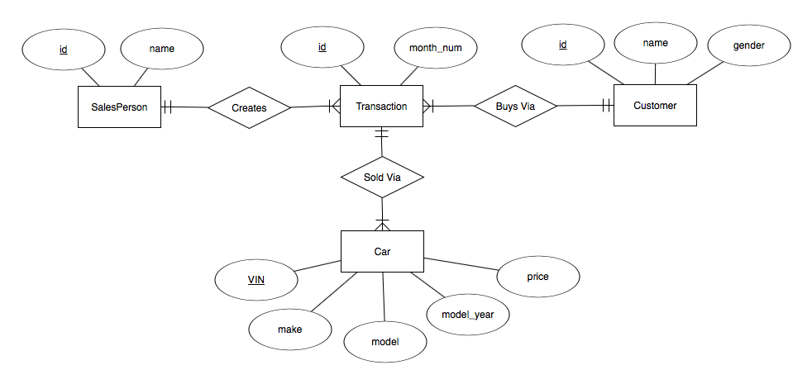
Database Design Example, cont’d

Slide 4
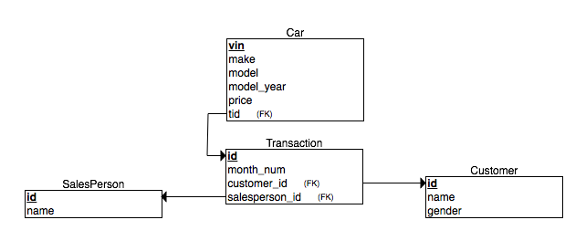
Database Design Example, cont’d

Slide 5
Table SalesPerson
MariaDB [midtermdb]> SELECT * FROM salesperson;
+----+--------+
| id | name |
+----+--------+
| 11 | Sarah |
| 22 | Leslie |
| 33 | Steve |
| 44 | Judy |
| 55 | Bruno |
+----+--------+
5 rows in set (0.00 sec)

Slide 6
Table Customer
MariaDB [midtermdb]> SELECT * FROM customer;
+-----+--------+--------+
| id | name | gender |
+-----+--------+--------+
| 111 | Ron | m |
| 222 | Mara | f |
| 333 | Tom | m |
| 444 | Susan | f |
| 555 | Marsha | f |
| 666 | Max | m |
| 777 | Arnold | m |
+-----+--------+--------+
7 rows in set (0.00 sec)

Slide 7
Table Transaction
MariaDB [midtermdb]> SELECT * FROM transaction;
+----+-----------+-------------+----------------+
| id | month_num | customer_id | salesperson_id |
+----+-----------+-------------+----------------+
| 1 | 9 | 444 | 22 |
| 2 | 9 | 333 | 11 |
| 3 | 9 | 444 | 55 |
| 4 | 9 | 222 | 22 |
| 5 | 9 | 666 | 33 |
| 6 | 9 | 111 | 55 |
| 7 | 9 | 333 | 44 |
| 8 | 9 | 222 | 44 |
| 9 | 9 | 555 | 22 |
| 10 | 9 | 777 | 11 |
| 11 | 9 | 222 | 22 |
+----+-----------+-------------+----------------+
11 rows in set (0.00 sec)

Slide 8
Table Car
MariaDB [midtermdb]> SELECT * FROM car;
+-------+------------+--------+------------+-------+-----+
| vin | make | model | model_year | price | tid |
+-------+------------+--------+------------+-------+-----+
| 11111 | ford | taurus | 2016 | 30000 | 5 |
| 12345 | chevy | nova | 1975 | 8000 | 2 |
| 22222 | ford | fiesta | 2016 | 20000 | 7 |
| 33333 | volvo | x90 | 2015 | 30000 | 4 |
| 44444 | volvo | 850 | 1996 | 25000 | 1 |
| 45678 | volvo | 240 DL | 1983 | 10000 | 11 |
| 55555 | volvo | s60 | 2014 | 30000 | 6 |
| 66666 | honda | accord | 2014 | 22000 | 1 |
| 77777 | honda | civic | 2005 | 12000 | 10 |
| 88888 | toyota | prius | 2015 | 25000 | 2 |
| 98765 | volkswagen | beetle | 1965 | 2000 | 10 |
| 99999 | ford | focus | 2012 | 15000 | 7 |
+-------+------------+--------+------------+-------+-----+
12 rows in set (0.00 sec)

Slide 9
Database Design Example, cont’d
  Which salesperson sold the most cars in the month of September?
Before we can tell who has sold the most cars, we must know how many cars each salesperson sold in September.

Slide 10
Everything
SELECT salesperson.id AS pid, salesperson.name AS pname,
-> customer.id AS cid, customer.name AS cname,
-> customer.gender AS cgender,
-> transaction.id AS tid, vin, make, model_year, price
-> FROM salesperson, transaction, car, customer
-> WHERE transaction.salesperson_id = salesperson.id
-> AND transaction.id = car.tid
-> AND transaction.customer_id = customer.id
-> AND transaction.month_num = 9
-> ORDER BY pid, make, gender;
+-----+--------+-----+--------+---------+-----+-------+------------+------------+-------+
| pid | pname | cid | cname | cgender | tid | vin | make | model_year | price |
+-----+--------+-----+--------+---------+-----+-------+------------+------------+-------+
| 11 | Sarah | 333 | Tom | m | 2 | 12345 | chevy | 1975 | 8000 |
| 11 | Sarah | 777 | Arnold | m | 10 | 77777 | honda | 2005 | 12000 |
| 11 | Sarah | 333 | Tom | m | 2 | 88888 | toyota | 2015 | 25000 |
| 11 | Sarah | 777 | Arnold | m | 10 | 98765 | volkswagen | 1965 | 2000 |
| 22 | Leslie | 444 | Susan | f | 1 | 66666 | honda | 2014 | 22000 |
| 22 | Leslie | 222 | Mara | f | 4 | 33333 | volvo | 2015 | 30000 |
| 22 | Leslie | 444 | Susan | f | 1 | 44444 | volvo | 1996 | 25000 |
| 22 | Leslie | 222 | Mara | f | 11 | 45678 | volvo | 1983 | 10000 |
| 33 | Steve | 666 | Max | m | 5 | 11111 | ford | 2016 | 30000 |
| 44 | Judy | 333 | Tom | m | 7 | 99999 | ford | 2012 | 15000 |
| 44 | Judy | 333 | Tom | m | 7 | 22222 | ford | 2016 | 20000 |
| 55 | Bruno | 111 | Ron | m | 6 | 55555 | volvo | 2014 | 30000 |
+-----+--------+-----+--------+---------+-----+-------+------------+------------+-------+
12 rows in set (0.00 sec)

Slide 11
Project Only What We Need
SELECT salesperson.name AS name
-> FROM salesperson, transaction, car
-> WHERE salesperson_id = salesperson.id
-> AND transaction.id = car.tid
-> AND transaction.month_num = 9;
+--------+
| name |
+--------+
| Sarah |
| Sarah |
| Sarah |
| Sarah |
| Leslie |
| Leslie |
| Leslie |
| Leslie |
| Steve |
| Judy |
| Judy |
| Bruno |
+--------+
12 rows in set (0.00 sec)

Slide 12
Grouped with Counts
SELECT salesperson.name,
-> count(name) AS cars_sold
-> FROM salesperson, transaction, car
-> WHERE salesperson_id = salesperson.id
-> AND transaction.id = car.tid
-> AND transaction.month_num = 9
-> GROUP BY name;
+--------+-----------+
| name | cars_sold |
+--------+-----------+
| Bruno | 1 |
| Judy | 2 |
| Leslie | 4 |
| Sarah | 4 |
| Steve | 1 |
+--------+-----------+
5 rows in set (0.00 sec)

Slide 13
Database Design Example, cont’d
How can we query against the number of cars sold by each salesperson in September?
  We can make the previous query a nested query.
  But the code is simpler if we make it a view.

Slide 14
Create a View
CREATE view soldview AS
-> SELECT salesperson.name,
-> count(name) AS cars_sold
-> FROM salesperson, transaction, car
-> WHERE salesperson_id = salesperson.id
-> AND transaction.id = car.tid
-> AND transaction.month_num = 9
-> GROUP BY name;
Query OK, 0 rows affected (0.02 sec)
MariaDB [midtermdb]> SELECT * FROM soldview;
+--------+-----------+
| name | cars_sold |
+--------+-----------+
| Bruno | 1 |
| Judy | 2 |
| Leslie | 4 |
| Sarah | 4 |
| Steve | 1 |
+--------+-----------+
5 rows in set (0.00 sec)

Slide 15
Maximum Cars Sold
MariaDB [midtermdb]> SELECT max(cars_sold) FROM soldview;
+----------------+
| max(cars_sold) |
+----------------+
| 4 |
+----------------+
1 row in set (0.01 sec)
SELECT *
-> FROM soldview
-> WHERE cars_sold = (SELECT max(cars_sold) FROM soldview);
+--------+-----------+
| name | cars_sold |
+--------+-----------+
| Leslie | 4 |
| Sarah | 4 |
+--------+-----------+
2 rows in set (0.00 sec)

Slide 16
Solution: Most Cars Sold
CREATE view soldview AS
SELECT salesperson.name,
count(name) AS cars_sold
FROM salesperson, transaction, car
WHERE salesperson_id = salesperson.id
AND transaction.id = car.tid
AND transaction.month_num = 9
GROUP BY name;
SELECT *
FROM soldview
WHERE cars_sold = (SELECT max(cars_sold) FROM soldview);

Slide 17
Database Design Example, cont’d
Which salespersons in September sold
fewer than the average number of cars
sold per salesperson during that month?

Slide 18
Average Cars Sold
MariaDB [midtermdb]> SELECT avg(cars_sold) FROM soldview;
+----------------+
| avg(cars_sold) |
+----------------+
| 2.4000 |
+----------------+
1 row in set (0.00 sec)
SELECT *
-> FROM soldview
-> WHERE cars_sold < (SELECT avg(cars_sold) FROM soldview);
+-------+-----------+
| name | cars_sold |
+-------+-----------+
| Bruno | 1 |
| Judy | 2 |
| Steve | 1 |
+-------+-----------+
3 rows in set (0.00 sec)

Slide 19
Solution: Fewer Than Average Cars Sold
CREATE view soldview AS
SELECT salesperson.name,
count(name) AS cars_sold
FROM salesperson, transaction, car
WHERE salesperson_id = salesperson.id
AND transaction.id = car.tid
AND transaction.month_num = 9
GROUP BY name;
SELECT *
FROM soldview
WHERE cars_sold < (SELECT avg(cars_sold) FROM soldview);

Slide 20
Database Design Example, cont’d
What is the number and average price of cars sold by each salesperson of each make (Ford, Chevy, etc.) to male and female customers in September? Only consider groups of more than two cars sold.

Slide 21
Makes, Genders, and Prices
SELECT salesperson.name AS name,
-> make, gender as cgender, price
-> FROM salesperson, transaction, car, customer
-> WHERE salesperson_id = salesperson.id
-> AND transaction.id = car.tid
-> AND transaction.customer_id = customer.id
-> AND transaction.month_num = 9;
+--------+------------+---------+-------+
| name | make | cgender | price |
+--------+------------+---------+-------+
| Sarah | chevy | m | 8000 |
| Sarah | honda | m | 12000 |
| Sarah | toyota | m | 25000 |
| Sarah | volkswagen | m | 2000 |
| Leslie | volvo | f | 30000 |
| Leslie | volvo | f | 25000 |
| Leslie | volvo | f | 10000 |
| Leslie | honda | f | 22000 |
| Steve | ford | m | 30000 |
| Judy | ford | m | 20000 |
| Judy | ford | m | 15000 |
| Bruno | volvo | m | 30000 |
+--------+------------+---------+-------+
12 rows in set (0.00 sec)

Slide 22
Group by Name, Make, Gender
SELECT salesperson.name AS name,
-> make, gender as cgender,
-> count(make) as count, avg(price)
-> FROM salesperson, transaction, car, customer
-> WHERE salesperson_id = salesperson.id
-> AND transaction.id = car.tid
-> AND transaction.customer_id = customer.id
-> AND transaction.month_num = 9
-> GROUP BY name, make, cgender;
+--------+------------+---------+-------+------------+
| name | make | cgender | count | avg(price) |
+--------+------------+---------+-------+------------+
| Bruno | volvo | m | 1 | 30000.0000 |
| Judy | ford | m | 2 | 17500.0000 |
| Leslie | honda | f | 1 | 22000.0000 |
| Leslie | volvo | f | 3 | 21666.6667 |
| Sarah | chevy | m | 1 | 8000.0000 |
| Sarah | honda | m | 1 | 12000.0000 |
| Sarah | toyota | m | 1 | 25000.0000 |
| Sarah | volkswagen | m | 1 | 2000.0000 |
| Steve | ford | m | 1 | 30000.0000 |
+--------+------------+---------+-------+------------+
9 rows in set (0.00 sec)

Slide 23
Group by Having
SELECT salesperson.name AS name,
-> make, gender as cgender,
-> count(make) as count, avg(price)
-> FROM salesperson, transaction, car, customer
-> WHERE salesperson_id = salesperson.id
-> AND transaction.id = car.tid
-> AND transaction.customer_id = customer.id
-> AND transaction.month_num = 9
-> GROUP BY name, make, cgender
-> HAVING count > 2;
+--------+-------+---------+-------+------------+
| name | make | cgender | count | avg(price) |
+--------+-------+---------+-------+------------+
| Leslie | volvo | f | 3 | 21666.6667 |
+--------+-------+---------+-------+------------+
1 row in set (0.00 sec)

Slide 24
Solution: Number and Average Price
SELECT salesperson.name AS name,
make, gender as cgender,
count(make) as count, avg(price)
FROM salesperson, transaction, car, customer
WHERE salesperson_id = salesperson.id
AND transaction.id = car.tid
AND transaction.customer_id = customer.id
AND transaction.month_num = 9
GROUP BY name, make, cgender
HAVING count > 2;

Slide 25
Stored Procedures
A stored procedure is procedural code that executes SQL commands.
A named procedure with parameters
and local variables.
IF, CASE, and looping statements.
Invoked by the CALL statement or by triggers.

Slide 26
Stored Procedures, cont’d
Advantages
  Compiled code that increases performance.
  Stored in the database server,
  so reduced network traffic.
  Reusable and secure code.
Disadvantages
  Hard to debug and maintain.
  Heavy computational load on the database server.

Slide 27
Stored Procedures, cont’d
Tutorial: http://www.mysqltutorial.org/mysql-stored-procedure-tutorial.aspx

Slide 28
Stored Procedures: No Parameters
CREATE PROCEDURE all_people()
BEGIN
SELECT * FROM people;
END
mysql> call all_people();
+-----+--------+-------+--------+--------+
| id | first | last | gender | salary |
+-----+--------+-------+--------+--------+
| 101 | John | Adams | M | 120000 |
| 102 | Mary | Smith | F | 155000 |
| 105 | Helen | Troy | F | 75000 |
| 110 | Albert | Jones | M | 160000 |
+-----+--------+-------+--------+--------+
4 rows in set (0.00 sec)
Query OK, 0 rows affected (0.00 sec)

Slide 29
Stored Procedures: Parameters
CREATE PROCEDURE fetch_by_gender(IN which CHAR)
BEGIN
SELECT *
FROM people
WHERE gender = which;
END

Slide 30
Stored Procedures: Parameters, cont’d
mysql> call fetch_by_gender('f');
+-----+-------+-------+--------+--------+
| id | first | last | gender | salary |
+-----+-------+-------+--------+--------+
| 102 | Mary | Smith | F | 155000 |
| 105 | Helen | Troy | F | 75000 |
+-----+-------+-------+--------+--------+
2 rows in set (0.10 sec)
Query OK, 0 rows affected (0.11 sec)
mysql> call fetch_by_gender('m');
+-----+--------+-------+--------+--------+
| id | first | last | gender | salary |
+-----+--------+-------+--------+--------+
| 101 | John | Adams | M | 120000 |
| 110 | Albert | Jones | M | 160000 |
+-----+--------+-------+--------+--------+
2 rows in set (0.00 sec)
Query OK, 0 rows affected (0.00 sec)

Slide 31
Stored Procedures: IF
CREATE PROCEDURE GetCustomerLevel(
IN p_customerNumber int(11),
OUT p_customerLevel varchar(10))
BEGIN
DECLARE creditlim double;
SELECT creditlimit INTO creditlim
FROM customers
WHERE customerNumber = p_customerNumber;
IF creditlim > 50000 THEN
SET p_customerLevel = 'PLATINUM';
ELSEIF (creditlim <= 50000 AND creditlim >= 10000) THEN
SET p_customerLevel = 'GOLD';
ELSEIF creditlim < 10000 THEN
SET p_customerLevel = 'SILVER';
END IF;
END

Slide 32
Stored Procedures: CASE
CREATE PROCEDURE GetCustomerShipping(
IN p_customerNumber int(11),
OUT p_shiping varchar(50))
BEGIN
DECLARE customerCountry varchar(50);
SELECT country INTO customerCountry
FROM customers
WHERE customerNumber = p_customerNumber;
CASE customerCountry
WHEN 'USA' THEN
SET p_shiping = '2-day Shipping';
WHEN 'Canada' THEN
SET p_shiping = '3-day Shipping';
ELSE
SET p_shiping = '5-day Shipping';
END CASE;
END

Slide 33
Stored Procedures: WHILE
CREATE PROCEDURE WhileLoopProc()
BEGIN
DECLARE x INT;
DECLARE str VARCHAR(255);
SET x = 1;
SET str = '';
WHILE x <= 5 DO
SET str = CONCAT(str,x,',');
SET x = x + 1;
END WHILE;
SELECT str;
END

Slide 34
Stored Procedures: REPEAT
CREATE PROCEDURE RepeatLoopProc()
BEGIN
DECLARE x INT;
DECLARE str VARCHAR(255);
SET x = 1;
SET str = '';
REPEAT
SET str = CONCAT(str,x,',');
SET x = x + 1;
UNTIL x > 5
END REPEAT;
SELECT str;
END

Slide 35
Stored Procedures: LOOP
CREATE PROCEDURE LOOPLoopProc()
BEGIN
DECLARE x INT;
DECLARE str VARCHAR(255);
SET x = 1;
SET str = '';
loop_label: LOOP
IF x > 10 THEN
LEAVE loop_label;
END IF;
SET x = x + 1;
IF (x mod 2) THEN
ITERATE loop_label;
ELSE
SET str = CONCAT(str,x,',');
END IF;
END LOOP;
SELECT str;
END

Slide 36
Triggers
A trigger is procedural + SQL code that is automatically invoked by the insertion, modification, or deletion of a record.
Often used to enforce user-defined constraints.

Slide 37
Triggers, cont’d
CREATE TRIGGER studentinserttrigger
BEFORE INSERT ON student
FOR EACH ROW
BEGIN
DECLARE totaladvised INT DEFAULT 0;
SELECT COUNT(*) INTO totaladvised
FROM student
WHERE advisorid = NEW.advisorid;
IF (totaladvised >= 10) THEN
SET NEW.advisorid = NULL;
END IF;
END;
Database Systems
by Jukić, Vrbsky, & Nestorov
Pearson 2014
ISBN 978-0-13-257567-6

Slide 38
Triggers, cont’d
CREATE TRIGGER studentupdatetrigger
BEFORE UPDATE ON student
FOR EACH ROW
BEGIN
DECLARE totaladvised INT DEFAULT 0;
SELECT COUNT(*) INTO totaladvised
FROM student
WHERE advisorid = NEW.advisorid;
IF (totaladvised >= 10) THEN
SET NEW.Advisorid = NULL;
END IF;
END;
Database Systems
by Jukić, Vrbsky, & Nestorov
Pearson 2014
ISBN 978-0-13-257567-6

Slide 39
Break

Slide 40
Transaction Management
Protect the database during transactions.
Concurrency control
  Allow simultaneous use of the database
  without users interfering with one another.
Recovery
  Restore the database to
  a correct state after a failure.

Slide 41
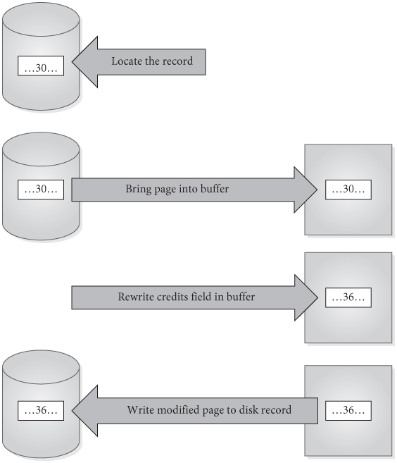
Simple Update of One Record
Locate the record to be updated.
Bring the page into the buffer
Write the update to the buffer.
Write the modified page out to disk.
Databases Illuminated, 3rd ed.
by Ricardo & Urban
Jones & Bartlett Learning, 2017
ISBN 978-1-284-05694-5

Slide 42
Steps in a Transaction
More complicated transactions may involve several updates.
A modified buffer page might not be written to disk immediately after transaction terminates.
Assume there is a delay before the actual disk write is done.

Slide 43
Basic Ideas About Transactions
Transaction: a logical unit of work that takes the database from one consistent state to another.
Transactions can terminate successfully
and commit.
Transactions can terminate unsuccessfully
and be aborted.
Aborted transactions must be rolled back (undone) if they changed the database.
Committed transactions cannot be rolled back.

Slide 44
ACID Properties of Transactions: Atomicity
The entire set of database update operations
are all carried out, or none are.
The DBMS must roll back transactions
if they have changed the database but
will not be able to complete successfully.
The rollback process uses the log
of the transaction writes.

Slide 45
ACID Properties of Transactions: Consistency
Users are responsible for ensuring that each transaction, if executed individually, leaves
the database in a consistent state.
The concurrency control subsystem must ensure this for multiple transactions.

Slide 46
ACID Properties of Transactions: Isolation
When transactions execute simultaneously,
the DBMS ensures that the final effect is
as if the transactions were executed serially.

Slide 47
ACID Properties of Transactions: Durability
The effect of any committed transaction
is recorded in the database.
  Even if the system crashes before all its writes are made to the database.
The recovery subsystem guarantees durability.

Slide 48
Transaction Support in MySQL
MySQL is normally in auto-commit mode.
  Each statement is committed as soon as it has executed.
  Each statement is its own transaction.
To perform an explicit transaction, turn off
auto-commit with START TRANSACTION.
ROLLBACK or COMMIT a transaction.

Slide 49
MySQL Transaction Example
> use superhakerz;
> create table test (fld int);
> select * from test;
Empty set (0.00 sec)
> insert into test (fld) values (10);
> select * from test;
+------+
| fld |
+------+
| 10 |
+------+
> start transaction;
> insert into test (fld) values (20);
> insert into test (fld) values (30);
> select * from test;
+------+
| fld |
+------+
| 10 |
| 20 |
| 30 |
+------+

Slide 50
MySQL Transaction Example, cont’d
> insert into test (foo) values (40);
ERROR 1054 (42S22): Unknown column 'foo' in 'field list'
> select * from test;
+------+
| fld |
+------+
| 10 |
| 20 |
| 30 |
+------+
> rollback;
> select * from test;
+------+
| fld |
+------+
| 10 |
+------+

Slide 51
MySQL Transaction Example, cont’d
> start transaction;
> insert into test (fld) values (40);
> insert into test (fld) values (50);
> commit;
> select * from test;
+------+
| fld |
+------+
| 10 |
| 40 |
| 50 |
+------+
> start transaction;
> insert into test (fld) values (60);
> select * from test;
+------+
| fld |
+------+
| 10 |
| 40 |
| 50 |
| 60 |
+------+

Slide 52
MySQL Transaction Example, cont’d
> insert into test (foo) values (70);
ERROR 1054 (42S22): Unknown column 'foo' in 'field list’
> rollback;
> select * from test;
+------+
| fld |
+------+
| 10 |
| 40 |
| 50 |
+------+

Slide 53
Concurrency Problems
Concurrency control is needed when transactions are permitted to execute simultaneously, if at least one is an update.
Potential problems due to lack of
concurrency control:
  Lost update
  Uncommitted update
  Inconsistent analysis

Slide 54
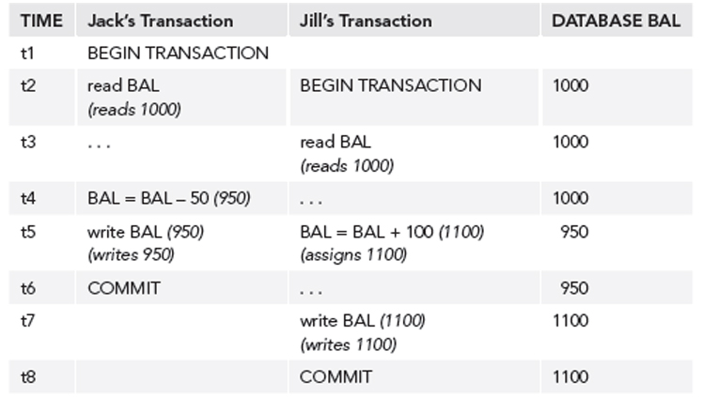
Lost Update Problem
Jack’s update is lost.

Slide 55
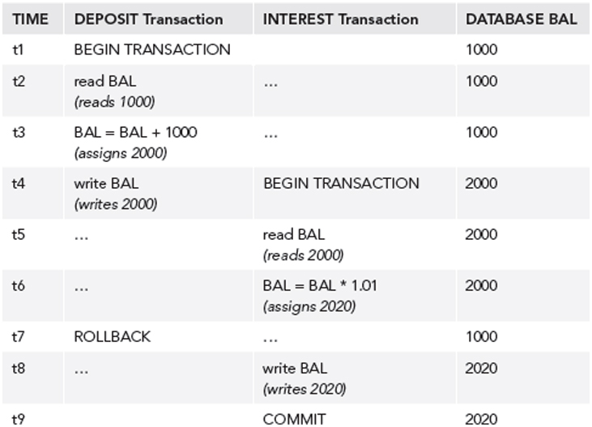
Uncommitted Update Problem
The rollback invalidates
data used by the other.

Slide 56
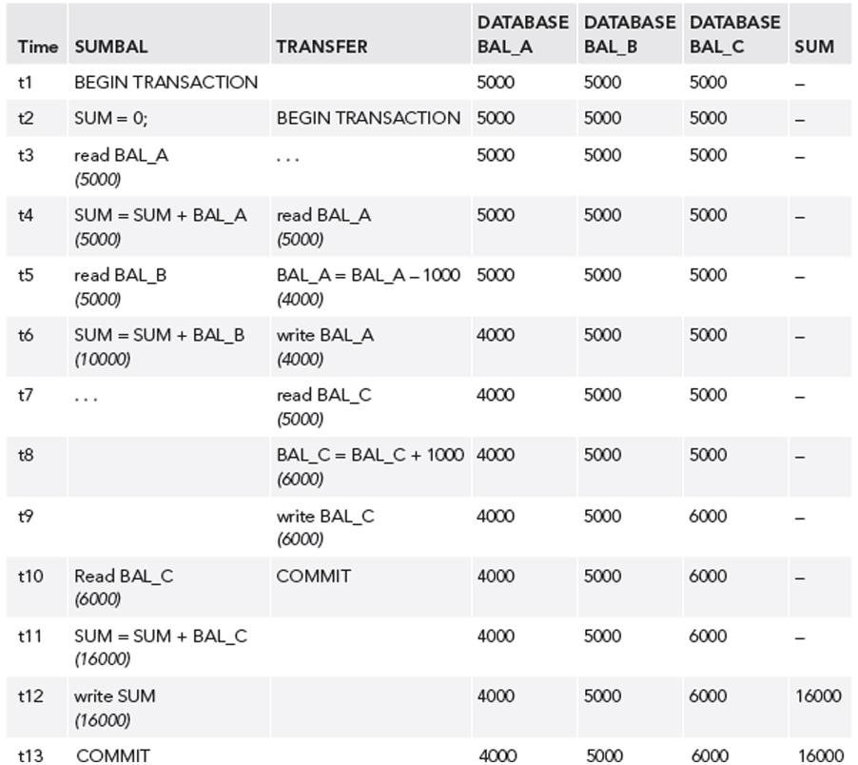
Inconsistent Analysis Problem
Transaction SUMBAL
reads several values
to sum them.
But meanwhile,
transaction TRANSFER
updates those values.

Slide 57
Non-Repeatable Read Problem
The first transaction reads an item.
The second transaction writes
a new value for the item.
  The first transaction rereads the item
  and gets a different value.

Slide 58
Phantom Data Problem
The transaction T1 reads a set of rows.
The transaction T2 inserts a row.
  The transaction T1 reads the rows again
  and sees the new row.

Slide 59
Transaction Conflicts
If two transactions are only reading data items, they do not conflict and order is not important.
If two transactions operate on completely separate data items, they do not conflict and order is not important.
If one transaction writes to a data item and another either reads or writes to the same data item, then the order of execution is important.

Slide 60
Transaction Conflicts, cont’d
Therefore, two operations conflict
only if all of these are true:
  They belong to different transactions.
  They access the same data item.
  At least one of them writes the item.

Slide 61
Locking
A transaction can ask the DBMS to place locks on database objects to prevent another transaction from modifying the objects.
Transactions may be made to wait
until locks are released before their
lock requests can be granted.
Objects of various sizes (DB, table, page, record, data item) can be locked.
  Size determines the granularity of the lock.

Slide 62
Shared and Exclusive Locks
A transaction must acquire a lock on any item
that it needs to read or write.
Shared lock
  Can read but not update the item.
Exclusive lock
  Can both read and update the item.

Slide 63
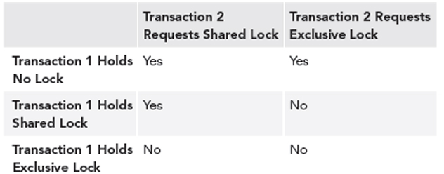
Lock Compatibility

Slide 64
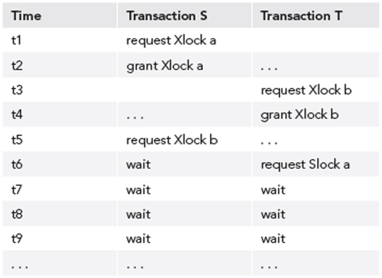
Deadlocks
Two transactions are each waiting for locks
held by the other to be released.

Slide 65
Two-Phase Locking Protocol
Guarantees serializability.
Every transaction acquires all its locks before releasing any, but not necessarily all at once.
A transaction has two phases:
  Growing phase: The transaction obtains locks.
  Shrinking phase: The transaction releases locks.
Once it enters its shrinking phase, a transaction can never obtain a new lock.

Slide 66
Two-Phase Locking Protocol, cont’d
Recall:

Slide 67
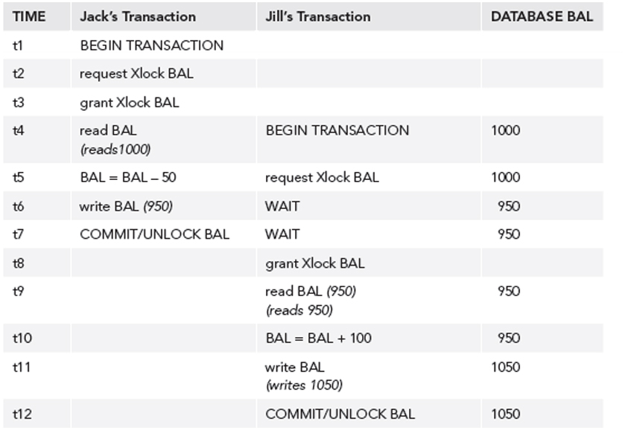
Two-Phase Locking Protocol, cont’d
After application of two-phase locking:

Slide 68
Optimistic Techniques
AKA validation techniques.
Assume that conflicts will be rare.
Transactions proceed as if there were no concurrency problems.
Before a transaction commits, perform a check to determine whether a conflict has occurred.
  If there is a conflict, must roll back the transaction.
  Assume rollback will be rare
  Rollback is the price to be paid for eliminating locks.
Allow more concurrency, since no locking.

Slide 69
Need for Recovery
Many different types of failures can affect database processing:
  Natural physical disasters
  Sabotage
  Carelessness
  Disk malfunctions that result in loss of stored data.
  System crashes due to hardware malfunctions that result in loss of main and cache memory
  System software errors that result in abnormal termination or damage to the DBMS
  Application software errors

Slide 70
Possible Effects of Failure
Loss of main memory,
including database buffers.
Loss of the disk copy of the database.
Failure to write data safely to disk.
The DBMS recovery subsystem uses techniques that minimize these effects.

Slide 71
Recovery Manager
DBMS subsystem responsible for ensuring atomicity and durability for transactions in the event of failure.
Atomicity: Perform all or none of a transaction.
  All the effects of committed transactions must reach the database, and that the effects of any uncommitted transactions must be undone.
Durability: Effects of a committed transaction are permanent.
  All effects must survive loss of main memory, loss of disk storage, and failure to write safely to disk.

Slide 72
Loss of Disk Data
Do frequent backups.
In case of disk failure, the backup can be brought up to date using a log of transactions.
Good practices:
  mirrored disks
  other RAID storage
  remote live backup site

Slide 73
Failure to Write
Write modified pages first to the local disk
and then to the mirror or remote disk.
  The output is considered done
  after both writes are complete.
If a data transfer error is detected,
examine both copies.
  If they are identical, the data is correct.
  If one has an error condition, use the other copy to replace the faulty data.
  If neither has an error condition but they have different values, undo the writes.

Slide 74
System Failure
If system failure occurs:
  Database buffers are lost.
  Disk copy of the database survives, but it may be incorrect due to partial transactions.
A transaction can commit once its writes are made to the database buffers.
Updates made to buffers are not automatically written to disk, even for committed transactions

Slide 75
System Failure, cont’d
There may be a delay between a commit and actual disk writing.
If the system fails during this delay, we must ensure that these updates reach the disk copy of the database.

Slide 76
Recovery Log
Contains records of each transaction showing:
  the start of a transaction
  the write operations of a transaction
  the end of a transaction
If system fails, the log is examined:
  what transactions to redo
  what transactions to undo
Redo: Redo writes,
not re-execute the transaction.
Undo: Roll back writes.

Slide 77
Deferred Update Protocol
The DBMS does all database writes in the log, and does not write to the database until the transaction is ready to commit.
The log protects against system failures.
Use log records to perform the updates to the database buffers.
  Later, these updated pages will be written to disk.
If the transaction aborts, ignore the log records.

Slide 78
Checkpoints
After a failure, we may not know how far back in the log to search for redo of transactions.
Limit log searching by using checkpoints.
  Scheduled at predetermined intervals.
Checkpoint operations
  Write modified blocks in the database buffers to disk.
  Write a checkpoint record to the log that contains the names of all the transactions that are active at the time of the checkpoint.
  Write all log records now in main memory out to disk.

Slide 79
Midterm Preparation
Closed book. No notes, laptop, or smartphone.
No communication or sharing with anyone else during the exam!
One hour + 15 minutes.
Key ideas behind databases in general
and relational databases in particular.
Basic HTML and object-oriented PHP.
PHP connection to a MySQL database via PDO.

Slide 80
Midterm Preparation, cont’d
Data models: conceptual, logical, and physical
Relational database model
  entity-relationship diagrams
  mapping ER diagrams to relational models
  constraints
Normalization
  functional dependencies

Slide 81
Midterm Preparation, cont’d
SQL
  selection, projection, and join operations
  PHP prepared statements
  constraint management
Object-relational mapping
  object-oriented PHP
Transaction management

Slide 82
Midterm Preparation, cont’d
Be prepared to do database design!
Be able to draw ER diagrams and
relational schemas by hand.

Slide 83
Example Midterm Question
Table of daily departing airline flights:
  Insertion, deletion, and modification anomalies?
  Full key, partial, and transitive functional dependencies?
  Normalize to 3rd normal form?
Date | Airline Id | Airline Name | Terminal Id | Gate Count | Flight Count
Mar 22 | AA | American | A | 18 | 11
Mar 22 | DL | Delta | B | 12 | 20
Mar 22 | JB | JetBlue | B | 12 | 6
Mar 22 | UA | United | A | 18 | 34
Mar 22 | VA | Virgin | A | 18 | 17
Mar 23 | DL | Delta | B | 12 | 20
Mar 23 | SWA | Southwest | C | 12 | 17
Mar 23 | UA | United | A | 18 | 29

Slide 84
Example Midterm Question Solution
Date | Airline Id | Airline Name | Terminal Id | Gate Count | Flight Count
Mar 22 | AA | American | A | 18 | 11
Mar 22 | DL | Delta | B | 12 | 20
Mar 22 | JB | JetBlue | B | 12 | 6
Mar 22 | UA | United | A | 18 | 34
Mar 22 | VA | Virgin | A | 18 | 17
Mar 23 | DL | Delta | B | 12 | 20
Mar 23 | SWA | Southwest | C | 12 | 17
Mar 23 | UA | United | A | 18 | 29
Example of an insertion anomaly.
  Cannot add a new terminal if there is no airline
  that uses it.
Example of a deletion anomaly.
  Deleting Southwest Airlines also deletes Terminal C.
Example of a modification anomaly.
  Change the gate count of Terminal A.

Slide 85
Example Midterm Question Solution, cont’d
partial
Date
Airline Id
Airline Name
Terminal Id
Gate Count
Flight Count
transitive
full key
Normalized to 3NF:
Date
Airline Id
Flight Count
Airline Id
Airline Name
Terminal Id
Terminal Id
Gate Count

