Slide 1


CMPE 226
Database Systems
January 31 Class Meeting
Department of Computer Engineering
San Jose State University
Spring 2017
Instructor: Ron Mak
www.cs.sjsu.edu/~mak

Slide 2
Basic Info
Office hours
  Th 2:30 – 4:30 PM
  ENG 250
Website
  Faculty webpage: http://www.cs.sjsu.edu/~mak/
  Class webpage: http://www.cs.sjsu.edu/~mak/CMPE226/
  Green sheet
  Assignments
  Lecture notes

Slide 3
Course Objectives
The primary goal of this class is to learn the fundamentals of databases and data management tools and procedures in order to develop a significant data-driven enterprise application by the end of the semester .
You will gain important data management and project development skills that are valued by employers.

Slide 4
Course Objectives, cont’d
You will understand practical aspects of
data modeling, relational databases, SQL,
and object-relational mapping.
You will learn how to develop a web-based
front-end for a back-end database.
You will understand how to design and deploy operational databases and analytical databases.

Slide 5
Course Objectives, cont’d
You will also learn about data warehousing, OLAP (online analytical processing),
data virtualization, unstructured data, XML,
and NoSQL databases.
With cooperation from local companies,
you will practice using their commercial data management tools for your assignments and projects.

Slide 6
Course Objectives, cont’d
Not course objectives:
  Deep expertise in any one topic
  Database theory
  Database management system (DBMS) implementation
  Database administration (DBA)

Slide 7
Permission Codes?
If you need a permission code to enroll in this class, see the department’s instructions at https://cmpe.sjsu.edu/content/Undergraduate-Permission-Number-Requests
Complete the form at https://goo.gl/forms/Ayl0jablW5Ythquf1

Slide 8
Prerequisites
CMPE 272: Enterprise Software Platforms
  Grade C- or better
  Or instructor consent
To get instructor consent, you must show:
  Experience working with enterprise systems.
  Experience working with (but not necessarily designing) databases

Slide 9
Required Text
Database Systems: Introduction to Databases and Data Warehouses
  Authors: Nenad Jukic, Susan Vrbsky,
  and Svetlozar Nestorov
  Publisher: Prospect Press, 2017
  Paperback ISBN: 978-1-943153-19-0
  (available from Redshelf.com)
  eTextbook ISBN: 978-1-943153-18-3
  (available from Redshelf.com and VitalSource.com)
These are much less expensive versions of the textbook
originally published in 2014 by Pearson.
Pearson ISBN: 978-0-13-257567-6

Slide 10
Software to Install
Download and install XAMPP
  https://www.apachefriends.org/index.html
  Available for Mac, Windows, Linux
Contents:
  Apache Web Server
  PHP
  MariaDB database server
  (compatible with MySQL)

Slide 11
Project Teams
Assignments will be done by
small project teams.
Form your own teams of 4 members each.
Choose your team members wisely!
  Be sure you’ll be able to meet and communicate
  with each other and work together well.
  No moving from team to team.

Slide 12
Project Teams, cont’d
Each team member will receive the same score on each team assignment and team project.
Each team email to ron.mak@sjsu.edu
by Monday, February 6:
  Your team name
  A list of team members and email addresses
Subject: CMPE 226 Team Team Name
  Example: CMPE 226 Team Super Coders

Slide 13
Individual Responsibilities
  You are personally responsible for participating
  and contributing to your team’s work, and for
  understanding each part of the work for every
  assignment whether or not you worked on that part.

Slide 14
Postmortem Assessment Report
At the end of the semester, each student will individually turn in a short (one page) report:
  A brief description of what you learned in the course.
  An assessment of your personal accomplishments
  for your project team.
  An assessment of each of
  your project team members.
This report will be seen only by the instructor.

Slide 15
Final Individual Class Grade
Your final class grade will be adjusted
up or down depending on your
level and quality of participation,
as determined by the project tracking tools
and your teammates’ postmortem reports.
30% assignments
35% project
15% midterm
20% final
During the semester, keep track of your progress in Canvas.
At the end of the semester, students with the median score will get the B+ grade.
Higher and lower grades will then be assigned based on
how the scores cluster above and below the median.
Therefore, your final class grade will be based primarily on your performance relative to the other students in the class.

Slide 16
Participation is Important
Can move your final grade up or down,
especially in borderline cases.
Participation in class.
Participation in your team.
  As reported by the postmortem assessment reports.

Slide 17
Install XAMPP
Download and install XAMPP
  Installs and configures Apache (with PHP)
  and MariaDB in one package.
  Both Windows and Mac.
See: https://www.apachefriends.org/index.html

Slide 18
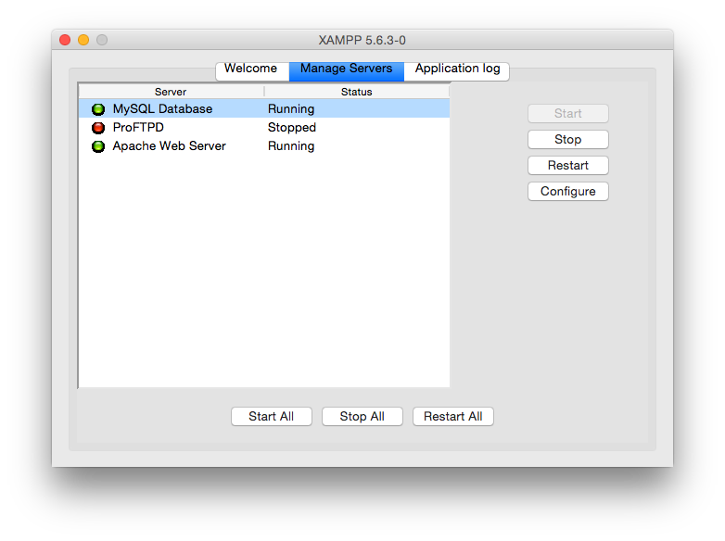
XAMPP Control Panel
Use the XAMPP control panel to start or stop:
  Apache Web Server
  MariaDB Database Server
  FTP server

Slide 19
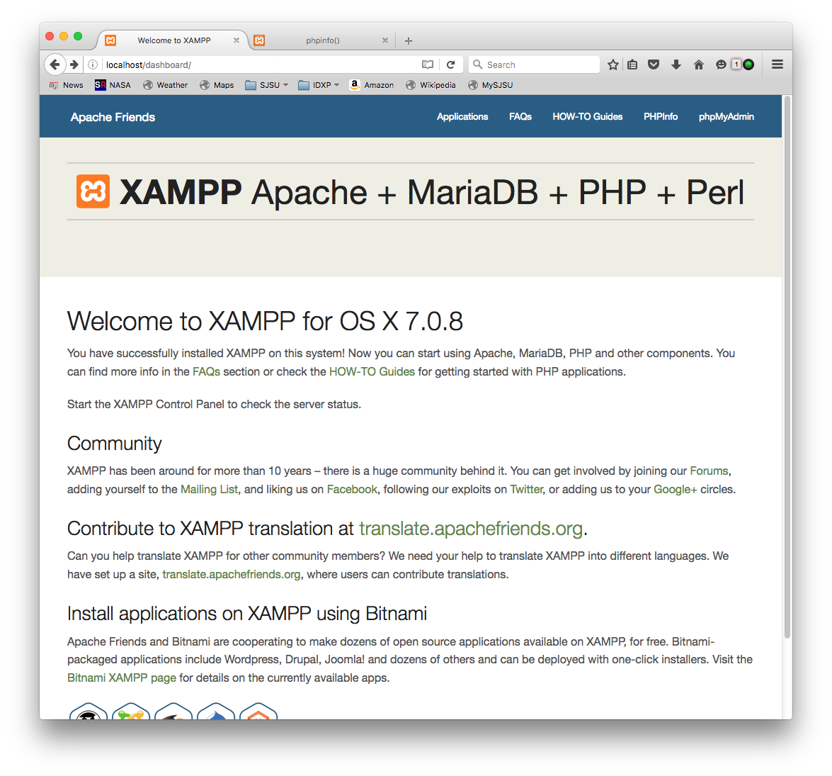
“localhost” Home Page
First, you may have to visit
http://localhost/xampp/lang.php?en
which automatically initializes
some pages.

Slide 20
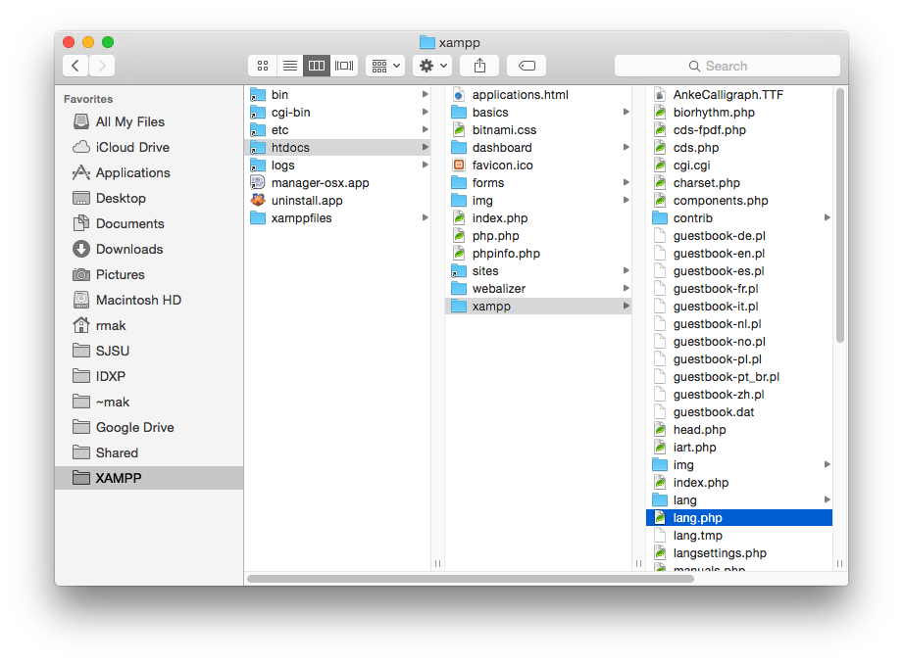
XAMPP Directory Structure
Folder htdocs is the root
of all the web pages
on your web server.

Slide 21
Take Roll!

Slide 22
Key Database Concepts
Why have databases?
  Why not simply store all our data in plain files?
  What advantages do databases provide?
Sophisticated modern database techniques
have been developed by computer scientists starting in the 1970s.

Slide 23
Major Issues in Transaction Processing
Efficiency
  Algorithms permit thousands of customers
  to simultaneously conduct transactions.
  No conflicts or inconsistencies.
Reliability
  Algorithms allow data to survive intact
  despite storage and network failures.
Canonical example: Online banking

Slide 24
Fundamental Ideas
Write-ahead logging
  To-do list
Two-phase commit
  Prepare then commit
Relational databases
  Virtual tables

Slide 25
Structured vs. Unstructured Data
Example of unstructured data:
Example of structured data:
Rosa is 22 and friends with Mike, who is 23.
Jill is 25 and Steve is 24. There are friendships
among the four of them.
Name | Age | Friends
Rosa | 22 | Mike
Jill | 25 | Mike, Steve
Mike | 23 | Rosa, Jill, Steve
Steve | 24 | Jill, Mike

Slide 26
Data Consistency
What is wrong with this table?
  Rosa is a friend of Jill, but Jill is not a friend of Rosa.
This type of data inconsistency is easy to avoid when new data is added to the database.
  Check for the rule “If a R b then b R a”
  where R is some relation such as “friends of”.
Name | Age | Friends
Rosa | 22 | Mike, Jill
Jill | 25 | Mike, Steve
Mike | 23 | Rosa, Jill, Steve
Steve | 24 | Jill, Mike

Slide 27
Data Consistency, cont’d
Name | Age | Friends
Rosa | 22 | Mike, Jill
Jill | 25 | Mike, Steve
Mike | 23 | Rosa, Jill, Steve
Steve | 24 | Jill, Mike
But other types of data inconsistency are harder to detect and require more advanced solutions.

Slide 28
Data Consistency, cont’d
Computers can crash.
  After a crash, data that wasn’t saved to
  external storage may not be recoverable.
Storage devices such as disk drives can only write small amounts of data at a time.
  Typically, one sector at a time, often 512 bytes.
  Therefore, a disk file is changed only a few hundred characters at a time.

Slide 29
Data Consistency, cont’d
Suppose we can update only one row of a database table at a time on disk.
  Table to update:
  Update the first row:
Name | Age | Friends
Rosa | 22 | none
Jill | 25 | none
Mike | 23 | none
Steve | 24 | none
Name | Age | Friends
Rosa | 22 | Jill
Jill | 25 | none
Mike | 23 | none
Steve | 24 | none

Slide 30
Data Consistency, cont’d
Name | Age | Friends
Rosa | 22 | Jill
Jill | 25 | none
Mike | 23 | none
Steve | 24 | none
Now the computer must update the second row to indicate that Jill’s friends include Rosa.
If the computer crashes before that happens, the table is left in an inconsistent state.
  This is easy to detect and fix with a program
  that periodically scans the database.

Slide 31
Data Consistency, cont’d
A banking example:
Sally requests a transfer of $200 from her checking account to her savings account.
Update the first row
by reducing the
checking balance
by $200.
Name | Account | Balance
Sally | checking | $800
Sally | savings | $300
Name | Account | Balance
Sally | checking | $600
Sally | savings | $300

Slide 32
Data Consistency, cont’d
Name | Account | Balance
Sally | checking | $800
Sally | savings | $300
Name | Account | Balance
Sally | checking | $600
Sally | savings | $300
Then the computer crashes.
  Sally has lost $200.
There is no apparent data inconsistency!
  Initially, Sally had $1100 in both accounts.
  After the crash, she has only $900.
  Sally did not withdraw any money.
How to prevent this type of inconsistency?

Slide 33
The Transaction Concept
A transaction is a set of changes that
must all occur in order for the database
to remain consistent.
  If only some of the changes in a transaction are performed, the database might become inconsistent.
A database program issues a begin transaction command before issuing the set of changes, and finishes with an end transaction command.
  The database computer must guarantee that
  all the changes will occur.

Slide 34
The Transaction Concept, cont’d
But what if the database computer crashes
in the middle of a transaction?
After the computer restarts, the application program is told that the transaction failed.
The program “rolls back” the transaction to return the database to its consistent state before the transaction started.
The program resubmits the transaction.
  If it’s successful, the database is still consistent.

Slide 35
Write-Ahead Logging
How to implement transactions?
Use a write-ahead log (a “to-do list”).
In some permanent storage, the database maintains a log of actions it’s planning to do, such as for a transaction.
Even if there’s a crash and then a restart,
the list of actions has survived and can be reused.

Slide 36
Write-Ahead Logging, cont’d
Write-ahead log
  Begin transfer transaction.
  Update Sally’s checking balance from $800 to $600.
  Update Sally’s savings balance from $300 to $500.
  End transfer transaction.
Name | Account | Balance
Sally | checking | $800
Sally | savings | $300
Name | Account | Balance
Sally | checking | $600
Sally | savings | $500

Slide 37
Write-Ahead Logging, cont’d
What’s wrong with this log?
  Begin transfer transaction.
  Subtract $200 from
  Sally’s checking balance.
  Add $200 to
  Sally’s savings balance.
  End transfer transaction.
Name | Account | Balance
Sally | checking | $800
Sally | savings | $300
Name | Account | Balance
Sally | checking | $600
Sally | savings | $500

Slide 38
Write-Ahead Logging, cont’d
The log must be idempotent.
  Begin transfer transaction.
  Update Sally’s checking
  balance to $600.
  Update Sally’s savings
  balance to $500.
  End transfer transaction.
Each action is undoable.
Each action can be performed multiple times.
Name | Account | Balance
Sally | checking | $800
Sally | savings | $300
Name | Account | Balance
Sally | checking | $600
Sally | savings | $500

Slide 39
Atomicity
Every transaction is atomic.
A transaction cannot be divided
into smaller actions.
Either the entire transaction completes successfully, or the database is returned
to its state before the transaction started.

Slide 40
Atomicity, cont’d
Therefore:
Is consistency sufficient
for efficiency and reliability?
Transactions prevent data corruption,
but what about data loss?
write-ahead logging
transactions
consistency

Slide 41
Break

Slide 42
Transactions and Database Locking
In a busy database, many transactions can be occurring at the same time.
Sometimes, it is important for the database
to lock certain records during a transaction.

Slide 43

Transactions and Database Locking, cont’d
Name | Account | Balance
Sally | checking | $800
Sally | savings | $300
Name | Account | Balance
Sally | checking | $600
Sally | savings | $300
For example, during the transaction to transfer $200 from Sally’s checking account to her savings account, those two rows of the database table must be locked.
You don’t want another transaction to modify those same rows while the first transaction is occurring.

Slide 44
Transactions and Database Locking, cont’d
A transaction can fail if a deadlock occurs.
  Transaction A locks
  Sally’s checking row
  and Transaction B
  locks the savings row.
  Now Transaction A
  wants to lock the
  savings row, and
  Transaction B wants
  to lock the checking row.
  Each transaction is locked out by the other.
Name | Account | Balance
Sally | checking | $800
Sally | savings | $300
A
B
Name | Account | Balance
Sally | checking | $800
Sally | savings | $300
A
X
B
B
X
A

Slide 45
Transactions and Database Locking, cont’d
Name | Account | Balance
Sally | checking | $800
Sally | savings | $300
A
X
B
B
X
A
If the database detects that a deadlock
has occurred between two transactions,
it must abort and roll back one of the transactions.

Slide 46
Replicated Databases
Transactions allow a database to recover
from certain types of crashes.
  You can roll back and restart a transaction.
Assumption: The data that existed before the transaction is still there.
  What if the database’s hard drives crashed
  with permanent data loss?
Multiple copies of a replicated database
are stored in different locations.

Slide 47
Replicated vs. Backup
A backup of a database is a snapshot of the contents of a database at a particular time.
  Backups can be made automatically,
  such as nightly.
  A backup is not necessarily up-to-date, since changes to the database since the last update are not captured until the next update.
A replicated database keeps all copies
of the database in sync at all times.
  Each change to the database is instantly made
  to all the replicas.

Slide 48
Two-Phase Commit Protocol
What happens if one of the replicas
encounters a problem during a transaction?

Slide 49
Analogy of a Two-Phase Commit
You are on a three-student project team.
You need to schedule a meeting.
You propose 7:30 to Teammate A.
Teammate A agrees.
  You tell her to pencil in that time
  and wait for confirmation.
You propose 7:30 to Teammate B.
Teammate B agrees.
You confirm with Teammate B.
You confirm with Teammate A.
Phase 1:
Prepare
Phase 2:
Commit

Slide 50
Analogy of a Two-Phase Commit, cont’d
But suppose Teammate B can’t make it at 7:30.
Tell Teammate B to forget 7:30.
Tell Teammate A to forget 7:30.
Choose a different time and repeat.
Phase 2:
Abort

Slide 51
Two-Phase Commit and Replication
What happens if one of the replicas encounters a problem during a transaction?
Suppose Replica A acts as the master
during a transaction to add new data.
Table
B
Log
Table
A
Log
add new data
Table
C
Log

Slide 52
Two-Phase Commit and Replication, cont’d
Phase 1: Prepare
Phase 2: Commit
Table
B
Log
add data?
add new data
Table
A
Log
OK
add new data
add data?
C
Table
Log
OK
add new data
Table
B
Log
commit
new data
Table
A
Log
new data
commit
C
Table
Log
new data

Slide 53
Two-Phase Commit and Replication, cont’d
Phase 1: Prepare
Phase 2: Abort
Table
B
Log
add data?
add new data
Table
A
Log
OK
add new data
add data?
C
Table
Log
error
Table
B
Log
roll back
Table
A
Log
roll back
C
Table
Log

Slide 54
Relational Databases
student name | course number | course title | instructor name | room number
Frank | CMPE101 | Intro Programming | O’Brien | 432
Frank | HIST256 | European History | Evans | 111
Susan | CS153 | Compiler Design | Mak | 225
Eric | CS153 | Compiler Design | Mak | 225
Luis | HIST256 | European History | Evans | 111
Luis | CS153 | Compiler Design | Mak | 225
Bill | CMPE101 | Intro Programming | O’Brien | 432
Bill | HIST256 | European History | Evans | 111
Rosa | CS153 | Compiler Design | Mak | 225
Rosa | CMPE101 | Intro Programming | O’Brien | 432
A table of student
and course
information.
  10 rows X 5 columns
  = 50 data items

Slide 55
Relational Databases, cont’d
student name | course number
Frank | CMPE101
Frank | HIST256
Susan | CS153
Eric | CS153
Luis | HIST256
Luis | CS153
Bill | CMPE101
Bill | HIST256
Rosa | CS153
Rosa | CMPE101
course number | course title | instructor name | room number
CMPE101 | Intro Programming | O’Brien | 432
HIST256 | European History | Evans | 111
CS153 | Compiler Design | Mak | 225
Two tables
  10 rows X 2 columns = 20 data items
  3 rows X 4 columns = 12 data items
  32 data items total
Easier to update data.
  Example: Move CMPE101 to room 400

Slide 56
Keys
student name | course number
Frank | CMPE101
Frank | HIST256
Susan | CS153
Eric | CS153
Luis | HIST256
Luis | CS153
Bill | CMPE101
Bill | HIST256
Rosa | CS153
Rosa | CMPE101
course number | course title | instructor name | room number
CMPE101 | Intro Programming | O’Brien | 432
HIST256 | European History | Evans | 111
CS153 | Compiler Design | Mak | 225
A column in one table contains keys to look up rows in another table.

Slide 57
Virtual Tables
student name | course number
Frank | CMPE101
Frank | HIST256
Susan | CS153
Eric | CS153
Luis | HIST256
Luis | CS153
Bill | CMPE101
Bill | HIST256
Rosa | CS153
course number | course title | instructor name | room number
CMPE101 | Intro Programming | O’Brien | 432
HIST256 | European History | Evans | 111
CS153 | Compiler Design | Mak | 225
Who takes classes
from Prof. Mak?
Join operation of the two tables:
  Combine each row of one
  table with the corresponding
  row of the other table based
  on matching key values.

Slide 58
Virtual Tables, cont’d
student name | course number
Frank | CMPE101
Frank | HIST256
Susan | CS153
Eric | CS153
Luis | HIST256
Luis | CS153
Bill | CMPE101
Bill | HIST256
Rosa | CS153
course number | course title | instructor name | room number
CMPE101 | Intro Programming | O’Brien | 432
HIST256 | European History | Evans | 111
CS153 | Compiler Design | Mak | 225
Join the
two tables.
student name | course number | course title | instructor name | room number
Frank | CMPE101 | Intro Programming | O’Brien | 432
Frank | HIST256 | European History | Evans | 111
Susan | CS153 | Compiler Design | Mak | 225
Eric | CS153 | Compiler Design | Mak | 225
Luis | HIST256 | European History | Evans | 111
Luis | CS153 | Compiler Design | Mak | 225
Bill | CMPE101 | Intro Programming | O’Brien | 432
Bill | HIST256 | European History | Evans | 111
Rosa | CS153 | Compiler Design | Mak | 225
Rosa | CMPE101 | Intro Programming | O’Brien | 432

Slide 59
Virtual Tables, cont’d
The projection operation removes unneeded columns.
student name | course number | course title | instructor name | room number
Frank | CMPE101 | Intro Programming | O’Brien | 432
Frank | HIST256 | European History | Evans | 111
Susan | CS153 | Compiler Design | Mak | 225
Eric | CS153 | Compiler Design | Mak | 225
Luis | HIST256 | European History | Evans | 111
Luis | CS153 | Compiler Design | Mak | 225
Bill | CMPE101 | Intro Programming | O’Brien | 432
Bill | HIST256 | European History | Evans | 111
Rosa | CS153 | Compiler Design | Mak | 225
Rosa | CMPE101 | Intro Programming | O’Brien | 432
student name | instructor name
Frank | O’Brien
Frank | Evans
Susan | Mak
Eric | Mak
Luis | Evans
Luis | Mak
Bill | O’Brien
Bill | Evans
Rosa | Mak

Slide 60
Virtual Tables, cont’d
The selection operation
chooses only rows
with instructor “Mak”.
Project again to remove the unneeded instructor column.
student name | instructor name
Susan | Mak
Eric | Mak
Luis | Mak
Rosa | Mak
student name
Susan
Eric
Luis
Rosa
Who takes classes
from Prof. Mak?

Slide 61
Relational Algebra
The mathematical theory behind
database operations:
  join
  project
  select

Slide 62
Form Teams!

