Slide 1


CMPE 202
Software Systems Engineering
April 8 Class Meeting
Engineering Extended Studies
San Jose State University
Spring 2025
Instructor: Ron Mak
www.cs.sjsu.edu/~mak

Slide 2
Today
The Singleton Design Pattern
  A collection of only one object.
The Iterator Design Pattern
  One algorithm operates on different collections.
Break
The Visitor Design Pattern
  Different algorithms operate on a single collection.
Design patterns for navigating collections of objects.

Slide 3
Assignment #5
Describe your proposed project
in a few paragraphs.
  What will it do?
  What will be some of its major classes?
Implement a key use case of your application.
  GUI-based user interface backed by working code.
  Describe what is happening in a paragraph or two with screenshots.
  Instructions on how the grader should run it.
Due Friday, April 11.

Slide 4
Your Team Projects
An application that is sufficiently substantial to demonstrate your use of good design principles and design patterns.
  There should be more to it than the example RPS application.
Mandatory: written in C++
Mandatory: GUI-based using Qt6
Short written report
  Basically, a write-up of your oral presentation.

Slide 5
Assignment #5, cont’d
Example applications from past semesters.
Inventory management
Hot meals vending machine
Snakes game
Role-playing game
Distributed RPS
Bookstore chain
Morse code translator
Cookie shop inventory
First person shooter (FPS) game
Tetris game
Chess game
City building game
Meme machine
Trivia game
Boba barista simulator
Runners simulator
Auction management
Pong game with machine learning
Cupcake store management
Fireball game
Food ordering

Slide 6
Oral presentations on Tuesday, May 6
What is your application?
What is its architecture?
  You can use slides, such as PowerPoint.
  Show high-level UML diagrams.
  Point out your use of good design principles
    Examples: cohesive classes, loose coupling, coding to the interface, delegation, etc.
  Point out code modeled by design patterns.
    Which patterns?
    How did your code benefit
    from the patterns?
Live demo of the application.
Maximum 20 minutes per presentation.
Students in the class will help grade each oral presentation via a Canvas survey. You will know the survey questions before the presentation day.

Slide 7
The Singleton Design Pattern
The Singleton Design Pattern models the simplest case of a collection with only one object.
Only one instance of its class, the singleton object, can exist during the application’s run time.

Slide 8
Example Application: Executive Pass
The college sports stadium has an executive suite available for use during only certain sporting events.
There is only one pass that allows someone to use the suite whenever it’s available.
Therefore, the pass is a singleton object,
and there can be at most one of them.

Slide 9
Desired Features
DF 1. There must be a way for the application to access the singleton object.
DF 2. Whenever the application needs the singleton object, it must always access the same object.
DF 3. If the singleton object doesn’t already exist, one must be created without any action by the application.
DF 4. The singleton object doesn’t need to exist if the application never accesses the object.
DF 5. There can never be more than one instance of the singleton object.

Slide 10
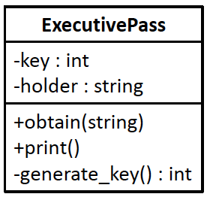

Before Using the Singleton DP
Member function obtain() allows a named user to obtain and hold the pass. The pass has a randomly generated four-digit key to identify it. Member function print() prints the name of the holder and the value of the key.
14.1/ ExecutivePass.h
14.1/tester.cpp
obtain: Executive pass now held by Ron, key = 7807
obtain: Executive pass now held by Sal, key = 7807
copy 1: Executive pass now held by Bob, key = 1073
copy 2: Executive pass now held by Flo, key = 4658
Ron and Sal both hold the same pass.
Two more passes were created.

Slide 11
Problems with “Before”
Use of a global variable. We should not have global variables in a well-designed application.
  Different parts of the application can access a global variable. One part can change the variable’s value unbeknownst to other parts, resulting in unwanted surprises and possible logic errors.
Order of creation. If different global objects declared in different source files depend on each other, logic errors can occur because the order in which the objects are created when the application starts is undefined.

Slide 12
Problems with “Before”, cont’d
Object is always present. In our example, the executive suite is not open for every sporting event. We defined the pass globally, so it is always present.
  This can be a problem if the singleton object is costly to construct or consumes many resources.
  We can’t delete the global object.
Possible to copy and assign the object. These operations will create more instances of the supposedly singleton object.

Slide 13
The Singleton Design Pattern
The Singleton Design Pattern
“Ensure a class has only one instance, and provide a global point of access to it.” [GoF 127]

Slide 14
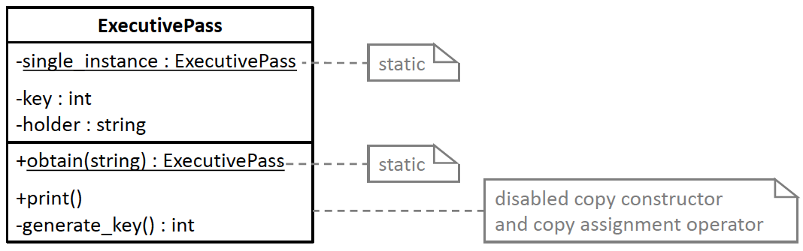

After Using the Singleton DP
14.2/ExecutivePass.h
14.2/ExecutivePass.cpp
14.2/tester.cpp
We must make the constructor private.
  We cannot allow code to declare an ExecutivePass object
  or to create one dynamically with new.
  We must control the creation of a singleton pass object and create the object only when it’s needed (lazy construction).
A private static ExecutivePass member variable must point to the one and only singleton object, if it exists.
  Otherwise, the variable’s value must be nullptr.

Slide 15
After Using the Singleton DP, cont’d
A public static obtain() member function must return a pointer to the singleton object and set who’s holding the pass.
  It must create the object if it doesn’t already exist.
  ExecutivePass::obtain() is the global point of access
  to the singleton object.
Deleting the singleton object must enable
creating a new one later.

Slide 16
After Using the Singleton DP, cont’d
We must disable the copy constructor
and the copy assignment operator.
  We cannot allow making copies of a singleton object.
ExecutivePass(ExecutivePass& other) = delete;
ExecutivePass& operator =(ExecutivePass& other) = delete;

Slide 17
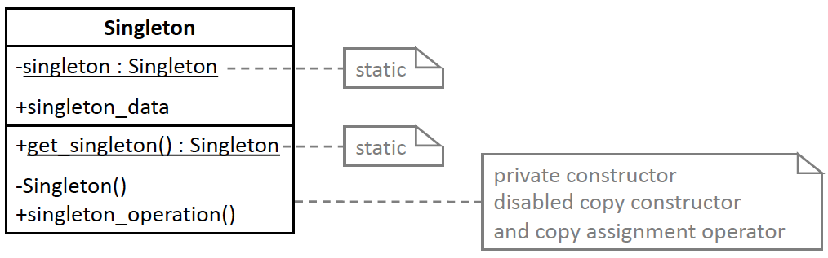
Singleton DP Generic Model
The private static member variable singleton points to the Singleton object if it exists; otherwise, its value is nullptr. The private static member function get_singleton() returns a pointer to the existing Singleton object. If the singleton object doesn’t already exist, the function creates and returns the pointer to a newly created Singleton object.
Design pattern | Applied by the example application
Class Singleton | Class ExecutivePass
Static member variable singleton | Static member variable single_instance
Static member function get_singleton() | Static member function obtain()
Private constructor Singleton() | Private constructor ExecutivePass()
Member variable singleton_data | Member variables key and holder
Member function singleton_operation() | Member function print()
obtain: Executive pass now held by Ron, key = 7807
obtain: Executive pass now held by Sal, key = 7807
delete
obtain: Executive pass now held by Bob, key = 6249
obtain: Executive pass now held by Flo, key = 6249

Slide 18
Warning about Singleton Objects
The Singleton Objects and Multithreading
We must be extra cautious when creating singleton objects in a multithreaded program. In our example application, member function obtain() of class ExecutivePass first checks whether the singleton object already exists. If not, it creates one. But if multiple threads simultaneously execute this member function when the singleton object doesn’t already exist, more than one thread can test that the value of the static member variable single_instance is nullptr, and each of those threads will create a singleton object. Member variable single_instance will point to the last one that was created.

Slide 19
The Iterator and Visitor Design Patterns
These two design patterns are models for applications that must flexibly access data stored in various data structures such as vectors, lists, and trees.
  The Iterator Design Pattern enables a single algorithm to iterate over multiple sequential collections of objects without needing to know how the collections are implemented.
  The Visitor Design Pattern encapsulates different algorithms that are each designed to process the nodes of a single tree structure.

Slide 20
The Iterator Design Pattern
An application must iterate over multiple sequential collections of objects with a common algorithm, without knowing how the collections are implemented.
A sequential collection of objects is either empty,
or it has these properties:
  One of the objects is the first object, and one of the objects is the last object. If there is only one object in the collection, then that object is both the first and the last of the sequence.
  Each object except the last is followed by a unique next object.
  We can access the objects in the collection one at a time in order from the first one through the last one.
  We can tell when we’ve accessed all the objects in the sequence, i.e., when we’ve reached the end of the collection.

Slide 21
Example Application: Player Lists
The athletics department wants to print lists of the players on each intramural baseball team.
  The department doesn’t care about the particular order of the players in each list, so long as it includes every player’s student id and name.
TEAM 1
12436 Alwin, Jim
26410 Bond, Bob
14306 Charles, Ronda
61835 Dunn, Fred
30437 Edwards, Gina
76517 Fanning, Pat
98734 Galway, Leslie
14998 Hiroshi, Scott
47303 Ingles, Mary
TEAM 2
12436 Jackson, Tammy
44551 Killebrew, Wally
14306 Lamprey, Roberta
61835 Mays, Serena
30437 Norton, Donna
76517 OBrien, George
98734 Paulson, Marsha
14998 Quark, John
47303 Rogers, Jena
TEAM 3
10547 Ulster, Doug
38331 Vicks, Ron
40067 Aaron, Patricia
46841 Smith, Ken
47781 Wong, Henrietta
56712 Yonnick, Billy
61472 Xavier, Nancy
72288 Zachs, Robby
98765 Terrance, Laura

Slide 22
Player Lists, cont’d
array
vector
map
TEAM 1
12436 Alwin, Jim
26410 Bond, Bob
14306 Charles, Ronda
61835 Dunn, Fred
30437 Edwards, Gina
76517 Fanning, Pat
98734 Galway, Leslie
14998 Hiroshi, Scott
47303 Ingles, Mary
TEAM 2
12436 Jackson, Tammy
44551 Killebrew, Wally
14306 Lamprey, Roberta
61835 Mays, Serena
30437 Norton, Donna
76517 OBrien, George
98734 Paulson, Marsha
14998 Quark, John
47303 Rogers, Jena
TEAM 3
10547 Ulster, Doug
38331 Vicks, Ron
40067 Aaron, Patricia
46841 Smith, Ken
47781 Wong, Henrietta
56712 Yonnick, Billy
61472 Xavier, Nancy
72288 Zachs, Robby
98765 Terrance, Laura
Due to lack of coordination, each team stores its list of Player objects as a sequential collection in a different form than the other teams.
  Team 1 uses an array.
  Team 2 uses a vector.
  Team 3 uses a map.
We may be dealing with legacy code, parts of which were written by different programmers at different times for different purposes.

Slide 23
Desired Design Features
DF 1: The application should be able to execute an algorithm that processes the objects without knowing how the sequential collections are implemented.
DF 2: The collections should be independent from one another.
DF 3: It should be possible to add new sequential collections without modifying the application’s algorithm code.

Slide 24
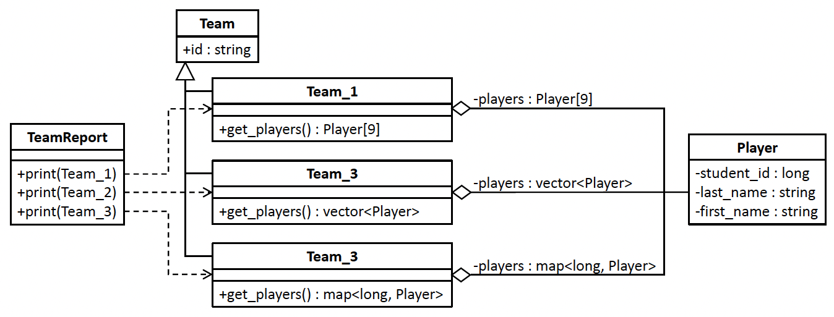
Before Using the Iterator DP
Each Team subclass stores its Player objects in a different type of sequential collection, array, vector, or map. Therefore, class TeamReport has three overloaded print() member functions, one for each type of collection.
11.1/Player.h
11.1/TeamReport.h
11.1/Team.h
11.1/TeaReport.cpp
11.1/Team.cpp
11.1/tester.cpp

Slide 25
Problems with “Before”
Inflexible. Adding another report with yet another form of sequential collection such as a linked list would require adding another overloaded print() member function. That violates DF 3.
Duplicated code. Each overloaded print() member function must iterate over its sequential collection of Player objects in a different way depending on the form of the collection. This will become a greater problem if there are more teams and sequential collections to store players, such as linked lists or trees.
Classes not loosely coupled. Each overloaded print() function must know how the Player objects are stored — as an array, a vector, or a map — to properly iterate over its sequential collection. Therefore, class TeamReport is not loosely coupled with the Team subclasses.

Slide 26
The Iterator Design Pattern
The Iterator Design Pattern
“Provide a way to access the elements of an aggregate object sequentially without exposing its underlying representation.” [GoF 139]

Slide 27
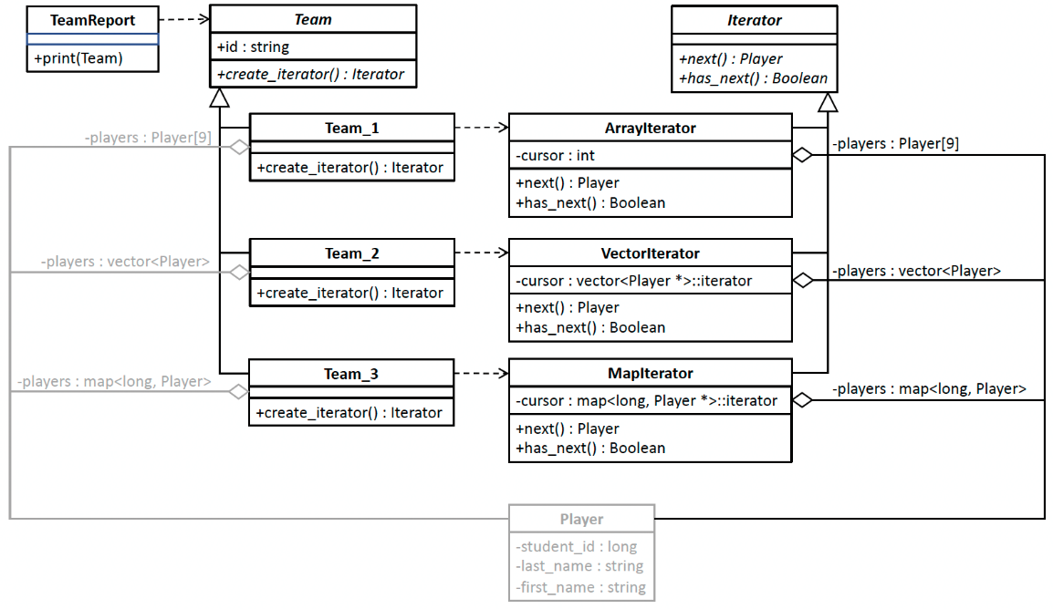
After Using the Iterator DP
11.2/Player.h
11.2/Iterator.h
11.2/Team.h
11.2/Team.cpp
11.2/TeamReport.h
11.2/TeaReport.cpp
11.2/tester.cpp
More classes, but the code is more flexible and scalable.
An iterator is a special-purpose adapter for a sequential collection.
Each Team subclass creates an iterator that is appropriate for its sequential collection of Player objects. Class TeamReport delegates iterating over the various forms of sequential collections to the Iterator subclasses. Each Iterator subclass knows how to iterate over its form of sequential collection and has a private cursor member variable to keep track of the current Player object. Class TeamReport does not know how each Team subclass stores its sequence of Player objects and therefore it is loosely coupled from the Team subclasses.

Slide 28
Benefits of “After”
Delegated iterations. Class TeamReport delegates iterating over the sequential collections to the Iterator subclasses, which is an application of the Delegation Principle.
Loosely coupled classes. Class TeamReport no longer needs to know how each Team subclass implements its sequential collection, which is an application of the Principle of Least Knowledge. Therefore, class TeamReport is loosely coupled from the Team subclasses.

Slide 29
Benefits of “After”, cont’d
Encapsulated iteration algorithms. The Iterator subclasses encapsulate the different algorithms to iterate over the various forms of sequential collections, which is an application of the Encapsulate What Varies Principle.
Reduced code duplication. The iteration algorithms are not duplicated, which is an application of the Don’t Repeat Yourself Principle.
Sharable iteration algorithms. It will be easy to share the iteration algorithms among similar sequential collections or to add new algorithms for other collections.

Slide 30
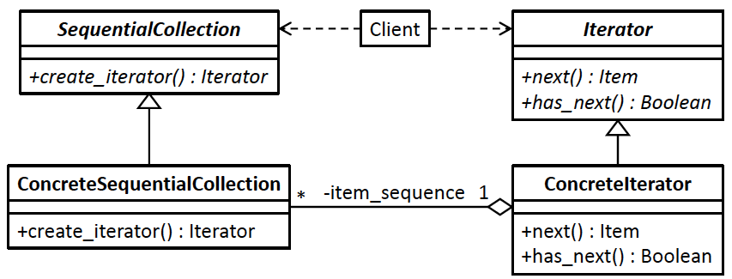
Iterator DP Generic Model
Design pattern | Applied by the example application
client class | class TeamReport
superclass SequentialCollection | superclass Team
concrete sequential collections | subclasses Team_1, Team_2, and Team_3
superclass Iterator | superclass Iterator
concrete iterators | ArrayIterator, VectorIterator, and MapIterator
item | Player object

Slide 31
C++ Iterators
Each C++ template class that represents a sequential collection such as vector has a
built-in iterator object.
  Example:
These iterators are not modeled by the Iterator Design Pattern.
  The iterators are not implementations of a common iterator interface.
  Therefore, a client class will not be loosely coupled from the sequential collection.
vector<string>::iterator it;

Slide 32
Break

Slide 33
The Visitor Design Pattern
The Visitor Design Pattern works with different algorithms that operate on an application’s single data collection of objects.
The pattern is often used to provide a model for an architecture where the collection is hierarchical, such as a tree data structure.
  The objects are nodes of the tree, and they can be instantiated from different classes and therefore the nodes’ data can be of different datatypes.

Slide 34
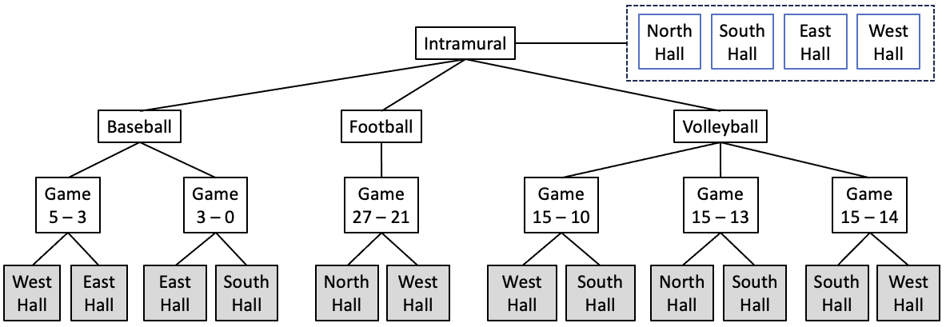
Example Application: Game Results
The college athletics department wants to print reports about intramural games.
  The games data collection is a tree structure.
A data collection as a tree structure that represents intramural baseball, football, and volleyball intramural games played by teams
from residence halls North, South, East, and West. Each Games node has pointers to the Hall nodes of the winning and losing
residence halls, and it also contains the winning and losing points of its game. The Intramural node also has a vector of Hall objects.

Slide 35
Game Results, cont’d
Three passes over the tree structure.
  Pass 1 algorithm prints:
  Pass 2 algorithm prints:
  Pass 3 algorithm prints:
SCORES REPORT
baseball
West Hall beat East Hall 5 to 3
East Hall beat South Hall 3 to 0
football
North Hall beat West Hall 27 to 21
volleyball
West Hall beat South Hall 15 to 10
North Hall beat South Hall 15 to 13
South Hall beat West Hall 15 to 14
ACTIVITIES REPORT
baseball: 2 game(s)
football: 1 game(s)
WINNINGS REPORT
North Hall won 2 game(s)
South Hall won 1 game(s)
East Hall won 1 game(s)
West Hall won 2 game(s)

Slide 36
Desired Design Features
DF 1: The pass algorithms should be independent from each other .
DF 2: The data collection and the algorithms that operate on the collection’s data should be independent from each other.
DF 3: Adding new passes and their algorithms should not require modifying the data collection.

Slide 37
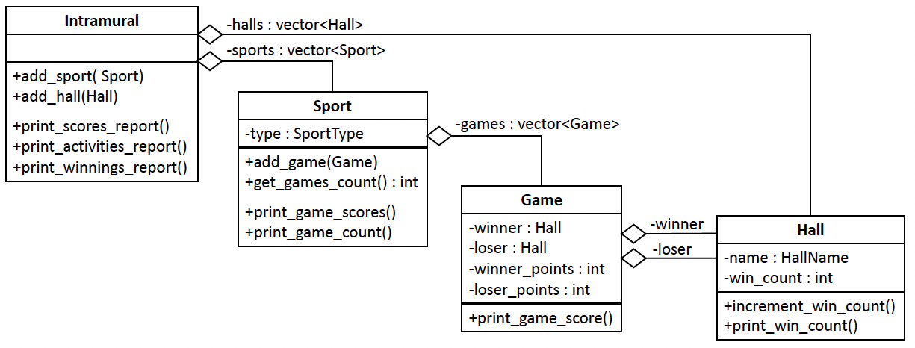
Before Using the Visitor DP
This is a complicated program!
The four major classes of the first version of the intramural game results application. To implement the hierarchical tree structure, each class except Hall aggregates the next class below in the hierarchy. Each class has member variables and member functions to implement the algorithms that generate the reports. The Intramural class’s vector of Hall objects is not part of the hierarchy.
11.3/Enums.h
11.3/Intramural.h
11.3/Sport.h
11.3/Game.h
11.3/Hall.h
11.3/tester.cpp
11.3/Intramural.cpp
11.3/Sport.cpp
11.3/Game.cpp
11.3/Hall.cpp

Slide 38
Before Using the Visitor DP, cont’d
The public printing member functions of class Intramural generate the three intramural sports reports.
  Scores Report. Member function print_scores_report() iterates over the Sport objects and calls member function print_game_scores() on each object.
  Activities Report. Member function print_activities_report() iterates over the Sport objects and calls member function print_game_count() on each object.
  Winnings Report. Member function print_winnings_report() iterates over the Hall objects and calls member function print_win_count() on each object.
SCORES REPORT
baseball
West Hall beat East Hall 5 to 3
East Hall beat South Hall 3 to 0
football
North Hall beat West Hall 27 to 21
volleyball
West Hall beat South Hall 15 to 10
North Hall beat South Hall 15 to 13
South Hall beat West Hall 15 to 14
ACTIVITIES REPORT
baseball: 2 game(s)
football: 1 game(s)
WINNINGS REPORT
North Hall won 2 game(s)
South Hall won 1 game(s)
East Hall won 1 game(s)
West Hall won 2 game(s)

Slide 39
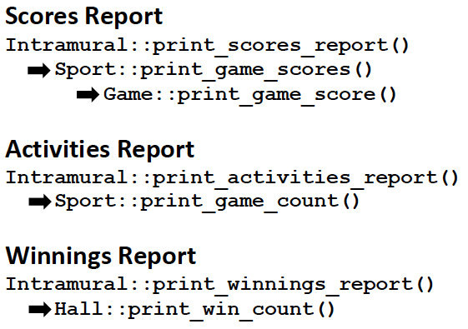
Before Using the Visitor DP, cont’d
Generating each report requires a call chain among the member functions of the main classes:
SCORES REPORT
baseball
West Hall beat East Hall 5 to 3
East Hall beat South Hall 3 to 0
football
North Hall beat West Hall 27 to 21
volleyball
West Hall beat South Hall 15 to 10
North Hall beat South Hall 15 to 13
South Hall beat West Hall 15 to 14
ACTIVITIES REPORT
baseball: 2 game(s)
football: 1 game(s)
WINNINGS REPORT
North Hall won 2 game(s)
South Hall won 1 game(s)
East Hall won 1 game(s)
West Hall won 2 game(s)
The algorithms to generate the three intramural reports are implemented in bits and pieces among the tree node classes
Intramural, Sport, Game, and Hall. That violates DF 2.

Slide 40
Problems with “Before”
Classes with multiple responsibilities. Each of the classes Intramural, Sport, and Game has multiple responsibilities.
  Each class must have member variables and member functions to implement the data collection as a tree structure.
  But each class must also have member variables and member functions to implement the three report generation algorithms.
Inflexible application architecture. If we decide to modify a report’s content, or add a new report, we will need to make changes throughout the classes.

Slide 41
The Visitor Design Pattern
The Visitor Design Pattern
“Represent an operation to be performed on the elements of an object structure. Visitor lets you define a new operation without changing the classes of the elements on which it operates.” [GoF 139]

Slide 42
Home Remodeling Analogy
You hire different craftsmen (“visitors”)
to work on your house.
  painter visitor
  flooring visitor
  electrician visitor
Each visitor has a task for each room (“node”).
  Example: The painter paints a color depending on the room.
Each room “accepts” each craftsman (“visitor”).
Once in a room, a craftsman “visits” the room by performing the task appropriate for what the room is (the room’s “node type”).
Each visitor encapsulates an operation: painting, laying floors, electrical wiring.

Slide 43
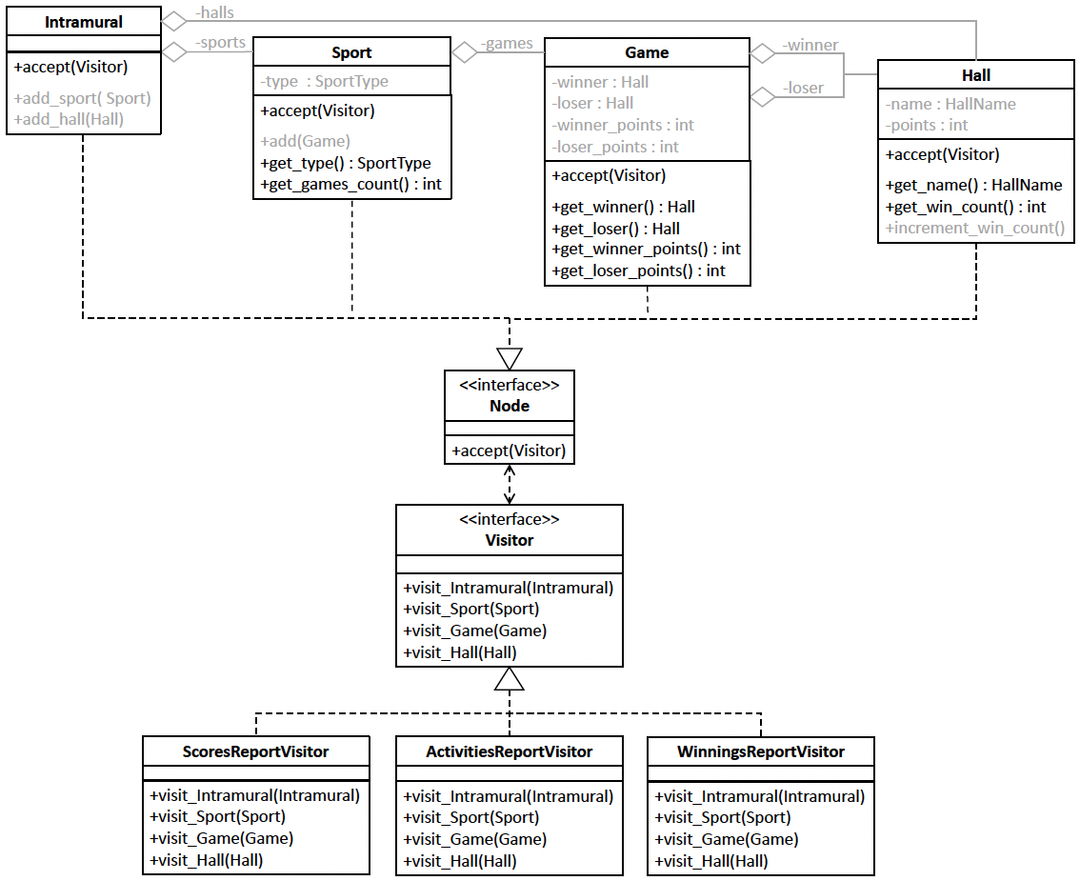
After Using the Visitor DP
11.4/Enums.h
11.4/tester.cpp
Each tree node class implements interface Node and has member function accept() to accept a Visitor object. The three Visitor classes ScoresReportVisitor, ActivitiesReportVisitor, and WinningsReportVisitor each implements interface Visitor and encapsulates a report generation algorithm. Each Visitor class has member functions that visit the tree nodes, one visit function for each type of node .
11.4/Intramural.h
11.4/Sport.h
11.4/Game.h
11.4/Hall.h
11.4/Node.h
11.4/ScoresReportVisitor.h
11.4/Visitor.h
11.4/ActivitiesReportVisitor.h
11.4/WinningsReportVisitor.h

Slide 44
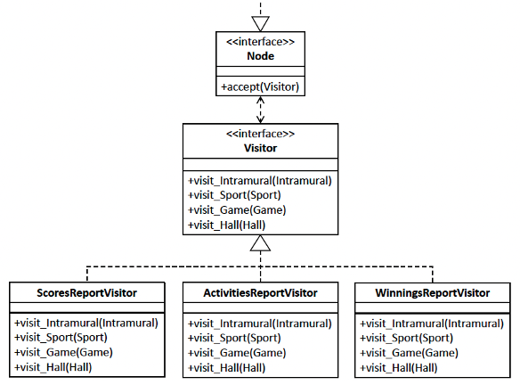
After Using the Visitor DP, cont’d
Each node must implement the accept() member function to “accept” a Visitor object.
  It’s declared as an abstract member function
  in superclass Node:
Once a node has accepted a Visitor object,
the node asks the object to visit it.
  For example, in class Hall:
virtual void accept(Visitor& visitor) = 0;
void accept(Visitor& visitor) override
{
visitor.visit_Hall(this);
}

Slide 45
After Using the Visitor DP, cont’d
Once a node has accepted a Visitor object and has been visited, the node can ask other nodes to accept that Visitor object.
  For example, in class Intramural:
void accept(Visitor& visitor) override
{
visitor.visit_Intramural(this);
for (Sport *sport : sports) sport->accept(visitor);
for (Hall *hall : halls) hall->accept(visitor);
}

Slide 46
After Using the Visitor DP, cont’d
Each Visitor class encapsulates a report generation algorithm.
Each Visitor class must implement a visit member function for each Node type.
  These are declared as abstract member functions
  in superclass Visitor:
virtual void visit_Intramural(Intramural *node) = 0;
virtual void visit_Sport(Sport *node) = 0;
virtual void visit_Game(Game *node) = 0;
virtual void visit_Hall(Hall *node) = 0;

Slide 47
After Using the Visitor DP, cont’d
To generate a report, each Visitor object has a specific task to perform when it visits a node.
The task for each node type is performed by
the visit member function for that node type.

Slide 48
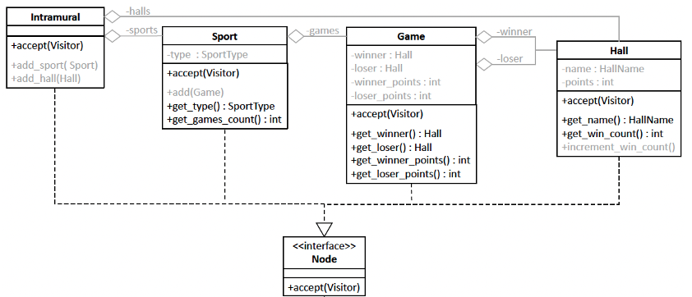
ScoresReportVisitor
void ScoresReportVisitor::visit_Intramural(Intramural *intramural)
{
cout << endl << "SCORES REPORT" << endl;
}
void ScoresReportVisitor::visit_Sport(Sport *sport)
{
cout << endl << " " << sport->get_type() << endl;
}
void ScoresReportVisitor::visit_Game(Game *game)
{
Hall *winner = game->get_winner();
Hall *loser = game->get_loser();
int winner_points = game->get_winner_points();
int loser_points = game->get_loser_points();
cout << setw(14) << winner->get_name() << " beat "
<< setw(10) << loser->get_name()
<< setw(3) << winner_points
<< " to " << setw(2) << loser_points << endl;
}
void ScoresReportVisitor::visit_Hall(Hall *hall)
{
// do nothing
}
SCORES REPORT
baseball
West Hall beat East Hall 5 to 3
East Hall beat South Hall 3 to 0
football
North Hall beat West Hall 27 to 21
volleyball
West Hall beat South Hall 15 to 10
North Hall beat South Hall 15 to 13
South Hall beat West Hall 15 to 14

Slide 49
ActivitiesReportVisitor
void ActivitiesReportVisitor::visit_Intramural(Intramural *intramural)
{
cout << endl << "ACTIVITIES REPORT" << endl << endl;
}
void ActivitiesReportVisitor::visit_Sport(Sport *sport)
{
cout << setw(12) << sport->get_type() << ": "
<< sport->get_games_count() << " game(s)" << endl;
}
void ActivitiesReportVisitor::visit_Game(Game *game)
{
// do nothing
}
void ActivitiesReportVisitor::visit_Hall(Hall *hall)
{
// do nothing
}
ACTIVITIES REPORT
baseball: 2 game(s)
football: 1 game(s)
volleyball: 3 game(s)

Slide 50
WinningsReportVisitor
void WinningsReportVisitor::visit_Intramural(Intramural *intramural)
{
cout << endl << "WINNINGS REPORT" << endl << endl;
}
void WinningsReportVisitor::visit_Sport(Sport *sport)
{
// do nothing
}
void WinningsReportVisitor::visit_Game(Game *game)
{
// do nothing
}
void WinningsReportVisitor::visit_Hall(Hall *hall)
{
cout << setw(12) << hall->get_name() << " won "
<< hall->get_win_count() << " game(s)" << endl;
}
WINNINGS REPORT
North Hall won 2 game(s)
South Hall won 1 game(s)
East Hall won 1 game(s)
West Hall won 2 game(s)
We can make Visitor into a superclass where the default implementation of each member function does nothing. Then a Visitor subclass needs to override only the member functions that do something. There are ways to remove other duplicate code.

Slide 51
The main() Starts Report Generation
The nodes of the tree accept each report visitor.
  Each visit generates a report.
11.4/tester.cpp
int main()
{
Intramural *intramural_node = build_tree();
ScoresReportVisitor scores_report_visitor;
ActivitiesReportVisitor activities_report_visitor;
WinningsReportVisitor winnings_report_visitor;
intramural_node->accept(scores_report_visitor);
intramural_node->accept(activities_report_visitor);
intramural_node->accept(winnings_report_visitor);
delete intramural_node;
return 0;
}

Slide 52
The Benefits of “After”
Encapsulated algorithms. The algorithms to generate and print the Games Report, the Sports Report, and the Residence Halls Report are each encapsulated in the Visitor classes ScoresReportVisitor, ActivitiesReportVisitor, and WinningsReportVisitor, respectively.
  This is the Encapsulate What Varies Principle. It will be possible to modify or delete a report algorithm or add new ones without affecting other classes.

Slide 53
The Benefits of “After”, cont’d
Classes with single responsibility.
  The Node classes Intramural, Sport, Game, and Hall are responsible only for maintaining the tree data structure.
  The Visitor classes are responsible only for report generation. This is the Single Responsibility Principle.

Slide 54
The Benefits of “After”, cont’d
Loose coupling. The tree data structure is loosely coupled with the report generation algorithms, and the algorithms are loosely coupled with each other.
  The Node classes do not know what the report generation algorithms are or how they’re implemented by the Visitor classes.
  This is the Principle of Least Knowledge. We will be able to modify or delete algorithms or add new algorithms without modifying the data structure or the existing algorithms .

Slide 55
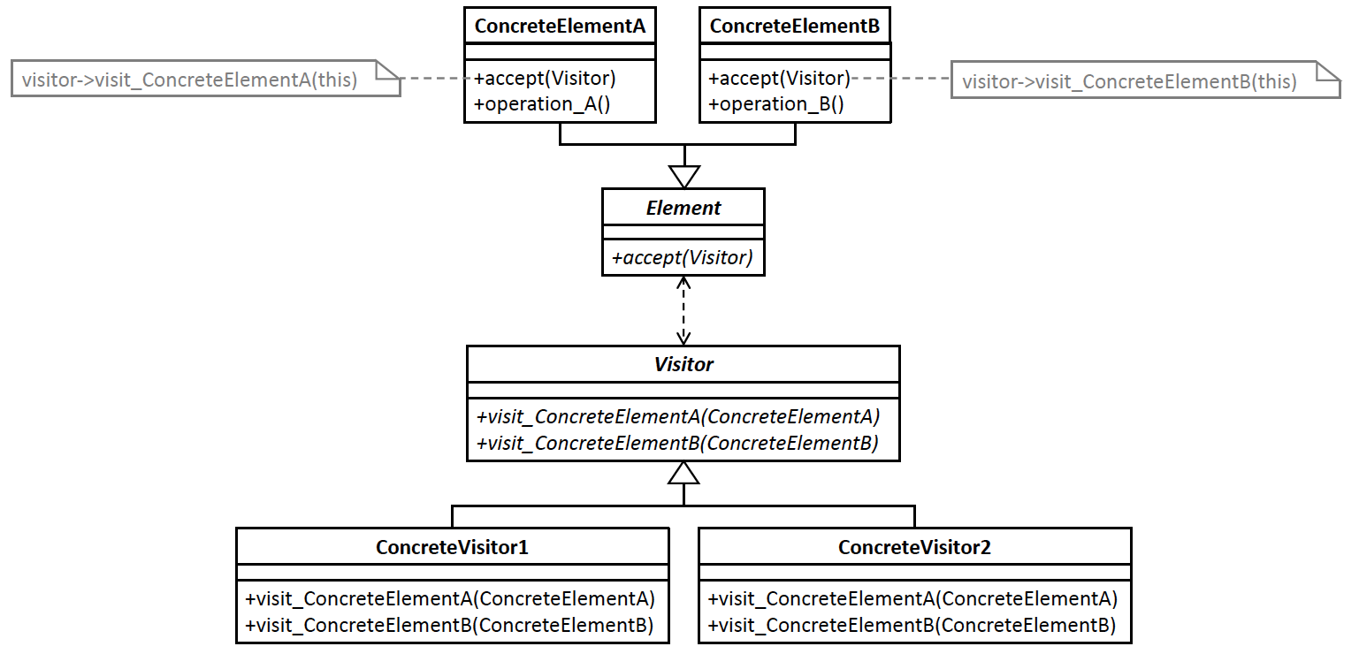
Visitor DP Generic Model
Design pattern | Applied by the example application
Superclass Element | Interface Node
Subclasses ConcreteElementA, etc. | Classes Intramural, Sport, Game, and Hall
Superclass Visitor | Interface Visitor
Subclasses ConcreteVisitor1, etc. | Classes ScoresReportVisitor, ActivitiesReportVisitor, and WinningsReportVisitor
Member functions visit_ConcreteElementA(), etc. | Member functions visit_Intramural(), visit_Sport(), visit_Game(), and visit_Hall()

