Slide 1


CMPE 202
Software Systems Engineering
March 4 Class Meeting
Engineering Extended Studies
San Jose State University
Spring 2025
Instructor: Ron Mak
www.cs.sjsu.edu/~mak

Slide 2
Today
Midterm exam
Break
GUI-based programming with Qt

Slide 3
Unofficial Field Trip
Computer History Museum in Mt. View
  http://www.computerhistory.org/
  Provide your own transportation to the museum.
Saturday, March 15, 11:30 AM
  Special free admission for my students.
    Meet in the front lobby for your free pass.
  Stay as long as you like, until closing time
  Do a self-guided tour of the Revolution exhibit.
  Experience a fully restored IBM 1401 mainframe computer from the early 1960s in operation.

Slide 4
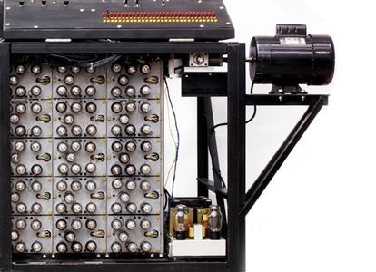
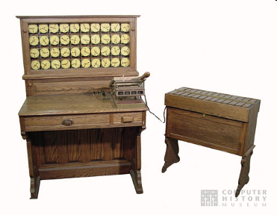
Unofficial Field Trip, cont’d
See the extensive Revolution exhibit!
  Walk through a timeline of the
  First 2000 Years of Computing History.
  Historic computer systems, data processing equipment,
  and other artifacts.
  Small theater presentations.
Hollerith
Census
Machine
Atanasoff-Berry
Computer

Slide 5
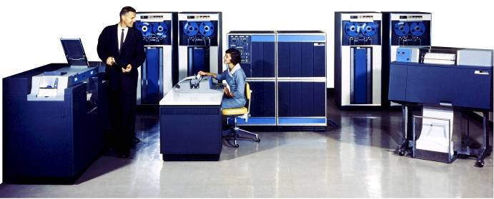
Unofficial Field Trip, cont’d
IBM 1401 computer, fully restored and operational.
  A small transistor-based mainframe computer.
  Extremely popular with small businesses
  in the late 1950s through the mid 1960s
    Maximum of 16K bytes of memory.
    800 card/minute card reader (wire brushes).
    600 line/minute line printer (impact).
    6 magnetic tape drives, no disk drives.

Slide 6
Unofficial Field Trip, cont’d
Information on the IBM 1401:
  General info: http://en.wikipedia.org/wiki/IBM_1401
  My summer seminar: http://www.cs.sjsu.edu/~mak/1401/
  Restoration: http://ed-thelen.org/1401Project/1401RestorationPage.html

Slide 7
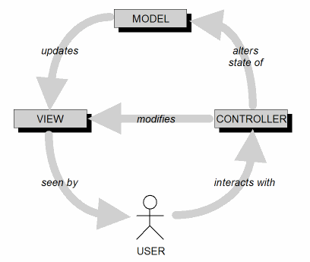
Model-View-Controller Architecture (MVC)
MVC is an ideal architecture for GUI applications.
Design goal: Identify which application components are model, view, or controller.
A user cannot directly modify the model.

Slide 8
MVC Implementation: Loose Coupling
Keep the implementations of the
three object types separate.
  Cohesive classes!
Each type of object does not depend
on how the other types are implemented.
  Loosely coupled classes!
Your application is
  easier to develop and maintain
  faster to develop
  more robust (resilient to runtime errors)

Slide 9
MVC Model Objects
Model objects represent the persistent information maintained by your application.
The information can be kept in memory,
in files, or in a database.

Slide 10
MVC View Objects
View objects represent
user interface components.
  Input components such as text fields,
  buttons, menus, checkboxes, and
  radio buttons.
In each use case, users interact
with at least one view object.
A view object collects information from users
in a form that the model and controller objects
can use.

Slide 11
MVC Controller Objects
Controller objects coordinate the model and view objects.
Often have no physical counterpart
in the real world.
Dispatches information
from the view objects
to the model objects.
  This is how user-entered data
  can update the model.

Slide 12
Software Frameworks
A software framework consists of a set of cooperating classes.
  These classes implement the essential mechanisms
  for a particular problem domain.
  Example: Qt 6 is a C++ software framework
  for multi-platform GUI programming.
A framework imposes a structure on the
design and development of applications.
  It has classes and API that implement the structure.
  It is more than simply a library.

Slide 13
Software Frameworks, cont’d
A programmer builds an application by:
  Subclassing framework classes.
  Adding new classes that provide
  custom functionality.
Inversion of control
  The framework controls the execution flow.
  The programmer registers callback functions,
  mostly as event handlers, with the framework.
  The framework invokes the callback functions at the appropriate times, such as in response to events.
    Example event: The user clicks a button.

Slide 14
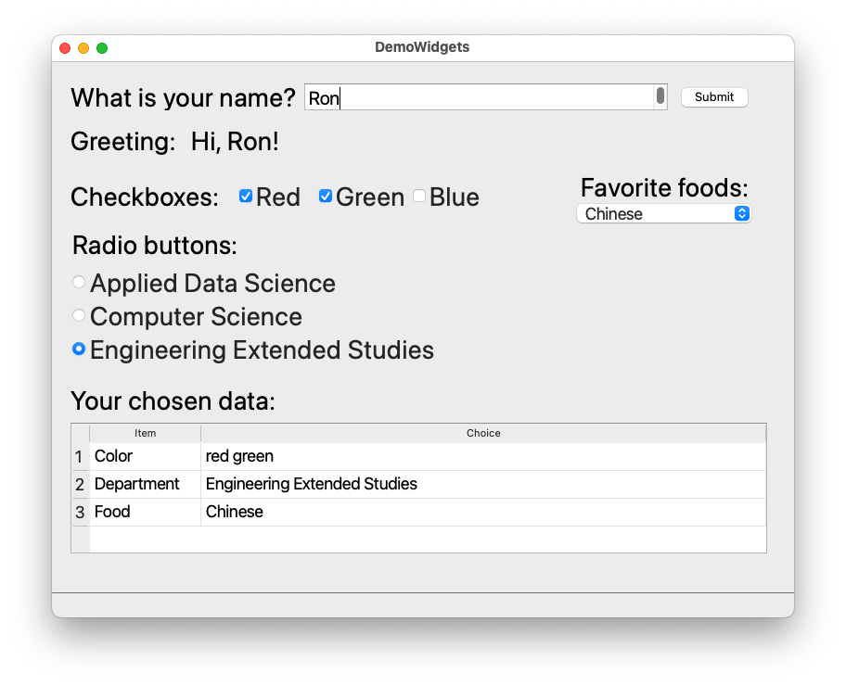
Demo Qt 6 Widgets Application

Slide 15
Free Qt 6 for Education
https://doc.qt.io/qt-6/qt-edu-for-developers.html
Tool: Qt Creator
  Generate desktop C++ GUI-based applications.
  Drag-and-drop GUI design tool.
  IDE for C++.
Generate multi-platform applications.

Slide 16
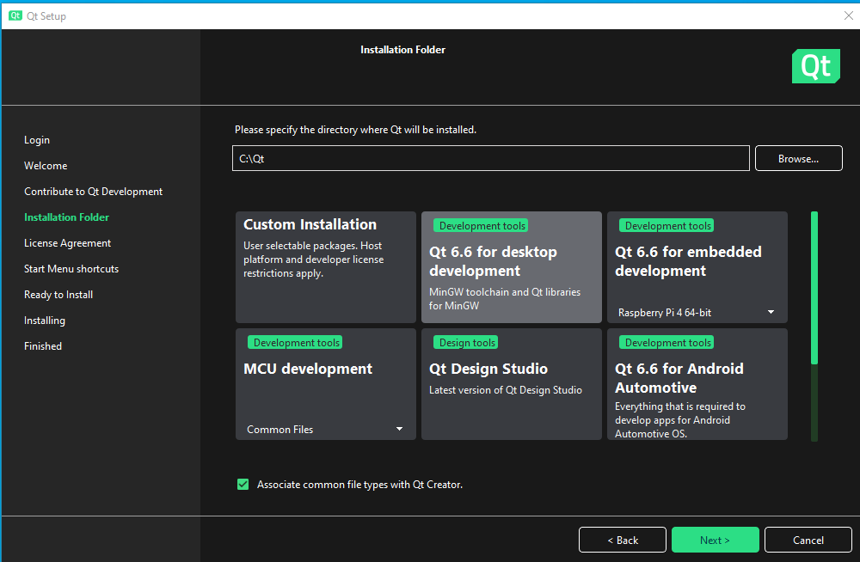
Install Qt 6
When installing, be sure to select the “Qt 6.6 for desktop development” option.

Slide 17
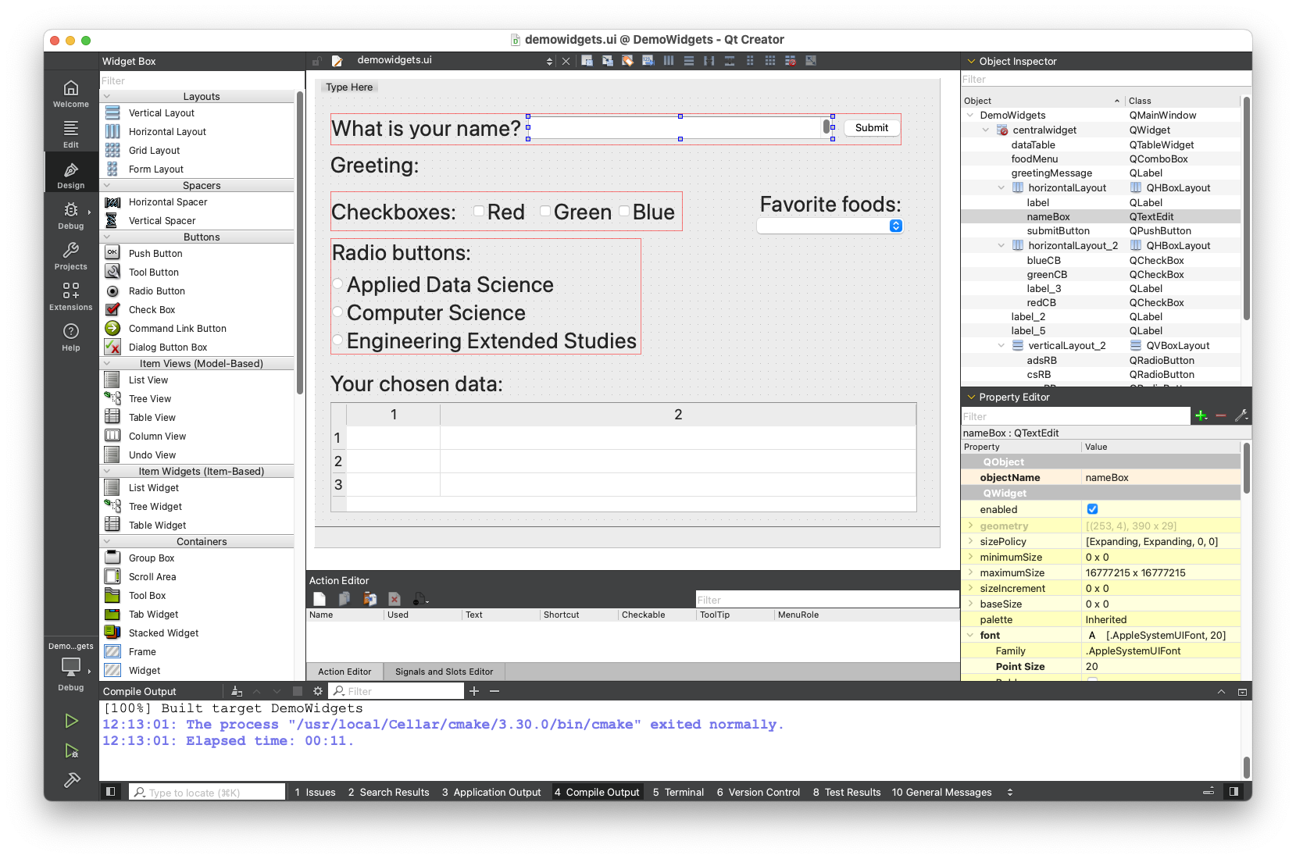
Qt Creator

Slide 18
Qt Creator Tutorial
Tutorial to build a Qt desktop app:
https://doc.qt.io/qtcreator/creator-writing-program.html
Demo widgets example app:
DemoWidgets.zip

Slide 19
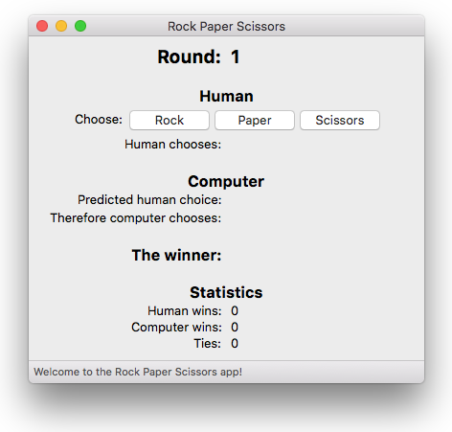
Goal: GUI Version of RPS

