Slide 1


CMPE 202
Software Systems Engineering
February 25 Class Meeting
Engineering Extended Studies
San Jose State University
Spring 2025
Instructor: Ron Mak
www.cs.sjsu.edu/~mak

Slide 2
Today
Recursion
Towers of Hanoi puzzle
Binary Search Tree
Break
Quicksort
The Fibonacci recursion disaster
Recursion with dynamic backtracking
The Eight Queens puzzle
Solving Sudoku puzzles

Slide 3
Recursion
Recursion is a powerful programming technique.
For appropriate types of problems, it can often produce simple and elegant solutions that are difficult to solve otherwise.
  Some would claim the solutions are “magical”.
  However, it is often misunderstood and avoided
  by less-experienced programmers.
Recursion requires a different way of thinking about how to design a programming solution to a problem.

Slide 4
Recursion, cont’d
The key idea behind recursion is that we solve a programming problem by dividing it into a smaller but similar problem that we can solve the same way.
  Solving the smaller problem leads to the solution
  of the larger problem.
Keep dividing a problem into smaller and smaller similar problems until the problem is so small that its solution is obvious and immediate.
  This smallest problem is called a base case of the recursion.

Slide 5
Recursion, cont’d
Having the solution to the base case enables us to solve the next smallest problem, which in turn enables us to solve the next-to-the-next smallest problem, etc.
Keep “unwinding” the recursion until the original problem is solved.

Slide 6
Recursion vs. Iteration
We can compare recursion to this for loop:
for (int i = INITIAL_VALUE; i < LIMIT_VALUE; i++) ...
 | for loop | Recursion
Initial condition | i = INITIAL_VALUE | The original problem.
Repeated updating | i++ | Repeatedly divide the problem into smaller but similar problems whose solutions will solve the original problem.
Terminating condition | i >= LIMIT_VALUE | The problem is so small that its solution is immediate and obvious (a base case).

Slide 7
Recursive Function
A C++ function is recursive if it calls itself.
  It calls itself to solve the smaller but similar problem.
  Calling itself is a recursive call.
Like any other call, a recursive call of a function has its separate values for its local variables.
To avoid infinite recursion, each call must approach the base case.
  At the base case, the function returns the obvious and immediate value without making another recursive call.

Slide 8
Examples of Recursive Functions
We’ll start with recursive functions that solve some simple programming problems.
These are examples to teach recursion.
  The programming problems they solve are actually much better solved with traditional iteration.
Later, we’ll look at problems that are much easier and more elegantly solved by recursion.

Slide 9
Largest Value
Find the largest value in a nonempty vector
of values.
  Recursive idea: Compare the first element of the vector to the largest value found in the rest of the vector, which is shorter
  Base case. A vector consisting of a single element:
  the immediate and obvious solution is that element.
  Simpler case. A shorter vector. Each recursive call must shorten the vector so that it approaches the base case.
We will solve this problem with recursive function largest() that is passed a vector.
  Shorten the vector by removing the first element, and then make a recursive call on the rest of the vector, which is shorter.

Slide 10
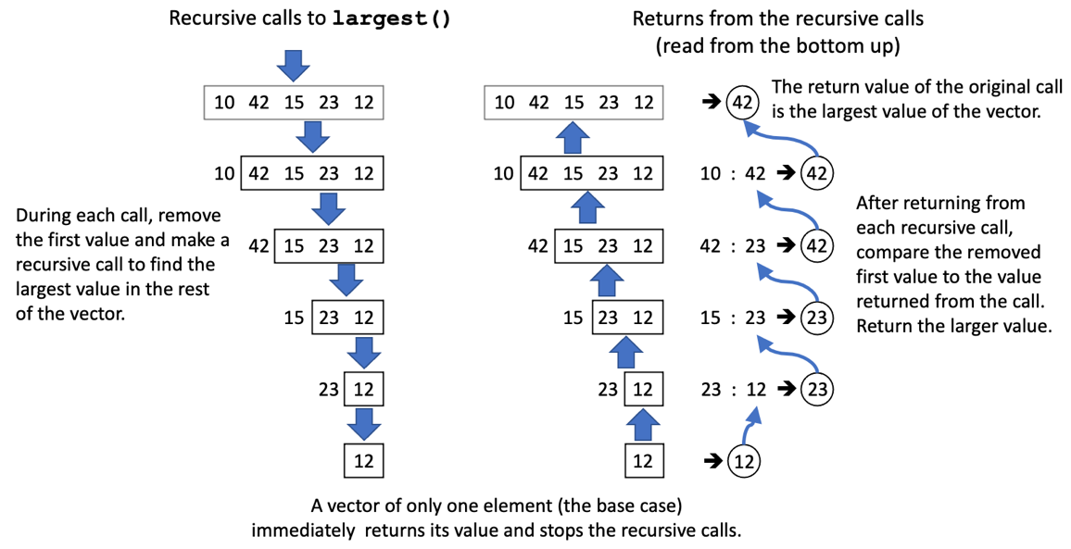
Largest Value, cont’d
Base case

Slide 11
Largest Value, cont’d
15.1/largest.cpp
int largest(vector<int> v)
{
// Base case.
if (v.size() == 1) return v[0];
// Remove and save first value.
int first_value = v[0];
v.erase(v.begin());
// Recursive call on the shorter vector:
// Return the largest value
// of the rest of the vector.
int largest_of_rest = largest(v);
// Return the larger of: (a) the saved value, or
// (b) the largest value of the rest of the vector.
return first_value > largest_of_rest ? first_value
: largest_of_rest;
}

Slide 12
Reverse Vector
Reverse the order of the elements of
a nonempty vector.
  Recursive idea: Remove the first element of the vector, recursively reverse the rest of the vector, which is shorter, and then append the first element at the end.
  Base case: The vector has only one element.
  Simpler case: A shorter vector. Each recursive call must shorten the vector so that it approaches the base case.

Slide 13
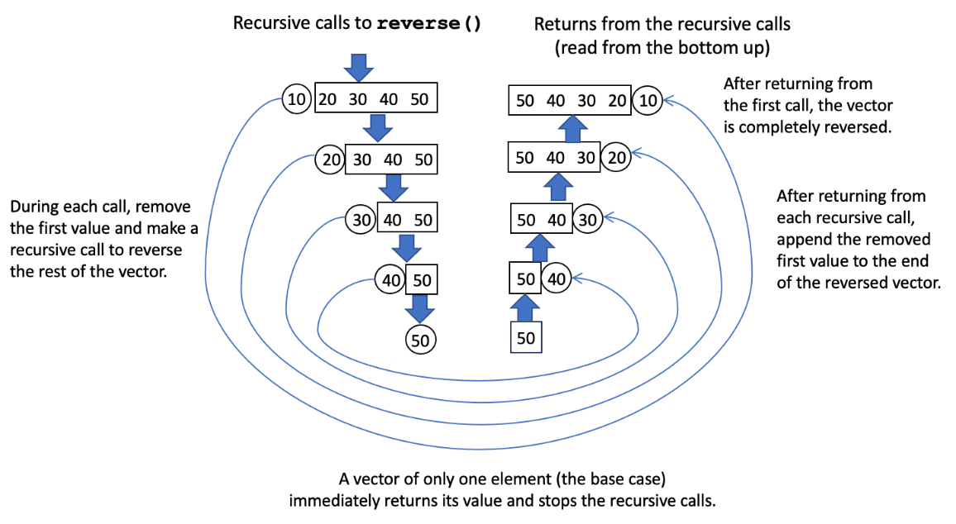
Reverse Vector, cont’d

Slide 14
Reverse Vector, cont’d
15.2/reverse.cpp
void reverse(vector<int>& v)
{
// Base case.
if (v.size() == 1) return;
// Remove and save first value.
int first_value = v[0];
v.erase(v.begin());
// Recursive call on the shorter vector:
// Reverse the rest of the vector.
reverse(v);
// Append the saved value to the end
// of the reversed vector.
v.push_back(first_value);
}

Slide 15
Member of
Is value x in a nonempty vector of integers?
  Recursive idea: Is x is equal to the head of the vector, OR is x a member of the rest of the vector?
  Base case: The vector has only one element:
  It is or isn’t x.
  Simpler case: Is x a member of the rest of the vector? The rest of the vector is one element shorter,
  and so it’s closer to the base case.
The vector: 30 10 50 80 60 12 40 20 70
50 is in the vector.
65 is not in the vector.
80 is in the vector.
47 is not in the vector.
MemberOf.cpp

Slide 16
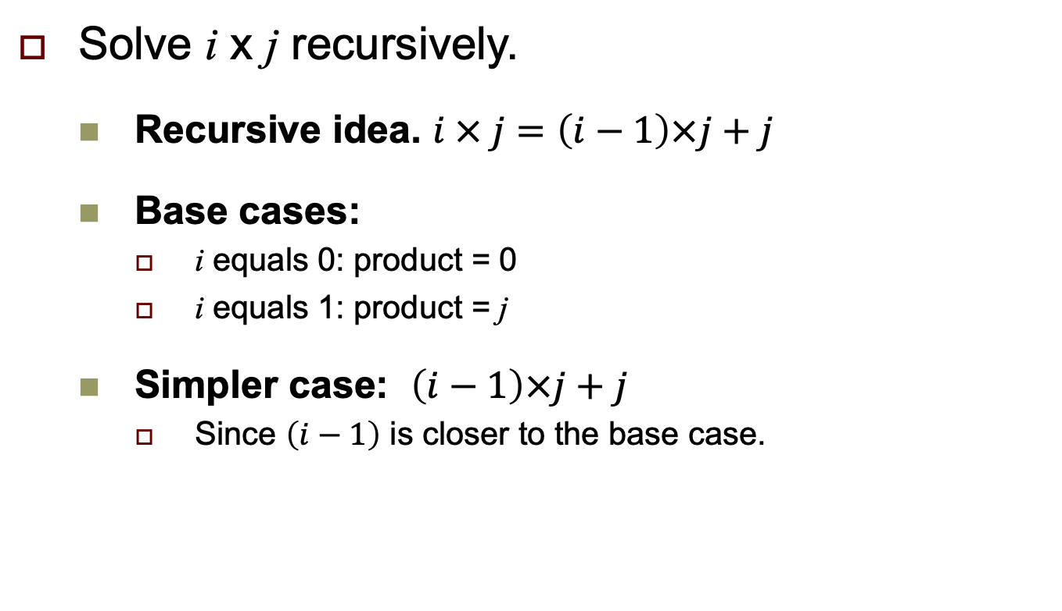
Exercise: Recursive Multiplication
Solve i x j recursively.
  Recursive idea. $i × j=\left(i−1\right)×j+j$
  Base cases:
    i equals 0: product = 0
    i equals 1: product = j
  Simpler case: $\left(i−1\right)×j+j$
    Since $\left(i−1\right)$ is closer to the base case.
Multiply.cpp

Slide 17
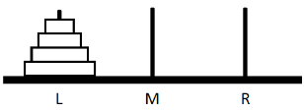
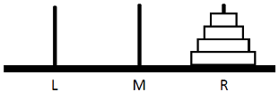
Towers of Hanoi
A puzzle consisting of a tower of disks stacked in size order on the source pin L:
The goal is to move all the disks
to the destination pin R:
Rules:
  Move only one disk at a time.
  Never put a larger disk on top of a smaller disk.
  Use the third pin (initially M) as a temporary location to move a disk.

Slide 18
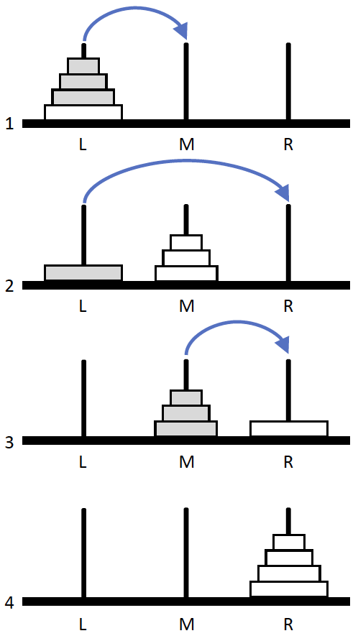
Towers of Hanoi, cont’d
Conceptual solution with 4 disks:
Recursively move the top 3 disks (fewer disks) from the source pin L to the temporary pin M.
Move the largest disk from the source pin L
to the destination pin R (base case of 1 disk).
Recursively move the 3 disks from the temporary pin L to the destination pin R.
Solved!

Slide 19
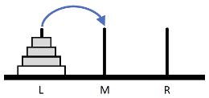
Towers of Hanoi, cont’d
  Move only one disk at a time.
  Never put a larger disk on top of a smaller disk.
  Use the third pin as a temporary location to move a disk.
But how can we move three disks (a simpler case than four disks) according to the rules?
We do it recursively!
  Three disks is a smaller number of disks that’s closer to the base case of one disk.

Slide 20
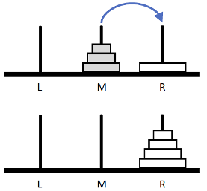
Towers of Hanoi, cont’d
To move 3 disks (such as from M to R):
  Recursively move 2 disks from the
  source pin M to the temporary pin L.
  Move 1 disk from the source pin M
  to the destination pin R.
  Recursively move 2 disks from the
  temporary pin L to the destination
  pin R.
Use recursive calls to move two disks.
  The pins L, M, and R each changes roles being the source, temporary, or destination pin during the calls.

Slide 21
Towers of Hanoi, cont’d
15.3/towers.cpp
void solve(const int n,
const char source,
const char temporary,
const char destination)
{
if (n == 1)
{
// Base case: Move a single disk.
cout << "Move " << source << " ==> " << destination << endl;
}
else
{
// Solve for 1 fewer disk: n - 1
solve(n - 1, source, destination, temporary);
solve(1, source, temporary, destination);
solve(n - 1, temporary, source, destination);
}
}
The Towers of Hanoi puzzle is very difficult to solve without recursion!

Slide 22
Print a Binary Search Tree
A binary search tree (BST) is a binary tree with the additional restrictions that, at any particular node X:
  All the nodes in the left subtree of node X have values less than or equal to the value at node X.
  All the nodes in the right subtree of node X have values greater than the value at node X.
We can write a recursive function that prints the nodes of the binary tree in order.
  Recursively print the left subtree.
  Recursively print the right subtree.

Slide 23
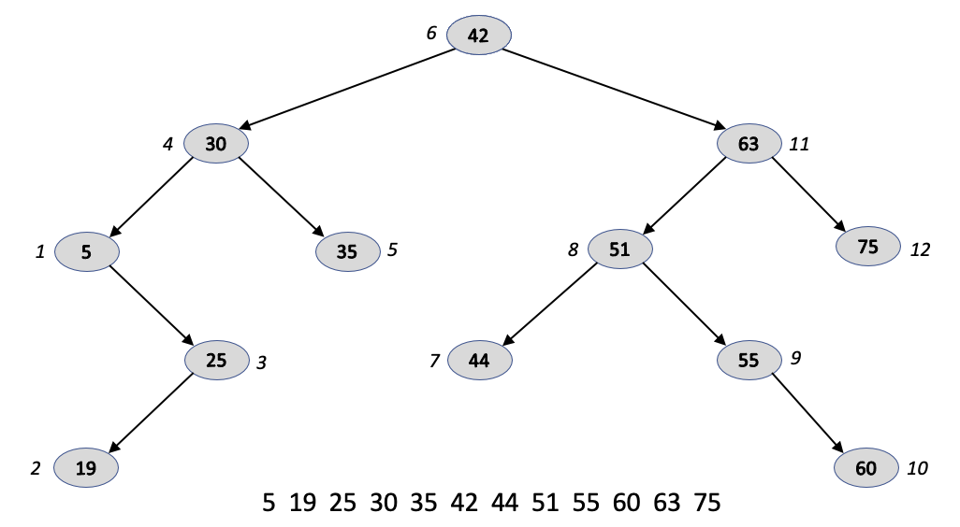
Binary Search Tree, cont’d
Base case:
A leaf node (the smallest possible subtree with only one node).
Therefore, no recursive calls on a leaf node.
Pass a tree node to the function.
Recursively call the function print() on the node’s left subtree
if it’s nonempty (a smaller tree).
Print the value of the node.
Recursively call the function print() on the node’s right subtree
if it’s nonempty (a smaller tree).

Slide 24
Binary Search Tree, cont’d
void BST::print(const Node * const link) const
{
if (link != nullptr)
{
print(link->left);
cout << setw(3) << link->value;
print(link->right);
}
}
15.4/BST.cpp

Slide 25
Binary Search Tree, cont’d
Also a recursive function to insert a value into a BST (and keep it as a BST):
And to recursively remove all its elements:
15.4/BST.cpp
void BST::insert(const int value, Node*& link)
{
if (link == nullptr) link = new Node(value);
else if (value <= link->value) insert(value, link->left);
else insert(value, link->right);
}
void BST::remove(const Node * const link) const
{
if (link != nullptr)
{
remove(link->left);
remove(link->right);
delete link;
}
}
15.4/BST.cpp

Slide 26
Break

Slide 27
Quicksort
Quicksort is an extremely efficient recursive sorting algorithm.
  Invented in 1961, it is reputed to be the
  “most elegant” algorithm in computer science.
A “divide and conquer” type algorithm that relies on two operations to sort an array:
  For each subarray (initially the entire array), select a pivot element and use it to partition the subarray into two smaller subarrays.
  Recursively apply the algorithm to the two smaller subarrays.

Slide 28
Example Partitioning Operation
Choose the middle element of the subarray as the pivot element:
Partition the subarray into two smaller subarrays by moving all the values less than or equal to the pivot to the left and all the values greater than the pivot to the right.
Partitioning places the pivot element in its correct position when the entire subarray is eventually sorted:
  Therefore, after each partitioning operation, at least one element (the pivot element) is sorted to its correct position.
6 15
16
21 26 32 34 51 61 61 76

Slide 29
How to Partition a Subarray
Choose one element of the array to be the pivot element. In our examples, we’ll choose the element at or near the middle (line A). .
Park the pivot element out of the way be swapping it with the rightmost element of the array (line B). Set variable i to the element index of the leftmost element and variable j to be the index of the element just to the left of the parked pivot element.
Move i to the right (i.e., increment i) while the value of the ith element is less than or equal to the pivot value. It is passing over values that are already on the correct side of the pivot. element. i might not move at all.
Move j to the left (i.e., decrement j) while the value of the jth element is greater than the pivot value (line C). It is passing over values that are already on the correct side of the pivot. j might not move at all.
After i and j have both stopped moving, if i < j, swap the ith and jth element values (line D).
Repeat steps 3, 4, and 5 (lines E through I) until j crosses i. Swap back in the value of the ith element with the pivot element that we had parked earlier at the right. The array is now partitioned into two subarrays on both sides of the pivot element.

Slide 30
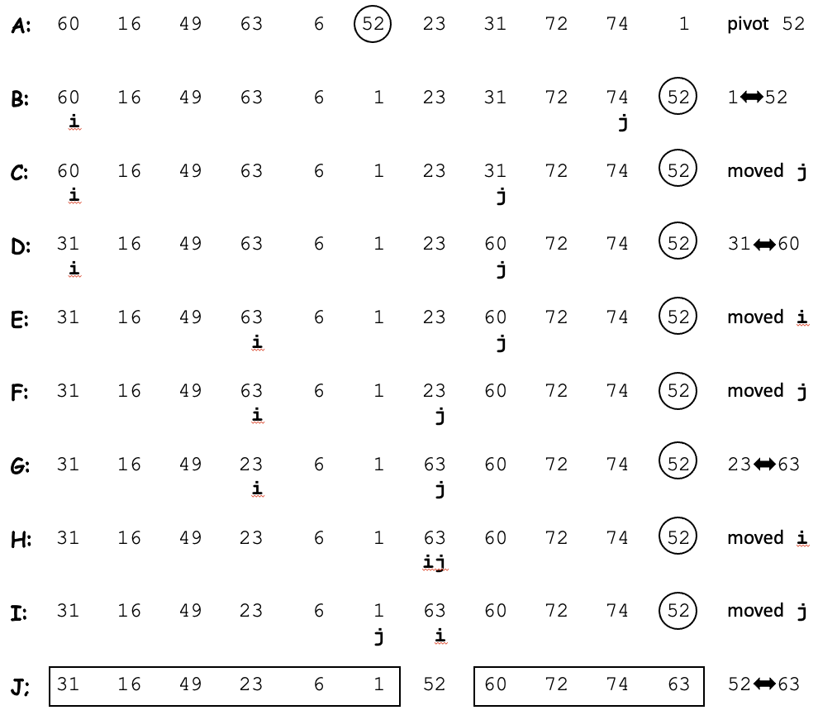
How to Partition a Subarray, cont’d
Goal: Move values <= the pivot value 52 to the left and values > the pivot value to the right.
Success: The array is partitioned into two subarrays on either side of the pivot.

Slide 31
Quicksort, cont’d
int Quicksort::partition(const int left_index, const int right_index)
{
int middle_index = (left_index + right_index)/2;
int pivot_value = data[middle_index];
swap_values_at(middle_index, right_index);
int i = left_index - 1;
int j = right_index;
while (i < j)
{
do
{
i++;
} while ((i < right_index) && (data[i] < pivot_value));
do
{
j--;
} while ((j >= left_index) && (data[j] > pivot_value));
if (i < j) swap_values_at(i, j);
}
swap_values_at(i, right_index);
return i;
}
Partition the array delimited by left_index and right_index.
Choose the pivot element.
Park the pivot element.
Loop until j crosses i.
Move i to the right.
Move j to the left.
Swap elements.
Swap the pivot element back in.
Return the pivot index.
15.5/Quicksort.cpp

Slide 32
Quicksort, cont’d
15.5/Quicksort.h
class Quicksort
{
public:
Quicksort(int * const d, const int s) : data(d), size(s) {};
void sort() { sort(0, size-1); } // start with the entire array
bool verify_sorted();
private:
int *data;
int size;
void sort(const int left_index, const int right_index);
int partition(const int left_index, const int right_index);
void swap_values_at(const int index1, const int index2);
friend ostream& operator <<(ostream& ostr, const Quicksort& q);
};

Slide 33
Quicksort, cont’d
Sorting a subarray:
  Partition the subarray into two smaller subarrays.
  Recursively sort each subarray.
The base cases:
  A subarray of size 0 or 1: Do nothing.
  No recursive call.
  A subarray of size 2: Swap the two elements if
  necessary. No recursive call.

Slide 34
Quicksort, cont’d
void Quicksort::sort(const int left_index, const int right_index)
{
int subarray_size = right_index - left_index + 1;
if (subarray_size < 2) return;
if (subarray_size == 2)
{
if (data[left_index] > data[right_index])
{
swap_values_at(left_index, right_index);
}
}
else
{
int pivot_index = partition(left_index, right_index);
sort(left_index, pivot_index - 1);
sort(pivot_index + 1, right_index);
}
}
Base case: size 0 or 1
Base case: size 2
Recursively sort the left subarray.
Recursively sort the right subarray.
15.5/Quicksort.cpp

Slide 35
Exercise: Compare Quicksort with Insertion Sort
Sort similar arrays of 100,000 random values.
Exercise-Sorting

Slide 36
Fibonacci
The well-known Fibonacci sequence starts with 0 and 1, and each subsequent value is the sum of the two previous values:
Can we use a recursive algorithm to generate this sequence?
0, 1, 1, 2, 3, 5, 8, 13, 21, 34, 55, 89, 144, ....

Slide 37
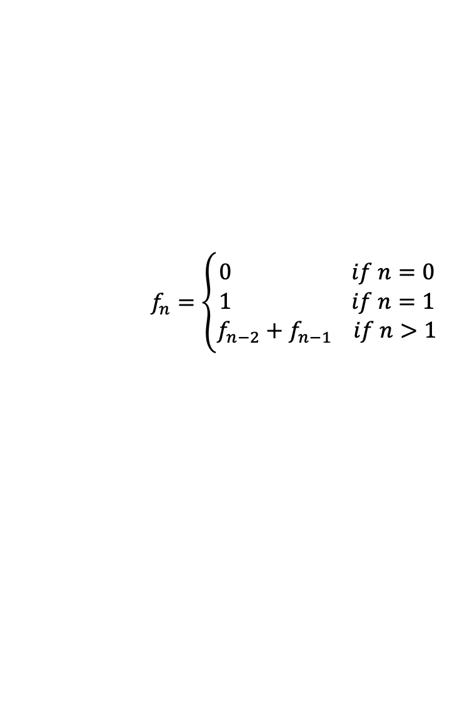
Fibonacci, cont’d
We may be tempted to program the Fibonacci sequence from its recursive mathematical definition:
15.6/fibonacci.cpp
long f(const int n)
{
if (n == 0) return 0;
else if (n == 1) return 1;
else return f(n-2) + f(n-1);
}
$$f_{n}=\left\{\begin{aligned}0 if n=0 \\ &1 if n=1 \\ f_{n−2}+f_{n−1} if n>1\end{aligned}\right.$$

Slide 38
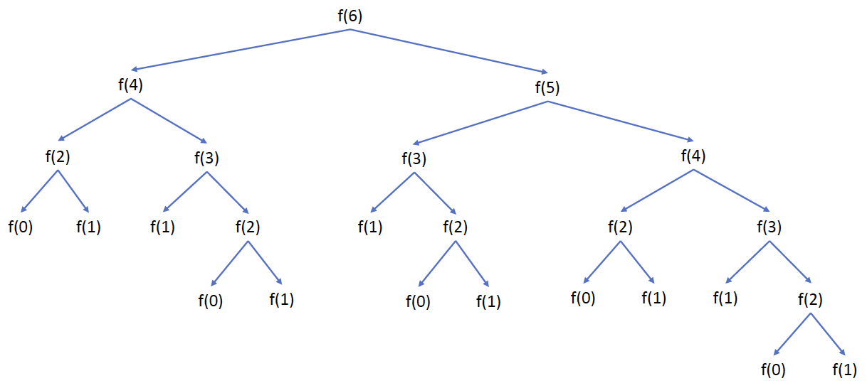
Fibonacci, cont’d
Recursive Fibonacci bogs down!
  It’s best programmed iteratively.
Recursion is a powerful tool,
but use it appropriately.
  Improper use of recursion can
  cause very bad performance.

Slide 39
Dynamic Backtracking + Recursion
Dynamic backtracking is the ability of a running program to try different solution paths and back out of a path after checking it for a solution.
Combine with recursion to look for solutions.
Classic example problem: the Eight Queens
  Place eight chess queens on
  a chessboard so that no queen
  can attack another.
  Including reflections and rotations,
  there are 92 solutions.
Q . . . . . . .
. . . . . . Q .
. . . . Q . . .
. . . . . . . Q
. Q . . . . . .
. . . Q . . . .
. . . . . Q . .
. . Q . . . . .

Slide 40
Eight Queens
Solve a column at a time, left to right.
Search each safe square of the current column.
  A safe square for a queen is one where she won’t be attacked by existing queens in columns to the left.
  Recursively search for solutions in columns to the right.
After searching for solutions from a safe square, backtrack and try the next safe square of the current column.
  After searching from all the squares of a column,
  return to the previous column and do a backtrack there.

Slide 41
Eight Queens, cont’d
Function is_safe_square() is passed the row and column indexes for a queen’s square and checks whether she can be attacked from columns to the left.
If a safe square is found, recursive function find_solutions() checks the columns to the right to search for solutions. Then backtrack to check the next safe square.
  Base case. At the rightmost column.
  Simpler case. One fewer column to check.
15.7/Queens.cpp

Slide 42
Sudoku
We can use the same recursion + backtracking technique to solve a Sudoku puzzle.
  It will be a brute-force solution.
At each cell, successively try the numbers 1 through 9.
  Starting at the upper left corner, go row by row down to the lower right corner.
For each number number in a cell, recursively check ahead if that number will yield a solution. If not, backtrack to the next number. Backtrack to the previous cell after trying all nine numbers.
  Base case. At the last cell (lower right corner)
  Simpler case: One fewer cell to check.
15.8/Sudoku.cpp

Slide 43
Midterm Next Week
First half of the class (75 minutes).
Closed book in Canvas.
Use the lockdown browser.
Covers everything through today’s lecture.
  multiple choices
  short answers
  short programming problems

