Slide 1


CMPE 180A
Data Structures and Algorithms in C++
December 1 Class Meeting
Department of Computer Engineering
San Jose State University
Fall 2020
Instructor: Ron Mak
www.cs.sjsu.edu/~mak

Slide 2
Some Multithreading Results
Compute one million digits of π
  Single-threaded:
  Multithreaded:
  Over 19% improvement in speed.
Elapsed time: 4,867,026,136 nsecs = 4.86703 seconds
Elapsed time: 3,921,408,994 nsecs = 3.92141 seconds

Slide 3
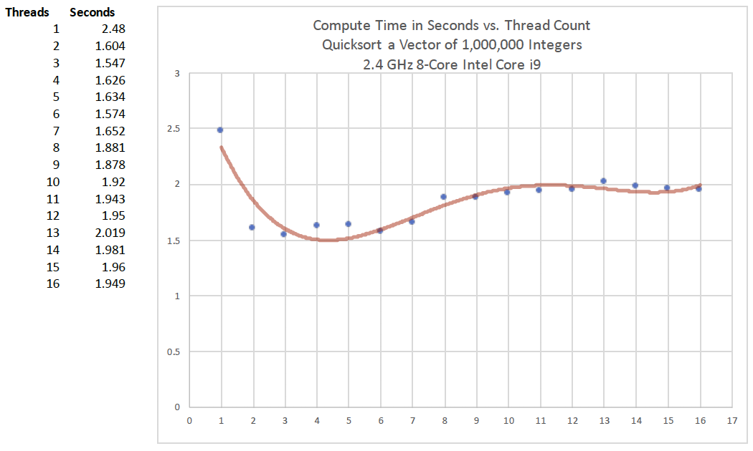
Some Multithreading Results, cont’d
Quicksort 1,000,000 elements:

Slide 4
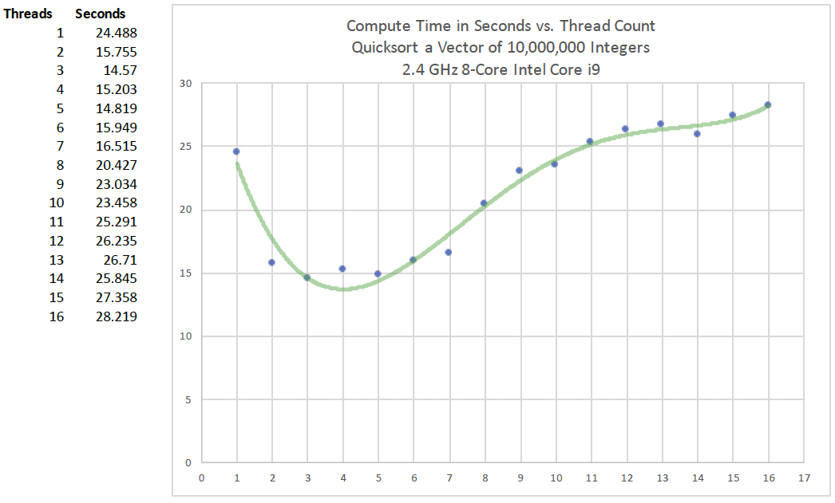
Some Multithreading Results, cont’d
Quicksort 10,000,000 elements:

Slide 5
Problems with a Standard (“Raw”) Pointer
A raw pointer’s declaration doesn’t indicate whether:
  It “owns” the object that points to
  (should you delete the object?)
  It points to a single object or to an array
  (should you call delete or delete[]?)
  Should you call a dedicated destructor function?
Will you delete the object exactly once?
  Memory leak if you never delete the object.
  Segmentation fault if you delete the object
  more than once.

Slide 6
Raw Pointers vs. Smart Pointers
Raw pointers are powerful but dangerous.
  Use a smart pointer instead.
Unique pointer
  Has exclusive ownership of the object it points to.
  The ownership can be transferred.
  The object is automatically deleted
  when the pointer goes out of scope.
Shared pointer
  Multiple pointers can point to the same object.
  The object is deleted only once.

Slide 7
Unique Pointer
Exclusive ownership of the object.
  An object can have at most one unique pointer
  at a time pointing to it.
Ownership can be transferred
to another unique pointer.
  The source pointer is automatically set to null.
When the owning pointer is set to point to another object or to null, or goes out of scope, the object it points to is automatically deleted.

Slide 8
Unique Pointer Example
We’ll use our old Birthday class.
  The default constructor, constructor, and destructor each writes a message when it’s called.
TestUnique.cpp
int main()
{
cout << "raw_ptr ..." << endl;
Birthday *raw_ptr = new Birthday();
cout << "*raw_ptr = " << *raw_ptr << endl;
cout << endl << "uniq_ptr1 and uniq_ptr2 ..." << endl;
unique_ptr<Birthday> uniq_ptr1(new Birthday(2001, 1, 1));
unique_ptr<Birthday> uniq_ptr2(nullptr);
cout << "*uniq_ptr1 = " << *uniq_ptr1 << endl;
...
Initialize a unique pointer
by passing a raw pointer
to its constructor.
raw_ptr ...
*** Default constructor called for 0/0/0
*raw_ptr = 0/0/0
uniq_ptr1 and uniq_ptr2 ...
*** Constructor called for 1/1/2001
*uniq_ptr1 = 1/1/2001

Slide 9
Unique Pointer Example, cont’d
“Move” the object from one pointer to another.
  Can’t copy, because of exclusive ownership.
  The source pointer is automatically set to nullptr.
cout << endl << "uniq_ptr2 = move(uniq_ptr1) ..." << endl;
uniq_ptr2 = move(uniq_ptr1);
if (uniq_ptr1 == nullptr) cout << "uniq_ptr1 is null" << endl;
else cout << "*uniq_ptr1 = " << *uniq_ptr1 << endl;
cout << "*uniq_ptr2 = " << *uniq_ptr2 << endl;
uniq_ptr2 = move(uniq_ptr1) ...
uniq_ptr1 is null
*uniq_ptr2 = 1/1/2001

Slide 10
Unique Pointer Example, cont’d
You can associate a custom destructor
with a unique pointer.
  In this example, we use a lambda expression.
  Also note the use of decltype.
function<void (Birthday *bptr)> delete_birthday = [] (Birthday *ptr)
{
cout << "Deleting " << *ptr << endl;
delete ptr;
};
cout << endl << "uniq_ptr3 ..." << endl;
unique_ptr<Birthday, decltype(delete_birthday)>
uniq_ptr3(new Birthday(2003, 3, 3), delete_birthday);
cout << "*uniq_ptr3 = " << *uniq_ptr3 << endl;
uniq_ptr3 ...
*** Constructor called for 3/3/2003
*uniq_ptr3 = 3/3/2003

Slide 11
Unique Pointer Example, cont’d
Use the reset member function to
change the value of a unique pointer.
cout << endl << "uniq_ptr4 ..." << endl;
unique_ptr<Birthday> uniq_ptr4(nullptr);
uniq_ptr4.reset(new Birthday(2004, 4, 4));
cout << "*uniq_ptr4 = " << *uniq_ptr4 << endl;
cout << endl << "uniq_ptr4.reset ..." << endl;
uniq_ptr4.reset(new Birthday(2005, 5, 5));
cout << "*uniq_ptr4 = " << *uniq_ptr4 << endl;
uniq_ptr4 ...
*** Constructor called for 4/4/2004
*uniq_ptr4 = 4/4/2004
uniq_ptr4.reset ...
*** Constructor called for 5/5/2005
*** Destructor called for 4/4/2004
*uniq_ptr4 = 5/5/2005

Slide 12
Unique Pointer Example, cont’d
When a unique smart pointer goes
out of scope, the object it points to is automatically removed from memory.
cout << endl << "Program termination ..." << endl;
return 0;
}
Program termination ...
*** Destructor called for 5/5/2005
Deleting 3/3/2003
*** Destructor called for 3/3/2003
*** Destructor called for 1/1/2001
?
Memory leak!
Birthday *raw_ptr = new Birthday();

Slide 13
Shared Pointer
Multiple shared smart pointers can point
at the same time to a single object.
  Shared-ownership resource management.
When the last pointer no longer points to the object, the object is automatically deleted.
  It is deleted only once.
Uses reference counts.
  Increment the count each time an object is pointed to.
  Decrement the count when it loses the pointer.
  Automatic deletion when the count becomes 0.

Slide 14
Shared Pointer Example
int main()
{
cout << endl << "shar_ptr1 and shar_ptr2 ..." << endl;
shared_ptr<Birthday> shar_ptr1(new Birthday(2001, 1, 1));
shared_ptr<Birthday> shar_ptr2(shar_ptr1);
cout << "*shar_ptr1 = " << *shar_ptr1 << endl;
cout << "*shar_ptr2 = " << *shar_ptr2 << endl;
{
cout << endl << "Entering new scope!" << endl;
shared_ptr<Birthday> shar_ptr3(shar_ptr2);
shared_ptr<Birthday> shar_ptr4(shar_ptr3);
cout << "*shar_ptr1 = " << *shar_ptr1 << endl;
cout << "*shar_ptr2 = " << *shar_ptr2 << endl;
cout << "*shar_ptr3 = " << *shar_ptr3 << endl;
cout << "*shar_ptr4 = " << *shar_ptr4 << endl;
cout << "Exiting scope!" << endl << endl;
}
cout << "*shar_ptr2 = " << *shar_ptr2 << endl;
cout << endl << "Program termination ..." << endl;
return 0;
}
TestShared.cpp
Nested
scope

Slide 15
Shared Pointer Example, cont’d
int main()
{
cout << "shar_ptr1 and shar_ptr2 ..." << endl;
shared_ptr<Birthday> shar_ptr1(new Birthday(2001, 1, 1));
shared_ptr<Birthday> shar_ptr2(shar_ptr1);
cout << "*shar_ptr1 = " << *shar_ptr1 << endl;
cout << "*shar_ptr2 = " << *shar_ptr2 << endl;
shar_ptr1 and shar_ptr2 ...
*** Constructor called for 1/1/2001
*shar_ptr1 = 1/1/2001
*shar_ptr2 = 1/1/2001

Slide 16
Shared Pointer Example, cont’d
{
cout << endl << "Entering new scope!" << endl;
shared_ptr<Birthday> shar_ptr3(shar_ptr2);
shared_ptr<Birthday> shar_ptr4(shar_ptr3);
cout << "*shar_ptr1 = " << *shar_ptr1 << endl;
cout << "*shar_ptr2 = " << *shar_ptr2 << endl;
cout << "*shar_ptr3 = " << *shar_ptr3 << endl;
cout << "*shar_ptr4 = " << *shar_ptr4 << endl;
cout << "Exiting scope!" << endl << endl;
}
Entering new scope!
*shar_ptr1 = 1/1/2001
*shar_ptr2 = 1/1/2001
*shar_ptr3 = 1/1/2001
*shar_ptr4 = 1/1/2001
Exiting scope!
Nothing special happens when we exit the scope.
  shar_ptr3 and shar_ptr4 go out of scope.

Slide 17
Shared Pointer Example, cont’d
cout << "*shar_ptr1 = " << *shar_ptr1 << endl;
cout << "*shar_ptr2 = " << *shar_ptr2 << endl;
cout << endl << "shar_ptr1.reset ..." << endl;
shar_ptr1.reset(new Birthday(2011, 11, 11));
cout << "*shar_ptr1 = " << *shar_ptr1 << endl;
cout << endl << "shar_ptr2.reset ..." << endl;
shar_ptr2.reset(new Birthday(2012, 12, 12));
cout << "*shar_ptr2 = " << *shar_ptr2 << endl;
*shar_ptr1 = 1/1/2001
*shar_ptr2 = 1/1/2001
shar_ptr1.reset ...
*** Constructor called for 11/11/2011
*shar_ptr1 = 11/11/2011
shar_ptr2.reset ...
*** Constructor called for 12/12/2012
*** Destructor called for 1/1/2001
*shar_ptr2 = 12/12/2012

Slide 18
Shared Pointer Example, cont’d
cout << endl << "Program termination ..." << endl;
return 0;
}
Program termination ...
*** Destructor called for 12/12/2012
*** Destructor called for 11/11/2011
The destructor is automatically called once
the last pointer to the object goes out of scope.

Slide 19
Circular References
If you have circular references, the reference counts of the objects will never go to zero even if the objects are no longer accessible:
This problem is solved with weak pointers.
  A weak_ptr to an object doesn’t affect the object’s reference count.

Slide 20
Shared Pointer Implementation
Effective Modern C++
by Scott Meyers
O’Reilly, 2015
ISBN 978-1-491-90399-5

Slide 21
Break

Slide 22
Graphs
A graph is one of the most versatile data structures in computer science.

Slide 23
Uses of Graphs
Model connectivity in computer
and communications networks.
Represent a map of locations
and distances between them.
Model flow capacities in transportation networks.
Find a path from a starting condition to a goal condition.
Model state transitions in computer algorithms.
Model an order for finishing subtasks
in a complex activity.
Model relationships such as family trees, business and military organizations, and scientific taxonomies.

Slide 24
Graph Terms
A graph G = (V, E) is a set of vertices V
and a set of edges (arcs) E.
An edge is a pair (v, w), where v and w are in V.
If the pair is ordered, the graph is directed
and is called a digraph.

Slide 25
Graph Terms, cont’d
Vertex w is adjacent to vertex v
if and only if (v, w) is in E.
In an undirected graph,
both (v, w) and (w, v) are in E.
  v is adjacent to w, and w is adjacent to v.
An edge can have a weight or cost component.

Slide 26
Graph Examples
FIGURE 12-3 Various undirected graphs
FIGURE 12-4 Various directed graphs
Data Structures Using C++
by D.S. Malik
Course Technology, 2010

Slide 27
Graph Terms, cont’d
A path is a sequence of vertices w₁, w₂, w₃, ..., w_{N} where (w_{i}, w_{i+1}) is in E, for 1 ≤ i < N.
The length of the path is
the number of edges on the path.
A simple path has all distinct vertices,
except that the first and last can be the same.
adjacent

Slide 28
Graph Terms, cont’d
A cycle in a directed graph is a
path of length ≥ 1 where w₁ = w_{N}.
A directed graph with no cycles is acyclic.
A DAG is a directed acyclic graph.
Data Structures and Algorithm
Analysis in C++, 4th ed.
by Mark Allen Weiss
Pearson Education, Inc., 2014

Slide 29
Graph Terms, cont’d
The indegree of a vertex v is the number of incoming edges (u, v).

Slide 30
Graph Representation
Represent a directed graph with an
adjacency list.
  For each vertex, keep a list
  of all adjacent vertices.
Data Structures and Algorithm
Analysis in C++, 4th ed.
by Mark Allen Weiss
Pearson Education, Inc., 2014

Slide 31
Topological Sort
We can use a graph to represent the
prerequisites in a
course of study.
  A directed edge
  from Course A to
  Course B means
  that Course A
  is a prerequisite
  for Course B.
Data Structures and Algorithm
Analysis in C++, 4th ed.
by Mark Allen Weiss
Pearson Education, Inc., 2014

Slide 32
Topological Sort, cont’d
A topological sort
of a directed graph
is an ordering of the
vertices such that
if there is a path
from v_{i} to v_{j}, then
v_{i} comes before v_{j}
in the ordering.
  The order is not
  necessarily unique.
Data Structures and Algorithm
Analysis in C++, 4th ed.
by Mark Allen Weiss
Pearson Education, Inc., 2014

Slide 33
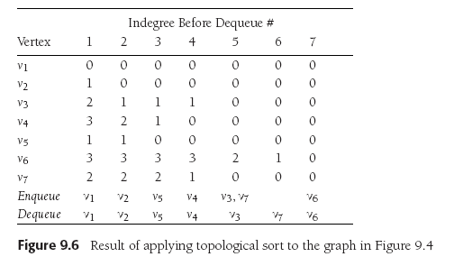
Topological Sort Using a Queue
Start with vertex v₁.
On each pass:
  Enqueue the vertices with indegree = 0.
  Dequeue a vertex and subtract 1 from the indegree
  of the adjacent vertices.
The topological sort is the order
in which the vertices dequeue.
Data Structures and Algorithm
Analysis in C++, 4th ed.
by Mark Allen Weiss
Pearson Education, Inc., 2014

Slide 34
Topological Sort Using a Queue, cont’d
Pseudocode
to perform a
topological sort.
  O(|E| + |V |) time
Data Structures and Algorithm
Analysis in C++, 4th ed.
by Mark Allen Weiss
Pearson Education, Inc., 2014

Slide 35
Shortest Path Algorithms
Assume there is a cost associated with each edge.
  The cost of a path is the sum of the cost
  of each edge on the path.
Find the least-cost path from a “distinguished” vertex s to every other vertex in the graph.
Data Structures and Algorithm
Analysis in C++, 4th ed.
by Mark Allen Weiss
Pearson Education, Inc., 2014

Slide 36
Shortest Path Algorithms, cont’d
A negative cost results in a negative-cost cycle.
  Make a path’s cost arbitrarily small by looping.
Data Structures and Algorithm
Analysis in C++, 4th ed.
by Mark Allen Weiss
Pearson Education, Inc., 2014

Slide 37
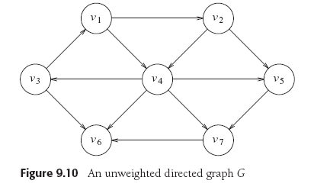
Unweighted Shortest Path
Minimize the lengths of paths.
  Assign a weight of 1 to each edge.
  In this example, let the distinguished vertex s be v₃.
Data Structures and Algorithm
Analysis in C++, 4th ed.
by Mark Allen Weiss
Pearson Education, Inc., 2014

Slide 38
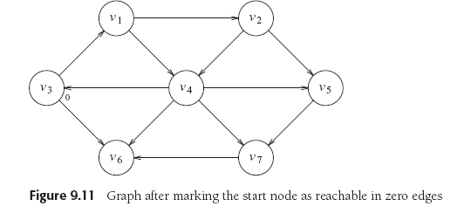
Unweighted Shortest Path, cont’d
The path from s to itself has length (cost) 0.
Data Structures and Algorithm
Analysis in C++, 4th ed.
by Mark Allen Weiss
Pearson Education, Inc., 2014

Slide 39
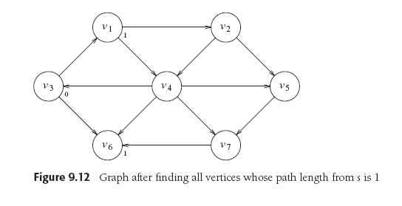
Unweighted Shortest Path, cont’d
Find vertices v₁ and v₆ that are distance 1 from v₃:
Data Structures and Algorithm
Analysis in C++, 4th ed.
by Mark Allen Weiss
Pearson Education, Inc., 2014

Slide 40
Unweighted Shortest Path, cont’d
Find all vertices that are distance 2 from v₃.
  Begin with the vertices adjacent to v₁ and v₆.
Data Structures and Algorithm
Analysis in C++, 4th ed.
by Mark Allen Weiss
Pearson Education, Inc., 2014

Slide 41
Unweighted Shortest Path, cont’d
Find all vertices that are distance 3 from v₃.
  Begin with the vertices adjacent to v₂ and v₄.
  Now we have the shortest paths from v₃ to every other vertex.
Data Structures and Algorithm
Analysis in C++, 4th ed.
by Mark Allen Weiss
Pearson Education, Inc., 2014

Slide 42
Unweighted Shortest Path, cont’d
Keep the tentative distance from vertex v₃
to another vertex in the d_{v} column.
Keep track of the path in the p_{v} column.
A vertex becomes “known”
after it has been processed.
  Don’t reprocess a known vertex.
  No cheaper path can be found.
Set all d_{v} = ∞.
Enqueue the distinquished vertex s
and set d_{s} = 0.
During each iteration, dequeue a vertex v.
  Mark v as known.
  For each vertex w adjacent to v whose d_{w} = ∞
    Set its distance d_{w} to d_{v} + 1
    Set its path p_{w} to v.
    Enqueue w.
Data Structures and Algorithm
Analysis in C++, 4th ed.
by Mark Allen Weiss
Pearson Education, Inc., 2014

Slide 43
Unweighted Shortest Path, cont’d
Data Structures and Algorithm
Analysis in C++, 4th ed.
by Mark Allen Weiss
Pearson Education, Inc., 2014

Slide 44
Unweighted Shortest Path, cont’d
Data Structures and Algorithm
Analysis in C++, 4th ed.
by Mark Allen Weiss
Pearson Education, Inc., 2014

Slide 45
Weighted Least Cost Path
Dijkstra’s Algorithm
  Example of a greedy algorithm.
Greedy algorithm
  At each stage, do what appears
  to be the best at that stage.
  A greedy algorithm may not always work.
Keep the same information for each vertex:
  Either known or unknown
  Tentative distance d_{v}
  Path information p_{v}

Slide 46
Dijkstra’s Algorithm
At each stage:
  Select an unknown vertex v that has the smallest d_{v}.
  Declare that the shortest path from s to v is known.
  For each vertex w adjacent to v:
    Set its distance d_{w} to the d_{v} + cost_{v,w}
    Set its path p_{w} to v.
Data Structures and Algorithm
Analysis in C++, 4th ed.
by Mark Allen Weiss
Pearson Education, Inc., 2014

Slide 47
Dijkstra’s Algorithm, cont’d
Start with s = v₁
Data Structures and Algorithm
Analysis in C++, 4th ed.
by Mark Allen Weiss
Pearson Education, Inc., 2014

Slide 48
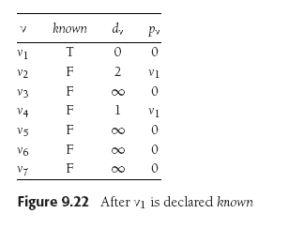
Dijkstra’s Algorithm, cont’d
Set v₁ to known.
v₂ and v₄ are unknown and adjacent to v₁:
  Set d₂ and d₄ to their costs + cost of v₁
  Set p₂ and p₄ to v₁.
Data Structures and Algorithm
Analysis in C++, 4th ed.
by Mark Allen Weiss
Pearson Education, Inc., 2014

Slide 49
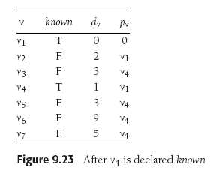
Dijkstra’s Algorithm, cont’d
d₄ was the smallest unknown. Set v₄ to known.
v₃, v₅, v₆, and v₇ are unknown and adjacent to v₄:
  Set their d_{w} to their costs + cost of v₄
  Set their p_{w} to v₄.
Data Structures and Algorithm
Analysis in C++, 4th ed.
by Mark Allen Weiss
Pearson Education, Inc., 2014

Slide 50
Dijkstra’s Algorithm, cont’d
d₂ was the smallest unknown. Set v₂ to known.
v₅ is unknown and adjacent:
  d₅ is already 3 which is less than
  2+10=12, so do not change v₅
Data Structures and Algorithm
Analysis in C++, 4th ed.
by Mark Allen Weiss
Pearson Education, Inc., 2014

Slide 51
Dijkstra’s Algorithm, cont’d
Set v₅ to known. v₇ is unknown and adjacent.
  Do not adjust since 5 < 3+6.
Set v₃ to known. v₆ is unknown and adjacent.
  Change d₆ to 3+5=8 which is less than
  its previous value of 9.
  Change p₆ to v₃.
Data Structures and Algorithm
Analysis in C++, 4th ed.
by Mark Allen Weiss
Pearson Education, Inc., 2014

Slide 52
Dijkstra’s Algorithm, cont’d
Set v₇ to known. v₆ is unknown and adjacent.
  Change d₆ to 5+1=6 which is less than
  its previous value of 8.
  Change p₆ to v₇.
Data Structures and Algorithm
Analysis in C++, 4th ed.
by Mark Allen Weiss
Pearson Education, Inc., 2014

Slide 53
Dijkstra’s Algorithm, cont’d
Set v₆ to known.
The algorithm terminates.
Data Structures and Algorithm
Analysis in C++, 4th ed.
by Mark Allen Weiss
Pearson Education, Inc., 2014

Slide 54
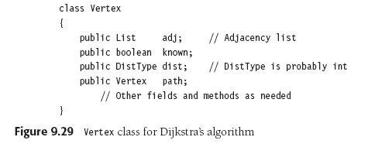
Dijkstra’s Algorithm, cont’d

Slide 55
Dijkstra’s Algorithm, cont’d

Slide 56
Dijkstra’s Algorithm, cont’d

Slide 57
Minimum Spanning Tree (MST)
Suppose you’re wiring a new house.
  What’s the minimum length of wire
  you need to purchase?
Represent the house as an undirected graph.
  Each electrical outlet is a vertex.
  The wires between the outlets are the edges.
  The cost of each edge is the length of the wire.

Slide 58
Minimum Spanning Tree (MST), cont’d
Create a tree formed from the edges of an undirected graph that connects all the vertices at the lowest total cost.

Slide 59
Minimum Spanning Tree (MST), cont’d
The MST
  Is an acyclic tree.
  Spans (includes)
  every vertex.
  Has |V |-1 edges.
  Has minimum total cost.
Data Structures and Algorithm
Analysis in C++, 4th ed.
by Mark Allen Weiss
Pearson Education, Inc., 2014

Slide 60
Minimum Spanning Tree (MST), cont’d
Add each edge to an MST in such a way that:
  It does not
  create a cycle.
  Is the least cost addition.
A greedy algorithm!
Data Structures and Algorithm
Analysis in C++, 4th ed.
by Mark Allen Weiss
Pearson Education, Inc., 2014

Slide 61
Prim’s Algorithm for MST
Rediscovered by Robert C. Prim in 1957 to solve connection network problems.
  First discovered in 1930 by Czech mathematician Vojtěch Jarník.
At any point during the algorithm,
some vertices are in the MST
and others are not.
Choose one vertex to start.

Slide 62
Prim’s Algorithm for MST, cont’d
At each stage, add another vertex to the tree.
Choose a vertex such that:
  The edge (u, v) has the lowest cost
  among all the edges.
  u is already in the tree and v is not.
Similar to Dijkstra’s algorithm for shortest paths.
  Maintain whether or not a vertex is known,
  and its d_{v} and p_{v} values.

Slide 63
Prim’s Algorithm for MST, cont’d
Data Structures and Algorithm
Analysis in C++, 4th ed.
by Mark Allen Weiss
Pearson Education, Inc., 2014

Slide 64
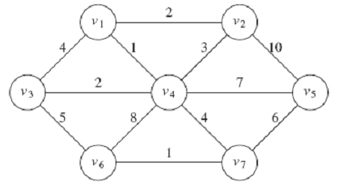
Prim’s Algorithm for MST, cont’d
Data Structures and Algorithm
Analysis in C++, 4th ed.
by Mark Allen Weiss
Pearson Education, Inc., 2014

Slide 65
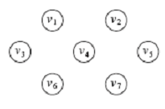
Prim’s Algorithm for MST, cont’d
Choose v₁ to start. Declare it known.
Set the d_{v} and p_{v} of v₁’s neighbors.
Data Structures and Algorithm
Analysis in C++, 4th ed.
by Mark Allen Weiss
Pearson Education, Inc., 2014

Slide 66
Prim’s Algorithm for MST, cont’d
Choose v₄ and declare it known.
Set the d_{v} and p_{v} of v₄’s neighbors
that are still unknown: v₃, v₅, v₆, and v₇.
Don’t do v₂ because d₂ = 2 < 3.
Data Structures and Algorithm
Analysis in C++, 4th ed.
by Mark Allen Weiss
Pearson Education, Inc., 2014

Slide 67
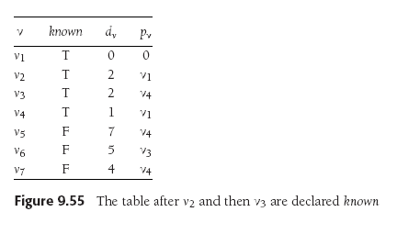
Prim’s Algorithm for MST, cont’d
Choose v₂ and declare it known.
No changes to the table.
Choose v₃ and declare it known.
Set the d_{v} and p_{v} of v₃’s neighbors
that still unknown: v₆.
Set d₆ = 5 < its previous value 8.
Data Structures and Algorithm
Analysis in C++, 4th ed.
by Mark Allen Weiss
Pearson Education, Inc., 2014

Slide 68
Prim’s Algorithm for MST, cont’d
Choose v₇ and declare it known.
Set the d_{v} and p_{v} of v₄’s neighbors
that still unknown: v₅ and v₆.
Set d₅ = 6 < its previous value 7.
Set d₆ = 1 < its previous value 5.
Data Structures and Algorithm
Analysis in C++, 4th ed.
by Mark Allen Weiss
Pearson Education, Inc., 2014

Slide 69
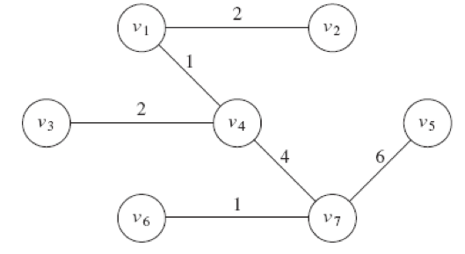
Prim’s Algorithm for MST, cont’d
Choose v₆ and declare it known.
No changes to the table.
Choose v₅ and declare it known.
No changes to the table.
Data Structures and Algorithm
Analysis in C++, 4th ed.
by Mark Allen Weiss
Pearson Education, Inc., 2014

Slide 70
Graph Traversal Algorithms
Graph traversal is similar to tree traversal.
  Visit each vertex of a graph in a particular order.
Special problems for graphs:
  It may not be possible to reach all vertices
  from the start vertex.
  The graph may contain cycles.
    Don’t go into an infinite loop.
    “Mark” each vertex after a visit.
    Don’t revisit marked vertices.

Slide 71
Find a Lost Child in a Large Building
Start in the room where the child was last seen.
Search each room adjacent to the first room.
  Put a tag on the door to mark a room
  you’ve already searched.
Then search each room adjacent to
the rooms you’ve already searched.
Repeatedly search all the rooms adjacent to rooms you’ve already searched before moving farther out from the first room.

Slide 72
Breadth-First Search
Represent the building as a graph.
  Each room is a vertex.
  Each hallway between rooms is an edge.
You are doing a breadth-first search
of the graph.
  The search expands evenly from the first vertex.

Slide 73
Breadth-First Search
void bfs(Vertex s)
{
Queue<Vertex> q = new Queue<>();
q.enqueue(s);
s.visited = true;
while (!q.empty())
{
Vertex v = q.dequeue();
for each Vertex w adjacent to v
{
if (!w.visited)
{
w.visited = true;
q.enqueue(w);
}
}
}
}

Slide 74
Breadth-First Search
2
B
F
H
6
8
C
3
1
A
D
G
I
4
7
9
E
5

Slide 75
You’re Lost in a Maze
You have a bag of breadcrumbs.
As you go down each path,
you drop breadcrumbs to mark your path.
Whenever you come to a dead end, you retrace your path by following your breadcrumbs.
You continue retracing your path (“backtracking”) until you come to an intersection with an unmarked path.
You (recursively) go down the unmarked path.

Slide 76
Depth-First Search
Represent the maze as a graph.
  Each path is an edge.
  Each intersection is a vertex.
You are doing a depth-first search of the graph.

Slide 77
Depth-First Search
void dfs(Vertex v)
{
v.visited = true; // mark
for each Vertex w adjacent to v
{
if (!w.visited)
{
dfs(w); // recursively visit w
}
}
}
Visits each vertex once.
Processes each edge once in a directed graph.
Processes each edge from both directions
in an undirected graph.
Therefore, O(|V | + |E |).

Slide 78
Depth-First Search
2
3
B
F
H
4
C
5
1
A
D
G
I
8
6
7
E
9

Slide 79
Depth-First Search and Games
Depth-first search is used by
game-playing programs.
  Example: IBM’s “Deep Blue”
  chess playing program.
Use a graph to represent the possible moves
from the present situation into the future.
Each vertex is a decision point
for either you or your opponent.

Slide 80
Depth-First Search and Games, cont’d
Perform a depth-first search to look at possible
move outcomes of both you and your opponent.
Each edge would have the
cost of going down that path.
Backtrack if a path is a dead end
or its cost is not beneficial.
How deeply your program can search
depends on the computer’s memory
and the allowed search time.

