Slide 1


CMPE 180A
Data Structures and Algorithms in C++
November 17 Class Meeting
Department of Computer Engineering
San Jose State University
Fall 2020
Instructor: Ron Mak
www.cs.sjsu.edu/~mak

Slide 2
Assignment #12: Solution
InsertionSort
ShellSortSuboptimal, ShellSortOptimal
QuickSorter
QuickSortSuboptimal, QuickSortOptimal
LinkedList
MergeSort

Slide 3
Trees
A tree is a collection of nodes:
  One node is the root node.
A node contains data and has pointers
(possibly null) to other nodes (its children).
  The pointers are directed edges.
  Each child node can itself be the root of a subtree.
  A leaf node is a node that has no children.
Each node other than the root node has
exactly one parent node.
Computer trees
grow upside-down!
Data Structures and Algorithm
Analysis in C++, 4th ed.
by Mark Allen Weiss
Pearson Education, Inc., 2014

Slide 4
Trees, cont’d
The path from node n₁ to node n_{k} is the sequence of nodes in the tree from n₁ to n_{k}.
  What is the path from A to Q? From E to J?
The length of a path is the number of its edges.
  What is the length of the path from A to Q?
Data Structures and Algorithm
Analysis in C++, 4th ed.
by Mark Allen Weiss
Pearson Education, Inc., 2014

Slide 5
Trees, cont’d
The depth of a node is the length of the path
from the root to that node.
  What is the depth of node J? Of the root node?
Data Structures and Algorithm
Analysis in C++, 4th ed.
by Mark Allen Weiss
Pearson Education, Inc., 2014

Slide 6
Trees, cont’d
The height of a node is the length of the longest path from the node to a leaf node.
  What is the height of node E? Of the root node?
Depth of a tree = depth of its deepest node = height of the tree
Data Structures and Algorithm
Analysis in C++, 4th ed.
by Mark Allen Weiss
Pearson Education, Inc., 2014

Slide 7
Tree Implementation
In general, a tree node can have
an arbitrary number of child nodes.
  A a binary tree node can have at most two children.
Therefore, each tree node can have
  a link to its first child, and
  a link to its next sibling:
class TreeNode
{
public:
...
private:
int data;
TreeNode *first_child;
TreeNode *next_sibling;
}
The value of the first_child link
of a leaf node would be nullptr.

Slide 8
Tree Implementation, cont’d
Conceptual view of a tree:
Implementation view of the same tree:
Is there an alternative
implementation?
Data Structures and Algorithm
Analysis in C++, 4th ed.
by Mark Allen Weiss
Pearson Education, Inc., 2014

Slide 9
Tree Implementation, cont’d
A very common alternative implementation is for each tree node to have a (possibly empty) vector of its children.
  Choose whichever implementation is most convenient for your program.
class TreeNode
{
public:
...
private:
int data;
vector<TreeNode *> children;
}
The children vector of a
leaf node would be empty.

Slide 10
Tree Traversals
There are several different algorithms
to “walk” or “traverse” a tree.
Each algorithm determines a unique order
that each and every node in the tree is “visited”.

Slide 11
Preorder Tree Traversal
First visit a node.
  Visit the node before visiting its child nodes.
Then recursively visit each of the
node’s child nodes in sibling order.

Slide 12
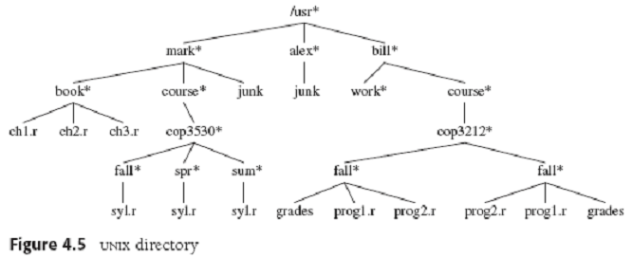
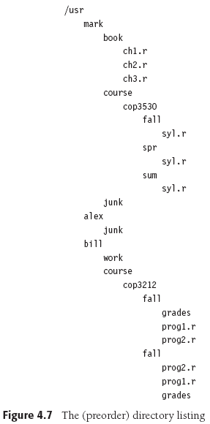
Preorder Tree Traversal, cont’d
void FileSystem::list_all(int depth = 0) const
{
print_name(depth);
if (is_directory())
{
for each file f in this directory
{
f.list_all(depth + 1);
}
}
}
Data Structures and Algorithm
Analysis in C++, 4th ed.
by Mark Allen Weiss
Pearson Education, Inc., 2014

Slide 13
Postorder Tree Traversal
First recursively visit each of a
node’s child nodes in sibling order.
Visit the node itself after visiting its children.

Slide 14
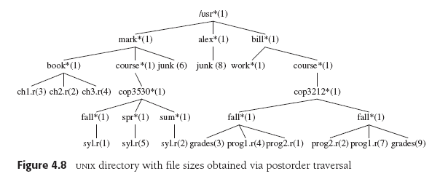
Postorder Tree Traversal, cont’d
int FileSystem::size() const
{
int total_size = size_of_this_file();
if (is_directory())
{
for each file f in this directory
{
total_size += f.size();
}
}
return totalSize;
}
Data Structures and Algorithm
Analysis in C++, 4th ed.
by Mark Allen Weiss
Pearson Education, Inc., 2014

Slide 15
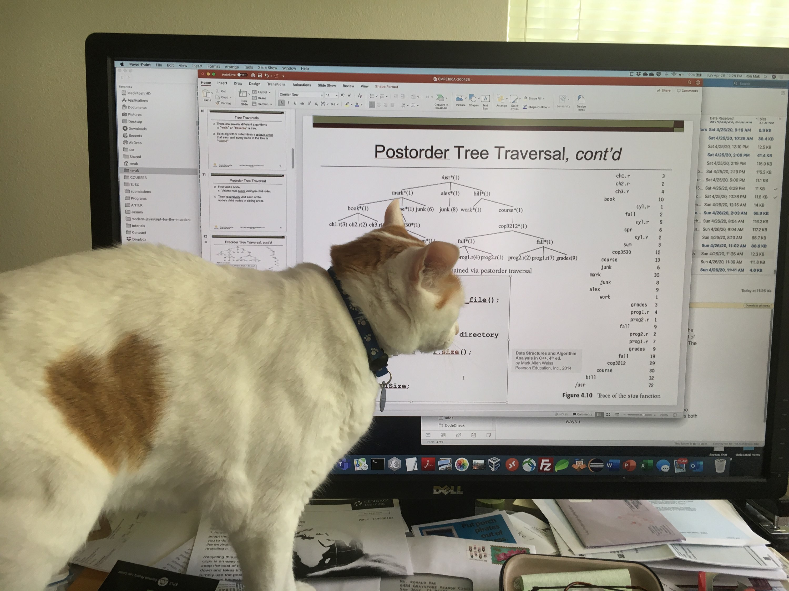
Postorder Tree Traversal, cont’d
Cats are experts at tree traversals.

Slide 16
Binary Trees
A binary tree is a tree where
each node can have 0, 1, or 2 child nodes.
Data Structures and Algorithm
Analysis in C++, 4th ed.
by Mark Allen Weiss
Pearson Education, Inc., 2014

Slide 17
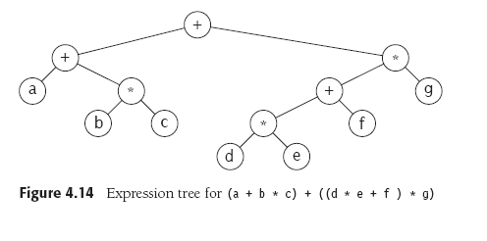
Binary Trees, cont’d
An arithmetic expression tree:
Data Structures and Algorithm
Analysis in C++, 4th ed.
by Mark Allen Weiss
Pearson Education, Inc., 2014

Slide 18
Conversion from Infix to Postfix Notation
Do a postorder walk of our expression tree to output the expression in postfix notation:
abc*+de*f+g*+
Data Structures and Algorithm
Analysis in C++, 4th ed.
by Mark Allen Weiss
Pearson Education, Inc., 2014

Slide 19
Binary Search Trees
A binary search tree (BST) has these properties
for each of its nodes:
  All the values in the node’s left subtree are
  less than the value of the node itself.
  All the values in the node’s right subtree are
  greater than the value of the node itself.
  Assume distinct nodes.
Data Structures and Algorithm
Analysis in C++, 4th ed.
by Mark Allen Weiss
Pearson Education, Inc., 2014

Slide 20
Inorder Tree Traversal
Recursively visit a node’s left subtree.
Visit the node itself in between
visiting the left and right subtrees.
Recursively visit the node’s right subtree.
If you do an inorder walk of a binary search tree, you will visit the nodes in sorted order.

Slide 21
Inorder Tree Traversal, cont’d
An inorder walk of the left tree
visits the nodes in sorted order: 1 2 3 4 6 8
Data Structures and Algorithm
Analysis in C++, 4th ed.
by Mark Allen Weiss
Pearson Education, Inc., 2014

Slide 22
The Binary Search Tree ADT
The node class of our binary search tree ADT.
Why did we name the
class placeholder Comparable?
template <class Comparable>
class BinaryNode
{
public:
BinaryNode(Comparable data);
BinaryNode(const Comparable& data, BinaryNode *left, BinaryNode *right);
virtual ~BinaryNode();
Comparable data;
BinaryNode *left;
BinaryNode *right;
};

Slide 23
The Binary Search Tree ADT, cont’d
template <typename Comparable>
class BinarySearchTree
{
public:
BinarySearchTree();
BinarySearchTree(const BinarySearchTree& rhs);
virtual ~BinarySearchTree();
BinarySearchTree& operator =(const BinarySearchTree& rhs);
BinaryNode<Comparable> *getRoot() const;
int height();
const Comparable& findMin() const;
const Comparable& findMax() const;
bool isEmpty() const;
bool contains(const Comparable& data) const;
void insert(const Comparable& data);
void remove(const Comparable& data);
...

Slide 24
The Binary Search Tree ADT, cont’d
...
protected:
virtual int height(BinaryNode<Comparable> *ptr);
virtual void insert(const Comparable& data, BinaryNode<Comparable>* &ptr);
virtual void remove(const Comparable& data, BinaryNode<Comparable>* &ptr);
private:
BinaryNode<Comparable> *root;
BinaryNode<Comparable> *findMin(BinaryNode<Comparable> *ptr) const;
BinaryNode<Comparable> *findMax(BinaryNode<Comparable> *ptr) const;
bool contains(const Comparable& data, BinaryNode<Comparable> *ptr) const;
};

Slide 25
The Binary Search Tree: Min and Max
Finding the minimum and maximum values
in a binary search tree is easy.
  The leftmost node has the minimum value.
  The rightmost node has the maximum value.
You can find the minimum and maximum values recursively or (better) iteratively.

Slide 26
The Binary Search Tree: Min and Max, cont’d
Iterative code to find the maximum value.
  Chase down the right child links.
  The maximum is the rightmost child.
template <typename Comparable>
BinaryNode<Comparable>
*BinarySearchTree<Comparable>::findMax(BinaryNode<Comparable> *ptr) const
{
if (ptr == nullptr) return nullptr; // empty tree
while(ptr->right != nullptr) ptr = ptr->right; // keep going right
return ptr; // rightmost node
}

Slide 27
The Binary Search Tree: Min and Max, cont’d
Recursive code to find the minimum value.
  Chase down the left child links.
  The minimum is the leftmost child.
template <typename Comparable>
BinaryNode<Comparable>
*BinarySearchTree<Comparable>::findMin(BinaryNode<Comparable> *ptr) const
{
if (ptr == nullptr) return nullptr; // empty tree
if (ptr->left == nullptr) return ptr; // leftmost node
return findMin(ptr->left); // keep going levt
}

Slide 28
The Binary Search Tree: Contains
Does a binary search tree contain
a target value?
Start an iterative search with a pointer to the root of the tree (or subtree) to search.

Slide 29
The Binary Search Tree: Contains, cont’d
Iterations
  If the value of the node the pointer points to is equal to the target value, the target is contained in the tree.
  If the pointer is null, then the target value is
  not contained in the tree.
  If the target value is less than the value of the node the pointer points to, then set the pointer to the node’s left child link and loop again.
  If the target value is greater than the value of the node the pointer points to, then set the pointer to the node’s right child link and loop again.

Slide 30
The Binary Search Tree: Contains, cont’d
template <typename Comparable>
bool BinarySearchTree<Comparable>::contains(const Comparable& data,
BinaryNode<Comparable> *ptr) const
{
while (ptr != nullptr)
{
if (data < ptr->data) ptr = ptr->left;
else if (data > ptr->data) ptr = ptr->right;
else return true; // found
}
return false; // not found
}

Slide 31
The Binary Search Tree: Contains, cont’d
The recursive version does not require a loop:
template <typename Comparable>
bool BinarySearchTree<Comparable>::contains(const Comparable& data,
BinaryNode<Comparable> *ptr) const
{
if (ptr == nullptr) return false;
else if (data == ptr->data) return true;
else if (data < ptr->data) return contains(data, ptr->left);
else return contains(data, ptr->right);
}

Slide 32
The Binary Search Tree: Insert
To insert a target value into the tree, proceed as if you were searching for the target value.
  You can do this recursively.
As you’re recursively examining left and right subtrees, if you encounter a null child link
(it’s either a left link or a right link), then
that’s where the new value should be inserted.
  Create a new node containing the target value
  and replace the null link with a link to the new node.
  So the new node is attached to the last-visited node.

Slide 33
The Binary Search Tree: Insert, cont’d
If the target value is already in the tree,
don’t insert but instead update the existing node.
  Example: Keep a frequency count in each node.
  Example: Maintain a linked list of duplicate nodes.

Slide 34
The Binary Search Tree: Insert
Data Structures and Algorithm
Analysis in C++, 4th ed.
by Mark Allen Weiss
Pearson Education, Inc., 2014

Slide 35
The Binary Search Tree: insert()
template <typename Comparable>
void BinarySearchTree<Comparable>::insert(const Comparable& data,
BinaryNode<Comparable>* &ptr)
{
if (ptr == nullptr) ptr = new BinaryNode(data);
else if (data < ptr->data) insert(data, ptr->left);
else if (data > ptr->data) insert(data, ptr->right);
// else update the node
}
ptr passed
by reference
Create a new node
only when a null link
is encountered.
Recursively attach the
newly created node
to the last-visited node
(pass the pointers by reference).

Slide 36
The Binary Search Tree: Remove
After removing a node from a binary search tree, the remaining nodes must still be in order.
No child case: The target node to be removed
is a leaf node.
  Just remove the target node.

Slide 37
The Binary Search Tree: Remove, cont’d
One child case: The target node to be removed has one child node.
  Change the parent’s link to the target node
  to point instead to the target node’s child.
Data Structures and Algorithm
Analysis in C++, 4th ed.
by Mark Allen Weiss
Pearson Education, Inc., 2014

Slide 38
The Binary Search Tree: Remove, cont’d
Two children case: The target node to be removed has two child nodes.
  This is the complicated case.
How do we restructure the tree so that
the order of the node values is preserved?

Slide 39
The Binary Search Tree: Remove, cont’d
Recall what happens you remove a list node.
  Assume that the list is sorted.
  If we delete target node 5, which node takes its place?
  The replacement node is the node that is
  immediately after the target node in the sorted order.
0
1
2
3
4
5
6
7
8
9
0
1
2
3
4
6
7
8
9

Slide 40
The Binary Search Tree: Remove, cont’d
A somewhat convoluted way to do this:
  Replace the target node’s value with
  the successor node’s value.
  Then remove the successor node,
  which is now “empty”.
0
1
2
3
4
5
6
7
8
9
0
1
2
3
4
6
7
8
9
0
1
2
3
4
6
7
8
9

Slide 41
The Binary Search Tree: Remove, cont’d
0
1
2
3
4
5
6
7
8
9
0
1
2
3
4
6
7
8
9
0
1
2
3
4
6
7
8
9
The same convoluted process happens when you remove a node from a binary search tree.
  Warning: What happens if there was a variable
  that pointed to the successor node?

Slide 42
The Binary Search Tree: Remove, cont’d
If you have a target node in a binary search tree, where is the node that is its immediate successor in the sort order?
  The successor’s value is > than the target value.
  It must be the minimum value in the right subtree.
General idea:
  Replace the value in the target node
  with the value of the successor node.
    The successor node is now “empty”.
  Recursively delete the successor node.

Slide 43
The Binary Search Tree: Remove, cont’d
X
The second node deletion
is easy because that node
never has a left child. (Why not?)
X
Replace the value of the target node 2
with the value of the successor node 3.
Now recursively remove node 3.
Data Structures and Algorithm
Analysis in C++, 4th ed.
by Mark Allen Weiss
Pearson Education, Inc., 2014

Slide 44
The Binary Search Tree: Remove, cont’d
ptr passed
by reference
template <typename Comparable>
void BinarySearchTree<Comparable>::remove(const Comparable& data,
BinaryNode<Comparable>* &ptr)
{
if (ptr == nullptr) return;
if (data < ptr->data) remove(data, ptr->left);
else if (data > ptr->data) remove(data, ptr->right);
else if ( (ptr->left != nullptr)
&& (ptr->right != nullptr))
{
ptr->data = find_min(ptr->right)->data;
remove(ptr->data, ptr->right);
}
else
{
BinaryNode *oldNode = ptr;
ptr = (ptr->left != nullptr) ? ptr->left
: ptr->right;
delete oldNode;
}
}
Target node not found: do nothing.
Recursively search for the
target node to remove.
Two children: Replace the target node’s
value with the successor node’s value.
Then recursively remove the successor node.
No children or only one child.

Slide 45
The Binary Search Tree Animations
Download Java applets from http://www.informit.com/content/images/0672324539/downloads/ExamplePrograms.ZIP
  These are from the book Data Structures and Algorithms in Java, 2nd edition, by Robert LaFlore:
  http://www.informit.com/store/data-structures-and-algorithms-in-java-9780672324536
The binary search tree applet is in Chap08/Tree
Run with the appletviewer application that is in your java/bin directory:
appletviewer Tree.html

Slide 46
Break
8:05

Slide 47
AVL Trees
An AVL tree is a binary search tree (BST)
with a balance condition.
  Named after its inventors,
  Adelson-Velskii and Landis.
For each node of the AVL tree, the heights of its
left and right subtrees can differ by at most 1.
  Remember that the height of a tree is the
  length of the longest path from the root to a leaf.
  The height of the root = the height of the tree.
  The height of an empty tree is -1.
See also:
red-black trees

Slide 48
AVL Trees, cont’d
Data Structures and Algorithm
Analysis in C++, 4th ed.
by Mark Allen Weiss
Pearson Education, Inc., 2014

Slide 49
Balancing AVL Trees
A balanced tree optimizes searches.
In a badly unbalanced tree, searches may go down subtrees with increased height.
Data Structures and Algorithm
Analysis in C++, 4th ed.
by Mark Allen Weiss
Pearson Education, Inc., 2014

Slide 50
Balancing AVL Trees, cont’d
We need to rebalance the tree whenever the balance condition is violated.
  Check after every insertion and deletion.
Data Structures and Algorithm
Analysis in C++, 4th ed.
by Mark Allen Weiss
Pearson Education, Inc., 2014

Slide 51
Balancing AVL Trees, cont’d
Assume the tree was balanced before
an insertion.
If it became unbalanced due to the insertion, then the inserted node must have caused
some nodes between itself and the root
to become unbalanced.
An unbalanced node must have the height of
one of its subtrees exactly 2 greater than the
height its other subtree.

Slide 52
Balancing AVL Trees, cont’d
Let the deepest unbalanced node be α.
  deepest = furthest from the root
Any node has at most two children.
A new height imbalance means that the
heights of α’s two subtrees now differ by 2.
α
α
1
2
3
4

Slide 53
Balancing AVL Trees, cont’d
α
Therefore, one of the following
had to occur:
  Case 1 (outside left-left):
  The insertion was into the
  left subtree of the left child of α.
  Case 2 (inside left-right): The insertion was into the right subtree of the left child of α.
  Case 3 (inside right-left): The insertion was into the left subtree of the right child of α.
  Case 4 (outside right-right): The insertion was into the right subtree of the right child of α.
1
2
3
4
Cases 1 and 4 are mirrors of each other,
and cases 2 and 3 are mirrors of each other.

Slide 54
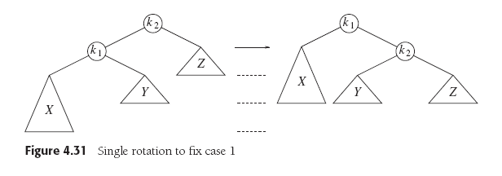
Balancing AVL Trees: Case 1
Case 1 (outside left-left):
Rebalance with a single right rotation.
  Rotate around node k₁:
Data Structures and Algorithm
Analysis in C++, 4th ed.
by Mark Allen Weiss
Pearson Education, Inc., 2014

Slide 55
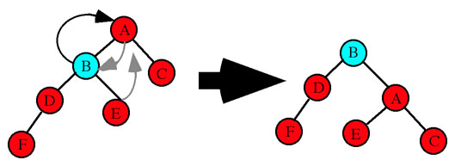
Balancing AVL Trees: Case 1, cont’d
Case 1 (outside left-left):
Rebalance with a single right rotation.
Node A is unbalanced.
Single right rotation: A's left
child B becomes the new
root of the subtree.
Node A becomes the right
child and adopts B's right child
as its new left child.
Node 8 is unbalanced.
Single right rotation: 8's left
child 7 becomes the new
root of the subtree.
Node 8 is the right child.
http://www.cs.uah.edu/~rcoleman/CS221/Trees/AVLTree.html
Data Structures and Algorithm
Analysis in C++, 4th ed.
by Mark Allen Weiss
Pearson Education, Inc., 2014

Slide 56
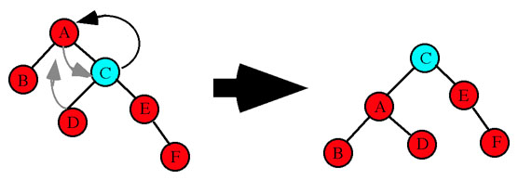
Balancing AVL Trees: Case 4
Case 4 (outside right-right):
Rebalance with a single left rotation.
  Rotate around node k₂:
Data Structures and Algorithm
Analysis in C++, 4th ed.
by Mark Allen Weiss
Pearson Education, Inc., 2014
Node A is unbalanced.
Single left rotation: A's right
child C becomes the new
root of the subtree.
Node A becomes the left
child and adopts C's left child
as its new right child.
http://www.cs.uah.edu/~rcoleman/CS221/Trees/AVLTree.html

Slide 57
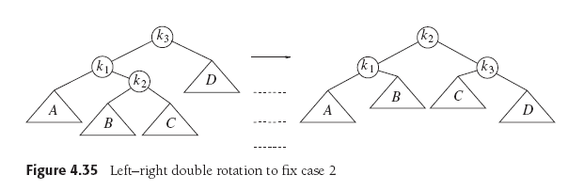
Balancing AVL Trees: Case 2
Case 2 (inside left-right):
Rebalance with a double left-right rotation.
  Left rotate around node k₁
  Then right rotate around node k₂:
Data Structures and Algorithm
Analysis in C++, 4th ed.
by Mark Allen Weiss
Pearson Education, Inc., 2014

Slide 58
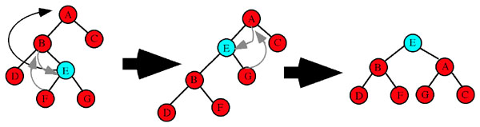
Balancing AVL Trees: Case 2, cont’d
Case 2 (inside left-right):
Rebalance with a double left-right rotation.
Node A is unbalanced.
Double left-right rotation: E becomes the new root of the subtree after two rotations.
Step 1 is a single left rotation between B and E. E replaces B as the subtree root.
B becomes E's left child and B adopts E's left child F as its new right child.
Step 2 is a single right rotation between E and A. E replaces A is the subtree root.
A becomes E's right child and A adopts E's right child G as its new left child.
http://www.cs.uah.edu/~rcoleman/CS221/Trees/AVLTree.html

Slide 59
Balancing AVL Trees: Case 3
Case 3 (inside right-left):
Rebalance with a double right-left rotation.
  Right rotate around node k₃
  Then left rotate around node k₂:
Data Structures and Algorithm
Analysis in C++, 4th ed.
by Mark Allen Weiss
Pearson Education, Inc., 2014

Slide 60
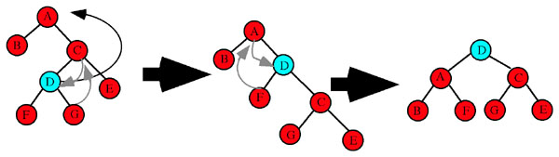
Balancing AVL Trees: Case 3, cont’d
Case 3 (inside right-left):
Rebalance with a double right-left rotation.
Node A is unbalanced.
Double right-left rotation: D becomes the new root of the subtree after two rotations.
Step 1 is a single right rotation between C and C. D replaces C as the subtree root.
C becomes D's right child and C adopts D's right child G as its new left child.
Step 2 is a single left rotation between D and A. D replaces A is the subtree root.
A becomes D's left child and A adopts D's left child F as its new right child.
http://www.cs.uah.edu/~rcoleman/CS221/Trees/AVLTree.html

Slide 61
AVL Tree Implementation
Since an AVL tree is just a BST with a balance condition, it makes sense to make the AVL tree class a subclass of the BST class.
template <class Comparable>
class AvlTree : public BinarySearchTree<Comparable>

Slide 62
The AVL Tree Node
With so many height calculations, it makes sense to store each node’s height in the node itself.
template <class Comparable>
class BinaryNode
{
public:
BinaryNode(Comparable data);
BinaryNode(const Comparable& data, BinaryNode *left, BinaryNode *right);
virtual ~BinaryNode();
Comparable data;
int height; // node height
BinaryNode *left;
BinaryNode *right;
};

Slide 63
AVL Tree Implementation, cont’d
Class AVLTree overrides the insert() and remove() methods of class BinarySearchTree.
  Each method calls the superclass’s method and then
  passes the node to the rebalance() member function.
template <class Comparable>
void AvlTree<Comparable>::insert(const Comparable& data, BinaryNode<Comparable>* &ptr)
{
BinarySearchTree<Comparable>::insert(data, ptr);
rebalance(ptr);
}
template <class Comparable>
void AvlTree<Comparable>::remove(const Comparable& data, BinaryNode<Comparable>* & ptr)
{
BinarySearchTree<Comparable>::remove(data, ptr);
rebalance(ptr);
}

Slide 64
AVL Tree Implementation, cont’d
The private AVLTree member function rebalance() checks whether the balance condition still holds and rebalances the tree with rotations whenever necessary.

Slide 65
AVL Tree Implementation, cont’d
template <class Comparable>
BinaryNode<Comparable> *AvlTree<Comparable>::rebalance(BinaryNode<Comparable>* &ptr)
{
if (ptr == nullptr) return ptr;
// Left side too high.
if (height(ptr->left) - height(ptr->right) > 1)
{
if (height(ptr->left->left)
>= height(ptr->left->right))
{
ptr = singleRightRotation(ptr);
cout << " --- Single right rotation at "
<< ptr->data << endl;
}
else
{
ptr = doubleLeftRightRotation(ptr);
cout << " --- Double left-right rotation at "
<< ptr->data << endl;
}
}
...
Case 1
Case 2

Slide 66
AVL Tree Implementation, cont’d
...
// Right side too high.
else if (height(ptr->right) - height(ptr->left) > 1)
{
if (height(ptr->right->right)
>= height(ptr->right->left))
{
ptr = singleLeftRotation(ptr);
cout << " --- Single left rotation at "
<< ptr->data << endl;
}
else
{
ptr = doubleRightLeftRotation(ptr);
cout << " --- Double right-left rotation at "
<< ptr->data << endl;
}
}
// Recompute the node's height.
node->height = (max(height(node->left),
height(node->right)) + 1);
return node;
}
Case 4
Case 3

Slide 67
Assignment #13
This assignment will give you practice with binary search trees (BST) and AVL trees.
You are provided a TreePrinter class that has a print() member function that will print any arbitrary binary tree.
  A template for how it prints a tree:
xx
/\
------------------------------ ------------------------------
/ \
xx xx
/\ /\
-------------- -------------- -------------- --------------
/ \ / \
xx xx xx xx
/\ /\ /\ /\
------ ------ ------ ------ ------ ------ ------ ------
/ \ / \ / \ / \
xx xx xx xx xx xx xx xx
/\ /\ /\ /\ /\ /\ /\ /\
-- -- -- -- -- -- -- -- -- -- -- -- -- -- -- --
/ \ / \ / \ / \ / \ / \ / \ / \
xx xx xx xx xx xx xx xx xx xx xx xx xx xx xx xx
/\ /\ /\ /\ /\ /\ /\ /\ /\ /\ /\ /\ /\ /\ /\ /\
/ \ / \ / \ / \ / \ / \ / \ / \ / \ / \ / \ / \ / \ / \ / \ / \
xx xx xx xx xx xx xx xx xx xx xx xx xx xx xx xx xx xx xx xx xx xx xx xx xx xx xx xx xx xx xx xx

Slide 68
Assignment #13, cont’d
TreePrinter is able to print trees with height up to 5, i.e., 32 node values on the bottom row.
  An example of an actual printed tree:
24
/\
-------------- --------------
/ \
18 73
/\ /\
------ ------ ------ ------
/ \ / \
12 19 38 87
/ /\ \
-- -- -- --
/ / \ \
10 37 41 90
\
\
64

Slide 69
Assignment #13: Part 1
The first part of the assignment makes sure that you can successfully insert nodes into, and delete nodes from, a binary search tree (BST) and an AVL tree.

Slide 70
Assignment #13: Part 1, cont’d
First create a BST, node by node.
  You will be provided the sequence of values
  to insert into the tree.
  Print the tree after each insertion.
  The tree will be unbalanced.
Now repeatedly delete the root of the tree.
  Print the tree after each deletion.
  Stop when the tree becomes empty.

Slide 71
Assignment #13: Part 1, cont’d
Second, create an AVL tree, node by node.
  Insert the same given sequence of values.
  Print the tree after each insertion to verify that
  you are keeping it balanced.
  Each time you do a rebalancing, print a message indicating which rotation operation(s) at which node.
    Example:
Insert node 10:
--- Single right rotation at node 21

Slide 72
Assignment #13: Part 1, cont’d
As you did with the BST, repeatedly delete the root of your AVL tree.
  Print the tree after each deletion to verify that
  you are keeping it balanced.
  Each time you do a rebalancing, print a message indicating which rotation operation(s) at which node.
    Example:
Delete root node 77:
--- Single left rotation at node 88
--- Double left-right rotation at node 29

Slide 73
Assignment #13: Part 1, cont’d
A handy AVL tree balance checker:
template <class Comparable>
int AvlTree<Comparable>::checkBalance(BinaryNode<Comparable> *ptr)
{
if (ptr == nullptr) return -1;
int leftHeight = checkBalance(ptr->left);
int rightHeight = checkBalance(ptr->right);
if ((abs(height(ptr->left) - height(ptr->right)) > 1)
|| (height(ptr->left) != leftHeight)
|| (height(ptr->right) != rightHeight))
{
return -2; // unbalanced
}
return height(ptr); // balanced
}

Slide 74
Assignment #13: Part 2
The second part of the assignment compares the performance of a BST vs. an AVL tree.
First, generate n random integers.
  n is some large number, to be explained.
Insert the random integers one at a time into the BST and AVL trees.

Slide 75
Assignment #13: Part 2, cont’d
For each tree, collect the following statistics:
  Probe counts: A probe is whenever you visit a tree node via a pointer to the node and perform any one of these operations:
    Check whether the node’s left or right child link is null.
    Use the left or right link to go to a child node.
    Access the node’s data value.
  Comparison counts: A comparison is whenever you compare a node’s data value to another value. A comparison is generally accompanied by a probe which accesses the node’s data value.
  Elapsed time in milliseconds

Slide 76
Assignment #13: Part 2, cont’d
Do not print the tree after each insertion.
Be sure to count probes and comparisons during AVL tree rotations.

Slide 77
Assignment #13: Part 2, cont’d
Second, generate another n random integer values.
Search the BST and AVL trees for the values, one at a time.
  Count probes and comparisons
  and compute elapsed times.
  It doesn’t matter whether or not a search succeeds.

Slide 78
Assignment #13: Part 2, cont’d
Choose values of n large enough to give you consistent timings that you can compare.
  Try values of n = 10,000 to 100,000
  in increments of 10,000
  Slower machines can use a different range of values for n.

Slide 79
Assignment #13: Part 2, cont’d
Print tables of these statistics for insertion and search with BST and AVL trees as comma-separated values.
Use Excel to create the following graphs,
each one containing plots for both BST and AVL:
  insertion probe counts
  search probe counts
  insertion compare counts
  search compare counts
  insertion elapsed time
  search elapsed time

Slide 80
Assignment #13, cont’d
Do Part 1 in CodeCheck.
  CodeCheck will check your output.
Do Part 2 outside of CodeCheck.
You can use any code from the lectures
or from the textbook or from the Web.
Be sure to give proper citations if you use code that you didn’t write yourself.
  Names of books, URLs, etc.
  Put the citations in your program comments.

