Slide 1


CMPE 180A
Data Structures and Algorithms in C++
November 3 Class Meeting
Department of Computer Engineering
San Jose State University
Fall 2020
Instructor: Ron Mak
www.cs.sjsu.edu/~mak

Slide 2
Assignment #10 Solution
What lessons did we learn about
STL vectors and lists?

Slide 3
Hash Tables
Consider an array or a vector.
  To access a value, you use an integer index.
The array maps the index to a data value
stored in the array.
  The mapping function is very efficient.
  As long as the index value is within range,
  there is a strict one-to-one correspondence
  between an index value and a stored data value.
We can consider the index value to be the
key to the corresponding data value.

Slide 4
Hash Tables, cont’d
A hash table also stores data values.
  Use a key to obtain the corresponding data value.
The key does not have to be an integer value.
  For example, the key could be a string.
There might not be a one-to-one correspondence between keys and data values.
The mapping function might not be trivial.

Slide 5
Hash Tables, cont’d
We can implement a hash table as an
array of cells.
  Refer to its size as TableSize.
If the hash table’s mapping function
maps a key value into an integer value
in the range 0 to TableSize – 1,
then we can use this integer value
as the index into the underlying array.

Slide 6
Hash Tables, cont’d
Suppose we’re storing employee data records
into a hash table.
We use an employee’s name as the key.

Slide 7
Hash Tables, cont’d
Suppose that the name
  john hashes (maps) to 3
  phil hashes to 4
  dave hashes to 6
  mary hashes to 7
This is an ideal situation because each employee record ended up in a different table cell.
Data Structures and Algorithms in Java, 3rd ed.
by Mark Allen Weiss
Pearson Education, Inc., 2012
ISBN 0-13-257627-9

Slide 8
Hash Function
We need an ideal hash function to map
each data record into a distinct table cell.
  It can be very difficult to find such a hash function.

Slide 9
A Simple Hash Function
Suppose our keys are words and the table size is 10,007 (a prime number).
Problem: This hash function does not distribute the keys well if the table is large.
  The maximum ASCII character value is 127.
  If a typical word is 8 characters long, the hash function generally has values from 0 to 1,016.
int hash(const string& word, int table_size)
{
int hashVal = 0;
for (char ch : word) hashVal += ch;
return hashVal%table_size;
}

Slide 10
Another Simple Hash Function
int hash(const string& word, int table_size)
{
return (key[0] + 27*key[1] + 729*key[2])%table_size;
}
We use only the first three letters of each word.
  27 letters in the alphabet + space
  729 = 27²
Good distribution into a table of 10,007 if the first three letters are random.
  But the English language is not random and
  many words will start with the same three letters.

Slide 11
A Better Hash Function
int hash(const string& word, int table_size)
{
unsigned int hashVal = 0;
for (char ch : word) hashVal = 37*hashVal + ch;
return hashVal%table_size;
}
Calculates a polynomial function
by nested multiplication (Horner’s rule).
Easy and fast to calculate.
Distributes the keys well into a large table.

Slide 12
Collisions
The more data we put into a hash table,
the more collisions occur.
A collision is when two or more data records
are mapped to the same table cell.
How can a hash table handle collisions?

Slide 13
Keys for Successful Hashing
Good hash function
Good collision resolution
Size of the underlying array a prime number

Slide 14
Collision Resolution
Separate chaining
Open addressing
  Linear probing
  Quadratic probing

Slide 15
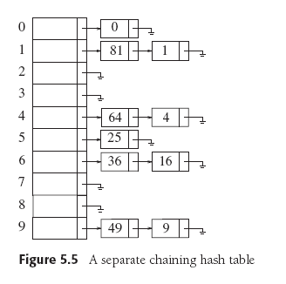
Collision Resolution: Separate Chaining
Each cell in a hash table is a pointer to a linked list of all the data records that hash to that entry.
To retrieve a data record, we first hash
to the cell.
Data Structures and Algorithms in Java, 3rd ed.
by Mark Allen Weiss
Pearson Education, Inc., 2012
ISBN 0-13-257627-9

Slide 16
Collision Resolution: Separate Chaining, cont’d
Then we search the associated linked list
for the data record.
We can sort the linked lists to improve search performance.
Data Structures and Algorithms in Java, 3rd ed.
by Mark Allen Weiss
Pearson Education, Inc., 2012
ISBN 0-13-257627-9

Slide 17
Collision Resolution: Open Addressing
Does not use linked lists.
All the data resides in the table.
When a collision occurs,
try a different table cell.
We will consider two types of open addressing:
  linear probing
  quadratic probing

Slide 18
Collision Resolution: Linear Probing
Try in succession h₀(x), h₁(x), h₂(x), …
h_{i}(x) = (hash(x) + f(i)) % TableSize, with f(0) = 0
      hash(x) produces the home cell.
Function f is the collision resolution strategy.
With linear probing, f is a linear function of i,
typically, f(i) = i

Slide 19
Collision Resolution: Linear Probing, cont’d
Insertion
  If a cell is filled, look for the next empty cell.
Search
  Start searching at the home cell, keep looking at the next cell until you find the matching key is found.
  If you encounter an empty cell, there is no key match.
Deletion
  Empty cells will prematurely terminate a search.
  Leave deleted items in the hash table but
  mark them as deleted.

Slide 20
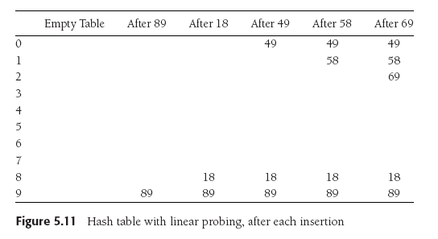
Collision Resolution: Linear Probing, cont’d
Suppose TableSize is 10, the keys are integer values, and the hash function is the key value modulo 10.
  We want to insert keys 89, 18, 49, 58, and 69.
Data Structures and Algorithms in Java, 3rd ed.
by Mark Allen Weiss
Pearson Education, Inc., 2012
ISBN 0-13-257627-9

Slide 21
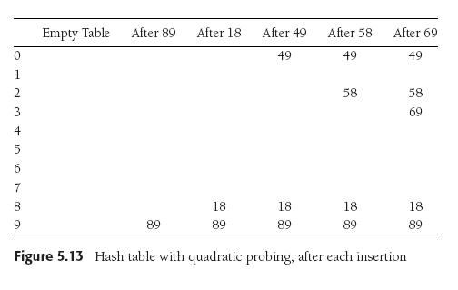
Collision Resolution: Quadratic Probing
Linear probing causes primary clustering.
Try quadratic probing instead: f(i) = i².
49 collides with 89:
the next empty cell
is 1 away.
58 collides with 18:
the next cell is filled.
Try 2² = 4 cells away
from the home cell.
Same for 69.
Data Structures and Algorithms in Java, 3rd ed.
by Mark Allen Weiss
Pearson Education, Inc., 2012
ISBN 0-13-257627-9

Slide 22
Collision Resolution: Quadratic Probing, cont’d
Try quadratic probing instead: f(i) = i².
i² is easy to compute, for i = 0, 1, 2, ...
  Remember that we proved that
1 = 1²
1 + 3 = 4 = 2²
1 + 3 + 5 = 9 = 3²
1 + 3 + 5 + 7 = 16 = 4²
…

Slide 23
Load Factor
The load factor λ of a hash table is the ratio of the number of elements in the table to the table size.
  λ is much more important than table size.
For probing collision resolution strategies,
it is important to keep λ under 0.5.
  Don’t let the table become more than half full.
If quadratic probing is used and the table size
is a prime number, then a new element can always be inserted if the table is at most half full.

Slide 24
Assignment #11
Read a copy of the U.S. Constitution and its amendments and build a concordance table.
  concordance: An alphabetical list of words in a text, each word with the number of times it appears.
Maintain the concordance in a sorted
STL vector, a sorted STL list, and an STL map.
Compare the timings of the vector, list, and map:
  Insertion of words
  Searching for words

Slide 25
Break
15 minutes

Slide 26
Introduction to Algorithm Analysis
To analyze an algorithm, we measure it.
A convenient measure must be:
  A resource we care about
  (elapsed time, memory usage, etc.).
  Quantitative, to make comparisons possible.
  Easy to compute.
  A good predictor of the “goodness”
  of the algorithm.
In this class, we will be concerned mostly with elapsed time.

Slide 27
Introduction to Algorithm Analysis, cont’d
Our concern generally is not how long
a particular run of an algorithm will take,
but how well the algorithm scales.
How does the run time increase
as the amount of input increases?
  Example: How does the reading time of a book increase as the number of pages increases?
  Example: How does the run time of a particular
  sort algorithm increase as the number of items
  to be sorted increases?

Slide 28
Example: Reading Books
Algorithm: Read a book.
Measure: Length of time to read a book.
Given a set of books to read, can we predict how long it will take to read each one,
without actually reading it?
Possible ways to compute reading time:
  weight of the book
  physical size (width, height, thickness) of the book
  total number of words
  total number of pages

Slide 29
Introduction to Algorithm Analysis, cont’d
When we compare two algorithms,
we want to compare how well they scale.
  How do their elapsed run times grow
  as the size of the input grows?
  How do their growth rates compare?
Can we do this comparison without
actually running the algorithms?
  Some algorithms may be too expensive to run.

Slide 30
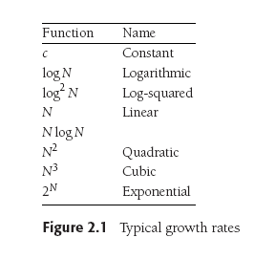
How Well Does an Algorithm Scale?
Data Structures and Algorithms in Java, 3rd ed.
by Mark Allen Weiss
Pearson Education, Inc., 2012
ISBN 978-0-13-257627-7

Slide 31
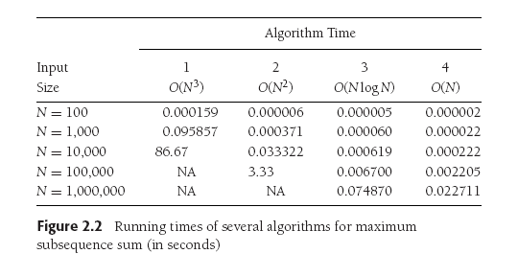
How Well Does an Algorithm Scale? cont’d
Data Structures and Algorithms in Java, 3rd ed.
by Mark Allen Weiss
Pearson Education, Inc., 2012
ISBN 978-0-13-257627-7

Slide 32
How Well Does an Algorithm Scale? cont’d
Data Structures and Algorithms in Java, 3rd ed.
by Mark Allen Weiss
Pearson Education, Inc., 2012
ISBN 978-0-13-257627-7

Slide 33
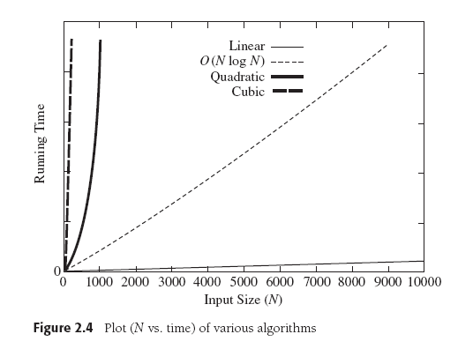
How Well Does an Algorithm Scale? cont’d
Data Structures and Algorithms in Java, 3rd ed.
by Mark Allen Weiss
Pearson Education, Inc., 2012
ISBN 978-0-13-257627-7

Slide 34
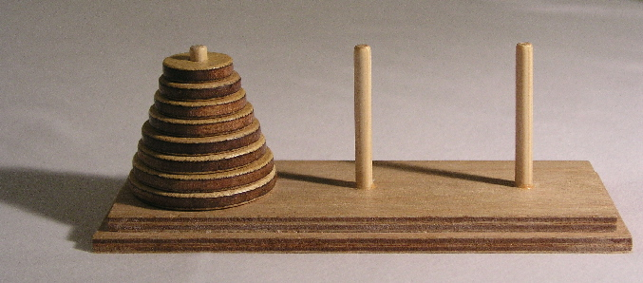
Towers of Hanoi
Goal: Move the stack of disks from the source pin
to the destination pin.
  You can move only one disk at a time.
  You cannot put a larger disk on top of a smaller disk.
  Use the third pin for temporary disk storage.

Slide 35
Towers of Hanoi, cont’d
Label the pins A, B, and C. Initial roles:
  A: source
  B: destination
  C: temporary
Base case: n = 1 disk
  Move disk from A to B (source ➔ destination)
Simpler but similar case: n-1 disks
  Solve for n-1 disks: A to C (source ➔ temp)
  Move 1 disk from A to B (source ➔ destination)
  Solve for n-1 disks: C to B (temp ➔ destination)
During recursive calls, the pins
will assume different roles.

Slide 36
Towers of Hanoi: Analysis
How can we measure how long it will take
to solve the puzzle for n disks?
What’s a good predictor?
  The number times we move a disk
  from one pin to another.
  Therefore, let’s count the number of moves.

Slide 37
Towers of Hanoi: Analysis, cont’d
Solve n disks
  Solve for n-1 disks (source ➔ temp)
  Move 1 disk (source ➔ destination)
  Solve for n-1 disks (temp ➔ destination)
What is the pattern in the number of moves
as n increases?
  Let f(n) be the number of moves for n disks.
{
1 n = 1
2f(n-1) + 1 n > 1
f(n) =

Slide 38
Towers of Hanoi: Analysis
{
1 n = 1
2f(n-1) + 1 n > 1
f(n) =
This is a recurrence relation.
  f shows up in its own definition: f(n) = 2f(n-1) + 1
  The mathematical analogy of recursion.
Can we find the definition of function f ?
  Observation:
  Since f(n) = 2f(n-1) + 1, we know that f(n) > 2f(n-1).
  Therefore, if we increase the number of disks from
  n to n+1, the number of moves will at least double.

Slide 39
Towers of Hanoi: Count Moves
int main()
{
cout << "Disks Moves" << endl;
for (int n = 1; n <= 10; n++) {
int count = 0;
solve(n, Pin::A, Pin::B, Pin::C, count);
cout << setw(5) << n << setw(5) << count << endl;
}
}
void move(Pin from, Pin to, int& count)
{
count++;
}
Hanoi2.cpp
Don’t print. Just count moves.
Demo

Slide 40
Towers of Hanoi: Analysis
Disks Moves
1 1
2 3
3 7
4 15
5 31
6 63
7 127
8 255
9 511
10 1023
What’s the pattern?
Can we prove this?
  Just because this formula holds
  for the first 10 values of n, can we assume that it will hold for all values of n ≥ 1?
f(n) = 2^{n} - 1

Slide 41
Proof by Induction: Base Case
Prove that if:
then:
{
1 n = 1
2f(n-1) + 1 n > 1
f(n) = 2^{n} - 1
for all n ≥ 1
f(n) =
Let n = 1.
Then f(1) = 2¹ - 1 = 1 is true.

Slide 42
Proof by Induction: Inductive Step
Prove that if:
then:
{
1 n = 1
2f(n-1) + 1 n > 1
f(n) = 2^{n} - 1
for all n ≥ 1
f(n) =
Let n > 1.
Induction hypothesis:
Assume that f(k) = 2^{k} - 1 is true for all k < n, where n > 1
Since n-1 < n, then by our hypothesis: f(n-1) = 2^{n-1} – 1.
From the recurrence relation:
f(n) = 2f(n-1) + 1 = 2(2^{n-1} - 1) + 1 = 2^{n} -1.
So f(n) = 2^{n} -1 for all n > 1.
Therefore, if f(k) = 2^{k} - 1 is true for all k < n,
it must also be true for n as well.

Slide 43
Proof by Induction: What Happened?
Prove that if:
then:
{
1 n = 1
2f(n-1) + 1 n > 1
f(n) = 2^{n} - 1
for all n ≥ 1
f(n) =
First we proved it for n = 1 (the base case).
Then we proved that if it’s true for all k < n, where n > 1 (the induction hypothesis) then it must also be true for n.
Suppose n = 2. Since we know it’s true for n = 1 (the base case), it must be true for n = 2 (from above).
Suppose n = 3. Since we know it’s true for n = 2 (from above), it must be true for n = 3.
Etc.!

Slide 44
Another Proof By Induction Example
Observe that:
Prove:
1 = 1²
1 + 3 = 4 = 2²
1 + 3 + 5 = 9 = 3²
1 + 3 + 5 + 7 = 16 = 4²
… ?
1 + 3 + 5 + 7 + … + (2n -1) = n² for all n > 0
Base case:
Let n = 1. Then 1 = 1² is obviously true.
Induction hypothesis:
Assume that 1 + 3 + 5 + 7 + … + (2k -1) = k² is true for some k > 0
Then show that: 1 + 3 + 5 + 7 + … + (2(k + 1) -1) = (k + 1)²
1 + 3 + 5 + 7 + …………… + (2(k + 1) -1) =
1 + 3 + 5 + 7 + … + (2k -1) + (2(k + 1) -1) =
k² + (2(k + 1) -1) = k² + 2k + 1
= (k + 1)²
True for n = 1.
If true for n = k
then true for n = k+1.

Slide 45
Algorithm Analysis
An algorithm is a set of operations to perform
in order to solve a problem.
We want to know how an algorithm scales
as its input size grows.
If T(N) is the running time of an algorithm
with N input values, then
how does T(N) change as N increases?

Slide 46
Big-Oh and its Cousins
Let T(N) be the running time of an algorithm
with N input values.
Big-Oh
  T(N) = O(f(N)) if there are positive constants c and n₀ such that T(N) ≤ cf(N) when N ≥ n₀.
  In other words, when N is sufficiently large,
  function f(N) is an upper bound for time function T(N).
    We don’t care about small values of N.
  T(N) will grow no faster than f(N) as N increases.

Slide 47
Big-Oh and its Cousins, cont’d
Let T(N) be the running time of an algorithm with N input values.
Omega
  T(N) = Ω(g(N)) if there are positive constants c and n₀ such that T(N) ≥ cg(N) when N ≥ n₀.
  In other words, when N is sufficiently large,
  function g(N) is lower bound for time function T(N).
    We don’t care about small values of N.
  T(N) will grow at least as fast as g(N) as N increases.

Slide 48
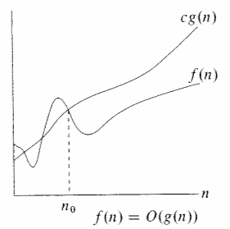
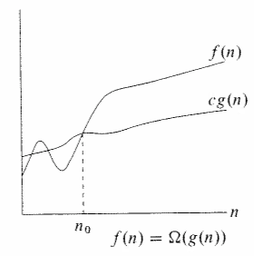
Big-Oh and its Cousins, cont’d
cf(N)
T(N)
T(N)
cg(N)
N
N
T(N) = O(f(N))
T(N) = Ω(g(N))
Upper bound
Lower bound

Slide 49
Big-Oh and its Cousins, cont’d
Let T(N) be the running time of an algorithm with N input values.
Theta
  T(N) = Θ(h(N)) if and only if:
    T(N) = O(h(N)) and
    T(N) = Ω(h(N))
  In other words, the rate of growth of T(N)
  equals the rate of growth of h(N).

Slide 50
Towers of Hanoi: Rate of Growth
We decided that a good predictor of T(n) for solving the Towers of Hanoi problem was f(n).
  n is the number of disks
  f(n) = 2^{n}-1 is the number of disk moves
Therefore,
T(n) = Θ(2^{n})

Slide 51
Big-Oh and its Cousins, cont’d
Let T(N) be the running time of an algorithm with N input values.
Little-Oh
  T(N) = o(p(N)) if there are positive constants c and n₀ such that T(N) < cp(N) when N ≥ n₀.
  p(N) is similar to the upper bound function f(N)
  but instead of T(N) ≤ cf(N) we have T(N) < cp(N).

Slide 52
Big-Oh and its Cousins, cont’d
If T₁(N) = O(f₁(N)) and T₂(N) = O(f₂(N)) then
  T₁(N) + T₂(N) = O(f₁(N) + f₂(N)) or O(max(f₁(N), f₂(N)))
  T₁(N) x T₂(N) = O(f₁(N) x f₂(N))
If T(N) is a polynomial of degree k, then
  T(N) = Θ(N^{k})
If T(N) = log^{k} N for any constant k, then
  T(N) = O(N)
  Logarithms grow slowly!

Slide 53
Compare Growth Rates
If we want to compare the growth rates of two functions f(N) and g(N), compute
  The limit is 0: f(N) = o(g(N))
  g(N) is an upper bound for f(N).
  The limit is a constant c ≠ 0: f(N) = Θ(g(N))
  f(N) and g(N) have the same growth rate.
  The limit is ∞: g(N) = o(f(N))
  f(N) is an upper bound for g(N).
lim f(N) / g(N)
N→∞

Slide 54
General Rules for Computing Running Time
Consecutive statements
  Add the running times of the statements.
  Generally, only consider the statement
  with the maximum running time.
Branching statement
  The running time of the entire statement is at most the maximum running time of its branches.

Slide 55
Computing Running Time, cont’d
Loop
  The running time of a loop is at most
  the number of iterations times
  the running time of the statements in the loop.
Nested loops
  Compute the running time of the statements in the innermost loop, then multiply by the product of the numbers of iterations of all the loops.

Slide 56
Scalability of Different Algorithms
Problem: Compute the n^{th} Fibonacci number.
Two algorithms to solve this problem:
  Start with 1, 1, and repeatedly
  add the previous two values.
    LinearGrowthRate: T(N) = O(N)
  Use recursion: fib(n) = fib(n-2) + fib(n-1)
    ExponentialGrowthRate: T(N) = Ω(1.5^{N})
Why is the growth
rate exponential?

Slide 57
Scalability of Different Algorithms, cont’d
One set of results for the Fibonacci problem.
  Times in milliseconds.
n Linear Exponential
5 0 0
10 0 1
15 0 0
20 0 2
25 0 3
30 0 4
35 0 45
40 0 504
45 0 5358
50 0 59267

