Slide 1


CMPE 180A
Data Structures and Algorithms in C++
September 1 Class Meeting
Department of Computer Engineering
San Jose State University
Fall 2020
Instructor: Ron Mak
www.cs.sjsu.edu/~mak

Slide 2
The C++ Division Operator
Some of you may have discovered this while programming the solution to Assignment #1.
If both operands of the / operator are integer constants or variables, then the result will be integer.
  Any fractional amount is truncated (not rounded).
  Examples: 7/3 ➔ 2 and 1/2 ➔ 0
If one or both operands are double constants
or variables, then the result will be double.
  Examples: 7/3.0 ➔ 2.333... and 1.0/2.0 ➔ 0.5

Slide 3

Assignment #1: Sample Solution
$$π=\frac{12}{\sqrt{190}}ln\left[\left(2\sqrt{2}+\sqrt{10}\right)\left(3+\sqrt{10}\right)\right]$$
void Ramanujan_0()
{
double const1 = 12/sqrt(190);
double const2 = 2*sqrt(2) + sqrt(10);
double const3 = 3 + sqrt(10);
double pi = const1*log(const2*const3);
cout << " Estimate: " << pi << endl;
}
The built-in square root sqrt and the natural logarithm log functions are from the cmath library:
#include <cmath>

Slide 4
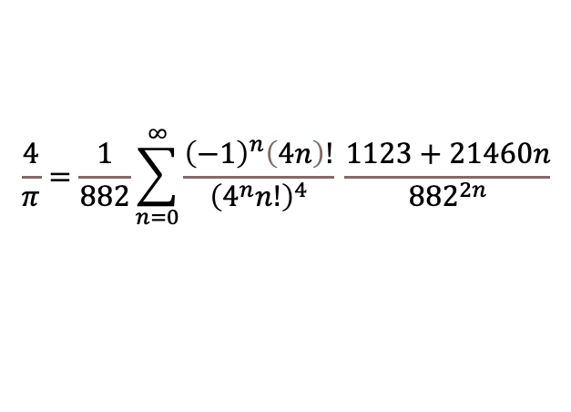
Assignment #1: Sample Solution, cont’d
$$\frac{4}{π}=\frac{1}{882}\sum_{n=0}^{∞}{\frac{{\left(−1\right)}^{n}\left(4n\right)!}{{\left(4^{n}n!\right)}^{4}} \frac{1123+21460n}{{882}^{2n}}}$$
What does the (-1)^{n} factor do?
  Whenever n is odd, the factor equals -1.
    Example: (-1)³ = (-1)(-1)(-1) = -1
  Whenever n is even, the factor equals +1.
    Example: (-1)⁴ = (-1)(-1)(-1)(-1) = +1
Therefore, the factor alternates between
adding and subtracting the term it multiplies.

Slide 5
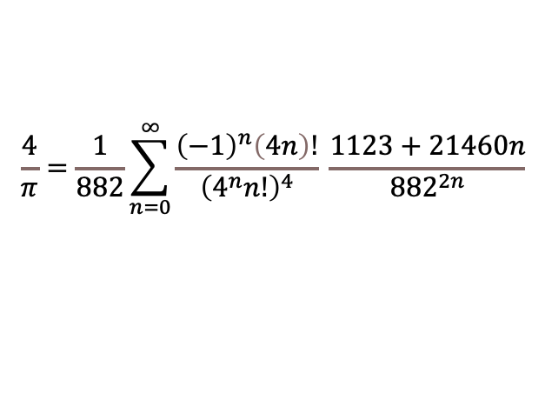
Assignment #1: Sample Solution, cont’d
$$\frac{4}{π}=\frac{1}{882}\sum_{n=0}^{∞}{\frac{{\left(−1\right)}^{n}\left(4n\right)!}{{\left(4^{n}n!\right)}^{4}} \frac{1123+21460n}{{882}^{2n}}}$$
It is inefficient to use the built-in power function for this purpose:
  Use a Boolean variable instead that
  alternates between true and false.
Copying a mathematical formula directly
can lead to inefficient or erroneous code.
  A formula that is not designed for computation can accumulate roundoff errors when it is used inside of a loop. It can also have overflow errors.
pow(-1, n)
See: https://www.amazon.com/Java-Number-Cruncher-Programmers-Numerical/dp/0130460419/ref=sr_1_1?dchild=1&keywords=java+number+cruncher&qid=1598936278&s=books&sr=1-1

Slide 6
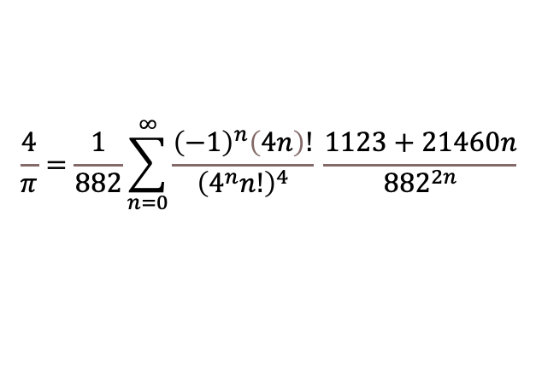
Assignment #1: Sample Solution, cont’d
$$\frac{4}{π}=\frac{1}{882}\sum_{n=0}^{∞}{\frac{{\left(−1\right)}^{n}\left(4n\right)!}{{\left(4^{n}n!\right)}^{4}} \frac{1123+21460n}{{882}^{2n}}}$$
void Ramanujan_2()
{
cout << " Iteration Estimate" << endl;
double four_over_pi;
double factor0 = ((double) 1)/882.0;
bool negate = false;
double sum = 0.0;
double prev = 0.0;
double diff = 0.0;
int n = 0;

Slide 7
Assignment #1: Sample Solution, cont’d
$$\frac{4}{π}=\frac{1}{882}\sum_{n=0}^{∞}{\frac{{\left(−1\right)}^{n}\left(4n\right)!}{{\left(4^{n}n!\right)}^{4}} \frac{1123+21460n}{{882}^{2n}}}$$
do
{
double factor1 = factorial(4*n)/pow((pow(4.0, n)*factorial(n)), 4);
double factor2 = (1123 + 21460*n)/pow(882.0, 2*n);
if (negate) factor1 = -factor1;
sum += factor1*factor2;
four_over_pi = factor0*sum;
cout << setw(11) << n+1 << " " << 4.0/four_over_pi << endl;
diff = abs(prev - four_over_pi);
prev = four_over_pi;
negate = !negate;
n++;
} while ((diff > TOLERANCE) && (n <= MAX_ITERATIONS));
}

Slide 8
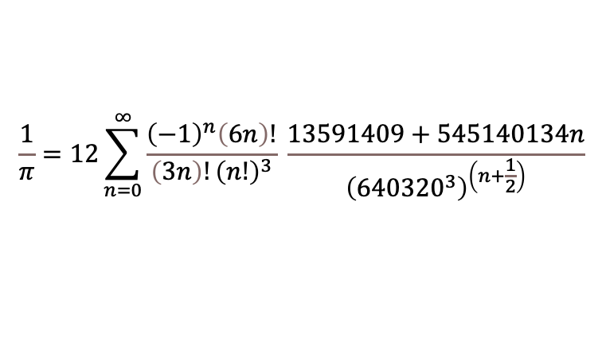
Assignment #1: Sample Solution, cont’d
$$\frac{1}{π}=12\sum_{n=0}^{∞}{\frac{{\left(−1\right)}^{n}\left(6n\right)!}{\left(3n\right)!{\left(n!\right)}^{3}} \frac{13591409+545140134n}{{\left({640320}^{3}\right)}^{\left(n+\frac{1}{2}\right)}}}$$
void Chudnovsky()
{
double one_over_pi;
double sum = 0.0;
double prev = 0.0;
double diff = 0.0;
bool negate = false;
int n = 0;

Slide 9
Assignment #1: Sample Solution, cont’d
$$\frac{1}{π}=12\sum_{n=0}^{∞}{\frac{{\left(−1\right)}^{n}\left(6n\right)!}{\left(3n\right)!{\left(n!\right)}^{3}} \frac{13591409+545140134n}{{\left({640320}^{3}\right)}^{\left(n+\frac{1}{2}\right)}}}$$
do
{
double factor1 = factorial(6*n)/(factorial(3*n)*pow(factorial(n), 3));
double factor2 = (13591409 + 545140134*n)/pow(640320, 3*n + 1.5);
if (negate) factor1 = -factor1;
sum += factor1*factor2;
one_over_pi = 12*sum;
cout << setw(11) << n+1 << " " << 1.0/one_over_pi << endl;
diff = abs(prev - one_over_pi);
prev = one_over_pi;
negate = !negate;
n++;
} while ((diff > TOLERANCE) && (n <= MAX_ITERATIONS));
}

Slide 10

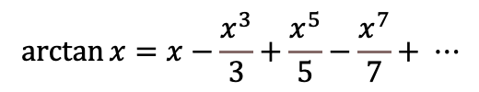
Assignment #1: Sample Solution, cont’d
$$\arctan{x=x−\frac{x^{3}}{3}+\frac{x^{5}}{5}−\frac{x^{7}}{7}+ ⋯}$$
$$\frac{π}{4}=4\arctan{\frac{1}{5}}−\arctan{\frac{1}{239}}$$
double arctangent(double x)
{
double arctan = x;
bool addsub = false;
double numerator = x;
double x_squared = x*x;
double term;
int odd = 3;
do
{
numerator *= x_squared;
term = numerator/odd;
if (addsub) arctan += term;
else arctan -= term;
odd += 2;
addsub = !addsub;
} while ((term > TOLERANCE) && (odd <= MAX_ITERATIONS));
return arctan;
}

Slide 11
Predefined Functions
C++ includes predefined functions.
  AKA built-in functions
  Example: Math function sqrt
Predefined functions are stored in libraries.
  Your program will need to include the appropriate library header files to enable the compiler to recognize the names of the predefined functions.
  Example: #include <cmath>
  in order to use predefined math functions like sqrt

Slide 12
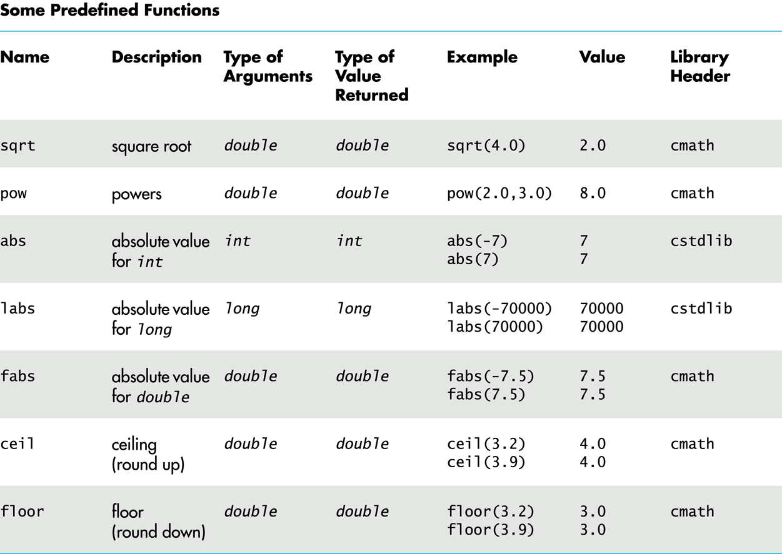
Predefined Functions, cont’d
Savitch_ch_04.ppt: slides 8 – 12, 72

Slide 13
Random Numbers
To generate (pseudo-) random numbers
using the predefined functions, first include
two library header files:
“Seed” the random number generator:
  If you don’t seed, you’ll always get the same “random” sequence (which may be useful for debugging).
#include <cstdlib>
#include <ctime>
srand(time(0));

Slide 14
Random Numbers, cont’d
Each subsequent call returns a “random” number ≥ 0 and ≤ RAND_MAX.
  RAND_MAX is library-dependent but is guaranteed to be at least 32,767.
Use + and % to scale to a desired number range.
  Example: Each execution of the expression
  returns a random number
  with the value 1, 2, 3, 4, 5, or 6.
rand();
rand()%6 + 1

Slide 15
Type Casting
Suppose integer variables i and j are initialized to 5 and 2, respectively.
What is the value of the division i/j ?
What if we wanted to have a quotient
of type double?
  We want to keep the fraction.

Slide 16
Type Casting, cont’d
One way is to convert one of the operands
(say i) to double.
  Then the quotient will be type double.
Why won’t the following work?
double quotient = static_cast<double>(i)/j;
double quotient = static_cast<double>(i/j);

Slide 17
Programmer-Defined Functions
In addition to using the predefined functions, you can write your own functions.
Programmer-defined functions are critical
for good program design.
In your C++ program, you can call a programmer-defined function only after the function has been declared or defined.

Slide 18
Function Declarations
A function declaration specifies:
  The function name.
  The number, order, and data types
  of its formal parameters.
  The data type of its return value.
Example:
double total_cost(double unit_cost, int count);

Slide 19
Function Definitions, cont’d
After you’ve declared a function,
you must define it.
  Write the code that is executed
  whenever the function is called.
  A return statement terminates execution
  of the function and returns a value to the caller.
Example:
double total_cost(double unit_cost, int count)
{
double total = count*unit_cost;
return total;
}

Slide 20
Function Calls
Call a function that you wrote just as
you would call a predefined function.
Example:
int how_many;
double how_much;
double spent;
how_many = 5;
how_much = 29.99;
spent = total_cost(how_much, how_many);

Slide 21
Void Functions
A void function performs some task
but does not return a value.
Therefore, its return statement terminates the function execution but does not include a value.
  A return statement is not necessary for a void function if the function terminates “naturally”
  after it finishes executing the last statement.
Example void
function definition:
void print_TF(bool b)
{
if (b) cout << "T";
else cout << "F";
}

Slide 22
Void Functions, cont’d
A call to a void function cannot be part of an expression, since the function doesn’t return
a value.
Instead, call a void function as a statement
by itself.
Example:
bool flag = true;
print_TF(flag);

Slide 23
Coding Convention with Functions
First declare all your functions.
Document each declaration with a comment that describes:
  What the function does.
  What is each function parameter.
  What is the return value.
Code the main function.
Define the functions.
  Don’t repeat the declaration’s comment.
  Only document each function’s internal operations.

Slide 24
Coding Convention with Functions, cont’d
#include <iostream>
using namespace std;
/**
* Add two integers and return their sum.
* @param n1 the first integer
* @param n2 the second integer
* @return their sum.
*/
int make_sum(int n1, int n2);
/**
* Print an integer value;
* @param n the value to print.
*/
void print(int n);
int main()
{
int i = 5, j = 7;
int sum = make_sum(i, j);
print(sum);
}
int make_sum(int n1, int n2)
{
return n1 + n2; // return their sum
}
void print(int n)
{
cout << "The value is " << n << endl;
}
The declarations tell you what
the functions will do and provide
the overall structure of the
program without all the details.
Function definitions.

Slide 25
Break

Slide 26
Top-Down Design
Top-down design is an important
software engineering principle.
Start with the topmost subproblem
of a programming problem.
  Write a function for solving the topmost subproblem.
Break each subproblem into smaller subproblems.
  Write a function to solve each subproblem.
  This process is called stepwise refinement.

Slide 27
Top-Down Design, cont’d
The result is a hierarchical decomposition
of the problem.
AKA functional decomposition

Slide 28
Top-Down Design Example
Write a program that inputs from the user that are positive integer values less than 1000.
Translate the value into words.
Example:
  The user enters 482
  The program writes four hundred eighty-two
Repeat until the user enters a value ≤ 0.

Slide 29
Top-Down Design Example, cont’d
What is the topmost problem?
  Read numbers entered by the user
  until the user enters a value ≤ 0.
  Translate each number to words.
This is a high-level description of what
the program is supposed to do.

Slide 30
Refinement 1
Loop to read and print the numbers.
Call a translate function,
but it doesn’t do anything yet.
translator1.cpp

Slide 31
Refinement 2
How to translate a number into words?
  Break the number into separate digits.
  Translate the digits into words such as one, two, ..., ten, eleven, twelve, ..., twenty, thirty, etc.
Refine the translate function to handle
some simple cases:
  translate_ones: 1 through 9
  translate_teens: 11 through 19
translator2.cpp

Slide 32
Refinement 3
The translate function takes a 3-digit number and separates out the hundreds digit.
Translate the hundreds digit.
  translate_hundreds
  Do this simply by translating the hundreds digits
  as we did a ones digit. Then append the word hundred.

Slide 33
Refinement 3, cont’d
Translate the last two digits:
  We can already translate a teens number.
  Otherwise, break apart the two digits
  into a tens digit and a ones digit.
    translateTens: 10, 20, 30, ..., 90
    We can already translate a ones digit.
translator3.cpp

Slide 34
Refinement 4
Add a hyphen between twenty, thirty, etc.
and a ones word.
  Example: twenty-one

Slide 35
Refinement 5
Break a 6-digit number into a 3-digit first part and a 3-digit second part.
Translate the first part and
then append the word thousand.
Translate the second part.

Slide 36
Refinement 6? 7?
Number? 300010
300010 : three hundred thousand ten
Extra space!
Insert commas into numbers?
  Example: 12,345

Slide 37
Scope and Local Variables
Any variable declared inside a function is
local to that function.
  The scope of the variable is that function.
  The variable is not accessible
  from outside the function.
  A variable with the same name declared inside another function is a different variable.
The same is true for any variable
declared inside the main function.

Slide 38
Block Scope
You can declare variables inside of a block.
  A block of code is delimited by { and }.
The variables are local to the block.
  Example:
if (x < y)
{
int i;
...
}

Slide 39
Global Constants and Variables
If a constant or a variable is declared
outside of and before the main and the
function definitions, then that constant
or variable is global and accessible
by the main and any function.
Global variables are not recommended.
  If a function modifies a global variable,
  that can affect other functions.
  Such “side effects” of a function can make a program error-prone and difficult to maintain.
Global constants are OK.

Slide 40
Overloading Function Names
A function is characterized by both its
name and its parameters.
  A function’s signature includes the number, order, and data types of the formal parameters.
You can overload a function name by defining another function with the same name but with a different signature.
  When you call a function with a shared name,
  the arguments of the call determine which function you mean.

Slide 41
Overloading Function Names, cont’d
Example declarations:
Example calls:
Be careful with automatic type conversions of arguments when overloading function names.
  See the Savitch text and slides.
double average(double n1, double n2);
double average(double n1, double n2, double n3);
double avg2 = average(x, y);
double avg3 = average(x, y, z);

Slide 42
Pass by Value
By default, arguments to a function are
passed by value.
  AKA call by value
A copy of the argument’s value
is passed to the function.
Any changes that the function makes to the parameters do not affect the calling arguments.
  Example: The faulty swap function.

Slide 43
Pass by Value, cont’d
void swap(int a, int b)
{
int temp = a;
a = b;
b = temp;
}
swaps.cpp
Why doesn’t this function do
what was intended?
Demo

Slide 44
Pass by Reference
If you want the function to be able to change the value of the caller’s arguments, you must use pass by reference.
  AKA call by reference
The address of the actual argument
is passed to the function.
  Example: The proper exchange function.

Slide 45
Pass by Reference, cont’d
void exchange(int& a, int& b)
{
int temp = a;
a = b;
b = temp;
}
swaps.cpp
Why is this code better?
Demo

Slide 46
Procedural Abstraction
Design your function such that the caller does not need to know how you implemented it.
The function is a “black box”.

Slide 47
Procedural Abstraction, cont’d
The function’s name, its formal parameters,
and your comments should be sufficient
for the caller.
Preconditions: What must be true when the function is called.
Postconditions: What will be true after the function completes its execution.

Slide 48
Testing and Debugging Functions
There are various techniques
to test and debug functions.
You can add temporary cout statements in your functions to print the values of local variables to help you determine what the function is doing.
With the Eclipse or the NetBeans IDE,
you can set breakpoints, watch variables, etc.

Slide 49
assert
Use the assert macro during development to check that a function’s preconditions hold.
  You must first #include <cassert>
  Example:
Later, when you are sure that your program is debugged and you are going into production, you can logically remove all the asserts by defining NDEBUG before the include:
assert(y != 0);
quotient = x/y;
#define NDEBUG
#include <cassert>

Slide 50
assert, cont’d
#include <iostream>
//#define NDEBUG
#include <cassert>
using namespace std;
/**
* Print a positive value.
* @param n the value which must be > 0.
*/
void print_positive(int n);
int main()
{
print_positive(-3);
return 0;
}
void print_positive(int n)
{
assert(n > 0);
cout << "n = " << n << endl;
}
assert.cpp
Demo

Slide 51
Assignment #2: Monty Hall Problem
Behind one door is a new car.
Behind the other two doors are goats.
Can you pick the right door?

Slide 52
Assignment #2: Monty Hall Problem, cont’d
Do a hierarchical decomposition.
  Iteratively add new functionality to code that works.
  Choose good function names.
  Use parameters wisely.
You will need to generate random numbers.
  Use the same seed value if you always want the same sequence of random numbers for testing.
Your final program should have
correct output and be easy to read.

