Slide 1


CMPE 135: Object-Oriented Analysis and Design
April 15 Class Meeting
Department of Computer Engineering
San Jose State University
Spring 2021
Instructor: Ron Mak
www.cs.sjsu.edu/~mak

Slide 2
Design Patterns
Strategy
Observer
Decorator
Factory Method
Singleton
Adapter
Façade
State

Slide 3
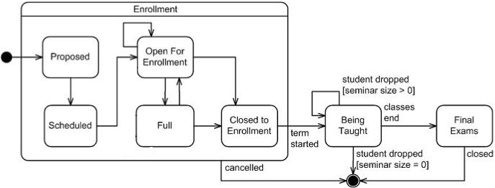
State Changes
Recall how an object during run time can
change its internal state.
  Each state is characterized by the object’s field values.
State changes of a
college class.

Slide 4
The State Design Pattern
The State Pattern helps objects
control their behavior by changing
their internal state.
Example: Design code to monitor
the state of gumball machines.
These examples and their images are from
Head First Design Patterns
by Eric & Elizabeth Freeman
O’Reilly, 2004

Slide 5
The State Design Pattern, cont’d

Slide 6
Example: Gumball Machine
Gather states

Slide 7
Example: Gumball Machine, cont’d
Hold the current state in an instance variable.
  Define values for each of the states.
C++
enum class State {SOLD_OUT, NO_QUARTER, HAS_QUARTER, SOLD};

Slide 8
Example: Gumball Machine, cont’d
Gather all the actions that can happen
in the system.

Slide 9
Example: Gumball Machine, cont’d
Create the state machine class.
  For each action, create a function that uses conditional statements to determine
  what behavior is appropriate in each state.

Slide 10
Example: Gumball Machine, cont’d

Slide 11
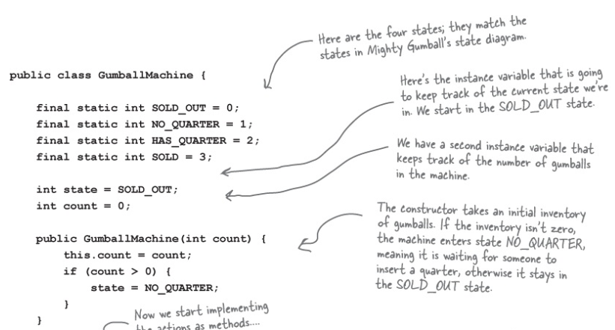
Example: Gumball Machine, cont’d

Slide 12
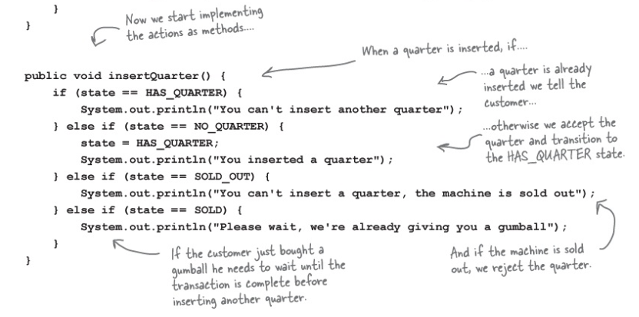
Gumball Machine: Insert Quarter

Slide 13
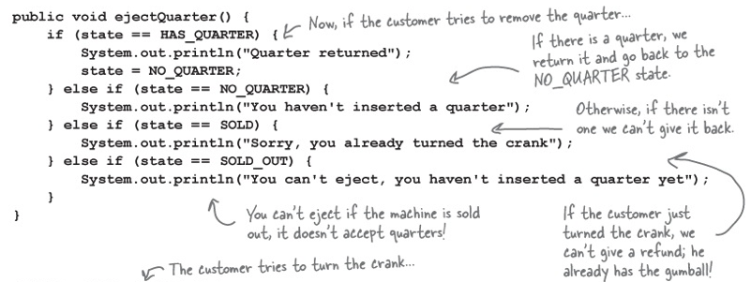
Gumball Machine: Eject Quarter

Slide 14
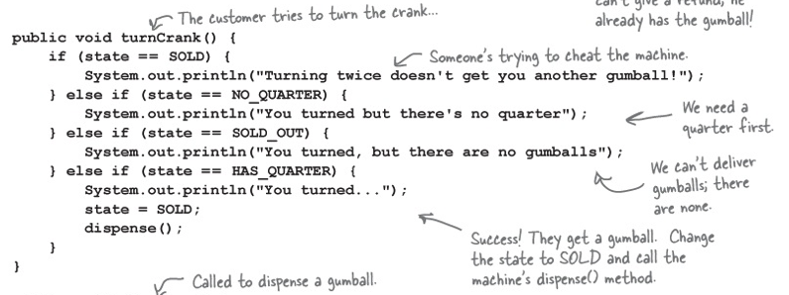
Gumball Machine: Turn Crank

Slide 15
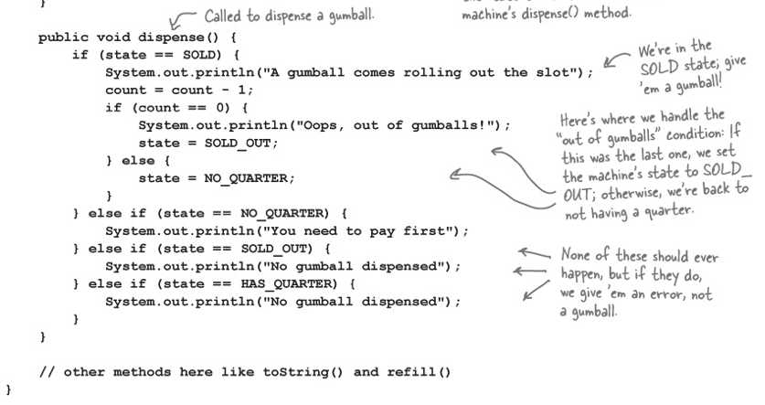
Gumball Machine: Dispense

Slide 16
Testing

Slide 17
A Change Request
C++

Slide 18
Hard to Extend the Code

Slide 19
The New Design
Define a State interface that contains a function for every Gumball Machine action.
Implement a State class for every state
of the machine.
  These classes will be responsible for the behavior
  of the machine when it is in the corresponding state.
Get rid of all the conditional code and instead delegate to the State class to do the work for us.

Slide 20
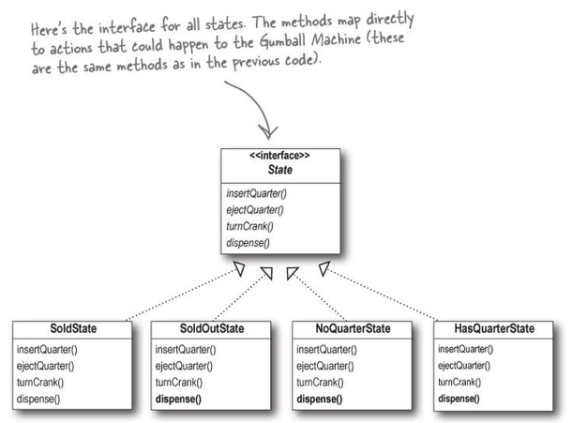
The State Interface
actions
states

Slide 21
Rework the Gumball Machine

Slide 22
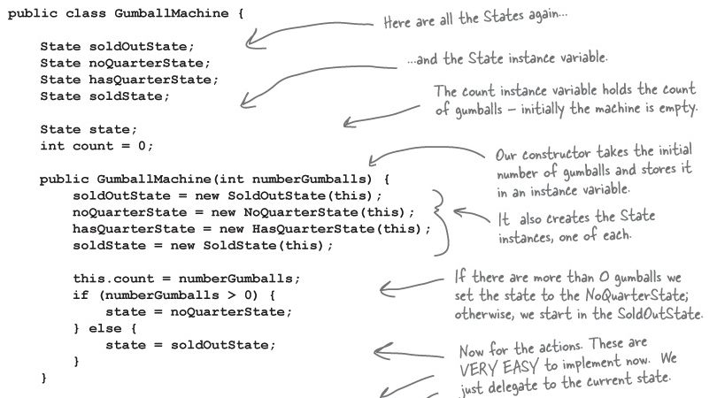
Rework the Gumball Machine, cont’d

Slide 23
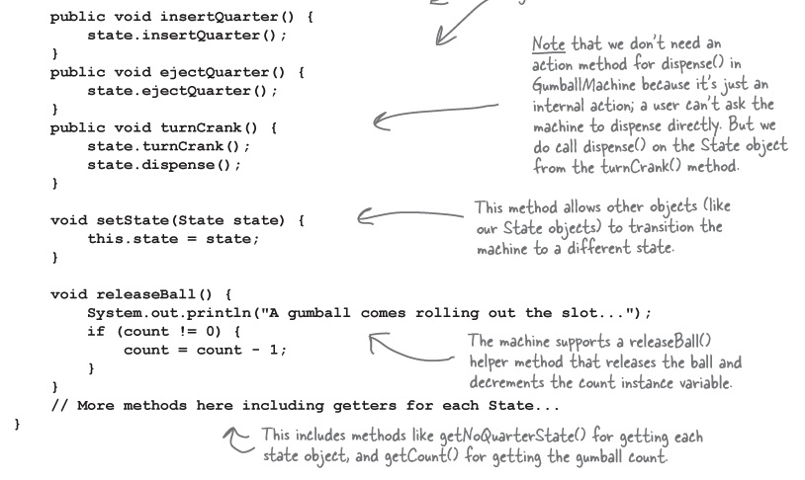
Rework the Gumball Machine, cont’d

Slide 24
State Classes: NoQuarterState
Actions
insert quarter
eject quarter
turn crank
dispense

Slide 25
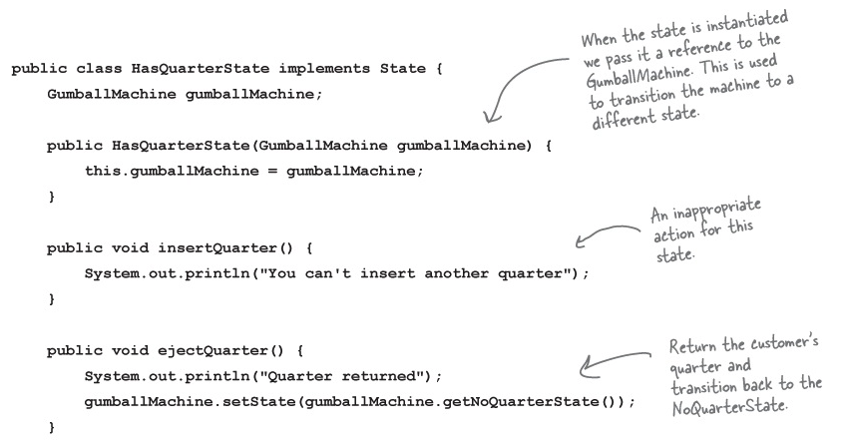
State Classes: HasQuarterState
Actions
insert quarter
eject quarter
turn crank
dispense

Slide 26
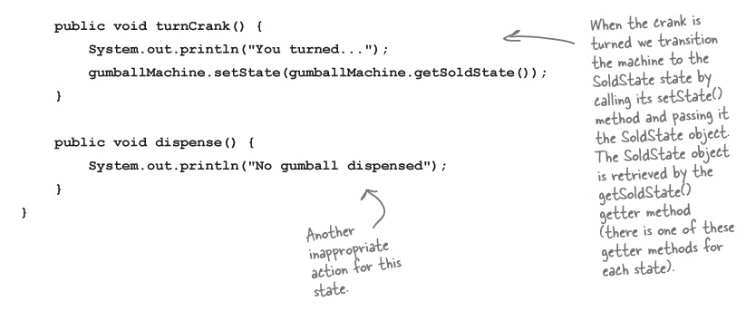
State Classes: HasQuarterState, cont’d
Actions
insert quarter
eject quarter
turn crank
dispense

Slide 27
State Classes: SoldState
Actions
insert quarter
eject quarter
turn crank
dispense

Slide 28
Our Accomplishments
We now have a Gumball Machine implementation that is structurally
quite different from the first version,
and yet functionally it is exactly the same.
When we refactor code,
we change its structure (to improve it)
but not its external behavior.

Slide 29
Our Accomplishments, cont’d
Localized the behavior of each state
into its own class.
Removed all the troublesome if statements
that would have been difficult to maintain.
Closed each state for modification, and yet left the Gumball Machine open to extension by adding new state classes.
Created a code base and class structure that maps much more closely to the Mighty Gumball diagram and is easier to read and understand.

Slide 30
Functional Aspects

Slide 31
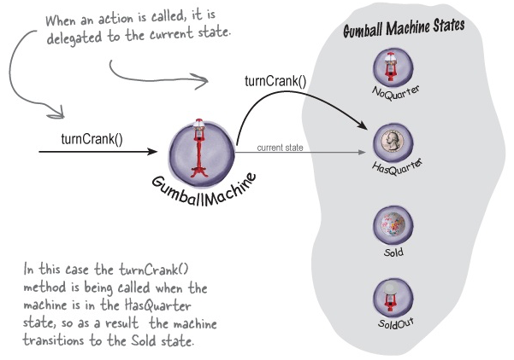
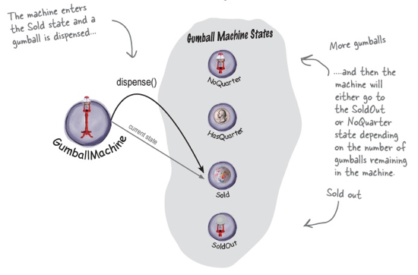
State Transition
transition to
SoldState

Slide 32
State Design Pattern Defined
The State Design Pattern allows
an object to alter its behavior
when its internal state changes.
The object will appear to change its class.
  If an object you’re using can completely change
  its behavior, then it appears that the object is actually instantiated from another class.
  In reality, however, we are using composition
  to give the appearance of a class change
  by simply referencing different state objects.

Slide 33
State Pattern Class Diagram

Slide 34
Complete the Gumball 1-in-10 Game

Slide 35
State Classes: WinnerState
Actions
insert quarter
eject quarter
turn crank
dispense

Slide 36
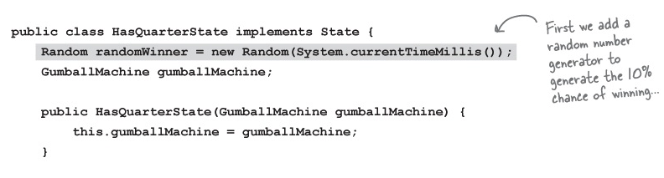
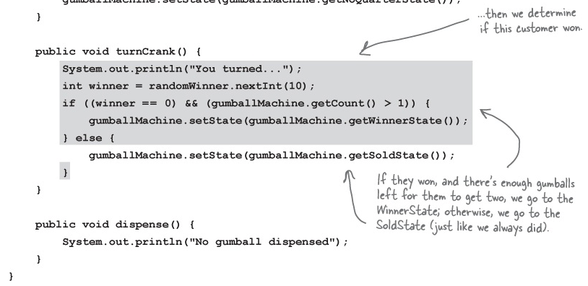
Revised HasQuarterState
. . .

Slide 37
Final Test Run

Slide 38
Final Test Run, cont’d

