Slide 1


CMPE 135
Object-Oriented Analysis and Design
March 25 Class Meeting
Department of Computer Engineering
San Jose State University
Spring 2021
Instructor: Ron Mak
www.cs.sjsu.edu/~mak

Slide 2
Review
Object-oriented design concepts
  Abstraction
  Encapsulation
  Inheritance
  Polymorphism
Object-oriented design principles
  Encapsulate what varies.
  Favor composition over inheritance.
  Program to interfaces, not to implementations.

Slide 3
Other Principles
Open-Closed Principle (OCP)
  Classes should be open for extension
  but closed for modification.
Don’t Repeat Yourself (DRY) Principle
  Abstract out things that are common
  and place them in a single location.
Single Responsibility Principle (SRP)
  Make every object cohesive by giving it a single responsibility that all its services should focus on carrying out.

Slide 4
Other Principles, cont’d
Code reuse
  Use delegation, composition, and aggregation
  to use behavior from other classes.

Slide 5
Goal: Better Software!
Well designed
  Implement object-oriented design basics.
  Follow object-oriented design principles.
Results
  More reliable software done sooner.
  Flexible enough to handle change.
  Easy to maintain.
It’s time to move up to an even higher level.

Slide 6
Design Patterns
A general reusable solution to a commonly occurring software design problem.
A template for how to solve a problem that
can be used in many different situations.
Formalized best practices that can be used
to solve common software design problems.
A shared vocabulary for discussing solutions
to software design problems.

Slide 7
Design Patterns, cont’d
Not cut and paste code to be inserted
into an application.
Discovered, not created from scratch.
  Found after many years of real-world programming experience by many top programmers.
Originated as a concept for designing buildings by architect Christopher Alexander.
Popularized in computer science by the “Gang of Four” (GoF) and their design patterns book.

Slide 8
Design Patterns, cont’d
The “Gang of Four” book.
https://www.amazon.com/Design-Patterns-Elements-Reusable-Object-Oriented/dp/0201633612/ref=sr_1_4?s=books&ie=UTF8&qid=1539843289&sr=1-4&keywords=design+patterns

Slide 9
Shared Pattern Vocabulary
Powerful
  A design pattern communicates not just its name, but the entire set of its qualities, characteristics,
  and constraints.
Say more with less
  Mention a design pattern and other developers quickly know precisely the design you have in mind.
Stay “in the design” longer
  Design pattern discussions stay at a high level without diving to soon into implementation details.

Slide 10
Shared Pattern Vocabulary, cont’d
Accelerate the design team
  A team well versed in design patterns can move
  more quickly with fewer misunderstandings.
Accelerate junior programmers
  Senior programmers who use design patterns
  are strong role models for junior programmers.

Slide 11
How to Use Design Patterns
Unlike library code that gets inserted into your code, design patterns go into your brain.
Framework and library code provide
specific implementations of solutions.
Design patterns are at a higher level.
  They tell us how to structure classes
  to solve certain software design problems.
  We must adapt the design patterns
  to fit each application.
  Built on design concepts and design principles.

Slide 12
The Strategy Pattern
We used the Strategy Design Pattern to create the SimUDuck application.
Today’s examples and some of the images are from
Head First Design Patterns
by Eric & Elizabeth Freeman
O’Reilly, 2004.
The Java code is ported to C++.

Slide 13
The Strategy Pattern, cont’d
Define a family of algorithms.
Encapsulate each algorithm.
Make them interchangeable within the family.
How does your
Rock Paper Scissors
application use the
Strategy Pattern?
https://en.wikipedia.org/wiki/Strategy_pattern

Slide 14
Example: Weather Monitoring Station
WeatherData object tracks current conditions.
  temperature, humidity, barometric pressure
Provide three display elements updated in
real time each time the WeatherData object obtains the most recent measurements:
  current conditions
  weather statistics
  simple forecast
Design an API for developers to create
their own weather displays.

Slide 15
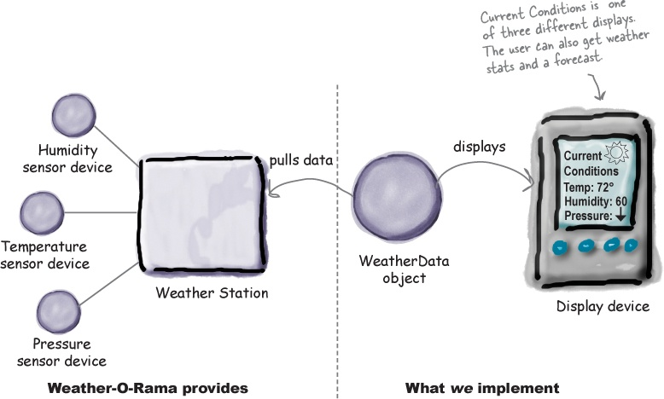
Weather Monitoring Station, cont’d

Slide 16
Display Elements, Version 1
<<interface>>
DisplayElement
+update()
+display()
CurrentConditionsDisplay
StatisticsDisplay
ForecastDisplay
+update()
+display()
+update()
+display()
+update()
+display()

Slide 17
Display Elements, Version 1, cont’d
DisplayElement.h
class DisplayElement
{
public:
virtual ~DisplayElement() {}
virtual void update(float temp, float hum, float pres) = 0;
virtual void display() = 0;
}
Abstract class!

Slide 18
Display Elements, Version 1, cont’d
class CurrentConditionsDisplay : public DisplayElement
{
private:
float temperature;
float humidity;
public:
CurrentConditionsDisplay() : temperature(0), humidity(0) {}
virtual ~CurrentConditionsDisplay() {}
void update(float temp, float hum, float pres)
{
temperature = temp;
humidity = hum;
display();
}
void display()
{
cout << "Current conditions: " << temperature
<< "F degrees and " << humidity << "% humidity" << endl;
}
};
CurrentConditionsDisplay.h

Slide 19
Display Elements, Version 1, cont’d
class StatisticsDisplay : public DisplayElement
{
private:
float maxTemp;
float minTemp;
float tempSum;
int numReadings;
public:
StatisticsDisplay()
: maxTemp(0.0f), minTemp(200), tempSum(0.0f), numReadings(0) {}
virtual ~StatisticsDisplay() {}
void update(float temp, float hum, float pres)
{
tempSum += temp;
numReadings++;
if (temp > maxTemp) maxTemp = temp;
if (temp < minTemp) minTemp = temp;
display();
}
void display()
{
cout << " Statistics: Avg/Max/Min temperature = "
<< tempSum/numReadings
<< "/" << maxTemp << "/" << minTemp << endl;
}
};
StatisticsDisplay.h

Slide 20
Display Elements, Version 1, cont’d
class ForecastDisplay : public DisplayElement
{
private:
float currentPressure;
float lastPressure;
public:
ForecastDisplay() : currentPressure(29.92f), lastPressure(0) {}
virtual ~ForecastDisplay() {}
void update(float temp, float hum, float pres)
{
lastPressure = currentPressure;
currentPressure = pres;
display();
}
void display()
{
cout << " Forecast: ";
if (currentPressure > lastPressure)
{
cout << "Improving weather on the way!" << endl;
}
else if (currentPressure == lastPressure)
{
cout << "More of the same" << endl;
}
else if (currentPressure < lastPressure)
{
cout << "Watch out for cooler, rainy weather" << endl;
}
}
};
ForecastDisplay.h

Slide 21
Weather Data, Version 1
WeatherData
These three member functions
enable the display elements
to obtain the latest temperature,
humidity, and barometric pressure
measurements.
How do we get the three display
elements to update their displays
whenever the measurements change?
+get_temperature()
+get_humidity()
+get_pressure()
+set_measurements()
–measurements_changed()
// other member functions

Slide 22
Weather Data, Version 1, cont’d
class WeatherData
{
private:
float temperature;
float humidity;
float pressure;
CurrentConditionsDisplay *current_conditions_display;
StatisticsDisplay *statistics_display;
ForecastDisplay *forecast_display;
void measurements_changed();
public:
WeatherData(CurrentConditionsDisplay *current,
StatisticsDisplay *statistics,
ForecastDisplay *forecast)
: temperature(0), humidity(0), pressure(0),
current_conditions_display(current),
statistics_display(statistics),
forecast_display(forecast) {}
float get_temperature() const { return temperature; }
float get_humidity() const { return humidity; }
float get_pressure() const { return pressure; }
void set_measurements(float temp, float hum, float pres);
};
WeatherData.h

Slide 23
Weather Data, Version 1, cont’d
void WeatherData::set_measurements(float temp, float hum, float pres)
{
temperature = temp;
humidity = hum;
pressure = pres;
cout << endl;
cout << "NEW WEATHER DATA: temperature " << temp
<< ", humidity " << hum << ", pressure " << pres << endl;
cout << endl;
measurements_changed();
}
void WeatherData::measurements_changed()
{
current_conditions_display->update(temperature, humidity, pressure);
statistics_display->update(temperature, humidity, pressure);
forecast_display->update(temperature, humidity, pressure);
}
WeatherData.cpp

Slide 24
Weather Station Test Program
WeatherStation.cpp
#include "WeatherData.h"
#include "CurrentConditionsDisplay.h"
#include "StatisticsDisplay.h"
#include "ForecastDisplay.h"
int main()
{
CurrentConditionsDisplay *current = new CurrentConditionsDisplay();
StatisticsDisplay *statistics = new StatisticsDisplay();
ForecastDisplay *forecast = new ForecastDisplay();
WeatherData *weatherData = new WeatherData(current, statistics, forecast);
// Simulate changes in weather measurements.
weatherData->set_measurements(80, 65, 30.4f);
weatherData->set_measurements(82, 70, 29.2f);
weatherData->set_measurements(78, 90, 29.2f);
return 0;
}

Slide 25
What’s Wrong with Version 1?
WeatherData.cpp
void WeatherData::measurements_changed()
{
current_conditions_display->update(temperature, humidity, pressure);
statistics_display->update(temperature, humidity, pressure);
forecast_display->update(temperature, humidity, pressure);
}
Good
  The display elements implement a common interface, and each has a similar update() function.
Bad
  We’ve hard-coded the display elements.
  It will be difficult to add or remove display elements.
  We need to encapsulate this area of change!

Slide 26
Newspaper Subscriptions
A newspaper publisher goes into business
and begins publishing newspapers.
You subscribe to a particular publisher, and every time there’s a new edition, it gets delivered to you.
  As long as you remain a subscriber, you get new newspapers.
You unsubscribe when you don’t want papers anymore.
  They stop being delivered.
While the publisher remains in business, people, hotels, airlines, and other businesses constantly subscribe and unsubscribe to the newspaper.

Slide 27
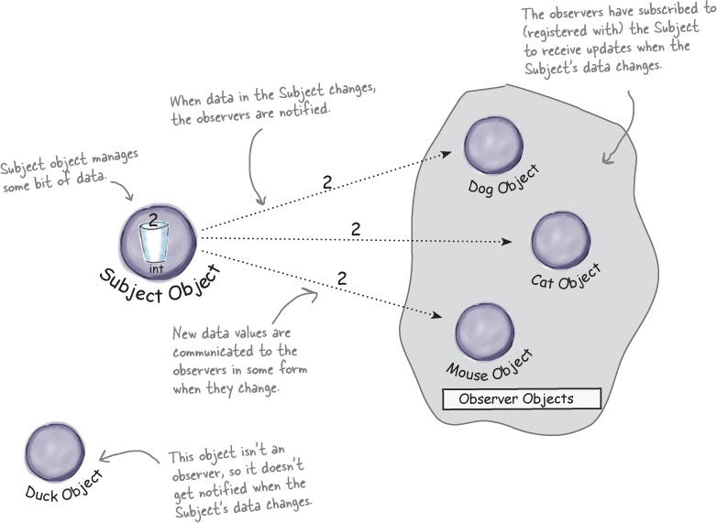
Publishers + Subscribers = Observer Pattern
Observer objects
can come and go.

Slide 28
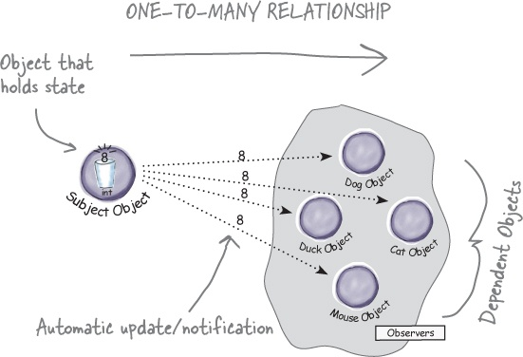
Observer Pattern Defined
Define a one-to-many dependency
between objects.
When an object changes state,
all of its dependents
are notified
and updated automatically.

Slide 29
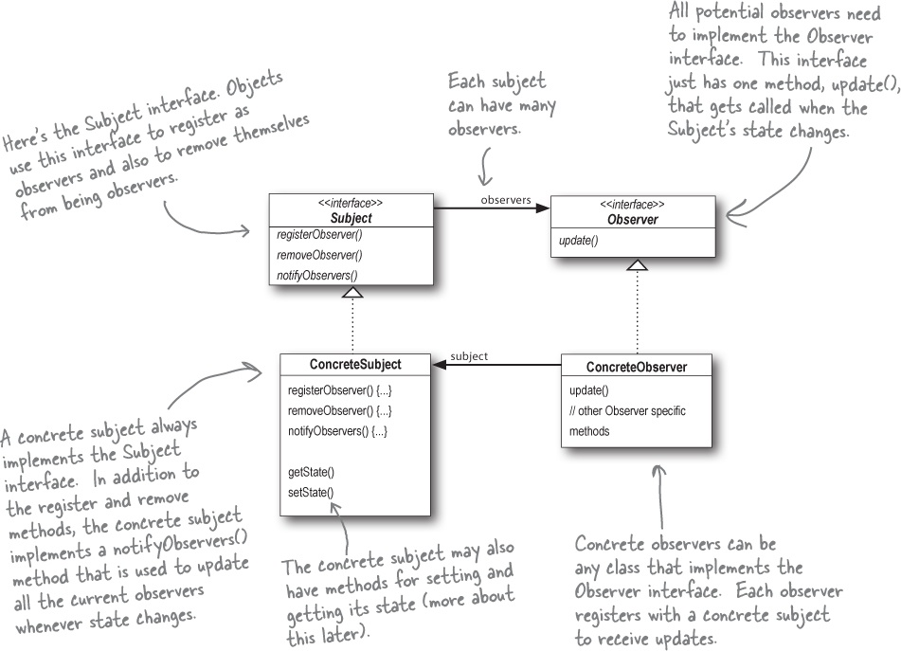
Observer Pattern UML

Slide 30
Loose Coupling
All the Subject knows about an observer is that it implements the Observer interface.
  The subject doesn’t care who the observer is
  or what it does with the data the subject provides.
We can add or remove observers at any time.
We never need to modify the subject
to add new types of observers.
We can reuse subjects or observers independently of each other.
Changes either to the subject or to an observer will not affect the other.

Slide 31
Improved Weather Station Design
<<interface>>
Subject
observers
<<interface>>
Observer
<<interface>>
DisplayElement
1
*
+register_observer()
+remove_observer()
+notify_observer()
+update()
+display()
subject
CurrentConditionsDisplay
+update()
+display()
WeatherData
+register_observer()
+remove_observer()
+notify_observer()
+get_temperature()
+get_humidity()
+get_pressure()
+set_measurements()
-measurements_changed()
StatisticsDisplay
+update()
+display()
ForecastDisplay
+update()
+display()
It won’t be difficult
to add or remove
display elements.

Slide 32
Improved Weather Station Interfaces
class Subject
{
public:
virtual ~Subject() {}
virtual void register_observer(Observer *o) = 0;
virtual void remove_observer(Observer *o) = 0;
virtual void notify_observers() = 0;
};
Subject.h
class Observer
{
public:
virtual ~Observer() {}
virtual void update(float temp, float humidity, float pressure) = 0;
};
Observer.h
class DisplayElement
{
public:
virtual ~DisplayElement() {}
virtual void display() = 0;
};
DisplayElement.h

Slide 33
Improved Weather Data
WeatherData.h
class WeatherData : public Subject
{
private:
vector<Observer *> observers;
float temperature;
float humidity;
float pressure;
void measurements_changed();
public:
float get_temperature() const { return temperature; }
float get_humidity() const { return humidity; }
float get_pressure() const { return pressure; }
void register_observer(Observer *o);
void remove_observer(Observer *o);
void notify_observers();
void set_measurements(float temp, float hum, float pres);
};

Slide 34
Improved Weather Data, cont’d
void WeatherData::register_observer(Observer *o)
{
observers.push_back(o);
}
void WeatherData::remove_observer(Observer *o)
{
vector<Observer *>::iterator it;
it = find(observers.begin(), observers.end(), o);
if (it != observers.end()) observers.erase(it);
}
void WeatherData::notify_observers()
{
for (Observer *o : observers)
{
o->update(temperature, humidity, pressure);
}
}
Notify all the
registered
observers.
WeatherData.cpp

Slide 35
Improved Weather Data, cont’d
void WeatherData::set_measurements(float temp, float hum, float pres)
{
temperature = temp;
humidity = hum;
pressure = pres;
cout << endl;
cout << "NEW WEATHER DATA: temperature " << temp
<< ", humidity " << hum << ", pressure " << pres << endl;
cout << endl;
measurements_changed();
}
void WeatherData::measurements_changed()
{
notify_observers();
}
Notify all the registered observers
whenever measurements change.
WeatherData.cpp

Slide 36
Improved Display Element
class CurrentConditionsDisplay : public Observer, DisplayElement
{
private:
float temperature;
float humidity;
Subject *subject;
public:
CurrentConditionsDisplay(Subject *sub)
: temperature(0), humidity(0), subject(sub)
{
subject->register_observer(this);
}
void update(float temp, float hum, float pres)
{
temperature = temp;
humidity = hum;
display();
}
void display()
{
cout << "Current conditions: " << temperature
<< "F degrees and " << humidity << "% humidity" << endl;
}
};
Register with the subject
in order to get notifications.
CurrentConditionsDisplay.h

Slide 37
Weather Station Test Output
NEW WEATHER DATA: temperature 80, humidity 65, pressure 30.4
Current conditions: 80F degrees and 65% humidity
Statistics: Avg/Max/Min temperature = 80/80/80
Forecast: Improving weather on the way!
NEW WEATHER DATA: temperature 82, humidity 70, pressure 29.2
Current conditions: 82F degrees and 70% humidity
Statistics: Avg/Max/Min temperature = 81/82/80
Forecast: Watch out for cooler, rainy weather
NEW WEATHER DATA: temperature 78, humidity 90, pressure 29.2
Current conditions: 78F degrees and 90% humidity
Statistics: Avg/Max/Min temperature = 80/82/78
Forecast: More of the same

Slide 38
Observer Pattern Summary
Design principle: Separate what varies
from what stays the same.
  What varies: The state of the subject and the number and types of observers.
Design principle: Program to an interface,
not to an implementation.
  Both the subject and the observer use interfaces.
  The subject keeps track of objects that implement the Observer interface.
  Observers register and are notified by the Subject interface.

Slide 39
Observer Pattern Summary, cont’d
Design principle:
Favor composition over inheritance.
  The Observer Pattern composes any number
  of observers with their subjects.
  These relationships are not part of
  an inheritance hierarchy.
  They are established at run time by composition.

