Slide 1


CMPE 135
Object-Oriented Analysis and Design
March 9 Class Meeting
Department of Computer Engineering
San Jose State University
Spring 2021
Instructor: Ron Mak
www.cs.sjsu.edu/~mak

Slide 2
Point-Circle-Rectangle
class Point
{
public:
Point(int x, int y) : x(x), y(y) {}
virtual ~Point() {}
int get_x() const { return x; }
int get_y() const { return y; }
void move(const int dx, const int dy) { x += dx; y += dy; }
private:
int x, y;
};
Is there anything
wrong with this code?
class Circle : public Point
{
public:
Circle(Point center, int r)
: Point(center.get_x(), center.get_y()),
radius(r)
{}
private:
int radius;
};
A Circle has a center Point.
But a Circle is not a Point.
Notes:
START HERE.

Slide 3
Point-Circle-Rectangle, cont’d
Even worse!
  The upper-left corner is kept in the superclass.
  The lower-right corner is a member variable.
class Rectangle : public Point
{
public:
Rectangle(Point upper_left, Point lr)
: Point(upper_left.get_x(), upper_left.get_y()),
lower_right(lr)
{}
void move(int dx, int dy) // override Point::move()
{
Point::move(dx, dy);
lower_right.move(dx, dy);
}
private:
Point lower_right;
};
A Rectangle has two Points.
But a Rectangle is not a Point.

Slide 4
Vector-Stack
#include <string>
#include <vector>
using namespace std;
class Stack : public vector<string>
{
public:
Stack();
void push(string item);
string pop();
};
void Stack::push(string item)
{
this->push_back(item);
}
string Stack::pop()
{
string top_item = this->back();
this->pop_back();
return top_item;
}
VectorStack1.cpp
int main()
{
Stack stk;
stk.push("A");
stk.push("B");
stk.push("C");
stk.erase(stk.begin() + 1); // remove "B"
}
A stack is not a special case
of a vector.
What is wrong
with this code?
Violates the Liskov Substitution Principle:
A vector cannot be substituted by a stack.

Slide 5
Vector-Stack: A Solution
class Stack
{
public:
Stack();
void push(string item);
string pop();
private:
vector<string> stack;
};
void Stack::push(string item)
{
stack.push_back(item);
}
string Stack::pop()
{
string top_item = stack.back();
stack.pop_back();
return top_item;
}
VectorStack2.cpp
int main()
{
Stack stk;
stk.push("A");
stk.push("B");
stk.push("C");
stk.erase(stk.begin() + 1); // remove "B"
}
Compile-time error!

Slide 6
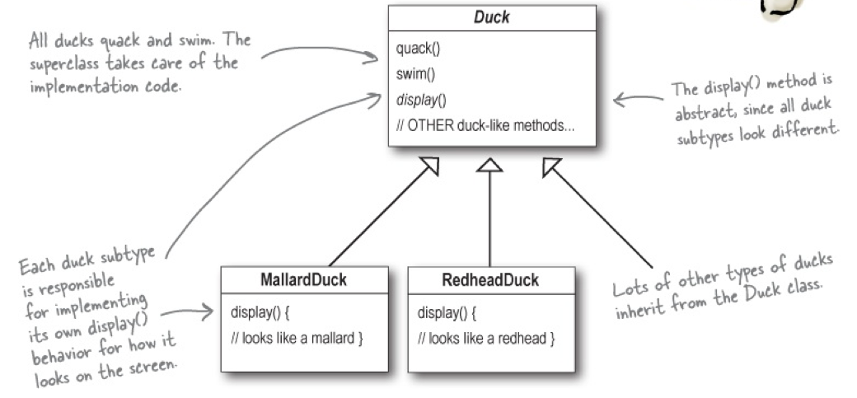
SimUDuck Simulation Game
Use object-oriented design techniques
to create a duck simulation game.
Head First Design Patterns
by Eric & Elisabeth Freeman
O’Reilly, 2004

Slide 7
SimUDuck Simulation Game, cont’d
We need to make the ducks fly.
Head First Design Patterns
by Eric & Elisabeth Freeman
O’Reilly, 2004

Slide 8
Something Went Wrong
Head First Design Patterns
by Eric & Elisabeth Freeman
O’Reilly, 2004

Slide 9
Joe Thinks about Inheritance
Head First Design Patterns
by Eric & Elisabeth Freeman
O’Reilly, 2004

Slide 10
What about Interfaces?
Head First Design Patterns
by Eric & Elisabeth Freeman
O’Reilly, 2004

Slide 11
What about Interfaces? cont’d
Head First Design Patterns
by Eric & Elisabeth Freeman
O’Reilly, 2004

Slide 12
What about Interfaces? cont’d
Head First Design Patterns
by Eric & Elisabeth Freeman
O’Reilly, 2004

Slide 13
Encapsulate What Varies
Head First Design Patterns
by Eric & Elisabeth Freeman
O’Reilly, 2004

Slide 14
Design the Duck Behaviors
In C++, an interface is a superclass,
which is often (but not necessarily) abstract.
Head First Design Patterns
by Eric & Elisabeth Freeman
O’Reilly, 2004

Slide 15
Program to an Interface
Suppose abstract class Animal has two concrete implementations, Dog and Cat.
Code to a specific
implementation:
Code to an interface:
  An improvement:
  Use a factory class to make animal objects.
Dog *d = new Dog();
d->bark();
inflexible
Animal *animal = new Dog();
animal->make_sound();
better
Head First Design Patterns
by Eric & Elisabeth Freeman
O’Reilly, 2004

Slide 16
Implement the Duck Behaviors
Head First Design Patterns
by Eric & Elisabeth Freeman
O’Reilly, 2004

Slide 17
Code Reuse
With this design, other types of objects can reuse our fly and quack behaviors because these behaviors are no longer hidden in our Duck classes.
We can add new behaviors without modifying any of our existing behavior classes or touching any of the Duck classes that use flying behaviors.
So we get the benefit of reuse without all the baggage that comes along with inheritance.

Slide 18
Delegate Duck Behaviors
A Duck can delegate its flying and quacking behavior, instead of using quacking and flying member functions defined in the Duck class or in the subclasses.

Slide 19
Delegate Duck Behaviors, cont’d
Head First Design Patterns
by Eric & Elisabeth Freeman
O’Reilly, 2004

Slide 20
Fly Behaviors
FlyBehavior.h
class FlyBehavior
{
public:
virtual ~FlyBehavior() {}
virtual void fly() = 0;
};
The interface
Fly.h
#include "FlyBehavior.h"
class Fly : public FlyBehavior
{
public:
void fly() { cout << " I can fly!" << endl; }
};
class NoFly : public FlyBehavior
{
public:
void fly() { cout << " I can't fly!" << endl; }
};
Specific
implementations

Slide 21
Quack Behaviors
QuackBehavior.h
class QuackBehavior
{
public:
virtual ~QuackBehavior() {}
virtual void quack() = 0;
};
The interface
Quack.h
#include "QuackBehavior.h"
class Quack : public QuackBehavior
{
public:
void quack() { cout << " Quack!" << endl; }
};
class Squeak : public QuackBehavior
{
public:
void quack() { cout << " Squeak!" << endl; }
};
class Mute : public QuackBehavior
{
public:
void quack() { /* silent */ }
};
Specific
implementations

Slide 22
The Abstract Duck Superclass
Duck.h
#include "QuackBehavior.h"
#include "FlyBehavior.h"
class Duck
{
public:
virtual ~Duck() {}
void perform_quack() { quack_behavior->quack(); }
void perform_fly() { fly_behavior->fly(); }
virtual void identify() = 0;
protected:
QuackBehavior *quack_behavior;
FlyBehavior *fly_behavior;
};
The interface
for a duck
Quacking is delegated to
the QuackBehavior object.
Flying is delegated to
the FlyBehavior object.

Slide 23
Create Ducks
#include "Duck.h"
#include "Quack.h"
#include "Fly.h"
class MallardDuck : public Duck
{
public:
MallardDuck()
{
quack_behavior = new Quack();
fly_behavior = new Fly();
}
void identify() { cout << "Mallard duck" << endl; }
};
class RubberDuck : public Duck
{
public:
RubberDuck()
{
quack_behavior = new Squeak();
fly_behavior = new NoFly();
}
void identify() { cout << "Rubber duck" << endl; }
};
DuckTypes.h
Specific duck
implementations
Set behavior
at run time.
Set behavior
at run time.

Slide 24
Test Ducks
DuckTest.cpp
#include "DuckTypes.h"
int main()
{
MallardDuck *mallard = new MallardDuck();
RubberDuck *rubber = new RubberDuck();
mallard->identify();
mallard->perform_quack();
mallard->perform_fly();
cout << endl;
rubber->identify();
rubber->perform_quack();
rubber->perform_fly();
return 0;
}
Mallard duck
Quack!
I can fly!
Rubber duck
Squeak!
I can't fly!

Slide 25
The Big Picture on Encapsulated Behaviors
Head First Design Patterns
by Eric & Elisabeth Freeman
O’Reilly, 2004

Slide 26
“Has a” is Often Better Than “Is a”
Design principle:
Composition is more flexible.
  A duck is composed of quack and fly behaviors.
You can set and change behavior at run time.
  If you’ve written code using inheritance, you must rewrite the code and recompile to change behaviors.
Favor composition over inheritance.
“has a”
“is a”

Slide 27
The Need for Virtual Destructors
class Employee
{
public:
Employee() { cout << "Employee called" << endl; }
~Employee() { cout << "~Employee called" << endl; }
};
class Manager : public Employee
{
public:
Manager() { cout << "Manager called" << endl; }
~Manager() { cout << "~Manager called" << endl; }
private:
string name;
};
Employee.h
Demo
#include "Employee.h"
int main()
{
Employee *ptr = new Manager();
delete ptr;
return 0;
}
Which destructor(s) is/are called?
DestructorTest.cpp

Slide 28
The Need for Virtual Destructors, cont’d
Employee.h
class Employee
{
public:
Employee() { cout << "Employee called" << endl; }
virtual ~Employee() { cout << "~Employee called" << endl; }
};
class Manager : public Employee
{
public:
Manager() { cout << "Manager called" << endl; }
~Manager() { cout << "~Manager called" << endl; }
private:
string name;
};
virtual
Demo

