Slide 1


CMPE/SE 131
Software Engineering
May 4 Class Meeting
Department of Computer Engineering
San José State University
Spring 2017
Instructor: Ron Mak
www.cs.sjsu.edu/~mak

Slide 2
The Rational Unified Process (RUP)
An agile and iterative software development process framework.
  Created by Rational Software Corporation,
  now a division of IBM.
  Based on the Rational Approach developed
  during the 1980s and 1990s.
Very different development philosophy from Extreme Programming.
  More formal, prescriptive, and process-oriented.
  Better-suited to more traditional corporate cultures.

Slide 3
RUP: Essential Principles
Attack major risks early and continuously.
  Or they will attack you.
Ensure that you deliver value to your customer.
Stay focused on executable software.
Accommodate change early in the project.
Baseline an executable architecture early on.
Build your system with components.
Work together as a team.
Make quality a way of life.
  Not an afterthought.

Slide 4
RUP: Four Key Modeling Elements
Roles
  who
Activities
  how
Artifacts
  what
Workflows
  when

Slide 5
Rational Unified Process: Roles
Emphasis on roles.
  architect
  developer
  business analyst
  database designer
  technical writer
  tester
Each project team member can have
one or more roles.
Some roles can be filled by more than
one team member.

Slide 6
Rational Unified Process: Artifacts
Artifact: A piece of information produced, modified, or used by a process.

Slide 7
Rational Unified Process: Artifacts, cont’d
Model
  use case
  design
Document
  vision statement
  business case
Source code
Executable
  prototype

Slide 8
Rational Unified Process: Workflows
Workflow: A description of:
  The sequence of events that produce a result.
  The interaction between roles.
Discipline: A high-level workflow.
Express workflows using UML diagrams.
  sequence diagram
  collaboration diagram
  activity diagram

Slide 9
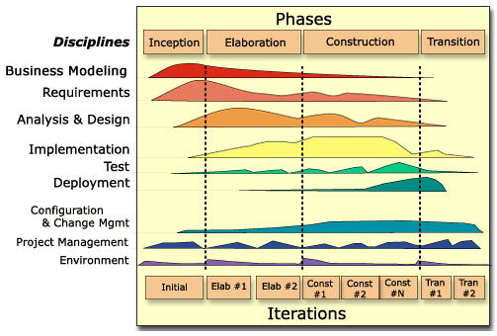
The Rational Unified Process: Disciplines
Not the phases of the waterfall model!

Slide 10
RUP: Inception Phase
Define the goals of the project.
Define the overall scope.
Define the high-level architecture.

Slide 11
RUP: Elaboration Phase
Iterations (each 2 to 6 weeks)
  Refine the scope.
  Define the overall architecture.
  Specify functionality and features.
  Create use cases.
  Build prototypes.

Slide 12
RUP: Construction Phase
Iterations (each 2 to 6 weeks)
  Design
  Develop
  Test

Slide 13
RUP: Transition Phase
Complete the documentation.
Release the product to the users.

Slide 14
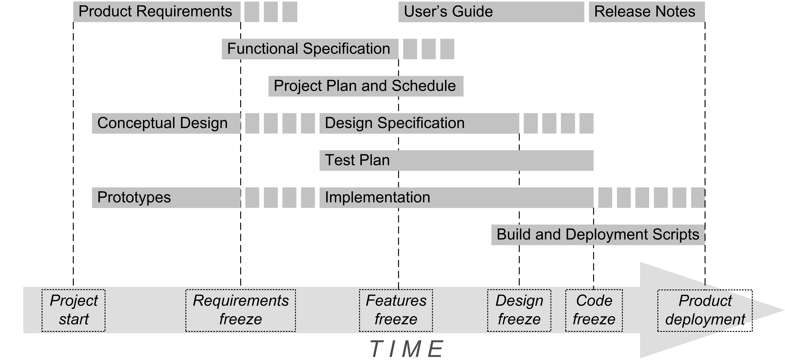
RUP: Comparison

Slide 15
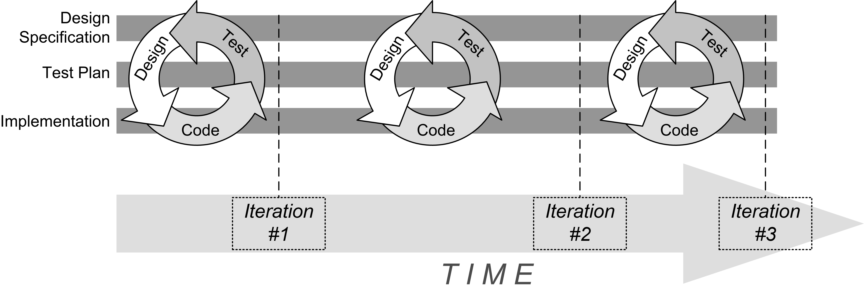
RUP: Comparison, cont’d

Slide 16
Cyberethics
Does computer technology warrant
a special branch of ethics?
Computer technology introduces new
and unique moral issues.
Examples:
  Software duplication and piracy
  Downloading copyrighted music without paying
  Phishing and scam e-mails
  Denial-of-service (DoS) attacks
Ethics & Technology: Ethical Issues in an Age of
Information and Communication Technology, 2nd edition
by Herman T. Tavani
Wiley 2007.

Slide 17
Four Major Time Periods of Cyberethics
1950s-1960s
  Technology: Large standalone mainframes
  Issues
    Artificial intelligence (AI)
    Database privacy (“Big Brother”)

Slide 18
Four Time Periods of Cyberethics, cont’d
1970s-1980s
  Technology: Interconnected minicomputers
  and PCs
  Issues
    Piracy of intellectual property and software
    Computer crime
    Communications privacy

Slide 19
Four Time Periods of Cyberethics, cont’d
1990s to the present
  Technology: Internet and the World Wide Web
  Issues
    Free speech, anonymity and virtual communities
    Legal jurisdiction

Slide 20
Four Time Periods of Cyberethics, cont’d
Present to the near future
  Technology: Convergence of information
  and communications technologies with nanotechnology and biotechnology
  Issues
    Decision-making artificial electronic agents (“bots”)
    Developments in nanocomputing, bioinformatics,
    and computational genomics
    Big Data, data mining, data analytics, machine learning
    Big Brother

Slide 21
What is Morality?
Morality is:
  A system of rules for guiding human conduct.
    What’s right and what’s wrong.
  A set of principles for evaluating those rules.
Sources of moral rules
  Religion
    “Thou shalt not steal.”
  Philosophy
    “Stealing is wrong. Don’t do it.”
  Legal
    “If you’re caught stealing, you’ll go to jail.”

Slide 22
What is Ethics?
Ethics: Pertaining to moral rules and principles, or the study of these rules and principles.
Ethical: Conforming to a set of moral rules.
  Example: ethical behavior

Slide 23
What is a Profession?
Profession: An occupational field that can be characterized by:
  systematic theory
  authority
  community sanction
  ethical codes
  culture

Slide 24
What is a Profession? cont’d
The software engineering profession has:
  theory (computer science)
  authority (professional societies such as the ACM and the IEEE)
  sanction (we’re allowed to develop software)
  codes for conduct (from the ACM and the IEEE)
  the “high tech” culture

Slide 25
Who is a Professional?
Professional
  Is an expert in a field
  Has advantages over a lay person
    The professional’s work can impact the lay person’s life positively or negatively.
  May have special moral responsibilities
Computer professionals
  Software engineers
  Computer science instructors
  End-user support personnel (e.g., database and network administrators)

Slide 26
Special Moral Responsibilities
Software engineers who develop safety-critical systems have significant opportunities to
  do good or cause harm
  enable others to do good or cause harm
  influence others to do good or cause harm

Slide 27
Safety-Critical Systems
Direct life-threatening impact
  aircraft, aircraft control,
  and mass transportation systems
  nuclear reactors
  missile systems
  medical treatment systems
Indirect life-threatening impact
  design of bridges and buildings
  development of analytical models
  for medical treatment

Slide 28
Professional Codes of Ethics and Conduct
Motivate members of a profession to behave in certain ways.
Inspire, guide, educate, and discipline the members.
Sufficiently broad to cover the ethical concerns that a professional may encounter in the field.
Sufficiently specific to service as a guide
to making sound decisions for practical action
in actual circumstances.

Slide 29
Professional Codes, cont’d
How to resolve conflicts between moral rules.
Inform clients and employers what to expect from the professional.
Microethics: Responsibilities of an individual professional.
Macroethics: Responsibilities of the profession itself.

Slide 30
Hierarchy of Codes
Codes of ethics
  “Aspirational”
    Mission statements, vision, objectives
  Violations considered minor.
Codes of conduct
  The professional’s attitude and behavior.
  Violations considered serious.
    Consequences range from warnings
    to exclusion from practice.
Codes of practice
  Operational activities within a profession.
  Violations can result in legal action.

Slide 31
Software Engineering Code
The IEEE-CS/ACM Software Engineering Code of Ethics and Professional Practice (SECEPP)
  The code for the software engineering profession.
  Developed jointly in the late 1990s by:
    The Computer Society of the Institute for Electrical and Electronics Engineers (IEEE-CS)
    The Association for Computing Machinery (ACM)
Following the directives of a code is not
a substitute for a careful moral deliberation.

Slide 32
Questions about Professional Responsibility
Should engineers be required to be
moral heroes and saints?
If engineers are held to a higher standard of social responsibility than ordinary people, then
  How much responsibility should the profession
  (e.g., software engineering) bear as a whole?
  Should engineers be encouraged to shift their thinking about responsibility from microethics (individual) to macroethics (their profession itself)?

Slide 33
Responsibility: Causality vs. Intent
Philosophical concepts.

Slide 34
Responsibility: Causality vs. Intent, cont’d
Person P is morally responsible for act A,
if P caused A, even if P did not intend A.
  Example: Robert Morris was a CS grad student who launched a software worm in 1988 that nearly shut down the Internet. He claimed that it was an experiment that got out of control.
    Morris was held responsible for the outcome even though
    it was not his intent.
  Example: You’re upset with your company and plant a virus in its software product. The virus is discovered and removed by the QA department before the product ships.
    You are held responsible even though the virus
    did not cause harm to customers.

Slide 35
Moral Responsibility
Attributes blame.
Typically applies to individuals
rather than to groups or collectives.
Applies notions of guilt or shame,
but not necessarily legal punishment
or compensation.

Slide 36
Legal Liability
Does not attribute blame or fault.
Typically applies to corporations
and property owners.
Compensation can be required even when responsibility is not admitted.
Can be disclaimed:
“This software is sold as-is.”

Slide 37
Accountability
Does not necessarily attribute blame
(in a moral sense).
Can apply to individuals, groups, and corporations.
Someone or some group is “answerable”.

Slide 38
Some Important Ethical Issues
Privacy
  Amount of personal information
  that can be gathered.
  The speed at which the information
  can be transmitted.
  The duration of time that the information
  can be retained.
  The kind of information that can be transferred.
Security
  Unauthorized access to data.
  Attacks on computer hardware and software.
  Attacks on computer networks.

Slide 39
Who’s to Blame? USS Vincennes
July 3, 1988: USS Vincennes fires two missiles at Iran Air Flight 655 in the Persian Gulf,
killing 290 civilians.
Sophisticated onboard $600M Aegis radar system misidentified the Airbus as an F-14 Tomcat fighter.
  Received the IFF transponder signal
  of a known Iranian F-14.

Slide 40
Who’s to Blame? USS Vincennes
The Airbus did not respond to radio commands to identify itself.
Both civilian and military aircraft used
Bandar Abbas airport.
  The US Navy did not monitor civilian flights.
The Iranian military and civilian controllers at the airport did not talk to each other.
“Hair trigger” rules of engagement.
  USS Stark previously hit by an Exocet missle.

Slide 41
Who’s to Blame? USS Vincennes, cont’d
User interface problems
  Three large displays.
  Rate of change of speed, range,
  and altitude not explicitly shown.
  Operators must make readings at different times
  and do manual calculations.
IFF monitor didn’t automatically
update its display.
  Still showed signals received from F-14s
  at the airport.

Slide 42
Who’s to Blame? USS Vincennes, cont’d
GUI designers gave the Navy what it asked for, not what it needed.
Overconfidence in the Aegis technology.
Operator errors and stress.

Slide 43
Who’s to Blame? USS Vincennes, cont’d
See:
  http://www-cs-students.stanford.edu/~lswartz/vincennes.pdf
  http://www.time.com/time/magazine/article/0,9171,1101880718-149693,00.html

