Slide 1


CMPE/SE 131
Software Engineering
April 18 Class Meeting
Department of Computer Engineering
San José State University
Spring 2017
Instructor: Ron Mak
www.cs.sjsu.edu/~mak

Slide 2
Code Reviews
AKA code inspection
Different levels: personal, walkthrough, formal
Personal review
  You carefully examine your own code
  to find and fix as many bugs as possible.
Code walkthrough
  An informal process where you walk through your code’s behavior in front of your project colleagues.
Formal review

Slide 3
Formal Code Review
Three phases:
  Preparation
  Inspection meeting
  Repair and report
Preparation
  Introductory meeting to ensure everyone understands what is being reviewed.
  Decide participants’ roles.
  Reviewers study the material being inspected.

Slide 4
Formal Code Review, cont’d
Inspection meeting
  Reviewers discuss inspection findings
  with the developers.
  Assign resolution responsibilities.
Rework
  Developers fix bugs.
  Write and submit an inspection report.
  Schedule a verification meeting.

Slide 5
Formal Code Review, cont’d
Verification meeting
  Reviewers verify bug fixes.

Slide 6
Formal Code Review, cont’d
Planning
Verify materials meet review criteria.
Schedule introductory meeting.
Rework
Developer fixes bugs.
Write and submit inspection report.
Schedule verification meeting.
Introductory meeting
Developer presents materials.
Decide participants’ roles.
Schedule inspection meeting.
Yes
More
bugs?
Inspection meeting
Group reviews materials.
Log bugs.
Recorder collects metrics.
No
Verification meeting
Reviewers verify bug fixes.
Any
bugs?
Yes
No
Done!

Slide 7
What to Review
Your source code, of course.
But also:
  design documentation
  project plans and schedules
  test plans
  deployment plans
  maintenance plans

Slide 8
What to Ask During a Code Review
What are the goals of the review?
  Reduce the number of bugs.
  Reduce support costs.
How will you collect metrics?
  Without a quantifiable measure of success,
  how do you know the review process is helping?
  Can you assign a dollar value to each measurable goal?

Slide 9
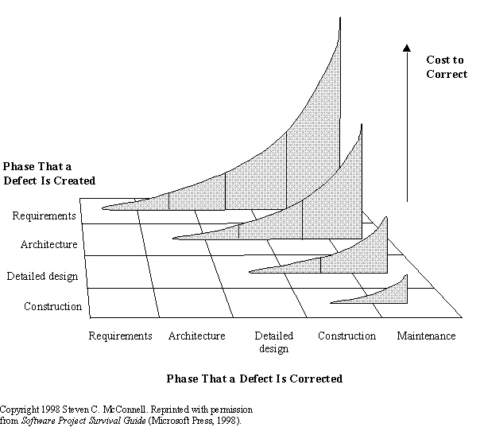
Why do Code Reviews?
Recall this diagram:
  The sooner you find and fix bugs,
  the less expensive it is.

Slide 10
Why do Code Reviews? cont’d
Recall:
change
complexity
collaboration
communication
coordination
Code reviews add collaboration,
communication, and coordination
to software development.
  Programmers want to work alone.
  Programmers unit test their own code,
  but another pair of eyes will catch more bugs.
An undetected defect can be extremely costly.
  One bug can result in the loss of market share.
A successfully implemented code review process can be a competitive advantage.

Slide 11
Benefits of Code Reviews
Direct benefits
  improved code quality
  fewer bugs
  improved communication about the code
  education of junior or newly hired programmers
Indirect benefits
  shorter development and test iterations
  reduced impact on technical support
  more customer satisfaction
  more maintainable code

Slide 12
Resistance to Code Reviews
Programmer egos
  Two classes of programmers:
  collaborators and isolationists
  Isolationists will thrash unproductively
  rather than admit to peers that they need help.
Perceived cost
  Too much trouble to prepare the materials.
  The entire procedure is too disruptive.
  Not worth the effort even if the code is improved.

Slide 13
Pros and Cons of Code Reviews
Synergy
  Pro: Teams find bugs that no individual would.
  Con: Find false-positives rather than real bugs.
Education
  Pro: Less experienced developers learn from pros.
  Con: Education by observation is less effective.
Deadline
  Pro: Reviews create schedules for the developers.
  Con: Too many meetings.

Slide 14
Pros and Cons of Code Reviews, cont’d
Competition
  Pro: Egos lead to personal incentives to do well.
  Con: Competition destroys teamwork.
Studies have shown that more actual bugs are found while preparing for a code review than during the inspection meeting itself.
  Would it be better to improve the testing procedures?

Slide 15
Continuous Code Review
The Extreme Programming methodology advocates pair programming.
  Two developers at a single workstation.
One developer codes while the other watches.
  They can take turns.
Continuous free-form discussion
and code review.
But then both developers may be too close to the code to see it with a fresh perspective.

Slide 16
Productive Code Reviews
Object-oriented code can be difficult to review.
  In order to understand one class,
  you may need to look at other classes.
  Reviewers may end up wandering aimlessly
  and end up reading code that is off-topic.
Developers should prepare a “reading plan”.
  A checklist of what to look for in the code.
  Use cases that the code should implement correctly.

Slide 17
What to Look For in a Code Review
Documentation
  comments
  corner cases
  complex algorithms
  non-obvious or unusual behavior
  incomplete TODO items
Testing
  unit tests written

Slide 18
What to Look For in a Code Review, cont’d
Error handing
  defensive programming throughout
Thread safety
  handle multiple processes and threads
Performance
  good CPU and memory utilization
  no unnecessary optimizations

Slide 19
A Code Review War Story
What I found during an actual code review.
  When I was a Research Staff Member at a 100+ year old computer company whose name I won’t mention but commonly known by its three initials.
Cfront: The original C++ compiler in 1983
which translated C++ source code into C.
  Did not support exceptions.
“We’ve always done it this way.”
  “If we added exception handling now,
  the new code will be different from the old code.”

Slide 20
Next Week: (Semi) Formal Code Reviews
Each project team will lead a code review.
Preparation
  Each team provides some source code for an important algorithm or use case.
    Other than logging in or logging out.
    Should take reviewers at most 20 minutes to read the code.
  Reading plan
    Checklist (what to look for)
    High-level description of the algorithm or use case.

Slide 21
Next Week: Code Reviews, cont’d
Create a zip file and submit into Canvas:
Code review material by Sunday night, Apr. 23
Inspection meetings
  12 minutes per team
  Briefly go the code being reviewed.
  Ask the reviewers questions.
  Solicit suggestions for improvement.
Tuesday Apr. 25 and Thursday Apr. 27

Slide 22
Software Metrics
Quantitative measurements
of a software project.
Attribute
  something you can measure
  number of lines of code
  number of bugs
Metric
  can be the same as an attribute
  can also be a calculated value
  number of bugs per thousand lines of code (KLOC)

Slide 23
What are Good Attributes and Metrics?
Simple
  The easier an attribute to understand, the better.
Measurable
  It’s not useful if you can’t measure it.
Relevant
  If it’s not a useful indicator, don’t bother measuring it.

Slide 24
What are Good Attributes and Metrics? cont’d
Objectivity
  Easier to get meaning results from objective data.
  Objective: The number of bugs.
  Subjective: Ease of use of the GUI.
Easily obtainable
  Gathering attribute data should not be a huge burden.

Slide 25
How to Use Metrics
Minimize a schedule.
Stay on schedule.
Reduce the number of bugs.
Predict the number of bugs that will arise.
Make bug fixing easier.
Assess ongoing quality.
Improve finished results.
Improve maintenance.
Detect risks such as schedule slips and
adjust staffing and work effort to address them.

Slide 26
How to Use Metrics, cont’d
Provide regular feedback to the project team.
Signposts that point in the right direction.
  Not always harbingers of doom.
Not to appraise individuals
or the team as a whole.
  Do not use to chastise, or you will no longer get accurate metric data.
Do not obsess over a particular metric.
  Don’t create a problem where none exists.

Slide 27
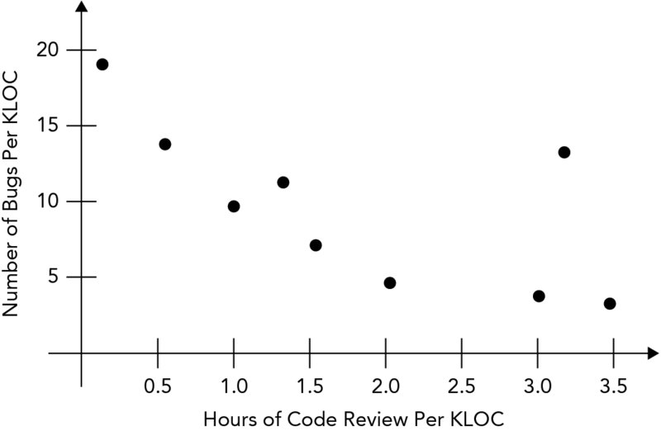
Process Metrics
Measure the development process.
Collect over a long period of time
over many projects.
Use to improve your development process.
Example:
  Spend 1.5 to 2 hours
  per KLOC for code
  reviews in future
  projects.
  KLOC: thousand
  lines of code
Beginning Software Engineering
by Rod Stephens
Wrox, 2015

Slide 28
Project Metrics
Measure a specific project.
Use to set project goals.
  Example: Write ten use cases per day.

Slide 29
Objective Project Metrics
Cost and effort
  $$$
  person-hours
Defect rates
  number of bugs discovered over time
Lines of code
  average LOC per day, or per developer per day
Pages of documentation

Slide 30
Subjective Project Metrics
Sufficiency
  Satisfies all requirements.
Robustness
  Recovers from all anomalous events.
Flexibility
  Easily adaptable to changes.
Reusability
  Can be reused in related applications.

Slide 31
Subjective Project Metrics, cont’d
Efficiency
  Meets speed and resource requirements.
Reliability
  Achieves the required mean time between failures.
Scalability
  Is the basis for a version with greater scope.
Security
  Resists security breaches.

Slide 32
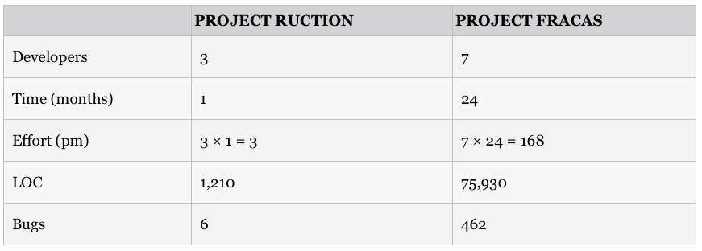
Metric Normalization
In which project were the developers
more productive?
Beginning Software Engineering
by Rod Stephens
Wrox, 2015

Slide 33
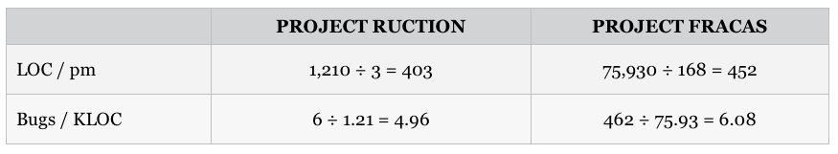
Size-Oriented Normalization
Divide each attribute value by the project size.
Project Fracas was more productive
in terms of lines of code.
Project Ruction had less buggy code.
Beginning Software Engineering
by Rod Stephens
Wrox, 2015

Slide 34
Function Point Normalization
Calculate an FP number to measure
the application’s complexity.
  Measure a project from the user’s point of view.
  Count what an application does, not how it does it.
Function points
  inputs: how many times internal data is updated
  output: how many times output occurs
  inquiries: how many query/response actions
  internal files: number of logical files
  external files: number of files used that are managed by external programs (such as databases)

Slide 35
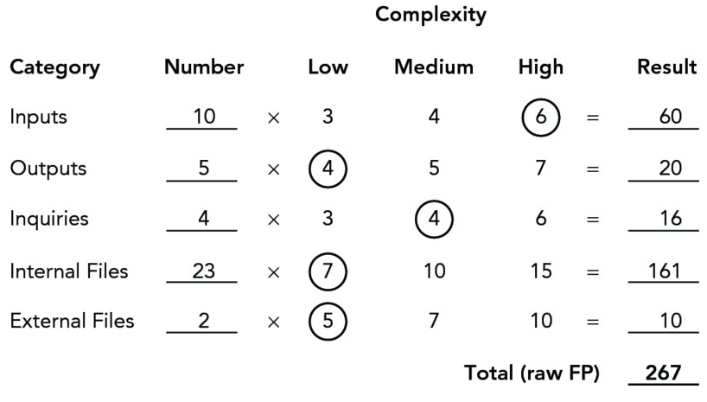
Function Point Normalization, cont’d
Multiply each FP metric by a complexity factor and sum up the products to get a total (raw) FP.
  Example:
Beginning Software Engineering
by Rod Stephens
Wrox, 2015

Slide 36
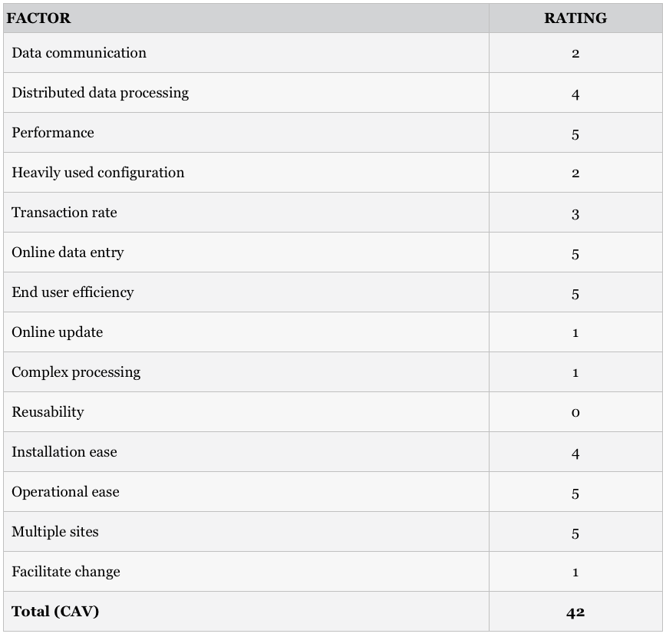
Function Point Normalization, cont’d
Calculate the complexity adjustment value (CAV)
  Example:
Importance | Rating
Irrelevant | 0
Minor | 1
Moderate | 2
Average | 3
Significant | 4
Essential | 5
Beginning Software Engineering
by Rod Stephens
Wrox, 2015

Slide 37
Function Point Normalization, cont’d
Calculate the final FP:
  Example: FP = 267 x (0.65 + 0.01 x 42) = 285.69
See https://cs.uwaterloo.ca/~apidduck/CS846/Seminars/abbas.pdf
FP = (raw FP) x (0.65 + 0.01 x CAV)
constants determined
empirically

