Slide 1


CMPE/SE 131
Software Engineering
March 21 Class Meeting
Department of Computer Engineering
San José State University
Spring 2017
Instructor: Ron Mak
www.cs.sjsu.edu/~mak

Slide 2
Midterm Stats
Median | 78.0
Average | 75.8
Standard deviation | 12.1

Slide 3
Midterm Solutions: Question 1
How does ORM deal with change?
  As part of the data access layer of an application, ORM helps to maintain loose coupling between the application body and the data repository.
How does ORM deal with complexity?
  ORM allows your Ruby code to work only with objects and not have to deal with the relational data model. The database code can be written by another programmer, thus partitioning the work.

Slide 4
Midterm Solutions: Question 1, cont’d
Give two examples of how Ruby’s ORM helps you as you write code for your application.
  You do not need to learn SQL.
  You write code to work with objects only.

Slide 5
Midterm Solutions: Question 2
You are developing a web-based ride-sharing application for students who commute to and from San Jose State. Students will be able to share their class schedules and locations and arrange carpools.
List three functional requirements.
  Each user shall have a profile.
  A user must enter his or her class schedule and locations.
  The application shall match users’ schedules and locations.

Slide 6
Midterm Solutions: Question 2, cont’d
List two nonfunctional requirements.
  The application must run on laptops and mobile devices.
  The application must have privacy and security measures.
Name four model components.
  student, profile, location, class time
Name three view components.
  student profile form, class schedule form, car pool route
Name three controller components.
  student log in and log out, match students, notify students

Slide 7
Midterm Solutions: Question 2, cont’d
Draw a use case diagram that contains three use cases and two actors.

Slide 8
Midterm Solutions: Question 2, cont’d
In which project documentation would this information appear, and why?
  Functional Specification: Requirements and use case diagram. Non-technical material that is part of the communication between users and developers.
  Design Document: MVC components. Implementation details.

Slide 9
Midterm Solutions: Question 3
Hand-draw an entity-relationship (ER) diagram for the database of the previous app. It must have a one-to-one relationship, a one-to-many relationship, and a many-to-many relationship.

Slide 10
Midterm Solutions: Question 3, cont’d

Slide 11
Midterm Solutions: Question 3, cont’d
Hand-draw the relational schema mapped from your
ER diagram.
In which project documentation would this information appear, and why?
  The ER diagram can go into the Functional Specification with the conceptual design, since it will be part of the non-technical communication between the customer and developer. It can also go into the Design Document along with the relational schema. The schema is database implementation details.

Slide 12
Bug Tracking
AKA defect tracking or issue tracking
A central place to store application bugs found:
  During development and testing
  After deployment
Store, categorize, and prioritize bugs.
Assign bugs to developers to fix.
Look up bugs in the bug database.
Keep track of the status of each bug.
Generate bug reports.

Slide 13
Bugzilla
A leading web-based bug-tracking tool.
  See http://www.bugzilla.org/about/
Features
  Track bugs and code changes
  Communicate with teammates
  Submit and review patches
  Manage quality assurance (QA)
Free Bugzilla hosting
  http://www.bugheaven.com/index.php/Free

Slide 14
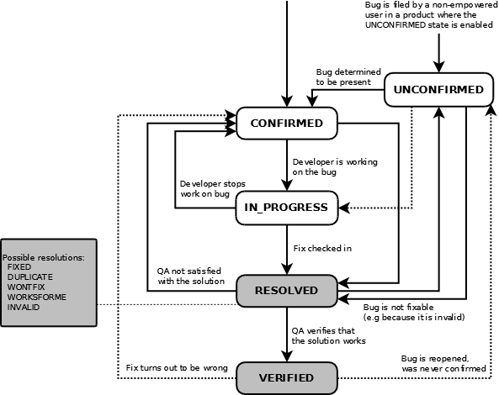
Lifecycle of a Bugzilla Bug
http://bugzilla.readthedocs.org/en/latest/_images/bzLifecycle.png

Slide 15
Managing Expectations
Estimation
  How long will tasks take, or
  how many resources will they consume.
  Should be an unbiased, analytical process.
  The goal is accuracy, not to seek a particular result.
Project planning
  A biased, goal-seeking process.
  The goal is to achieve specific outcomes
  (i.e., to hit a target).

Slide 16
Managing Expectations, cont’d
Estimates form the foundation for project plans.
But plans don’t have to be
the same as estimates.
Combining estimating and planning activities leads to bad estimates and poor plans.
A large gap between estimates
and planning targets results in
a high risk project.

Slide 17
Estimates, Targets, and Commitments
A typical scene from an all-too-familiar play:
  Product manager: We need to demo these features at a trade show in 3 months. [target]
  How long will it take?
  Project lead: I estimate it will us take 5 months.
  Manager: Wrong answer! Try again.
  Lead: OK, in 3 months, we can have the highest priority features done. [commitment]
Moral: When a project planners asks you for an estimate, determine whether you’re really being told to make a commitment to meet a target.

Slide 18
Primary Purpose of Software Estimation
Determine whether a project’s targets are realistic enough to allow the project to be controlled to meet them.
Good estimates are usually possible if the
initial targets and the initial estimates
are within 20% of each other.

Slide 19
“Good” Estimates
Estimates don’t need to be perfectly accurate as much as they need to be useful.
  “A good estimate is an estimate that provides a
  clear enough view of the project reality to allow
  the project leadership to make good decisions
  about how to control the project to hit its targets.”
  Steve McConnell, Software Estimation

Slide 20
Time Unit Inflation of Estimates
Time unit inflation:
hours → days → weeks → months → years
  “It should take me two hours to do this.”
  Reality: It will take two days.

Slide 21
Estimation Techniques
Complex mathematical formulas
  Best for the very largest projects.
  Done by professional estimators.
History and analogy
  How long did similar tasks take in the past?
Expert opinions
  But do you have similar skills as the experts?

Slide 22
Estimation Techniques, cont’d
Off-the-cuff “guesstimates”
  Based on personal experience.
  The smaller the task,
  the more accurate the estimate.

Slide 23
Project Schedules
Once estimates are put into a schedule,
they become commitments.
However, schedules can change (i.e., slip) ...
up to a point!

Slide 24
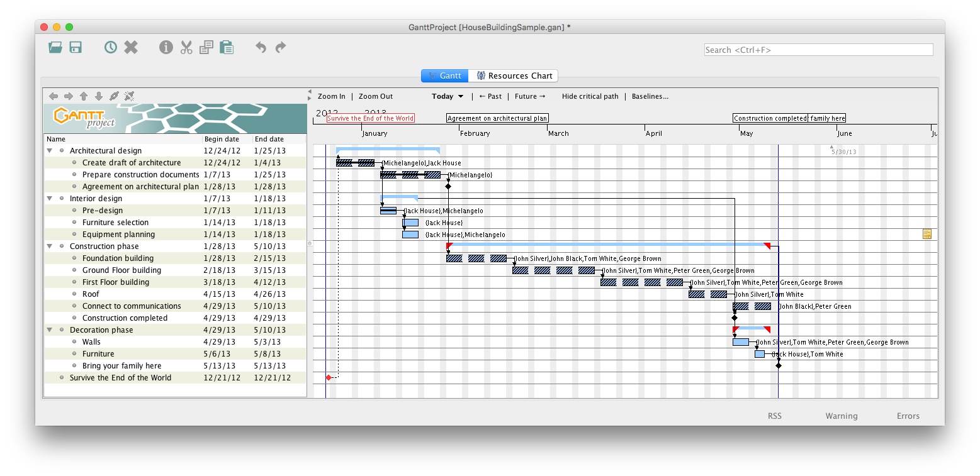
Example Project Schedule: Gantt Chart
Critical path

Slide 25
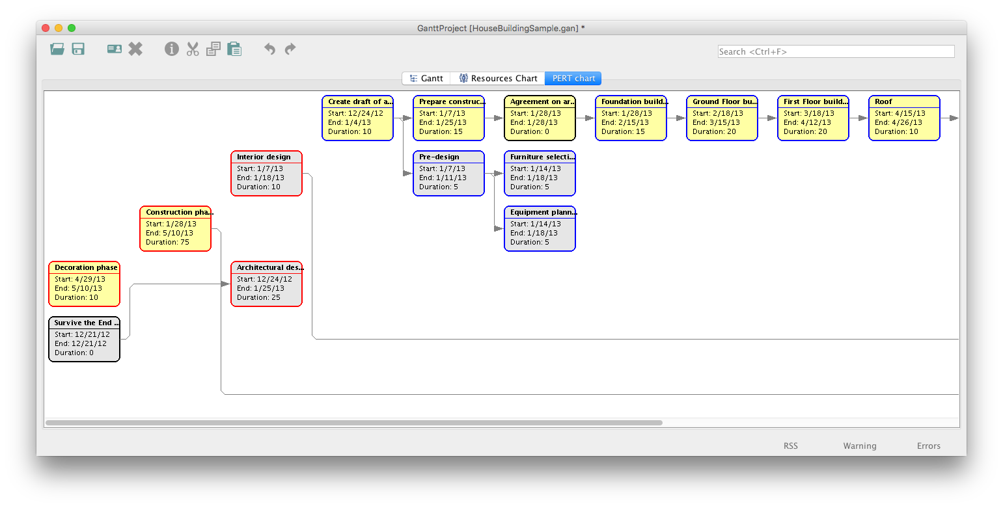
Example Project Schedule: PERT Chart

Slide 26
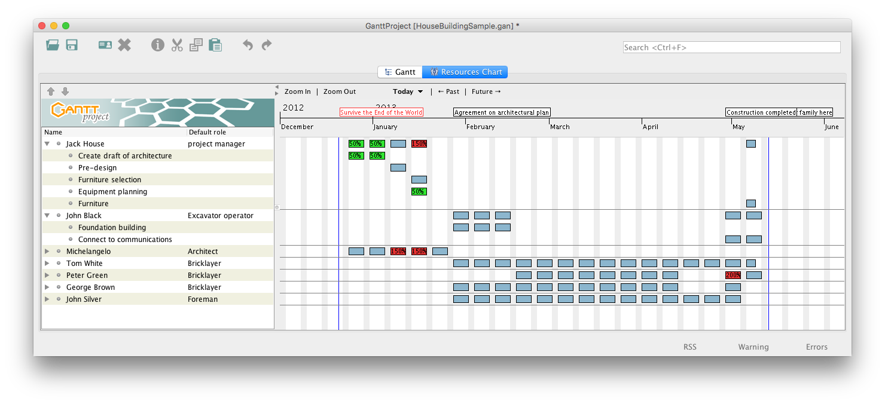
Example Project Schedule: Resources Chart

