Slide 1


CMPE/SE 131
Software Engineering
February 22 Class Meeting
Department of Computer Engineering
San José State University
Spring 2017
Instructor: Ron Mak
www.cs.sjsu.edu/~mak

Slide 2
Analysis
Analysis is reasoning about the architecture
of the application being developed.
Ingredients for doing analysis
  requirements
  use cases
  conceptual design
  prototypes

Slide 3
The Goal of Analysis
The goal of analysis is to
build models of the application.
  A model is an abstract, implementation-independent representation of the application.
  Models should be correct, complete, consistent,
  and unambiguous.
Model building is a highly iterative, incremental, and collaborative activity.
  Developers work with their customers to
  update the Functional Specification as they
  discover new requirements.

Slide 4
Analysis Models
Functional model
  What the application can do
  UML use case diagrams and descriptions
Object model
  What the application will be made of
  UML class and object diagrams
Dynamic model
  How the application will behave
  UML sequence diagrams and statecharts

Slide 5
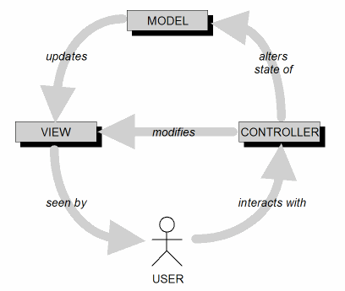
Object Model: MVC
In an MVC architecture, part of analysis is to identify which objects are model, view, or controller.

Slide 6
MVC Implementation: Loose Coupling
Keep the implementations of the
three objects types separate.
Each type of objects does not depend
on how the other types are implemented.
Your application is more robust
(resilient to change).

Slide 7
MVC Model Objects
Represent the persistent information
maintained by your application.
  AKA entity objects
Examine the participating objects
in your use case descriptions.
Map parts of speech (nouns, ‘doing’ verbs,
‘having’ verbs, ‘being’ verbs, adjectives, etc.)
to model components (classes, objects, operations, attributes, relationships, etc.)

Slide 8
MVC Model Objects, cont’d
Part of Speech
Model Component
Example
Proper noun
Object
Alice
Common noun
Class
Policeman
‘Doing’ verb
Operation
Creates, submits, selects
‘Being’ verb
Inheritance
Is a kind of, is one of either
‘Having’ verb
Aggregation
Has a, consists of, includes
Modal verb
Constraints
Must be, shall be
Adjective
Attribute
Color, size, position

Slide 9
MVC View Objects
View objects represent
user interface components.
In each use case, actors interact
with at least one view object.
A view object collects information from actors
in a form that the model and controller objects
can use.

Slide 10
MVC Controller Objects
Coordinate the model and view objects.
  Often have no physical counterpart in the real world.
  Closely related to a use case.
  Collect information from view objects
  for dispatch to model objects.
  This is how user-entered data can update the model.
Represent application control flows.

Slide 11
Example: Bank ATM System
Start up
ATM
Shut down
ATM
Operator
Log in
customer
Log out
customer
Withdraw
cash
Customer
Display
balance
Bank

Slide 12
Example: Bank ATM System, cont’d
Model objects
  operator
  customer
  bank account
  cash
  messages
View objects
  display
  options (withdraw cash,
  deposit check, etc.)
  text
Controller objects
  Start up controller (“Start up ATM” use case)
  User verification controller (“Log in customer” use case)
  Withdrawal controller (“Withdraw cash” use case)
Start up
ATM
Shut down
ATM
Operator
Log in
customer
Log out
customer
Withdraw
cash
Customer
Display
balance
Bank

Slide 13
Object Model Associations
An association is a relationship
between two or more classes.
Draw a line between two classes in a
UML class diagram to show a relationship.
Team
member
Test case

Slide 14
Object Model Associations, cont’d
Clarify the object model by
making relationships explicit.
  Discover constraints associated with relationships.
  An association can have a name.
  You can show roles and multiplicities at each end.
Do not overdo showing associations.
Team
member
1
writes
*
Test case
author
artifact

Slide 15
Aggregations and Compositions
An aggregation is an “ownership” or “has a” association.
  Although there is a strong association between the
  object and its owner, the object can exist on its own.
  An object can change owners or have several owners.
A composition is a “made up of” association.
  The constituent objects generally would not exist alone.
  This is a stronger association.
Student
Book
Page
Shelf
composition
aggregation

Slide 16
Generalization
Generalization is a special association that consolidates common attributes or behavior among classes.
Subclasses inherit attributes and behavior
from their superclasses.
Person
superclass
Instructor
Student
subclasses

Slide 17
Attributes
An attribute is a property of an object.
  An association with another object is not an attribute.
Attributes are the least stable part
of an object model.
  Attributes often change or are discovered late.
  At the beginning, it’s not necessary
  for attributes to describe fine details.
Student
Class name
gender : {male, female}
id : String
year : integer
Attributes
Methods will go here

Slide 18
Dynamic Model: UML Sequence Diagram
A UML sequence diagram represents how the
behavior of a use case is distributed among the participating objects.

Slide 19
Example Dynamic Model: ATM Cash Withdrawal
“Withdraw cash”
Display
Keypad
Bank
Account
Customer
select
notify
display confirmation
T
I
M
E
enter amount
notify
notify
display bank ads
verify
accept
notify
dispense cash
UML Sequence Diagram

Slide 20
Dynamic Model: UML Sequence Diagram, cont’d
Columns of the diagram represent the objects.
Horizontal arrows from one column to another represent messages or stimuli sent from one object to another (method invocations).
Time proceeds from top to bottom.
Receiving a message by an object triggers
the object to activate an operation.
Vertical rectangles represent the duration
of an operation’s activation.

Slide 21
Dynamic Model: UML Statechart Diagram
A UML statechart diagram represents the behavior of the system from the perspective
of a single object.
Create statechart diagrams only for objects
with extended lifetimes and state-dependent behavior.
  Always for controller objects
  Sometimes for model objects
  Almost never for view objects

Slide 22
Example: Customer Withdraws Cash from ATM
swipe bank card
Card
accepted
enter PIN
Logged in
enter withdrawal amount
Reading
bank ads
get cash
Has cash
leave
UML Statechart Diagram
Customer’s Perspective

Slide 23
System Design
System design is the transformation
of your analysis models into an overall
system design model.
  system = application
A system design model describes
  system decomposition
  global control flow
  boundary condition handling
  inter-subsystem communication protocols
System design model = software architecture

Slide 24
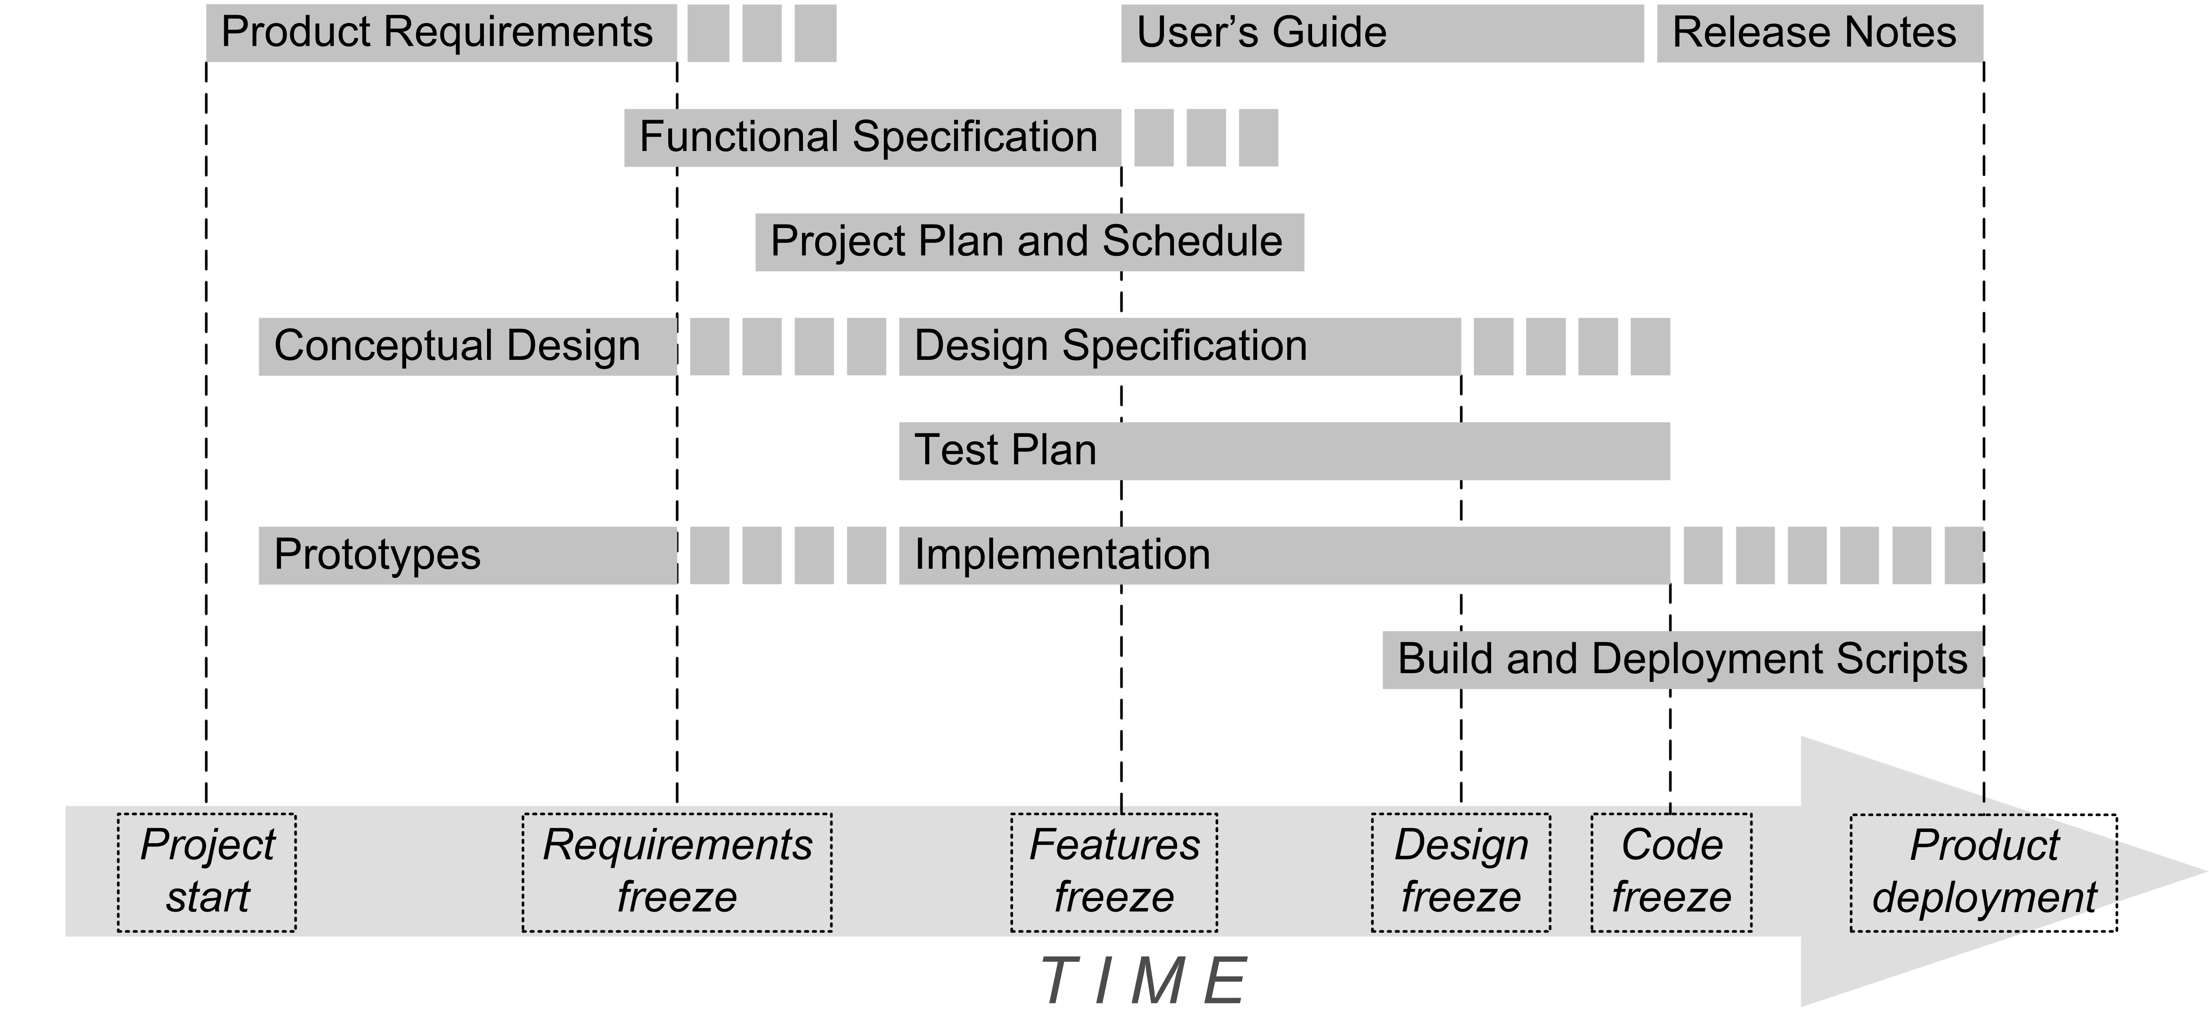
System Design, cont’d
The system design model is a key part of your
Design Specification document.
√
√
√
YOU ARE
HERE!
√

Slide 25
Example: Designing a Compiler
A compiler for a programming language
is a complex program!

Slide 26
Compiler Requirements
Functional
  It must translate a source program written in a
  high-level programming language.
  It must interpret the source program by executing it.
  It must compile the source program into machine code.
Nonfunctional
  Both the interpreter and the compiled code shall
  run on any Java platform.
  The translator framework shall support translating multiple programming languages.

Slide 27
Partitioning
Partition a system into subsystems.
Partitioning is way to decompose a system
in order to deal with complexity.
Each subsystem is responsible for a
different set of services.

Slide 28
Translator Partitions
front end
intermediate tier
back end
UML package diagrams
Front end
  parsing and scanning services
Intermediate tier
  symbol table and parse tree services
Back end
  execution (interpreter) services and
  code generation (compiler) services

Slide 29
Coupling
front end
intermediate tier
back end
Coupling refers to the number of associations (dependencies) between two subsystems.
Goal: Loose coupling.
Loosely-coupled subsystems are
relatively independent of each other.

Slide 30
Loose Coupling
front end
intermediate tier
back end
Another way to deal with change.
Changes to one subsystem have little impact
on the other subsystems.

Slide 31
Translator Framework Classes
front end
intermediate tier
back end
Parser
Processor
Symbol
Table
Scanner
Parse
Tree
Executor
Code
Generator
Token
Build the framework classes first.
  These classes will hold your application together.
Building them first will ensure that your architecture is sound and that the major components will work together.
  Rails scaffolding.

Slide 32
Translator Framework Classes, cont’d
front end
intermediate tier
back end
Parser
Processor
Symbol
Table
Scanner
Parse
Tree
Executor
Code
Generator
Token
As soon as possible, establish the initial thread of control through the framework classes.
The initial implementations (prototypes)
are simple skeletons that don’t do much.
From then on, you will
always build on code that already works.

Slide 33
Cohesion
front end
intermediate tier
back end
Parser
Processor
Symbol
Table
Scanner
Parse
Tree
Executor
Code
Generator
Token
Cohesion is the number of associations (dependencies) within a subsystem.
Goal: High cohesion

Slide 34
High Cohesion
front end
intermediate tier
back end
Parser
Processor
Symbol
Table
Scanner
Parse
Tree
Executor
Code
Generator
Token
A subsystem with high cohesion contains objects that are related to each other and perform similar tasks.
A subsystem with low cohesion contains unrelated objects.

Slide 35
Services
A service is a set of related operations
that share a common purpose.
A subsystem is characterized by the services
it provides to the other subsystems.
The provided services form the
subsystem interface.

Slide 36
Subsystem Interface
Later, during object design,
the subsystem interface is the basis for the application programmer interface (API).
The Façade Design Pattern can encapsulate
a subsystem with a simple, unified interface.

Slide 37
Translator Front End Services
front end
FrontEnd
readSourceLine() : String
generateParseTree() : Node
handleSyntaxError()
Façade
Parser
Scanner
Token

Slide 38
Tradeoff between Coupling and Cohesion
Increase cohesion by decomposing the system into smaller subsystems. (Good)
More subsystems ➔ more interfaces which increases coupling. (Bad)
Use the 7 ± 2 heuristic.
  No more than 7 ± 2 subsystems
  at any one level of abstraction.
  No more than 7 ± 2 services
  in any one subsystem.

