Slide 1


CMPE/SE 131
Software Engineering
February 21 Class Meeting
Department of Computer Engineering
San José State University
Spring 2017
Instructor: Ron Mak
www.cs.sjsu.edu/~mak

Slide 2
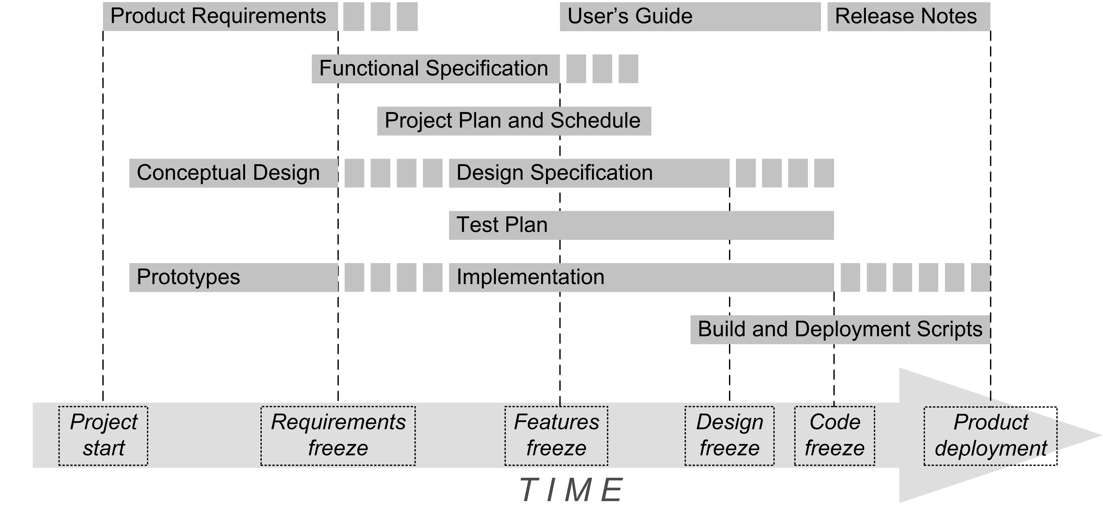
Conceptual Design

Slide 3
Conceptual Design, cont’d
A high-level description of your
application design.
  A written report and an oral presentation.
  A “product pitch”.
  Add to the Functional Specification.
Conceptual design ➔ formal design document
  Created by the software developers.
  Understandable by the product’s users, clients,
  and stakeholders.

Slide 4
Conceptual Design Contents
Problem statement and objectives.
  Copy from the Functional Specification for now.
  Remove later when adding the Conceptual Design to the Functional Specification.
Overview of your solution
  A list of major features.
  A description of your application’s major modules and how they will interact with each other.
  High-level diagrams.
  No implementation details.

Slide 5
Conceptual Design Contents, cont’d
Prototype of a key use case
  A sequence of screen shots.
  Or a live demo with mocked-up web pages
  (can be static pages).
  Or Rails-generated web pages.

Slide 6
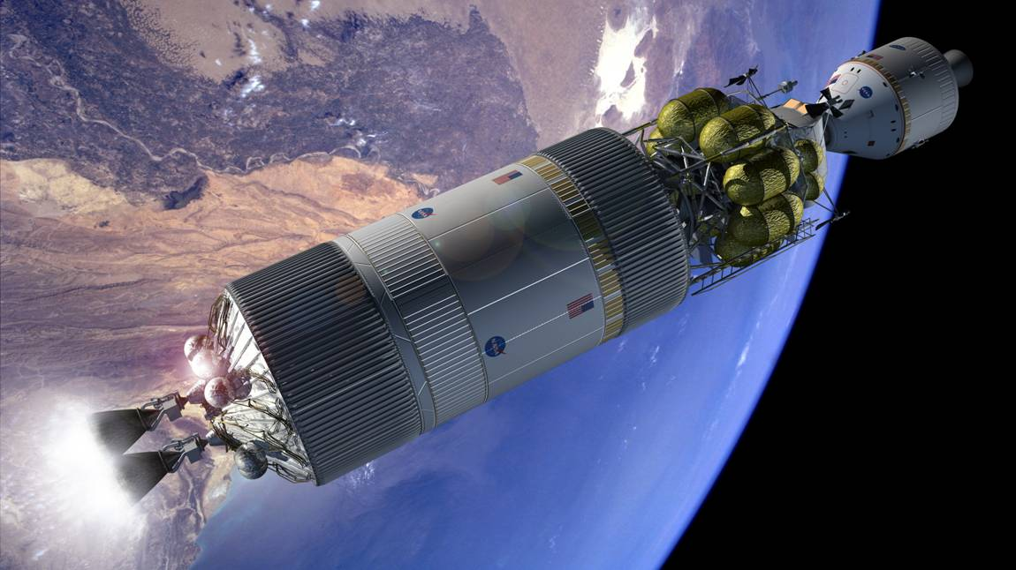
Example Conceptual Design Presentation
Real-time Fault Analysis
for
Crewed Space Vehicle Systems
(Based on a real NASA application
and an actual presentation.)

Slide 7
Problem Statement
During emergency situations, a real-time
fault analysis system must rapidly suggest correct remedies for the onboard astronauts
to implement.
Space vehicle fault analysis is a daunting task, especially in extremely remote environments.

Slide 8
Project Objectives
Design and develop a real-time fault analysis system for crewed space vehicles that overcomes the following challenges:
  Diverse and disparate data sources
  Incomplete or imprecise vehicle sensor data
  Insufficient working knowledge of the vehicle system
  Real time diagnosis and rapid response
  Limited system resources
  Loss of communication with ground control

Slide 9
Product Features
A web application that stores and remembers past faults and their remedies in a repository.
  Each fault is defined by a snapshot of
  sensor readings.
Collect and integrate data from various sources.
  Sensor readings
  Parts lists
  Maintenance manuals

Slide 10
Product Features, cont’d
When a fault occurs, search for it
in the repository.
  If there is a fault match, display its remedy.
  If there are no exact matches, then display the remedies of the closest matches.
  Compute and display the confidence level of each displayed remedy based on the closeness of match.
Enter the latest fault and its solution
into the repository.
  The repository “gains experience”
  and becomes more useful.

Slide 11
Major Modules
Data
sources
Databases
Sensors
Files
A high-level diagram
Server system
Web
server
Application
server
Virtual
data views
Data integration server
Faults
matching
engine
Faults database
Matching
rules base
Users
Web
objects
Application
objects
Faults archive server

Slide 12
Fault Analysis Use Case
Name: Fix Coolant Leak
Goal: Provide remedies to a coolant leak.
Summary: An astronaut must be provided remedies to a detected coolant leak in the space vehicle.
Actors: The astronaut and the system sensors

Slide 13
Fault Analysis Use Case, cont’d
Preconditions
  The astronaut is in the space vehicle.
  The space vehicle is in space.
  The system sensors are actively monitoring
  the vehicle.
Primary trigger
  The vehicle sensors detect a drop
  in the warp engine coolant level.

Slide 14
Fault Analysis Use Case, cont’d
Primary sequence
  The astronaut sees warnings of a coolant leak on the sensor monitor display.
  The astronaut sees possible diagnoses generated by real-time fault analysis.
    See use case “Match fault”
    See use case “Compute confidence level”
  The astronaut clicks on each diagnosis
  to display the associated remedy.

Slide 15
Fault Analysis Use Case, cont’d
Primary postconditions
  The astronaut chooses the most likely diagnosis.
  The astronaut implements the corresponding remedy.
Alternate sequences
  etc.
Nonfunctional requirements
  The system sensors are constantly active.
  The system displays alerts in real time.
Glossary
  astronaut = a person flying in the space vehicle.
  space vehicle = etc.

Slide 16
Use Case Demo
http://www.cs.sjsu.edu/~mak/CMPE131/lectures/prototype/

Slide 17
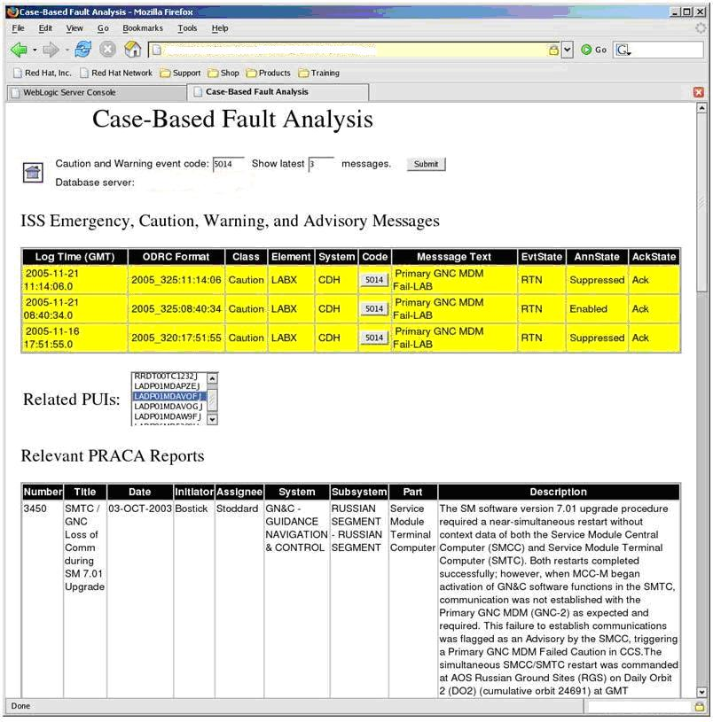
Actual Screen Shot
NASA lingo
  ISS
  International Space Station
  PUI
  Program Unique Identifier (i.e., part number)
  PRACA
  Problem Report and Corrective Action

Slide 18
Assignment #4: Conceptual Design
Oral presentations next week.
  5 - 6 teams Tuesday
  5 - 6 teams Thursday
  We will draw lots at the start of class,
  so each team must be prepared to present.
Do a product pitch for your web application.
  Each project team has up to 12 minutes.
  Grab the audience’s attention in the first minute.
PowerPoint slides plus a live web demo.
  Demo the prototype of a key use case.
  Rails application (preferred) or PowerPoint slides.
16 teams in Section 3

Slide 19
Assignment #4: Conceptual Design, cont’d
The rest of the class will represent
potential future customers of your product.
Allow a few minutes for Q&A and suggestions.
The rest of the class will fill out survey forms
to rate your presentation.

Slide 20
Assignment #4: Conceptual Design, cont’d
Create a 1- or 2-page marketing brochure:
  The name of your product (the web application)
  Problem statement and objectives
    What is the purpose of this application?
    What will it do?
  A list of major features
Submit your brochure (as a PDF, JPEG, or GIF) to at least one day before your presentation.
  Canvas: Assignment #4. Brochure
  I will post it on the class website.

Slide 21
Assignment #4: Conceptual Design, cont’d
Written Conceptual Design
  At the conclusion of your project, you will add this
  to your Functional Specification.
An overview of your solution
  A list of major features.
  A description of your application’s major modules and how they will interact with each other.
  High-level architecture diagrams.
  No implementation details.

Slide 22
Assignment #4: Conceptual Design, cont’d
Screen shots of mocked-up web pages.
  Illustrate the sequence of web pages
  for a key use case.
  Taken from your live presentation.
Due Friday, March 3.
Submit to Canvas:
  Assignment #4. Conceptual Design

Slide 23
Design Meeting Video
A video of a typical design meeting between
software product developers and their clients.
  https://www.youtube.com/watch?v=BKorP55Aqvg

